Slide 1
Alternative Caching Products for Health Data Collection in North Carolina
Project Team 7: Marco Paparatto, Sean Slusarz, Shrey Patel, Justin Tecson

Slide 2
Our Team Objective
The North Carolina Department of Health and Services’ goal for the transition to managed care is to improve the health of North Carolinians through an integrated and well-coordinated system of care that addresses both medical and nonmedical drivers of health.
Standard Plans and BH I/DD Tailored Plans will be fully integrated managed care plans with a benefits package that spans both physical and behavioral health services, as well as long-term services and supports (LTSS)
Our team is considering an alternative database product for a system to better serve these new data requirements

Slide 3
OUR SUGGESTED SERVICES
Based on our research, these products are sufficient in providing the services required to manage Health Data Collection in the state of North Carolina
InterSystems
Provides data and analytics services with features that support health care needs
Fastly CDN
A content delivery system that aims to support a variety of different file types.
HarmonyHIT
Another data and analytics service tailored specifically for health care and data migration

Slide 4
OUR CRITERIA
How we will decide which service to choose:
Must accommodate all kinds of various data types
The scope of the product’s data stores cannot be constricted to limited file types
Must be safe and secure to protect and recover data
Outside threats cannot gain access to, steal, or obstruct stored information
Must be able to manipulate data freely
Ease of access to data as well as functions like analytics or metrics

Slide 5
What is InterSystems
InterSystems corporation is a privately held vendor of software systems and technology for high performance data management, rapid application development, integration, and Healthcare information systems.

Slide 6
Products of InterSystems
Products Including
InterSystems IRIS data platform: is a platform for rapidly developing and deploying important applications.
InterSystems IRIS for Health: is the world's first and only data platform specifically engineered to extract values from healthcare data
HealthShare: Provides industry acclaimed data aggregation, normalization. Deduplication and care management capability.
TrackCar: is a unified healthcare information system and electronic medical record tool for healthcare professionals.
InterSystems Cache: Commercial operational database management system
InterSystems Ensemble: is a seamless platform for rapid connectivity and the development of new connectable applications

Slide 7
InterSystems Security Measures
Products are designed to support secure application development in three ways.
Secure the Product environment itself
Making it easy for developers to build security features into their applications
Ensure that products work effectively with and do not compromise the security of the operation environment.
Security Measures implemented in order to protect data.
Authentication: Determine what resources a user in allowed to use, view, or alter.
Authorization: Authorization determines what resources a user is allowed to use, view, or alter.
Encryption: Provide mechanisms for encryption both data-at-rest and data in motion.
Auditing: All systems and application events are recorded in a tamper-proof appedonly log, which is compatible with any query or repotting tool that uses SQL to review and analyze audit records.

Slide 8
Why InterSystems
Why Choose InterSystems?
Simplify architecture while improving performance
Integrate, normalize and harmonize data from different sources
Enable digital transformation with automation and API management
Empower your developers with freedom of choice
Build Cutting edge predictive applications

Slide 9
Data Privacy and Patient Privacy laws at InterSystems
Does this product adhere to any data privacy or patient privacy laws?
Intersystems is one of the best when it comes to patient privacy, as mentioned earlier in the presentation.
Intersystem do transfer information to third parties located in countries outside the EEA including countries which have different data protection standards than those that apply in the EEA.

Slide 10
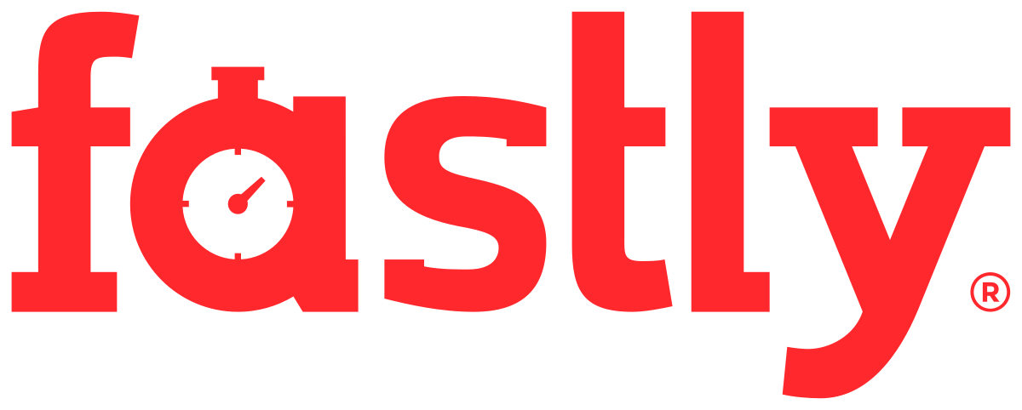
Fastly
Fastly offers a product called Fastly CDN (Content Delivery Network). A CDN, as the name would suggest, is a network that is meant to be distributed on a large scale and is meant to make data or a service readily and quickly available to end users.
The CDN is very developer oriented and Fastly itself is not specifically tailored for healthcare use but for all types of files, with a very specific emphasis on video and audio files.
The Fastly documentation includes information on how to use the CDN to cache and transmit sensitive patient information and to remain HIPAA compliant.

Slide 11
Fastly - Security & Support
Security
  Is up to industry standard - supports a minimum of TLS 1.2 (Transport Layer Security) or higher
  Adheres to the NIST Cybersecurity Framework
  Use of a WAF (Web Application Firewall)
  DDoS (Distributed Denial of Service) attack vectors are also monitored
Support
  Fastly provides immediate onboarding - a quick transition to using Fastly’s CDN
  A support team is available in the event services go down or if there is an attack
  The Fastly team will tailor an incident response plan based on company needs
Notes:
Security - This service ensures that it is up to industry standard, as it supports a minimum of TLS 1.2 encryption or higher for data storage and manipulation
The service is also in accordance with the NIST Cybersecurity Framework when delivering its functions
Monitored around the clock by Cybersecurity engineers trained with best practices in mind

Slide 12
Fastly - Data & Privacy
Privacy
  PCI-Compliant Data Caching (Payment Card Information)
  HIPPA-Compliant Data Caching (Health Insurance and Portability and Accountability Act)
Data
  Fastly offers “On the Fly Packaging” , which supports the transfer of HTTP based streaming formats, standard video codecs, and source video container formats (ex. fMP4, MP3, MP4, .mov)
  It encrypts all data at rest and in transit
Notes:
Privacy
Is PCI Compliant when caching data, meaning that payments are kept secured when using this service
Is also compliant with HIPPA, meaning that patient information is kept confidential

Slide 13
Why Fastly?
Why Fastly?
  Very developer oriented - customizable to meet user’s needs
  Easy to debug and troubleshoot with built in tools for ease of access
  Well protected against unwanted intrusions towards confidential health data
  Maintains uptime through DDoS Protection and a support team
  Content sent through the CDN has its quality maintained throughout the transfer process from the server to the end user
  In addition to normal document formats, it supports almost all audio and visual media files such as .mp4 and .mov
Notes:
Why Fastly?

Slide 14
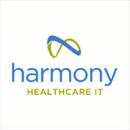
HarmonyHIT
Seems to be the most oriented towards healthcare facilities.
“HealthData Archiver” product aims to be a HIPPA compliant software for storing and managing patient information.

Slide 15
Why HarmonyHIT?
Offers many solutions tailored for the healthcare field, not just the Archival of patient information
  Patient Management
  HIPPA compliant disposal and destruction of information
Will even make it very easy to transfer information from old EMR services.
Offers Third-Party Integrations for Auditing, Single Sign-On, and a Master Patient Index backend to increase patient context accuracy
Works with Hospitals to set it up (do not need expertise in system)

Slide 16
HarmonyHIT Security
HarmonyHIT provides a recovery plan that allows for fast and complete recover from any kind of disaster or disruption.
The facilities and data centers used by HarmonyHIT are fully secured with industry-standard access measures. Direct access to HarmonyHIT servers is heavily restricted.
Provides authentication measures to ensure the data is not being accessed by unauthorized individuals; this includes multi-factor authentication.
HarmonyHIT implements their own layered security with firewall and network filtering technology

Slide 17
Selecting the Final Product
Based on our criteria, our best candidate is Harmony Healthcare IT
This is because it supports many data types:
  The service offers supports for legacy health data records and is constantly updating in order to support future data types in order to remain state compliant
Provides privacy and security to patient health records:
  Uses industry standard and HITRUST certified cybersecurity defenses, ranging from adequate role based access controls, layered firewalls, and active monitoring
  Records are kept in compliance with HIPPA standards and are purged when necessary
Allows for the free manipulation of data:
  Offers EMR conversion systems, data migration services, and provides reports, analytics and business metrics for stored data

Slide 18
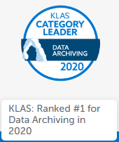
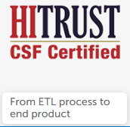
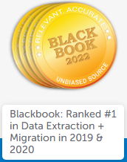
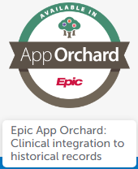
Conclusion
All in all, to serve the new data requirements (Standard Plans, BH I/DD Plans, and LTSS) of the North Carolina Department of Health and Services, our team settled with Harmony Healthcare IT.
Looking back on our criteria, we did not pick Intersystems due to its more large scale global analytics and developer oriented focus. Fastly was also out of the question because it did not offer integration for new data or legacy data and did not offer analytics services to gather intel from stored data.
If that wasn’t enough - HarmonyHIT is specialized solely for the healthcare industry and strives to meet the highest of demands as evidenced by their awards:

Slide 19
REFERENCES
https://docs.fastly.com/products/hipaa-compliant-caching-and-delivery
https://www.intersystems.com/
https://www.harmonyhit.com/
https://www.harmonyhit.com/security/

