Slide 1
EDES 301 Trach Hero Proposal
10/05/2025
Meghan Paral

Slide 2
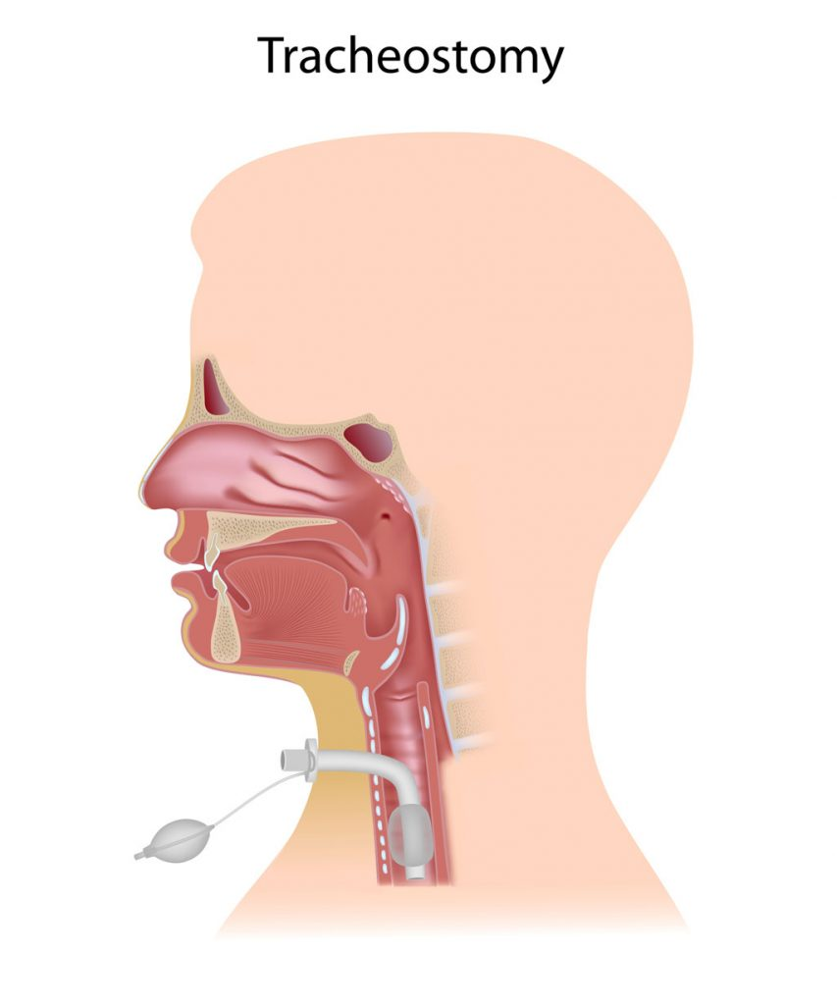

Background Information
No existing projects I have found with a similar premise – here are some useful hackster pages though:
https://www.hackster.io/SURYATEJA/amazing-games-using-hall-effect-sensors-518818
Goal
Create a low-cost, "gamified“ system to train caregivers in critical tracheostomy care skills, such as suctioning and tube changes.
-Solution-
-Problem-
Problem
System
Lack of accessible, affordable at-home training tools for caregivers of children with tracheostomies
Sensors and real-time feedback with LEDs, acoustic, and haptic feedback

Slide 3
System Block Diagram
User
Suction
Trach Tube
USER INTERACTION
Pushbutton
ToF Distance Sensor
(VL6180X)
Hall-Effect Sensor (US5881LUA)
GPIO
I2C
GPIO
PocketBeagle
I2C
GPIO
GPIO
GPIO
7-Segment Display(Adafruit ID 1002)
LEDs (LTL-4234)
Buzzer (Adafruit ID 1536)
Servo (FS90RZ)
FEEDBACK

Slide 4
Power Block Diagram
4.8V-6V
Servo (FS90RZ)
ToF Distance Sensor (VL6180X)
2.6V-3.0V
5V Power Rail
Buzzer (Adafruit ID 1536)
3V – 5V
Max 15mA
USB Wall Adaptor
5V
PocketBeagle
3.3V Power Rail
LEDs (LTL-4234)
~30mA – continuous forward current
7-Segment Display(Adafruit ID 1002)
5 V
Hall-Effect Sensor (US5881LUA)
3.5-24V supply voltage
1.5-5mA supply current

Slide 5
Components / Budget - $27.85
Component | EDES301 to Buy? | Cost
PocketBeagle(parts kit) | No | $0.00
Pushbuttons(parts kit) | No | $0.00
LEDs(parts kit) | No | $0.00
Adafruit 0.56 4-Digit 7-Segment Display w/I2C Backpack - White [STEMMA QT / qwiic] : ID 1002 : Adafruit Industries, Unique & fun DIY electronics and kits | Yes | $10.95
Buzzer 5V - Breadboard friendly : ID 1536 : Adafruit Industries, Unique & fun DIY electronics and kits | Yes | $0.95
Adafruit VL6180X Time of Flight Distance Ranging Sensor (VL6180) [STEMMA QT] : ID 3316 : Adafruit Industries, Unique & fun DIY electronics and kits NOT ON PARTS LIST | Yes | $13.95
Hall effect sensor [US5881LUA] : ID 158 : Adafruit Industries, Unique & fun DIY electronics and kits NOT ON PARTS LIST | Yes | $2.00
Amazon.com: FEETECH FS90RZ 360 Degree Continuous Rotation Micro Servo Motor 9g Servo Mini Servo with Matching Wheels for RC Helicopter Airplane Car Boat Robot Controls : Toys & Games | No | $5.40

