Slide 1



A56 FindingSRAM
GAN CHIP — Deep Learning Accelerator (DLA) Engine
Schematic Review Video: https://drive.google.com/file/d/1JfOFYj1lsYQqmhWTVg9je3te7nSkuVEE/view?usp=drive_link
Discord name | Affiliation | Experience | Role
mpa216 | Bandung Insittute of Technology | Undergraduate | Team lead
fairuz0722 | Bandung Insittute of Technology | Undergraduate | Circuit Design and Layout
Track A · Open-source ASIC · GF180MCU 180 nm · OpenLane / LibreLane

Slide 2
Results - Signoff Table
Check | Tool | Result
DRC (full) | Magic | 0 violations COUNT: 0, illegal‑overlap 0
DRC (routing) | OpenROAD DRT | 0
Antenna | OpenROAD | 0 nets / 0 pins closed via clustering + density sweep
LVS | Netgen | Circuits match uniquely 23,540 devices / 13,621 nets, 0 errors
GDS XOR | Magic ⟷ KLayout | 0 differences
Setup | OpenSTA · 9 corners | MET - worst +15.74 ns @ max_ss_125C_3v00 · 0 vios
Hold | OpenSTA · 9 corners | MET - worst +0.118 ns @ min_ff_n40C_3v60 · 0 vios

Slide 3
Results - 9 Corner Timing
Corner | Setup WS (ns) | Hold WS (ns) | Setup vio | Hold vio
min_tt_025C_3v30 | 25.200 | 0.2147 | 0 | 0
nom_tt_025C_3v30 | 24.990 | 0.2156 | 0 | 0
max_tt_025C_3v30 | 24.741 | 0.2168 | 0 | 0
min_ss_125C_3v00 | 16.278 | 0.3658 | 0 | 0
nom_ss_125C_3v00 | 16.030 | 0.3671 | 0 | 0
max_ss_125C_3v00 ◄ worst setup | 15.743 | 0.3686 | 0 | 0
min_ff_n40C_3v60 ◄ worst hold | 29.601 | 0.1176 | 0 | 0
nom_ff_n40C_3v60 | 29.425 | 0.1183 | 0 | 0
max_ff_n40C_3v60 | 29.216 | 0.1192 | 0 | 0

Slide 4
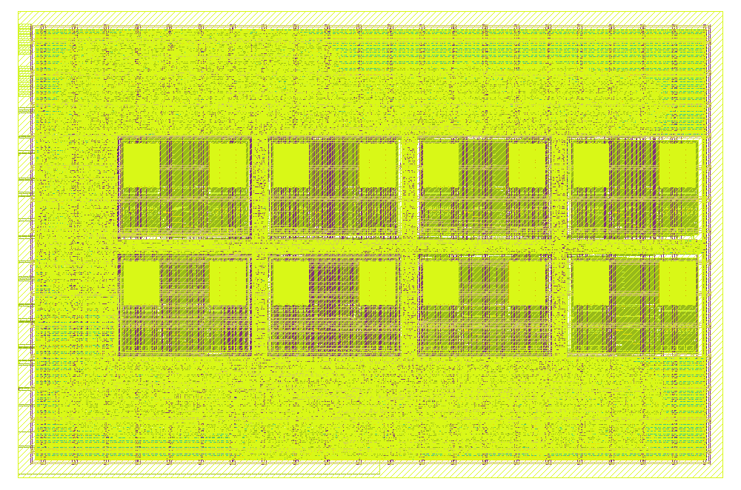
Layout Render - Klayout
KLayout — GDS view. The streamed‑out dla_engine_top.gds (fill + every metal). Eight SRAM macros clustered into a central 4×2 block; the yellow sea is std‑cell logic + fill. DRC‑clean, LVS‑verified, antenna 0.
Floorplan at a glance.
A buffer (weights, row broadcast) → bottom row, 4 macros
B buffer (inputs, column broadcast) → top row, 4 macros
C buffer (results) → flip‑flops in the fabric — no macro
Clustered central block (55 µm channels) + perimeter logic/fill

Slide 5
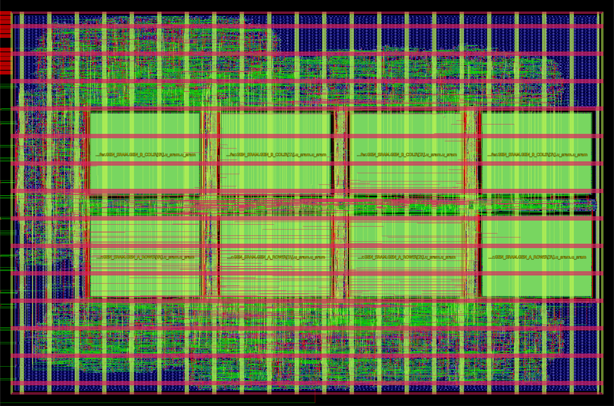
Layout Render - Openroad
OpenROAD — design view. Same die from the P&R database. Macros auto‑labeled u_sram.u_sram (top row = B buffer, bottom = A buffer), pulled together so the SRAM→PE broadcast nets stay short; green diamonds are the boundary pins.
Signoff metrics
Clock | 25 MHz / 40 ns
Antenna | 0 / 0
DRC / LVS | 0 / match
Timing (9 corners) | met
Utilization | 57.09 %
Total power (tt) | 121 mW
Instances | 84,875

Slide 6
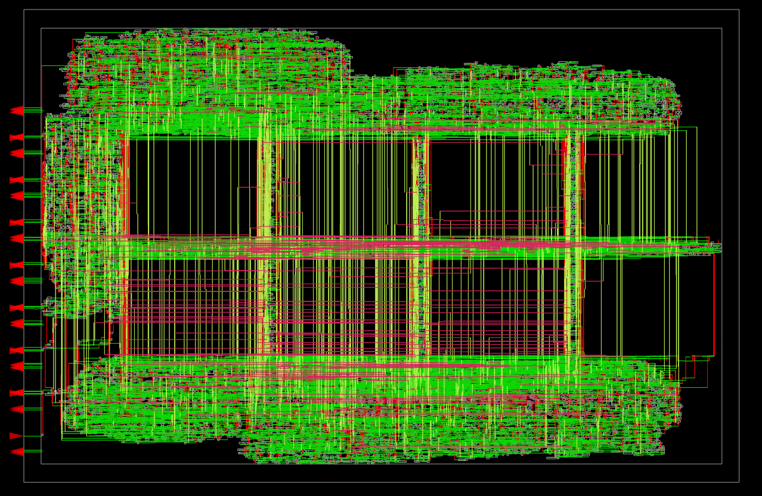
Layout Render - Openroad
OpenROAD — signal nets only. Datapath + control routing (green/red/pink by layer) concentrated over the clustered macros and the mid‑channel — the traffic that the clustering keeps short.
Signoff metrics
Worst VDD drop | 0.348 mV
Worst VSS bounce | 0.798 mV
Average drop | 0.006 mV
Power‑grid violations | 0 / 0

Slide 7
How the die is built
Parameter | Value | Notes
Die / Core | 1600 × 1100 µm 1,691,570 µm² core | Rectangular by request (1.76 mm²). ~16 µm core margin reserved for a future padring hookup.
Macros | 8 × sram256x8m8wm1 301.30 × 224.93 µm ea. | Clustered central 4×2. x = 114.9 / 471.2 / 827.5 / 1183.8; y = 297.57 (A row) / 577.5 (B row). 55 µm channels, N orientation. Block = 1370 × 505 µm centered in the die.
C buffer | flip‑flops | 16 × 24‑bit registers + 1‑cycle registered read. Removes the 9th macro; the register bank places freely in the fabric.
Target density | 50 % → 57.09 % achieved | Chosen by the antenna sweep (slide 7). Clustering shortens the broadcast nets; density 50 is the placement that routes them all clean.
Instances | 84,875 total | 31,844 std cells · 10,002 antenna diodes · 8 macros · balance = fill/tap/decap/endcap.
PDN | Metal4 ∥ + Metal5 ⟂ straps | Single 3.3 V VDD/VSS grid, 5 µm straps @ 75 µm pitch. Macro pins connect on Metal3 (OCD SRAM tops out at Metal3 — custom pdn_cfg.tcl). No core ring (a core macro; the ring is a padring‑stage job).
Ports | 13 signal ports | clk, rst_n, start, wr_en/sel/addr/data, rd_en/addr/data, busy, done, wb_done — on the core boundary; VDD/VSS enter through the grid.

Slide 8
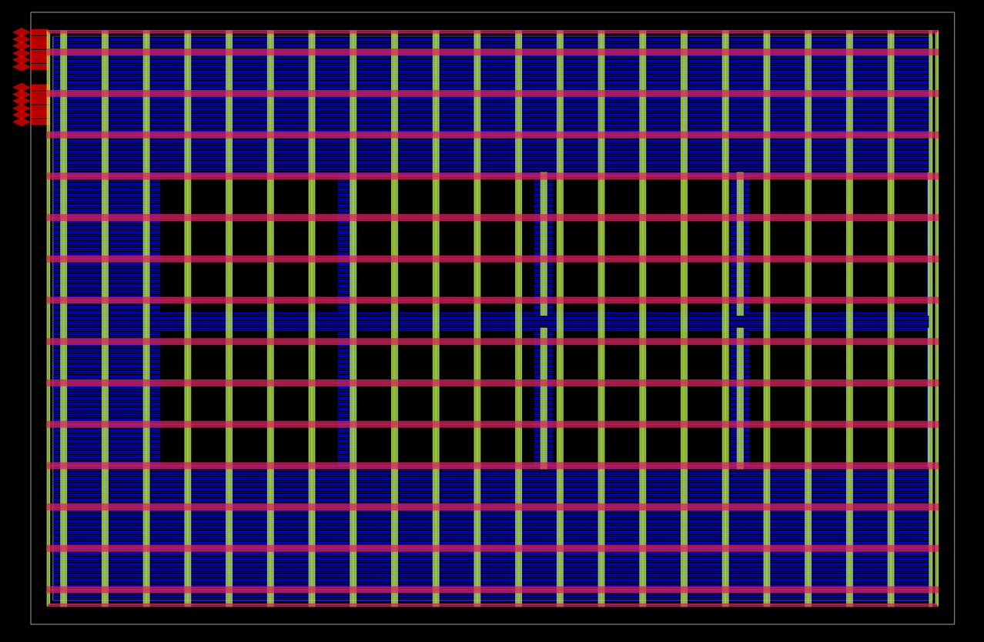
Power delivery network
OpenROAD — power nets only. Vertical green = Metal4 VDD/VSS straps (5 µm @ 75 µm pitch); horizontal blue = per‑row Metal1 rails. The dark rectangles are the 8 macros (fed on Metal3); green diamonds are the power pins.
Single 3.3 V domain (VDD/VSS) — no domain crossings, no level shifting. Running VDD/VSS as closely‑spaced interleaved straps is intentional: it lowers PDN loop inductance and adds decoupling capacitance.
Both SRAM banks tied to the grid explicitly on Metal3 via PDN_MACRO_CONNECTIONS; well/substrate taps in every AS std cell + macro (DRC‑enforced spacing).
IR‑drop & EM low: 121 mW at 25 MHz with min‑drive cells; straps sized far above demand. No core ring by design — added at the padring stage.

Slide 9
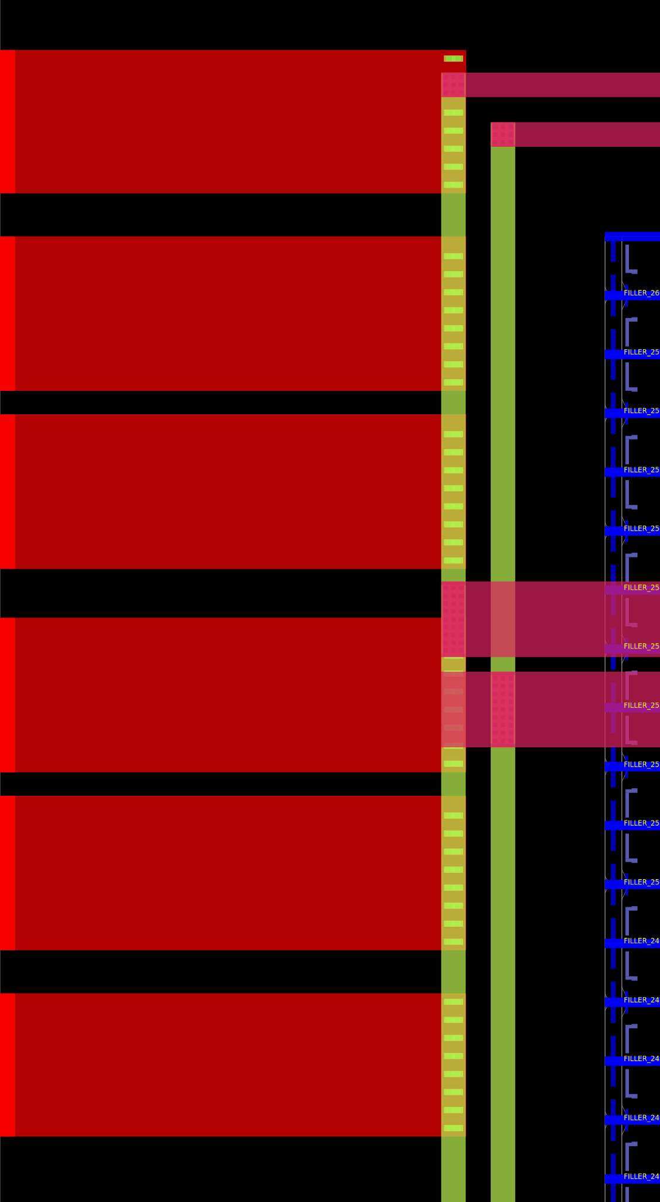
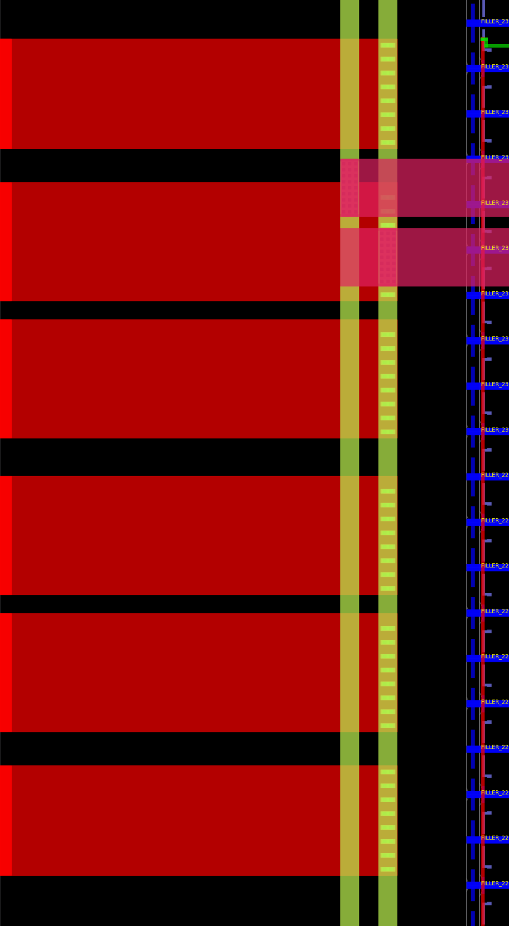
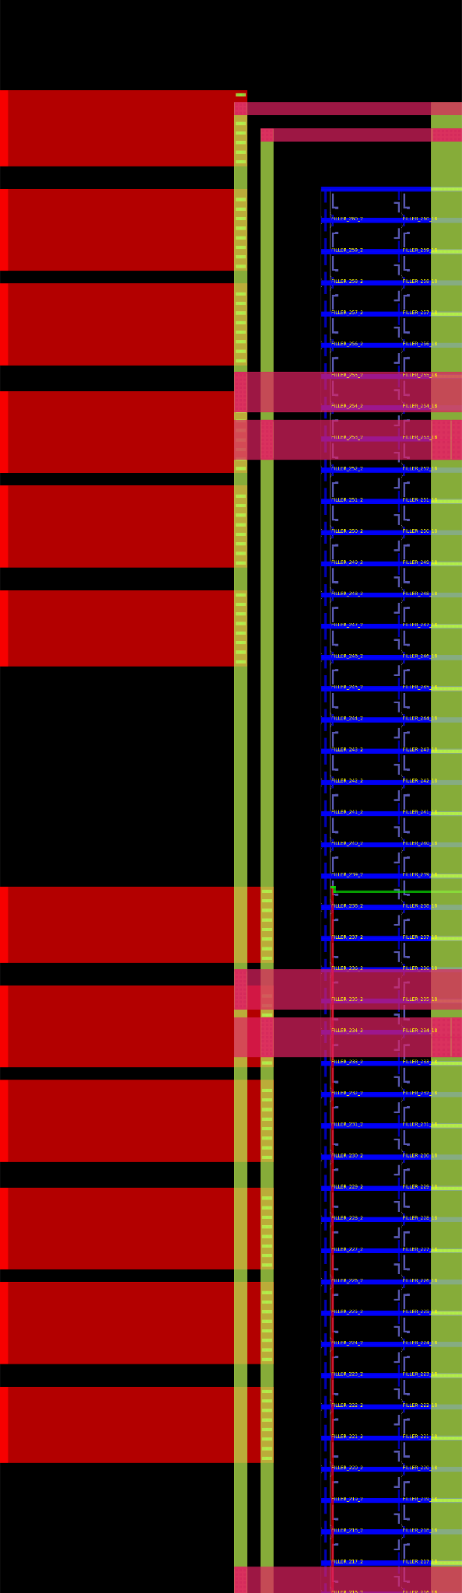
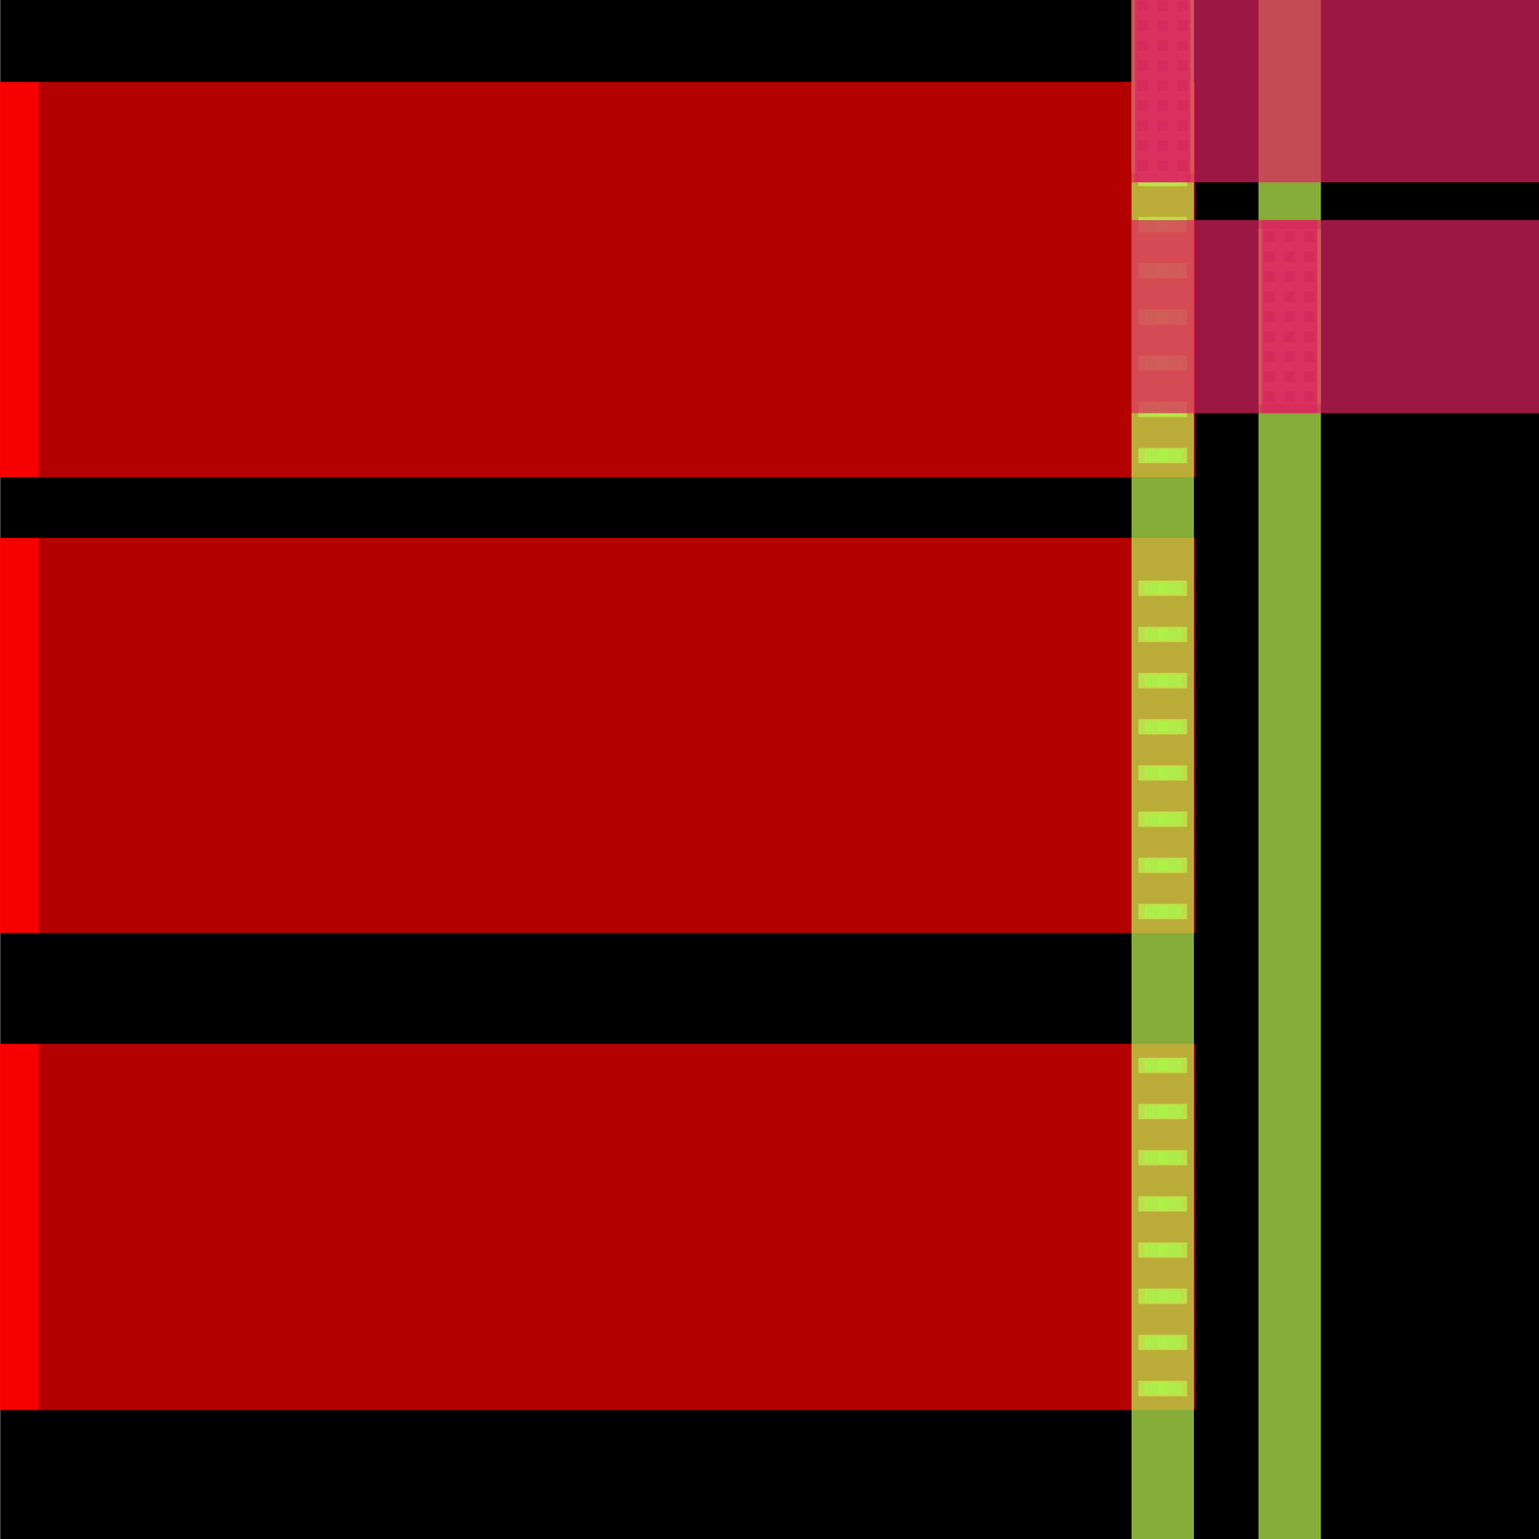
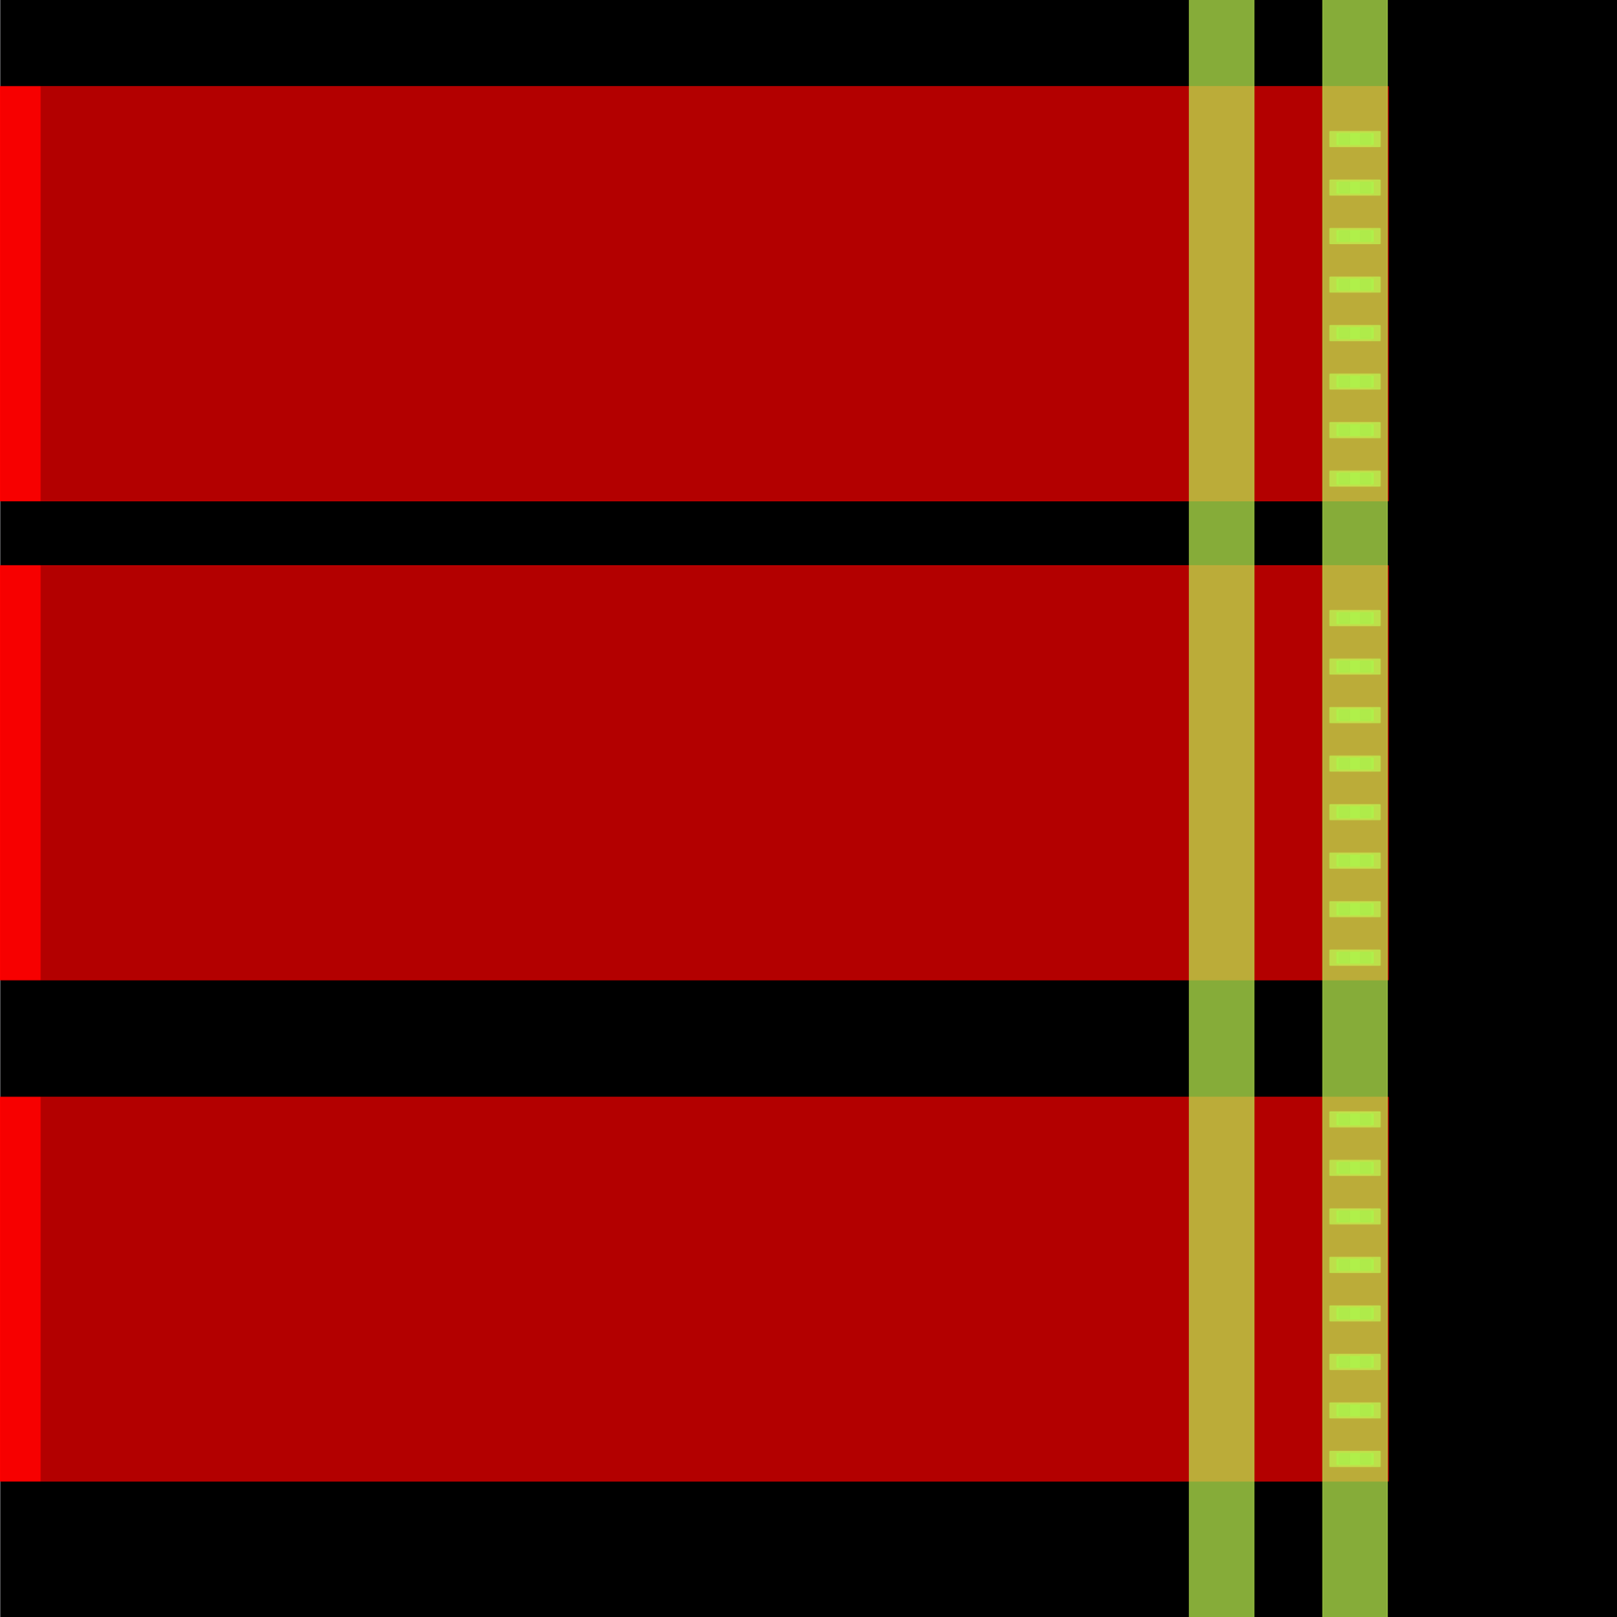
Power delivery network - DEF template connection
Power Pin Connection
VSS
VDD
Using python Scripts to manually draw the connection to the chip
VSS Zoomed
VDD Zoomed

Slide 10
Remaining Review Criteria
Analog / Matching
Fully digital — no analog circuitry. No PLL, no matched pairs, no sensitive nodes. The only analog‑adjacent structures are the SRAM sense amps, pre‑qualified foundry IP used as‑is.
Top‑Level Integration
Top cell dla_engine_top everywhere (RTL ⟷ netlist ⟷ layout).
Pin names match RTL 1:1 — proven end‑to‑end by LVS.
Ports on the core boundary; ~16 µm margin ready for the shuttle padring.
Stage‑1 core macro; the shared padframe is a separate Stage‑2 run.
Reliability & PD Risk
Antenna: 0 violations — closed to literal zero (slide 7); no residual charge‑accumulation risk.
Latch‑up: taps in every std cell + macro, DRC‑enforced spacing.
Voltage: single 3.3 V, all AS cells + OCD SRAM 3.3 V‑rated.
EM / current density: negligible at 25 MHz, min‑drive cells.
ESD: pad‑level clamps — padring scope, out of this core block.
Rubric 1 recap (DRC/LVS): Magic DRC 0, routing DRC 0, GDS XOR 0; Netgen LVS matches uniquely across 23,540 devices — layout corresponds to the RTL device‑for‑device. Full signoff on slide 2.

Slide 11
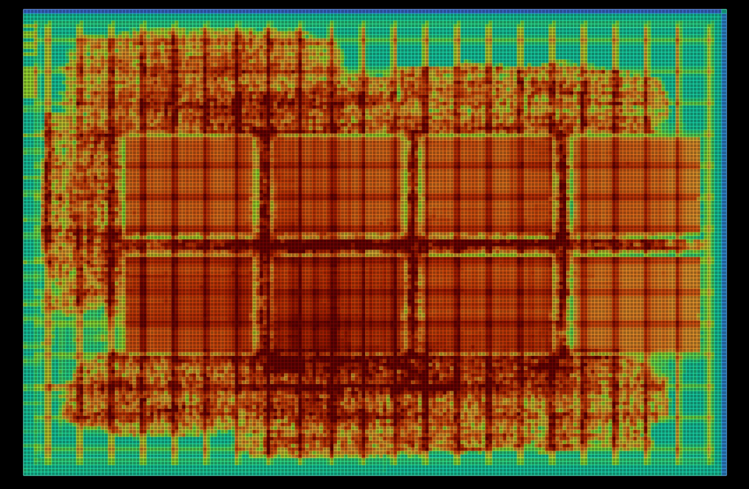
Antenna closure: 4 → 2 → 0
Experiment | Antenna | Note
baseline (roomy, d56) | 4 | worst 1.44×
+ diode margin 40 | 4 | no help — length problem
cluster 35 µm | — | CTS crash (too tight)
cluster 55 µm, d48 | 2 | macro‑broadcast net fixed
cluster + density 44 | 1
cluster + density 50 | 0 ✅ | winner
cluster + density 52 | 2
Lesson: extra diodes can't shorten a wire — clustering the macros shortened the broadcast nets (root cause), and a density re‑roll then routed the last marginal nets clean. All runs stayed DRC/LVS‑clean throughout.
OpenROAD — placement‑density heatmap. Red = packed, teal = sparse. The datapath logic packs tightly around the clustered macros (the placer pulls connected cells to the memories), with routable breathing room at the perimeter — exactly the compact arrangement that keeps the broadcast nets short.

Slide 12
UVM environment (pyuvm on cocotb)
UVM (IEEE 1800.2) builds a testbench from cooperating components that speak in transactions, not wires. Here it runs in Python via pyuvm (a faithful port of the standard classes) driving the DUT through Icarus — every class name is identical to SystemVerilog UVM.
Mapped to the accelerator
DlaOp = one matmul job (A 4×256 weights, B 256×4 inputs).
Sequence = 1 directed (A=B=1 ⇒ every C=256) + 3 constrained‑random ops.
Driver = real protocol: stream A/B, pulse start, wait wb_done, read 16 C.
Monitor = reconstructs the 16 C outputs from the read‑back bus.
Scoreboard = predicts C=A·B (INT8, 24‑bit wrap) and compares.
DlaTest (uvm_test) — builds env, starts sequence, checks tally
DlaEnv (uvm_env) — wires analysis ports
DlaAgent (uvm_agent)
├ Sequencer — routes DlaOp items
├ Driver — the only pin‑wiggler
└ Monitor — passive; rebuilds C from pins
DlaScoreboard
golden matmul + checker
# cd /foss/designs/tb/uvm && make
[directed_ones] PASS: 16/16 match (C[0][0]=256)
[rand_0] PASS [rand_1] PASS [rand_2] PASS
ALL 4 TRANSACTIONS PASSED — 4 passed, 0 failed
Sequence → Sequencer → Driver →(pins)→ DUT
DUT →(pins)→ Monitor →(observed C)→ Scoreboard
Driver →(applied A,B)──────────────→ Scoreboard

Slide 13
Notes for the reviewer
Why C moved to flip‑flops
C holds only 16 accumulators (48 bytes) — a wasteful 64×8 macro. As flip‑flops it costs ~408 registers (tiny in an 85k‑instance die), removes a macro, cuts writeback 48→16 cycles, and drops the C read latency 4–5→1 cycle. A/B stay SRAM because they need four parallel 8‑bit lanes each.
Why cluster the macros
A roomy die spreads the memories apart, so the SRAM→PE broadcast nets route long and trip antennas. Pulling the 8 macros into a compact central block (55 µm channels) shortens those nets at the source; a density sweep then finds the placement (d50) that routes the residue clean. Result: antenna 0, timing/DRC/LVS unchanged.
Opening this design in OpenROAD
# interactive GUI (needs a display) — pan/zoom, toggle layers & the PDN, inspect timing
openroad -gui runs/longtin_a3b_d50/final/odb/dla_engine_top.odb
# in the GUI: Nets ▸ turn off Signal to get the Power/Ground view (slide 5)
# headless screenshot (full die), for the design views:
QT_QPA_PLATFORM=offscreen openroad -exit _or_render.tcl
# read_db .../final/odb/dla_engine_top.odb ; save_image -area {0 0 1600 1100} out.png
# the raw GDS stream is a KLayout job (OpenROAD has no GDS reader):
klayout runs/longtin_a3b_d50/final/gds/dla_engine_top.gds

