Slide 1
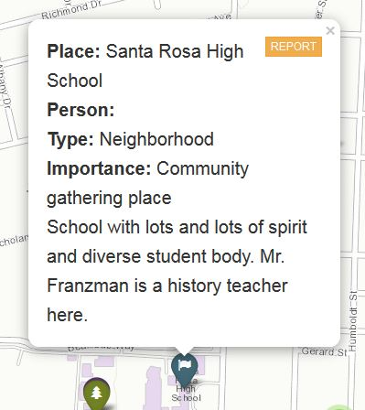
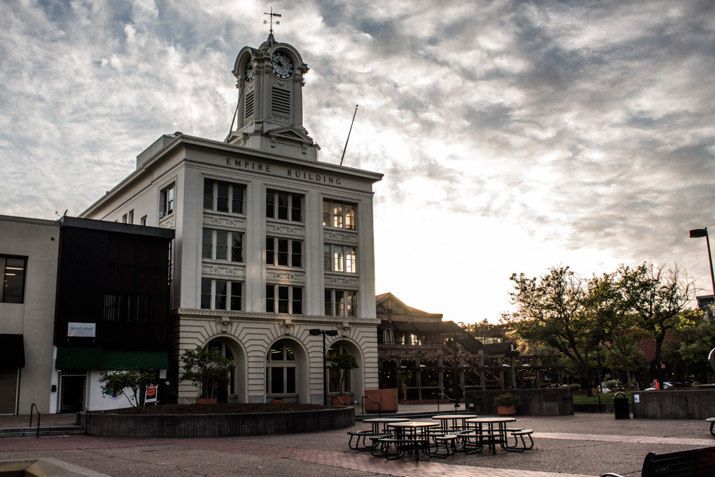
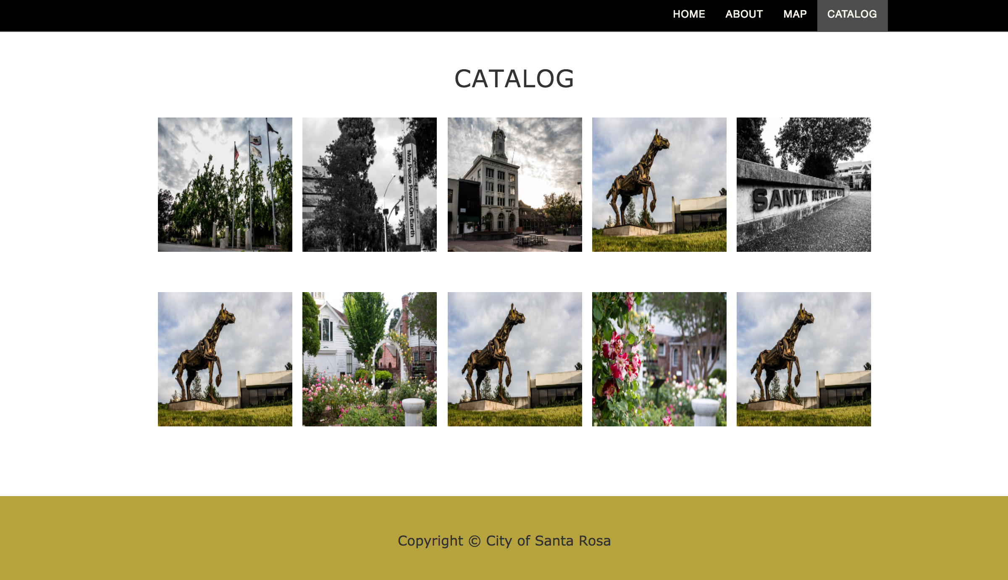



Santa Rosa Neighborhood Heritage Mapping
Weston Mitchell, Lucas Winkelmann, Fern Vue, Michelle Padgett, Nicole Snyder
Computer Science Department, Sonoma State University
Advisor: Dr. Ali Kooshesh
Overview
The Santa Rosa Neighborhood Heritage Mapping Project is a neighborhood-based community mapping program we are conducting over the next year and a half in the city of Santa Rosa, California. The project is designed as a broad-based community engagement program that works with the city’s existing neighborhoods to create an interactive digital map of sites, places and stories important to the people who live there.
Goals
Create a user friendly web application that looks esthetically pleasing and easy to use.
Share special places with the community and tourists of Santa Rosa via the Web App’s map feature.
Project Methodology
Using the ArcGIS and ESRI APIs, we load the Santa Rosa map with pins that represent each special event or place.
Provide a browser based tool using modern web tools: node.js, jQuery, and Bootstrap rather than a stand-alone program that must be downloaded natively.
Example of a pin on the map
Place: What place is this?
Person: Who posted this pin?
Type: What type of place is this?
Importance: Why is this place important?
Diversity
Santa Rosa is a place with many diverse neighborhoods, and each has its own stories to tell.
Celebrating the 150th anniversary of the city’s founding gives us an opportunity to document all those stories, and use them to create a single, shared map of this place we all call “home”.
Some of those neighborhood stories are about the earliest days of the city’s history.
Catalog
Contains all of the pins on the map and displays them nicely on the screen for the user to read.
Catalog Items may contain pictures or videos relevant to the locations significance.
If the user wants to see the catalog item on the map, can click on that catalogs “See on Map” button.
Future Work
There will also be an Archive Map that will have more layers and features present to work with.
Create a CronJob for the server to restart app in case of crashes.
Acknowledgments
Dr. Margarett Purser, Associate Professor at Sonoma State University for her guidance, expertise in social domain, and the enthusiasm for the project.
Evan Zufah, graduate student who works with Dr. Purser, for inspiration and technical advice regarding ESRI and ArcGIS.
Notes:
Motivation: go back a step some notion of processor are circutis that phyically execute instrucions. Consolidate first two bullet point remove third it’s in the motivation. Want to do this in the browser not having to download anythging.
Blow up the datapath to two column on both WeMips example
Don’t pretend it’s a science. Sturucture poster around graphics. Make this more concise less wordie.

