Slide 1
Data Science Case Study – Sales Forecasting
Aditya MP
22nd May 2019

Slide 2
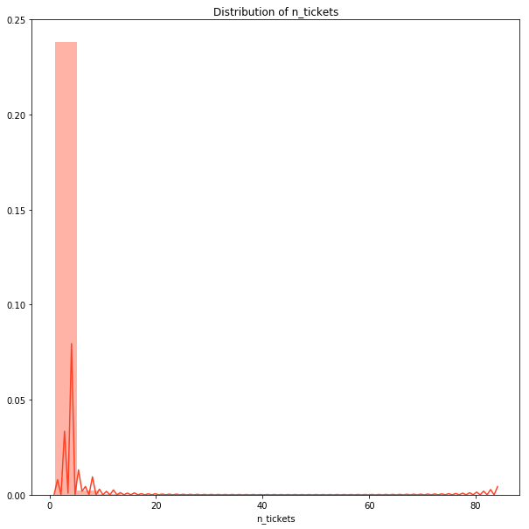
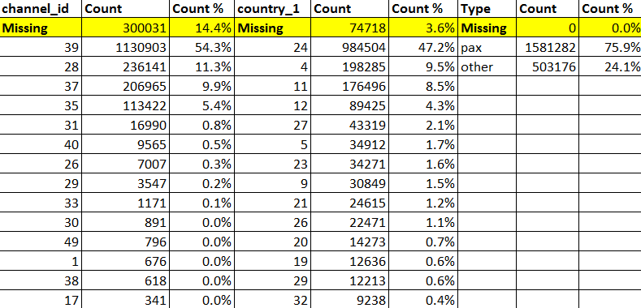
Separate category for missing data of channel_id
Country_1 codes clubbed into “Others” (these ids are statistically insignificant)
Channel_id, country_1, country_2 and type are all categorical variables, only n_tickets is continuous variable.
Country_2 is used to impute missing values of country_1. Country_2 is not considered further for analysis (more than 40% missing; redundant information of country_1; no correlation with other variables).
Remaining rows with missing values of country_1 (3%) are removed since the no of rows are small.
For channel_id, we cannot use any mean/median since it is a categorical variable. If we simply use the mode, it reduces the variance of the variable. Since the correlation with other variables (on next slide) is very low, imputation using prediction by ML algorithm was also found to be ineffective. The best method is to consider all missing values as a separate category so that it does not bias the data.
Only the top 5 categories of channel_id & country_1 account for 98% and 89% of all data respectively. So, it is a reasonable assumption to club all other categories into one (“Others”) and not consider them separately, especially for a short forecast window of 10 days.
Daily sum of n_tickets is highly skewed (+ve)
Channel_id codes clubbed into “Others” (these ids are statistically insignificant)

Slide 3
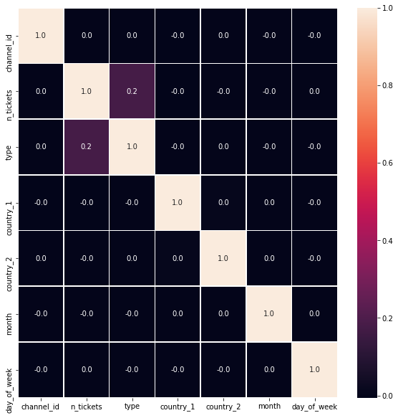
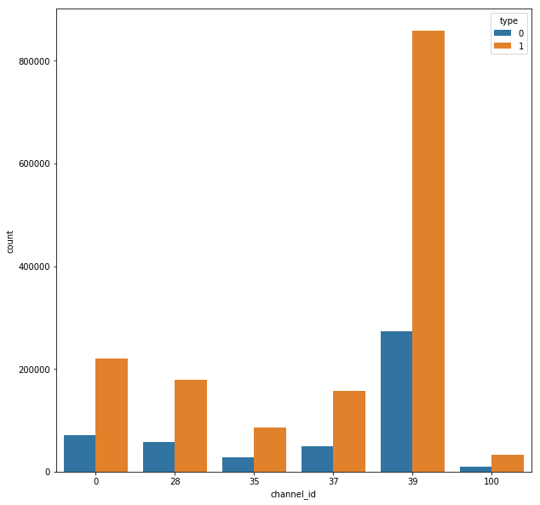
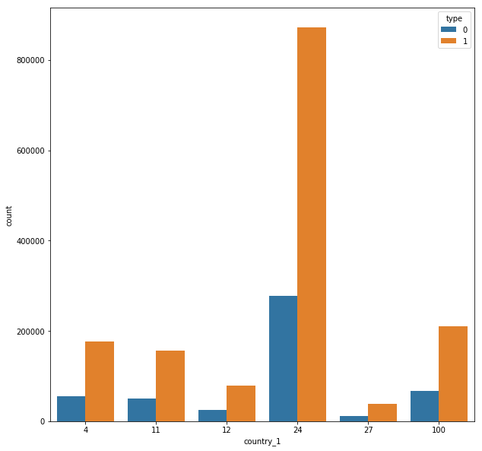

Heatmap based on Pearson’s Correlation shows no correlation amongst any variables
Channel_id = 39 and country_1 = 24 dominate the orders (sell large amount of tickets per day).
For every category of channel or country, type = pax results dominates the orders.
The mean tickets sold for type = pax is higher than type=other.
Note: Additional features created from date include “month” for yearly seasonality and “day of week” for weekly seasonality (next slide)

Slide 4
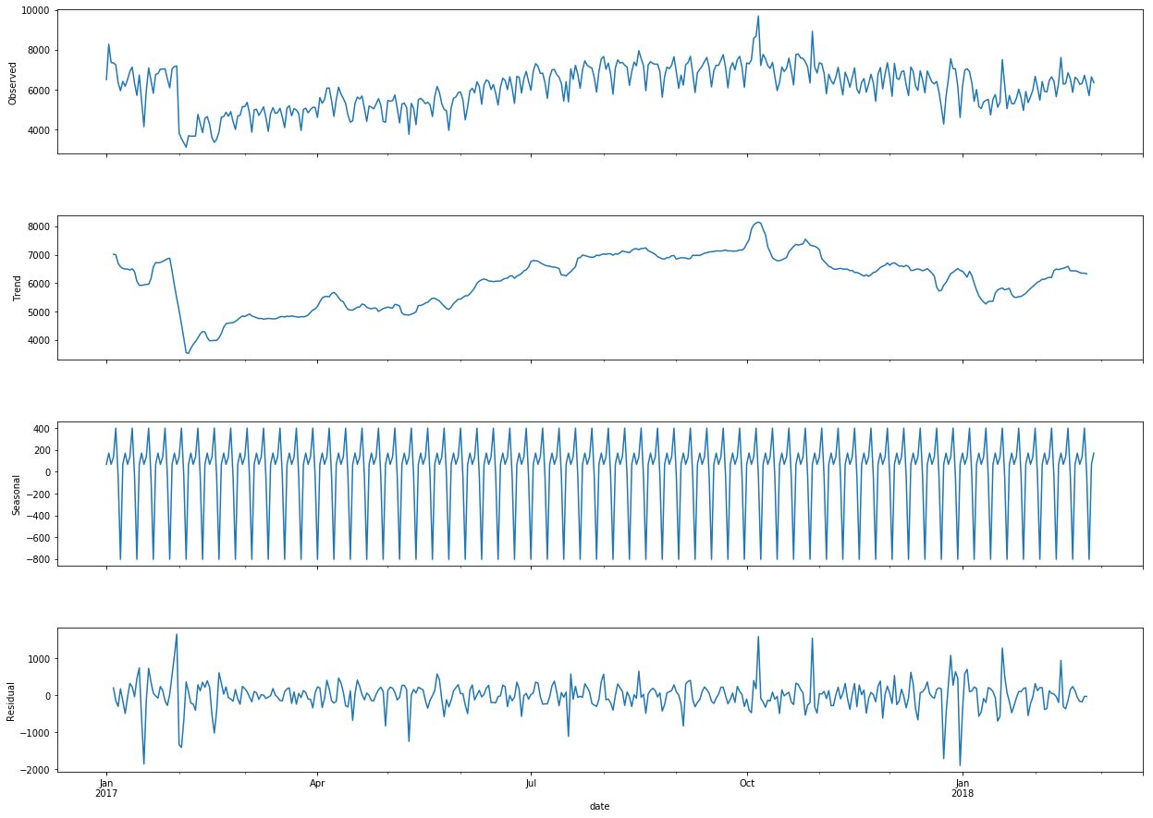
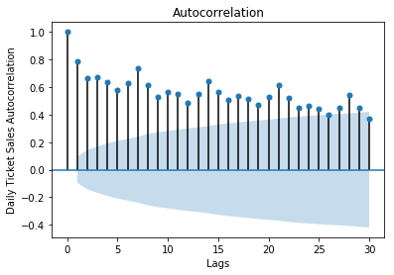
The Autocorrelation Factor (ACF) plot shows spikes at lags of multiples of 7 indicating weekly seasonality.
The seasonal decomposition of total daily n_tickets also shows some trend and seasonality.
This relationship of total daily n_tickets with values on previous days is shown further on next slide.

Slide 5
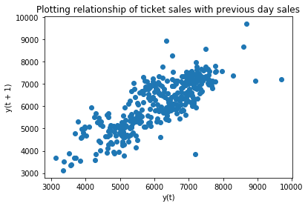
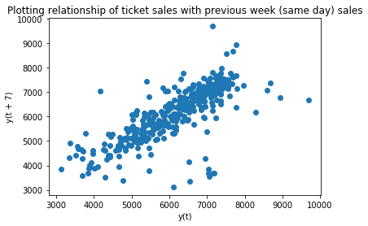
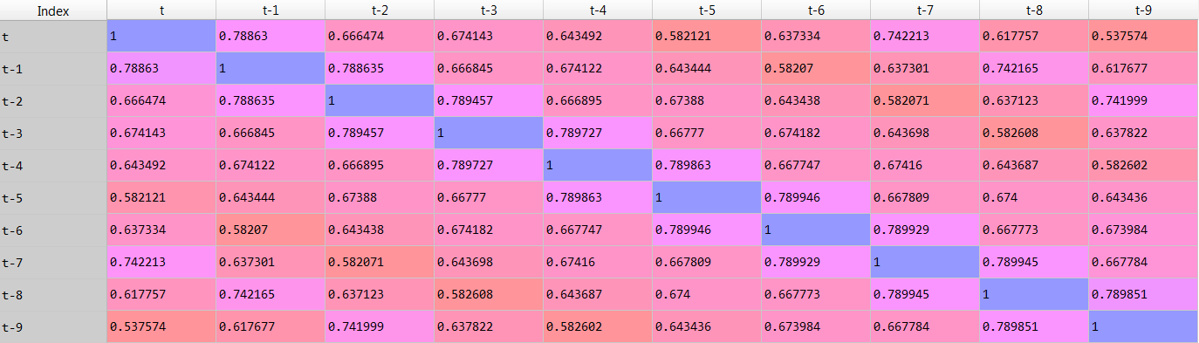
Plot of total daily n_tickets with lag =1 (previous day) and lag = 7 (same day previous week) are spread across the (y=x) line.
The correlation for these lags are also the highest at the table at the bottom.
So if these lags are fed into the model as explicit variables, they will be useful predictors.

Slide 6
Even though n_tickets has many values which are far away from the mean, these ‘outliers’ are not removed since we do not know the meaning/reason for these large values.
One Hot Encoding of channel_id (6 categories), country_1 (6 categories) and type (2 categories).
Newly Created Features: “month”, “day_of_week”, “lag_1”, “lag_7” (here, lag_1 and lag_7 are the mean of the previous day and week instead of taking the unique lag values for every combination of (channel_id, country_1) for the sake of simplicity.
Groupby (channel_id, country_1) and then groupby date and calculate the sum for total tickets per day and mode for type.
Q. Should we build one time-series model for each combination of (channel_id, country_1) or a single model that considers all the combinations?
A single model (if built correctly) can capture all the interrelations between different combinations. It also uses all the data available (unlike building separate models which make the data relatively sparse). Also, by using the lags as explicit features in the model, we capture the time series component of the data as well. Finally, a single model is simple to develop and deploy.
A Random Forest model was built, trained and used to forecast the n_tickets for all the 36 combinations (6 channel * 6 country_1) for the next 10 days.
rf = RandomForestRegressor(random_state= 0, n_estimators = 500, max_depth = 9)
Model Building

Slide 7
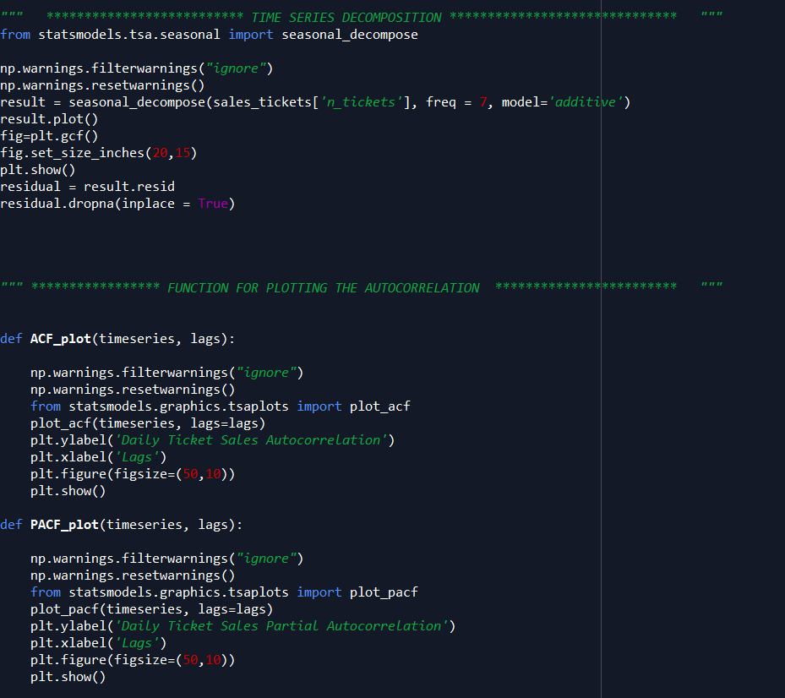
Code Screenshot

Slide 8
Large missing values in channel_id. And since it is assumed to be categorical variable (one id is not numerically higher or lower than another id), it is difficult to impute.
Large number of categories of channel_id and country_1.
Each date has varying no of entries (multiple) for every combination of (channel_id, country_1).
Weak correlation amongst variables. So less features available to predict.
Lags, day of week are making lesser impact on prediction of daily tickets total. The tickets mainly depends on the channel_id and country_1.
Challenges

