Slide 1
ΕΛΠ 221: Οργάνωση Υπολογιστών Εργασία 6
BENCHMARK 508.namd_r
Βαλεντίνος Παρίζα
Μάριος Παφίτης
909759, 911719

Slide 2
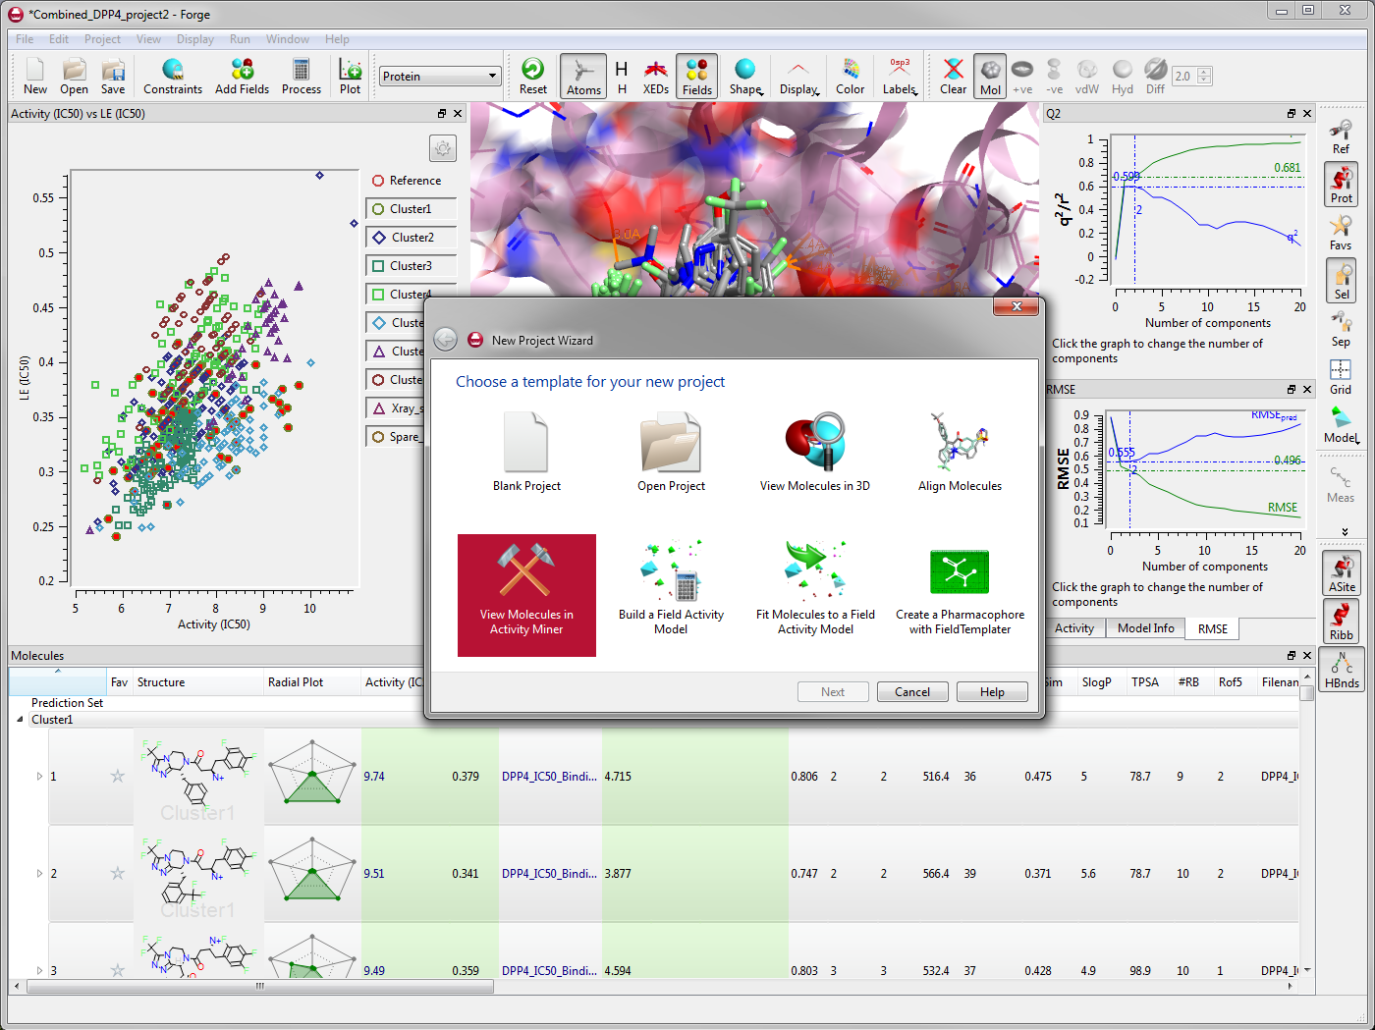
Description of Benchmark:
This Benchmark ,which is known as 508.namd_r is derived-taken from the program NAMD (Basically from the data layout and inner loop of NAMD) and is a program for simulating large biomolecular systems(more specific, simulating millions of atoms).
NAMD is the abbreviation for Nanoscale Molecular Dynamics ,and it is a computer software for molecular dynamics simulation (δυναμική μοριακή προσομοίωση), build with Charm++. NAMD scales to over 200,000 cores for very large systems in order to simulate efficiently its biomolecular systems(using all the parallel capabilities that PCs offers).
In this benchmark analysis the benchmark was tested in single performance. Because of the efficiency of this program, its maturing and of the importance of the operations that this program does this program was used as a compact benchmark for CPU2017.
This program makes a lot calculations with floating
point numbers.
This benchmark simulates proteins-atoms in
biomolecular systems, and can be used to observe
the interactions of the atoms inside these systems.
But at this point it is used to examine the performance
of a CPU at some situations.

Slide 3
Analysis/Association of time with time and perf stat
From the execution of the command “time” 10 times we took the averages :
Average IPC for 10 executions -> IPC=2.57 .We know that CPI=1/IPC So CPI= 0.389
From the array of the next slide we took the averages of the statistics
which are mentioned-used below for calculating the execution time(USER):
Execution time with CYCLES statistic from (perf stat) :
For 3.3 GHz (Standard): Cycles_Statistic*(Cycle_Time) = 307.471s Cycle_time=1/(3.3E+10)
For 3.7 GHz (Turbo Boost): Cycles_Statistic*(Cycle_Time) = 274.231s Cycle_time=1/(3.7E+10)
Now calculating execution time with CYCLES=INSTRUCTIONS*CPI :
Cycles_Calculated = CPI*instructions = 0.389 *2,598,612,782,571 = 1,010,860,372,420.119
For 3.3 GHz (Standard): Cycles_Calculated*(Cycle_Time) = 306.321s Cycle_time=1/(3.3E+10)
For 3.7 GHz (Turbo Boost): Cycles_ Calculated *(Cycle_Time) = 273.206s Cycle_time=1/(3.7E+10)
CPU frequency→ ( cycles / execution_time_from_command_time_User)/(10E+9) = 3.66GH
CPU frequency→ ( cycles / execution_time_from_perf_stat )/(10E+9) = 3.62GH
=> The time multiplexing is a factor which changes (significantly) the statistics we estimate .
Average Time:
real | 277.502
user | 277.364
sys | 0.052
Notes:
The time multiplexing is a factor which changes (significantly) the statistics we estimate.
Because we use different statistics like the number of cycles, the time and others in our calculations for the execution time and for the processor frequency , the values taken from the command perf stat are scaled and not they are not the actual values because of the lack of hardware counters.
So we can see that there is a deviation and the results aren’t equal because of this factor.

Slide 4
Mean/Standard Deviation of Statistics for 10 executions
Standard Deviation/ Average | Average | Standard Deviation | Diversion Percentage (%)
Time: | 279.70 | 1.84 | 0.66
Instructions: | 2598612782571 | 520287031 | 0.02
Cycles: | 1014653654177 | 2808275224 | 0.28
Cache-References: | 449971763 | 36352832 | 8.08
Cache Misses | 94312208 | 8367359 | 8.87
Branch-Instructions: | 42013192364 | 42036526 | 0.10
Branch-Misses: | 1867356594 | 1295047 | 0.07
L1-dcache-loads | 707313493358 | 91651835 | 0.01
L1-dcache-load-misses | 31907089229 | 49679082 | 0.16
L1-dcache-stores: | 242144245126 | 40051837 | 0.02
L1-icache-load-misses: | 18399756 | 336468 | 1.83
LLC-loads: | 381215876 | 36698914 | 9.63
LLC-load-misses: | 76630123 | 4205048 | 5.49
LLC-stores: | 39202624 | 4154680 | 10.60
LLC-store-misses: | 16277009 | 2348003 | 14.43
dTLB-loads: | 706276858458 | 203576469 | 0.03
dTLB-load-misses: | 6467694 | 717839 | 11.10
dTLB-stores: | 241604005925 | 47710291 | 0.02
dTLB-store-misses: | 2118082 | 133914 | 6.32
iTLB-loads: | 38456 | 7586 | 19.73
iTLB-load-misses: | 408499 | 76830 | 18.81
Branch_Instructions appear 1.6% of the instructions
Branch_Misses appear 4.44% of Branch_Instructions
L1 dcache-loads appear 27.2% of the instructions
L1-dcache-load misses appear 4.5% of L1-cache-loads
Depends every time from the processes that run on PC and also from time multiplexing

Slide 5
IPC Correlation Statistics
Formula for normalizing graph values :
X = (Statistic * 1000) / Instructions
Statistic' = (X - MIN(All X)) / MAX(All X)
Notes:
Branch Misses - Branch Instructions
Here we do not see the values of each statistic but we emphasis on their behavior. For example it seems weird to see branch misses to be higher than branch instructions ,but this is because the number of instructions isn’t less than branch misses in every second
The rate of branch misses increases , respectively when branch instructions are increasing.
Because the rate of branch instructions appears is low(in association with instructions) .The number of branch misses doesn’t appear to have a negative correlation as expected with IPC.
The effect of branch misses on IPC isn’t as expected because of the small number of appearances.
The idea that always the things are as expected doesn’t apply always.
dTLB Loads - L1 dCache Loads
dTLB Loads and L1 dCache Loads are behaving commonly and with same amount of values-appears. This applies as expected because the number of dTLB Loads and L1 dCache Loads are associated extremely high. Whenever the CPU wants something from memory .The reference to L1-dcache for load presupposes the use of dTLB for load of a physical address( convert from virtual)
We observe that the dTLB-load misses is correlated positive with both L1 dCache Loads and dTLB Loads ,because as the number of dTLB-loads and L1-dcache-loads increases the dTLB-load-misses is increasing. That’s because the possibility of having a dTLB-load-miss is higher when having lots of dTLB-loads and L1-dcache-loads

Slide 6
IPC Correlation Statistics
Notes:
Cache Misses - LLC Load Misses
Cache misses and LLC load misses are correlated between them because LLC represents the misses that occur from load at the last level caches and cache misses are the misses that occur generally from all the cache(information that needed doesn’t exist in none of the leved caches). We can see that both of them are negative correlated with IPC because as the number of cache misses and LLC-load misses increases the IPC is decreased as expected

Slide 7
IPC Correlation Statistics
Correlation | IPC:
Time: | 0.144
Instructions: | 0.996
Cycles: | 0.907
Cache-References: | -0.019
Cache Misses | -0.286
Branch-Instructions: | 0.444
Branch-Misses: | 0.432
L1-dcache-loads | 0.518
L1-dcache-load-misses | 0.177
L1-dcache-stores: | 0.009
L1-icache-load-misses: | 0.091
LLC-loads: | -0.077
LLC-load-misses: | -0.359
LLC-stores: | -0.023
LLC-store-misses: | 0.039
dTLB-loads: | 0.518
dTLB-load-misses: | -0.292
dTLB-stores: | 0.010
dTLB-store-misses: | 0.023
iTLB-loads: | 0.052
iTLB-load-misses: | 0.089
IPC=Instructions/Cycles
Processor operates in different frequencies as we can see from the cycles per seconds. So As the cycles increases-> the instructions increases respectively making changing respectively the IPC

Slide 8
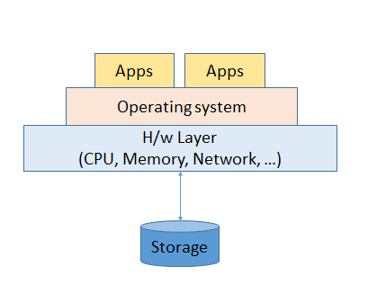
Conclusions
The programs depends not only on software, but there are many factors that can affect significantly the performance of a program
We have observed and realized that we can recognize some phases of the program (like functions with many branches , phases handling a lot of data) by observing how the program behaves during the execution .By observing we can derive many information about the behavior of a program
Last we have realized that many factors that we think affect the hardware , at the end might not affect it, as we think, but with a different way
We have seen how different behaviors ,(like the number of branch-misses doesn’t affect directly IPC ) of a program can significantly affect other parts.
We should observe the behavior of hardware
during the execution of a program. We should
look deeper than the abstraction of the code of
the software.

