Slide 1
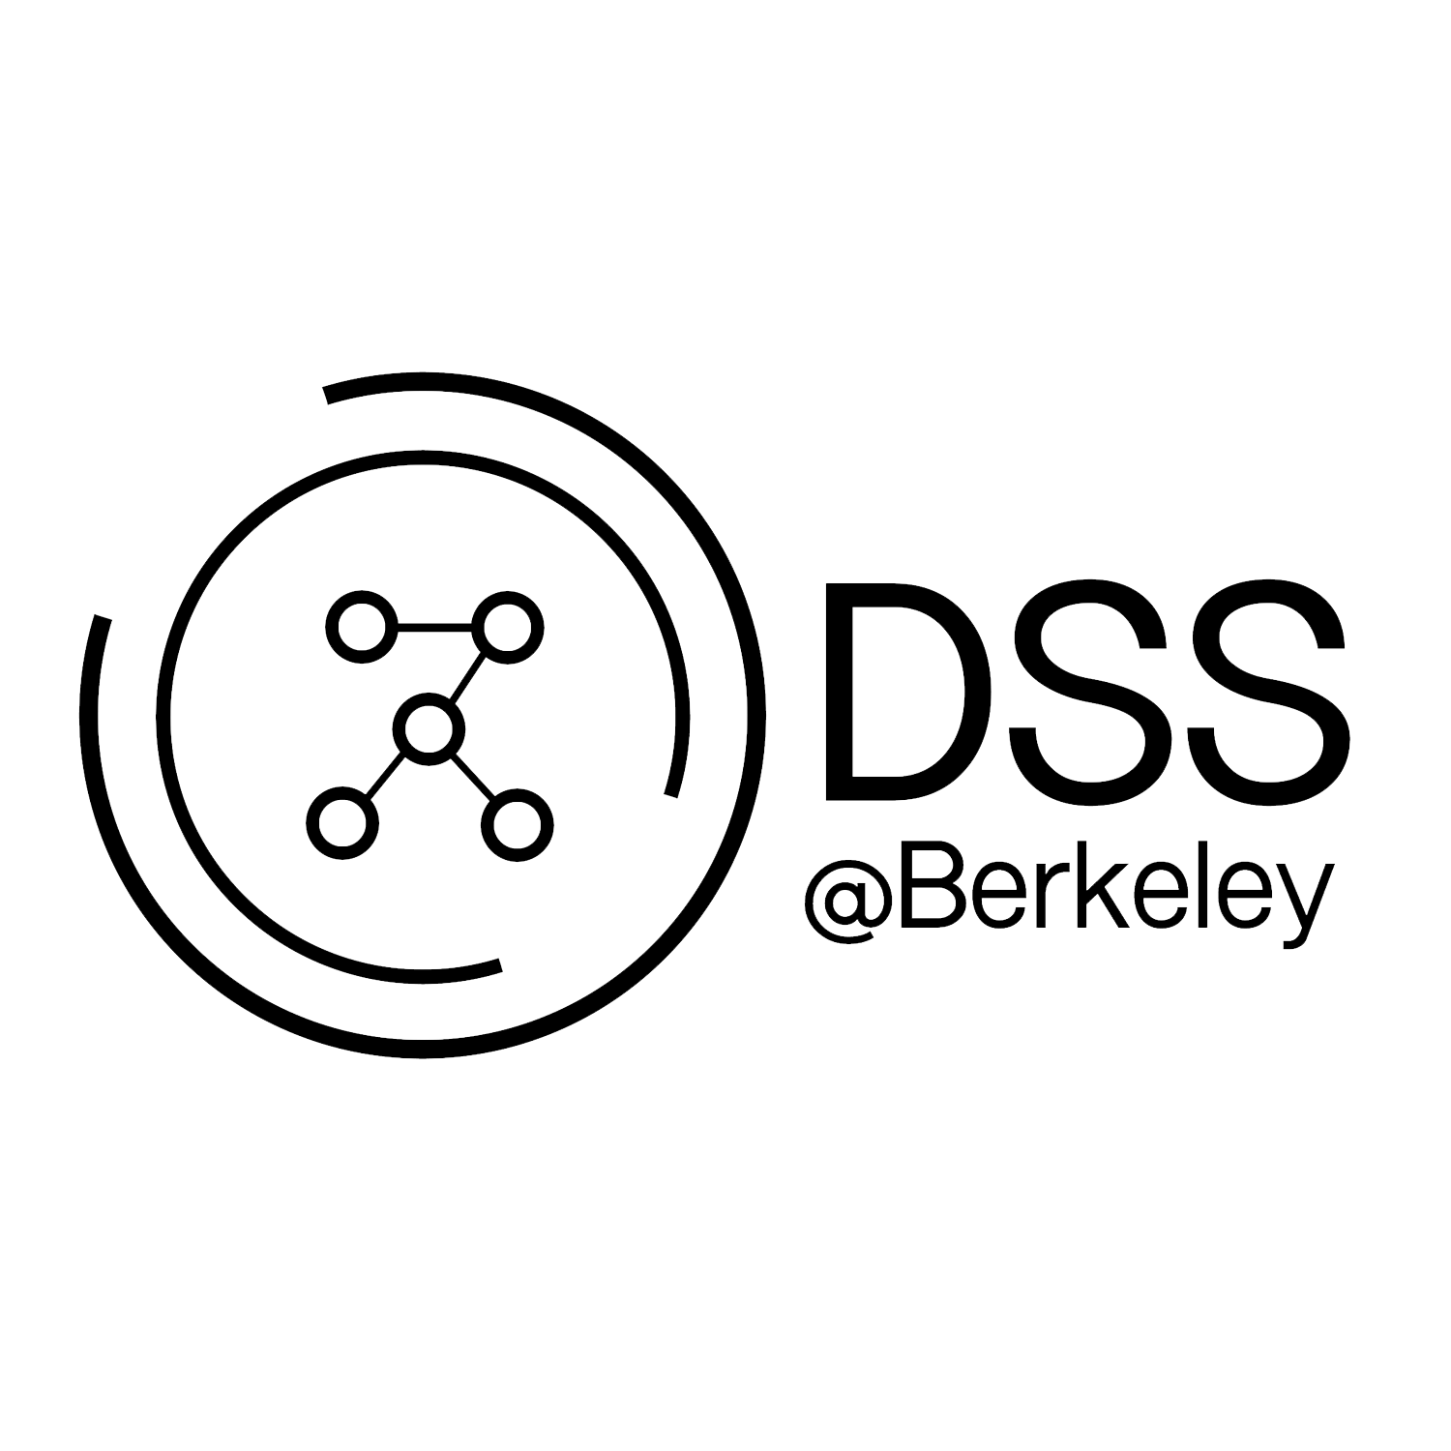
Visualizations for
Data Science
April 1, 2019
https://tinyurl.com/dss-visualization

Slide 2



https://tinyurl.com/dss-visualization
Instructors
Zachary Chao
Junior
Computer Science
Marissa Pagador
Sophomore
Data Science

Slide 3
https://tinyurl.com/dss-visualization
Agenda
Data Visualization
What makes a good visualization?
Plotting quantitative vs qualitative variables
Bad plots - things to consider
Libraries for Visualization
Demo on jupyter notebook

Slide 4
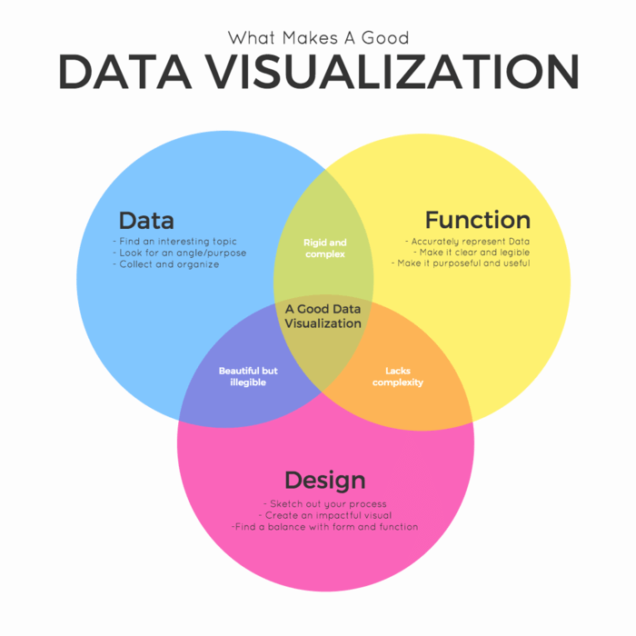
Data Visualization
Visualizations are essential to data analysis
It involves communicating your findings effectively through graphical means
Ex: trends, anomalies, etc.
It might include graphs, charts, mind maps, infographics, and other visuals to help convey key data findings and insights.

Slide 6
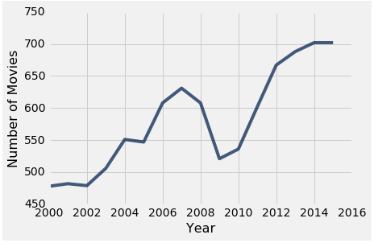
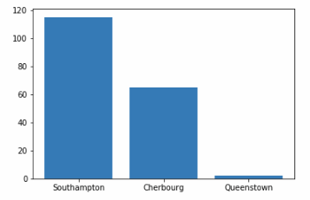
Data Visualization
Quantitative variables - numerical (ex: height, number of friends)
Line graphs
Histograms
Box plots
Scatter plots
Qualitative variables - categorical (ex: names, ice cream flavors)
Bar charts
Pie charts

Slide 7
Important thing to Consider
Are the graphics and info presented misleading?
Scale - consistency between axes
Conditioning - effectively comparing multiple distributions
Perception - concrete color scheme
Context - title, caption, labels, units

Slide 8
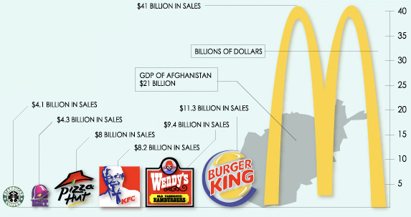
What’s wrong with this visualization?
Notes:
Why is this a bad graph? There are problems with each of the 4 things that should’ve been considered (scale, conditioning, perception, context)

Slide 9

Python Libraries for Visualization
Matplotlib - standard plotting library for Python and Numpy
Documentation on https://matplotlib.org/
Use to set plot title, labels, axes limits, legend, size, etc.
Seaborn - based on matplotlib, capable of more complex statistical graphics and generally more visually appealing plots
Documentation on https://seaborn.pydata.org/
Good for complex graphs and analysis
Sometimes has simpler syntax

Slide 10
Graphing Cheat Sheet
Function | Matplotlib (plt) | Seaborn (sns)
Line graph | plt.plot(x, y) | sns.lineplot(x, y, data)
Scatter plot | plt.scatter(x, y) | sns.lmplot(x, y, hue, data)
Bar chart | plt.bar(x, y, width) | sns.countplot(x, y, hue, data)
Histogram | plt.hist(data) | sns.distplot(x)
Pie chart | plt.pie(data, labels= list) | n/a
Set title | plt.title(“Graph 1”) | plt.title(“Graph 1”)
Set x axis label | plt.xlabel(“Label 1”) | plt.xlabel(“Label 1”)
Set y axis label | plt.ylabel(“Label 2”) | plt.ylabel(“Label 2”)
Add a legend | plt.legend(loc= int) | plt.legend(loc= int)
Notes:
Check documentation for details and other types of graphs!

Slide 11
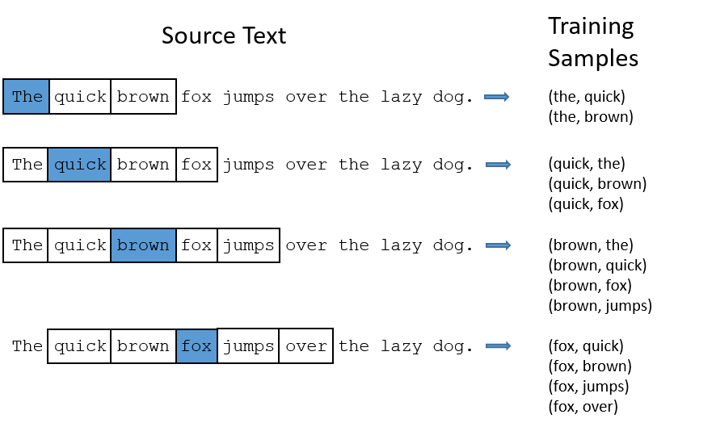
Word2Vec

Slide 12
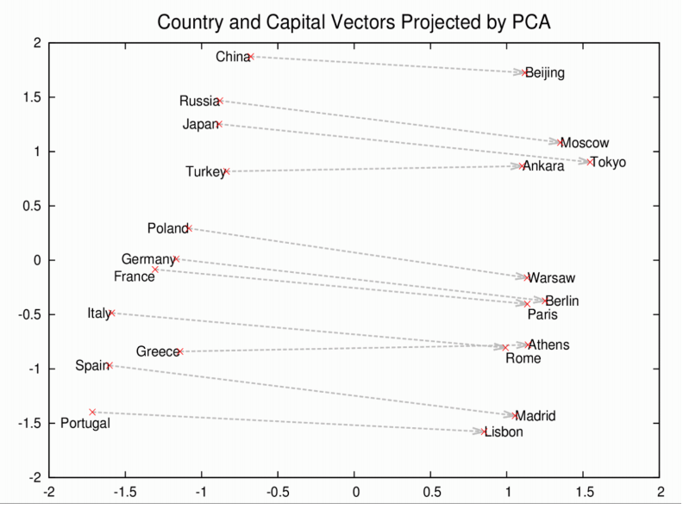

Slide 13
DEMO
https://tinyurl.com/dss-visualization
Notes:
Demo link to ipynb file, download and upload to local jupyterhub/datahub or open with google collaboratory

Slide 14
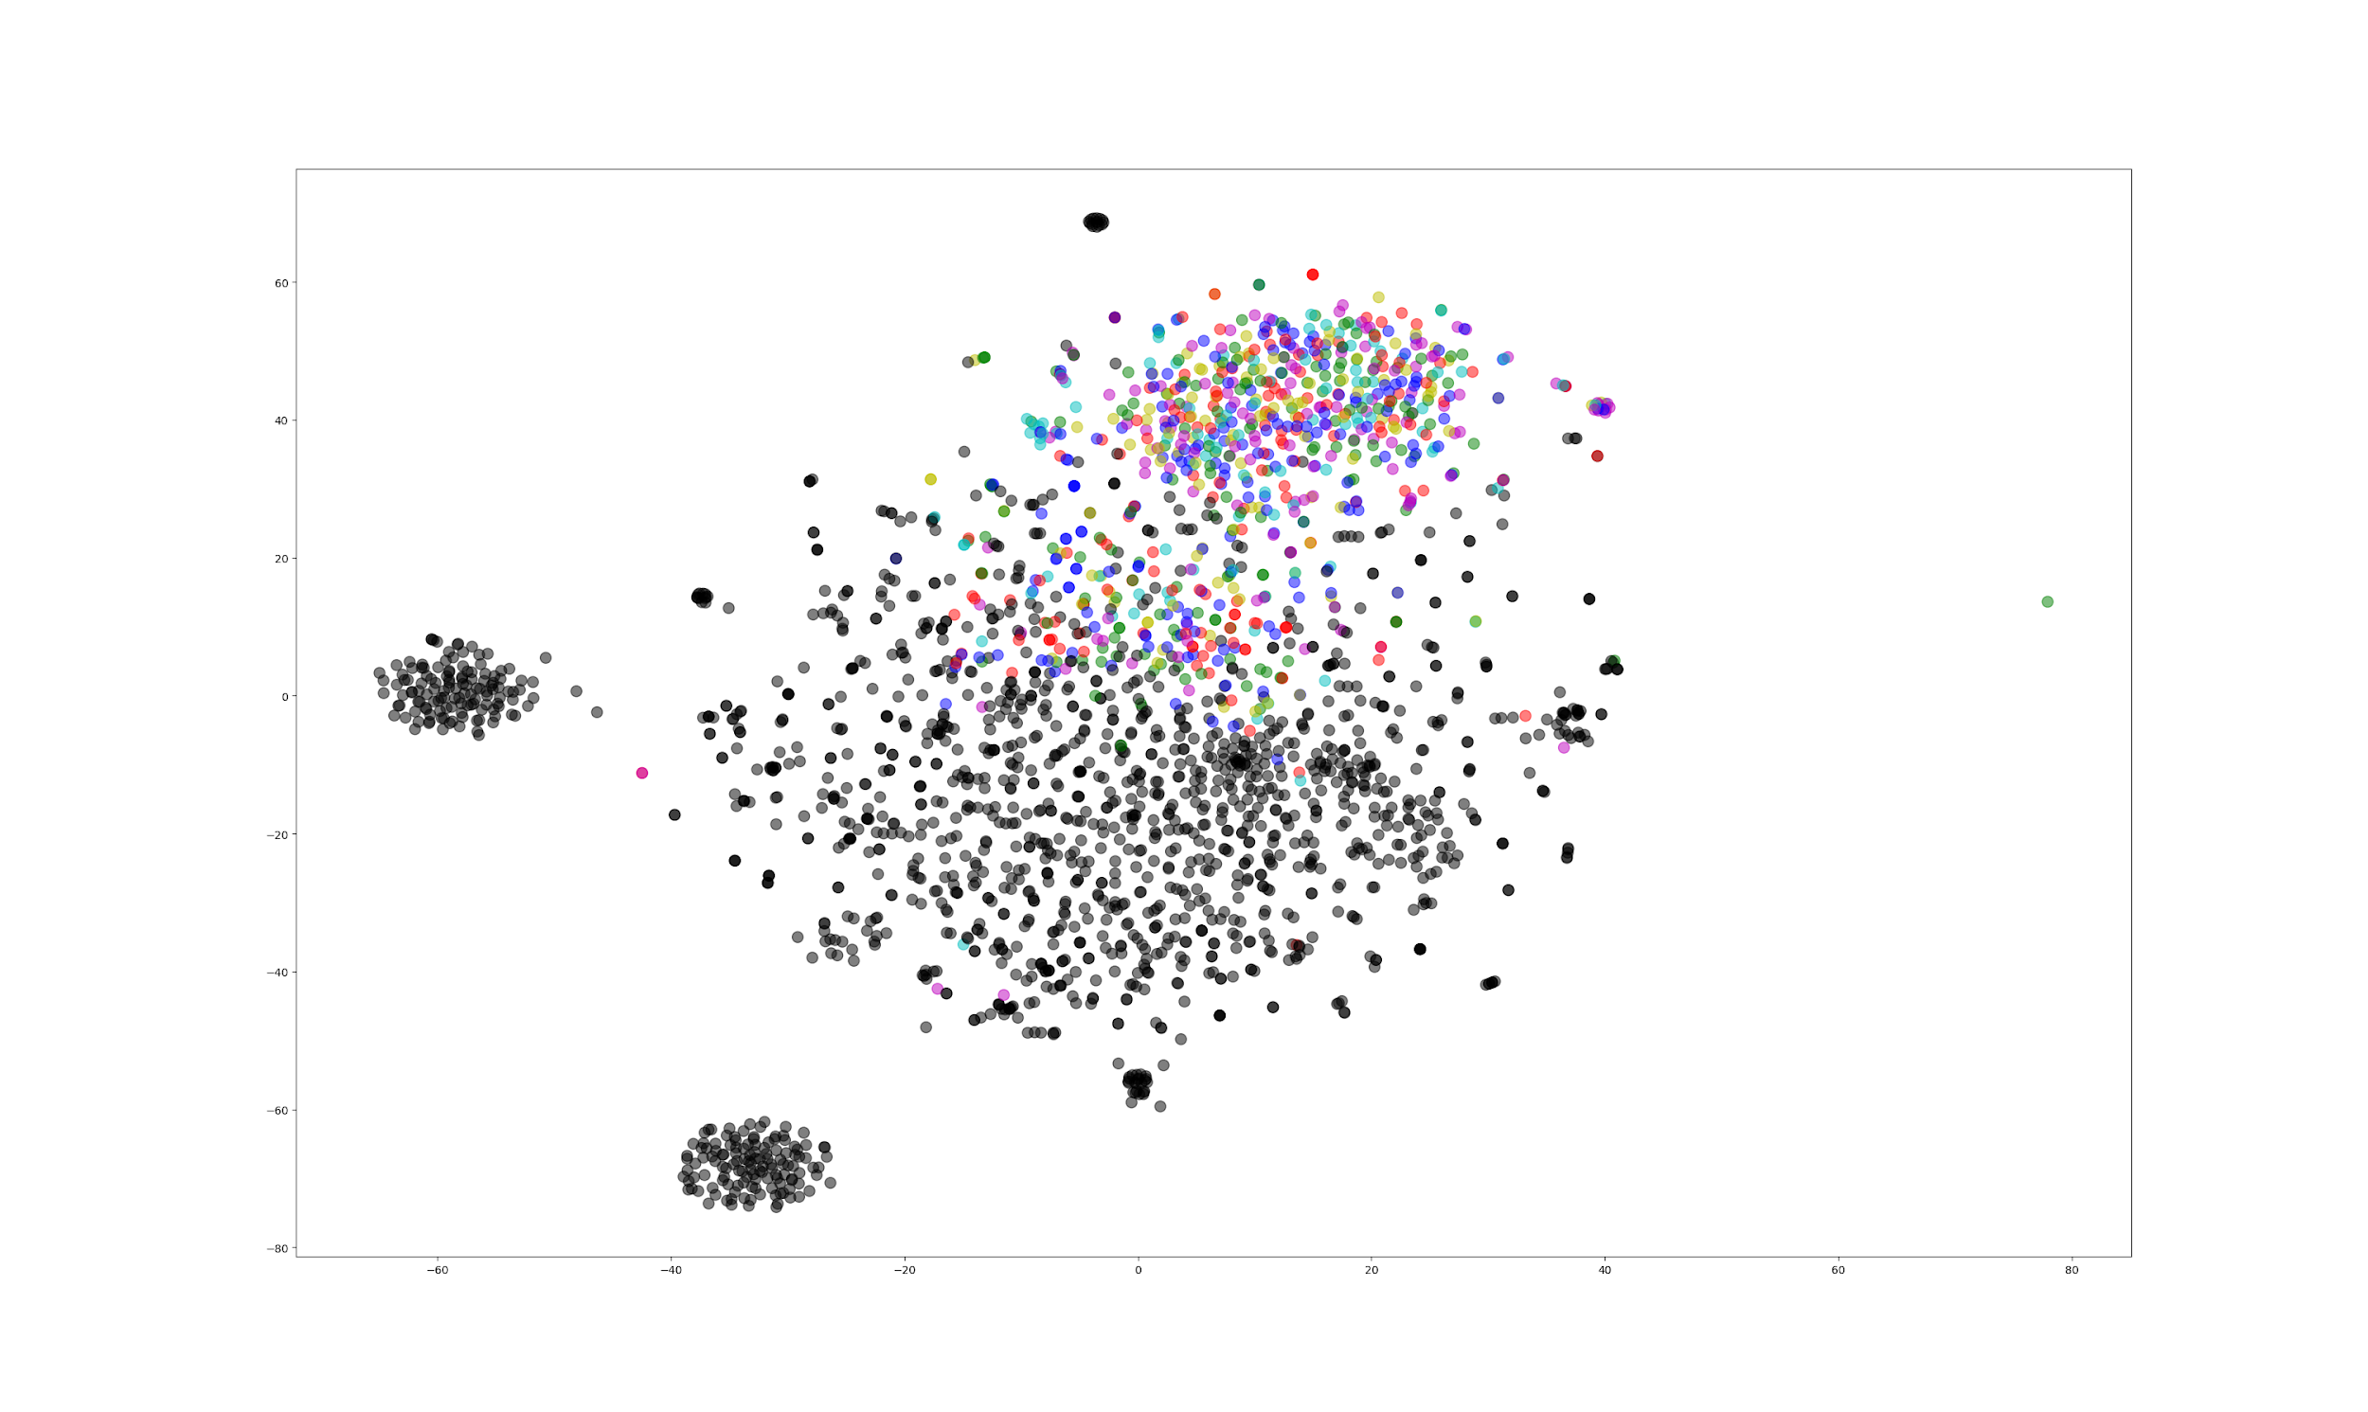

Slide 15
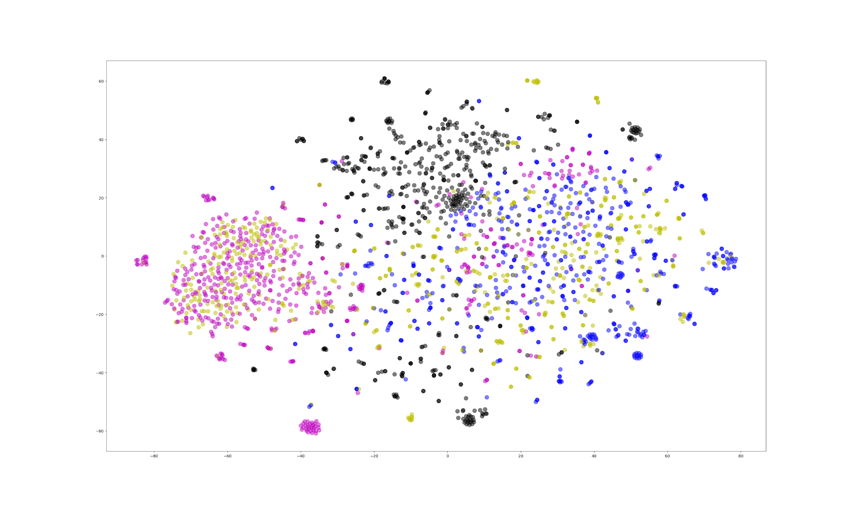

Slide 16
Questions
Applications - What are some other applications you can think of? Can this be applied to your data sets?
Real World Uses - Where might word and document embeddings be used in the real world?

Slide 17
Answers
Real World Uses - Where might word and document embeddings be used in the real world?
Text prediction on your phone
Analyzing sub cultures for marketing
Search Engines
Classifying text
Spam detection
etc

