Slide 1
THE 10TH NATIONAL CONFERENCE ON COMMUNICATIONS (NCC 2026)
A 1D CNN Edge Forecasting Approach for Spatiotemporal Environmental Monitoring via Mobile Wireless Sensor Networks
Owori Charles, Nakanyike Belinda, Excellence Favor, Stanley Mugisha
Presenter: Nakanyike Belinda
Dept. of Electronics and Computer Engineering, Soroti University
September 24, 2026

Slide 2
Outline
Motivation and Research gap
System Architecture
Hardware Prototype
Study Area and Data Collection
1D CNN Forecasting Model
Results-Model Comparison
Communication and Energy Efficiency
Limitations and Conclusion

Slide 3
Motivation and Research Gap
02
~4.2M
Deaths per yr linked to air pollution worldwide
0
Continuous reference monitors in Soroti before this work
Fixed monitoring stations are accurate but geographically sparse ,they miss local spatiotemporal variability
Secondary cities such as Soroti remain comparatively under-monitored as compared Kampala
Gap: few systems integrate mobile sensing + GNSS mapping + edge forecasting in one low-cost node

Slide 4
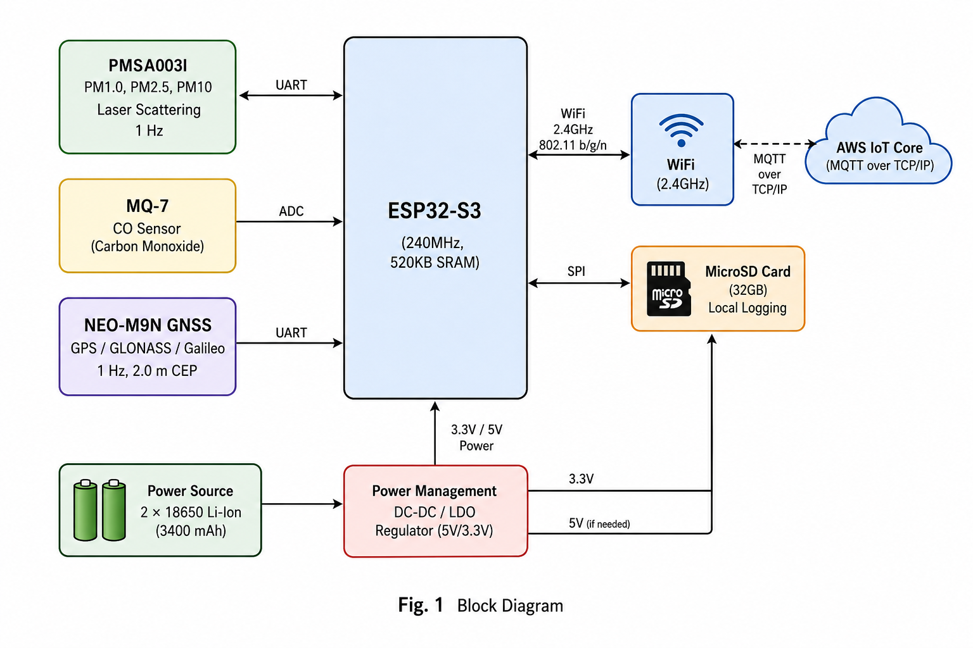
System Architecture
03
ESP32-S3 controller + PMSA003I (PM), MQ-7 (CO), NEO-M9N GNSS
WiFi 2.4 GHz / MQTT; local microSD logging
FreeRTOS: sensing, edge inference and communication run as independent tasks
Fig. 1: System architecture of the mobile sensor node

Slide 5
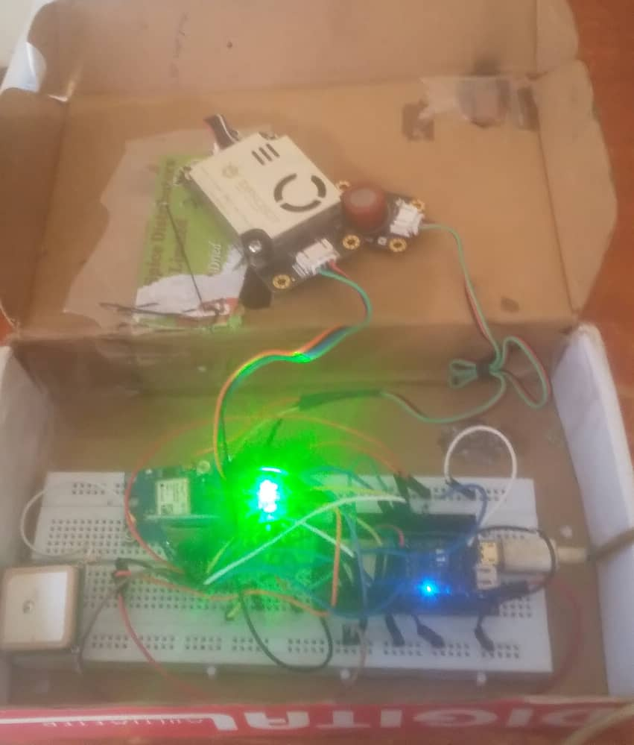
Hardware Prototype
04
Breadboard prototype: ESP32-S3 + PMSA003I PM sensor + NEO-M9N GNSS module +CO sensor + sd module
Deployed in a ventilated enclosure for in vehicle mounting
Powered by 2×18650 Li-Ion cells through a voltage regulation circuit
USD 50
Total component cost
Fig. 2: Assembled mobile sensor node hardware

Slide 6
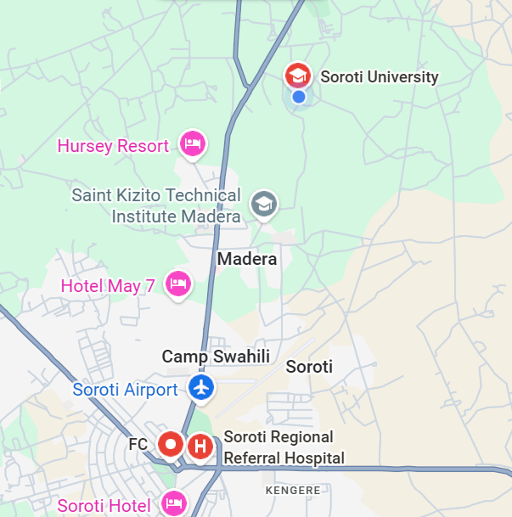
Study Area and Data Collection
05
~5 km
Monitored route into Soroti CBD
~11,500
Sensor observations recorded
4 trips
Over 12 h (06:00–18:00)
20 km/h
Average transit speed
Centered on Soroti University (1.714°N, 33.611°E); route elevation 1,097–1,105 m, passing schools, a hospital and a major intersection
Platform: a university van (Nissan); dry day, 28°C, 55% RH

Slide 7
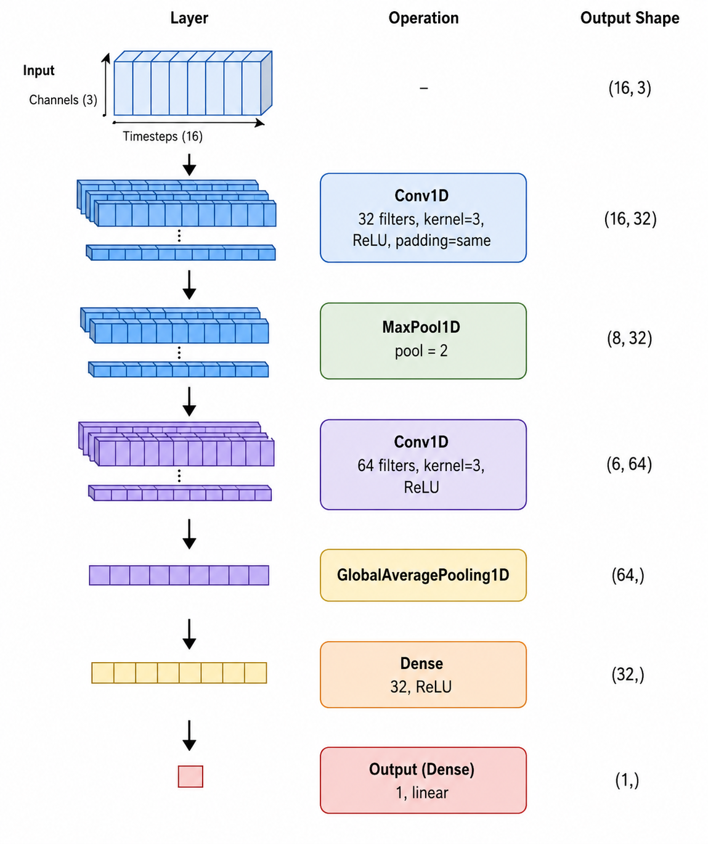
1D CNN Forecasting Model
06
Input: 16 timesteps × 3 channels (PM2.5, gas, GPS speed)
Conv1D(32)→Pool→Conv1D(64)→GlobalAvgPool→Dense(32)→Dense(1)
Baselines: Linear Regression and LSTM
8,472
Model parameters
16 steps
Input window (≈ 10 s)
t + 5
Forecast horizon
Fig. 3: Architecture of the proposed 1D CNN

Slide 8
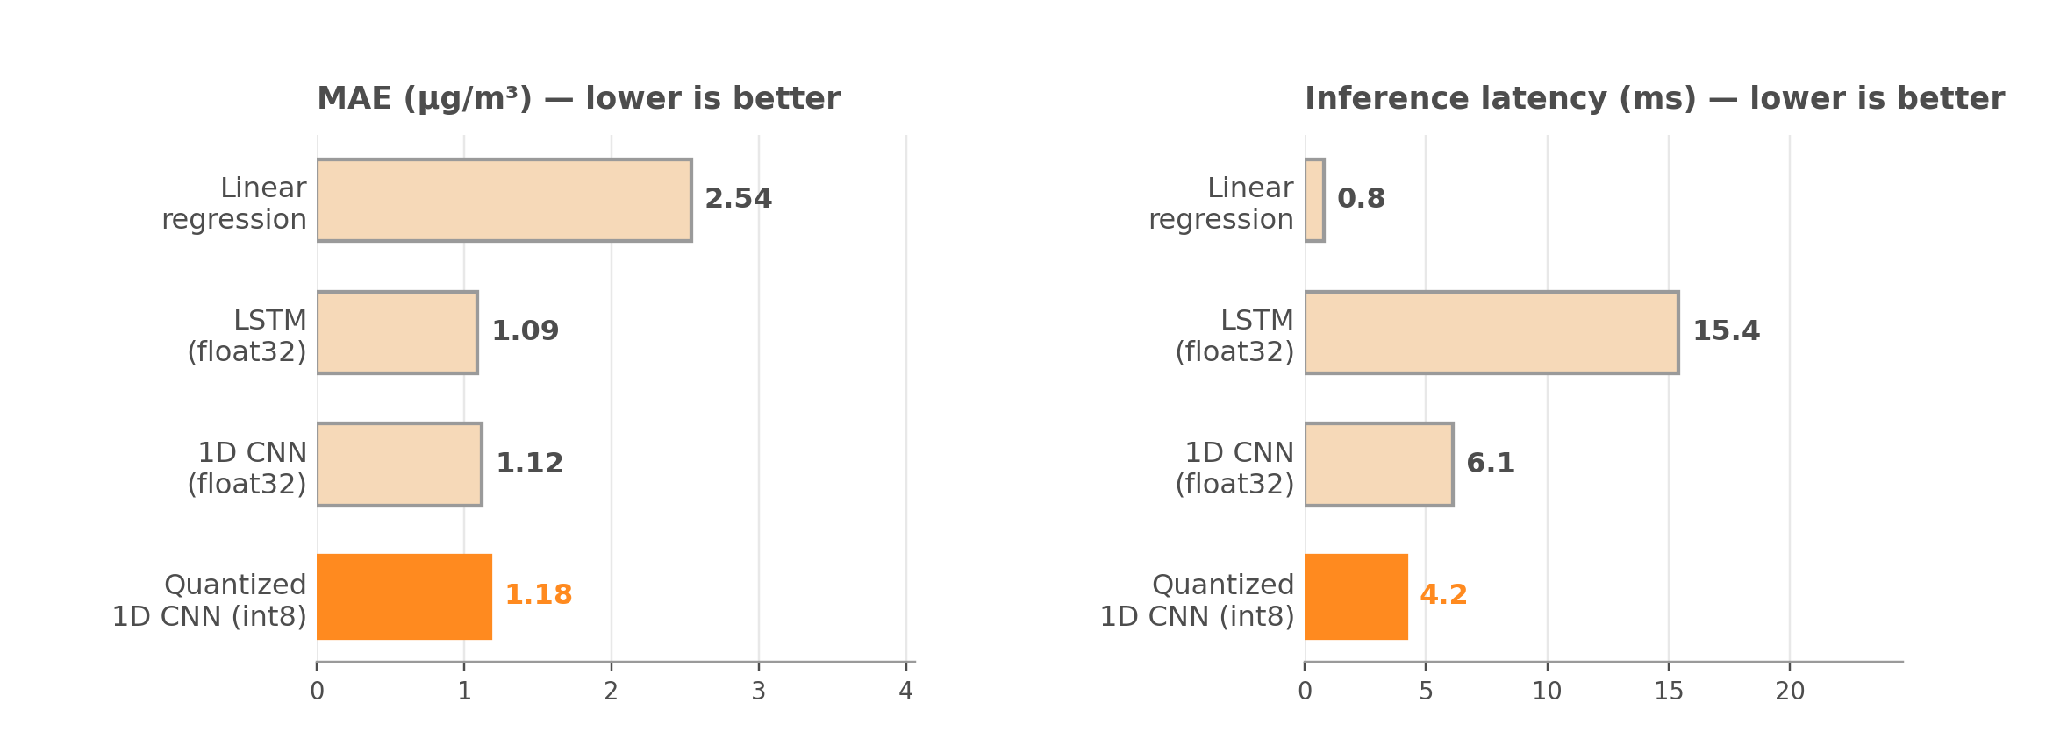
Results — Model Comparison
07
LSTM has the lowest MAE, but its latency is ~3.7× the quantized CNN the 1D CNN is chosen for the edge

Slide 9
Effect of Quantization
08
Float32 CNN
1.12 µg/m³
MAE
6.1 ms
Inference latency
Quantized int8 CNN (selected)
1.18 µg/m³
MAE
4.2 ms
Inference latency
• Only +0.06 µg/m³ MAE for a 31% latency cut selected as the operational edge model
• Quantized model footprint: ≈ 24 KB flash / 6 KB RAM fits the ESP32-S3's constrained memory

Slide 10
Communication and Energy Efficiency
09
≈ 80%
Cut in cloud-transmitted data (threshold alerts only)
35 mA
Average current with adaptive buffering
≈ 48 h
Estimated runtime on the 2-cell battery
Alerts sent only when predicted PM2.5 > 15 µg/m³ the complete raw stream still logs to SD card locally
80% figure is a transmission reduction, not a reduction in data sensed or stored
Battery figure is a reported prototype configuration, not a universal estimate

Slide 11
Limitations and Conclusion
10
LIMITATIONS
KEY TAKEAWAYS
Single day, one node no day-to-day or seasonal variability captured
Reference monitor fixed at the campus gate that is not continuously co-located
No wind or rainfall data included in the forecasting model
Altitude pollution link is contextual, not proven causal
1.18 µg/m³
Edge-model MAE at 4.2 ms inference
~80%
Cloud-data reduction, raw data retained locally
USD 50
Low-cost prototype hardware cost
▸ A prototype demonstrating feasibility for secondary-city air-quality monitoring

Slide 12
THANK YOU
Questions?

