Slide 1



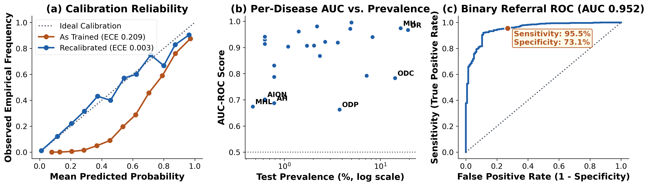
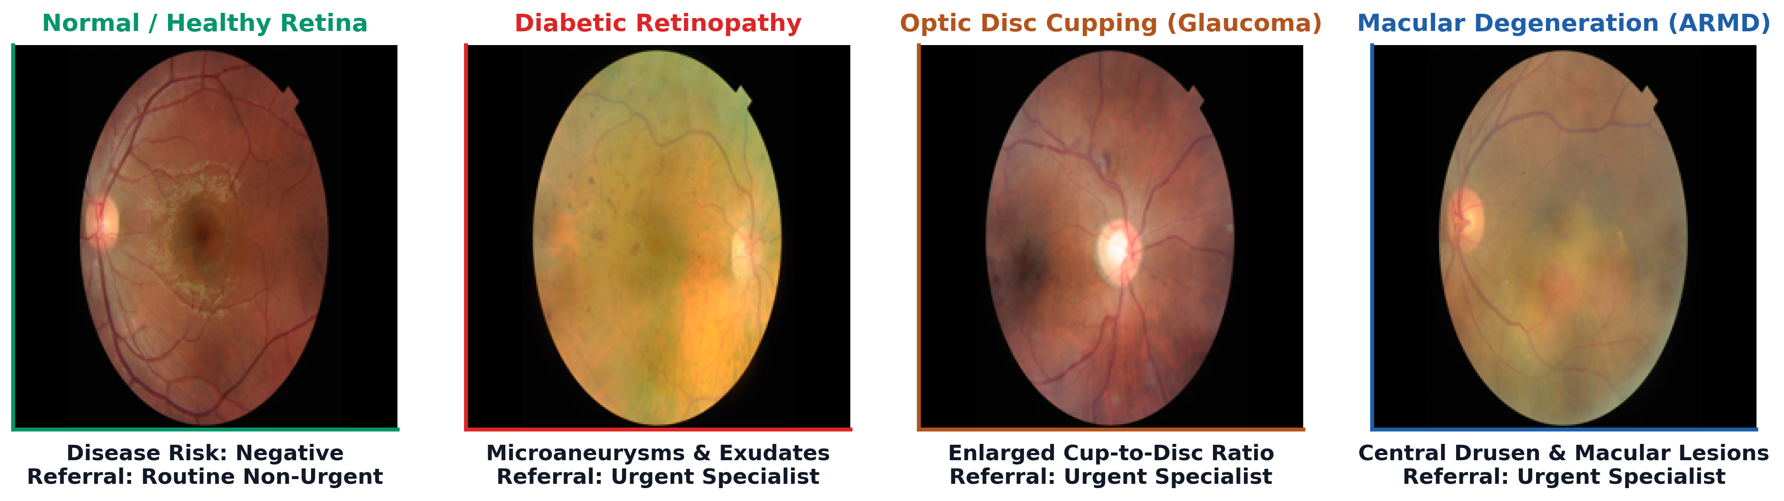
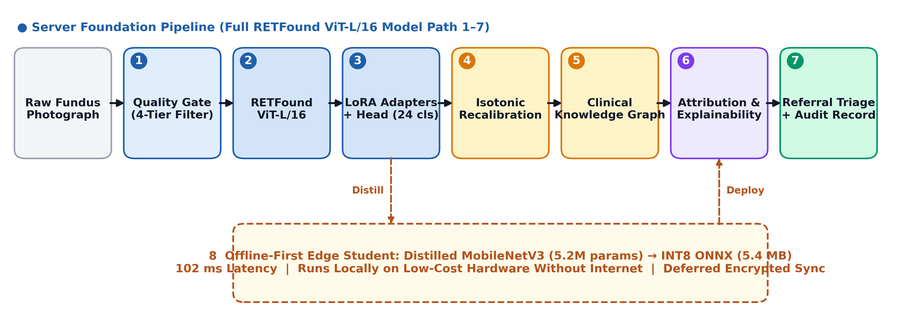
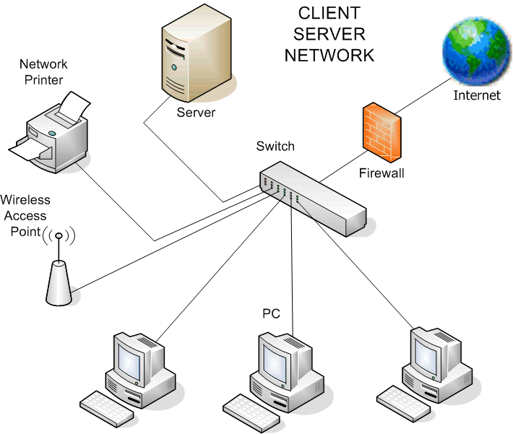
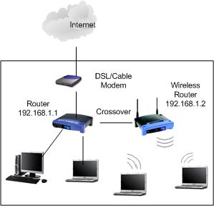
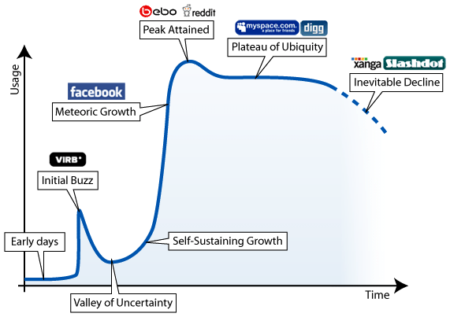
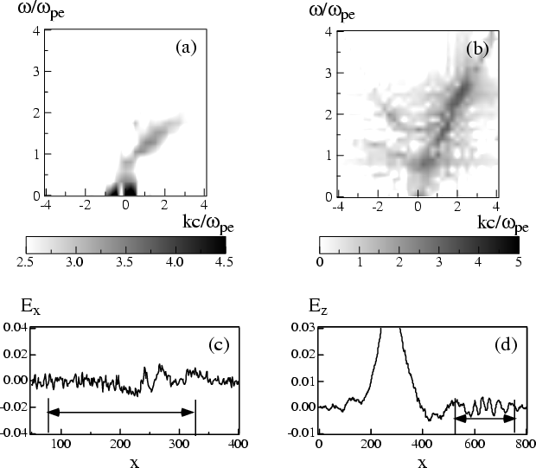
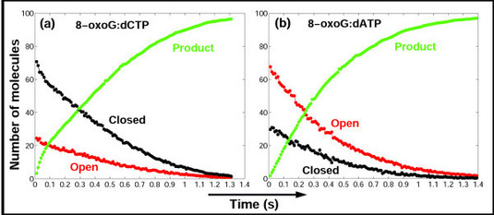
National Conference on Communications (NCC)
CEDAT, Makerere University
OptiscanAI: Large Vision Models for Multi-Disease Retinal Screening
in Ugandan Healthcare — A Benchmark and Deployment Study (Paper 83)
Lauben Mpairwe¹ Shadia Nankya¹ Rebecca Yapyeko¹ Marvin Ggaliwango²
¹ Department of Networks, ² Department of Computer Science, College of Computing and Information Sciences (CoCIS), Makerere University, Kampala, Uganda
Correspondence: {mpairwe_lauben, nankya.shadia, yapyeko.rebecca}@students.mak.ac.ug, ggaliwango.marvin@cit.ac.ug — Interactive System: https://landwind22-retinal-screening.hf.space
Abstract
Results & Clinical Validation
Preventable blindness from vitreoretinal and optic nerve pathologies presents a critical global burden, exacerbated by the acute shortage of specialist ophthalmologists across sub-Saharan Africa. In Uganda, non-specialist primary healthcare workers serve as initial gatekeepers for ocular screening without specialist grading support.
OptiscanAI adapts a domain-specific foundation model (RETFound ViT-L/16) via Low-Rank Adaptation (LoRA), evaluated strictly on the official held-out test partition (640 images) of the Retinal Fundus Multi-Disease Image Dataset (RFMiD). We report 0.872 macro AUC across 24 conditions, diagnose an uncalibrated overconfidence defect (ECE 0.209) mitigated to 0.003 via isotonic Platt scaling, achieve 0.952 referral triage AUC, and evaluate an offline edge student running in 102 ms at 5.4 MB for rural primary care.
• Macro Discrimination (24 Diseases): Evaluated strictly on the held-out 640-image RFMiD test partition, OptiscanAI achieves 0.872 macro AUC-ROC (95% CI: 0.846–0.896) and 0.357 macro AUPRC across all 24 held-out diagnostic conditions.
• High-Prevalence Accuracy: Outstanding diagnostic accuracy on major preventable conditions: Myopia (AUC 0.996), Media Haze (0.974), Macular Degeneration (0.972), and Diabetic Retinopathy (0.967, AUPRC 0.873).
• Power Bounds on Rare Classes: Diagnostic accuracy tracks positive training sample count (Fig. 2b); rare conditions (<20 test positives) exhibit wider bootstrap confidence intervals and require prospective validation.
• Binary Referral Triage: High discriminative power for referral screening (AUC 0.952; Sensitivity 95.5%, Specificity 73.1%), safely sorting urgent specialist cases from routine checks.
Problem Statement
• Avoidable Blindness in Uganda: Over 2.2 billion individuals suffer vision impairment globally. In Uganda, ophthalmologists are concentrated in urban tertiary hospitals, leaving frontline primary health workers as gatekeepers without expert grading support.
• Frontline Screening Bottlenecks: Non-mydriatic cameras in rural clinics face variable illumination, focus blur, and dust artifacts, while manual grading by distant specialists is economically and logistically inaccessible.
• Multi-Disease Co-morbidities: Patients present overlapping pathologies across 24 conditions (diabetic retinopathy, glaucoma cupping, ARMD, vein occlusions), rendering single-disease screening tools inadequate.
• Silent Channels & Prevalence Shift: Uncalibrated foundation model outputs exhibit severe overconfidence, causing static decision thresholds to silence rare disease channels. Furthermore, high benchmark PPV collapses in low-prevalence rural screening.
• Core Objective: Adapt a domain-specific foundation model for multi-disease retinal screening, eliminate calibration failures, and distill a 5.4 MB offline-first edge student for rural primary care.
Fig. 2: Empirical test evidence: (a) Calibration reliability; (b) AUC vs prevalence; (c) Binary referral ROC (AUC 0.952).
System Architecture
• Cascaded 4-Tier Intake Gate: Verifies resolution (≥1536×1024), focus sharpness (Laplacian variance), illumination uniformity, and MobileNet usability scoring (≥0.70) with real-time recapture guidance.
• RETFound ViT-L/16 + LoRA Adapters: Foundation model (1.6M retinal pretraining) fine-tuned via LoRA (r=16, α=32) updating only 2.44M of 305.7M parameters (0.8%). Top-32 patch attention feeds a 512→128→24 bottleneck head.
• Symbolic Clinical Knowledge Graph: 24 disease nodes and 54 typed edges curated from AAO and Uganda MOH guidelines inject epidemiological co-occurrence priors into referral triage.
• Distilled Offline Edge Student: 5.2M MobileNetV3 student distilled to INT8 ONNX (5.4 MB) executes locally in 102 ms per image on low-cost edge laptops without telecommunications.
Fig. 3: Representative held-out fundus screening cases with automated triage referral actions (Green: Routine; Red/Amber: Urgent Referral).
Quantitative Outcomes
• Probability Calibration Fix: Raw model probabilities suffer severe over-confidence (mean 0.251 vs 0.042 empirical rate; ECE 0.209), causing precision-floor thresholds to silence 5 disease channels. Monotone Platt scaling resolves ECE to 0.003 while strictly preserving ROC ranking.
• Operating Policy Optimization: Sensitivity target ≥ 0.90 restores detection across all 24 diseases (0 silent channels vs 6 uniform, 5 precision floor) with 81.1% sensitivity.
• INT8 Dynamic Quantization: Compresses model footprint by 74.7% (1224 MB → 310 MB) while preserving AUC (0.872 → 0.873). Distilled MobileNetV3 student operates at 5.4 MB ONNX and 102 ms median latency with 99.6% decision concordance.
Screening Caseload Population | Prevalence | PPV | NPV | Referral %
RFMiD Held-Out Test (Benchmark) | 79.0 % | 0.931 | 0.810 | 81.0 %
Specialized Eye Clinic (Projected) | 30.0 % | 0.604 | 0.974 | 47.0 %
District Hospital Triage (Projected) | 20.0 % | 0.470 | 0.985 | 41.0 %
Rural Primary Care Clinic (Projected) | 10.0 % | 0.283 | 0.993 | 34.0 %
Community Mobile Screening (Projected) | 5.0 % | 0.158 | 0.997 | 30.0 %
Fig. 1: Modular OptiscanAI pipeline: Server foundation pathway (1–7) and distilled offline edge student (8).
Table 2: Clinical prevalence transfer holding operating point fixed (Sensitivity 95.5%, Specificity 73.1%).
Model Adaptation & Ablation
• Referral Bottleneck & Rule-Out Sieve Role: In community caseloads (5–10% prevalence), PPV drops from 93.1% to 15.8%–28.3%. Sizing tertiary referral capacity on raw benchmark PPV would overburden clinics by 3x–6x. However, NPV exceeds 99.3%, proving OptiscanAI's value as a frontline rule-out sieve.
• Explainability Faithfulness Audit: Grad-CAM (p=0.029) and Integrated Gradients (p=0.008) pass RISE deletion tests, confirming spatial saliency. Both fail insertion tests due to floor probabilities (min prob 0.064); maps must serve as clinician hints, not autonomous decisions.
Arm / Model Component | Total (M) | Train. % | AUC-ROC | AUPRC
ResNet-50 (ImageNet full FT) | 23.56 | 100.0 % | 0.867 | 0.336
EfficientNet-B3 (ImageNet FT) | 10.73 | 100.0 % | 0.819 | 0.377
ViT-B/16 (ImageNet full FT) | 85.82 | 100.0 % | 0.871 | 0.472
RETFound ViT-L (head only) | 2.44 | 0.8 % | 0.877 | 0.360
RETFound ViT-L + LoRA (r=16) | 4.01 | 1.3 % | 0.882 | 0.392
RETFound + LoRA (Dataset Norm) | 4.01 | 1.3 % | 0.827 | 0.285
ImageNet Norm + CLAHE | 4.01 | 1.3 % | 0.866 | 0.341
OptiscanAI Deployed Checkpoint† | 2.44 | 0.8 % | 0.872 | 0.357
Conclusions
Table 1: Controlled component ablation on official RFMiD test split (shared 15-epoch training recipe).
• Foundation Model Adaptation: Parameter-efficient foundation model adaptation (RETFound + LoRA, 0.8% trainable params) delivers strong multi-disease ranking (AUC 0.872). Probability calibration is essential to prevent silent-channel triage failure, while INT8 edge distillation enables instant local inference on low-cost clinic hardware.
• Clinical Separation Principle: High benchmark metrics on curated datasets do not guarantee clinical readiness. When transferring to rural primary care prevalence, PPV drops substantially; OptiscanAI is designed as a frontline rule-out sieve (NPV > 99.3%) that filters out healthy retinas and escalates suspected pathology to human clinicians.
• Translational Roadmap: Future translation demands prospective multi-centre trials across Ugandan district health centres, validation with low-cost handheld fundus cameras, local mobile network integration, and Uganda National Drug Authority (NDA) regulatory clearance.
• Pretraining Efficiency vs Full Fine-Tuning: RETFound frozen head-only (0.8% trainable params) achieves 0.877 AUC, outperforming fully fine-tuned ImageNet ResNet-50 (0.867) and EfficientNet-B3 (0.819). Adding LoRA (r=16) gains +0.005 AUC and +0.032 AUPRC for only 1.6M additional parameters.
• Rare Positives Trade-off: Full fine-tuning of ViT-B/16 on ImageNet reaches higher AUPRC (0.472 vs 0.392) by updating all 85.8M weights. Foundation models excel at ranking efficiency on constrained institutional GPU budgets, while full tuning retrieves rare positives better.
• Distribution Alignment & CLAHE Penalty: Replacing ImageNet normalization with dataset-specific channel statistics collapses AUC by 0.054 and AUPRC by 0.107. CLAHE contrast equalisation reduces AUC by 0.016 by stripping subtle vascular diagnostic cues.
Clinical Knowledge Graph & Gating
References
• Evidence-Based Clinical Ontology: 24 disease nodes and 54 typed edges curated from American Academy of Ophthalmology (AAO) Preferred Practice Patterns, AREDS-39, and Uganda Ministry of Health Guidelines (2024). Spans vascular, degenerative, glaucomatous, and inflammatory taxonomy.
• Uganda-Specific Epidemiological Weighting: Attaches localized clinical prevalence factors for 6 priority conditions (diabetic retinopathy, optic disc cupping/glaucoma, retinal vein occlusions, macular scars) reflecting East African disease burdens.
• Monotonic Risk Stratification: Under calibrated sensitivity-targeted thresholds, the symbolic graph cleanly stratifies referral priority: 84.5% routed to Urgent (86.9% confirmed true pathology), 10.8% to Routine (47.8%), and 4.7% to Follow-up (10.0%).
• Transparent Synergistic Scope: Co-occurrence rules alter only 12.7% of predictions because 21 rare partner classes were dropped from RFMiD for having <10 training positives. OptiscanAI explicitly bounds claims rather than asserting unverified global synergy.
• Frontline Usability & Recapture Guidance: The cascaded quality filter provides explicit failure codes (low focus sharpness, improper pupil centering, underexposure) enabling community health extension workers to recapture diagnostic-grade fundus photos immediately.
• Human-in-the-Loop Clinical Safeguards: All AI triage outputs include calibrated confidence scores and attribution maps, requiring final sign-off by a visiting ophthalmic clinical officer (OCO) rather than making automated autonomous clinical judgments.
[1] S. Pachade, P. Porwal, D. Thulkar et al., “Retinal fundus multi-disease image dataset (RFMiD): A dataset for multi-disease detection research,” Data, vol. 6, no. 2, p. 14, 2021.
[2] Y. Zhou, M. A. Chia, S. K. Wagner et al., “A foundation model for generalizable disease detection from retinal images,” Nature, vol. 622, pp. 156–163, 2023.
[3] E. J. Hu, Y. Shen, P. Wallis et al., “LoRA: Low-rank adaptation of large language models,” in Proc. Int. Conf. Learning Representations (ICLR), 2022.
[4] C. Guo, G. Pleiss, Y. Sun et al., “On calibration of modern neural networks,” in Proc. Int. Conf. Machine Learning (ICML), 2017, pp. 1321–1330.
[5] K. Lekadir, A. Frangi, A. R. Porras et al., “FUTURE-AI: International consensus guideline for trustworthy and deployable artificial intelligence in healthcare,” BMJ, vol. 388, e081554, 2025.
[6] G. S. Collins, K. G. M. Moons, P. Dhiman et al., “TRIPOD+AI statement: Updated guidance for reporting clinical prediction models,” BMJ, vol. 385, e078378, 2024.
[7] A. S. Tejani, M. E. Klontzas, A. A. Gatti et al., “Checklist for Artificial Intelligence in Medical Imaging (CLAIM): 2024 update,” Radiology: Artificial Intelligence, vol. 6, no. 4, e240300, 2024.
[8] E. Beede, E. Baylor, F. Hersch et al., “A human-centered evaluation of a deep learning system deployed in clinics for the detection of diabetic retinopathy,” in Proc. CHI Conf. Human Factors in Computing Systems, 2020, pp. 1–12.
OptiscanAI (Paper 83) • National Conference on Communications (NCC), September 24–25, 2026 • CEDAT / CoCIS, Makerere University
OptiscanAI (Paper 83) • National Conference on Communications (NCC), September 24–25, 2026 • CEDAT / CoCIS, Makerere University
Notes:
<number>

