Slide 1
THE 10TH NATIONAL CONFERENCE ON COMMUNICATIONS (NCC 2026)
OptiscanAI: Large Vision Models for Multi-Disease Retinal Screening
A Benchmark and Deployment Study in Ugandan Healthcare • Paper 83
Lauben Mpairwe¹, Shadia Nankya¹, Rebecca Yapyeko¹, Marvin Ggaliwango²
Presenter: Mpairwe Lauben
Dept. of Networks, College of Computing and Information Sciences (CoCIS)
Makerere University, Kampala, Uganda
September 24, 2026

Slide 2
Three Core Realities in Retinal AI
02
01
The Clinical Tragedy
2.2 billion people suffer visual impairment globally. In Uganda, <45 specialists serve 48 million citizens. The doctors are in Kampala; the blindness is in rural districts.
02
The Benchmark Illusion
A 93% PPV on an enriched international benchmark collapses to 16% in rural primary care. We cannot confuse academic leaderboards with clinical readiness.
03
The Silent Defect
Severe probability over-confidence (ECE 0.209) silently disabled 5 whole disease channels. We confront this failure head-on and prove the isotonic remedy.
“Before deploying AI into human healthcare, we have a moral obligation to state where it breaks down — and engineer the remedy before it reaches the clinic.”

Slide 3
The Crisis: Avoidable Blindness in Uganda
03
2.2 Billion
Global Vision Impairment (WHO)
Over 50% is entirely preventable if diagnosed early.
< 45 Specialists
Ophthalmologists in Uganda
Serving 48M citizens — heavily concentrated in Mulago.
• The Asymmetric Clinical Cost: Diabetic retinopathy, glaucoma, and macular degeneration inflict irreversible blindness. Missing an insidious lesion strips individuals of agency, dignity, and livelihood.
• The Frontline Bottleneck: Primary nurses at Level III/IV health centres are frontline gatekeepers with zero ophthalmic diagnostic tools and minimal specialist training.
• The Technological Dilemma: Cloud-tethered 1 GB transformers fail when rural power drops and networks vanish. Screening requires an offline, highly specific rule-out sieve.

Slide 4
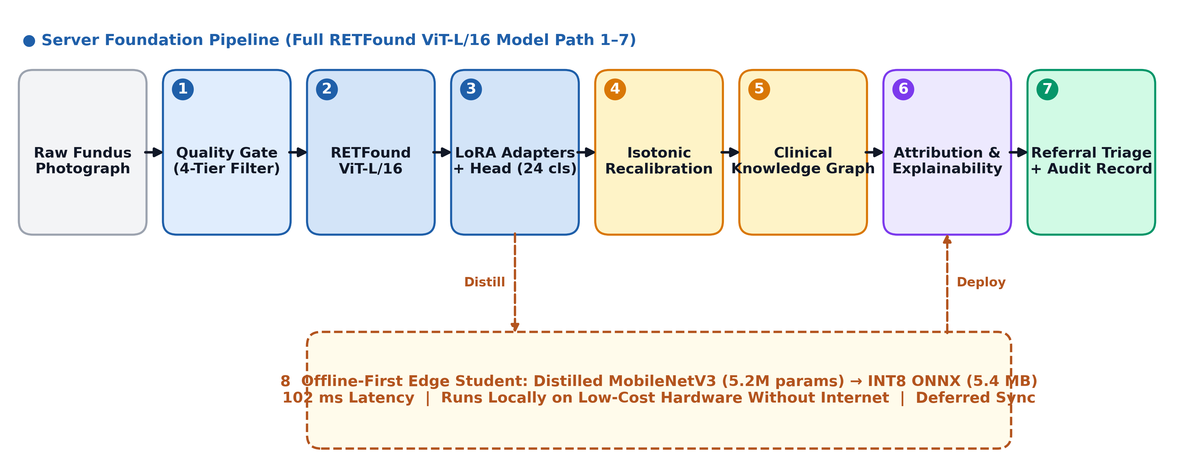
OptiscanAI: System Architecture
04
• (1) Quality Gate: Cascaded 4-tier intake filter (0.6s_stat + 0.4s_learned ≥ 0.70) rejects ungradable blurry photos.
• (2–3) RETFound ViT-L + LoRA: Pretrained on 1.6M retinal images; LoRA (r=16) adapts only 0.8% of weights (2.44M params).
• (4–5) Calibration & Knowledge Graph: Isotonic recalibration + 54-edge clinical ontology encoding AAO & Uganda MoH guidelines.
• (6–7) Referral Triage & Audit: Referral prioritization (Urgent vs Routine) with immutable cryptographic audit logging.

Slide 5
Offline Edge Distillation for Rural Clinics
05
5.4 MB
Model Size (INT8 ONNX)
Compressed 74.7% from 20.8 MB FP32 student.
102 ms
Median CPU Latency
Real-time inference on low-cost edge hardware.
99.6 %
Decision Concordance
Matches server FP32 decisions at τ = 0.50.
• The Reality of the Rural Clinic: In Soroti, Gulu, or Karamoja, the electrical grid drops for days. Bandwidth to stream 15 MB uncompressed TIFF scans to cloud servers is pure fantasy.
• Multi-Objective Knowledge Distillation: A compact MobileNetV3-Large student (5.2M parameters) learns from the 305.7M-parameter RETFound ViT-L teacher via combined soft logits and feature alignment.
• Zero-Network Autonomous Operation: Triage executes 100% on-device. Encrypted audit records stage locally and sync opportunistically only when connectivity returns.

Slide 6
Rigorous Empirical Setup on RFMiD
06
640
Held-Out Test
Evaluated strictly post-convergence.
24
Retained Classes
Excluded rare labels (n < 10).
1,000
Bootstrap CIs
95% percentile confidence bounds.
CLAIM
Reporting Standard
Conforming to TRIPOD+AI 2024.
• Strict Train / Val / Test Partition: 1,920 train, 640 validation, and 640 evaluation images. All threshold selections and calibrations were locked strictly on validation data.
• Input Normalisation Integrity: Retained ImageNet normalisation because the foundation backbone was pretrained in that feature space; switching costs 0.054 AUC.
• No Post-Hoc Cherry-Picking: We report exact per-disease sensitivity, specificity, PPV, and false-negative rates with 95% bootstrap intervals across all 24 categories.

Slide 7
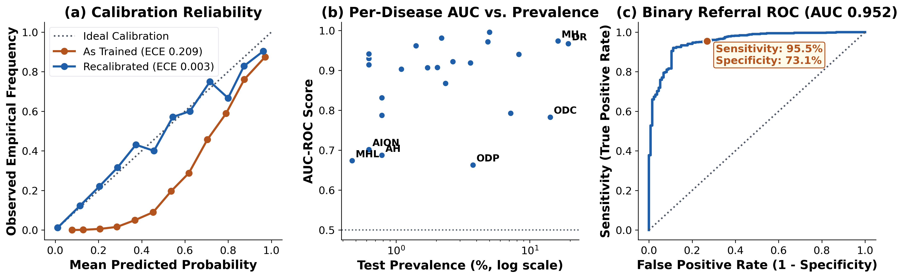
Multi-Disease Performance on RFMiD Test
07
• Macro Discrimination (0.872 AUC): Macro AUC reaches 0.872 (95% CI: 0.846–0.896) and Macro AUPRC reaches 0.357 across 24 multi-disease retinal categories.
• High-Prevalence Excellence: Myopia (0.996 AUC), Media Haze (0.974), Age-Related Macular Degeneration (0.972), and Diabetic Retinopathy (0.967 AUC, 0.873 AUPRC).
• The Statistical Boundary (Petersonian Honesty): Rare conditions with <20 test positives collapse: Optic Disc Pallor (0.663 AUC), Macular Hole (0.674). We refuse to claim clinical readiness where statistical power is absent.

Slide 8
The Silent Channel Defect & Remedy
08
0.209
Raw ECE (Failure)
Mean prob 0.251 vs 0.042 base rate. Extreme over-confidence.
5 Channels
Silenced Entirely
Static thresholding set fallback τ=0.95: zero sensitivity.
0.003
Recalibrated ECE
Platt scaling restores reliable probabilities, 0 silent channels.
• The Hidden Bug Nobody Measures: Asymmetric loss clipping (0.05) and label smoothing prevent the network from ever outputting confident zeros. Minimum probability over the entire test split was 0.064!
• The Fatal Interaction: Searching for precision ≥ 0.10 on rare classes forced thresholds to the 0.95 ceiling, permanently muting 5 diagnostic channels (AH, ODP, PT, EDN, MHL).
• The Monotone Solution: Per-class Platt recalibration resolves ECE to 0.003 while preserving AUC ranking. Adopting a sensitivity target ≥ 0.90 eliminates all silent channels and reduces misses by 59%.

Slide 9
Ablation: Foundation vs. ImageNet
09
Model Architecture & Adaptation | Params (M) | Train. % | AUC-ROC | AUPRC
ResNet-50 (ImageNet Full FT) | 23.56 | 100.0 % | 0.867 | 0.336
EfficientNet-B3 (ImageNet FT) | 10.73 | 100.0 % | 0.819 | 0.377
ViT-B/16 (ImageNet Full FT) | 85.82 | 100.0 % | 0.871 | 0.472
RETFound ViT-L (Head Only) | 2.44 | 0.8 % | 0.877 | 0.360
RETFound ViT-L + LoRA (r=16) | 4.01 | 1.3 % | 0.882 | 0.392
OptiscanAI Deployed Checkpoint | 2.44 | 0.8 % | 0.872 | 0.357
• Pretraining Efficiency: Freezing RETFound and tuning only 0.8% params achieves 0.877 AUC, beating fully trained ImageNet CNNs. LoRA adds +0.005 AUC and +0.032 AUPRC.
• The Fine-Tuning Nuance: ViT-B/16 full fine-tuning attains higher AUPRC (0.472 vs 0.392). Retinal foundation models give parameter efficiency, but full fine-tuning retrieves rare positives better.
• Normalisation Sensitivity: Substituting RFMiD channel statistics for ImageNet normalisation costs 0.054 AUC and 0.107 AUPRC. Preserving pretraining distribution alignment is critical.

Slide 10
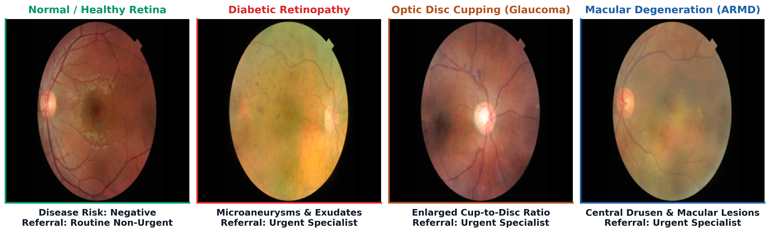
Clinical Screening Gallery: Real Cases
10
• Healthy Control Eye: Disease Risk Negative → Routine follow-up. Prevents needless tertiary hospital visits.
• Diabetic Retinopathy (DR): Microaneurysms detected → Automated Urgent Referral for laser photocoagulation.
• Optic Disc Cupping (ODC): C/D ratio > 0.6 detected → Urgent triage for intraocular pressure and visual field testing.
• Macular Degeneration (ARMD): Central drusen lesions detected → Urgent ophthalmology referral for anti-VEGF intervention.

Slide 11
Prevalence Shift: Benchmark vs. Clinic
11
Screening Caseload / Setting | Prevalence | PPV | NPV | Referral %
RFMiD Benchmark (Held-Out Test) | 79.0 % | 0.931 | 0.810 | 81.0 %
District Hospital Caseload | 20.0 % | 0.470 | 0.985 | 41.0 %
Rural Primary Care Clinic | 10.0 % | 0.283 | 0.993 | 34.0 %
Community Mobile Screening | 5.0 % | 0.158 | 0.997 | 30.0 %
• The Referral Bottleneck Tragedy: At 5% community prevalence, PPV drops from 93.1% to 15.8%. Sizing referral clinics on benchmark numbers will overburden ophthalmologists by 3x–6x with non-pathology cases.
• The True Role: A Safe Rule-Out Sieve: Negative Predictive Value (NPV) exceeds 99.7% in low prevalence. OptiscanAI is not an autonomous doctor; it is a high-confidence sieve to protect specialists.

Slide 12
Limitations and Conclusion
12
LIMITATIONS & PRECONDITIONS
KEY SCIENTIFIC TAKEAWAYS
• Zero Ugandan Patient Images: Evaluated on international benchmark (RFMiD). Multi-centre clinical trials in Ugandan district hospitals remain mandatory.
• Handheld Optical Shift: Validation on table-top fundus cameras cannot guarantee performance on low-cost smartphone adapters.
• Regulatory Preconditions: Requires Uganda National Drug Authority (NDA) and Data Protection Act (2019) clearance before clinical trials.
0.872 AUC / 0.952 Triage
Robust Ranking & Referral
Evaluated strictly on 640 held-out test images.
0.003 Calibrated ECE
Silent Channels Resolved
Platt recalibration restores 5 disabled disease channels.
5.4 MB / 102 ms
Offline Edge Distillation
Runs autonomously on mobile hardware in rural health centres.
▸ OptiscanAI establishes a disciplined scientific framework that separates benchmark excellence from clinical deployment reality.

Slide 13
THANK YOU
Questions & Discussion
OptiscanAI: Large Vision Models for Multi-Disease Retinal Screening
Paper 83 • The 10th National Conference on Communications (NCC 2026)
Presenter: Mpairwe Lauben (mpairwe_lauben@students.mak.ac.ug)
Department of Networks & Department of Computer Science, Makerere University
Live Interactive Prototype: https://landwind22-retinal-screening.hf.space

