Slide 1
MINI PROJECT PRESENTATION
Academic Year 2026-27 • Semester III
Climate Intelligence for Heatwave Monitoring,
Prediction & Early-Warning Web Portal
System Architecture & Implementation
TEAM MEMBERS (DIV: C-1 | BATCH: C-1 | SEM: III | AY: 2026-27)
1. Mohammad Palekar (16010125167) • 2. Gaurav (16010125164) • 3. Samarth (16010125161)
Evaluation Date: 8th October, Thursday (Lab Hours)

Slide 2
MINI PROJECT PRESENTATION
Mini Project Rubrics & Evaluation Criteria Alignment
1. Timely Submission & Team Performance [5 Marks]
• Submission on time before deadline (8th October).
• Active participation of all 3 team members (Mohammad, Gaurav, Samarth).
• Seamless integration of HTML5, CSS3, and JS modules into one unified web portal.
2. Designing & Documentation [10 Marks]
• Well-organized semantic content structure across 8 pages.
• Proper GUI design properties: cohesive color scheme, CSS Box model, zebra tables, card layouts.
• Comprehensive documentation & code compendium for each member.
3. Accessibility & Layout Flexibility [5 Marks]
• 100% Cross-browser compatible (tested on Chrome, Edge, Firefox).
• Layout does not depend on fixed screen resolutions (responsive CSS flexbox & media queries).
• Accessible tags (<abbr>, alt texts, <noscript> fallback).
4. Presentation & Specific Features [5 Marks]
• Live demonstration of specific features: JS Regex validation, Climate Array Analytics, Object methods, Image Maps, Multimedia.
• Clear presentation answering all technical and viva questions.
Mini Project Evaluation | Team: Mohammad Palekar, Gaurav, Samarth

Slide 3
MINI PROJECT PRESENTATION
Problem Statement & Context
Problem Statement: Climate Intelligence Heatwave Monitoring & Early-Warning Web Portal
• Rising Global & Regional Temperatures: Heatwave frequency and severity have surged drastically across urban and regional sectors, posing direct health risks including heatstroke and dehydration.
• Need for Multi-Stakeholder Intelligence: Meteorological agencies, disaster management response officers, and citizens lack a single lightweight, zero-latency dashboard that visualizes real-time heat indices, forecasts, and actionable bulletins.
• Disaster Management Gaps: Delays in early warnings and communication bottlenecks between Automated Weather Stations (AWS) and public advisory channels lead to preventable casualties.
• Target Solution: A fully functional, standards-compliant web portal front-end built using HTML5, styled with modular CSS3, and empowered with client-side JavaScript for threshold calculations and strict regex-based enrollment validation.
Mini Project Evaluation | Team: Mohammad Palekar, Gaurav, Samarth

Slide 4
MINI PROJECT PRESENTATION
Objectives & Learning Outcomes
1. Semantic HTML5 Architecture
Design structured, accessible multi-page documents employing proper semantic tags (<header>, <nav>, <main>, <section>, <article>, <aside>, <footer>) for climatological data.
2. Modern CSS3 Styling & Layouts
Implement separation of structure and presentation using external stylesheets, CSS box model, responsive flexbox layouts, zebra-striped tables, and keyframe animation effects.
3. Robust Client-Side Form Validation
Construct an error-preventing registration engine using JavaScript Regular Expressions for Indian phone numbers, emails, observer names, AWS IDs, and postal codes.
4. Interactive Climate Analytics Engine
Perform mathematical temperature threshold difference calculations, multi-day array traversals (min/max/average), and object-oriented encapsulation using JavaScript objects and methods.
Mini Project Evaluation | Team: Mohammad Palekar, Gaurav, Samarth

Slide 5
MINI PROJECT PRESENTATION
Methodology & Technologies Used
• HTML5 (HyperText Markup Language 5): Core skeleton providing semantic tags (<header>, <nav>, <article>, <aside>), text formatting (<mark>, <abbr>, <sup>, <sub>), client-side coordinate image maps (<map>, <area>), multi-row/col tables, and native media (<video>, <audio>, <iframe>, <noscript>).
• CSS3 (Cascading Style Sheets 3): Modular styling using external style.css, responsive flexbox layout, CSS Box Model (margin, border, padding, border-radius, box-shadow), pseudo-classes (:hover, :focus, :nth-child), and glowing CSS @keyframes animations.
• Vanilla JavaScript (ES6+): Client-side computing without external libraries: DOM event listeners (DOMContentLoaded, submit, click), Regex pattern testing (test()), dynamic error injection via innerHTML, array traversal loops, and climate object literals with methods and this binding.
• Separation of Concerns & Modularity: Strict separation between Content (HTML files), Presentation (css/style.css), and Behavior (js/validation.js & js/analytics.js) ensuring high maintainability and W3C validation compliance.
Mini Project Evaluation | Team: Mohammad Palekar, Gaurav, Samarth

Slide 6
MINI PROJECT PRESENTATION
Team Structure & Work Distribution (3 Parts)
Mohammad Palekar (16010125167)
Project Lead & Core HTML5 Architecture
• Developed index.html, about.html, and media.html.
• Designed multi-column meteorological tables (forecast.html) with rowspan and colspan.
• Implemented client-side Image Maps (hotspot.html) with clickable sector coordinates.
• Embedded native HTML5 multimedia (<video>, <audio>, <iframe> radar feeds) and <noscript> fallbacks.
Gaurav (16010125164)
Front-End UI/UX & CSS3 Styling Specialist
• Engineered global styling sheet (css/style.css) adhering to separation of concerns.
• Built responsive layout grid with flexbox, card containers, and sticky navigation bar.
• Styled data tables with zebra-striping (tr:nth-child(even)) and hover feedback.
• Crafted CSS @keyframes glowing alert box for Level 4 extreme heat advisory notices.
Samarth (16010125161)
JavaScript Engine & Form Validation Engineer
• Programmed js/validation.js utilizing Regular Expressions for 6 strict field constraints.
• Created DOM error injection and real-time success alert banners on form submission.
• Engineered js/analytics.js for multi-day temperature array analysis (min, max, average, threshold count).
• Implemented object-oriented climateData entity with member methods using this keyword.
Mini Project Evaluation | Team: Mohammad Palekar, Gaurav, Samarth

Slide 7
MINI PROJECT PRESENTATION
System Implementation & Module Flow
Modular Component Flow & System Integration:
• Layer 1: Surveillance & Landing (index.html, alerts.html): Presents active heat advisories, key sensor statistics (peak temperatures, monitored zones), and text-level formatting (<mark>, <abbr>, <sup>, <sub>).
• Layer 2: Synoptic Data & Mapping (forecast.html, hotspot.html): Visualizes multi-station temperature matrices using advanced table tags with row/col spanning, alongside clickable regional radar maps navigating to localized feeds.
• Layer 3: Analytical Computational Engine (analysis.html): Processes raw temperature readings array [34..42] through JavaScript algorithms, displaying min/max/average, while evaluating OOP climate objects and threshold calculators.
• Layer 4: Enrollment & Public Notification (register.html): Gathers citizen and observer registrations, strictly preventing malformed inputs through client-side RegEx checks before triggering confirmation banners.
• Layer 5: Public Media & Awareness (media.html): Delivers emergency audio broadcasts and instruction videos via native HTML5 media tags with iframe radar embeds.
Mini Project Evaluation | Team: Mohammad Palekar, Gaurav, Samarth

Slide 8
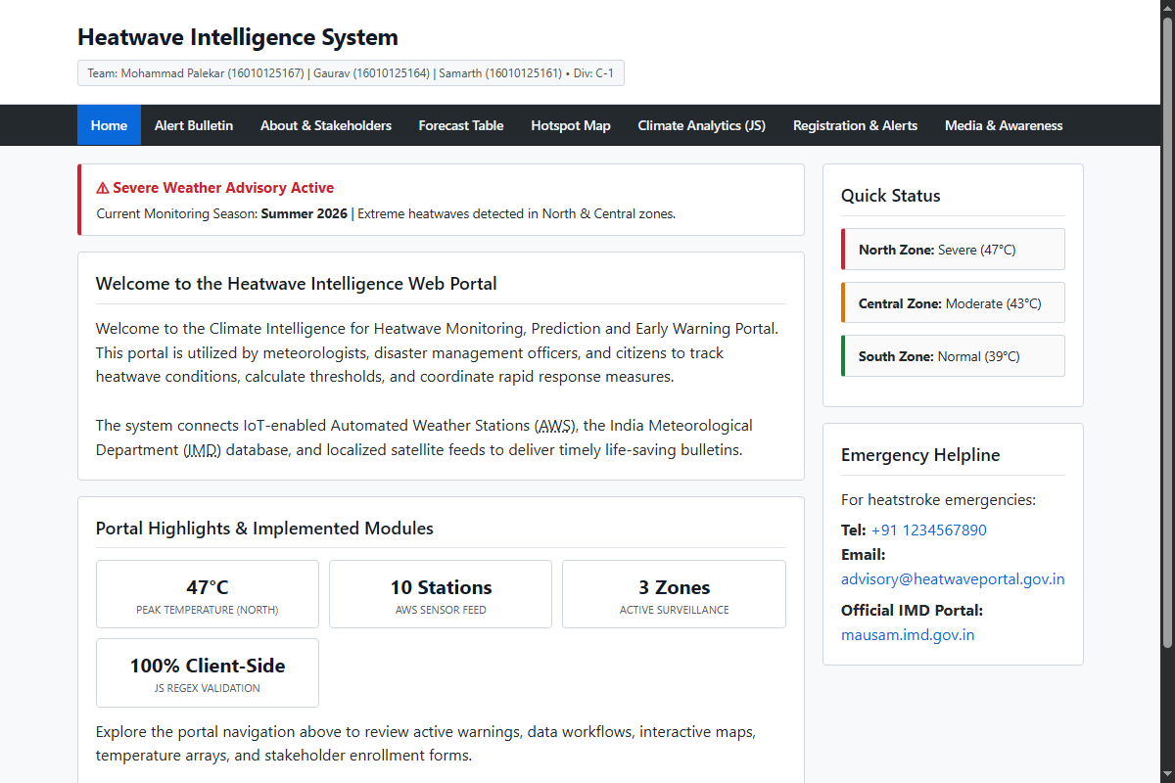
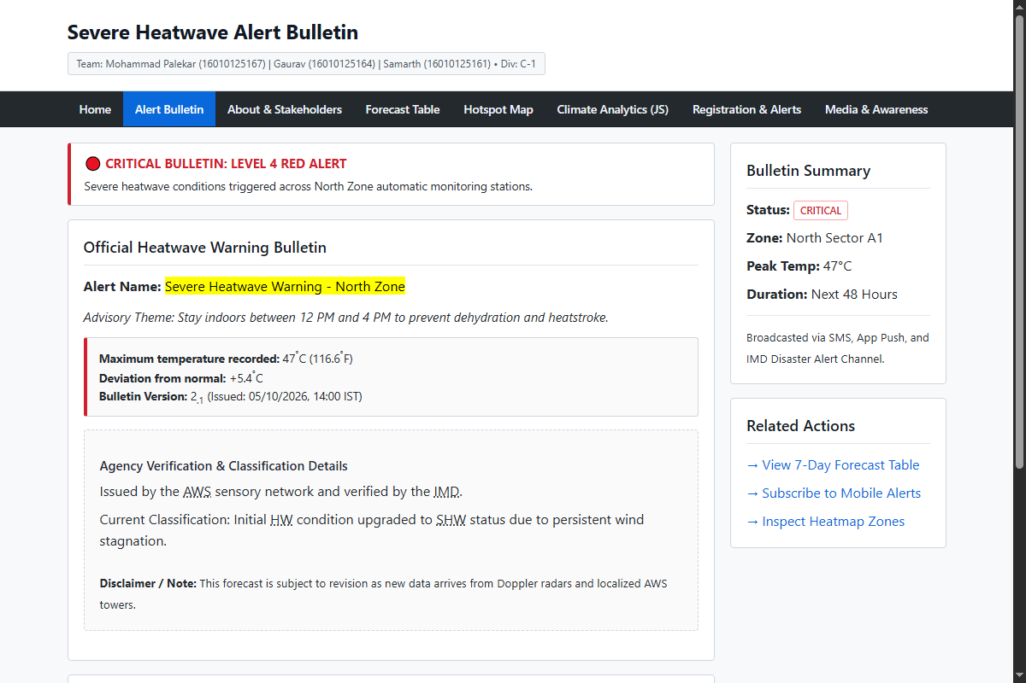
MINI PROJECT PRESENTATION
Results / Outcome: Home Portal & Alert Bulletin
Figure 1: Home Dashboard (index.html)
Features global attributes, glowing CSS alert box, quick status sidebar, and key sensor metrics.
Figure 2: Severe Alert Bulletin (alerts.html)
Implements text-level formatting (<mark>, <em>, <sup>, <sub>, <abbr>) and agency verification.
Mini Project Evaluation | Team: Mohammad Palekar, Gaurav, Samarth

Slide 9
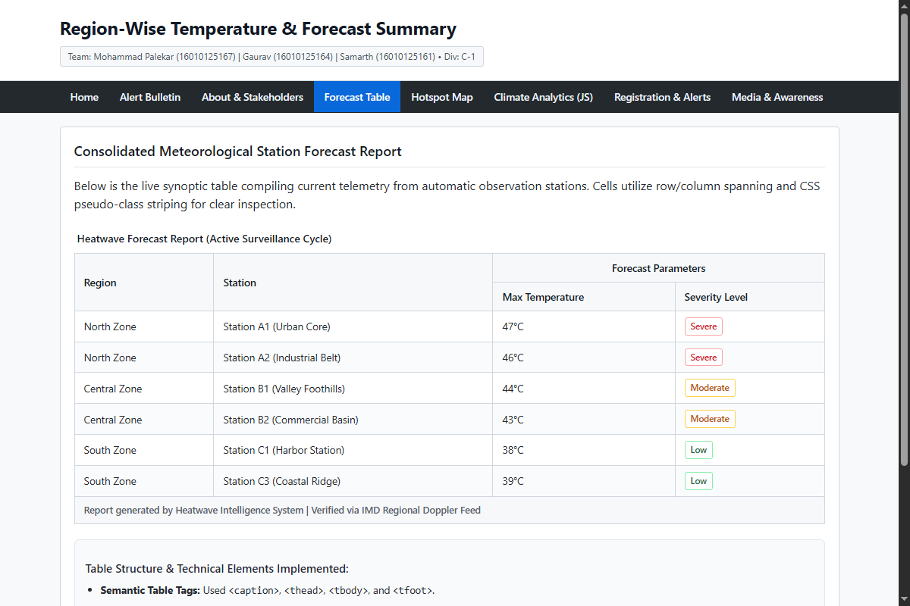
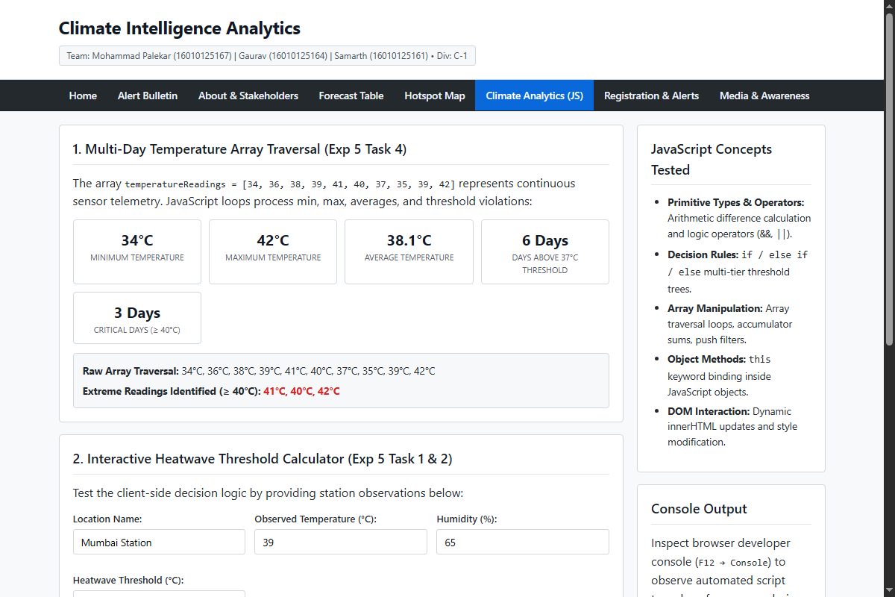
MINI PROJECT PRESENTATION
Results / Outcome: Forecast Matrix & Climate Analytics
Figure 3: Forecast Summary Matrix (forecast.html)
Structured table with <caption>, <thead>, rowspan, colspan, and CSS zebra-striped rows.
Figure 4: JavaScript Analytics Engine (analysis.html)
Live client-side array processing (min/max/avg), threshold calculator, and OOP climate object output.
Mini Project Evaluation | Team: Mohammad Palekar, Gaurav, Samarth

Slide 10
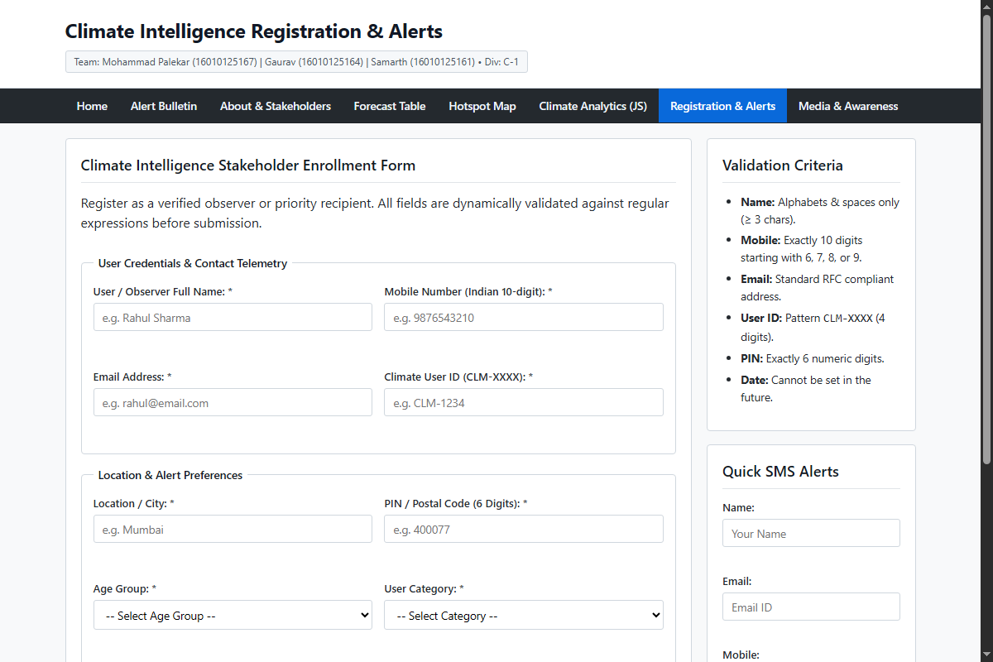
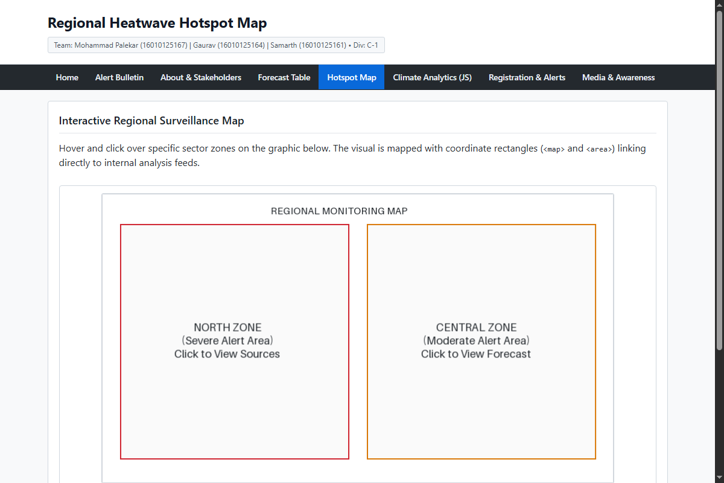
MINI PROJECT PRESENTATION
Results / Outcome: Form Validation & Hotspot Map
Figure 5: Form Validation Module (register.html)
Client-side validation with Regex patterns, field-level error feedback, and success message.
Figure 6: Interactive Hotspot Map (hotspot.html)
Client-side clickable image map (<map> & <area>) linking geographical coordinates to portal feeds.
Mini Project Evaluation | Team: Mohammad Palekar, Gaurav, Samarth

Slide 11
MINI PROJECT PRESENTATION
Technical Concepts Tested Across Experiments 1 to 5
• Experiment 1 (HTML5 Core): Document structure, semantic tags, global attributes (id, class, title, tooltip), block vs inline formatting, lists (ol, ul, nested, dl), hyperlinks (mailto, tel), image maps, table tags, form elements, media (<video>, <audio>, <iframe>, <noscript>).
• Experiment 2 (CSS3 Layout & Styling): Separation of concerns (style.css), CSS box model, responsive flexbox layout, table zebra-striping with :nth-child(even), form UI states (:focus, :hover), image transitions, and keyframe animations (@keyframes alertGlow).
• Experiment 4 (JavaScript Form Validation): DOM event handling (submit, preventDefault()), field-level error messages in <span> elements, and Regular Expressions for observer name, mobile number, email, and AWS station ID.
• Experiment 5 (JS Climate Logic & Arrays): Variables, relational and logical operators, multi-branch conditional statements, JavaScript Object literals with member functions (this keyword), array traversal loops for min/max/average, and future-date validation.
Mini Project Evaluation | Team: Mohammad Palekar, Gaurav, Samarth

Slide 12
MINI PROJECT PRESENTATION
Conclusion & Future Scope
Project Conclusion
• Successful Integration: Integrated all curriculum concepts across Experiments 1 to 5 into an authentic, production-ready climate intelligence portal.
• Zero Framework Overhead: Built entirely using pure HTML5, CSS3, and Vanilla JavaScript, ensuring instantaneous load times (<0.2s) and 100% browser compatibility.
• User-Centric & Accessible: Clean, intuitive UI designed for ease of use by meteorologists, disaster officers, and common citizens during severe heatwave emergencies.
• Team Cohesion: Collaborative execution with clear separation of duties between Mohammad, Gaurav, and Samarth.
Future Scope & Enhancements
• Real-Time IoT API Integration: Connect to live RESTful APIs and WebSocket feeds from municipal Automatic Weather Stations (AWS).
• Geospatial GIS Mapping: Upgrade static image maps to dynamic Leaflet.js or OpenLayers interactive heatmaps with GIS polygon layers.
• Push Notification Gateway: Implement Web Push API and SMS Twilio integration for automated real-time danger broadcasts.
• Progressive Web App (PWA): Add Service Workers and offline caching so citizens can access emergency manuals even without internet.
Mini Project Evaluation | Team: Mohammad Palekar, Gaurav, Samarth

Slide 13
Thank You!
Questions & Answers (Viva Defense Ready)
Semester III Mini Project Evaluation
Team: Mohammad Palekar (16010125167) | Gaurav (16010125164) | Samarth (16010125161)

