Slide 1

23rd IEEE International Symposium
on Multimedia (ISM 2021)
Combining Global and Local Attention with Positional Encoding
for Video Summarization
E. Apostolidis^{1,2}, G. Balaouras¹, V. Mezaris¹, I. Patras²
¹ Information Technologies Institute, CERTH, Thermi - Thessaloniki, Greece
² School of EECS, Queen Mary University of London, London, UK

Slide 2
Outline
Problem statement
Related work
Developed approach
Experiments
Conclusions

Slide 3

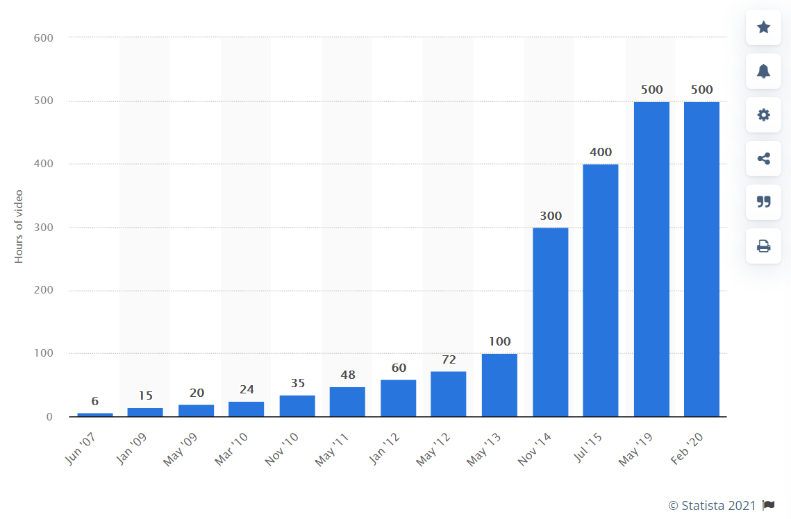
Problem statement
Video is everywhere!
Captured by smart devices and instantly shared online
Constantly and rapidly increasing volumes of video content on the Web
Hours of video content uploaded on YouTube every minute
Image sources: https://www.financialexpress.com/india-news/govt-agencies-adopt-new-age-video-sharing-apps-like-tiktok/1767354/ (left) & https://www.statista.com/ (right)
Notes:
To present the problem, we start by the observation that nowadays, video, the most rich and descriptive means of communication, is everywhere. Captured by smart devices and instantly shared online through social networks and video sharing platforms. The current volume of video content on the Web is constantly and rapidly increasing. As seen in this Fig. according to recent announcements, only Youtube receives more than 500 hours of video content every single minute.
Nowadays, we see a constantly growing engagement of users social media and content sharing platforms, as well as with devices (such as smart-phones, wearables etc.) that allow recording and instant upload of videos on the Web. Thousands of hours of video are uploaded every single hour on the Web, mostly on video sharing platforms (e.g. YouTube, DailyMotion, Vimeo) and social networks (e.g. Facebook, Twitter, Instagram), but also on online repositories. As depicted on the image on the right, as of February 2020 approximately 500 hrs of video are uploaded only on YouTube very minute!

Slide 4

Problem statement
But how to find what we are looking for in endless collections of video content?
Quickly inspect a video’s content by checking its synopsis!
Image source: https://www.voicendata.com/sprint-removes-video-streaming-limits/
Notes:
However, this tremendous growth of the available video material lead to a serious problem. How the viewers can navigate within endless collections of videos in a time-efficient manner, and find the piece of video content that they are looking for? Part of the response to this demand is related to the development of techniques that allow to create and provide a synopsis that conveys the important parts of the full-length video; based on this, viewers can have a quick overview of the whole story without having to watch the entire content.

Slide 5



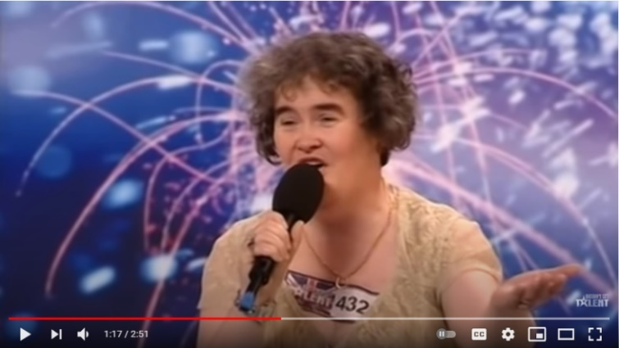




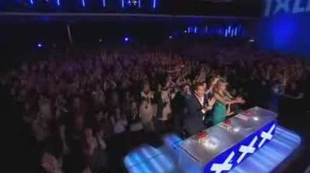

Goal of video summarization technologies
“Generate a short visual synopsis that summarizes the video content by selecting the most informative and important parts of it”
Video content
Key-fragment
Key-frame
Analysis outcomes
This synopsis can be:
Static, composed of a set representative video (key-)frames (a.k.a. video storyboard)
Dynamic, formed of a set of representative video (key-)fragments (a.k.a. video skim)
Video title: “Susan Boyle's First Audition - I Dreamed a Dream - Britain's Got Talent 2009”
Video source: OVP dataset (video also available at: https://www.youtube.com/watch?v=deRF9oEbRso)
Dynamic video summary
(made of selected key-fragments)
Static video summary
(made of selected key-frames)
Notes:
The video summary is a short visual summary that encapsulates the flow of the story and the essential parts of the full-length video. And in terms of presentation format, there are two fundamental types of video summaries: static video summary (a.k.a. video storyboard) and dynamic video summary (a.k.a. video skim). The video storyboard is a collection of representative video frames extracted from the original video. The video skim is a set of short video clips joined in a sequence and played as a video. For example here we can see a short clip from a British talent show, and on the right side there is a storyboard that gives a static summary of the video content. Sets of representative frames are not restricted by timing or synchronization issues and, therefore, they offer much more flexibility in terms of organization for browsing and navigation purposes. On the other hand though, video skims include audio and motion elements and thus they offer a more natural story narration, that is often more entertaining and interesting to the users.
The produced summary is usually composed of a set of representative video frames (a.k.a. video key-frames), or video fragments (a.k.a. video key-fragments) that have been stitched in chronological order to form a shorter video. The former type of a video summary is known as video storyboard, and the latter type is known as video skim. One advantage of video skims over static sets of frames is the ability to include audio and motion elements that offer a more natural story narration and potentially enhance the expressiveness and the amount of information conveyed by the video summary. Furthermore, it is often more entertaining and interesting for the viewer to watch a skim rather than a slide show of frames [14]. On the other hand, storyboards are not restricted by timing or synchronization issues and, therefore, they offer more flexibility in terms of data organization for browsing and navigation purposes

Slide 6
Related work (supervised approaches)
Methods modeling the variable-range temporal dependence among frames, using:
Structures of Recurrent Neural Networks (RNNs)
Combinations of LSTMs with external storage or memory layers
Attention mechanisms combined with classic or seq2seq RNN-based architectures
Methods modeling the spatiotemporal structure of the video, using:
3D-Convolutional Neural Networks
Combinations of CNNs with convolutional LSTMs, GRUs and optical flow maps
Methods learning summarization using Generative Adversarial Networks
Summarizer aims to fool Discriminator when distinguishing machine- from human-generated summary
Methods modeling frames’ dependence by combining self-attention mechanisms, with:
Trainable Regressor Networks that estimate frames’ importance
Fragmentations of the video content in hierarchical key-frame selection strategies
Multiple representations of the visual content (CNN-based & Inflated 3D ConvNet)
Notes:
Various approaches have been introduced to automate video summarization, and the current state of the art is represented by methods utilizing deep network architectures. For the sake of space, here we present in brief the relevant literature on supervised video summarization.
…

Slide 7
Related work (supervised approaches)
Methods modeling the variable-range temporal dependence among frames, using:
Structures of Recurrent Neural Networks (RNNs)
Combinations of LSTMs with external storage or memory layers
Attention mechanisms combined with classic or seq2seq RNN-based architectures
Methods modeling the spatiotemporal structure of the video, using:
3D-Convolutional Neural Networks
Combinations of CNNs with convolutional LSTMs, GRUs and optical flow maps
Methods learning summarization using Generative Adversarial Networks
Summarizer aims to fool Discriminator when distinguishing machine- from human-generated summary
Methods modeling frames’ dependence by combining self-attention mechanisms, with:
Trainable Regressor Networks that estimate frames’ importance
Fragmentations of the video content in hierarchical key-frame selection strategies
Multiple representations of the visual content (CNN-based & Inflated 3D ConvNet)
Notes:
Most approaches utilize RNNs to model the temporal dependence among video frames and learn how to estimate the frames’ importance. However, the use of RNNs and their variations for video summarization shows some weaknesses; these relate to the long paths that forward and backward signals have to traverse in the network and to the limited amount of parallelizable operations during training.
To overcome these drawbacks, our method follows the approach of the last class of methods that rely on the use of feed-forward self-attention mechanisms that mainly involve easy-to-compute matrix multiplication processes.

Slide 8
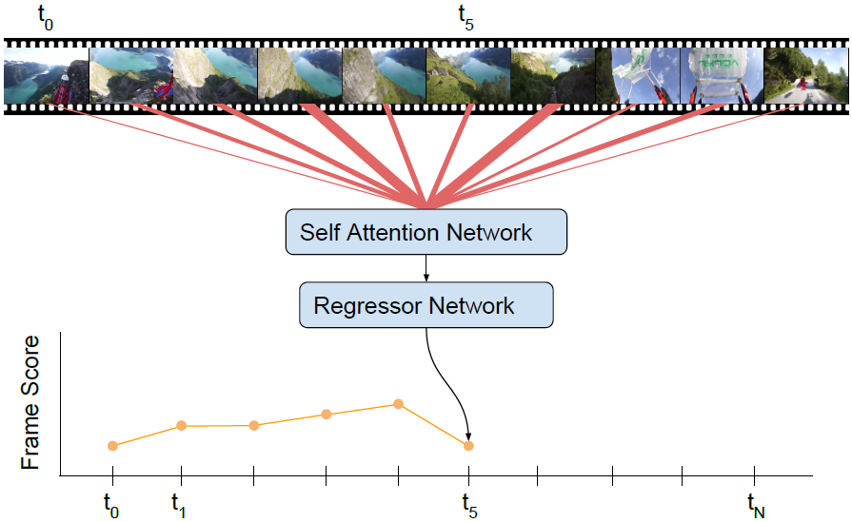
Developed approach
Starting point
VASNet model (Fajtl et al., 2018)
Seq2seq transformation using a soft self-attention mechanism
Main weaknesses
Lack of knowledge about the temporal position of video frames
Growing difficulty to estimate frames’ importance as video duration increases
Image source: Fajtl et al., “Summarizing Videos with Attention”, ACCV 2018 Workshops
J. Fajtl, H. S. Sokeh, V. Argyriou, D. Monekosso, P. Remagnino, “Summarizing Videos with Attention,” in Asian Conference on Computer Vision 2018 Workshops. Cham: Springer Int. Publishing, 2018, pp. 39-54.
Notes:
The starting point of our work was the supervised method of Fajtl et al. This method tackles video summarization as a sequence-to-sequence transformation, and uses a simple self-attention-based network to perform this transformation in a single feed forward pass and single backward pass during training. The output of this mechanism, namely the generated frame representations according to the computed attention weights, are then forwarded to a two-layer fully connected regressor network that produces estimates about each frame’s importance. These estimates are eventually compared to ground-truth annotations about the frames’ importance, thus allowing the network architecture to learn summarization in a supervised manner. This method has two main weaknesses that relate to: i) the complete lack of knowledge about the temporal position of the video frames (which is crucial when producing a temporally-coherent summary of the video content), and ii) the growing difficulty to accurately estimate the frames’ importance as the video duration increases.

Slide 9
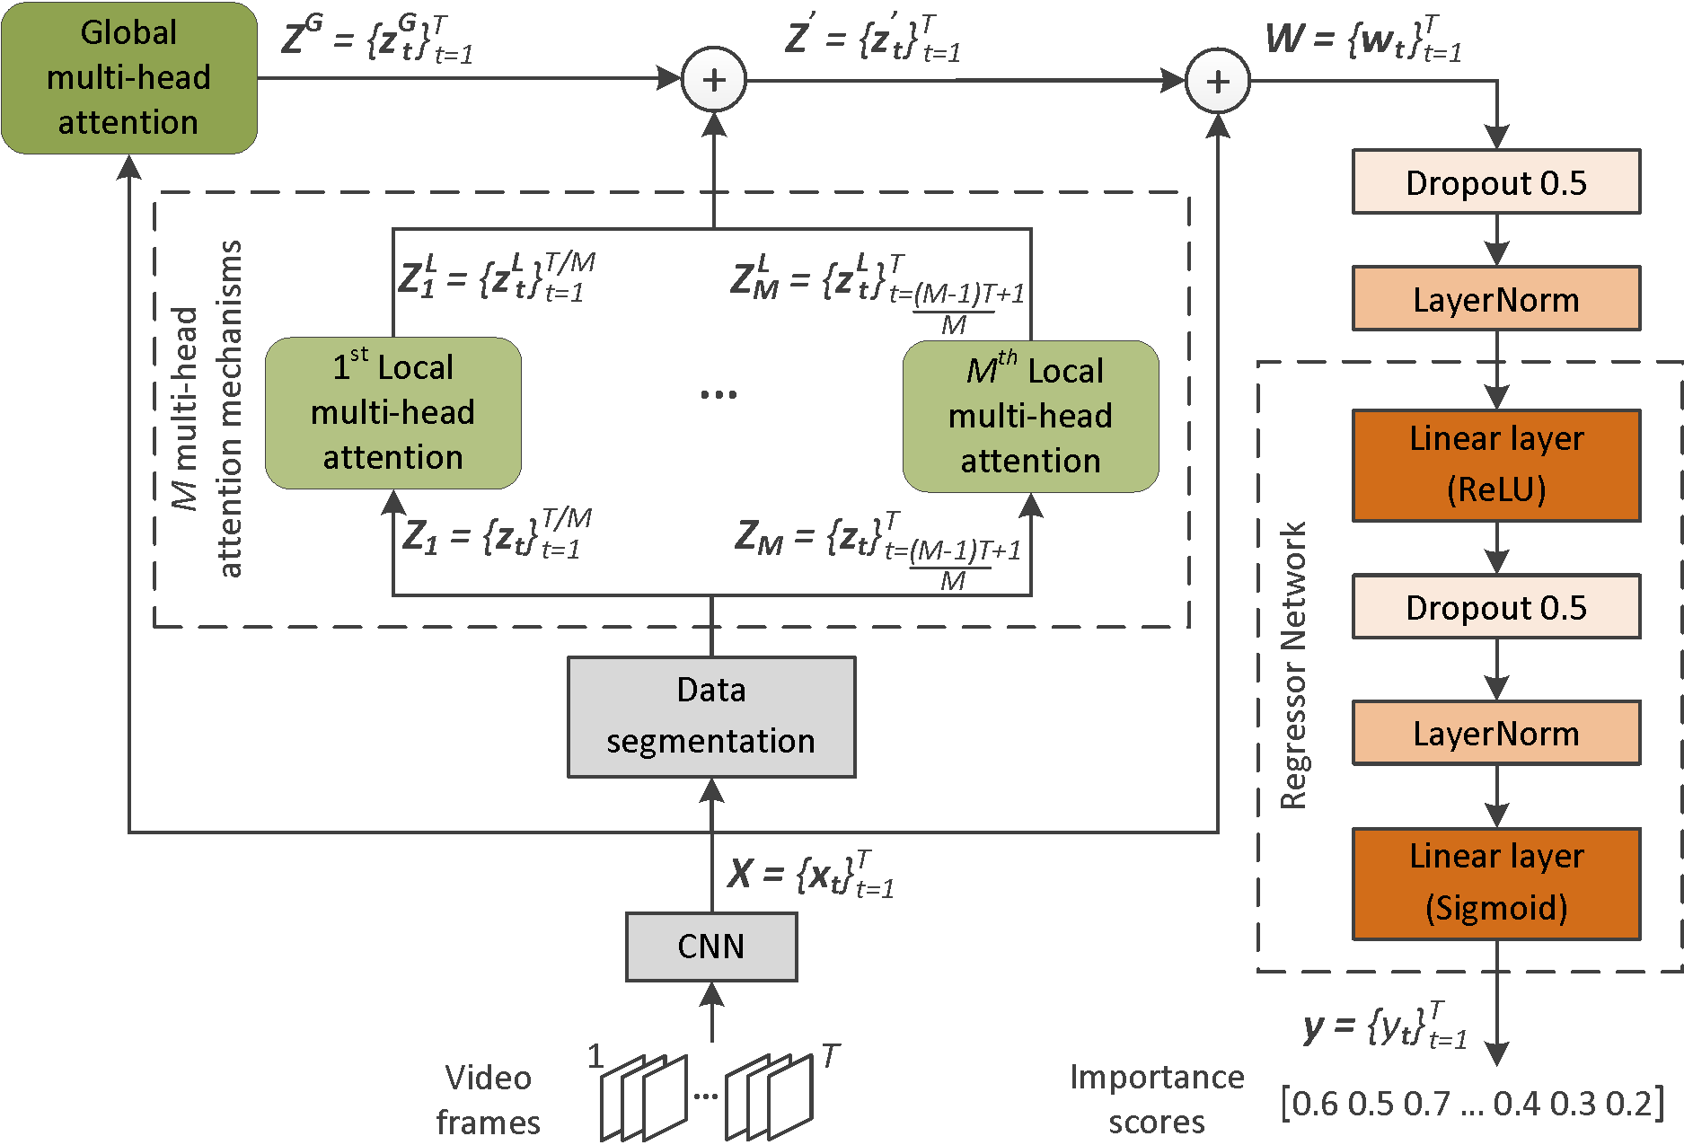
Developed approach
New network architecture (PGL-SUM)
Uses a multi-head attention mechanism to model frames’ dependence according to the entire frame sequence
Uses multiple multi-head attention mechanisms to model short-term dependencies over smaller video parts
Enhances these mechanisms by adding a component that encodes the temporal position of video frames
Notes:
To overcome these weaknesses we built a new architecture that extends the aforementioned one by: i) utilizing a multi-head attention mechanism for modeling the frames’ dependencies according to the entire frame sequence, ii) introducing multiple multihead attention mechanisms that model short-term dependencies via focusing on smaller parts of the video, and iii) enhancing these attention mechanisms with a component that encodes the temporal position of the video frames.

Slide 10
Developed approach
New network architecture (PGL-SUM)
Uses a multi-head attention mechanism to model frames’ dependence according to the entire frame sequence
Uses multiple multi-head attention mechanisms to model short-term dependencies over smaller video parts
Enhances these mechanisms by adding a component that encodes the temporal position of video frames
Notes:
Given a video of T frames, the developed model initially produces a set of deep feature representations using a pretrained CNN model. These representations form the input to the trainable part of the architecture and follow two different processing paths.

Slide 11
Developed approach
Global attention
Uses a multi-head attention mechanism to model frames’ dependence according to the entire frame sequence
Notes:
One of these paths includes a global multi-head attention mechanism that aims to discover different modelings of the frames’ dependencies according to the entire frame sequence.

Slide 12
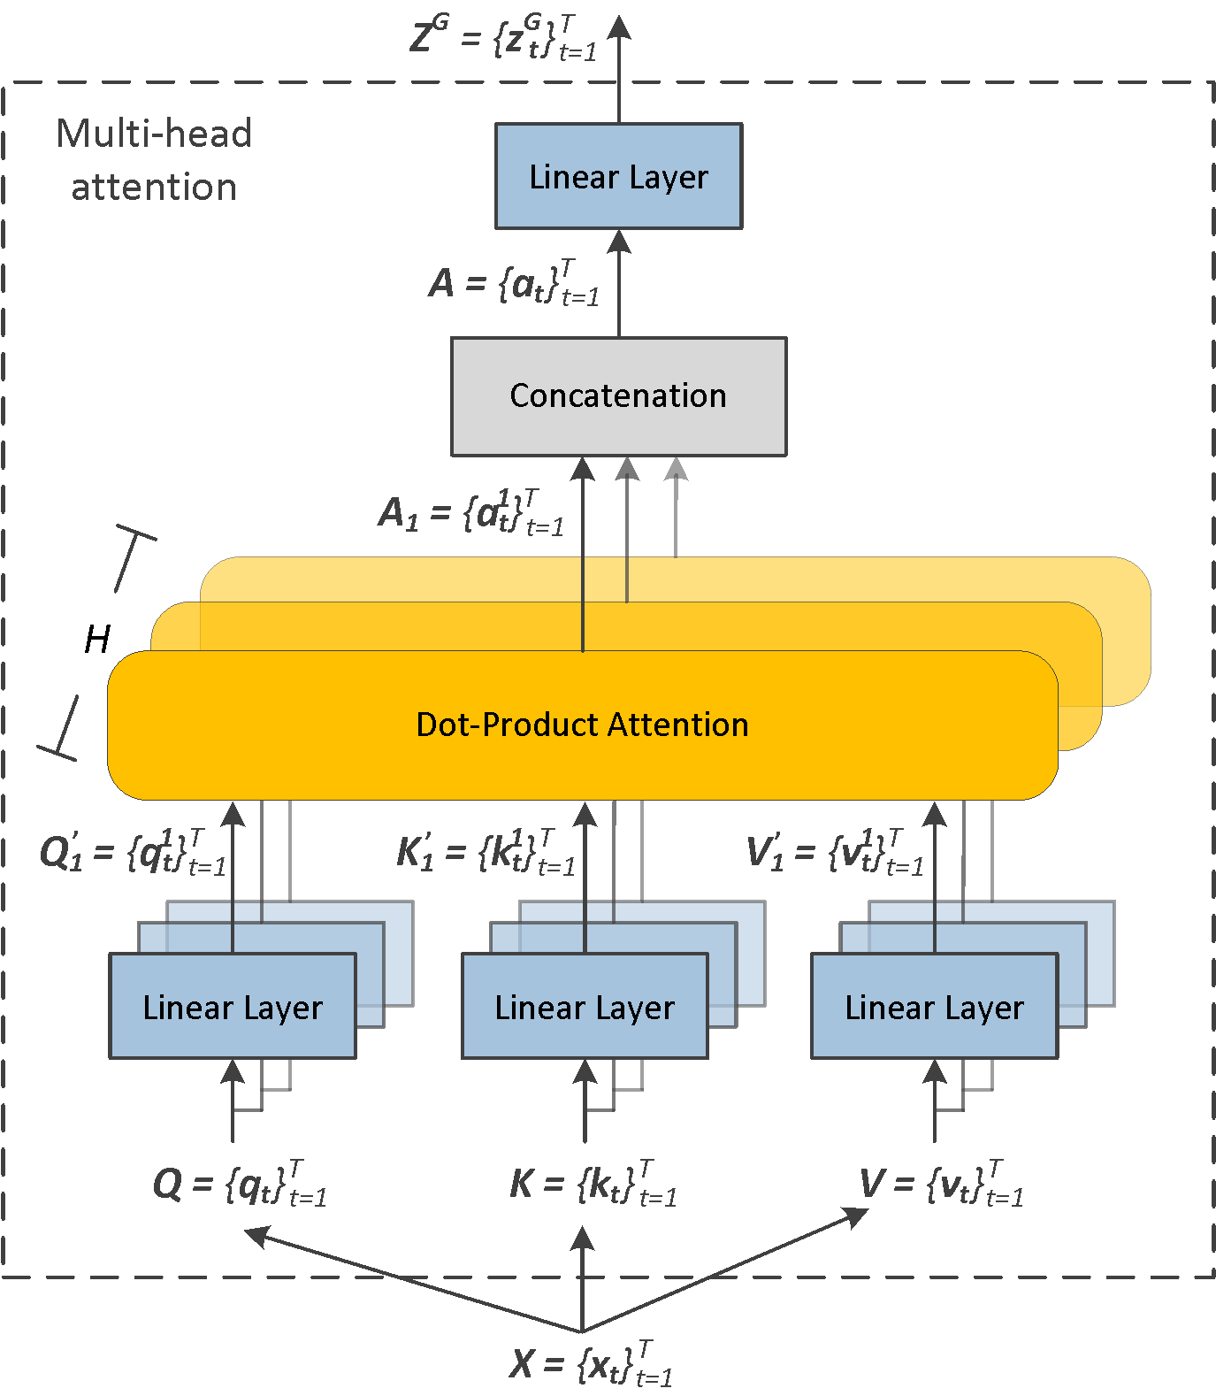
Developed approach
Global attention
Notes:
The used multi-head attention mechanism gets as input the set of feature vectors and forms the Query, Key and Value matrices of the training process. In the simplest case of single-head attention, these matrices are fed to a triplet of linear layers and the produced embeddings (that maintain the dimensions of Q, K, V), are given as input to the dot-product attention process, which produces the attention values for the video frames. In the case of multi-head attention the different heads (denoted by the existence of a set of H different linear layers associated to H dot-product attention processes), produce different embeddings for the Query, Key and Value matrices in which the dimension of each representation is reduced to D/H. Each triplet of these embeddings (for simplicity, in this figure we depict the output of only the first triplet of linear layers) is then forwarded to a different dot-product attention process that computes a set of attention values. The computed sets of attention values for the different triplets of embeddings are then concatenated. The output of this process is fed to a linear layer that forms the final outcome of the global multi-head attention mechanism.

Slide 13
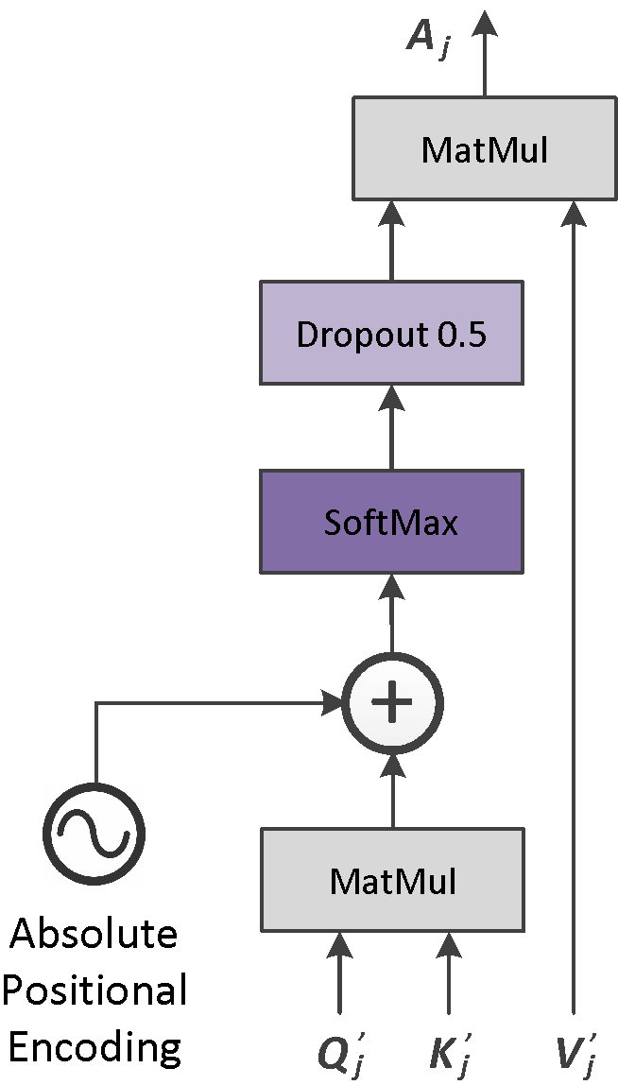

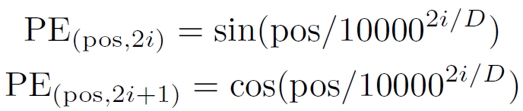
Developed approach
Global attention
Notes:
Regarding the dot-product attention, we enhance this process by incorporating knowledge about each frame’s position in the frame sequence. For this, we use a component that encodes the absolute position of the frames using sine and cosine functions of different frequencies (pos is the position and i is the index of each frame in the frame sequence). So, given the video of T frames that are represented by D-sized feature vectors, we compute a positional encoding matrix of size T×T. The encoded information of this T × T matrix is incorporated into the dot-product attention by being added to the output of a matrix multiplication that involves the Query and the (transposed) Key matrices.

Slide 14
Developed approach
Local attention
Uses multiple multi-head attention mechanisms to model short-term dependencies over smaller video parts
Notes:
The other processing path includes a segmentation step that splits the originally extracted set of deep feature vectors for the video frames into M consecutive and non-overlapping segments. Each one of these segments contains the deep feature vectors of the video frames that lie within the segment. Each set of feature vectors is then forwarded to a different local multi-head attention mechanism that focuses on the corresponding part of the video. Based on the analysis pipeline described for the case of the global multi-head attention mechanism, each local attention mechanism produces a new representation of the feature vectors of the frames that lie within the associated segment of the video, that encodes data about the importance of each video frame according to its dependence to the frames within the same segment. The only difference in this processing path is that the produced embeddings by the different heads of each local attention mechanism are formed through an additional dimensionality reduction step that relates to the number of video segments and results in representations of dimension equal to D/(H・M).
The reason for applying such an additional dimensionality reduction in the case of multi-head local attention mechanisms is to maintain a low level of
computational complexity, and it was based on the intuition that smaller representations would be sufficient for modeling dependencies over shorter sequences of video frames. This intuition was experimentally validated after evaluating the performance of a variation of the proposed model that does not perform the additional dimensionality reduction step.

Slide 15
Developed approach
Feature fusion & importance estimation
New representation that carries information about each frame’s global and local dependencies
Residual skip connection aims to facilitate backpropagation
Regressor produces a set of frame-level scores that indicate frames’ importance
Notes:
Having available the generated representations from the global and the multiple local multi-head attention mechanisms, the next step is to perform feature addition and produce a new representation for each video frame, that carries information about each frame’s global and local dependencies. The resulting set of representations is then added to the original deep representations via a residual skip connection that aims to facilitate backpropagation. The output of this operation (W) is forwarded to a dropout layer that is followed by a normalization layer. The resulting representation is given as input to the Regressor Network. Finally, the Regressor produces a set of frame-level scores that indicate the frames’ importance.

Slide 16
Developed approach
Training time
Compute MSE between machine and human frame-level importance scores
Inference time
Compute fragment-level importance based on a video segmentation
Create the summary by selecting the key-fragments based on a time budget and by solving the Knapsack problem
Notes:
Given the output of the aforementioned processing pipeline, at training time, we compute the Mean Squared Error between this output and the ground-truth annotations. At inference time, the estimated importance scores are used to select the key-fragments of the video and form the video summary. For this, given a temporal segmentation of the video into its building blocks (obtained e.g., using the KTS algorithm [30]) fragment-level importance is calculated by averaging the scores of each fragment’s frames. Finally, provided that the summary does not exceed 15% of the video duration (which is a common setting in the relevant literature), we form the video summary by solving the Knapsack problem.

Slide 17
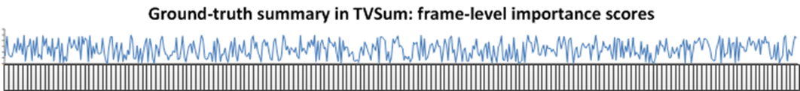
Experiments
Datasets
SumMe (https://gyglim.github.io/me/vsum/index.html#benchmark)
25 videos capturing multiple events (e.g. cooking and sports)
Video length: 1 to 6 min
Annotation: fragment-based video summaries (15-18 per video)
TVSum (https://github.com/yalesong/tvsum)
50 videos from 10 categories of TRECVid MED task
Video length: 1 to 11 min
Annotation: frame-level importance scores (20 per video)
Notes:
To evaluate the performance of our PGL-SUM model we use two benchmarking datasets. The SumMe dataset [31] contains 25 videos (1-6 min. duration) covering multiple events from both first-person and third-person view. Each video is associated to multiple (15-18) annotations in the form of key-fragments. Moreover, a single ground-truth summary in the form of frame-level importance scores (calculated by averaging the key-fragment user summaries per frame) is also provided for each video, to support supervised training. TVSum is composed of 50 videos (1-11 min. duration) from 10 categories of the TRECVid MED dataset. Each video is annotated by 20 users in the form of frame-level importance scores, and a single ground-truth summary (computed by averaging all users’ scores) is available as well.

Slide 18
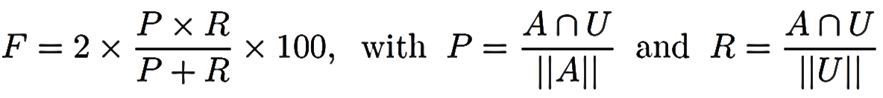
Experiments
Evaluation approach
The generated summary should not exceed 15% of the video length
Agreement between automatically-generated (A) and user-defined (U) summary is expressed by the F-Score (%), with (P)recision and (R)ecall measuring the temporal overlap (∩) (|| || means duration)
80% of video samples are used for training and the remaining 20% for testing
Model selection is based on a criterion that focuses on rapid changes in the curve of the training loss values or (if such changes do not occur) the minimization of the loss value
Summarization performance is formed by averaging the experimental results on five randomly-created splits of data
Notes:
For fair comparison with the majority of state-of-the-art approaches, we adopt the key-fragment-based evaluation protocol proposed in [2]. The similarity between a machine-generated and a user-defined summary is estimated by computing their overlap using the F-Score (as percentage). So, given a video, we compare the generated summary with the user summaries for this video, and compute an F-Score for each pair of compared summaries. Then, we average the computed F-Scores (for TVSum) or keep the maximum of them (for SumMe) and end up with the final F-Score for this video. The computed F-Scores for the entire set of test videos are averaged to form the final outcome about the method’s performance. This protocol is directly applicable on SumMe, as user
annotations are in the form of key-fragments. For TVSum, frame-level annotations are converted to key-fragment annotations. Finally, we follow the established approach of using 80% of the videos of each dataset for training and the remaining 20% for testing. After the end of the training, model selection is based on a criterion that focuses on rapid changes in the curve of the training loss values or (if such changes do not occur) the minimization of the loss value. Finally, similarly to other works in the literature, we run experiments on five different randomly-created splits for each dataset, and in the following we report the average performance over these runs.

Slide 19
Experiments
Implementation details
Videos were down-sampled to 2 fps
Feature extraction: pool5 layer of GoogleNet trained on ImageNet (D = 1024)
# local attention mechanisms = # video segments M: 4
# global and local attention heads: 8 and 4 respectively
Learning rate and L2 regularization factor: 5 x 10⁻⁵ and 10⁻⁵ respectively
Dropout rate: 0.5
Network initialization approach: Xavier uniform (gain = √2; biases = 0.1)
Training: full batch mode; Adam optimizer; 200 epochs
Hardware: NVIDIA TITAN XP
Notes:
As in most state-of-the-art methods, videos are downsampled to 2 fps. Deep representations of frames are obtained by taking the output of the pool5 layer of GoogleNet [27] trained on ImageNet, and thus are of size D = 1024. The number of video segments M, which also determines the amount of local attention mechanisms, equals to 4. The number of the utilized attention heads H is set to 8 and 4 for the global and local attention mechanisms, respectively. Wherever applied, data fusion is based on addition. The learning rate, dropout rate and L2 regularization factor are equal to 5 ・ 10−5, 0.5 and 10−5, respectively. For the network’s weights initialization, we use the Xavier uniform initialization approach with gain = √2 and biases = 0.1. Training is performed in a full-batch mode (i.e., batch size is equal to the number of samples) using the Adam optimizer, and stops after 200 epochs.

Slide 20
Experiments
Sensitivity analysis
# video segments (# local attention mech.) & global-local data fusion approach
# local and global attention heads
 | SumMe |  |  | TVSum
# Segm. Fusion | 2 | 4 | 8 | 2 | 4 | 8
Addition | 49.8 | 55.6 | 51.9 | 61.1 | 61.7 | 59.5
Average pooling | 51.5 | 54.1 | 52.5 | 61.1 | 59.7 | 58.7
Max pooling | 51.1 | 53.9 | 52.2 | 61.3 | 59.6 | 58.5
Multiplication | 46.3 | 52.1 | 52.5 | 47.3 | 47.6 | 46.9
 | SumMe |  |  | TVSum
Local Global | 2 | 4 | 8 | 2 | 4 | 8
2 | 52.4 | 52.4 | 52.8 | 61.4 | 61.6 | 61.4
4 | 54.9 | 58.5 | 49.2 | 60.9 | 61.3 | 60.4
8 | 55.8 | 58.8 | 57.1 | 60.3 | 61.1 | 60.9
16 | 56.7 | 57.7 | 54.9 | 61.3 | 60.9 | 60.1
Reported values represent F-Score (%)
Notes:
We start our experimentation by assessing the sensitivity of the proposed PGL-SUM model with respect to the main hyper-parameters of the network architecture and the different strategies for data fusion. Our plan is to estimate the maximum learning capacity of the network for each one of the different examined configurations. So, as the use of a model selection criterion can impact the evaluation outcome, in this set of experiments we do not consider such a criterion and the summarization performance is formed by averaging the maximum performance of each considered network configuration on the used data splits.
Our first experiment aims to investigate the optimal choices about the number of video segments (which determines the amount of the utilized local attention mechanisms as well) and the applied strategy for fusing the generated representations by the global and local attention mechanisms of the architecture. The considered cases and the outcomes of this experiment are presented in the Table on the left.

Slide 21
Experiments
Sensitivity analysis
# video segments (# local attention mech.) & global-local data fusion approach
# local and global attention heads
 | SumMe |  |  | TVSum
# Segm. Fusion | 2 | 4 | 8 | 2 | 4 | 8
Addition | 49.8 | 55.6 | 51.9 | 61.1 | 61.7 | 59.5
Average pooling | 51.5 | 54.1 | 52.5 | 61.1 | 59.7 | 58.7
Max pooling | 51.1 | 53.9 | 52.2 | 61.3 | 59.6 | 58.5
Multiplication | 46.3 | 52.1 | 52.5 | 47.3 | 47.6 | 46.9
 | SumMe |  |  | TVSum
Local Global | 2 | 4 | 8 | 2 | 4 | 8
2 | 52.4 | 52.4 | 52.8 | 61.4 | 61.6 | 61.4
4 | 54.9 | 58.5 | 49.2 | 60.9 | 61.3 | 60.4
8 | 55.8 | 58.8 | 57.1 | 60.3 | 61.1 | 60.9
16 | 56.7 | 57.7 | 54.9 | 61.3 | 60.9 | 60.1
Reported values represent F-Score (%)
Notes:
The reported values indicate the use of four video segments in combination with an addition-based data fusion approach, as the best option for both datasets. Following, we examine different choices about the amount of attention heads for the global and local attention mechanisms of the architecture.

Slide 22
Experiments
Sensitivity analysis
# video segments (# local attention mech.) & global-local data fusion approach
# local and global attention heads
 | SumMe |  |  | TVSum
# Segm. Fusion | 2 | 4 | 8 | 2 | 4 | 8
Addition | 49.8 | 55.6 | 51.9 | 61.1 | 61.7 | 59.5
Average pooling | 51.5 | 54.1 | 52.5 | 61.1 | 59.7 | 58.7
Max pooling | 51.1 | 53.9 | 52.2 | 61.3 | 59.6 | 58.5
Multiplication | 46.3 | 52.1 | 52.5 | 47.3 | 47.6 | 46.9
 | SumMe |  |  | TVSum
Local Global | 2 | 4 | 8 | 2 | 4 | 8
2 | 52.4 | 52.4 | 52.8 | 61.4 | 61.6 | 61.4
4 | 54.9 | 58.5 | 49.2 | 60.9 | 61.3 | 60.4
8 | 55.8 | 58.8 | 57.1 | 60.3 | 61.1 | 60.9
16 | 56.7 | 57.7 | 54.9 | 61.3 | 60.9 | 60.1
Reported values represent F-Score (%)
Notes:
The results in the Table on the right show that the use of 4-head local attention mechanisms is a good choice for both datasets.

Slide 23
Experiments
Sensitivity analysis
# video segments (# local attention mech.) & global-local data fusion approach
# local and global attention heads
 | SumMe |  |  | TVSum
# Segm. Fusion | 2 | 4 | 8 | 2 | 4 | 8
Addition | 49.8 | 55.6 | 51.9 | 61.1 | 61.7 | 59.5
Average pooling | 51.5 | 54.1 | 52.5 | 61.1 | 59.7 | 58.7
Max pooling | 51.1 | 53.9 | 52.2 | 61.3 | 59.6 | 58.5
Multiplication | 46.3 | 52.1 | 52.5 | 47.3 | 47.6 | 46.9
 | SumMe |  |  | TVSum
Local Global | 2 | 4 | 8 | 2 | 4 | 8
2 | 52.4 | 52.4 | 52.8 | 61.4 | 61.6 | 61.4
4 | 54.9 | 58.5 | 49.2 | 60.9 | 61.3 | 60.4
8 | 55.8 | 58.8 | 57.1 | 60.3 | 61.1 | 60.9
16 | 56.7 | 57.7 | 54.9 | 61.3 | 60.9 | 60.1
Reported values represent F-Score (%)
Notes:
Concerning global attention, a large number of heads (equal to eight) favors the summarization performance on SumMe, while a smaller number of heads (equal to two) leads to the best performance on TVSum.

Slide 24
Experiments
Sensitivity analysis
# video segments (# local attention mech.) & global-local data fusion approach
# local and global attention heads
 | SumMe |  |  | TVSum
# Segm. Fusion | 2 | 4 | 8 | 2 | 4 | 8
Addition | 49.8 | 55.6 | 51.9 | 61.1 | 61.7 | 59.5
Average pooling | 51.5 | 54.1 | 52.5 | 61.1 | 59.7 | 58.7
Max pooling | 51.1 | 53.9 | 52.2 | 61.3 | 59.6 | 58.5
Multiplication | 46.3 | 52.1 | 52.5 | 47.3 | 47.6 | 46.9
 | SumMe |  |  | TVSum
Local Global | 2 | 4 | 8 | 2 | 4 | 8
2 | 52.4 | 52.4 | 52.8 | 61.4 | 61.6 | 61.4
4 | 54.9 | 58.5 | 49.2 | 60.9 | 61.3 | 60.4
8 | 55.8 | 58.8 | 57.1 | 60.3 | 61.1 | 60.9
16 | 56.7 | 57.7 | 54.9 | 61.3 | 60.9 | 60.1
Reported values represent F-Score (%)
Notes:
To avoid dataset-tailored configurations of the network architecture, we decide to use an 8-head global attention mechanism in combination with the four 4-head local attention mechanisms, as this setting leads to consistently good performance on both datasets.

Slide 25
Experiments
Performance comparisons with two attention-based methods
Evaluation was made under the exact same experimental conditions
 | SumMe |  | TVSum |  | Average Rank | Data splits
 | F1 | Rank | F1 | Rank
VASNet (Fajtl et al., 2018) | 50.0 | 3 | 62.5 | 2 | 2.5 | 5 Rand
MSVA (Ghauri et al., 2021) | 54.0 | 2 | 62.4 | 3 | 2.5 | 5 Rand
PGL-SUM (Ours) | 57.1 | 1 | 62.7 | 1 | 1 | 5 Rand
F1 denotes F-Score (%)
J. Fajtl et al., “Summarizing Videos with Attention,” in Asian Conf. on Comp. Vision 2018 Workshops. Cham: Springer Int. Publishing, 2018, pp. 39–54.
J. Ghauri et al., “Supervised Video Summarization Via Multiple Feature Sets with Parallel Attention,” in 2021 IEEE Int. Conf. on Multimedia and Expo. CA, USA: IEEE, 2021, pp. 1–6.
Notes:
The best configuration of the PGL-SUM network architecture is subsequently compared with a set of supervised video summarization approaches from the bibliography. Our first set of comparisons is based on the experimental evaluation of two attention-based approaches of the literature with publicly-available implementations, that are among the most closely-related ones to our method. In particular, our method is compared with the VASNet method and the MSVA method, after evaluating all three methods under the exact same experimental conditions; i.e., using the same data splits, adopting the same batch size for training (that equals to one, according to the publicly-available implementations of the VASNet and MSVA methods), and applying the same evaluation approach that takes the average of the maximum values recorded for the videos of the test set of each utilized data split.
The results of this experiment, presented in this Table, show that our method significantly outperforms the other two approaches on the SumMe dataset, while being also slightly better on the TVSum dataset. Moreover, the comparison of our method with VASNet - which was the basis for our developments - indicates the positive impact of the introduced extensions to the network architecture of VASNet.

Slide 26
Experiments
Performance comparisons with SoA supervised methods
 | SumMe |  | TVSum |  | Avg Rank | Data splits
 | F1 | Rank | F1 | Rank
Random | 40.2 | 19 | 54.4 | 16 | 17.5 | -
vsLSTM | 37.6 | 22 | 54.2 | 17 | 19.5 | 1 Rand
dppLSTM | 38.6 | 21 | 54.7 | 15 | 18 | 1 Rand
ActionRanking | 40.1 | 20 | 56.3 | 14 | 17 | 1 Rand
*vsLSTM+Att | 43.2 | 16 | - | - | 16 | 1 Rand
*dppLSTM+Att | 43.8 | 15 | - | - | 15 | 1 Rand
H-RNN | 42.1 | 17 | 57.9 | 12 | 14.5 | -
*A-AVS | 43.9 | 14 | 59.4 | 8 | 11 | 5 Rand
*SF-CVS | 46.0 | 9 | 58.0 | 11 | 10 | -
SUM-FCN | 47.5 | 7 | 56.8 | 13 | 10 | M Rand
HSA-RNN | 44.1 | 13 | 59.8 | 7 | 10 | -
 | SumMe |  | TVSum |  | Avg Rank | Data splits
 | F1 | Rank | F1 | Rank
CRSum | 47.3 | 8 | 58.0 | 11 | 9.5 | 5 FCV
MAVS | 40.3 | 18 | 66.8 | 1 | 9.5 | 5 FCV
TTH-RNN | 44.3 | 12 | 60.2 | 6 | 9 | -
*M-AVS | 44.4 | 11 | 61.0 | 4 | 7.5 | 5 Rand
SUM-DeepLab | 48.8 | 5 | 58.4 | 10 | 7.5 | M Rand
*DASP | 45.5 | 10 | 63.6 | 3 | 6.5 | 5 Rand
*SUM-GDA | 52.8 | 3 | 58.9 | 9 | 6 | 5 FCV
SMLD | 47.6 | 6 | 61.0 | 4 | 5 | 5 FCV
*H-MAN | 51.8 | 4 | 60.4 | 5 | 4.5 | 5 FCV
SMN | 58.3 | 1 | 64.5 | 2 | 1.5 | 1 Rand
PGL-SUM | 55.6 | 2 | 61.0 | 4 | 3 | 5 Rand
Notes:
Following, the proposed method is compared with a random summarizer and several state-of-the-art supervised video summarization approaches. In this case, our PGL-SUM network architecture is trained in a full-batch mode, and a well-trained model is selected using the criterion described in Section IV-B.
The performance of a random summarizer on a given video is measured by: i) randomly assigning importance scores to the video frames based on a uniform distribution of probabilities, ii) computing fragment-level scores based on a predefined KTS-based segmentation of the video, iii) using the Knapsack algorithm to form a summary with a length that does not exceed 15% of video duration. Random summarization is performed 100 times and we report the average score. The performance of each compared supervised method is from the corresponding paper, as the source code for implementing and evaluating these methods on the used data splits is not publicly-available.

Slide 27
Experiments
Performance comparisons with SoA supervised methods
 | SumMe |  | TVSum |  | Avg Rank | Data splits
 | F1 | Rank | F1 | Rank
Random | 40.2 | 19 | 54.4 | 16 | 17.5 | -
vsLSTM | 37.6 | 22 | 54.2 | 17 | 19.5 | 1 Rand
dppLSTM | 38.6 | 21 | 54.7 | 15 | 18 | 1 Rand
ActionRanking | 40.1 | 20 | 56.3 | 14 | 17 | 1 Rand
*vsLSTM+Att | 43.2 | 16 | - | - | 16 | 1 Rand
*dppLSTM+Att | 43.8 | 15 | - | - | 15 | 1 Rand
H-RNN | 42.1 | 17 | 57.9 | 12 | 14.5 | -
*A-AVS | 43.9 | 14 | 59.4 | 8 | 11 | 5 Rand
*SF-CVS | 46.0 | 9 | 58.0 | 11 | 10 | -
SUM-FCN | 47.5 | 7 | 56.8 | 13 | 10 | M Rand
HSA-RNN | 44.1 | 13 | 59.8 | 7 | 10 | -
 | SumMe |  | TVSum |  | Avg Rank | Data splits
 | F1 | Rank | F1 | Rank
CRSum | 47.3 | 8 | 58.0 | 11 | 9.5 | 5 FCV
MAVS | 40.3 | 18 | 66.8 | 1 | 9.5 | 5 FCV
TTH-RNN | 44.3 | 12 | 60.2 | 6 | 9 | -
*M-AVS | 44.4 | 11 | 61.0 | 4 | 7.5 | 5 Rand
SUM-DeepLab | 48.8 | 5 | 58.4 | 10 | 7.5 | M Rand
*DASP | 45.5 | 10 | 63.6 | 3 | 6.5 | 5 Rand
*SUM-GDA | 52.8 | 3 | 58.9 | 9 | 6 | 5 FCV
SMLD | 47.6 | 6 | 61.0 | 4 | 5 | 5 FCV
*H-MAN | 51.8 | 4 | 60.4 | 5 | 4.5 | 5 FCV
SMN | 58.3 | 1 | 64.5 | 2 | 1.5 | 1 Rand
PGL-SUM | 55.6 | 2 | 61.0 | 4 | 3 | 5 Rand
18
Notes:
The reported values in Table IV show that the proposed approach is the best-performing one compared to other existing attention-based summarization approaches (marked with * in Table IV).

Slide 28
Experiments
Performance comparisons with SoA supervised methods
 | SumMe |  | TVSum |  | Avg Rank | Data splits
 | F1 | Rank | F1 | Rank
Random | 40.2 | 19 | 54.4 | 16 | 17.5 | -
vsLSTM | 37.6 | 22 | 54.2 | 17 | 19.5 | 1 Rand
dppLSTM | 38.6 | 21 | 54.7 | 15 | 18 | 1 Rand
ActionRanking | 40.1 | 20 | 56.3 | 14 | 17 | 1 Rand
*vsLSTM+Att | 43.2 | 16 | - | - | 16 | 1 Rand
*dppLSTM+Att | 43.8 | 15 | - | - | 15 | 1 Rand
H-RNN | 42.1 | 17 | 57.9 | 12 | 14.5 | -
*A-AVS | 43.9 | 14 | 59.4 | 8 | 11 | 5 Rand
*SF-CVS | 46.0 | 9 | 58.0 | 11 | 10 | -
SUM-FCN | 47.5 | 7 | 56.8 | 13 | 10 | M Rand
HSA-RNN | 44.1 | 13 | 59.8 | 7 | 10 | -
 | SumMe |  | TVSum |  | Avg Rank | Data splits
 | F1 | Rank | F1 | Rank
CRSum | 47.3 | 8 | 58.0 | 11 | 9.5 | 5 FCV
MAVS | 40.3 | 18 | 66.8 | 1 | 9.5 | 5 FCV
TTH-RNN | 44.3 | 12 | 60.2 | 6 | 9 | -
*M-AVS | 44.4 | 11 | 61.0 | 4 | 7.5 | 5 Rand
SUM-DeepLab | 48.8 | 5 | 58.4 | 10 | 7.5 | M Rand
*DASP | 45.5 | 10 | 63.6 | 3 | 6.5 | 5 Rand
*SUM-GDA | 52.8 | 3 | 58.9 | 9 | 6 | 5 FCV
SMLD | 47.6 | 6 | 61.0 | 4 | 5 | 5 FCV
*H-MAN | 51.8 | 4 | 60.4 | 5 | 4.5 | 5 FCV
SMN | 58.3 | 1 | 64.5 | 2 | 1.5 | 1 Rand
PGL-SUM | 55.6 | 2 | 61.0 | 4 | 3 | 5 Rand
Notes:
Moreover, according to the average ranking, our method is the second-best among a large set of state-of-the-art supervised summarization methods, performing consistently well in both of the utilized datasets.

Slide 29
Experiments
Performance comparisons with SoA supervised methods
 | SumMe |  | TVSum |  | Avg Rank | Data splits
 | F1 | Rank | F1 | Rank
Random | 40.2 | 19 | 54.4 | 16 | 17.5 | -
vsLSTM | 37.6 | 22 | 54.2 | 17 | 19.5 | 1 Rand
dppLSTM | 38.6 | 21 | 54.7 | 15 | 18 | 1 Rand
ActionRanking | 40.1 | 20 | 56.3 | 14 | 17 | 1 Rand
*vsLSTM+Att | 43.2 | 16 | - | - | 16 | 1 Rand
*dppLSTM+Att | 43.8 | 15 | - | - | 15 | 1 Rand
H-RNN | 42.1 | 17 | 57.9 | 12 | 14.5 | -
*A-AVS | 43.9 | 14 | 59.4 | 8 | 11 | 5 Rand
*SF-CVS | 46.0 | 9 | 58.0 | 11 | 10 | -
SUM-FCN | 47.5 | 7 | 56.8 | 13 | 10 | M Rand
HSA-RNN | 44.1 | 13 | 59.8 | 7 | 10 | -
 | SumMe |  | TVSum |  | Avg Rank | Data splits
 | F1 | Rank | F1 | Rank
CRSum | 47.3 | 8 | 58.0 | 11 | 9.5 | 5 FCV
MAVS | 40.3 | 18 | 66.8 | 1 | 9.5 | 5 FCV
TTH-RNN | 44.3 | 12 | 60.2 | 6 | 9 | -
*M-AVS | 44.4 | 11 | 61.0 | 4 | 7.5 | 5 Rand
SUM-DeepLab | 48.8 | 5 | 58.4 | 10 | 7.5 | M Rand
*DASP | 45.5 | 10 | 63.6 | 3 | 6.5 | 5 Rand
*SUM-GDA | 52.8 | 3 | 58.9 | 9 | 6 | 5 FCV
SMLD | 47.6 | 6 | 61.0 | 4 | 5 | 5 FCV
*H-MAN | 51.8 | 4 | 60.4 | 5 | 4.5 | 5 FCV
SMN | 58.3 | 1 | 64.5 | 2 | 1.5 | 1 Rand
PGL-SUM | 55.6 | 2 | 61.0 | 4 | 3 | 5 Rand
Notes:
Contrarily, the top-performing method on TVSum (MAVS [9]) shows random performance on SumMe. The best-performing method on SumMe (SMN [10]) exhibits very good performance on TVSum as well (being the second-best on this dataset). However, this method has been evaluated using only one randomly-created split of the used data. As discussed in a recent work, these random data splits show significantly varying levels of difficulty that affect the evaluation
outcomes. And, to alleviate this effect to some extent, most works use more than one splits in their evaluations (see the rightmost column of the Table). Moreover, the SMN model [10] relies on the use of LSTMs, and thus its training can not be made in a fully-parallel way.
Despite the fact that our PGL-SUM model has 3 times more learnable parameters than the SMN model, comparisons with a baseline variation of this model (called “Stack-LSTM” in [10]) that contains less parameters than SMN, showed that our model is trained 2.5 and 6 times faster on SumMe and TVSum, respectively.

Slide 30
Experiments
Ablation study
 | Core components |  |  | SumMe | TVSum
 | Global attention | Local attention | Positional encoding
Variant #1 | X | √ | √ | 46.9 | 52.4
Variant #2 | √ | X | √ | 46.7 | 59.9
Variant #3 | √ | √ | X | 53.1 | 61.0
PGL-SUM (Proposed) | √ | √ | √ | 55.6 | 61.0
Reported values represent F-Score (%)
Notes:
To evaluate the contribution of each of the core components of our model, we conduct an ablation study that includes three variants of the proposed architecture. One that leaves out the global attention mechanism and uses only local attention to model the frames’ dependencies. One that does not
contain any local attention mechanism and the modeling of frames’ dependencies relies on global attention. And one that excludes the absolute positional encoding component that is originally used when computing the dot-product attention.

Slide 31
Experiments
Ablation study
 | Core components |  |  | SumMe | TVSum
 | Global attention | Local attention | Positional encoding
Variant #1 | X | √ | √ | 46.9 | 52.4
Variant #2 | √ | X | √ | 46.7 | 59.9
Variant #3 | √ | √ | X | 53.1 | 61.0
PGL-SUM (Proposed) | √ | √ | √ | 55.6 | 61.0
Combing global and local attention allows to learn a better modeling of frames’ dependencies
Reported values represent F-Score (%)
Notes:
The results in this Table show that the combination of global and local attention mechanisms is a good approach for modeling frames’ dependencies, as the removal of one of these mechanisms (and especially of the global one) severely affects the summarization performance on at least one of the used datasets.

Slide 32
Experiments
Ablation study
 | Core components |  |  | SumMe | TVSum
 | Global attention | Local attention | Positional encoding
Variant #1 | X | √ | √ | 46.9 | 52.4
Variant #2 | √ | X | √ | 46.7 | 59.9
Variant #3 | √ | √ | X | 53.1 | 61.0
PGL-SUM (Proposed) | √ | √ | √ | 55.6 | 61.0
Integrating knowledge about the frames’ position positively affects the summarization performance
Reported values represent F-Score (%)
Notes:
Moreover, the positional encoding component is also shown to have a positive impact, as it leads to improved performance on SumMe, while allowing the
network to maintain the same high levels of summarization performance on TVSum.

Slide 33
Conclusions
PGL-SUM model for supervised video summarization aims to improve
modeling of long-range frames’ dependencies
parallelization ability of the training process
granularity level at which the temporal dependencies between frames are modeled
PGL-SUM contains multiple attention mechanisms that encode frames’ position
A global multi-head attention mechanism models frames’ dependence based on the entire video
Multiple local multi-head attention mechanisms discover modelings of frames’ dependencies by focusing on smaller parts of the video
Experiments on two benchmark datasets (SumMe and TVSum)
Showed PGL-SUM’s excellence against other methods that rely on self-attention mechanisms
Demonstrated PGL-SUM’s competitiveness against other SoA supervised summarization approaches
Documented the positive contribution of combining global and local multi-head attention with absolute positional encoding
Notes:
In this work, we proposed a new network architecture for supervised video summarization, that aims to overcome limitations of existing approaches with respect to: i) the modeling of long-range frames’ dependencies, ii) the parallelization ability of the training process (two drawbacks of existing RNN-based methods), and iii) the granularity level at which the temporal dependencies between frames are modeled (a weakness of existing self-attention-based methods). The developed PGL-SUM model uses a number of multi-head attention mechanisms that integrate a component for encoding the temporal position of the video frames. One of these mechanisms aims to model the temporal dependence of frames according to the entire frame sequence, while the remaining ones try to discover modelings of such temporal dependencies by focusing on smaller parts of the video. Experiments on two benchmarking datasets (SumMe and TVSum) showed that our PGL-SUM model is the best-performing one compared to existing methods that rely on self-attention mechanisms, demonstrated its competitiveness against other state-of-the-art supervised summarization approaches, and documented the positive contribution of our proposals, namely the use of global and local multihead attention mechanisms in combination with an absolute positional encoding component.

Slide 34

Thank you for your attention! Questions?
Evlampios Apostolidis, apostolid@iti.gr
Code and documentation publicly available at: https://github.com/e-apostolidis/PGL-SUM
This work was supported by the EUs Horizon 2020 research and innovation programme under grant agreement H2020-832921 MIRROR, and by EPSRC under grant No. EP/R026424/1

