Slide 1

2022 ACM International Conference on Multimedia Retrieval
Summarizing Videos using Concentrated Attention and
Considering the Uniqueness and Diversity of the Video Frames
E. Apostolidis^{1,2}, G. Balaouras¹, V. Mezaris¹, I. Patras²
¹ Information Technologies Institute, CERTH, Thermi - Thessaloniki, Greece
² School of EECS, Queen Mary University of London, London, UK

Slide 2
Outline
Problem statement
Related work
Developed approach
Experiments
Conclusions

Slide 3

Problem statement
Current practice in Media industry for producing a video summary
An editor has to watch the entire content and decide about the parts that should be included in the summary
Time-consuming task that can be significantly accelerated by technologies for automated video summarization
Image source: https://www.premiumbeat.com/ blog/3-tips-for-difficult-video-edit/
Notes:
Current practice in the media industry for the production of a video summary requires an editor to watch the entire content and decide about the parts of it that should be included in the summary. This time-consuming and cumbersome task can be significantly accelerated by technologies for automated video summarization.

Slide 4
Problem statement
Current practice in Media industry for producing a video summary
An editor has to watch the entire content and decide about the parts that should be included in the summary
Time-consuming task that can be significantly accelerated by technologies for automated video summarization
Video summarization technologies can drastically reduce the needed resources for video summary production in terms of both time and human effort
Image source: https://www.premiumbeat.com/ blog/3-tips-for-difficult-video-edit/
Notes:
Hence, such technologies are nowadays of high demand by media organizations, as they can drastically reduce the needed resources for video summary production in terms of both time and human effort.

Slide 5



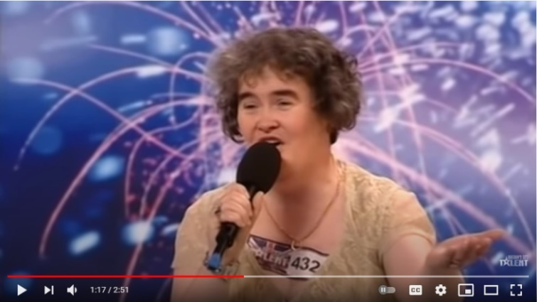



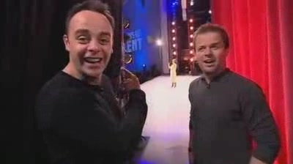
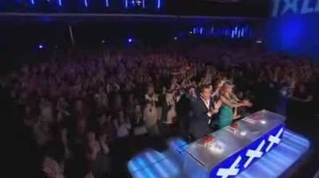

Goal of video summarization technologies
“Generate a short visual synopsis that summarizes the video content by selecting the most informative and important parts of it”
Video content
Key-fragment
Key-frame
Analysis outcomes
This synopsis can be:
Static, composed of a set representative video (key-)frames (a.k.a. video storyboard)
Dynamic, formed of a set of representative video (key-)fragments (a.k.a. video skim)
Video title: “Susan Boyle's First Audition - I Dreamed a Dream - Britain's Got Talent 2009”
Video source: OVP dataset (video also available at: https://www.youtube.com/watch?v=deRF9oEbRso)
Dynamic video summary
(made of selected key-fragments)
Static video summary
(made of selected key-frames)
Notes:
The video summary is a short visual summary that encapsulates the flow of the story and the essential parts of the full-length video. And in terms of presentation format, there are two fundamental types of video summaries: static video summary (a.k.a. video storyboard) and dynamic video summary (a.k.a. video skim). The video storyboard is a collection of representative video frames extracted from the original video. The video skim is a set of short video clips joined in a sequence and played as a video. For example here we can see a short clip from a British talent show, and on the right side there is a storyboard that gives a static summary of the video content. Sets of representative frames are not restricted by timing or synchronization issues and, therefore, they offer much more flexibility in terms of organization for browsing and navigation purposes. On the other hand though, video skims include audio and motion elements and thus they offer a more natural story narration, that is often more entertaining and interesting to the users.

Slide 6
Related work (unsupervised approaches)
Increasing the summary representativeness using summary-to-video reconstruction mechanisms as part of adversarially-trained Generator-Discriminator architectures
Frames’ importance estimation is based on
Long Short-Term Memory networks (LSTMs)
Combinations of LSTMs with tailored multi-level (local, global) attention mechanisms
Combinations of LSTMs with Transformer-based multi-head self-attention mechanisms
Combinations of LSTMs with Actor-Critic (AC) models
Transformer-based multi-level (local, global) self-attention mechanisms
Summary-to-video reconstruction is made using
Variational Auto-Encoders (VAE)
Deterministic Attentive Auto-Encoders (AAE)
Notes:
Various approaches have been introduced to automate video summarization, and the current state of the art is represented by methods utilizing deep network architectures. For the sake of space, here we present in brief the relevant literature on unsupervised video summarization, as the relevant approaches are most closely related to the proposed method.
The complete absence of any guidance (in the form of ground-truth data) for learning video summarization, led researchers in seeking the most important characteristics of a good video summary. To this direction, most existing unsupervised approaches aim to learn how to build summaries that are highly representative of the video content.
Based on the intuition that a representative summary ought to assist the viewer to infer the original video content, most of these methods rely on the use of Generator-Discriminator architectures along with adversarial learning mechanisms that force the summarization component (which is usually a part of the Generator) to build a summary that allows a good reconstruction of the original video.

Slide 7
Related work (unsupervised approaches)
Targeting additional desired characteristics for a video summary
Identify relationships among high priority entities of the visual content via spatiotemporal analysis, and maintain these entities in the video summary
Apply reinforcement learning (RL) using hand-crafted reward functions that reward
Representativeness, diversity and temporal coherence of the video summary
Preservation in the summary of the video’s main spatiotemporal patterns
Learning a video-to-summary mapping function from unpaired data
Summary generation is based on a Fully-Convolutional Sequence Network (FCSN) Encoder-Decoder
Summary discrimination is based on an FCSN decoder
Observed limitations
Unstable training of Generator - Discriminator architectures
Limited ability of RNNs for modeling long-range frame dependencies
Parallelization ability of the training process of RNN-based network architectures
Notes:
In another recent work, Wu et al. [29] suggested that taking into account only the representativeness of the video summary is not sufficient for learning the summarization task, as a good summary should also contain the high priority events/entities of the visual content. Based on this observation, Wu et al. [29] extended a Generator-Discriminator architecture by introducing an Adversarial Spatio-Temporal network that constructs the relationship among entities, using this information while estimating frames’ importance, and improving the stability of the Discriminator’s training using the earth moving distance of the Wasserstein GAN [6].
A few unsupervised approaches define different hand-crafted reward functions that quantify the existence of desired characteristics in the generated summary, and train a network architecture for video summarization based on reinforcement learning. In this context, Zhou et al. [34] formulated video summarization as a sequential decision-making process and trained a simple LSTM-based network architecture using a pair of diversity and representativeness rewards. The former computes the dissimilarity among the selected key-frames and the latter measures the distance (i.e., the visual resemblance) of the selected key-frames from the remaining video frames. Gonuguntla et al. [8] utilized Temporal Segment Networks [28] to extract spatial and temporal information about the video frames, and trained a video summarization architecture based on a reward function that evaluates the preservation of the video’s main spatiotemporal patterns in the produced summary. Zhao et al. [33] described a mechanism that performs both video summarization and reconstruction. Video reconstruction aims to assess the extent to which the summary allows the viewer to infer the original video, and video summarization is learned based on the output of the video reconstruction process and the output of trained models that evaluate the representativeness and diversity of the generated summary. In another recent work, Yaliniz et al. [30] used Independently Recurrent Neural Networks (IndRNNs) [18] to model the temporal dependence of video frames, and learned summarization by using rewards associated with the representativeness, diversity and uniformity (i.e., the temporal coherence) of the video summary. Finally, Phaphuangwittayakul et al. [21] presented a variation of the network architecture from [34], which estimates the frames’ importance by combining the created representations for the video frames at the output of a bi-directional RNN and a self-attention mechanism.
On a different basis, Rochan et al. [23] used a Generator-Discriminator architecture to learn video summarization from unpaired data. The generative part is composed of a Fully-Convolutional Sequence Network (FCSN) encoder-decoder, while the discriminative part contains only the decoding part of the FCSN. The goal is to learn a mapping function of a raw video to a humanlike summary, such that the distribution of the generated summary is similar to the distribution of human-created summaries.

Slide 8
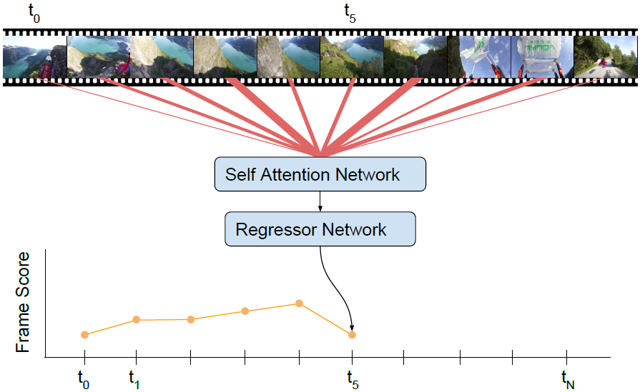
Developed approach: Starting point
Supervised VASNet model (Fajtl et al., 2018)
Frames’ importance estimation (for video summarization) is formulated as a seq2seq transformation
Frames’ dependencies are modeled using a soft self-attention mechanism
Image source: Fajtl et al., “Summarizing Videos with Attention”, ACCV 2018 Workshops
J. Fajtl, et al., “Summarizing Videos with Attention,” in Asian Conf. on Computer Vision 2018 Workshops. Cham: Springer Int. Publishing, 2018, pp. 39-54.
Notes:
The basis of our developments was the network architecture of VASNet. The heart of this supervised video summarization method is a soft self-attention mechanism that takes into account the entire frame sequence and models the frames’ dependencies according to their pair-wise similarities in a learned latent space. The output of this mechanism is forwarded to a two-layer, fully connected network that produces estimates about each frame’s importance. These estimates are compared with ground-truth annotations about the frames’ importance, and the computed loss value guides the supervised training of the architecture.

Slide 9
Developed approach: End point
Unsupervised CA-SUM model
Attention mechanism able to:
Concentrate on specific parts of the attention matrix
Better estimate frames’ significance using information also about their uniqueness and diversity
Significantly reduce the number of learnable parameters
Learn the task via a simple loss function that relates to the length of the summary
Frames’ uniqueness and diversity
Image source: Fajtl et al., “Summarizing Videos with Attention”, ACCV 2018 Workshops
Notes:
To train this architecture in a fully-unsupervised manner, we developed a new method that allows the attention mechanism to: i) concentrate on specific parts of the attention matrix, that correspond to different non-overlapping video fragments of fixed length, ii) make better estimates about the significance of each of these parts, by extracting and exploiting information about the uniqueness and diversity of the associated video frames, iii) produce a block diagonal sparse attention matrix, thus significantly reducing the number of learnable parameters, and iv) learn the video summarization task via a simple loss function that relates to the length of the generated summary.

Slide 10
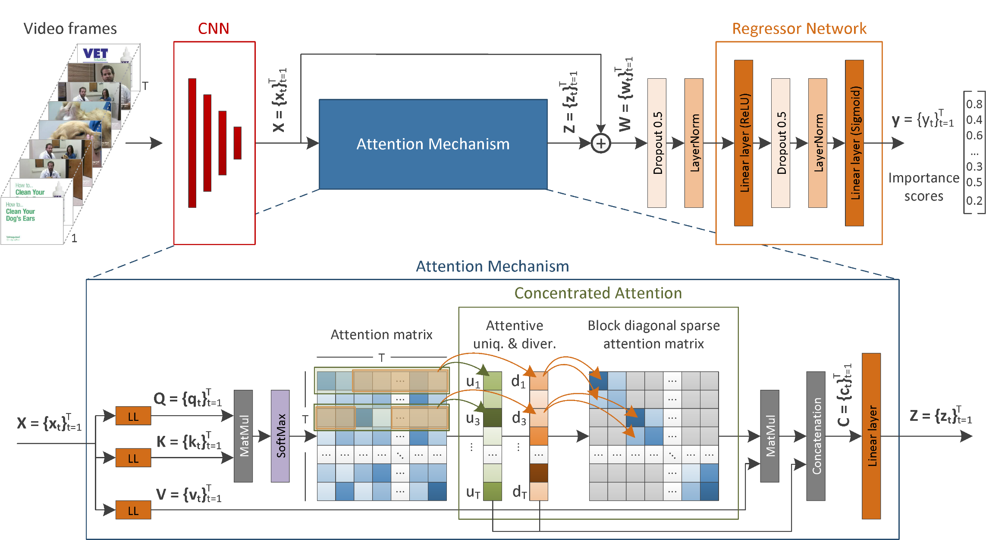
Developed approach: CA-SUM model
Notes:
Given a video of T frames,

Slide 11
Developed approach: CA-SUM model
Notes:
… the CA-SUM method initially produces a set of deep feature representations using a pretrained CNN model.

Slide 12
Developed approach: CA-SUM model
Notes:
These representations form the input of the attention mechanism and are utilized also via a residual skip connection to facilitate back-propagation and assist the model’s convergence.

Slide 13
Developed approach: CA-SUM model
Notes:
As illustrated in the lower part of the figure, the attention mechanism passes the set of frame feature vectors through three different linear layers and forms the Query, Key and Value matrices of the training process. The Query and Key matrices participate in a matrix multiplication process that is followed by a softmax layer, and formulate the values of the attention matrix.

Slide 14
Developed approach: CA-SUM model
Notes:
The computed attention values are then utilized by the concentrated attention mechanism.

Slide 15
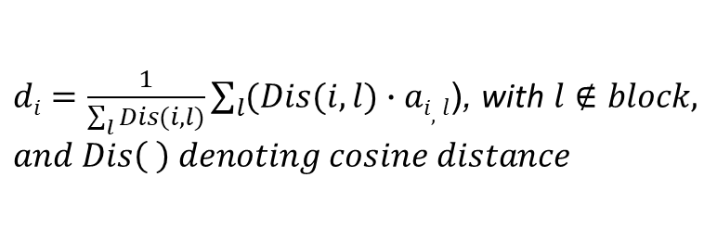
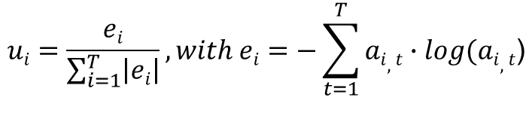
Developed approach: CA-SUM model
$$ui=\frac{ei}{\sum_{i=1}^{T}{\left|ei\right|}}, with ei=−\sum_{t=1}^{T}{ai,t}∙log(ai,t\text{)}$$
$di=\frac{1}{\sum_{l}{Dis(i,l)}}\sum_{l}{(Dis(i,l)}∙ai,l$), with $l∉block, and Dis\left( \right) denoting cosine distance$
Notes:
This mechanism focuses on non-overlapping blocks of size 𝑀 that are in the main diagonal of the attention matrix, and aims to enrich the existing information in each of these blocks by integrating knowledge about the attentive uniqueness and diversity of the associated frames of the video. The adopted terminology for these two values relates to the fact that the computed attention values are taken into account for estimating the frames’ uniqueness and diversity. The outputs of this mechanism are: i) a block diagonal sparse attention matrix that concentrates the information about the significance of different consecutive and non-overlapping parts of the video in a narrow area around its main diagonal, and ii) a pair of values for each frame, that represent its attentive uniqueness (𝑢𝑡 ∈ R+ and 𝑡 ∈ [1,𝑇 ]) and diversity (𝑑𝑡 ∈ R+ and 𝑡 ∈ [1,𝑇 ]) from the video frames outside the block of interest.

Slide 16
Developed approach: CA-SUM model
Notes:
Each pair of attentive uniqueness and diversity values is concatenated at the end of the corresponding feature vector that is created after a matrix multiplication process involving the block diagonal sparse attention matrix and the Value matrix. The generated feature vectors of size 𝐷 + 2 pass through a linear layer that reduces their dimensionality to 𝐷.

Slide 17
Developed approach: CA-SUM model
Notes:
The generated feature vectors at the output of the attention mechanism are then added to the original feature vectors via a residual skip connection.

Slide 18
Developed approach: CA-SUM model
Notes:
The result of this operation is forwarded to a dropout layer that is followed by a normalization layer. The produced representations are given as input to the Regressor Network, which produces a set of frame-level scores that indicate the frames’ importance.

Slide 19

Developed approach: CA-SUM model
Training time
Compute a length regularization loss
Inference time
Compute fragment-level importance based on a video segmentation
Create the summary by selecting the key-fragments based on a time budget and by solving the Knapsack problem
$Lreg= \left|\frac{1}{T} \sum_{t=1}^{T}{yt}−σ\right|$
Notes:
Given the output of the aforementioned processing pipeline, at training time, we compute a length regularization loss, where 𝜎 is the summary length regularization factor, a tunable hyper-parameter of our method. The computed training loss is then back-propagated to compute the gradients and update all the different parts of the architecture.
At inference time, the estimated importance scores are used to select the key-fragments of the video and form the video summary. For this, given a temporal segmentation of the video into its building blocks (obtained e.g., using the KTS algorithm), fragment-level importance is calculated by averaging the scores of the frames within each fragment. Finally, provided that the summary does not exceed 15% of the video duration (which is a common setting in the relevant literature), we form the video summary by solving the Knapsack problem.

Slide 20
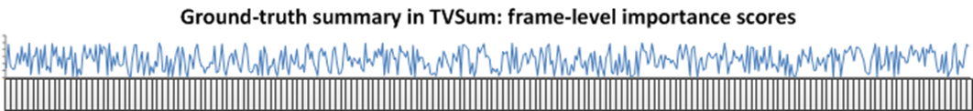
Experiments: Datasets
SumMe (https://gyglim.github.io/me/vsum/index.html#benchmark)
25 videos capturing multiple events (e.g. cooking and sports)
Video length: 1 to 6 min
Annotation: fragment-based video summaries (15-18 per video)
TVSum (https://github.com/yalesong/tvsum)
50 videos from 10 categories of TRECVid MED task
Video length: 1 to 11 min
Annotation: frame-level importance scores (20 per video)
Notes:
To evaluate the performance of our CA-SUM model we use two benchmarking datasets. The SumMe dataset includes 25 videos (1-6 min. duration) with diverse video contents (e.g., covering holidays, events and sports), captured from both first-person and third-person view. Each video has been annotated by 15 to 18 users in the form of key-fragments, and thus is associated to multiple user summaries of varying length (5-15% of the initial video duration). The TVSum dataset [26] contains 50 videos (1-11 min. duration) from 10 categories of the TRECVid MED task [25] (5 videos per category). Each video has been annotated by 20 users in the form of frame-level importance scores, ranging from 1 (not important) to 5 (very important).

Slide 21
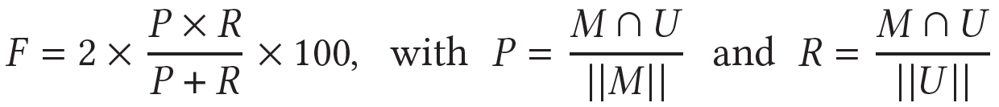
Experiments: Evaluation approach
Approach #1
The generated summary should not exceed 15% of the video length
Agreement between machine-generated (M) and user-defined (U) summary is expressed by the F-Score (%), with (P)recision and (R)ecall measuring the temporal overlap (∩) (|| || means duration)
Directly applicable on SumMe videos, where annotations define videos’ key-fragments
TVSum videos’ frame-level annotations are initially converted to define key-fragments
Notes:
Our assessments are based on two different evaluation approaches. The first approach (adopted by the majority of the state of the art video summarization methods) estimates the similarity between a machine-generated and a user-defined summary by computing their overlap using the F-Score (as percentage). So, given a video, we compare the generated summary with the user summaries for this video, and compute an F-Score for each pair of compared summaries. Then, we average the computed F-Scores (for TVSum) or keep the maximum of them (for SumMe, to account for the fact that multiple summaries of varying length are possible for a video) and end up with the final F-Score for this video. The computed F-Scores for all test videos are averaged and this average indicates the method’s performance on the test set. This protocol is directly applicable on the SumMe dataset, as the video annotations are in the form of key-fragments. For the TVSum, the frame-level annotations of the videos are initially converted to key-fragment annotations.

Slide 22
Experiments: Evaluation approach
Approach #2
Eliminates the impact of video fragmentation and key-fragment selection mechanisms
Alignment between machine-estimated and user-defined frame-level importance scores is estimated using the Kendall’s τ an Spearman’s ρ rank correlation coefficients
Applicable only on TVSum videos, where annotations define frame’s importance
Common rules
80% of video samples are used for training and the remaining 20% for testing
Summarization performance is formed by averaging the experimental results on five randomly-created splits of data
Notes:
The second evaluation approach (proposed in [20]) eliminates the impact of any utilized video fragmentation and key-fragment selection mechanism (e.g., the Knapsack algorithm). It assesses the quality of a machine-generated video summary by considering the produced frame-level importance scores at the output of a network architecture as rankings, and comparing them with the user-generated frame-level importance scores using the Kendall’s 𝜏 and Spearman’s 𝜌 rank correlation coefficients. In this case, for a given test video we compare the estimated frame-level importance scores with the available user annotations (also frame-level importance scores) for this video, and compute the 𝜏 and 𝜌 values for each pair of comparisons. Then, we average the computed sets of 𝜏 and 𝜌 values, and form the final 𝜏 and 𝜌 values for this video. The computed 𝜏 and 𝜌 values for all test videos are then averaged and this average defines the method’s performance on the test set. This evaluation approach is applicable only on the videos of the TVSum dataset, that have been annotated with frame-level importance scores.
Finally, similarly to most of the existing works we split each dataset into a training (80% of the videos) and a testing set (the remaining 20% of the videos) and we run experiments on five different randomly-created splits for each dataset. In the following, we report the average performance over these runs (cf. Tables 1-3 and 5).

Slide 23
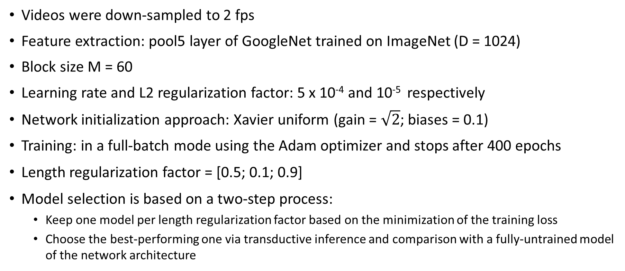
Experiments: Implementation details
Videos were down-sampled to 2 fps
Feature extraction: pool5 layer of GoogleNet trained on ImageNet (D = 1024)
Block size M = 60
Learning rate and L2 regularization factor: 5 x 10⁻⁴ and 10⁻⁵ respectively
Network initialization approach: Xavier uniform (gain = $\sqrt{2}$; biases = 0.1)
Training: in a full-batch mode using the Adam optimizer and stops after 400 epochs
Length regularization factor = [0.5; 0.1; 0.9]
Model selection is based on a two-step process:
Keep one model per length regularization factor based on the minimization of the training loss
Choose the best-performing one via transductive inference and comparison with a fully-untrained model of the network architecture
Notes:
As in most state-of-the-art methods, videos are downsampled to 2 fps. Deep representations of frames are obtained by taking the output of the pool5 layer of GoogleNet trained on ImageNet, and thus are of size D = 1024. The block size 𝑀 is set to 60, based on the findings of a sensitivity analysis that examined different options for the value of parameter 𝑀. The learning rate and the L2 regularization factor for training the architecture are equal to 5 ・ 10−4, and 10−5, respectively. For initializing the network’s parameters we use the Xavier uniform initialization approach with gain = √2 and biases = 0.1 (as in VASNet). Training is performed in a full-batch mode (i.e., batch size is equal to the number of training samples) using the Adam optimizer, and stops after 400 epochs.
The selection of a well-trained model is based on a two-step process. First, we keep one trained model per considered value for the length regularization factor sigma, by selecting the model (i.e., the epoch) that minimizes the training loss. Then, we choose the best-performing model (i.e., the sigma value) for a given data split through a mechanism that involves a fully-untrained model of the architecture and is based on transductive inference.

Slide 24
Experiments: Sensitivity analysis
Tuning of block size M
Indicates the level of granularity for estimating attention-based significance of the video
Largest value is dictated by the shortest video in our datasets (60 sec.)
Block size | SumMe | TVSum | TVSum
 | F-score |  | Spearmans’ ρ | Kendall’s τ
10 | 44.8 | 55.7 | 0.090 | 0.070
20 | 46.3 | 57.0 | 0.140 | 0.110
30 | 47.0 | 57.6 | 0.160 | 0.120
40 | 46.1 | 60.5 | 0.170 | 0.130
50 | 44.3 | 60.4 | 0.190 | 0.150
60 | 51.1 | 61.4 | 0.210 | 0.160
KTS | 40.8 | 52.7 | 0.060 | 0.050
Notes:
Since the concentrated attention mechanism, which produces the block diagonal sparse attention matrix, is in the core of the processing pipeline at both training and inference stage, we examined different options about the size 𝑀 of the block. This size indicates the length of the video fragment where the attention mechanism concentrates each time, and thus the level of granularity for estimating the attention-based significance of the video. The different options for this hyper-parameter, and the summarization performance of the CA-SUM model according to the F-Score, Spearman’s 𝜌 and Kendall’s 𝜏 measures, are presented in the Table. These results show that the increment of the block size almost constantly leads to improved summarization performance on TVSum, but the findings for the SumMe dataset are mixed. The best option for this hyper-parameter is 𝑀 = 60 as it leads to the highest performance on both datasets and according to all considered measures. Higher values were not taken under consideration in this experiment, as the maximum possible value is dictated by the shortest video in our datasets, which in our case is 60 frames. Finally, the use of blocks that correspond to the detected video fragments by the KTS algorithm (which is the most commonly used approach for video segmentation in the relevant literature) results in the worst summarization performance.

Slide 25
Experiments: Performance comparisons
Against SoA unsupervised methods based on F-Score
Method | SumMe |  | TVSum |  | Avg Rank | Data splits
 | F1 | Rank | F1 | Rank
Random | 40.2 | 18 | 54.4 | 15 | 16.5 | -
SUM-FCN_{unsup} | 41.5 | 16 | 52.7 | 16 | 16 | M Rand
DR-DSN | 41.4 | 17 | 57.6 | 12 | 14.5 | 5 Rand
EDSN | 42.6 | 14 | 57.3 | 13 | 13.5 | 5 Rand
RSGN_{unsup} | 42.3 | 15 | 58.0 | 11 | 13 | 5 Rand
UnpairedVSN | 47.5 | 11 | 55.6 | 14 | 12.5 | 5 Rand
PCDL | 42.7 | 13 | 58.4 | 9 | 11 | 5 FCV
ACGAN | 46.0 | 12 | 58.5 | 8 | 10 | 5 FCV
SUM-Ind_{LU} | 46.0 | 12 | 58.7 | 7 | 9.5 | 5 Rand
ERA | 48.8 | 8 | 58.0 | 11 | 9.5 | 5 Rand
Method | SumMe |  | TVSum |  | Avg Rank | Data splits
 | F1 | Rank | F1 | Rank
SUM-GAN-sl | 47.8 | 10 | 58.4 | 9 | 9.5 | 5 Rand
SUM-GAN-AAE | 48.9 | 7 | 58.3 | 10 | 8.5 | 5 Rand
MCSF_{late} | 47.9 | 9 | 59.1 | 5 | 7 | 5 Rand
SUM-GDA_{unsup} | 50.0 | 6 | 59.6 | 4 | 5 | 5 FCV
CSNet+GL-RPE | 50.2 | 5 | 59.1 | 5 | 5 | 5 FCV
CSNet | 51.3 | 1 | 58.8 | 6 | 3.5 | 5 FCV
DSR-RL-GRU | 50.3 | 4 | 60.2 | 3 | 3.5 | 5 Rand
AC-SUM-GAN | 50.8 | 3 | 60.6 | 2 | 2.5 | 5 Rand
CA-SUM | 51.1 | 2 | 61.4 | 1 | 1.5 | 5 Rand
Notes:
The best configuration of the CA-SUM network architecture was subsequently compared with a random summarizer and several state-of-the-art unsupervised video summarization approaches.
The performance of a random summarizer on a given video was measured as proposed in [1]. In particular, we initially assigned randomly-created importance scores to the video frames based on a uniform distribution of probabilities. Then, we computed fragment-level scores based on a predefined KTS-based segmentation of the video. Finally, we used the Knapsack algorithm to form a summary with a length that does not exceed 15% of video duration. Random summarization was performed 100 times and we report the average score over these runs.
The reported values in Table 2 show that the proposed CA-SUM method performs consistently good on both of the utilized datasets, being the top-performing one on TVSum and the second best performing one on SumMe, according to the F-Score measure.

Slide 26
Experiments: Performance comparisons
Against SoA unsupervised methods based on F-Score
Method | SumMe |  | TVSum |  | Avg Rank | Data splits
 | F1 | Rank | F1 | Rank
Random | 40.2 | 18 | 54.4 | 15 | 16.5 | -
SUM-FCN_{unsup} | 41.5 | 16 | 52.7 | 16 | 16 | M Rand
DR-DSN | 41.4 | 17 | 57.6 | 12 | 14.5 | 5 Rand
EDSN | 42.6 | 14 | 57.3 | 13 | 13.5 | 5 Rand
RSGN_{unsup} | 42.3 | 15 | 58.0 | 11 | 13 | 5 Rand
UnpairedVSN | 47.5 | 11 | 55.6 | 14 | 12.5 | 5 Rand
PCDL | 42.7 | 13 | 58.4 | 9 | 11 | 5 FCV
ACGAN | 46.0 | 12 | 58.5 | 8 | 10 | 5 FCV
SUM-Ind_{LU} | 46.0 | 12 | 58.7 | 7 | 9.5 | 5 Rand
ERA | 48.8 | 8 | 58.0 | 11 | 9.5 | 5 Rand
Method | SumMe |  | TVSum |  | Avg Rank | Data splits
 | F1 | Rank | F1 | Rank
SUM-GAN-sl | 47.8 | 10 | 58.4 | 9 | 9.5 | 5 Rand
SUM-GAN-AAE | 48.9 | 7 | 58.3 | 10 | 8.5 | 5 Rand
MCSF_{late} | 47.9 | 9 | 59.1 | 5 | 7 | 5 Rand
SUM-GDA_{unsup} | 50.0 | 6 | 59.6 | 4 | 5 | 5 FCV
CSNet+GL-RPE | 50.2 | 5 | 59.1 | 5 | 5 | 5 FCV
CSNet | 51.3 | 1 | 58.8 | 6 | 3.5 | 5 FCV
DSR-RL-GRU | 50.3 | 4 | 60.2 | 3 | 3.5 | 5 Rand
AC-SUM-GAN | 50.8 | 3 | 60.6 | 2 | 2.5 | 5 Rand
CA-SUM | 51.1 | 2 | 61.4 | 1 | 1.5 | 5 Rand
Notes:
In addition, our idea to work with a self-attention mechanism seems to be right, as five out of the six top-performing approaches (including our CA-SUM model) contain some kind of attention mechanism.

Slide 27
Experiments: Performance comparisons
Against SoA unsupervised methods using rank correlation coefficients
Method | Spearman’s ρ | Kendall’s τ
Random summary | 0.000 | 0.000
Human summary | 0.204 | 0.177
DR-DSN | 0.026 | 0.020
CSNet | 0.034 | 0.025
RSGN_{unsup} | 0.052 | 0.048
CSNet+GL-RPE | 0.091 | 0.070
DSR-RL-GRU | 0.114 | 0.086
CA-SUM | 0.210 | 0.160
Notes:
The improved summarization performance of the proposed CA-SUM method is highlighted also by the results shown in this Table. Our method is by far the top performing one, according to both Spearman’s 𝜌 and Kendall’s 𝜏 rank correlation coefficients. Moreover, the performance of CA-SUM on the used data splits of the TVSum dataset approximates the performance of the average human annotator. These results clearly indicate that the proposed method is able to produce structures of frame-level importance scores, that are highly aligned to the human preferences.

Slide 28
Experiments: Performance comparisons
In terms of training time and number of learnable parameters
Method | Training time (sec / epoch) |  | # Parameters (in Millions)
 | SumMe | TVSum
DR-DSN | 0.33 | 0.98 | 2.63
SUM-Ind_{LU} | 2.07 | 9.84 | 0.33
SUM-GAN-sl | 11.85 | 38.95 | 23.31
SUM-GAN-AAE | 16.39 | 54.23 | 24.31
CSNet | 28.43 | 89.85 | 100.76
DSR-RL-GRU | 0.23 | 0.50 | 13.64
AC-SUM-GAN | 28.25 | 93.80 | 26.75
CA-SUM | 0.06 | 0.13 | 5.25
Notes:
Finally, we compared different unsupervised video summarization methods with publicly available implementations, with respect to the training time (seconds per training epoch) and the amount of learnable parameters (in Millions). These experiments were carried out using the same PC (with an i5-11600K CPU, 32GB RAM and an NVIDIA RTX 2080 Ti GPU) and the exact same five splits of data. The findings presented in this Table show that…

Slide 29
Experiments: Performance comparisons
In terms of training time and number of learnable parameters
Method | Training time (sec / epoch) |  | # Parameters (in Millions)
 | SumMe | TVSum
DR-DSN | 0.33 | 0.98 | 2.63
SUM-Ind_{LU} | 2.07 | 9.84 | 0.33
SUM-GAN-sl | 11.85 | 38.95 | 23.31
SUM-GAN-AAE | 16.39 | 54.23 | 24.31
CSNet | 28.43 | 89.85 | 100.76
DSR-RL-GRU | 0.23 | 0.50 | 13.64
AC-SUM-GAN | 28.25 | 93.80 | 26.75
CA-SUM | 0.06 | 0.13 | 5.25
Notes:
…the use of Generator-Discriminator architectures for learning the summarization task is the most demanding approach, in terms of both the training time and the memory required.

Slide 30
Experiments: Performance comparisons
In terms of training time and number of learnable parameters
Method | Training time (sec / epoch) |  | # Parameters (in Millions)
 | SumMe | TVSum
DR-DSN | 0.33 | 0.98 | 2.63
SUM-Ind_{LU} | 2.07 | 9.84 | 0.33
SUM-GAN-sl | 11.85 | 38.95 | 23.31
SUM-GAN-AAE | 16.39 | 54.23 | 24.31
CSNet | 28.43 | 89.85 | 100.76
DSR-RL-GRU | 0.23 | 0.50 | 13.64
AC-SUM-GAN | 28.25 | 93.80 | 26.75
CA-SUM | 0.06 | 0.13 | 5.25
Notes:
The use of less complex architectures where the estimation of the frames’ importance is based on the modeling of the frames’ dependencies purely using RNNs, can significantly reduce the training time, but at the cost of a lower summarization performance (as shown before).

Slide 31
Experiments: Performance comparisons
In terms of training time and number of learnable parameters
Method | Training time (sec / epoch) |  | # Parameters (in Millions)
 | SumMe | TVSum
DR-DSN | 0.33 | 0.98 | 2.63
SUM-Ind_{LU} | 2.07 | 9.84 | 0.33
SUM-GAN-sl | 11.85 | 38.95 | 23.31
SUM-GAN-AAE | 16.39 | 54.23 | 24.31
CSNet | 28.43 | 89.85 | 100.76
DSR-RL-GRU | 0.23 | 0.50 | 13.64
AC-SUM-GAN | 28.25 | 93.80 | 26.75
CA-SUM | 0.06 | 0.13 | 5.25
Notes:
Finally, the use of self-attention mechanisms - either solely (as in our proposed method) or in combination with RNNs - leads to several times faster training, while ensuring high summarization performance.

Slide 32
Experiments: Performance comparisons
In terms of training time and number of learnable parameters
Method | Training time (sec / epoch) |  | # Parameters (in Millions)
 | SumMe | TVSum
DR-DSN | 0.33 | 0.98 | 2.63
SUM-Ind_{LU} | 2.07 | 9.84 | 0.33
SUM-GAN-sl | 11.85 | 38.95 | 23.31
SUM-GAN-AAE | 16.39 | 54.23 | 24.31
CSNet | 28.43 | 89.85 | 100.76
DSR-RL-GRU | 0.23 | 0.50 | 13.64
AC-SUM-GAN | 28.25 | 93.80 | 26.75
CA-SUM | 0.06 | 0.13 | 5.25
Notes:
Being highly parallelizable, the proposed CA-SUM method needs the least time for model training.
With respect to the required computational resources for training the proposed CA-SUM method, the memory footprint of the network architecture is 1.16 GBs; this means that our method can process up to 2 hours of video content (in a single-batch mode) using a GPU with memory capacity similar to that of an NVIDIA RTX 2080 Ti.

Slide 33
Experiments: Performance comparisons
Ablation study
Method | Block diagonal sparse attention matrix | Attentive frame uniqueness & diversity | SumMe | TVSum | TVSum
 |  |  | F-Score |  | Spearman’s ρ | Kendall’s τ
Variant #1 | X | X | 45.8 | 58.9 | NaN | NaN
Variant #2 | √ | X | 47.4 | 56.5 | 0.010 | 0.010
Variant #3 | X | √ | 45.8 | 58.9 | NaN | NaN
CA-SUM | √ | √ | 51.1 | 61.4 | 0.210 | 0.160
Notes:
To assess the impact of each of the main changes that were introduced in the processing pipeline of the supervised VASNet method [7] in order to develop our unsupervised CA-SUM model, we conducted an ablation study that included the following variants of the proposed architecture:
• Variant #1 leaves out the entire concentrated attention mechanism, thus avoiding the computation of both the block diagonal sparse attention matrix and the estimates about the attentive uniqueness and diversity of the video frames.
• Variant #2 does not compute any estimates about the frames’ uniqueness and diversity, and the created block diagonal sparse attention matrix can be seen as the case where the attention mechanism performs local attention only.
• Variant #3 excludes the generation of a block diagonal sparse attention matrix, and the computed estimates about the frames’ attentive uniqueness and diversity are used only to enrich the output of a matrix multiplication process that involves the Attention (𝑨) and the Value (𝑽) matrices.
The results in this Table show that…

Slide 34
Experiments: Performance comparisons
Ablation study
Method | Block diagonal sparse attention matrix | Attentive frame uniqueness & diversity | SumMe | TVSum | TVSum
 |  |  | F-Score |  | Spearman’s ρ | Kendall’s τ
Variant #1 | X | X | 45.8 | 58.9 | NaN | NaN
Variant #2 | √ | X | 47.4 | 56.5 | 0.010 | 0.010
Variant #3 | X | √ | 45.8 | 58.9 | NaN | NaN
CA-SUM | √ | √ | 51.1 | 61.4 | 0.210 | 0.160
Removing the block diagonal sparse attention matrix does not allow the network to learn anything meaningful
Notes:
…removing the block diagonal sparse attention matrix does not allow the network to learn anything meaningful. In particular, the network sticks in a case where all the video frames are assigned with the same extremely low (≈ 0) or extremely high (≈ 1) importance scores. The generation of the summary completely depends on the choices made by the Knapsack algorithm, that are purely related to the length of the video fragments. Since there is no counted variation in the assigned importance scores, no values can be computed for the Spearman’s 𝜌 and Kendall’s 𝜏 rank correlation coefficients.

Slide 35
Experiments: Performance comparisons
Ablation study
Method | Block diagonal sparse attention matrix | Attentive frame uniqueness & diversity | SumMe | TVSum | TVSum
 |  |  | F-Score |  | Spearman’s ρ | Kendall’s τ
Variant #1 | X | X | 45.8 | 58.9 | NaN | NaN
Variant #2 | √ | X | 47.4 | 56.5 | 0.010 | 0.010
Variant #3 | X | √ | 45.8 | 58.9 | NaN | NaN
CA-SUM | √ | √ | 51.1 | 61.4 | 0.210 | 0.160
Ignoring the frames’ uniqueness & diversity and using only local attention, results in poor summarization performance
Notes:
When no estimates about the frames’ attentive uniqueness and diversity are being computed, and the block diagonal sparse attention matrix provides information about the frames’ attention only at the local-level, the network also fails to learn the summarization task. The computed F-Score, Spearman’s 𝜌 and Kendall’s 𝜏 values, indicate a random-level performing summarizer on both utilized datasets.

Slide 36
Experiments: Performance comparisons
Ablation study
Method | Block diagonal sparse attention matrix | Attentive frame uniqueness & diversity | SumMe | TVSum | TVSum
 |  |  | F-Score |  | Spearman’s ρ | Kendall’s τ
Variant #1 | X | X | 45.8 | 58.9 | NaN | NaN
Variant #2 | √ | X | 47.4 | 56.5 | 0.010 | 0.010
Variant #3 | X | √ | 45.8 | 58.9 | NaN | NaN
CA-SUM | √ | √ | 51.1 | 61.4 | 0.210 | 0.160
Combining a block diagonal sparse attention matrix with attention-based statistics about the frames’ uniqueness & diversity, allows the network to effectively learn the video summarization task
Notes:
The combination of a block diagonal sparse attention matrix with attention-based statistics about the frames’ uniqueness and diversity, as proposed, allows the network architecture to effectively learn the video summarization task and exhibit state-of-the-art performance on both of the utilized datasets and according to both of the adopted evaluation protocols.

Slide 37
Conclusions
CA-SUM model for unsupervised video summarization overcomes drawbacks of existing methods, with regards to:
The unstable training of Generator - Discriminator architectures
The limited ability of RNNs for modeling long-range frames’ dependencies
The parallelization of the training process of existing RNN-based network architectures
CA-SUM adapts and extends the use of a self-attention mechanism to:
Concentrate on non-overlapping blocks in the main diagonal of the attention matrix
Utilize information about the frames’ uniqueness and diversity
Make better estimates about the importance of different parts of the video
Experiments on two benchmark datasets (SumMe and TVSum)
Documented CA-SUM’s competitiveness against other SoA unsupervised summarization approaches
Demonstrated CA-SUM’s ability to produce summaries that meet the human expectations
Notes:
We proposed a new method for unsupervised video summarization, that aims to overcome drawbacks of existing approaches with respect to: i) unstable training of Generator – Discriminator architectures, ii) the use of RNNs for modeling long-range frames’ dependencies, and iii) the parallelization ability of the training process of existing RNN-based network architectures. The developed CA-SUM method relies on the use of a self-attention mechanism, and extends its functionality by concentrating attention on non-overlapping blocks in the main diagonal of the attention matrix and by utilizing information about the frames’ uniqueness and diversity. The proposed methodology allows the attention mechanism to make better estimates about the importance of different parts of the video. Experiments on two benchmarking datasets (SumMe and TVSum) indicated the competitiveness of our CA-SUM method against other state-of-the-art unsupervised summarization approaches, and demonstrated its ability to produce summaries that meet the human expectations.

Slide 38

Thank you for your attention! Questions?
Evlampios Apostolidis, apostolid@iti.gr
Code and documentation publicly available at: https://github.com/e-apostolidis/CA-SUM
This work was supported by the EUs Horizon 2020 research and innovation programme
under grant agreements H2020-832921 MIRROR and H2020-951911 AI4Media

