Slide 1
PJs Simulation Engine
Final Report
Matthew Pallansch

Slide 2
Goals
Overall: Create a distributed simulation engine using JavaScript
Create a NodeJS script to run on a server and support concurrent local processes
Create a JavaScript library that hooks into the NodeJS backend server, allowing web pages to act as simulation processes
Create an proof of concept simulation which utilizes this library

Slide 3
Accomplished

Slide 4
Server Script
Written in NodeJS
Handles registration of local processes and synchronizes the start of the simulation
Handles requests to send events between processes
Handles GVT calculations
Handles unregistering processes and ending the simulation

Slide 5
Front-End Library
Allows users to define a simulation by the following
A JavaScript object with key/value pairs, defining the starting state of a process
An array of events which augment the state properties and send messages to other processes
A draw function that defines how the state information will be displayed to a user
Queries the backend to send/receive events, get GVT, etc.
Only supports discrete event simulators, not process-oriented or continuous simulators
Events are executed in an unpaced interval (time delay between event processing is constant and independent of the time stamp)

Slide 6
Proof of Concept
Air traffic control simulator based on class notes
Three types of events: departure, arrival, landing
Three state variables: onTheGround, inTheAir, runwayFree
Three airports were created with scheduled departure events: ATL, LAX, CHI
Below is shown the number of planes that take off and land at each airport:
CHI
3
3
2
1
2
ATL
LAX
3

Slide 7
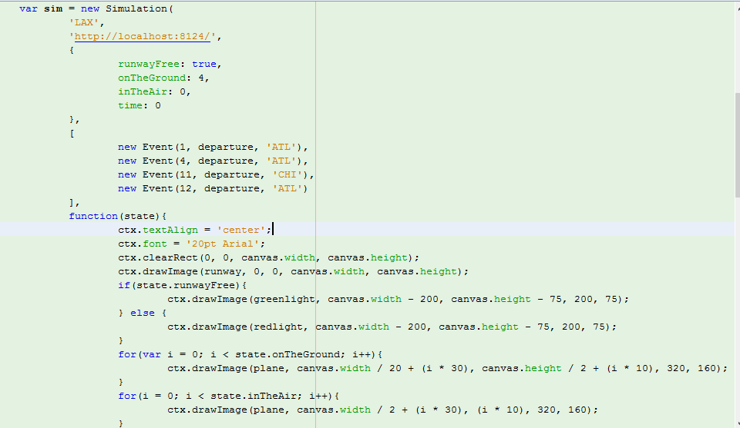
Proof of Concept – Sample

Slide 8
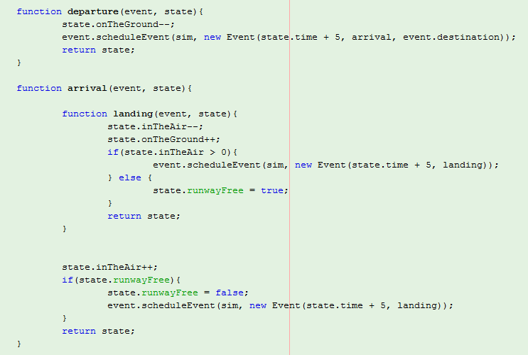
Proof of Concept – Sample

Slide 9
DEMO

Slide 10
Future Work
Important changes before release:
Fixing security vulnerability of allowing JavaScript to be passed over the query string. Could be fixed by:
Allowing the administrator process to define a password that all processes will need to access the simulation
Instead of sending JavaScript code, send names of global functions, that will be defined in a JavaScript file references by each simulation process page
Allow administrator process to see which processes are connected before the simulations starts

Slide 11
Future Work
Additional enhancements:
Allow for configuration of simulation execution to support a wider range of simulations. Examples include:
Process oriented simulations
Paced simulation time
Incremental state saving
Partial state saving
Add more analytical features, to track progression of variables and provide aggregated data at the end of a simulation

Slide 12
Future Work
Use the engine to create many simulations!

