Slide 1
Human Error After Robot Finished
HEARF

Slide 2
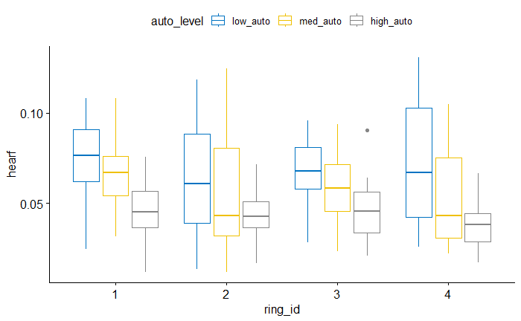

Slide 3
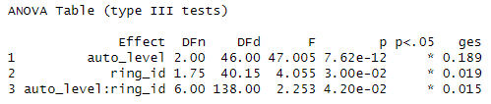
ANOVA

Slide 4
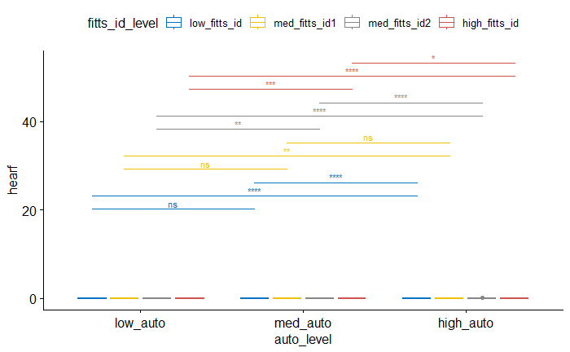
Pairwise (between autonomy levels for each difficulty)

Slide 5
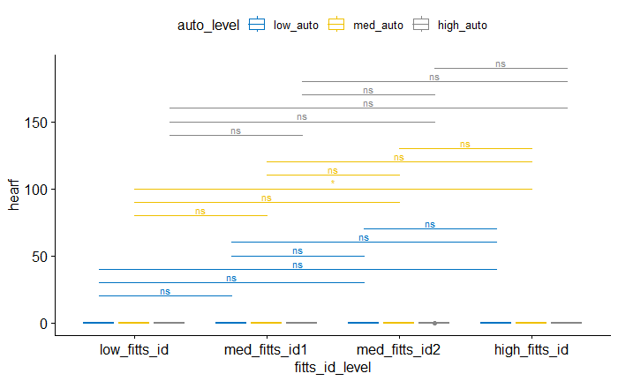
Pairwise (between difficulties for each autonomy)

Slide 6
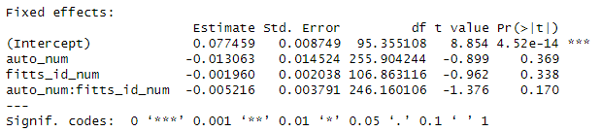
LMM

Slide 7
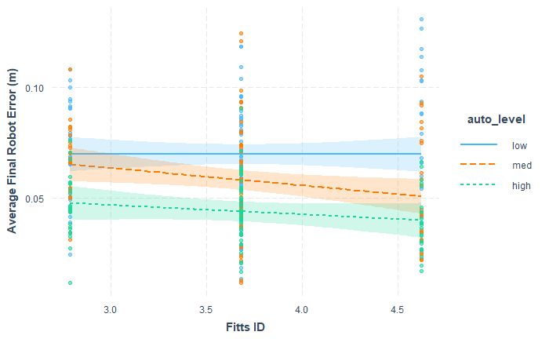
Interaction Plot

