Slide 1
Autonomy Fitts
Data analysis - results

Slide 2
List of (interesting) measures
Move Times
NASA-TLX Averaged
NASA-TLX (how hard? Mental demand, Physical demand, How successful?)
MDMT Averaged
Pupil index
Single-scale trust
Perceived autonomy
Effective ID
Effective Autonomy
ARF Human ID
ARF Human Fitts Law

Slide 3
Move time - Summary
- Follows Fitts Law under 0 autonomy (rings 2 and 3 are non-diff only for 0 autonomy)
- Interaction effect
higher autonomy yields greater decrease in movement times for more difficulty rings
Higher difficulty yield less increase in movement time under higher autonomy
- Adapted Fitts equation accounting for robot autonomy

Slide 4
NASA-TLX (Averaged) – Summary
- No difference between {med, high} autonomy for all difficulty levels
40% and 80% robot assistance yield the same level of perceived cognitive load across all rings
- No difference in all pairs of difficulty levels for medium autonomy
Under 40% robot assistance, the perceived differences in difficulty were most saturated (human the most adaptive)
- Significant positive slope of movement time against difficulty level, no interaction effect

Slide 5
NASA-TLX (how hard?) - Summary
- [ONLY] No difference between {low, med} autonomy for easiest ring, no different between {med, high} autonomy for hardest ring.
Ring 1 is too easy such that people found 40% robot assistance to be no more helpful than 0 assistance
Ring 4 is too hard such that people found 80% robot assistance to be no more helpful than 40%
- No difference in all pairs of difficulty levels for medium autonomy
- Interaction effect
Higher autonomy yields more decrease in perceived effort for more difficulty rings
More difficult rings yield less increase in perceived effort under higher autonomy

Slide 6
NASA-TLX (mental demand) - Summary
- [ONLY] No difference between {low, med} autonomy for easiest ring, no different between {med, high} autonomy for hardest ring.
Ring 1 is too easy such that people found 40% robot assistance to be no more helpful than 0 assistance
Ring 4 is too hard such that people found 80% robot assistance to be no more helpful than 40%
- No difference in all pairs of difficulty levels for medium autonomy
- Interaction effect
Higher autonomy yields more decrease in perceived mental demand for more difficulty rings
More difficult rings yield less increase in perceived mental demand under higher autonomy

Slide 7
NASA-TLX (physical demand) - Summary
- [ONLY] No difference between {low, med} autonomy for easiest ring, no different between {med, high} autonomy for hardest ring.
Ring 1 is too easy such that people found 40% robot assistance to be no more helpful than 0 assistance
Ring 4 is too hard such that people found 80% robot assistance to be no more helpful than 40%
- No difference in all pairs of difficulty levels for medium autonomy
- Interaction effect
Higher autonomy yields more decrease in perceived physical demand for more difficulty rings
More difficult rings yield less increase in perceived physical demand under higher autonomy

Slide 8
NASA-TLX (how successful?) - Summary
- No difference in all pairs of difficulty levels for medium autonomy (except between easiest and hardest rings)
- Significant increase in perceived success under higher autonomy
- Significant decrease in perceived success for higher difficulty
- No interaction

Slide 9
MDMT (Averaged) – Summary
- No difference in Trust between {low, med} autonomy for all difficulty levels
40% robot assistance is no more trustworthy than 0 assistance for all rings
However, 80% assistance is significantly more trustworthy than both 0% and 40%, EXCEPT for the most difficult ring, where no assistance and 80% assistance are trusted the same
- No difference in trust for all pairs of difficulty levels under both {low, medium} autonomy levels, EXCEPT between rings 3 and 4 for medium autonomy
- Marginally significant interaction effect
Higher robot assistance yields less increase in trust for more difficulty tasks
Higher difficulty yields more decrease in trust for higher autonomy [INTERESTING]

Slide 10
Pupil Index – Summary
- No nothing ☹

Slide 11
Single-Scale Trust – Summary
- All pairs of difficulty levels had no significant effect on trust for each autonomy level
- Significant increase in trust for higher robot autonomy
- Significant decrease in trust for higher task difficulty
- No interaction

Slide 12
Perceived Autonomy – Summary
- All pairs of autonomy levels are significantly different for each difficulty level
- No difference for all pairs of difficulty level under {low, med} autonomy
- Marginally significant interaction effect
Higher autonomy yield less increase in perceived autonomy for more difficult tasks
Higher difficulty yield more decrease in perceived autonomy under higher autonomy

Slide 13
Effective ID [y]
Calculated through linear regression of ID -> MT under no autonomy

Slide 14
Effective ID - Summary
- Significant positive slope (approximately 1) of Effective ID against actual ID
- Interaction effect
Higher autonomy yield more decrease in effective ID for more difficulty tasks
Higher difficulty yield less increase in effective ID under higher autonomy
- Strong correlations between ID and Effective ID (for each autonomy level) and overall

Slide 15
Effective Autonomy [y]
Calculated through the parameter which blends the recorded human and robot times

Slide 16
Effective Autonomy – Summary
- Significant effect of Autonomy on Effective autonomy for all difficulty levels
- Effective autonomy not different for difficulty levels, EXCEPT for the ring pairs (1, 3), (1, 4), (2, 3), (2, 4)
- No significant interaction, however, upon visual inspection, under high autonomy, the effective autonomy follows a decreasing trend across increasing difficulty
For harder rings, people find it more difficult to keep up (be in sync) with high robot autonomy, well, simply because the robot goes at constant velocity and does not follow typical Fitts
- Strong correlation between autonomy and effective autonomy (for each difficulty level) and overall

Slide 17
ARF (After Robot Finishes) Human ID [y]

Slide 18
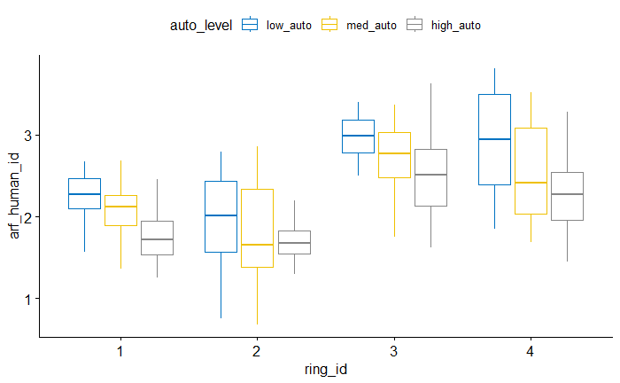

Slide 19
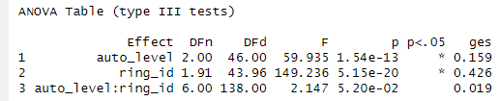
ANOVA

Slide 20
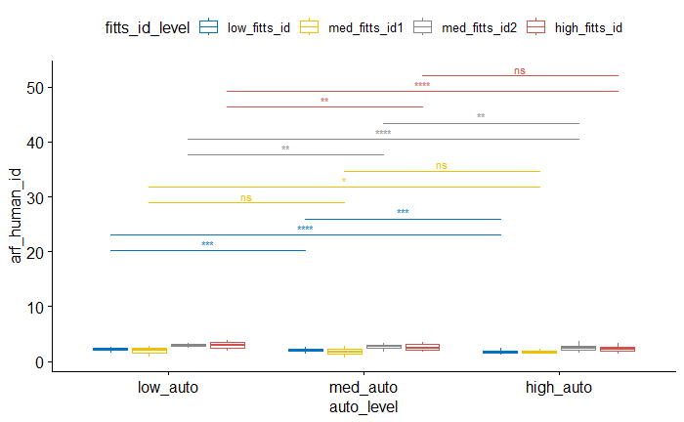
Pairwise (between autonomy levels for each difficulty)

Slide 21
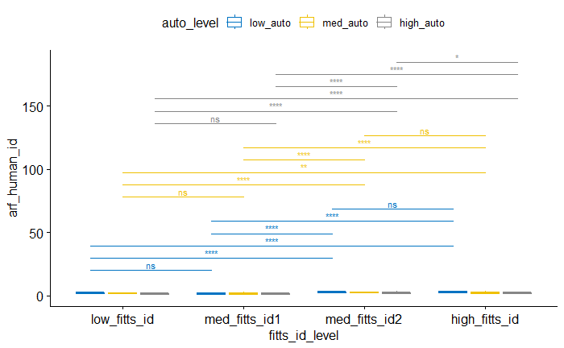
Pairwise (between difficulties for each autonomy)

Slide 22
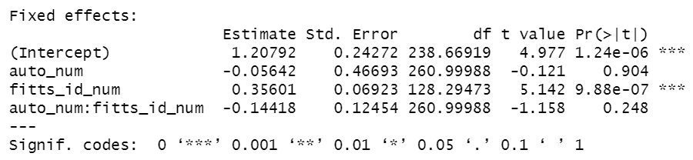
LMM

Slide 23
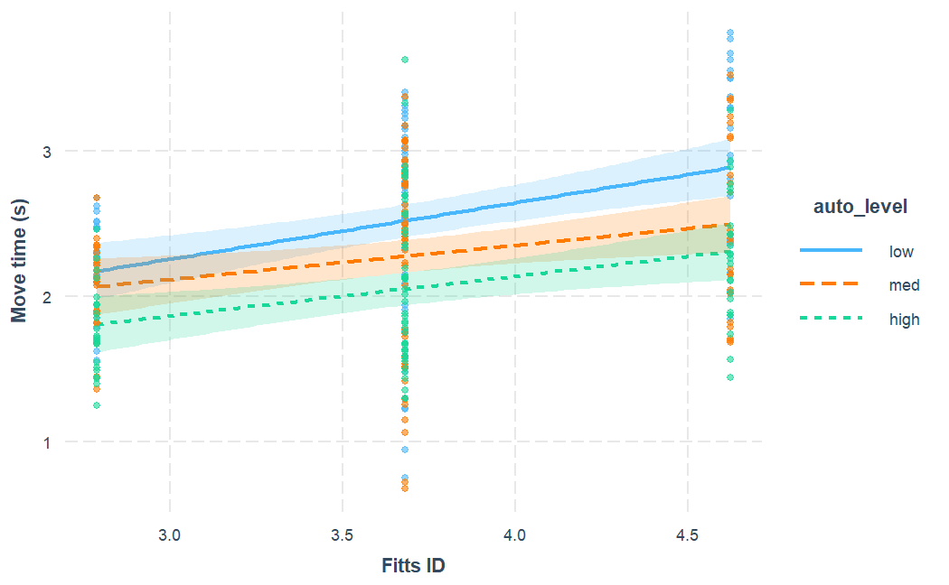
Interaction Plot

Slide 24
ARF Human ID – Summary
- ANOVA = Significant effect of both autonomy and difficulty on ARF Human ID, no interaction effect
Higher autonomy gets human closer to the target (for the same width)
Higher difficulty results in higher remaining difficulty level
- LMM = only significant positive slope of ARF ID against ID

Slide 25
ARF Fitts Regression [y]
ARF Human move time ~ ARF Human ID

Slide 26
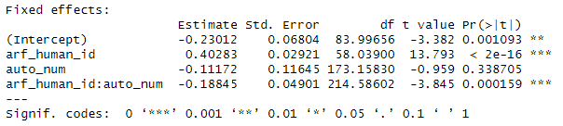
LMM

Slide 27
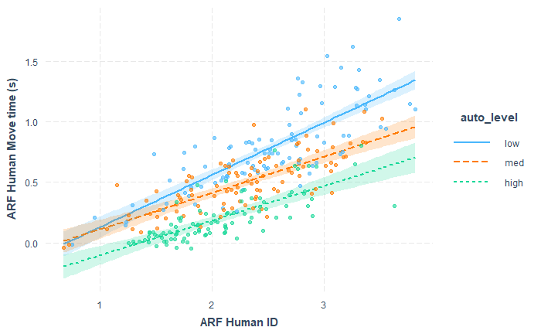
Interaction Plot

Slide 28
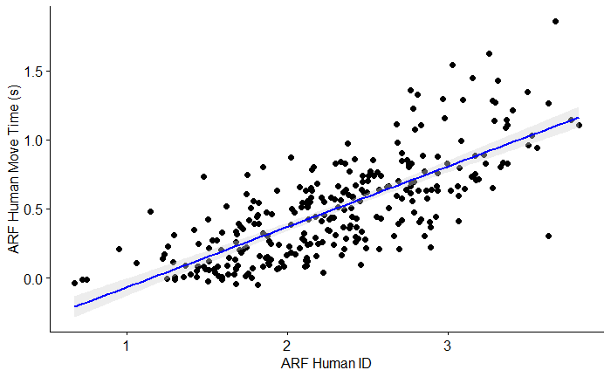
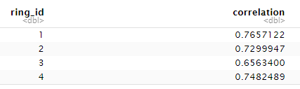
Correlation = 0.75

Slide 29
ARF Fitts Regression – Summary
- Fitts Law holds => Higher ARF ID predicts higher ARF time
- Interaction effect
Higher ARF ID yields less increase in ARF time under higher robot autonomy
Higher robot autonomy (assistance) improves user movement efficiency / throughput (i.e. user is in sync with the robot)
- Strong correlation between ARF time and ARF ID (for each autonomy level) and overall

Slide 31
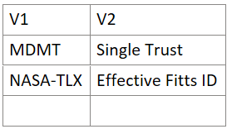
ANOVA
Additional Correlations

Slide 32
Predicted <-> Actual ARF Move Time [y]
Predicted using ARF id and the {a, b} regressed from zero-autonomy trials

Slide 33
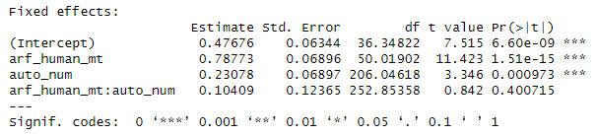
LMM

Slide 34
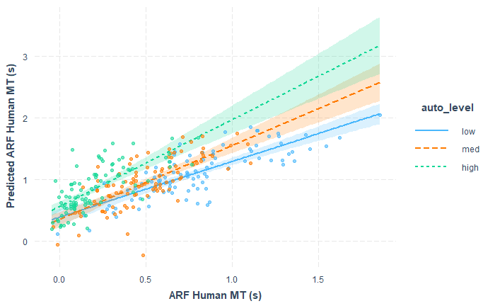
MDMT Single-trust – Interaction Plot

Slide 35
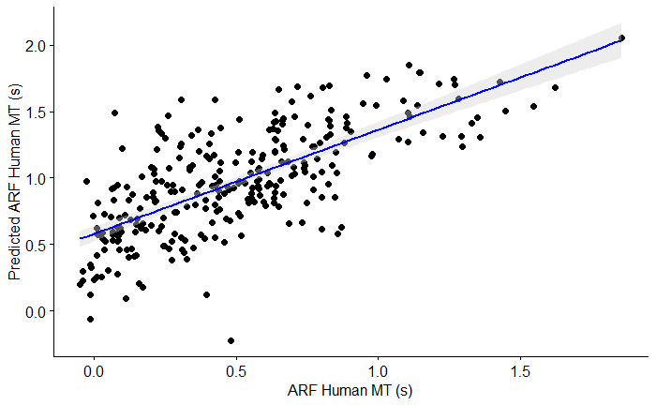
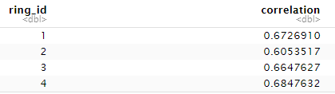
Correlation = 0.704

Slide 36
Serial (sum) vs. Average MT [y]

Slide 37
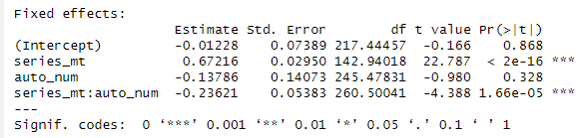
LMM

Slide 38
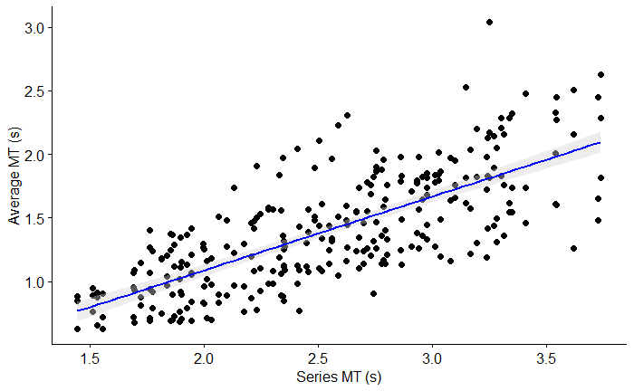
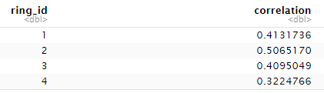
Correlation = 0.737

Slide 39
Serial MT Prediction – Summary
- Slope of 0.67 suggests that summing human and robot MTs is overestimating (almost double) the actual MT
- Interaction effect
Actual MT moves even further away (decreases) from the serial model under higher robot autonomy
Higher robot autonomy leads to participant being more in-sync with the robot
- some

Slide 40
Parallel (max) vs. Average MT [y]

Slide 41
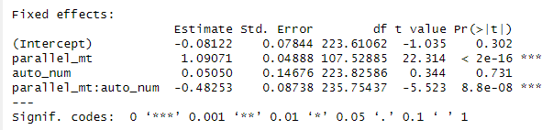
LMM

Slide 42
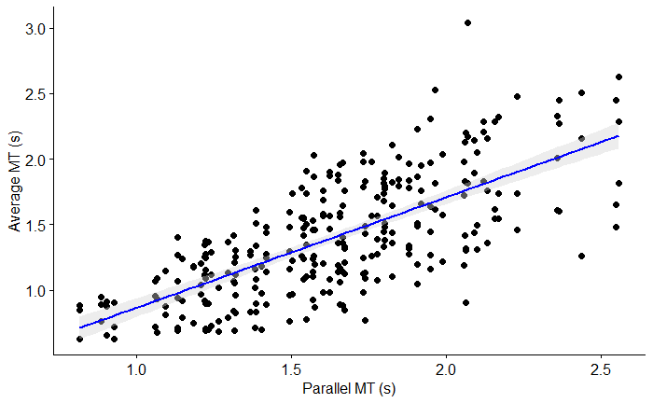
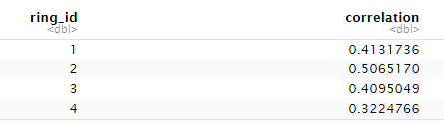
Correlation = 0.711

Slide 43
Parallel MT Prediction – Summary
- Slope of 1.09 suggests that taking the max of human and robot MTs is very slightly (almost not) underestimating the actual MT
- Interaction effect
Actual MT decreases to below the parallel model under higher robot autonomy
Since the human MT used in the parallel model uses the recorded “baseline” MT in the no autonomy trials, this means that higher robot assistance improves the human’s movement efficiency
- some

Slide 44
MDMT <-> Single-trust

Slide 45
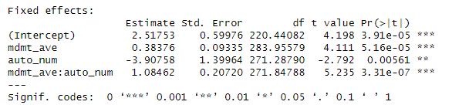
MDMT Single-trust - LMM

Slide 46
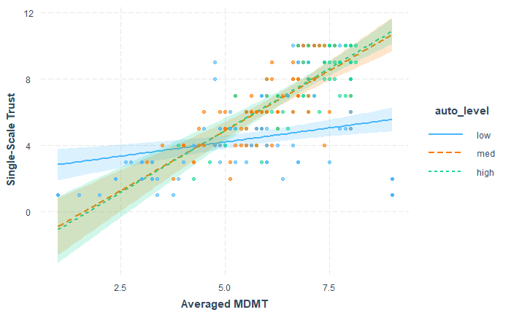
MDMT Single-trust – Interaction Plot

Slide 47
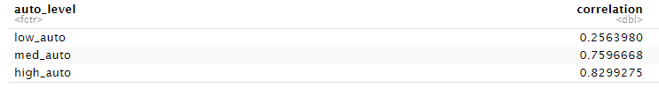
Correlation = 0.56

Slide 48
Effective ID <-> TLX

Slide 49
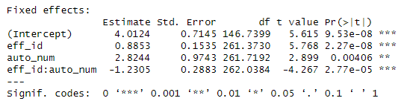
TLX Effective ID - LMM

Slide 50
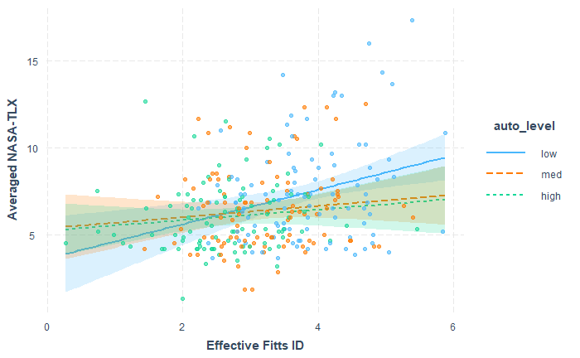
TLX Effective ID – Interaction Plot

Slide 51

Correlation = 0.26

Slide 52
Human Mean Velocity [y]

Slide 53
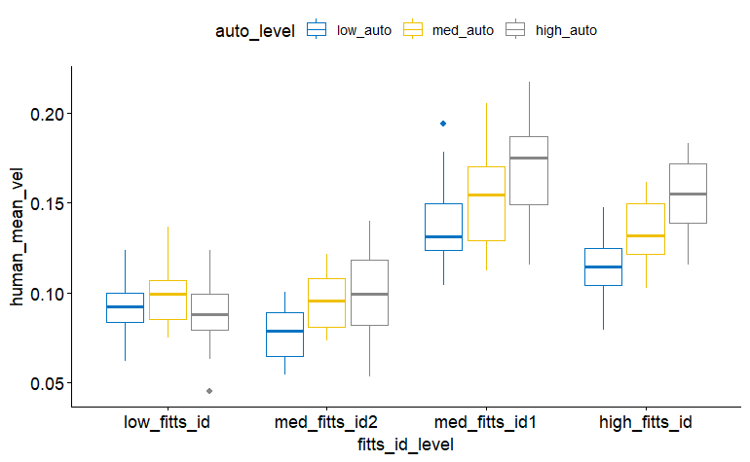

Slide 54
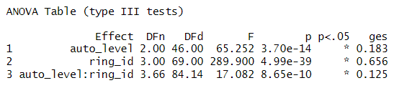
ANOVA

Slide 55
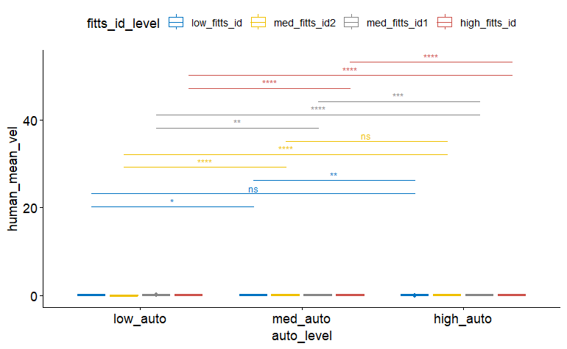
Pairwise (between autonomy levels for each difficulty)

Slide 56
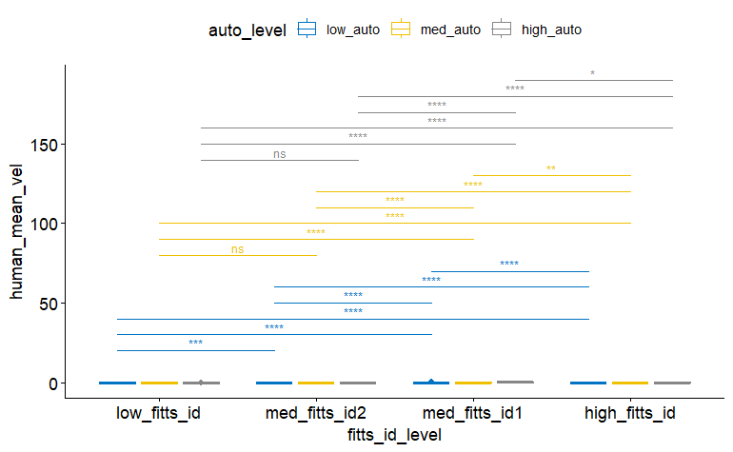
Pairwise (between difficulties for each autonomy)

Slide 57
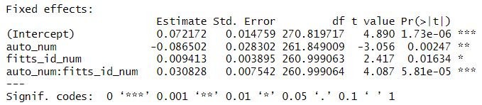
LMM

Slide 58
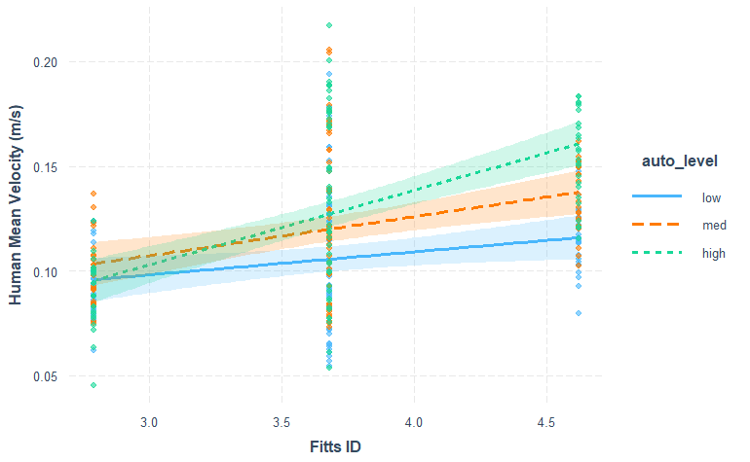
Interaction Plot

Slide 59
Human Mean Velocity – Summary
- ANOVA = Significant effect of both autonomy and difficulty, and interaction effect
Human moves faster under higher autonomy
Human moves faster in more difficult (larger amplitude) tasks
Interaction: The increase in mean velocity across more difficult tasks is greater for high autonomy level

Slide 60
Human-Robot Percent Overlap [y]

Slide 61
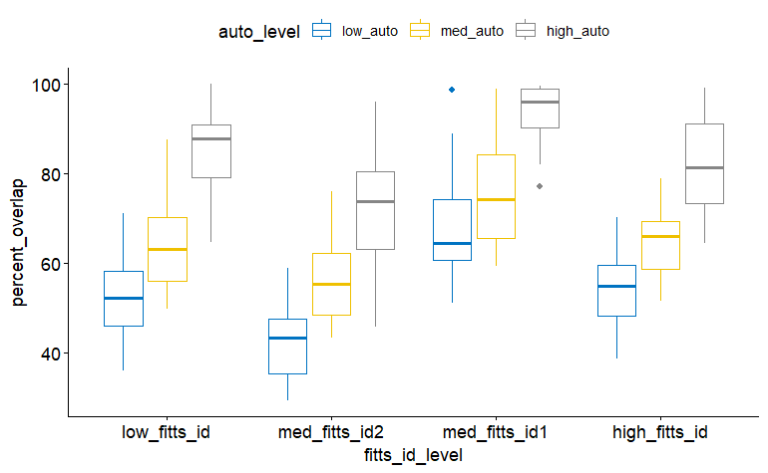

Slide 62
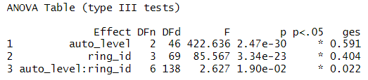
ANOVA

Slide 63
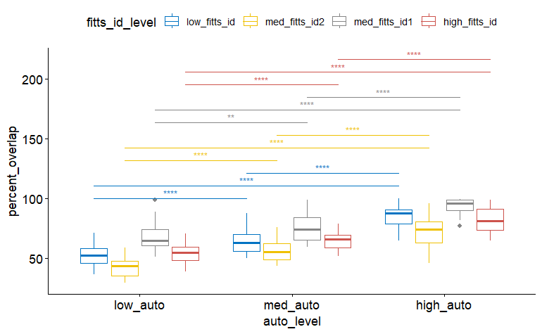
Pairwise (between autonomy levels for each difficulty)

Slide 64
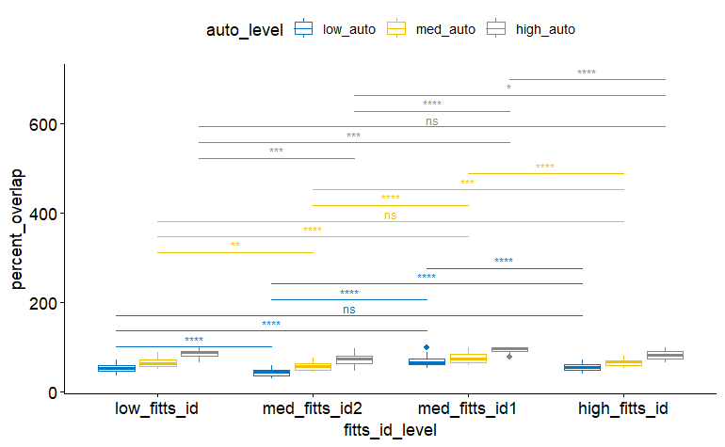
Pairwise (between difficulties for each autonomy)

Slide 65
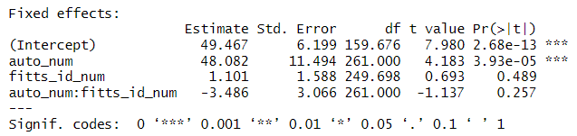
LMM

Slide 66
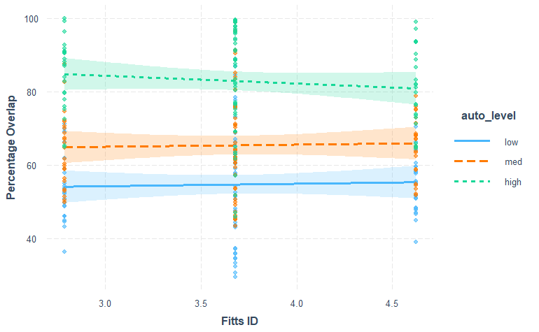
Interaction Plot

Slide 67
Human-Robot Percent Overlap – Summary
- ANOVA = Significant effect of both autonomy and difficulty, and interaction effect
Human more in sync with robot under higher autonomy
Smaller target causes the human to be less in sync with the robot, larger amplitude -> more in sync
Interaction

Slide 68
Robot Lead Human [y]
Average

Slide 69
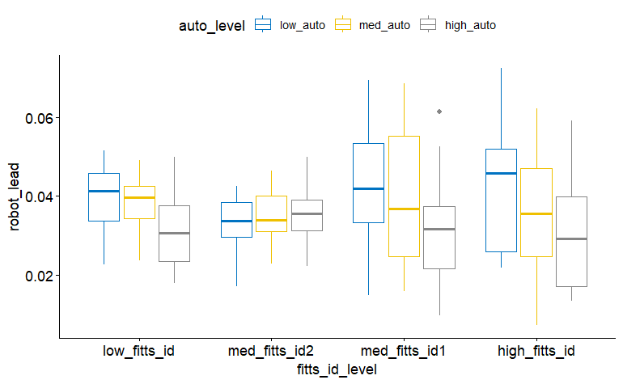

Slide 70
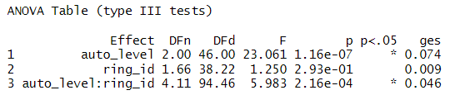
ANOVA

Slide 71
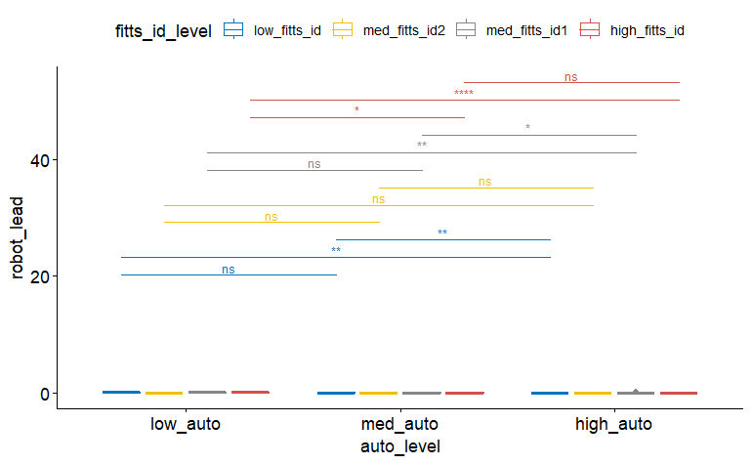
Pairwise (between autonomy levels for each difficulty)

Slide 72
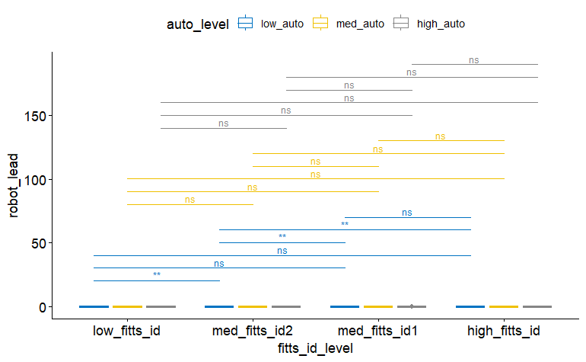
Pairwise (between difficulties for each autonomy)

Slide 73
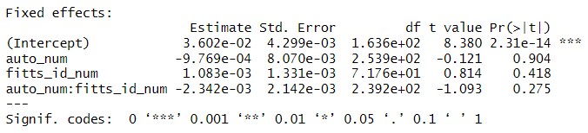
LMMs

Slide 74
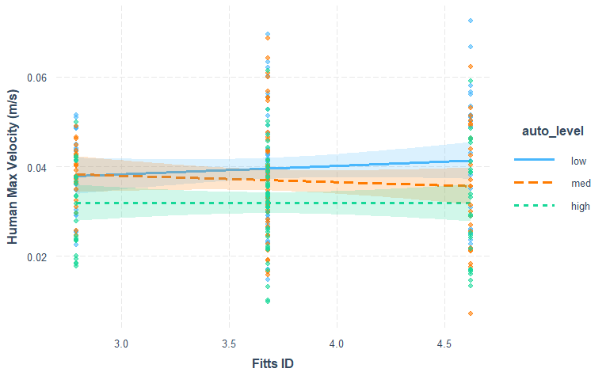
Interaction Plot

Slide 75
Robot Lead Human – Summary
- ANOVA = Significant effect of autonomy, and interaction effect
Human keeps up with robot better under higher autonomy
Effect more significant for higher difficulty? Or lower difficulty?

Slide 76
THE END

