Slide 1
Autonomy Fitts
Data analysis - results

Slide 2
List of (interesting) measures
Move Times
NASA-TLX Averaged
NASA-TLX (how hard? Mental demand, Physical demand, How successful?)
MDMT Averaged
Pupil index
Single-scale trust
Perceived autonomy
Effective ID
Effective Autonomy
ARF Human ID
ARF Human Fitts Law

Slide 3
Move Times [y]

Slide 4
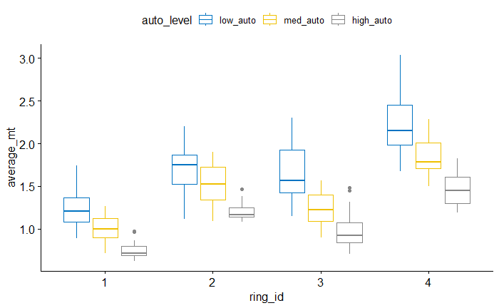
Move Times

Slide 5
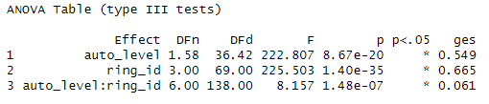
Move Times - ANOVA

Slide 6
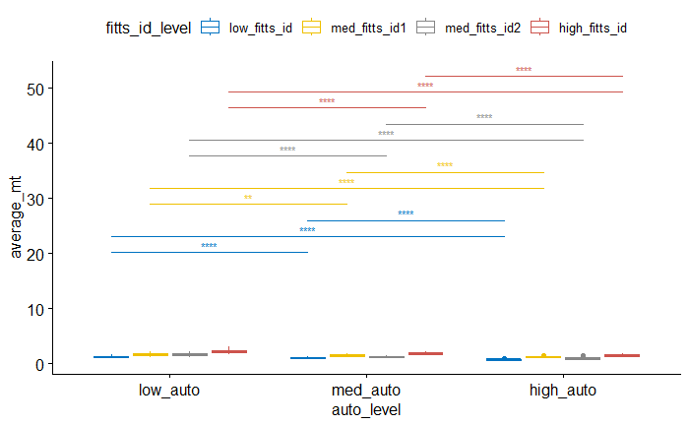
Pairwise (between autonomy levels for each difficulty)

Slide 7
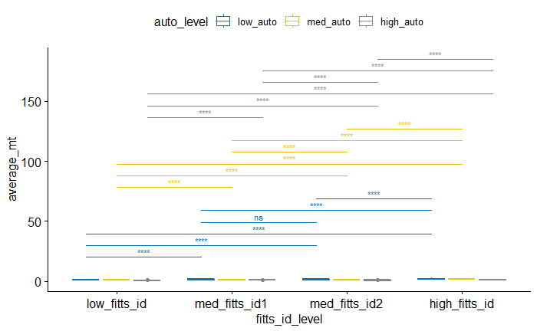
Pairwise (between difficulties for each autonomy)

Slide 8
Between rings 2 and 3
- no difference for {low} autonomy
- difference for {med, high} autonomy

Slide 9
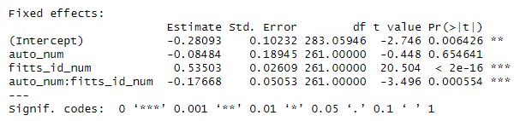
Move Times - LMM

Slide 10
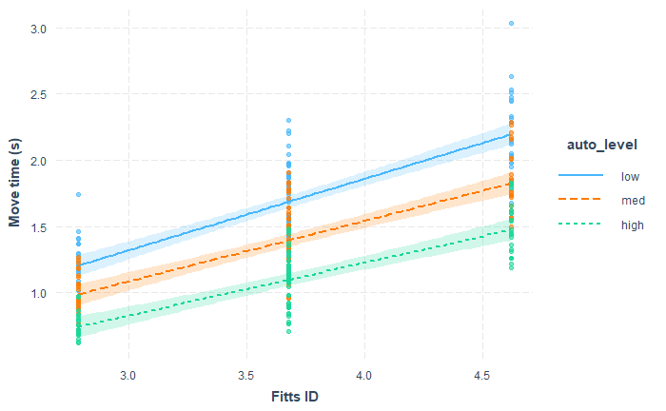
Move Times – Interaction Plot

Slide 11
Move time - Summary
- Follows Fitts Law under 0 autonomy (rings 2 and 3 are non-diff only for 0 autonomy)
- Interaction effect
higher autonomy yields greater decrease in movement times for more difficulty rings
Higher difficulty yield less increase in movement time under higher autonomy
- Adapted Fitts equation accounting for robot autonomy

Slide 12
NASA-TLX Averaged [y]

Slide 13
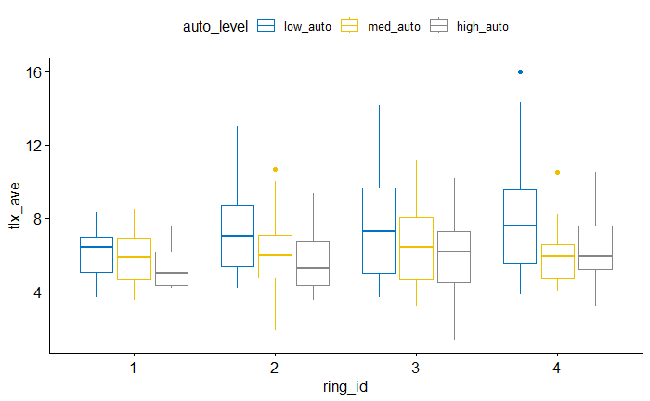

Slide 14
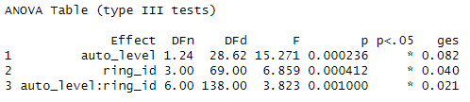
ANOVA

Slide 15
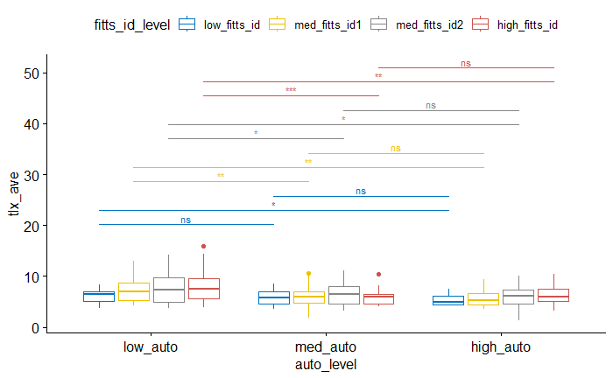
Pairwise (between autonomy levels for each difficulty)

Slide 16
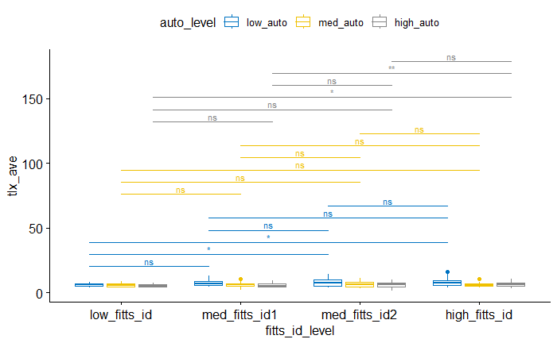
Pairwise (between difficulties for each autonomy)

Slide 17
Between rings 2 and 3
- no difference for {low, med, high} autonomy

Slide 18
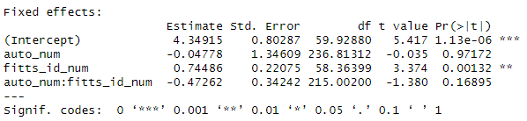
LMM

Slide 19
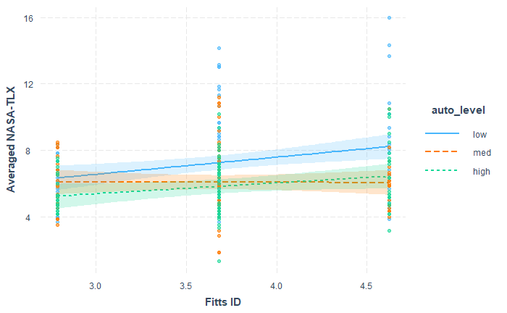
Interaction Plot

Slide 20
NASA-TLX (Averaged) – Summary
- No difference between {med, high} autonomy for all difficulty levels
40% and 80% robot assistance yield the same level of perceived cognitive load across all rings
- No difference in all pairs of difficulty levels for medium autonomy
Under 40% robot assistance, the perceived differences in difficulty were most saturated (human the most adaptive)
- Significant positive slope of movement time against difficulty level, no interaction effect

Slide 21
NASA-TLX (How hard did you have to work?) [y]

Slide 22
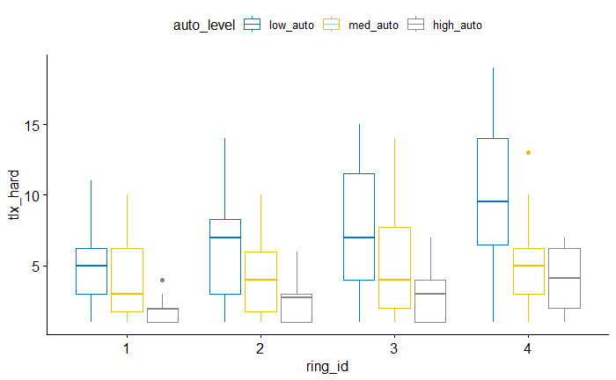

Slide 23
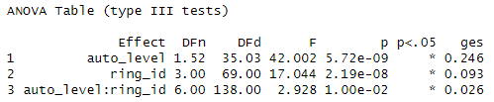
ANOVA

Slide 24
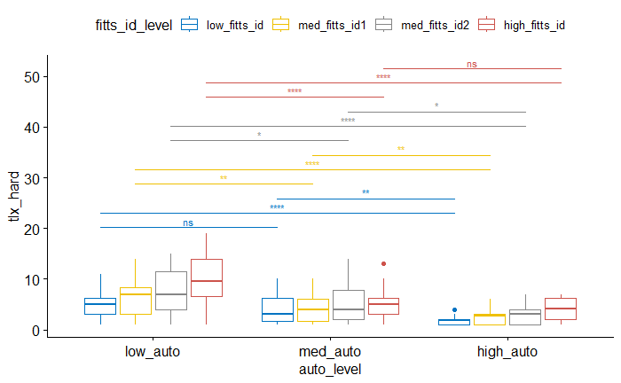
Pairwise (between autonomy levels for each difficulty)

Slide 25
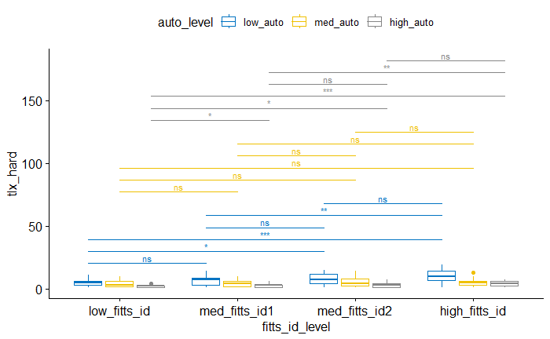
Pairwise (between difficulties for each autonomy)

Slide 26
Between rings 2 and 3
- no difference for {low, med, high} autonomy

Slide 27
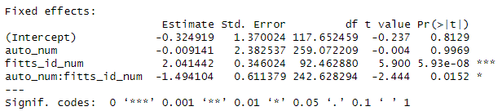
LMM

Slide 28
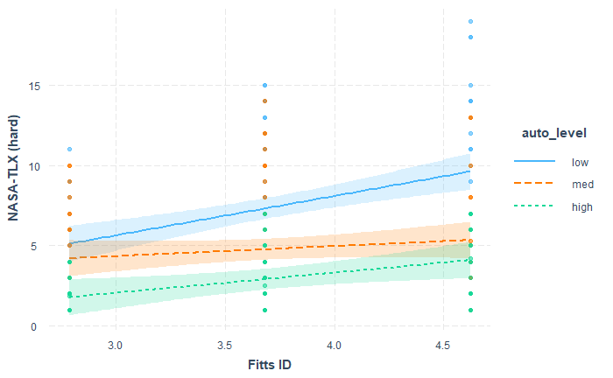
Interaction Plot

Slide 29
NASA-TLX (how hard?) - Summary
- [ONLY] No difference between {low, med} autonomy for easiest ring, no different between {med, high} autonomy for hardest ring.
Ring 1 is too easy such that people found 40% robot assistance to be no more helpful than 0 assistance
Ring 4 is too hard such that people found 80% robot assistance to be no more helpful than 40%
- No difference in all pairs of difficulty levels for medium autonomy
- Interaction effect
Higher autonomy yields more decrease in perceived effort for more difficulty rings
More difficult rings yield less increase in perceived effort under higher autonomy

Slide 30
NASA-TLX (How hurried was pace of task?) [n]

Slide 31
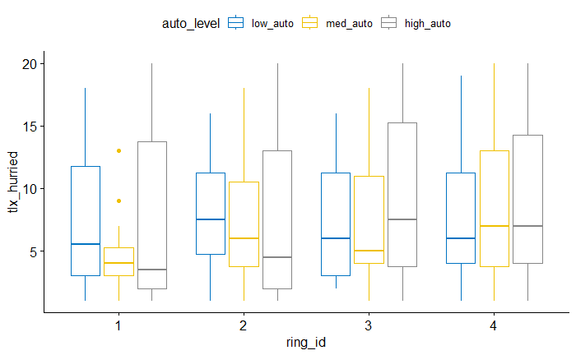

Slide 32
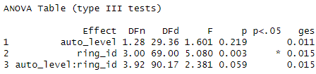
ANOVA

Slide 33
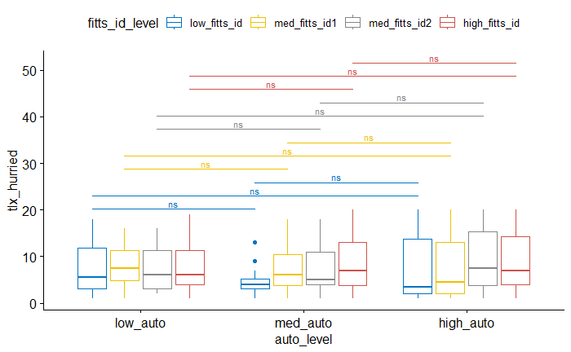
Pairwise (between autonomy levels for each difficulty)

Slide 34
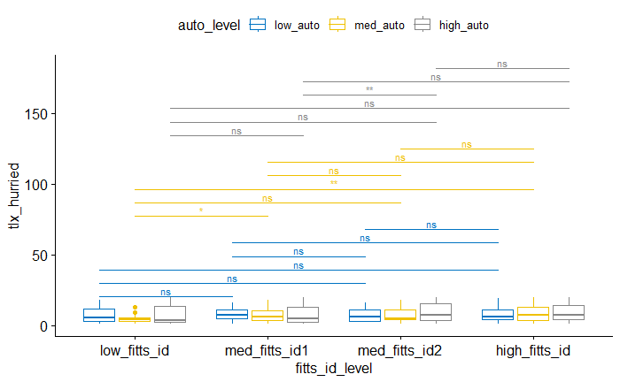
Pairwise (between difficulties for each autonomy)

Slide 35
Between rings 2 and 3
- no difference for {low, med} autonomy
- difference for {high} autonomy

Slide 36
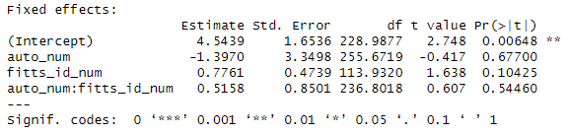
LMM

Slide 37
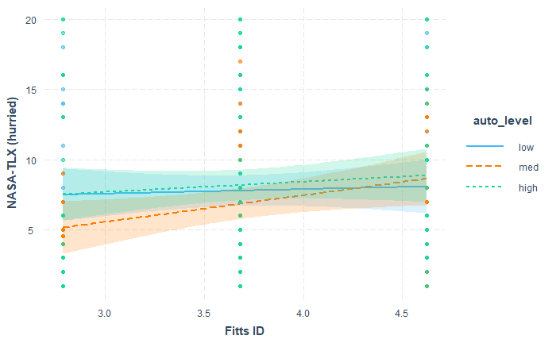
Interaction Plot

Slide 38
NASA-TLX (How insecure did feel?) [n]

Slide 39
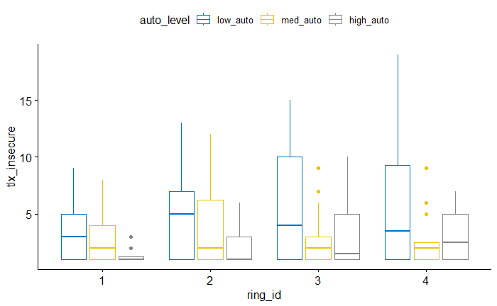

Slide 40
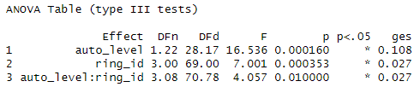
ANOVA

Slide 41
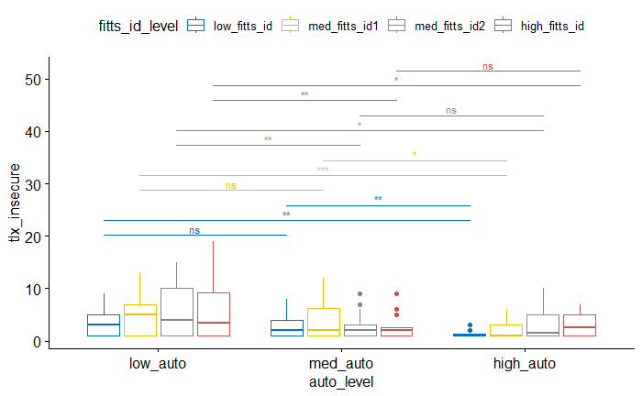
Pairwise (between autonomy levels for each difficulty)

Slide 42
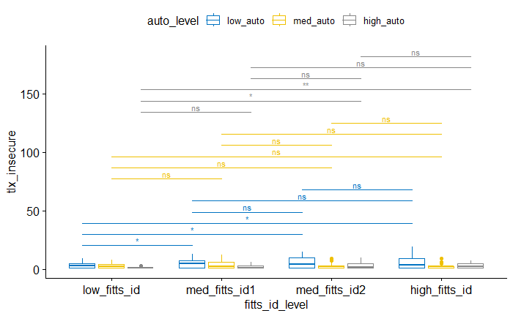
Pairwise (between difficulties for each autonomy)

Slide 43
Between rings 2 and 3
- no difference for {low, med, high} autonomy

Slide 44
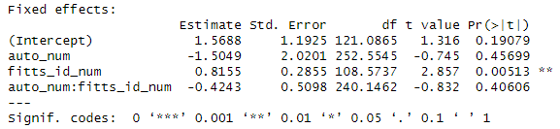
LMM

Slide 45
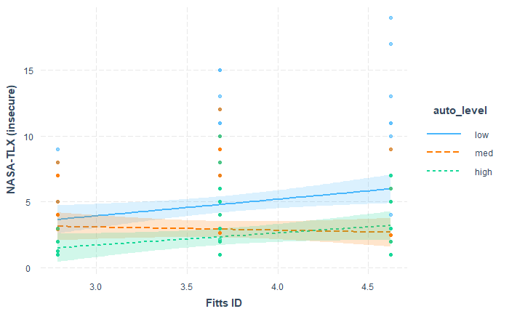
Interaction Plot

Slide 46
NASA-TLX (Mental demand?) [y]

Slide 47
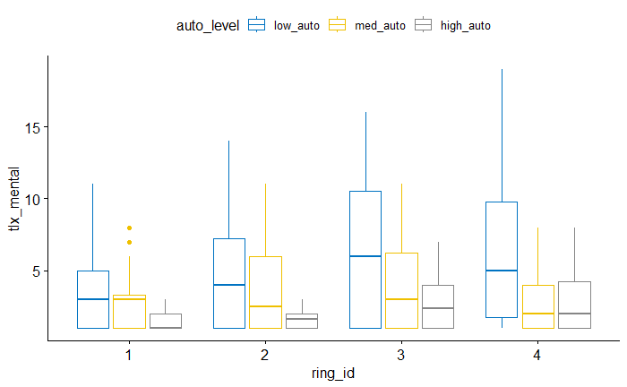

Slide 48
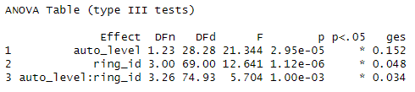
ANOVA

Slide 49
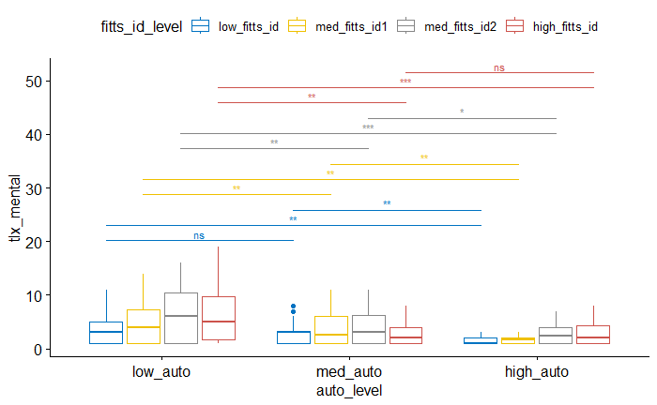
Pairwise (between autonomy levels for each difficulty)

Slide 50
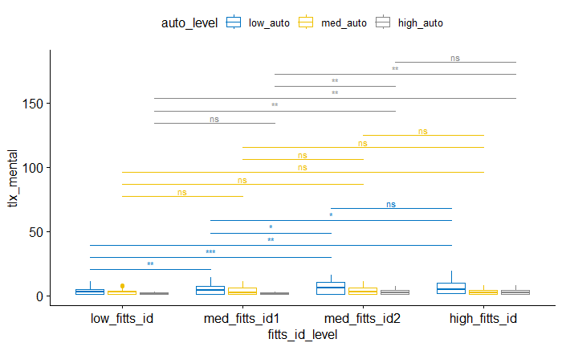
Pairwise (between difficulties for each autonomy)

Slide 51
Between rings 2 and 3
- no difference for {med} autonomy
- difference for {low, high} autonomy

Slide 52
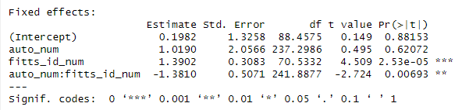
LMM

Slide 53
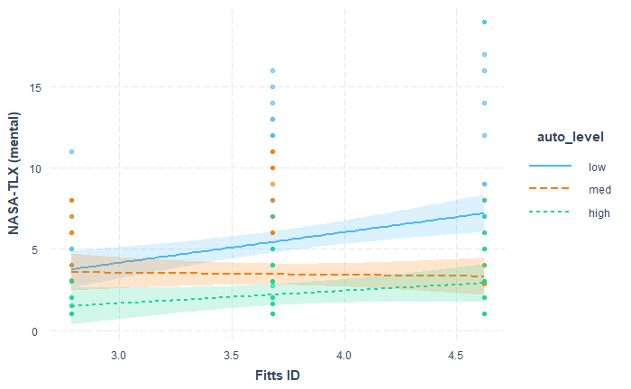
Interaction Plot

Slide 54
NASA-TLX (mental demand) - Summary
- [ONLY] No difference between {low, med} autonomy for easiest ring, no different between {med, high} autonomy for hardest ring.
Ring 1 is too easy such that people found 40% robot assistance to be no more helpful than 0 assistance
Ring 4 is too hard such that people found 80% robot assistance to be no more helpful than 40%
- No difference in all pairs of difficulty levels for medium autonomy
- Interaction effect
Higher autonomy yields more decrease in perceived mental demand for more difficulty rings
More difficult rings yield less increase in perceived mental demand under higher autonomy

Slide 55
NASA-TLX (physical demand) [y]

Slide 56
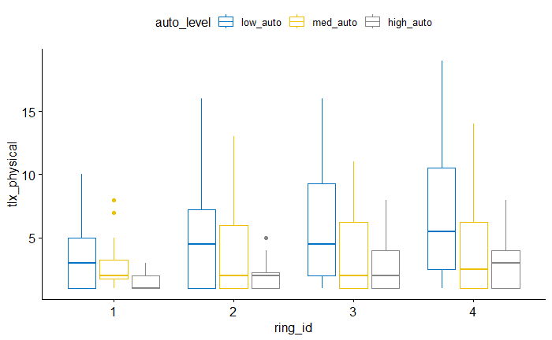

Slide 57
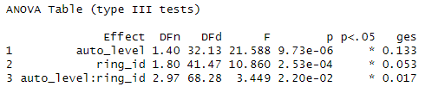
ANOVA

Slide 58
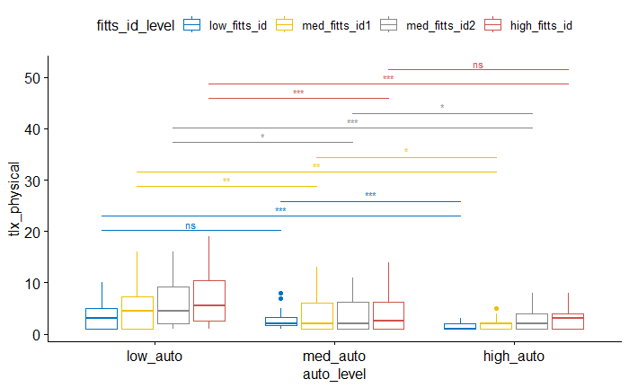
Pairwise (between autonomy levels for each difficulty)

Slide 59
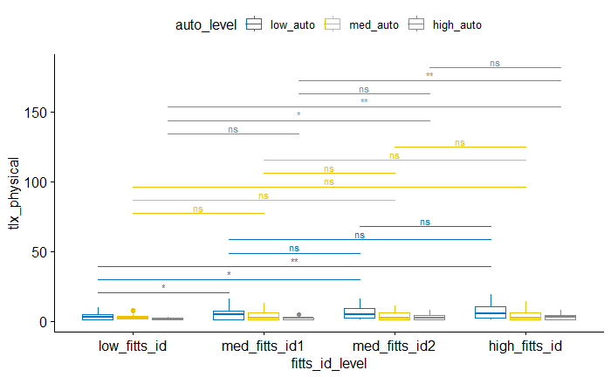
Pairwise (between difficulties for each autonomy)

Slide 60
Between rings 2 and 3
- no difference for {low, med, high} autonomy

Slide 61
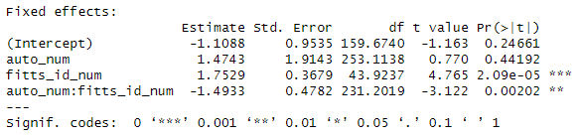
LMM

Slide 62
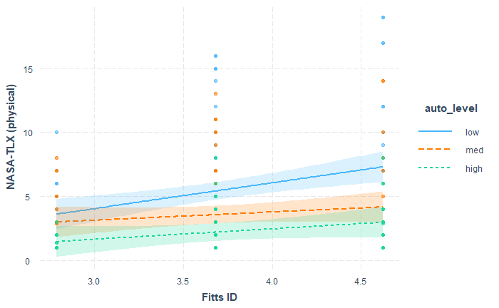
Interaction Plot

Slide 63
NASA-TLX (physical demand) - Summary
- [ONLY] No difference between {low, med} autonomy for easiest ring, no different between {med, high} autonomy for hardest ring.
Ring 1 is too easy such that people found 40% robot assistance to be no more helpful than 0 assistance
Ring 4 is too hard such that people found 80% robot assistance to be no more helpful than 40%
- No difference in all pairs of difficulty levels for medium autonomy
- Interaction effect
Higher autonomy yields more decrease in perceived physical demand for more difficulty rings
More difficult rings yield less increase in perceived physical demand under higher autonomy

Slide 64
NASA-TLX (How successful?) [y]

Slide 65
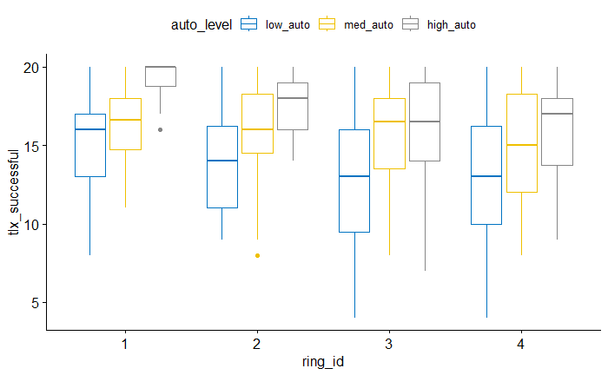

Slide 66
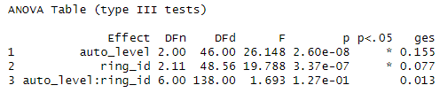
ANOVA

Slide 67
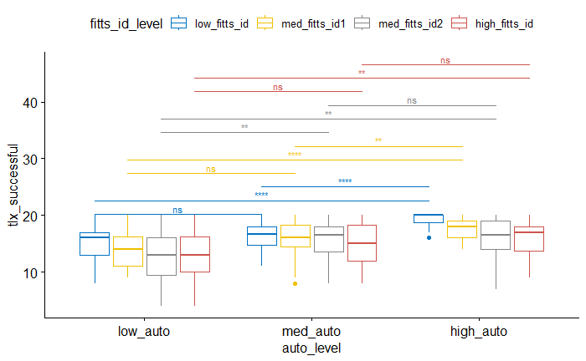
Pairwise (between autonomy levels for each difficulty)

Slide 68
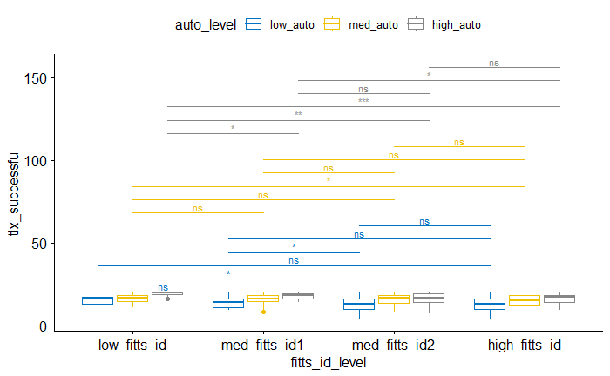
Pairwise (between difficulties for each autonomy)

Slide 69
Between rings 2 and 3
- no difference for {med, high} autonomy
- difference for {low} autonomy

Slide 70
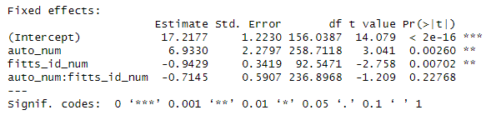
LMM

Slide 71
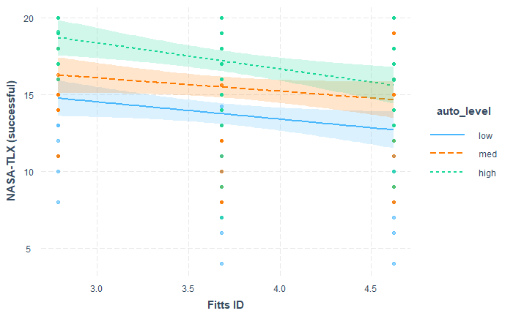
Interaction Plot

Slide 72
NASA-TLX (how successful?) - Summary
- No difference in all pairs of difficulty levels for medium autonomy (except between easiest and hardest rings)
- Significant increase in perceived success under higher autonomy
- Significant decrease in perceived success for higher difficulty
- No interaction

Slide 73
MDMT Averaged [y]

Slide 74
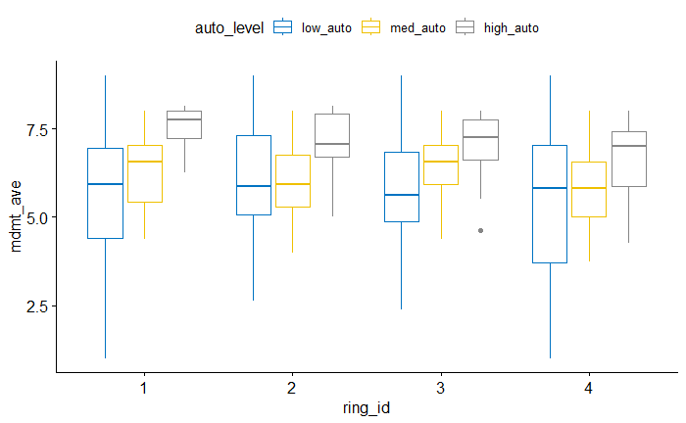

Slide 75
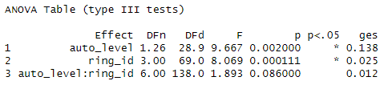
ANOVA

Slide 76

Pairwise (between autonomy levels for each difficulty)

Slide 77

Pairwise (between difficulties for each autonomy)

Slide 78
Between rings 2 and 3
- no difference for {low, med, high} autonomy

Slide 79

LMM

Slide 80

Interaction Plot

Slide 81
MDMT (Averaged) – Summary
- No difference in Trust between {low, med} autonomy for all difficulty levels
40% robot assistance is no more trustworthy than 0 assistance for all rings
However, 80% assistance is significantly more trustworthy than both 0% and 40%, EXCEPT for the most difficult ring, where no assistance and 80% assistance are trusted the same
- No difference in trust for all pairs of difficulty levels under both {low, medium} autonomy levels, EXCEPT between rings 3 and 4 for medium autonomy
- Marginally significant interaction effect
Higher robot assistance yields less increase in trust for more difficulty tasks
Higher difficulty yields more decrease in trust for higher autonomy [INTERESTING]

Slide 82
MDMT Capable Averaged [n]

Slide 83


Slide 84

ANOVA

Slide 85

Pairwise (between autonomy levels for each difficulty)

Slide 86

Pairwise (between difficulties for each autonomy)

Slide 87
Between rings 2 and 3
- no difference for {low, med, high} autonomy

Slide 88

LMM

Slide 89

Interaction Plot

Slide 90
MDMT Reliable Averaged [n]

Slide 91


Slide 92

ANOVA

Slide 93

Pairwise (between autonomy levels for each difficulty)

Slide 94

Pairwise (between difficulties for each autonomy)

Slide 95
Between rings 2 and 3
- no difference for {low, med, high} autonomy

Slide 96

LMM

Slide 97

Interaction Plot

Slide 98
Pupil Index [y]

Slide 99


Slide 100

ANOVA

Slide 101

Pairwise (between autonomy levels for each difficulty)

Slide 102

Pairwise (between difficulties for each autonomy)

Slide 103
Between rings 2 and 3
- no difference for {low, med, high} autonomy

Slide 104

LMM

Slide 105

Interaction Plot

Slide 106
Pupil Index – Summary
- No nothing!

Slide 107
Single-Scale Trust [y]

Slide 108


Slide 109

ANOVA

Slide 110

Pairwise (between autonomy levels for each difficulty)

Slide 111

Pairwise (between difficulties for each autonomy)

Slide 112
Between rings 2 and 3
- no difference for {low, med, high} autonomy

Slide 113

LMM

Slide 114

Interaction Plot

Slide 115
Single-Scale Trust – Summary
- All pairs of difficulty levels had no significant effect on trust for each autonomy level
- Significant increase in trust for higher robot autonomy
- Significant decrease in trust for higher task difficulty
- No interaction

Slide 116
Perceived Autonomy [y]

Slide 117


Slide 118

ANOVA

Slide 119

Pairwise (between autonomy levels for each difficulty)

Slide 120

Pairwise (between difficulties for each autonomy)

Slide 121
Between rings 2 and 3
- no difference for {low, med, high} autonomy

Slide 122

LMM

Slide 123

Interaction Plot

Slide 124
Perceived Autonomy – Summary
- All pairs of autonomy levels are significantly different for each difficulty level
- No difference for all pairs of difficulty level under {low, med} autonomy
- Marginally significant interaction effect
Higher autonomy yield less increase in perceived autonomy for more difficult tasks
Higher difficulty yield more decrease in perceived autonomy under higher autonomy

Slide 125
Effective ID [y]
Calculated through linear regression of ID -> MT under no autonomy

Slide 126


Slide 127

ANOVA

Slide 128

Pairwise (between autonomy levels for each difficulty)

Slide 129

Pairwise (between difficulties for each autonomy)

Slide 130
Between rings 2 and 3
- no difference for {low, high} autonomy
- difference for {med} autonomy

Slide 131

LMM

Slide 132

Interaction Plot

Slide 133


Correlation = 0.723

Slide 134
Effective ID - Summary
- Significant positive slope (approximately 1) of Effective ID against actual ID
- Interaction effect
Higher autonomy yield more decrease in effective ID for more difficulty tasks
Higher difficulty yield less increase in effective ID under higher autonomy
- Strong correlations between ID and Effective ID (for each autonomy level) and overall

Slide 135
Effective Autonomy [y]
Calculated through the parameter which blends the recorded human and robot times

Slide 136


Slide 137

ANOVA

Slide 138

Pairwise (between autonomy levels for each difficulty)

Slide 139

Pairwise (between difficulties for each autonomy)

Slide 140
Between rings 2 and 3
- no difference for {low, med} autonomy
- difference for {high} autonomy

Slide 141

LMM

Slide 142

Interaction Plot

Slide 143


Correlation = 0.881

Slide 144
Effective Autonomy – Summary
- Significant effect of Autonomy on Effective autonomy for all difficulty levels
- Effective autonomy not different for difficulty levels, EXCEPT for the ring pairs (1, 3), (1, 4), (2, 3), (2, 4)
- No significant interaction, however, upon visual inspection, under high autonomy, the effective autonomy follows a decreasing trend across increasing difficulty
For harder rings, people find it more difficult to keep up (be in sync) with high robot autonomy, well, simply because the robot goes at constant velocity and does not follow typical Fitts
- Strong correlation between autonomy and effective autonomy (for each difficulty level) and overall

Slide 145
ARF (After Robot Finishes) Human ID [y]

Slide 146


Slide 147

ANOVA

Slide 148

Pairwise (between autonomy levels for each difficulty)

Slide 149

Pairwise (between difficulties for each autonomy)

Slide 150

LMM

Slide 151

Interaction Plot

Slide 152
ARF Human ID – Summary
- ANOVA = Significant effect of both autonomy and difficulty on ARF Human ID, no interaction effect
Higher autonomy gets human closer to the target (for the same width)
Higher difficulty results in higher remaining difficulty level
- LMM = only significant positive slope of ARF ID against ID

Slide 153
ARF Fitts Regression [y]
ARF Human move time ~ ARF Human ID

Slide 154

LMM

Slide 155

Interaction Plot

Slide 156


Correlation = 0.75

Slide 157
ARF Fitts Regression – Summary
- Fitts Law holds => Higher ARF ID predicts higher ARF time
- Interaction effect
Higher ARF ID yields less increase in ARF time under higher robot autonomy
Higher robot autonomy (assistance) improves user movement efficiency / throughput (i.e. user is in sync with the robot)
- Strong correlation between ARF time and ARF ID (for each autonomy level) and overall

Slide 159

ANOVA
Additional Correlations

Slide 160
Predicted <-> Actual ARF Move Time [y]
Predicted using ARF id and the {a, b} regressed from zero-autonomy trials

Slide 161

LMM

Slide 162

MDMT Single-trust – Interaction Plot

Slide 163


Correlation = 0.704

Slide 164
Serial (sum) vs. Average MT [y]

Slide 165

LMM

Slide 166


Correlation = 0.737

Slide 167
Serial MT Prediction – Summary
- Slope of 0.67 suggests that summing human and robot MTs is overestimating (almost double) the actual MT
- Interaction effect
Actual MT moves even further away (decreases) from the serial model under higher robot autonomy
Higher robot autonomy leads to participant being more in-sync with the robot
- some

Slide 168
Parallel (max) vs. Average MT [y]

Slide 169

LMM

Slide 170


Correlation = 0.711

Slide 171
Parallel MT Prediction – Summary
- Slope of 1.09 suggests that taking the max of human and robot MTs is very slightly (almost not) underestimating the actual MT
- Interaction effect
Actual MT decreases to below the parallel model under higher robot autonomy
Since the human MT used in the parallel model uses the recorded “baseline” MT in the no autonomy trials, this means that higher robot assistance improves the human’s movement efficiency
- some

Slide 172
MDMT <-> Single-trust

Slide 173

MDMT Single-trust - LMM

Slide 174

MDMT Single-trust – Interaction Plot

Slide 175

Correlation = 0.56

Slide 176
Effective ID <-> TLX

Slide 177

TLX Effective ID - LMM

Slide 178

TLX Effective ID – Interaction Plot

Slide 179

Correlation = 0.26

Slide 180
THE END

