Slide 1
Autonomy Fitts
Data analysis - results

Slide 2
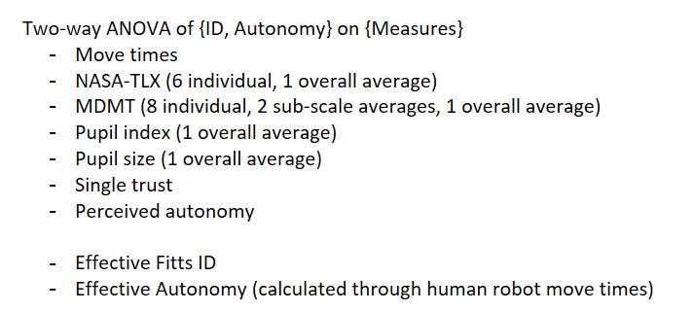
ANOVA

Slide 3
Move Times

Slide 4
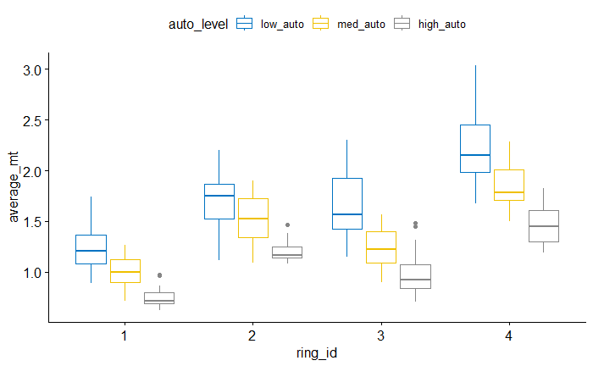
Move Times

Slide 5
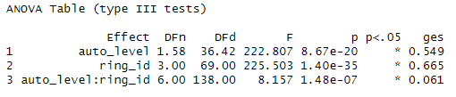
Move Times - ANOVA

Slide 6
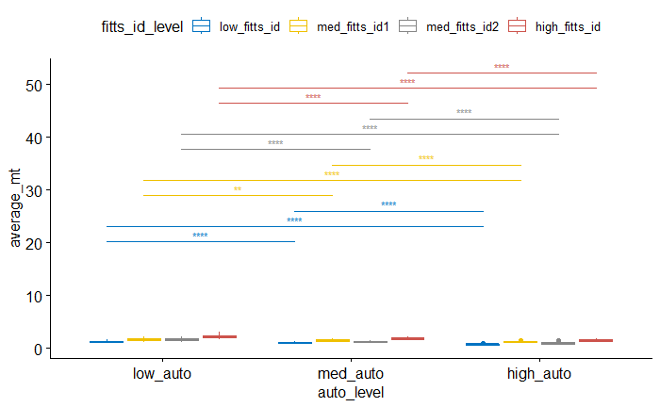
Pairwise (between autonomy levels for each difficulty)

Slide 7
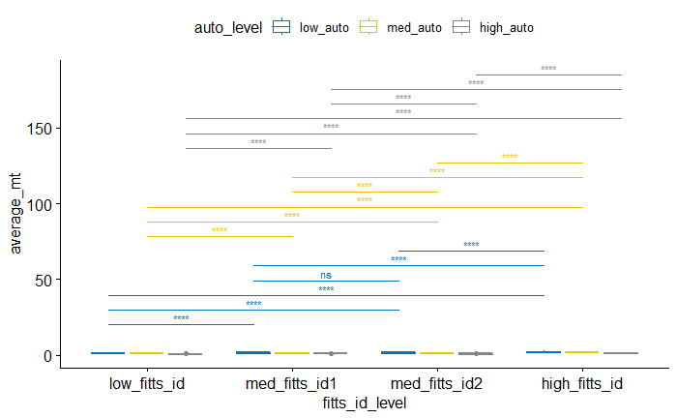
Pairwise (between difficulties for each autonomy)

Slide 8
Between rings 2 and 3
- no difference for {low} autonomy
- difference for {med, high} autonomy

Slide 9
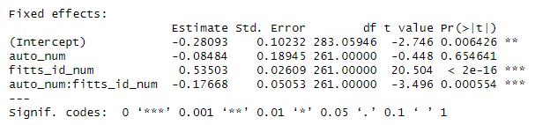
Move Times - LMM

Slide 10
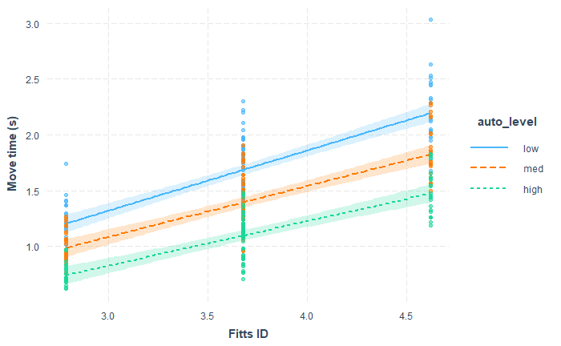
Move Times – Interaction Plot

Slide 11
NASA-TLX Averaged

Slide 12
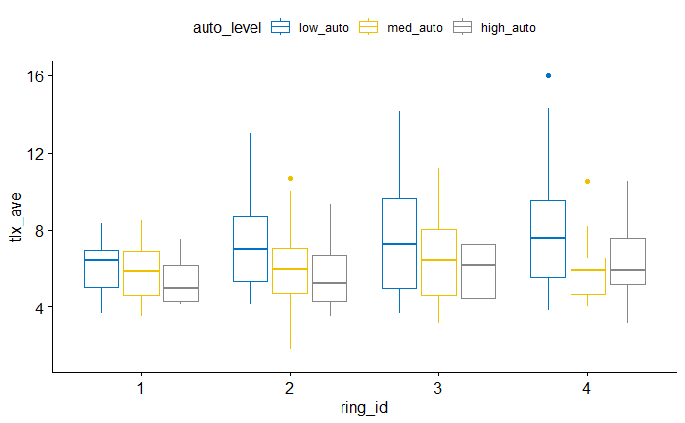

Slide 13
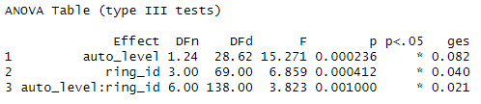
ANOVA

Slide 14
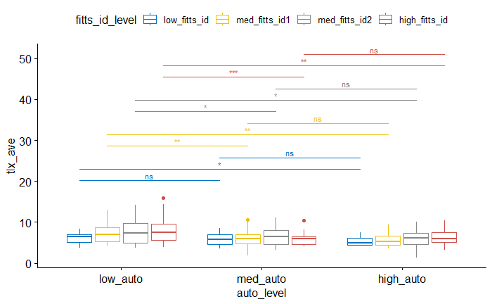
Pairwise (between autonomy levels for each difficulty)

Slide 15
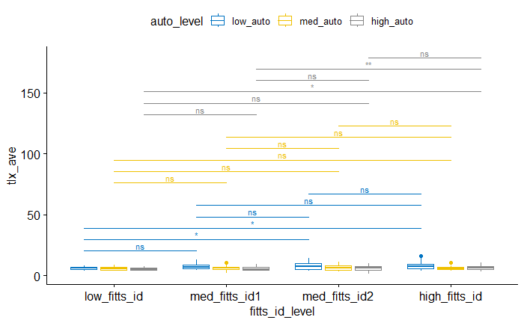
Pairwise (between difficulties for each autonomy)

Slide 16
Between rings 2 and 3
- no difference for {low, med, high} autonomy

Slide 17
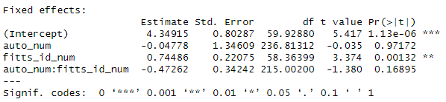
LMM

Slide 18
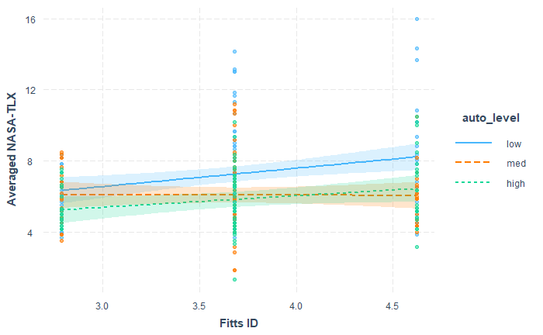
Interaction Plot

Slide 19
NASA-TLX (How hard did you have to work?)

Slide 20
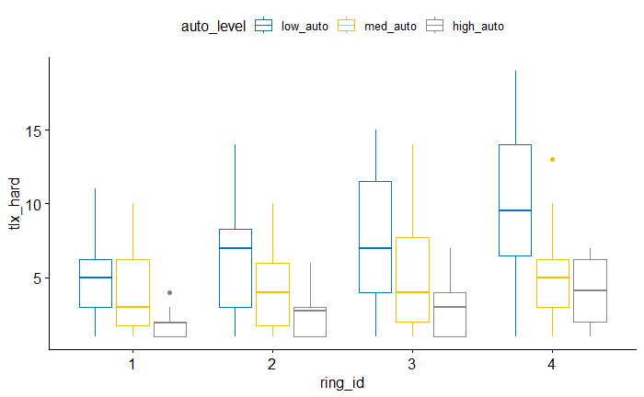

Slide 21
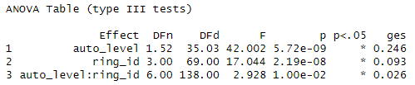
ANOVA

Slide 22
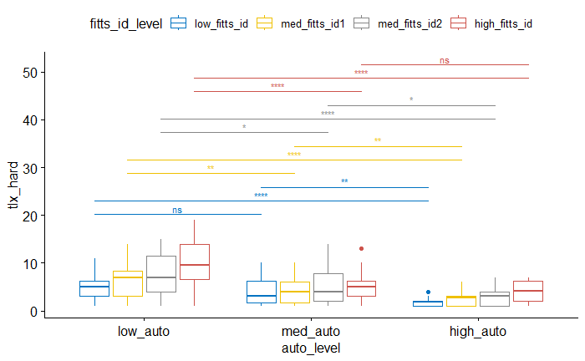
Pairwise (between autonomy levels for each difficulty)

Slide 23
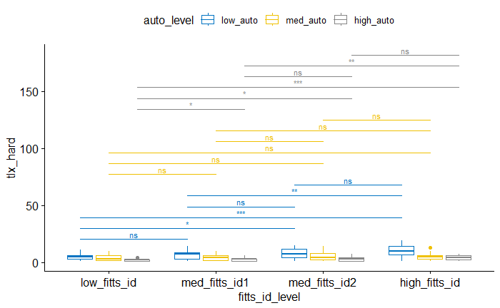
Pairwise (between difficulties for each autonomy)

Slide 24
Between rings 2 and 3
- no difference for {low, med, high} autonomy

Slide 25
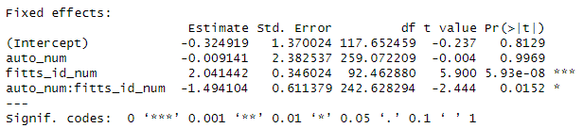
LMM

Slide 26
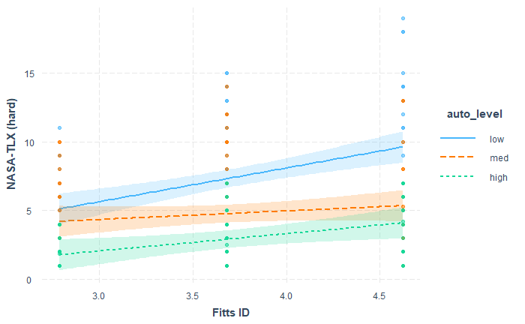
Interaction Plot

Slide 27
NASA-TLX (How hurried was the pace of task?)

Slide 28
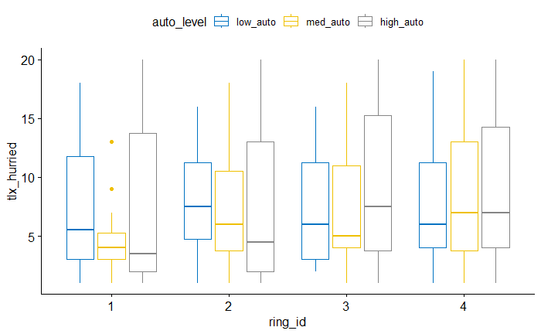

Slide 29
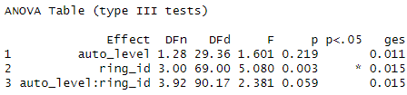
ANOVA

Slide 30
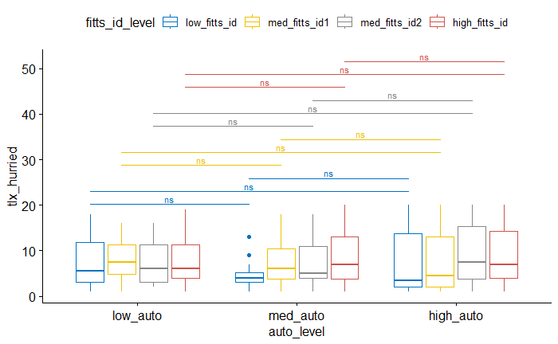
Pairwise (between autonomy levels for each difficulty)

Slide 31
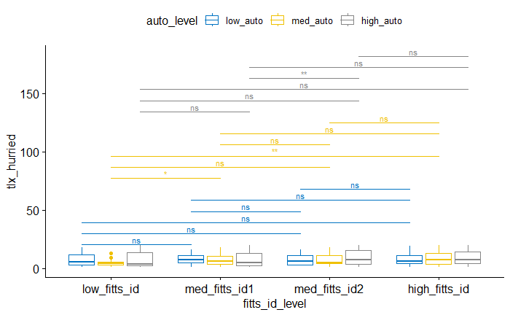
Pairwise (between difficulties for each autonomy)

Slide 32
Between rings 2 and 3
- no difference for {low, med} autonomy
- difference for {high} autonomy

Slide 33
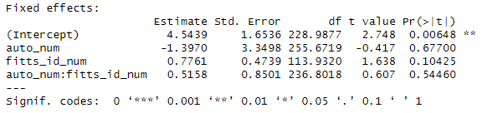
LMM

Slide 34
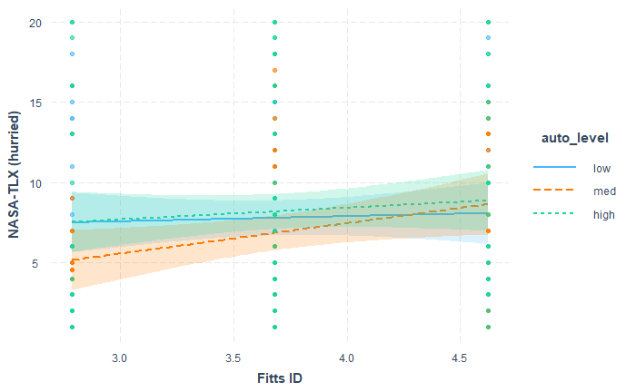
Interaction Plot

Slide 35
NASA-TLX (How insecure did you feel?)

Slide 36
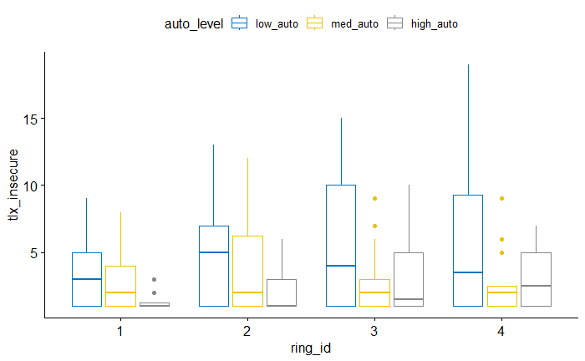

Slide 37
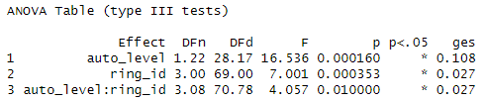
ANOVA

Slide 38
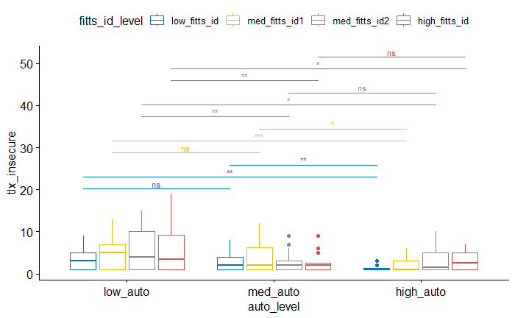
Pairwise (between autonomy levels for each difficulty)

Slide 39
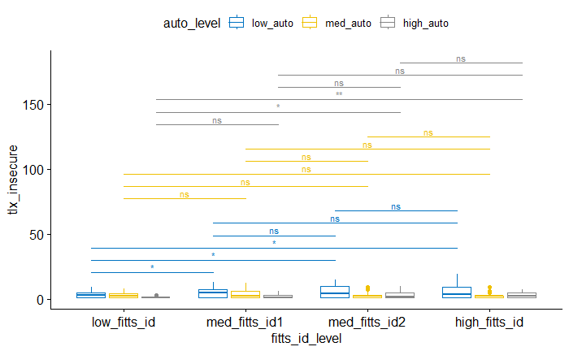
Pairwise (between difficulties for each autonomy)

Slide 40
Between rings 2 and 3
- no difference for {low, med, high} autonomy

Slide 41
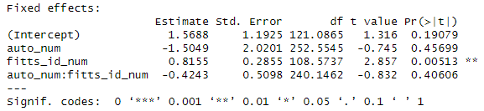
LMM

Slide 42
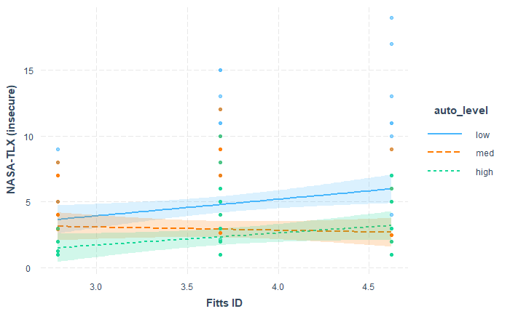
Interaction Plot

Slide 43
NASA-TLX (How mentally demanding?)

Slide 44
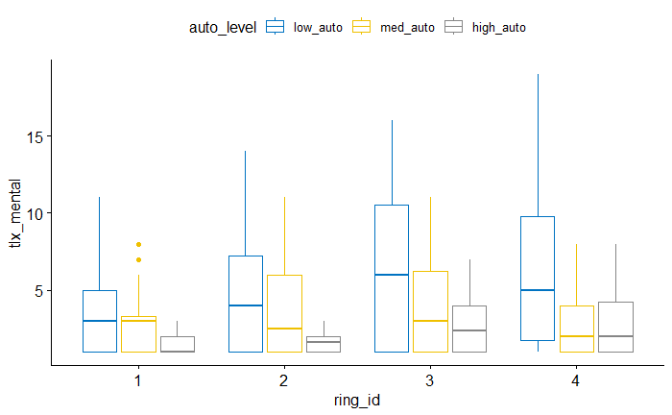

Slide 45
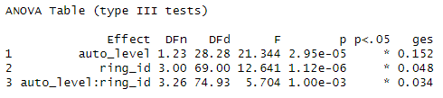
ANOVA

Slide 46
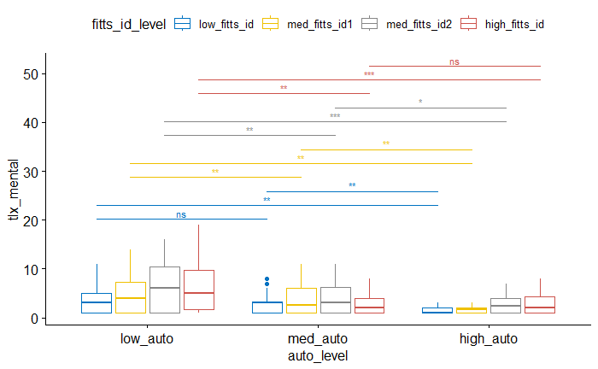
Pairwise (between autonomy levels for each difficulty)

Slide 47
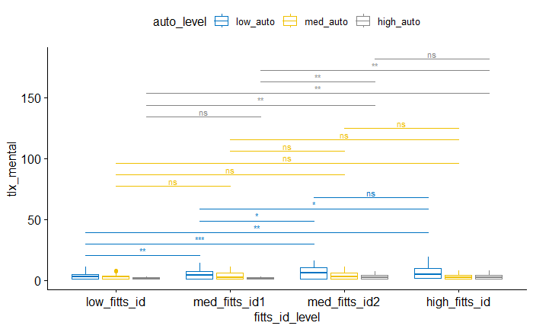
Pairwise (between difficulties for each autonomy)

Slide 48
Between rings 2 and 3
- no difference for {med} autonomy
- difference for {low, high} autonomy

Slide 49
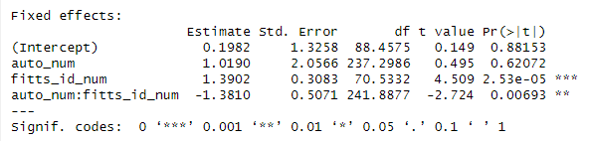
LMM

Slide 50
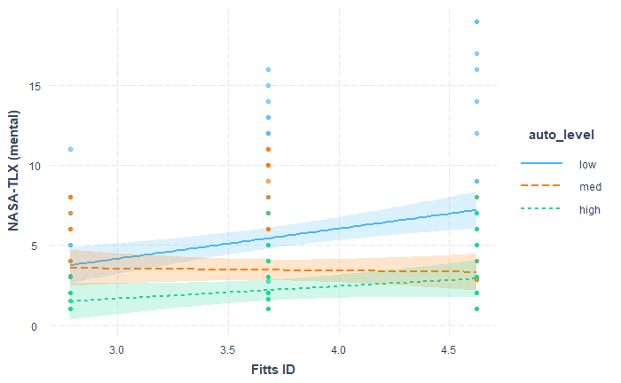
Interaction Plot

Slide 51
NASA-TLX (How physically demanding?)

Slide 52
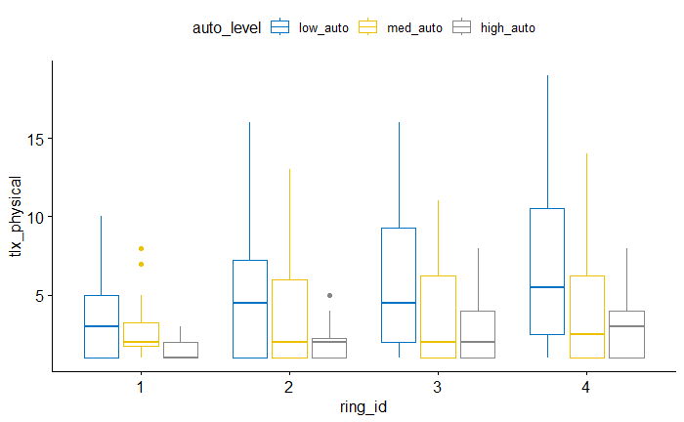

Slide 53
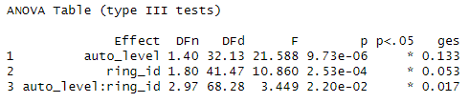
ANOVA

Slide 54
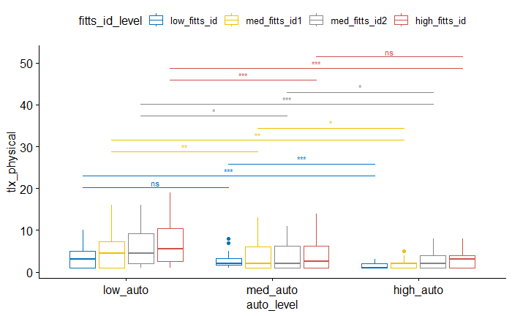
Pairwise (between autonomy levels for each difficulty)

Slide 55
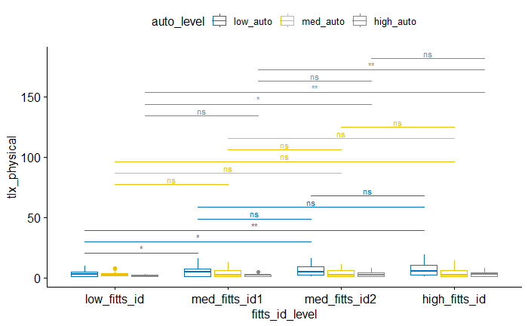
Pairwise (between difficulties for each autonomy)

Slide 56
Between rings 2 and 3
- no difference for {low, med, high} autonomy

Slide 57
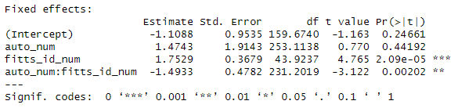
LMM

Slide 58
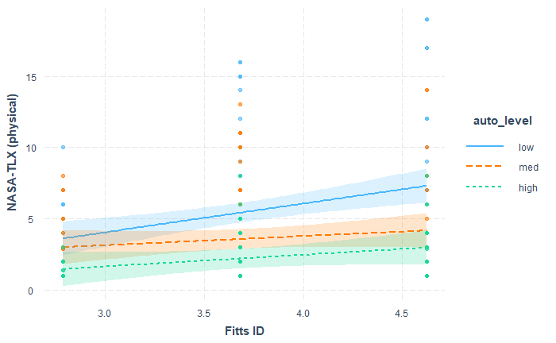
Interaction Plot

Slide 59
NASA-TLX (How successful were you?)

Slide 60
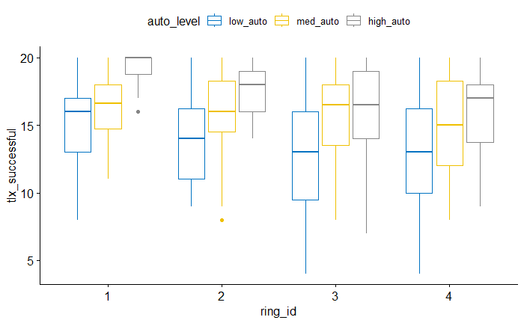

Slide 61
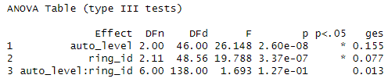
ANOVA

Slide 62
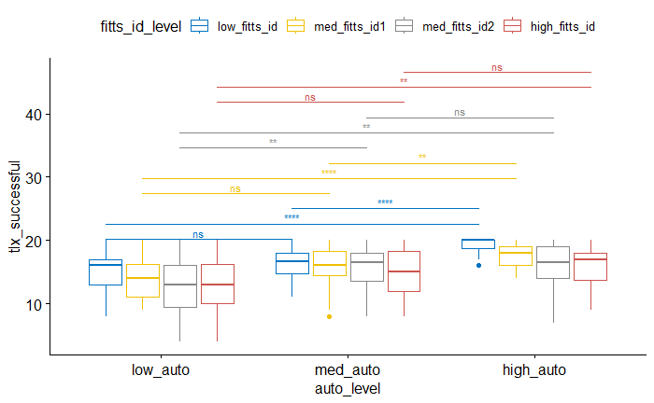
Pairwise (between autonomy levels for each difficulty)

Slide 63
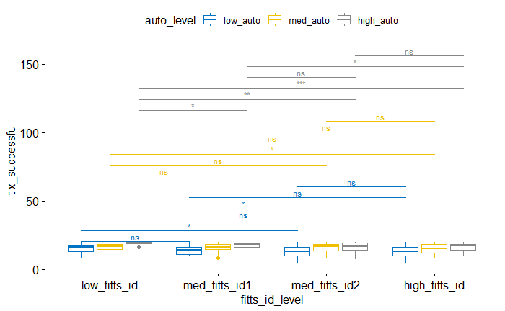
Pairwise (between difficulties for each autonomy)

Slide 64
Between rings 2 and 3
- no difference for {med, high} autonomy
- difference for {low} autonomy

Slide 65
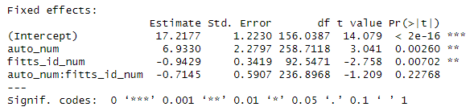
LMM

Slide 66
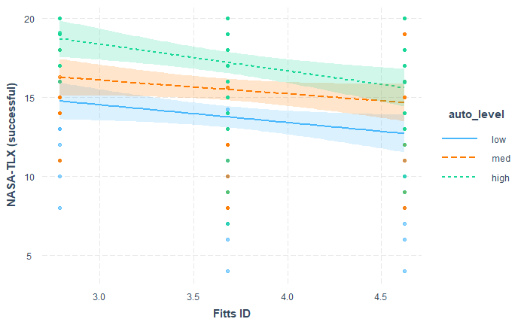
Interaction Plot

Slide 67
MDMT Averaged

Slide 68
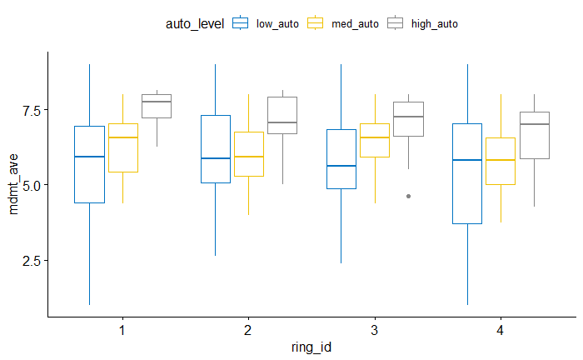

Slide 69

ANOVA

Slide 70

Pairwise (between autonomy levels for each difficulty)

Slide 71

Pairwise (between difficulties for each autonomy)

Slide 72
Between rings 2 and 3
- no difference for {low, med, high} autonomy

Slide 73

LMM

Slide 74

Interaction Plot

Slide 75
MDMT Capable Averaged

Slide 76


Slide 77

ANOVA

Slide 78

Pairwise (between autonomy levels for each difficulty)

Slide 79

Pairwise (between difficulties for each autonomy)

Slide 80
Between rings 2 and 3
- no difference for {low, med, high} autonomy

Slide 81

LMM

Slide 82

Interaction Plot

Slide 83
MDMT Reliable Averaged

Slide 84


Slide 85

ANOVA

Slide 86

Pairwise (between autonomy levels for each difficulty)

Slide 87

Pairwise (between difficulties for each autonomy)

Slide 88
Between rings 2 and 3
- no difference for {low, med, high} autonomy

Slide 89

LMM

Slide 90

Interaction Plot

Slide 91
Pupil Index

Slide 92


Slide 93

ANOVA

Slide 94

Pairwise (between autonomy levels for each difficulty)

Slide 95

Pairwise (between difficulties for each autonomy)

Slide 96
Between rings 2 and 3
- no difference for {low, med, high} autonomy

Slide 97

LMM

Slide 98

Interaction Plot

Slide 99
Single-Scale Trust

Slide 100


Slide 101

ANOVA

Slide 102

Pairwise (between autonomy levels for each difficulty)

Slide 103

Pairwise (between difficulties for each autonomy)

Slide 104
Between rings 2 and 3
- no difference for {low, med, high} autonomy

Slide 105

LMM

Slide 106

Interaction Plot

Slide 107
Perceived Autonomy

Slide 108


Slide 109

ANOVA

Slide 110

Pairwise (between autonomy levels for each difficulty)

Slide 111

Pairwise (between difficulties for each autonomy)

Slide 112
Between rings 2 and 3
- no difference for {low, med, high} autonomy

Slide 113

LMM

Slide 114

Interaction Plot

Slide 115
Effective ID
Calculated through linear regression of ID -> MT under no autonomy

Slide 116


Slide 117

ANOVA

Slide 118

Pairwise (between autonomy levels for each difficulty)

Slide 119

Pairwise (between difficulties for each autonomy)

Slide 120
Between rings 2 and 3
- no difference for {low, high} autonomy
- difference for {med} autonomy

Slide 121

LMM

Slide 122

Interaction Plot

Slide 123


Correlation = 0.723

Slide 124
Effective Autonomy
Calculated through the parameter which blends the recorded human and robot times

Slide 125


Slide 126

ANOVA

Slide 127

Pairwise (between autonomy levels for each difficulty)

Slide 128

Pairwise (between difficulties for each autonomy)

Slide 129
Between rings 2 and 3
- no difference for {low, med} autonomy
- difference for {high} autonomy

Slide 130

LMM

Slide 131

Interaction Plot

Slide 132


Correlation = 0.881

Slide 134

ANOVA
Additional Correlations

Slide 135
MDMT <-> Single-trust

Slide 136

MDMT Single-trust - LMM

Slide 137

MDMT Single-trust – Interaction Plot

Slide 138

Correlation = 0.56

Slide 139
Effective ID <-> TLX

Slide 140

TLX Effective ID - LMM

Slide 141

TLX Effective ID – Interaction Plot

Slide 142

Correlation = 0.26

Slide 143
THE END

