Slide 1
Study 2 Results
Summary

Slide 2
Note
For the conditions, “yes” = with HumanVertical visualization, “no” = without visualization
Tests = {repeated measures ANOVA, mixed ANOVA (within condition + between order), paired sample t-test between multiple levels}

Slide 3
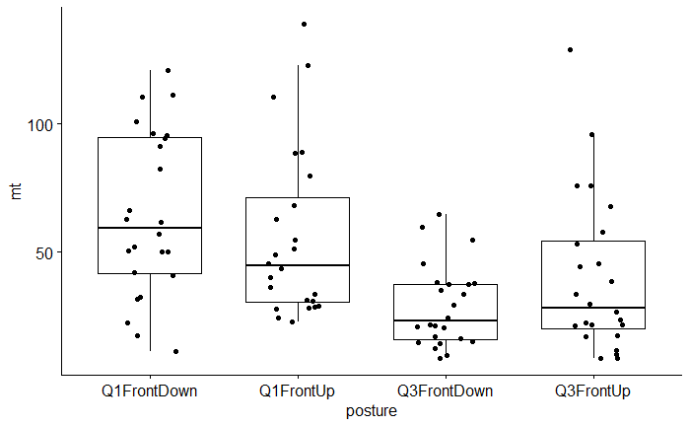
1. Posture -> Movement time

Slide 4

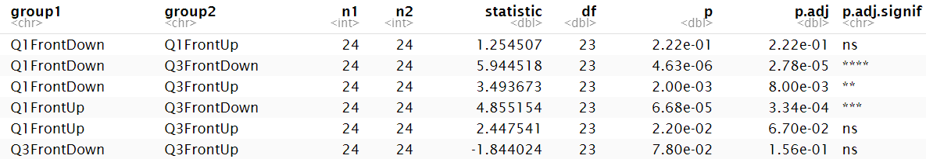
1. Posture -> Movement time

Slide 5
1. Posture -> Movement time
“Q1FrontDown” (elbow up, wrist down) seemed to be the most difficult / time-comsuming posture (also from the qual feedback)
Q1 postures (elbow up) seemed to be generally harder / more time-consuming than Q3 postures (elbow down)

Slide 6
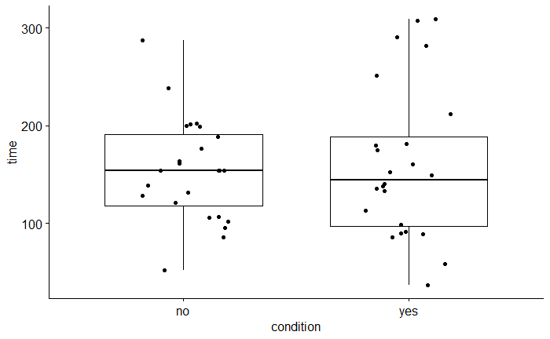
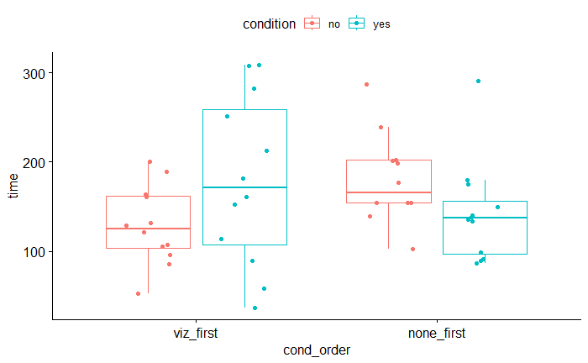
2. Viz -> Movement time

Slide 7


2. Viz -> Movement time

Slide 8
2. Viz -> Movement time
No clear effect of visualization on movement time
When shown viz first, mt decreased when shown no_viz after (learning)
When shown no_viz first, mt did not have significant improvement when shown viz after

Slide 9
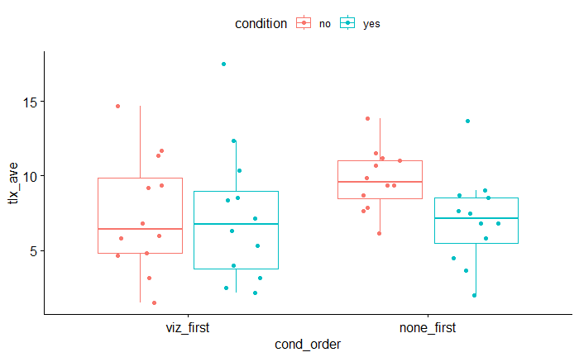
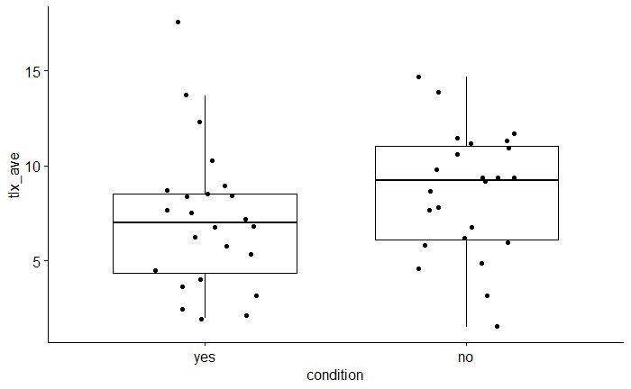
3. Viz -> TLX (average)

Slide 10

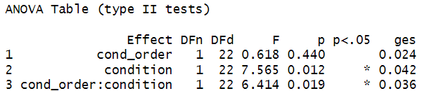
3. Viz -> TLX (average)

Slide 11
3. Viz -> TLX (average)
Visualization resulted in lower perceived cognitive load
When shown viz first, load did not significantly increase when shown no_viz after
When shown no_viz first, load significantly decreased when shown viz after

Slide 12
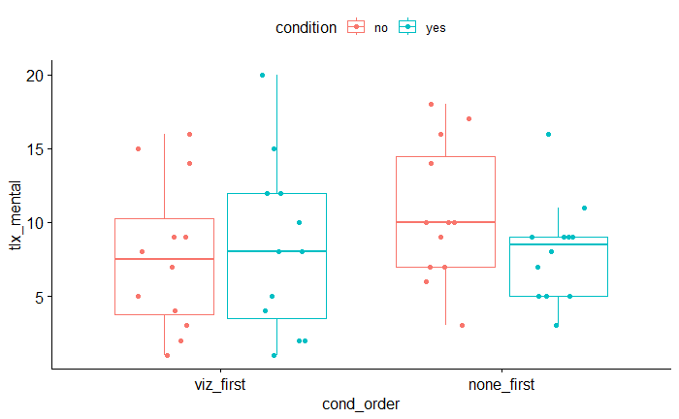
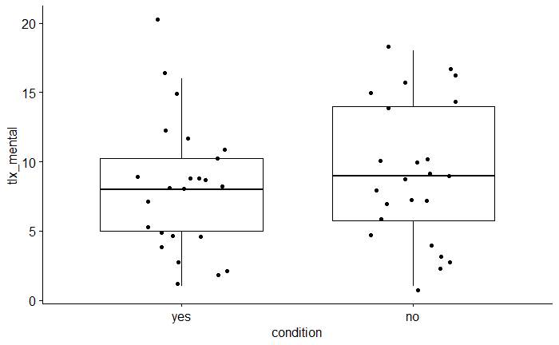
3. Viz -> TLX (how mentally demanding)

Slide 13
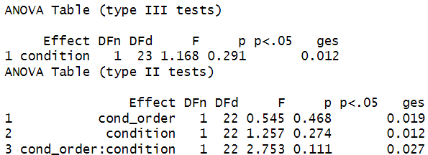
3. Viz -> TLX (how mentally demanding)

Slide 14
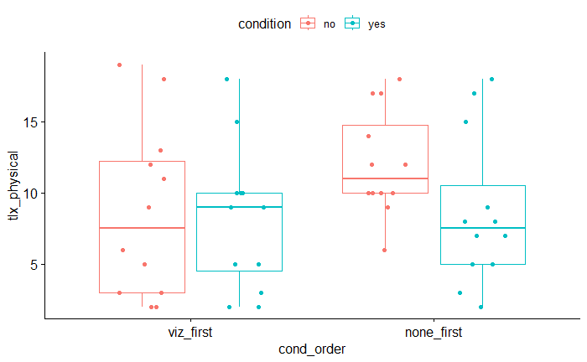
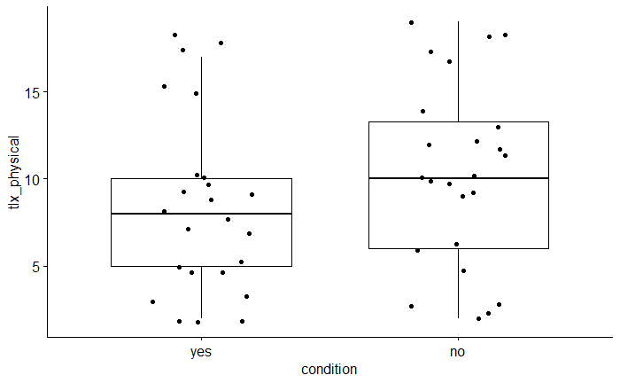
3. Viz -> TLX (how physically demanding)

Slide 15
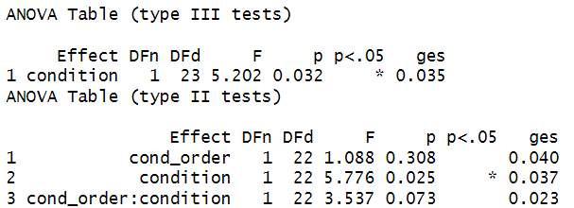
3. Viz -> TLX (how physically demanding)

Slide 16
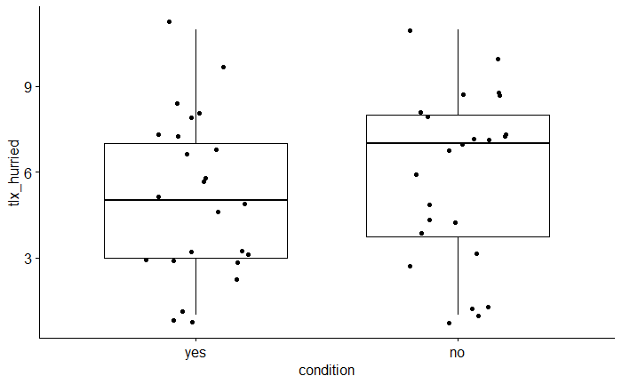
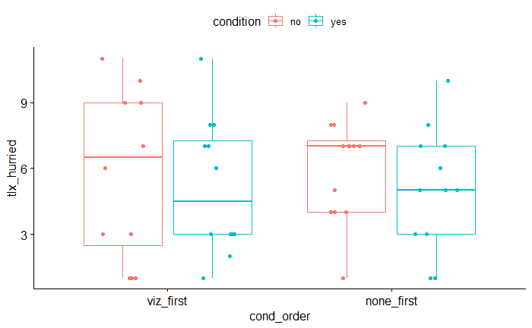
3. Viz -> TLX (how hurried)

Slide 17
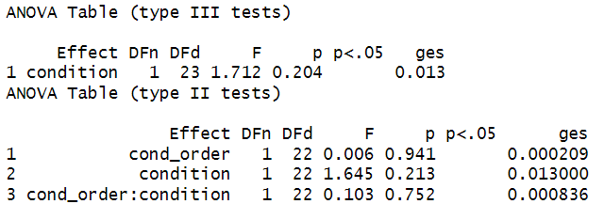
3. Viz -> TLX (how hurried)

Slide 18
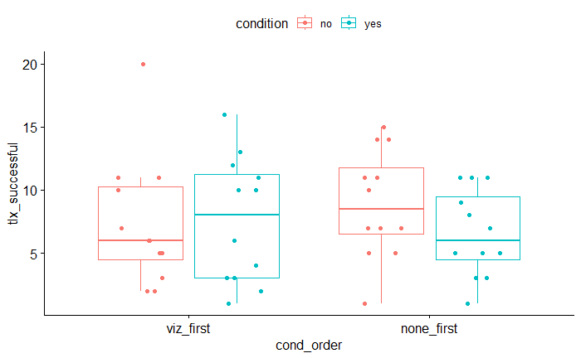
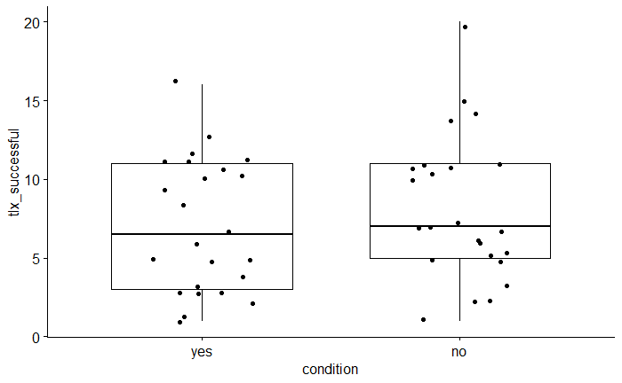
3. Viz -> TLX (21- how successful)

Slide 19
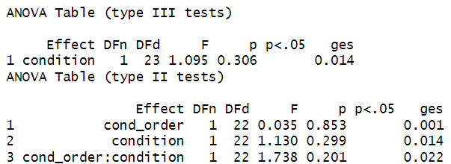
3. Viz -> TLX (21- how successful)

Slide 20
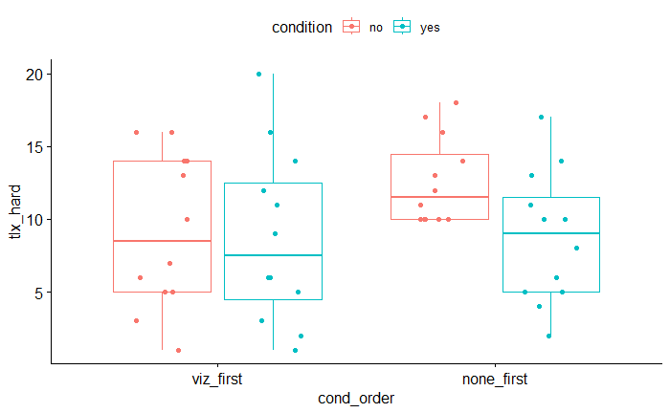
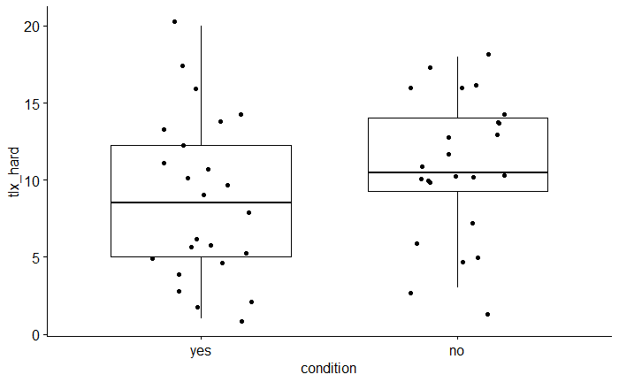
3. Viz -> TLX (how hard did you work)

Slide 21
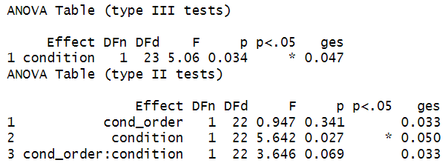
3. Viz -> TLX (how hard did you work)

Slide 22
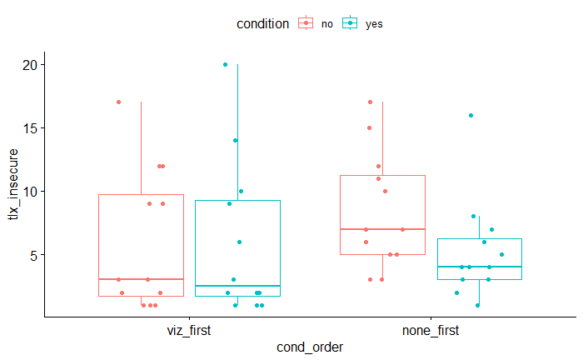
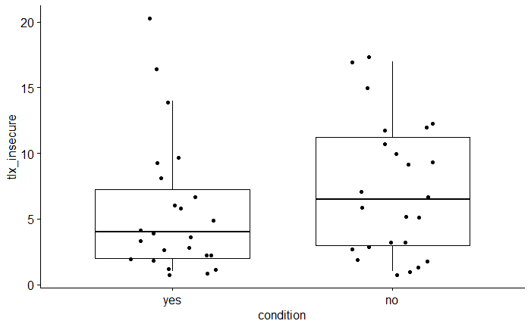
3. Viz -> TLX (how insecure)

Slide 23
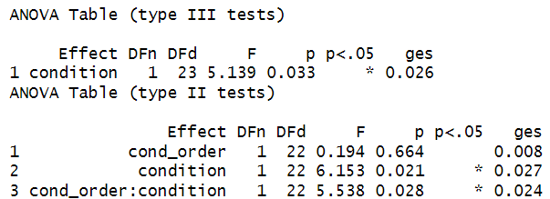
3. Viz -> TLX (how insecure)

Slide 24
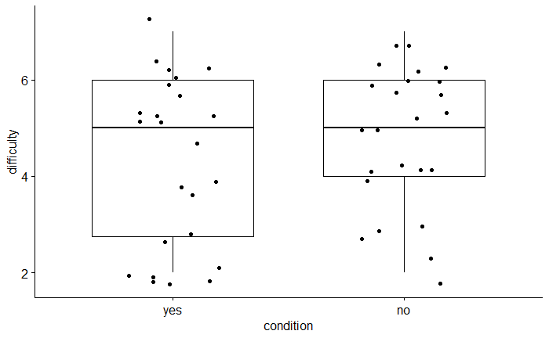
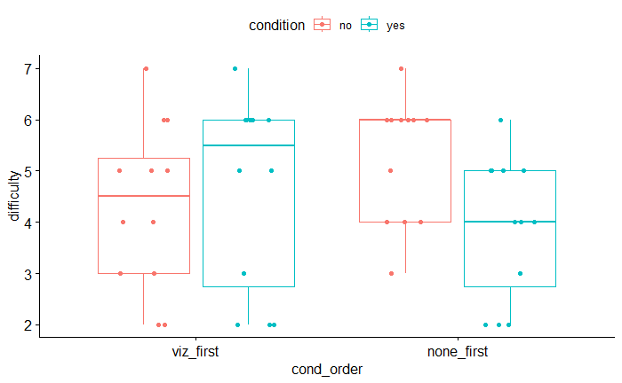
4. Viz -> Single-scale perceived difficulty

Slide 25

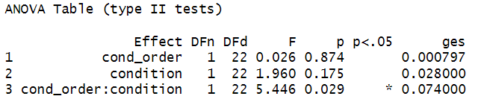
4. Viz -> Single-scale perceived difficulty

Slide 26
4. Viz -> Single-scale perceived difficulty
Visualization had no clear impact on perceived task difficulty
When shown viz first, perceived difficulty did not significantly increase when shown no_viz after
When shown no_viz first, perceived difficulty significantly decreased when shown viz after

Slide 27
5. Learning (movement time difference)
Time difference (time_diff) = time(no_viz) – time(viz) [a positive number is therefore expected if we hypothesize that viz results in quicker task completion than no_viz]
Between-subject condition = condition order (cond_order)

Slide 28
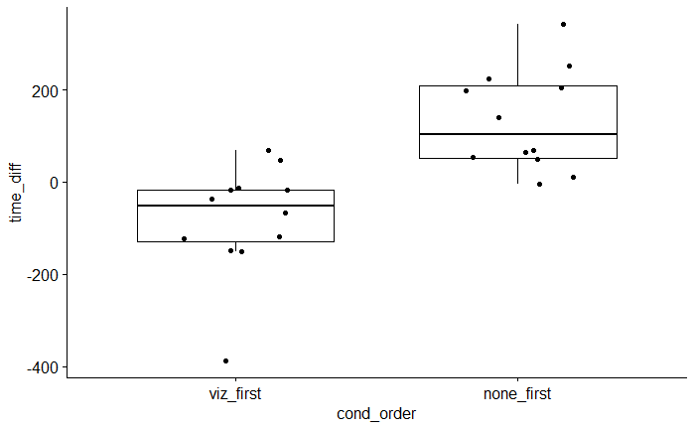
5. Learning (movement time difference)

Slide 29
5. Learning: Welch’s T-test (with Cohen’s d effect size)

Slide 30
5. Learning: Summary
When shown viz first, movement time remained roughly the same (even decreased) when shown no_viz after
When shown no_viz first, and then viz after, movement time decreased

