Slide 1

INTRODUCING AgileSites 0.5
Agile and Easy Development
for Oracle
WebCenter Sites

Slide 2

What is AgileSites?
Development with Oracle WebCenter Site is much harder than it should be
Mixing HTML and Code
Ugly and verbose API
Limited versioning capabilities
No developer isolation
Manual deployment of code
Very hard and manual testing

Slide 3
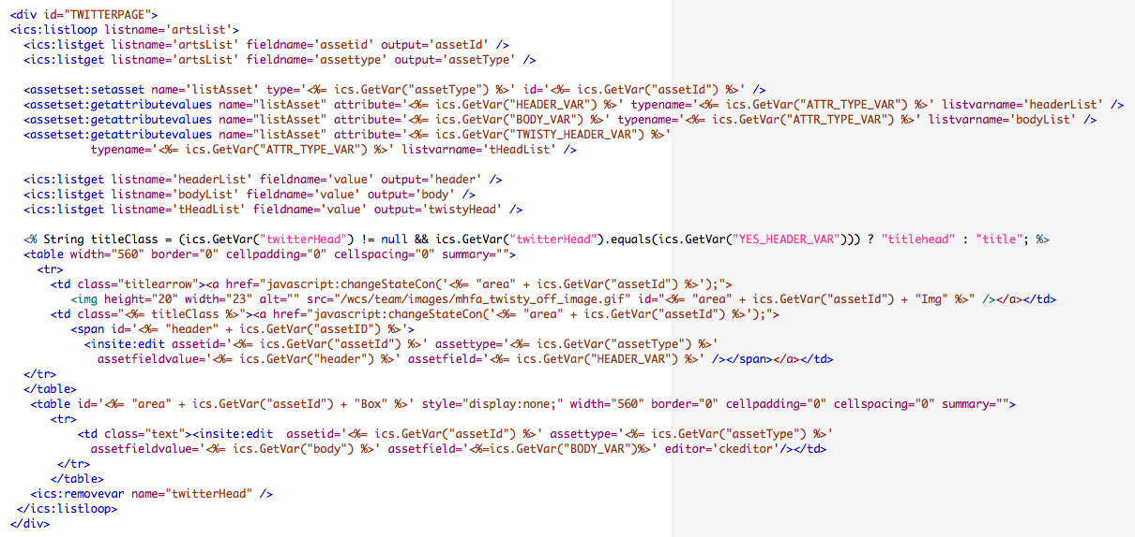
The (OLD) Sites way
HTML and Java Code Mixed Togeter

Slide 4
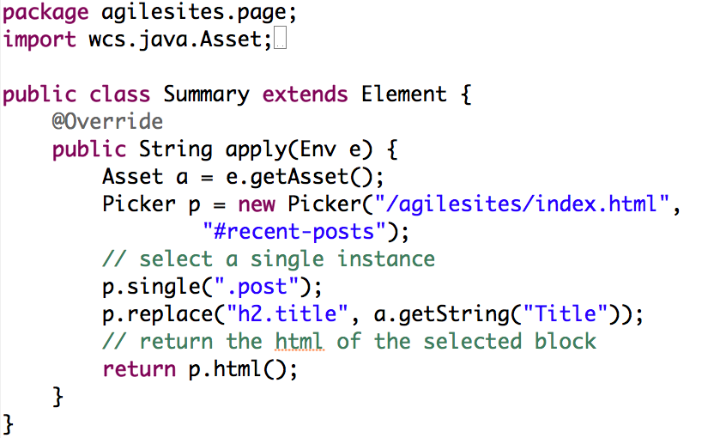
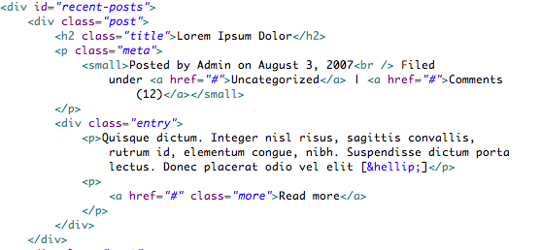
The AgileSites way (NEW)
Clean
Java only code…
…refers to the pure HTML mockup

Slide 5
Edit. Save. Test!

Slide 6
jQuery-Like HTML picker

Slide 7
You got a build. Finally!

Slide 8
Total Tools Freedoom
Any IDE
No additional plugins required
Sites requires Eclipse and a plugin
Any version control
No restrictions on VC
Sites require his Revision Tracking

