Slide 1
Notice Lists
Data Management cs347
Taylor Smith
Brian Quimio
Daniel Klein

Slide 2
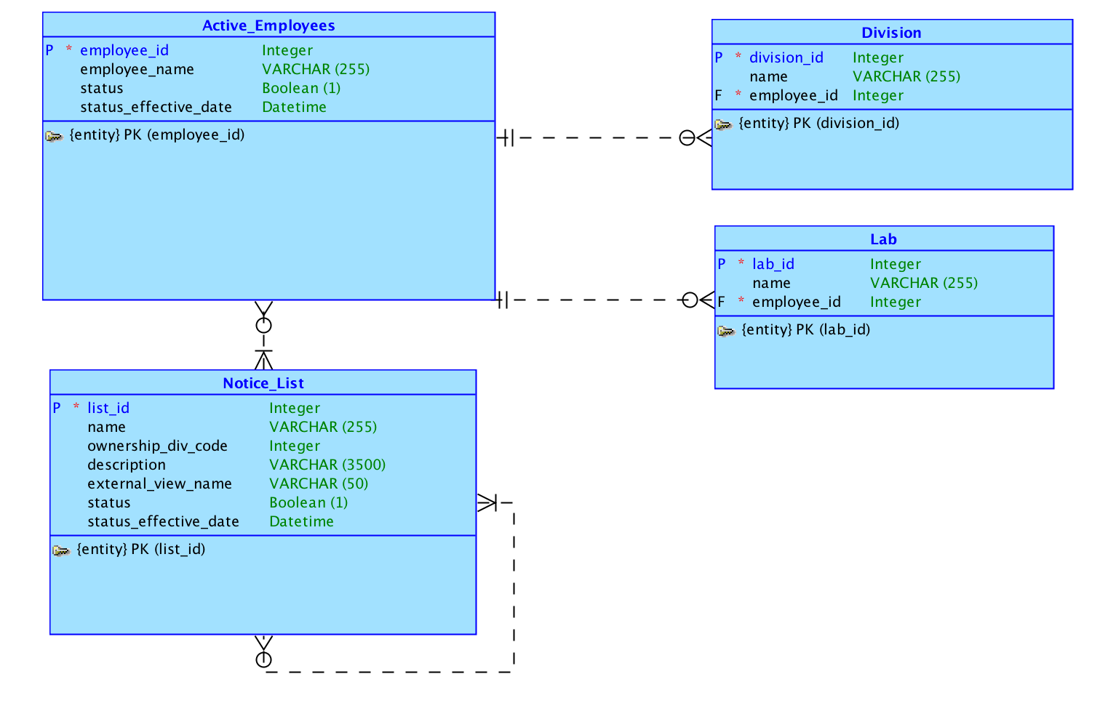
Logical Model

Slide 3
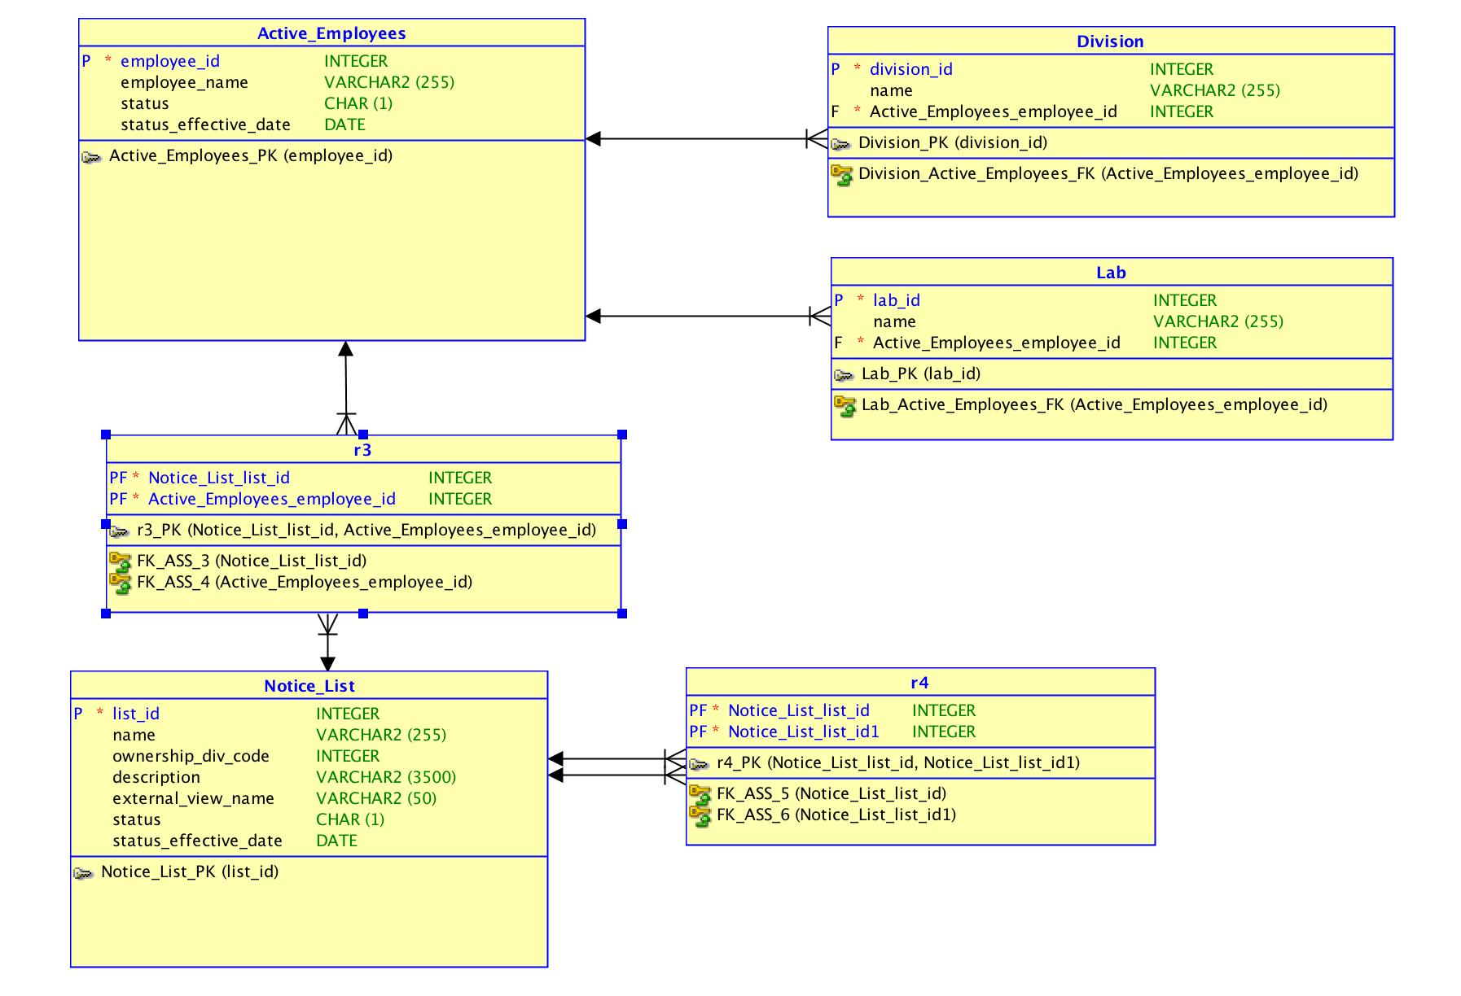
Relational Model

Slide 4
Questions
How will getting data work? What does it mean that the employees will be managed outside of this project. Will we have access to this database? Is this information even stored in a database? If so what type of database is it stored in?
What does appropriate access mean? Is there a nested access structure? Do we need to include some sort of permission logic?
What does cloning an employee mean? Does that mean that we create a new employee with the same lab, division, and list membership as an existing user? Or should it be a limited clone, where only certain parts of this information is copied?
Are the users that are logging in to use this tool a subset of the employees or is this a separate table? If the users table is separate, will it be tied to the employees table at all? We asked about permissions earlier, will these be tied to this user account type information? Do we need to worry about authentication and encrypting user login information?

Slide 5
Must Haves
Implementation Steps
The first step was to make sure we had the documentation necessary to replicate the must haves. We copied all of the guides that people posted and saved the screenshots.
Custom search should be implemented for the search on user name. Since the name stores both first and last name we can probably just search this column with a ‘LIKE’ query.
The tree view will be helpful in displaying a set of nested lists. Ie, a list that has another list of names can be displayed correctly with the tree structure people demonstrated in the projects.
Region display sectors will help to keep the app organized and make it easy to access.
There are several other projects people did that help with the form process, shuttles, returning to modals, and group select lists all fall into this general category.

Slide 6
Good to Have
Implementation Steps
Undo button might be a very useful feature and could help to prevent mistakes in managing lists.
Another guide on authorization could be helpful if we need to implement a users table with limits on what people can do.
Theme roller would be nice to style the app and make it feel more like a custom solution.

