Slide 1
Notice List Application
C S 347 – Data Management
Taylor Smith
Daniel Klein
Brian Quimio

Slide 2
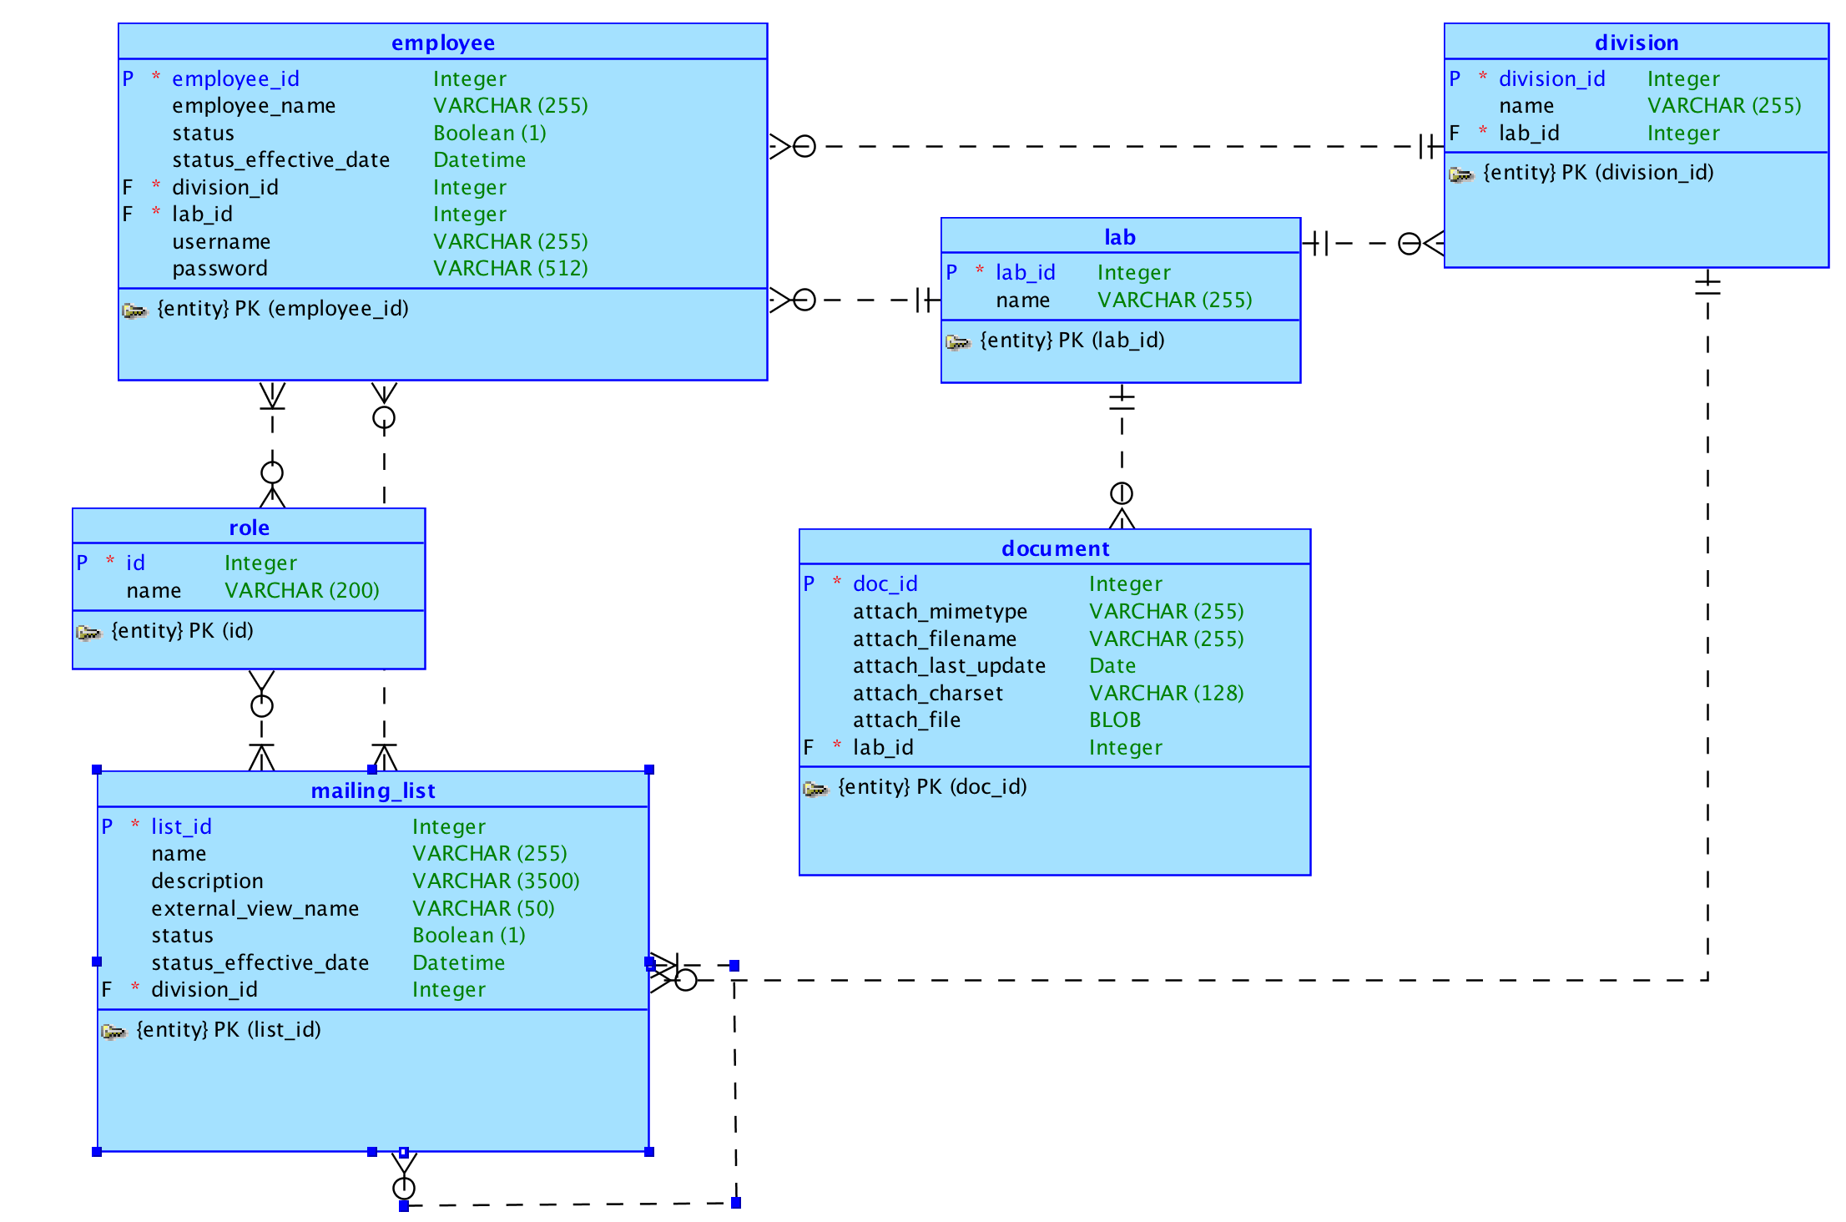
Logical Model

Slide 3
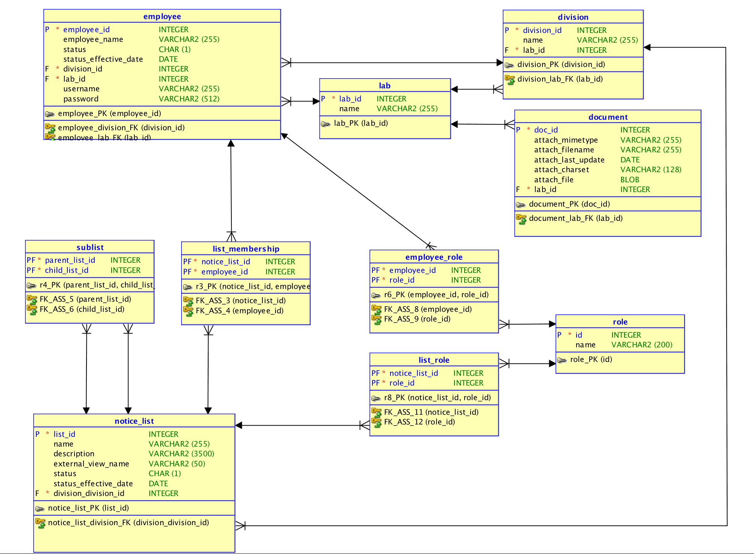
Relational Model

