Slide 1
Notice List Application
C S 347 – Data Management
Taylor Smith
Daniel Klein
Brian Quimio

Slide 2
Conceptual Model

Slide 3
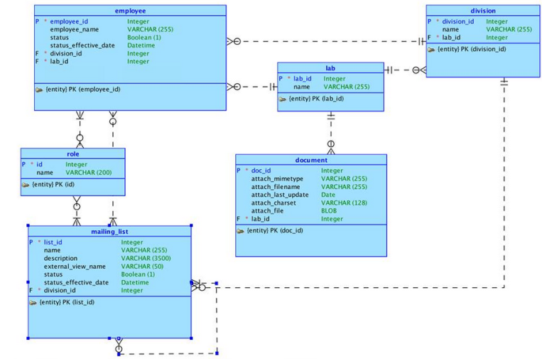
Logical Model

Slide 4
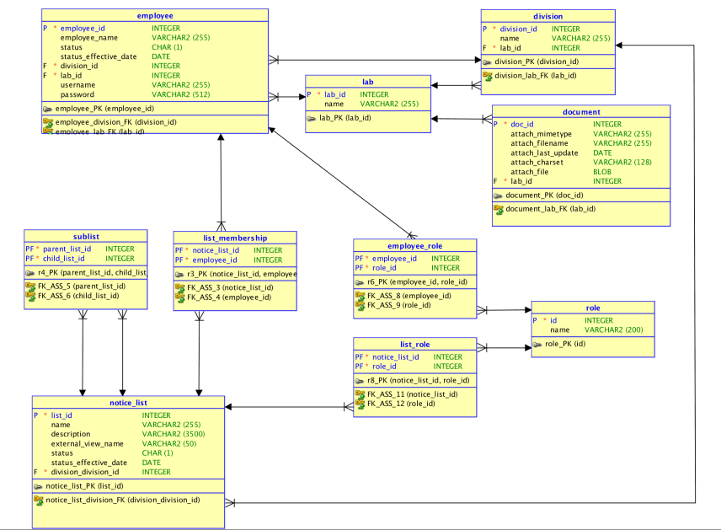
Relational Model

Slide 5
Must Haves
Chart
Search Bar*
Clone employees
Delete all membership for an employee
Region Display Sector*
Upload/download a document
Shuttle*
Group Select List
Add list to a list
Additional create buttons

Slide 6
Good to Have
Theme Roller
Apex Timer Plugin

Slide 7
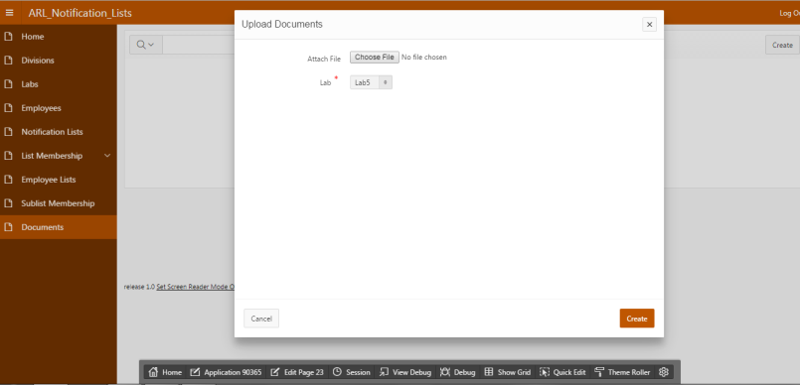
Upload Documents Page

Slide 8
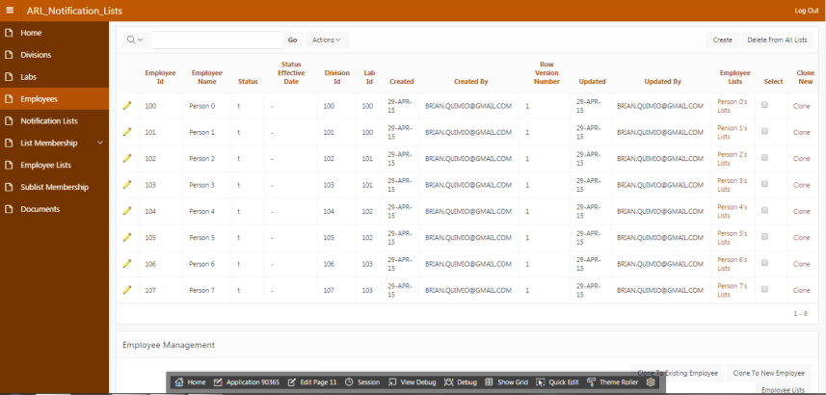
Clone Employees
Delete all membership from employees

Slide 9
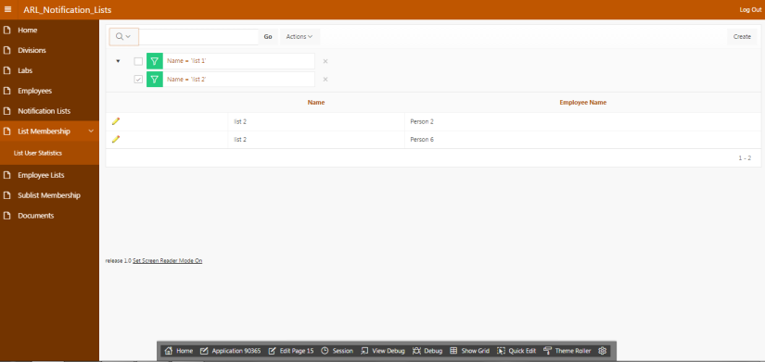
View all lists an employee belongs to

Slide 10
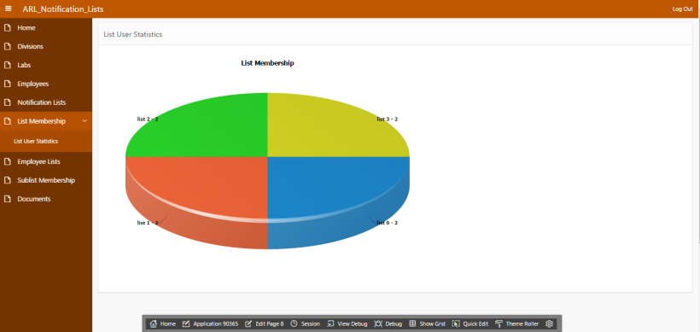
Pie chart: Breakdown of number of users per list

