Slide 1
Resolve DSO to Info Cube Load Failure.
Milind Parab

Slide 2
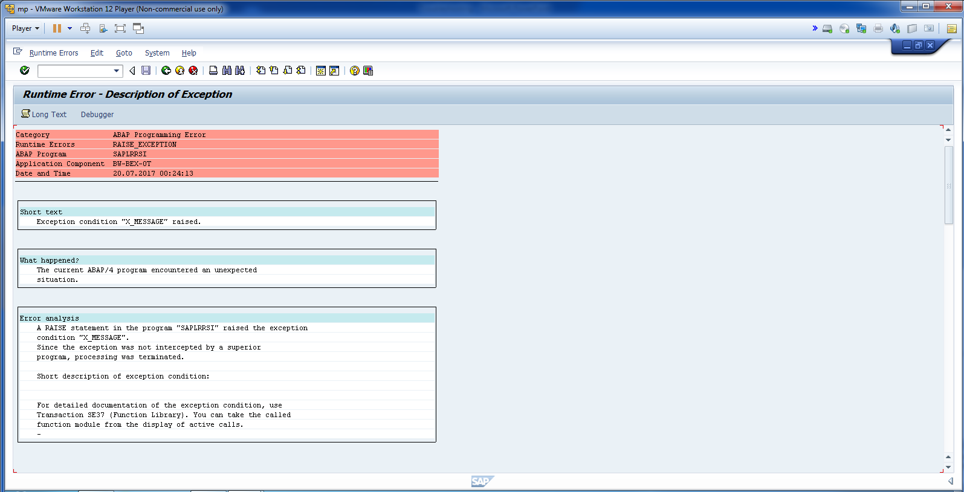
DSO to Info Cube Load Failure.

Slide 3
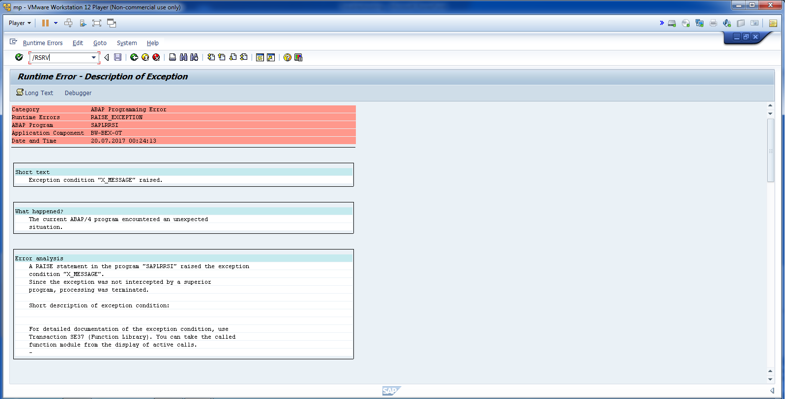
Go to Tcode: /RSRV

Slide 4
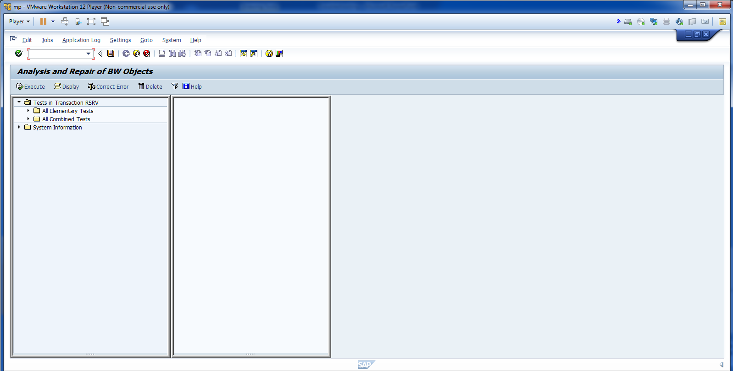
Cont.

Slide 5
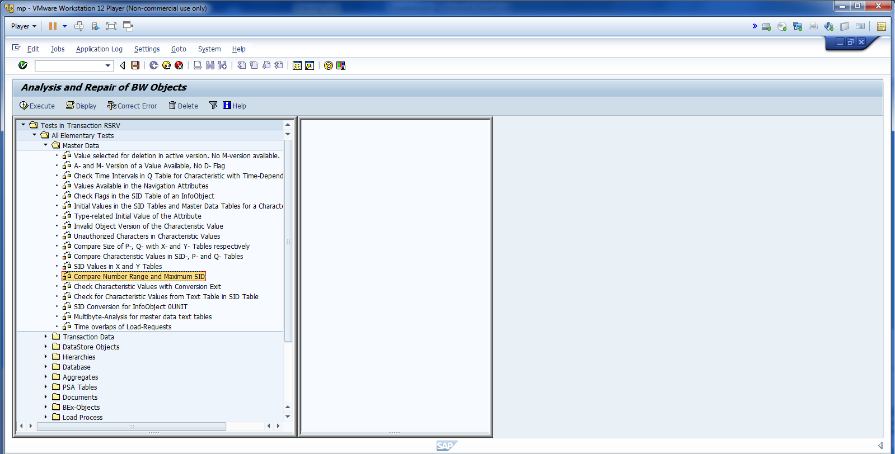
Click compare num. and drag it to right hand.

Slide 6
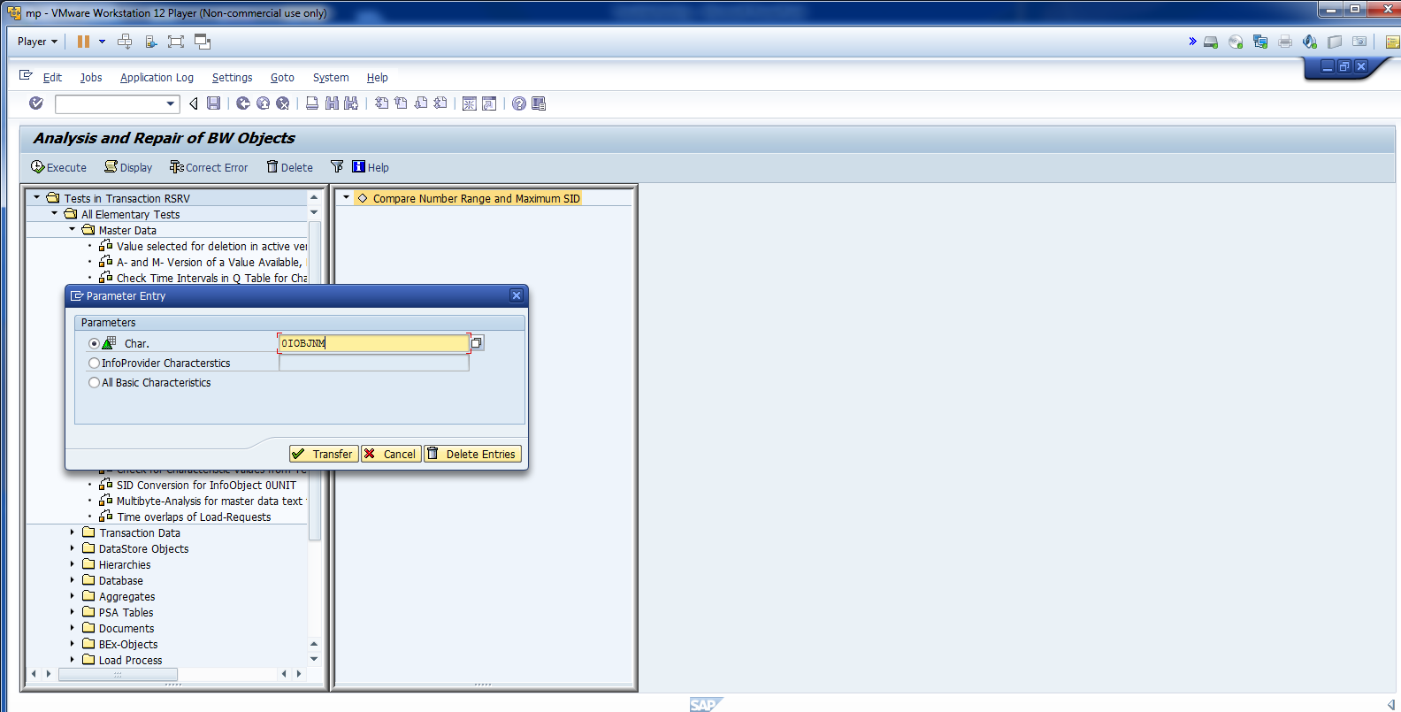
Cont.

Slide 7
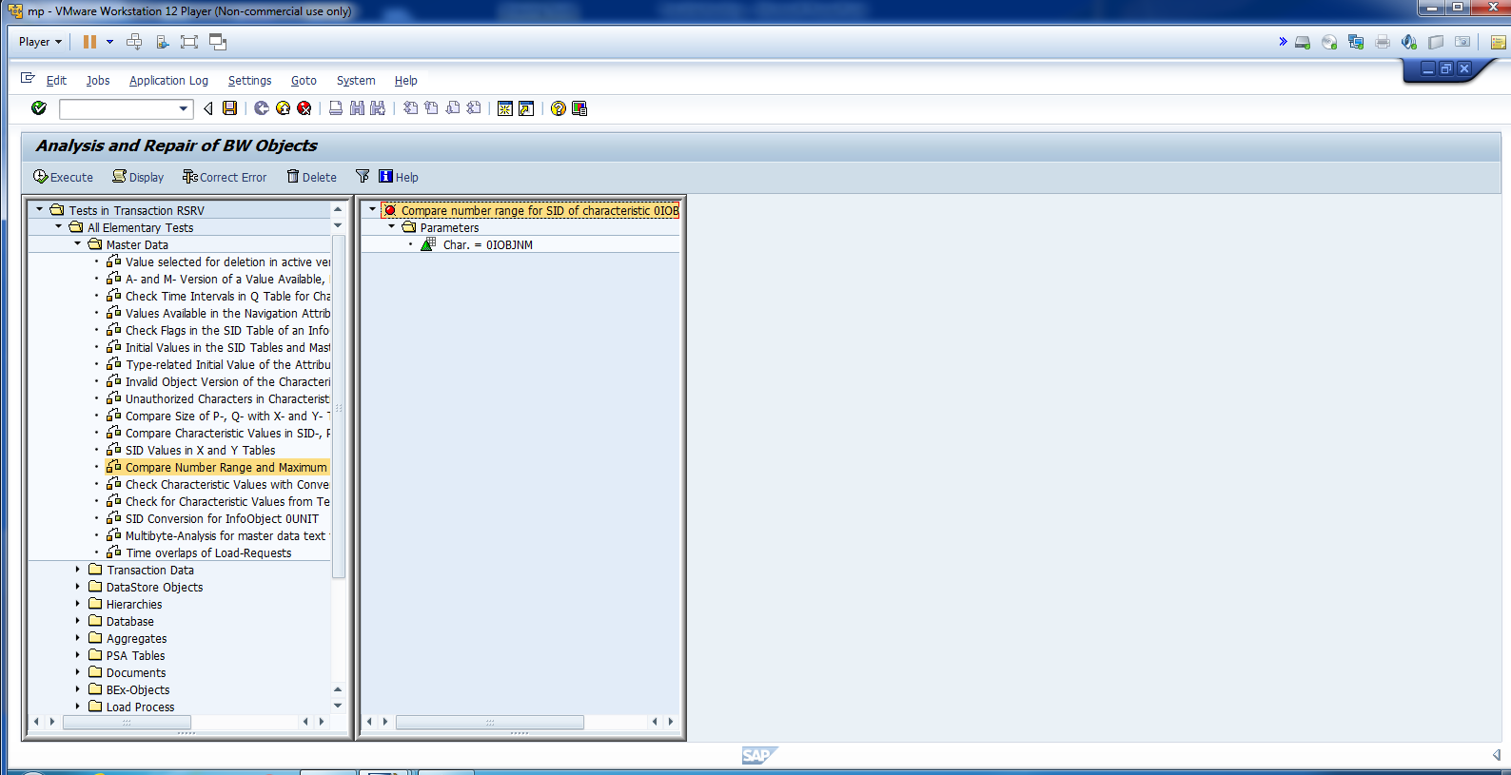
Still not resolved.

Slide 8
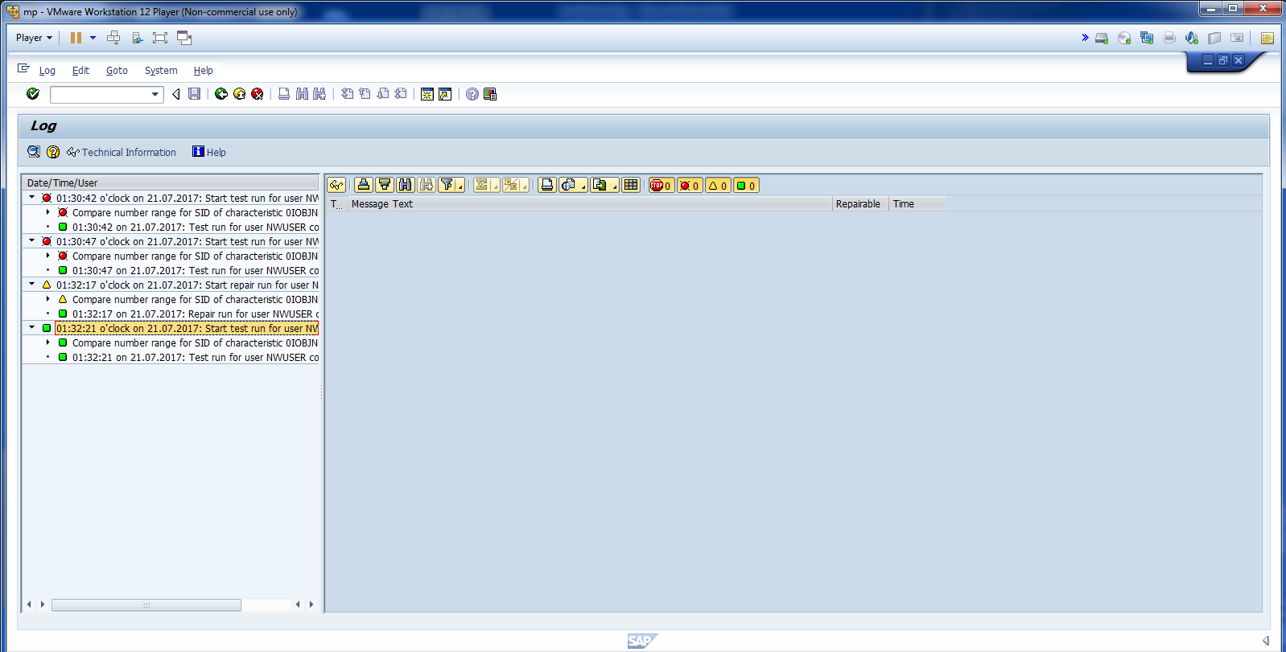
Click on correct error and execute again.

Slide 9
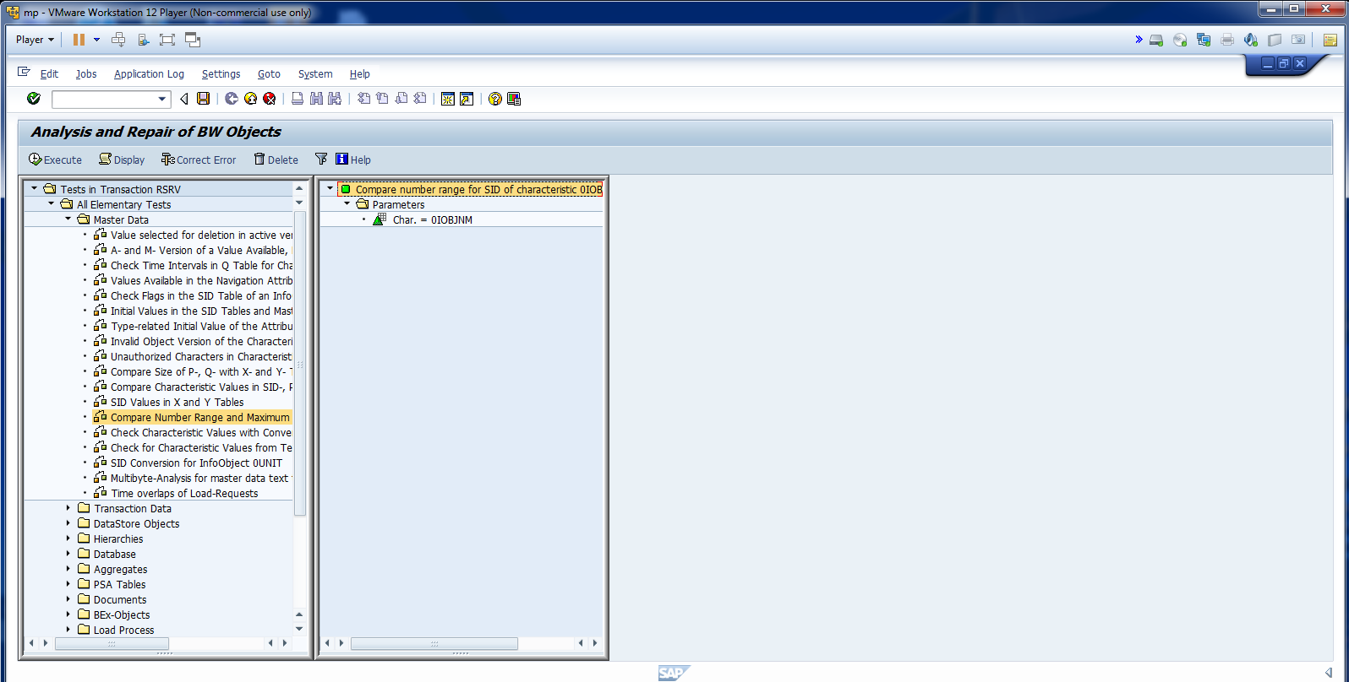
Cont.

