Slide 1

Olympic Historical Dataset (1896 - 2022)
Min Pak • Flora Aka • Maria Ardila

Slide 2

Data used
Kaggle: Olympic Historical Dataset (1896 - 2022)
Olympic_Athlete_Bio.csv
Olympic_Athlete_Event_Results.csv
Olympics_Games.csv
https://www.kaggle.com/datasets/muhammadehsan000/olympic-historical-dataset-1896-2020?select=Olympic_Athlete_Event_Results.csv

Slide 3
Questions we found interesting
Women's and men’s participation throughout the years
Which sports are common to men and women throughout the Olympics?
Is there a trend toward gender parity?
How height and weight have changed through the years
Are there any trends in the height and weight outliers?

Slide 4
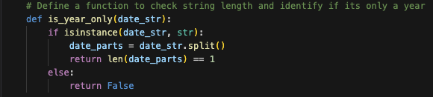
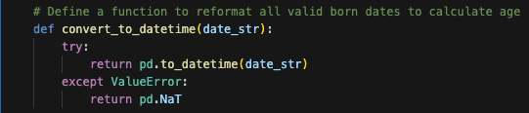
Data exploration and cleanup process
The datasets had information for the Summer and Winter Olympics. We wanted to focus only on the Summer Olympics.
For the age analysis, we had to understand all the date formats in the dataset.
The born column of the athletes_bio_csv had complete date format entries, month-year entries, year entries, typos, and empty values. We use only complete date format entries and month-year entries, knowing that the forced date format will automatically make the month-year entries the first day of the month. We only discarded the year entries, typos, and empty values.

Slide 5
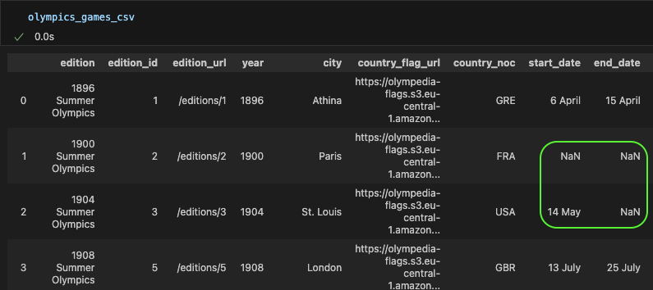
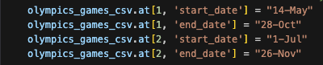

Data exploration and cleanup process
The Olympics_Games.csv had missing information that we had to enter manually.
Columns, such as dates, height, and weight, had to be forced to be the right type for further use (datetime64[ns] and integer).
Age was calculated based on the start date of the Olympics and the birth date.

Slide 6
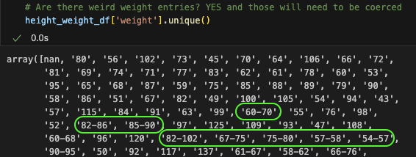
Data exploration and cleanup process
The Olympic_Athlete_Bio.csv had the name column labeled as ‘name’, but the Olympic_Athlete_Event_Results.csv had it labeled as ‘athlete’, so we removed one.
We had to check if the height and weight columns had weird entries.
For the gender, height, and weight analysis, we decided to have one population for the three analyses. We had to remove the duplicate athletes per year as they can participate in more than one event, and all rows in which height and weight were missing or one of them was missing.

Slide 7
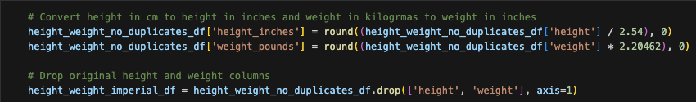
Data exploration and cleanup process
Height was converted from centimeters to inches and weight from kilograms to pounds.

Slide 8
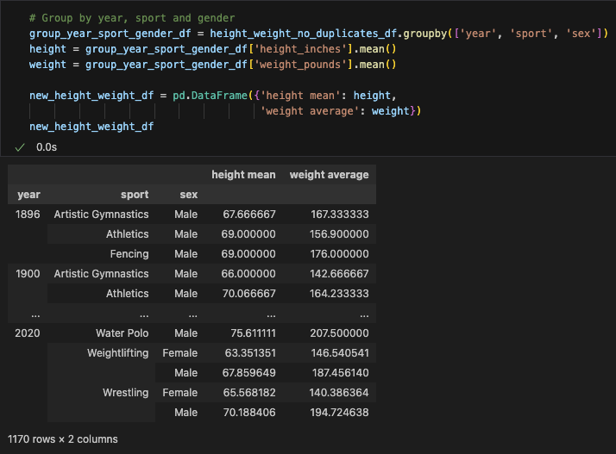
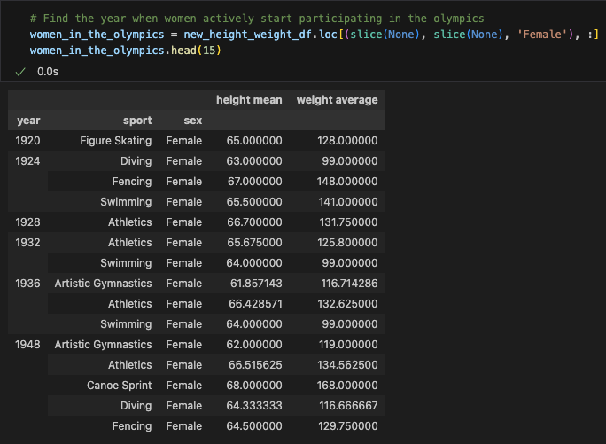
Analysis process
When grouping the df based on year, sport, and gender, we discovered that women didn’t participate at all in the first editions of the Olympics… so we decided to find out when women started participating and in which sports!
Women started participating in the Olympic after WWI (1920), and got really involved in many sports after WWII (1948)
1920 – Figure Skating
1924 – Diving, Fencing, Swimming
1928 – Athletics
1932 – Athletics and Swimming
1936 – Artistic Gymnastics, Athletics, Swimming

Slide 9
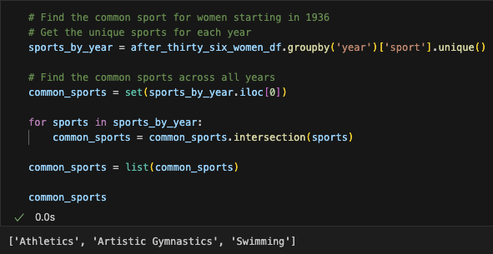
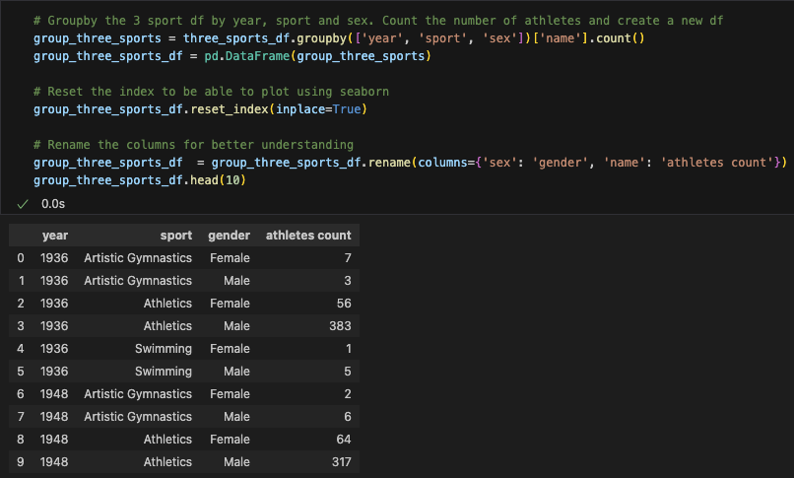
Analysis process
Starting in 1936, women consistently started participating in at least three sports in the Olympics. Which are the common sports for all the Olympic editions starting in 1936 for women?
Athletics
Artistic Gymnastics
Swimming
Fun Fact: We ran the same code for all Olympics, and the only sport in common for the 32 editions is Athletics
The population chosen for the analysis is men and women who participated in the Olympics in athletics, artistic gymnastics, and swimming from 1936 until 2020.

Slide 10
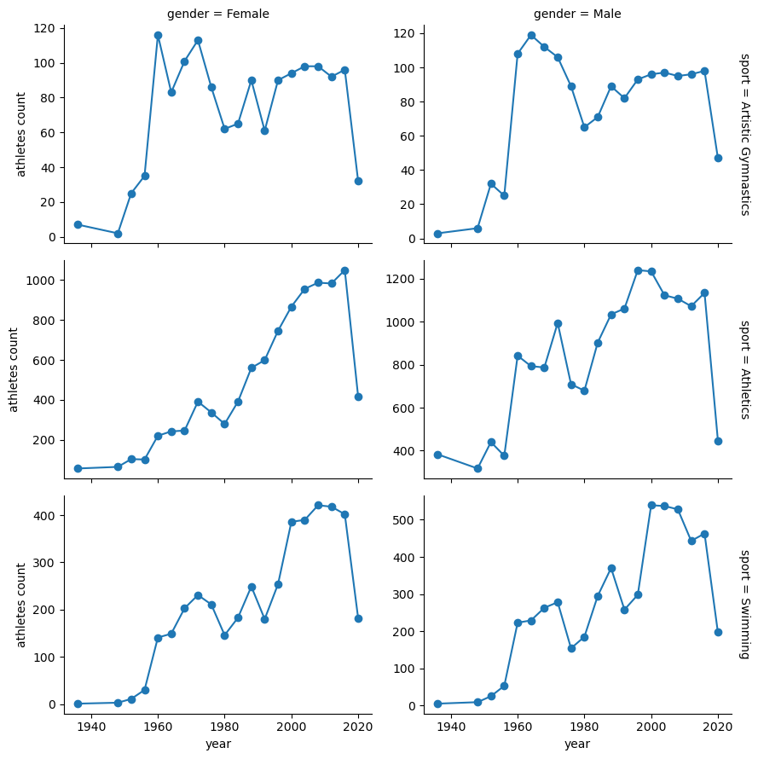
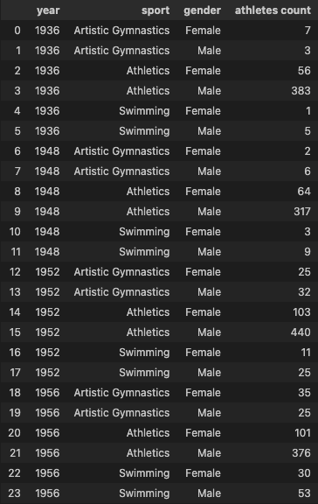
Conclusions & Implications
Number of women and men athletes who participated in athletics, artistic gymnastics, and swimming from 1936 until 2020.
Preliminary findings
Artistic Gymnastics – Although the first 6 editions analyzed show a difference in the trend of athlete count, the trend after 1968 looks similar
Athletics – It is the one that shows the most notorious differences in the trend of athlete count, up until the last 5 editions of the analysis
Swimming – Seems to be the one with the most similar trend of athlete count between women and men
For all 3 sports, it’s evident the impact of COVID on the athlete count in 2020 (2021)

Slide 11
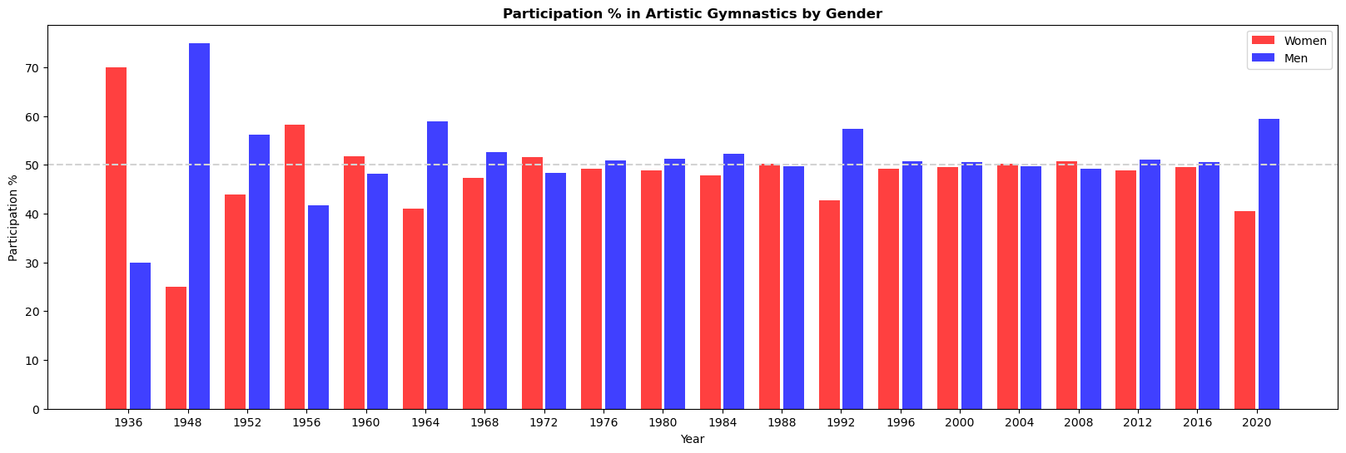
Conclusions & Implications
From a gender parity perspective, Artistic Gymnastics doesn’t show a trend of increasing women's participation to reach a 50/50 distribution between genders.
However, after the six first editions of the analysis, it's a sport with a 50/50 distribution between genders in most Olympic editions, confirming the preliminary finding of the athlete count.

Slide 12
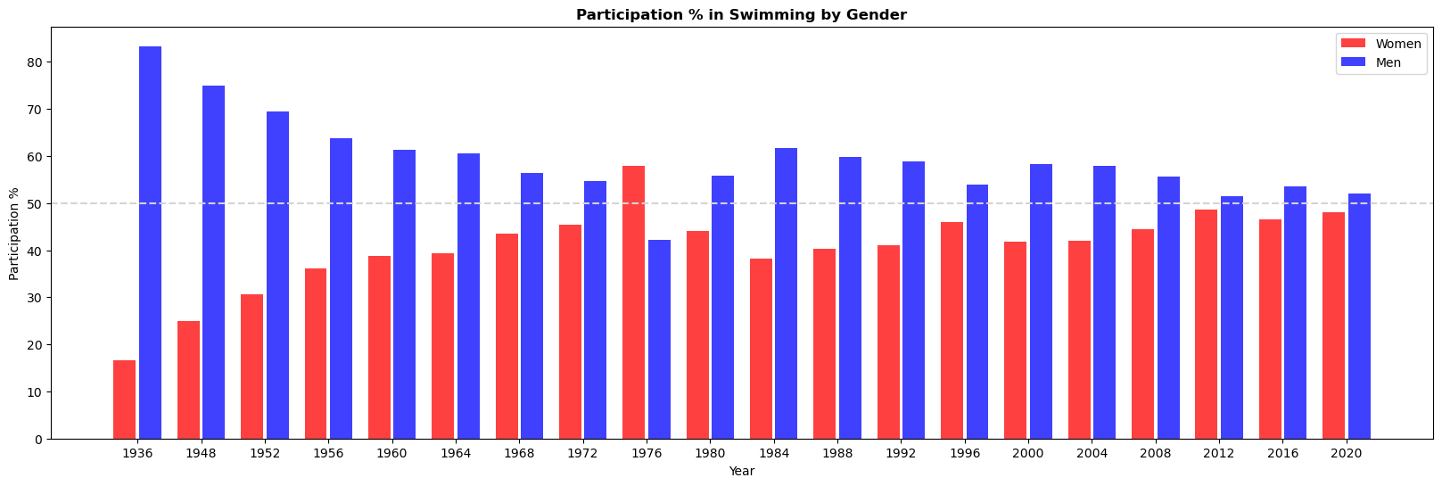
Conclusions & Implications
From a gender parity perspective, Swimming shows a trend of increasing women's participation during the first eight editions included in the analysis to reach a 50/50 distribution between genders.
The Olympics of 1976 and 1980 seem to be unique, and starting in 1984, we identify again the trend of increasing women's participation.

Slide 13
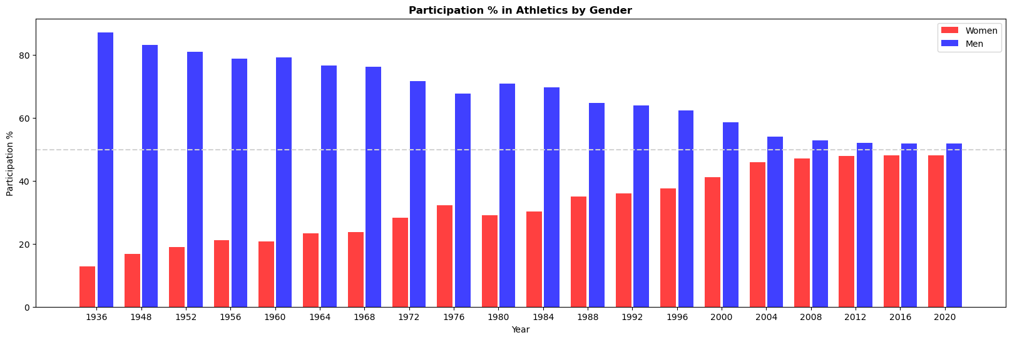
Conclusions & Implications
From a gender parity perspective, Athletics shows a trend of increasing women's participation to reach a 50/50 distribution between genders during the last five Olympic editions included in the analysis, confirming the preliminary finding of the athlete count.
Of the 3 sports analyzed, Athletics shows the most consistent growth trend.

Slide 14
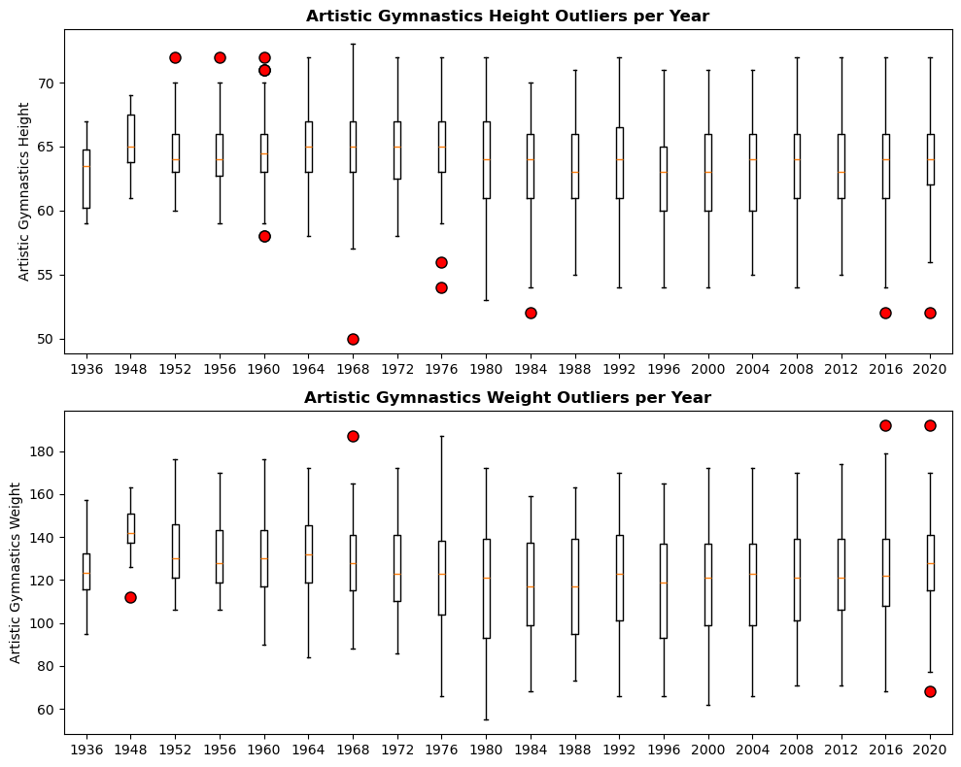
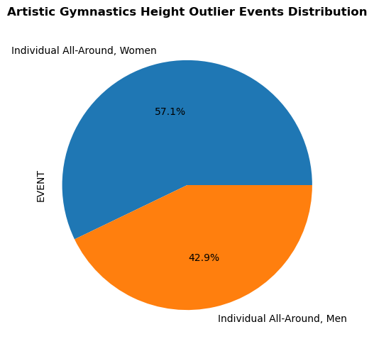
Conclusions & Implications
Artistic Gymnastics height and weight box plot
Almost all athletes' height and weight are inside the Interquartile Range or the lower and upper bound.
Total Height Outlier = 14
The Height Outliers are men and women, competing in the Individual All-Around event.
Artistic Gymnastics has a total of 14 events.
Total Weight Outlier = 5 (No trend was found in the weight outliers)

Slide 15
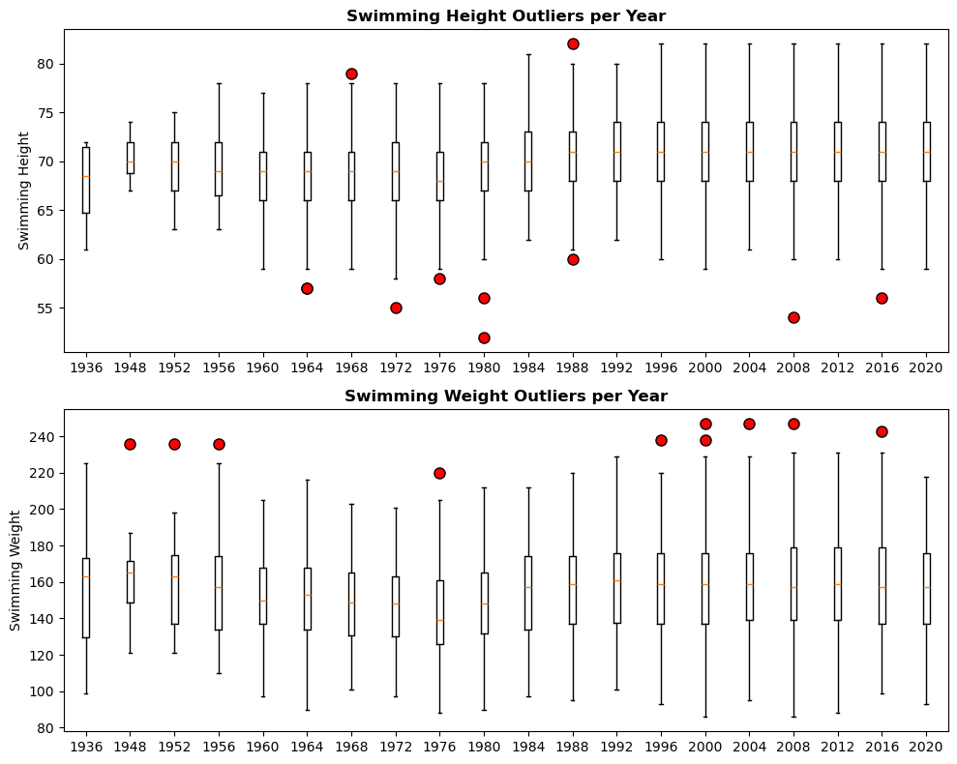
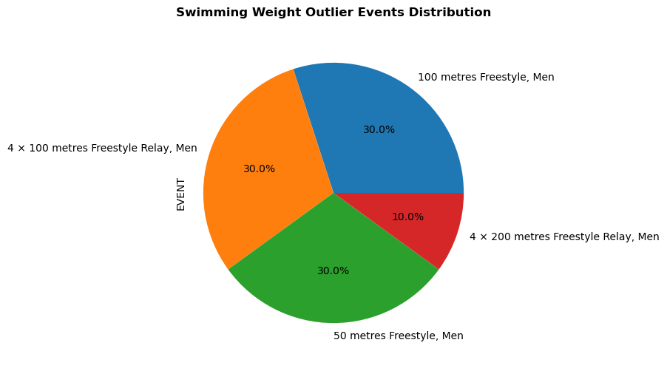
Conclusions & Implications
Swimming height and weight box plot
Almost all athletes' height and weight are inside the Interquartile Range or the lower and upper bound.
Total Height Outlier = 11 (No trend was found in the height outliers)
Total Weight Outlier = 10
The Weight Outliers are men competing in individual short-distance freestyle competitions or freestyle relay events.
Swimming has a total of 35 events.

Slide 16
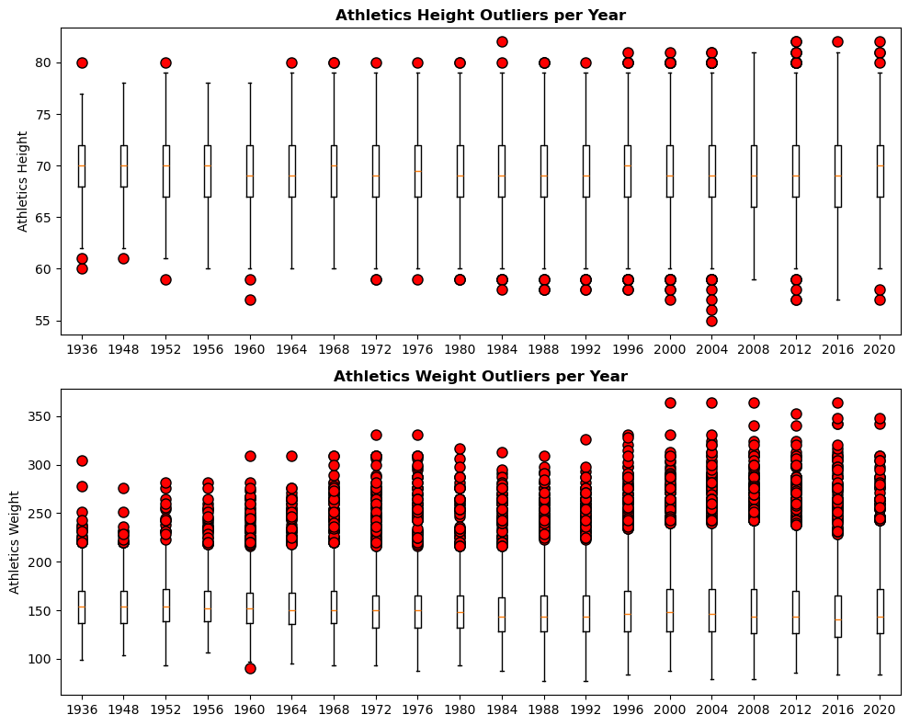
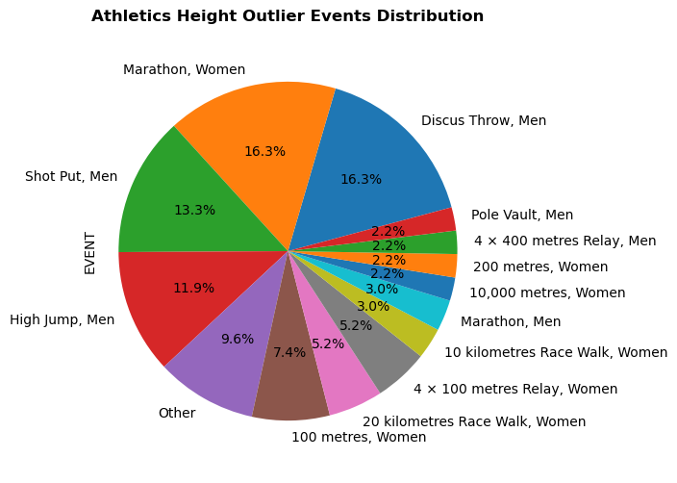
Conclusions & Implications
Athletics height box plot
Athletics is the sport with the more relevant number of outliers in bot, height and weight
Total Height Outlier = 135
The Height Outliers are men competing in throws events (Discus Throw and Shot Put), women competing in the Marathon, and men competing in the High Jump.
Athletics has a total of 55 events.
The category of ‘Other’ groups 9 events of the 22 listed on the Height Outliers.

Slide 17
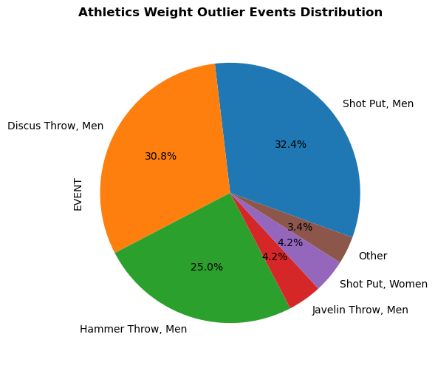
Conclusions & Implications
Athletics weight box plot
Athletics is the sport with the more relevant number of outliers in bot, height and weight
Total Weight Outlier = 1372
The Weight Outliers are mainly men competing in throws events (Shot Put, Discus Throw, and Hammer Throw).
Athletics has a total of 55 events.
Throw events measure the body strength, which explains why Weight Outliers are related to these events.
The category of ‘Other’ groups 7 events of the 13 listed on the Weight Outliers.

