Slide 1

LEDtrix
Maurizio Pasquinelli
Salome Müller

Slide 2
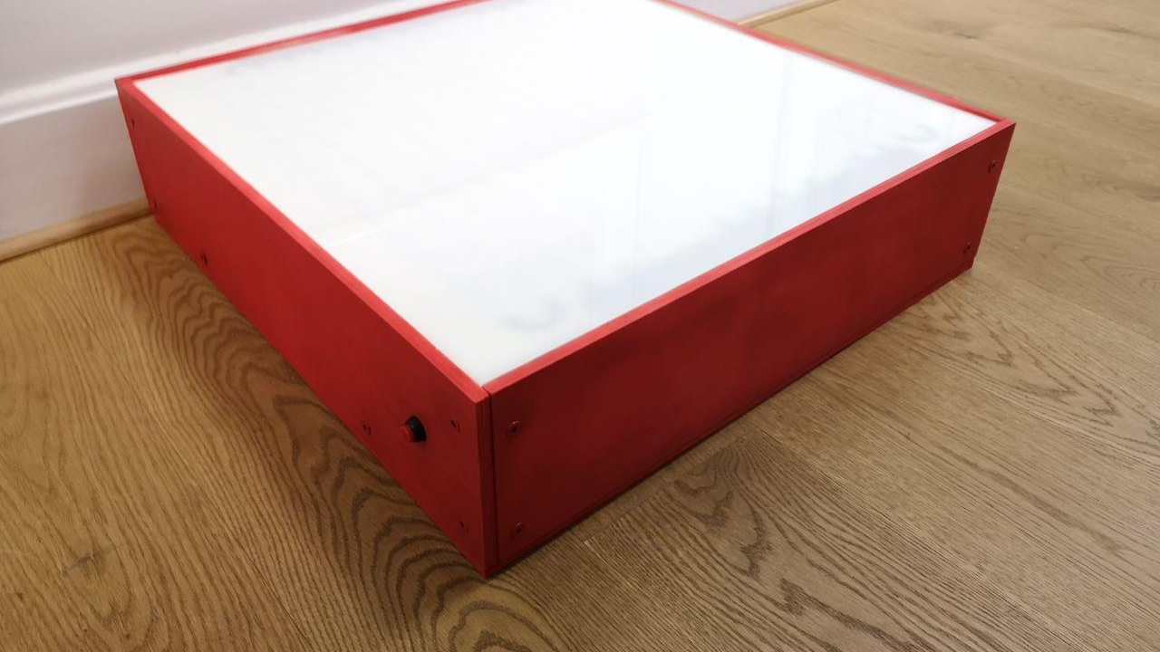
What is LEDtrix?
LED matrix in a box
Controlled by Raspberry Pi
Tic Tac Toe, Raindrops and Snake

Slide 3
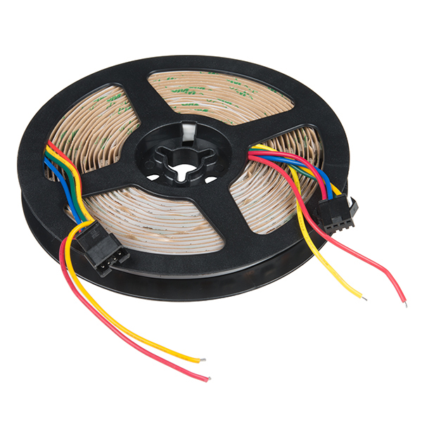
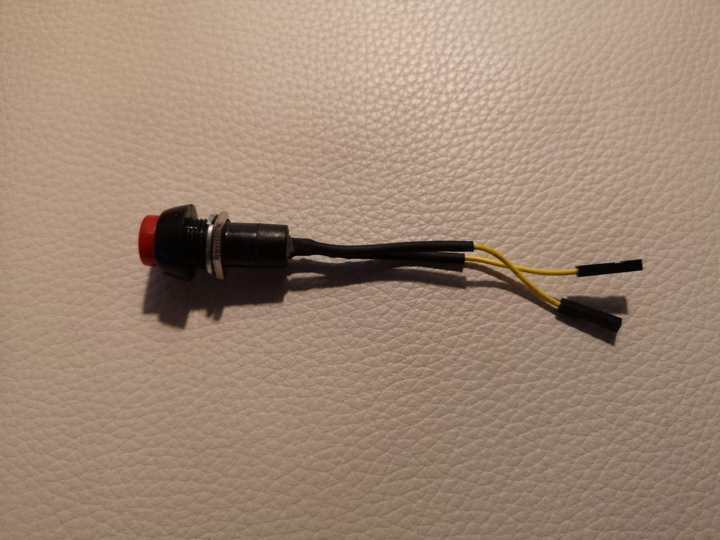
What we used and why
APA -102 LED-strip (PICTURE ufgrollt)
Squid-Buttons (PICTURE knöpf)
Acrylic glass

Slide 4

Budget
Too long strip
Not enough power
Flickering
Buttons

Slide 5
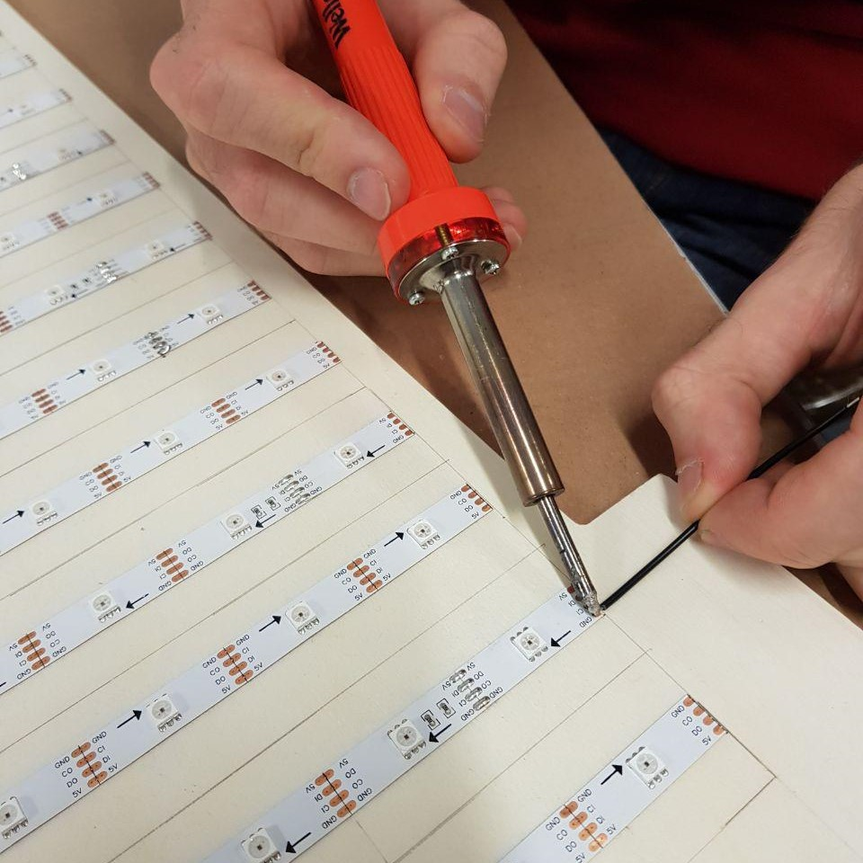
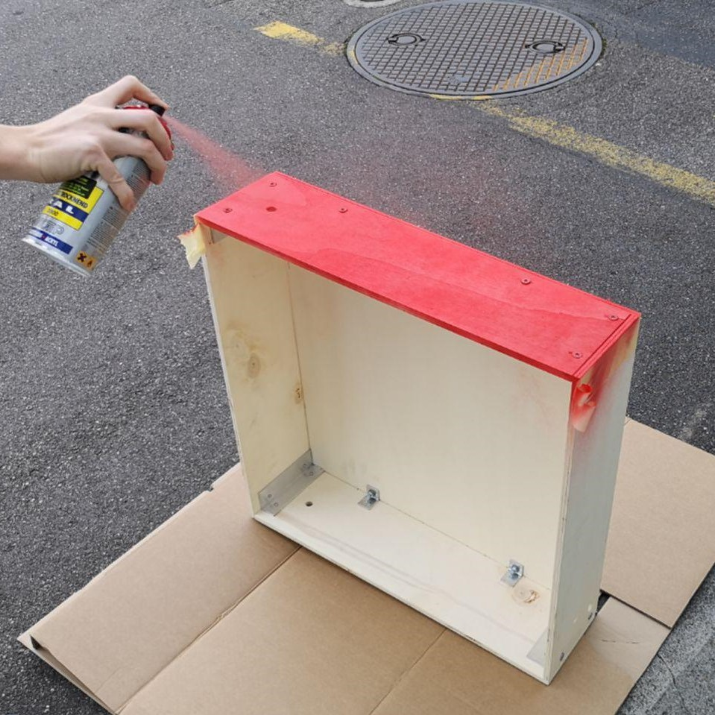
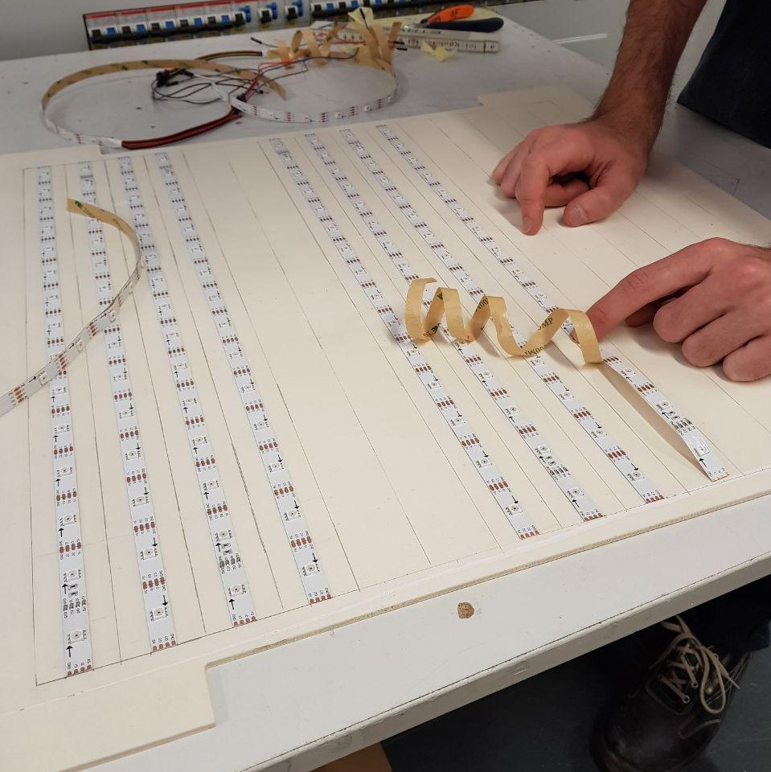
Hardware

Slide 6
Problems on the way
Too long strip
Not enough power
Flickering
Buttons

Slide 7
Lessons Learned
Code-and-Fix
More Brainstorming
Take notes

Slide 8
Questions?

