Slide 1

LEDtrix
Maurizio Pasquinelli, Salome Müller

Slide 2

What is LEDtrix?
LED matrix in a box
Controlled by Raspberry Pi
To play Tic Tac Toe, Raindrops and Snake
PICTURE fertigi box

Slide 3
What we used and why
APA -102 LED-strip (PICTURE ufgrollt)
Squid-Buttons (PICTURE knöpf)
Acrylic glass

Slide 4

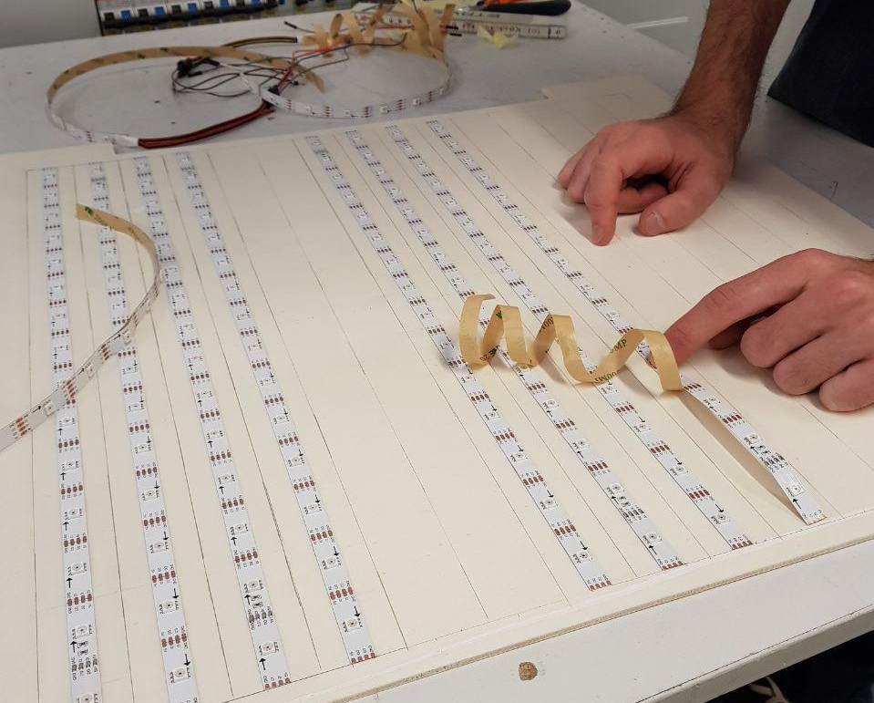
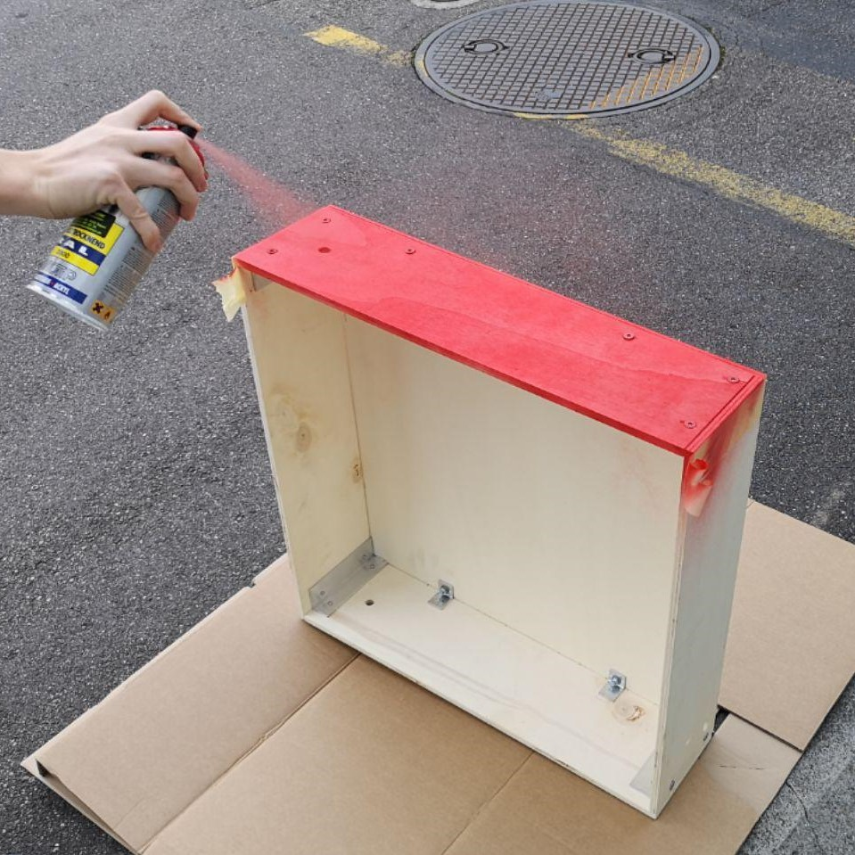
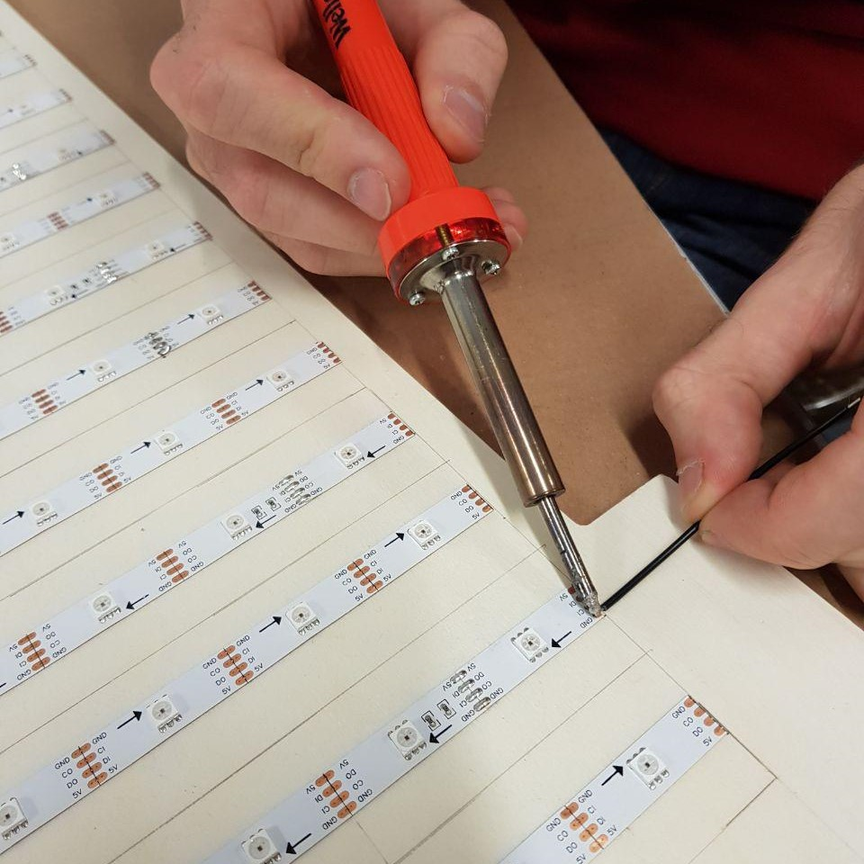
Hardware

Slide 5
Problems on the way
Too long strip
Not enough power
Flickering
Buttons

Slide 6
Lessons Learned
Code-and-Fix
More Brainstorming
Take notes

Slide 7
Questions?

