Slide 1

LEDtrix
Maurizio Pasquinelli
Salome Müller

Slide 2
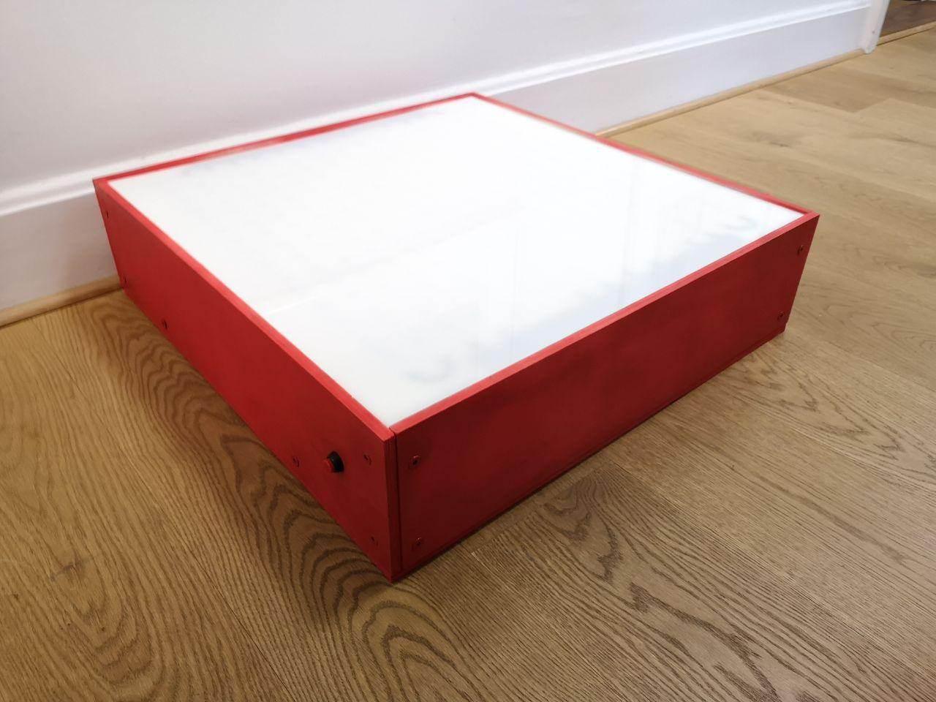
What is LEDtrix?
LED matrix in a box
Controlled by Raspberry Pi
Tic Tac Toe, Raindrops and Snake

Slide 3
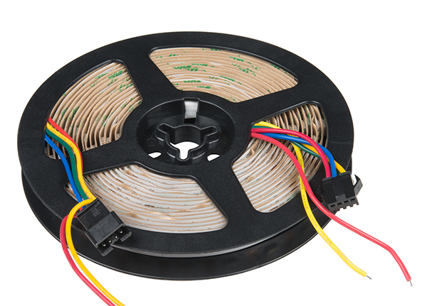

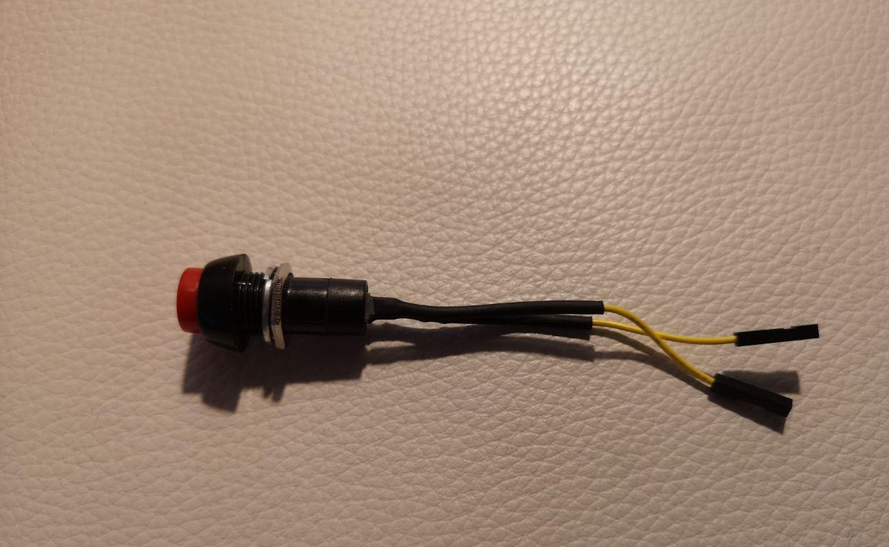
What we used
APA102 LED-strip
Squid-Buttons
Acrylic glass

Slide 4
Budget
Products | Estimated costs (CHF) | Final costs (CHF)
LEDs | 50 | 55
Wood | 30 | 30
Acrylic glass | 20 | 38
Buttons | 10 | 22
Cables | 10 | 5
Total | 120 | 150

Slide 5
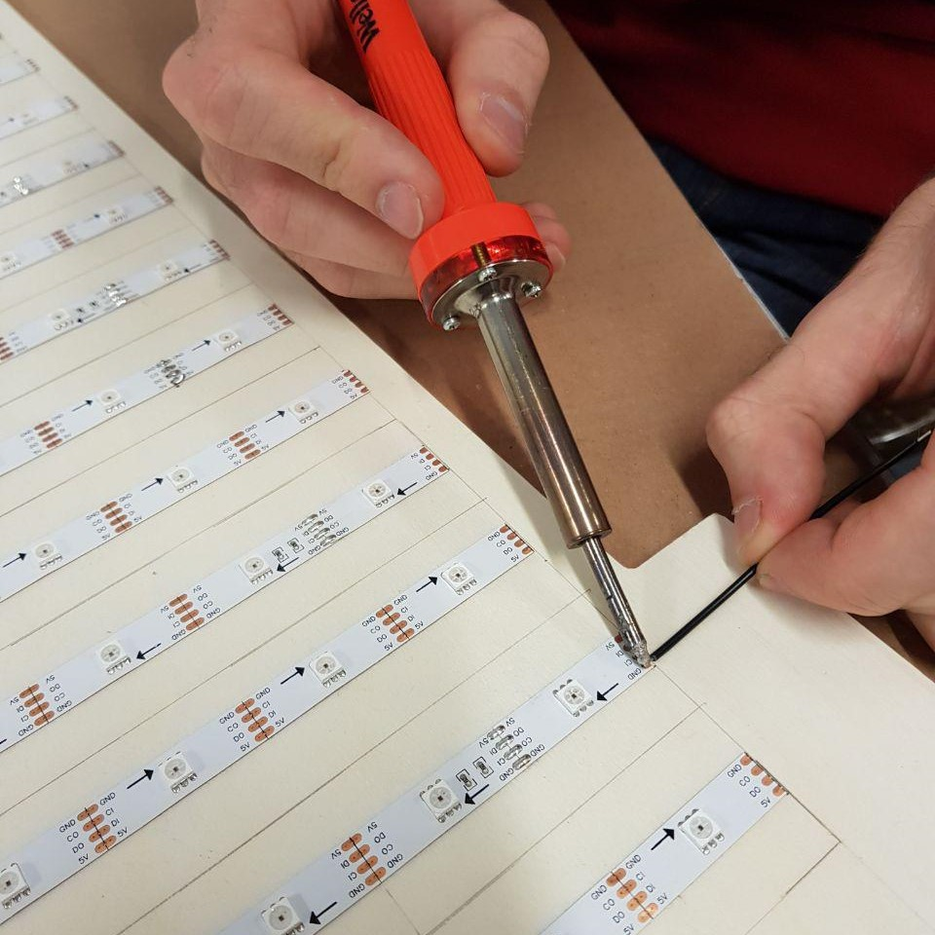
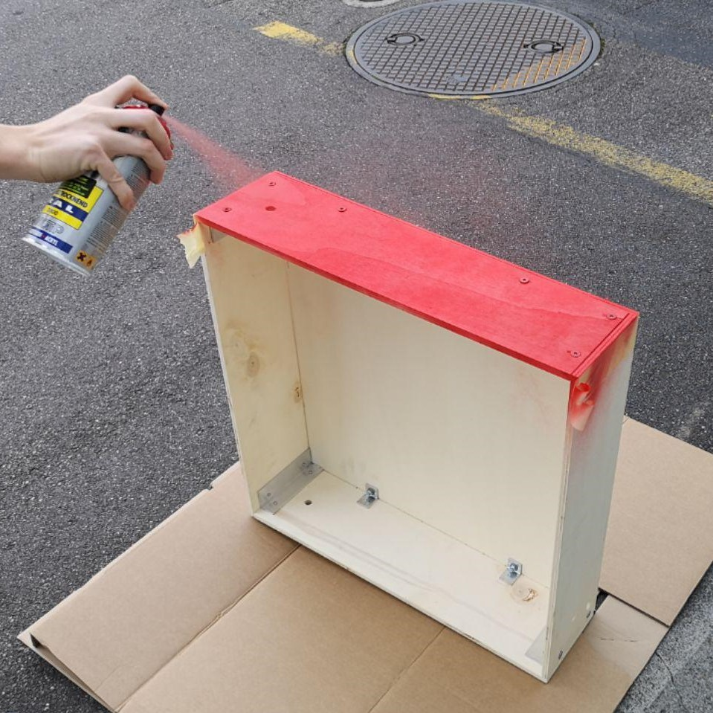
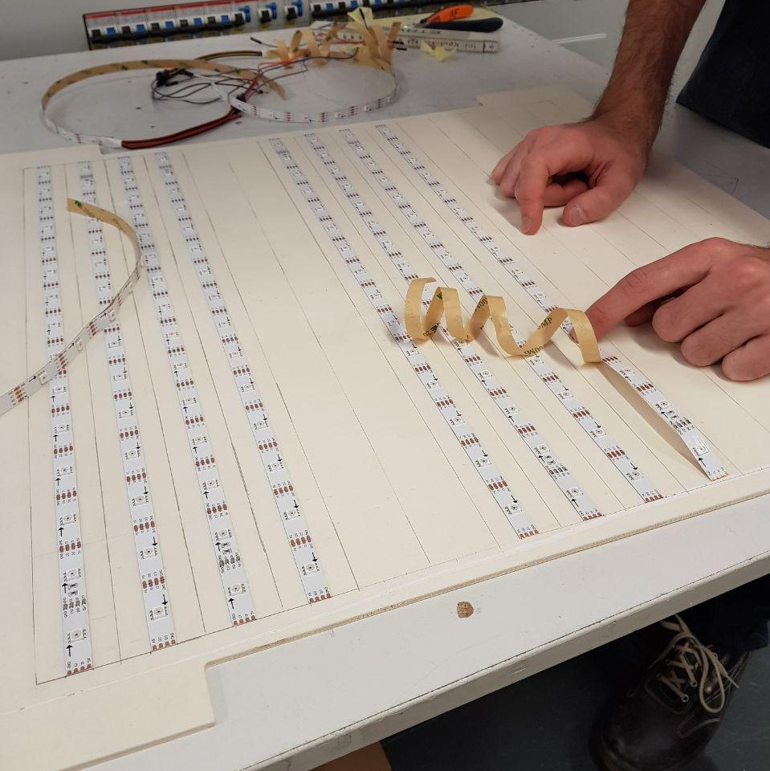
Handwork

Slide 6

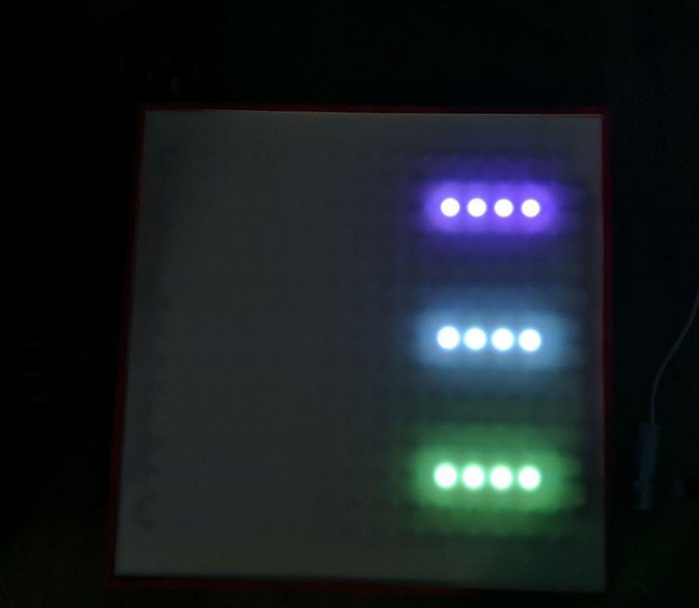
Problems on the way
Too long strip
Not enough power
Flickering
Buttons

Slide 7
Lessons Learned
Code-and-Fix
More Brainstorming
Take notes

Slide 8
Questions?

