Slide 1
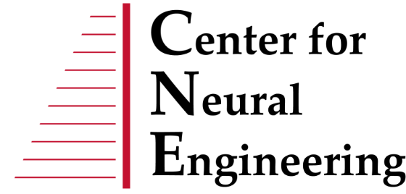
Modeling High-Frequency Stimulation for Blocking Nociception
Michael Paskett
Hunter Strathman

Slide 2
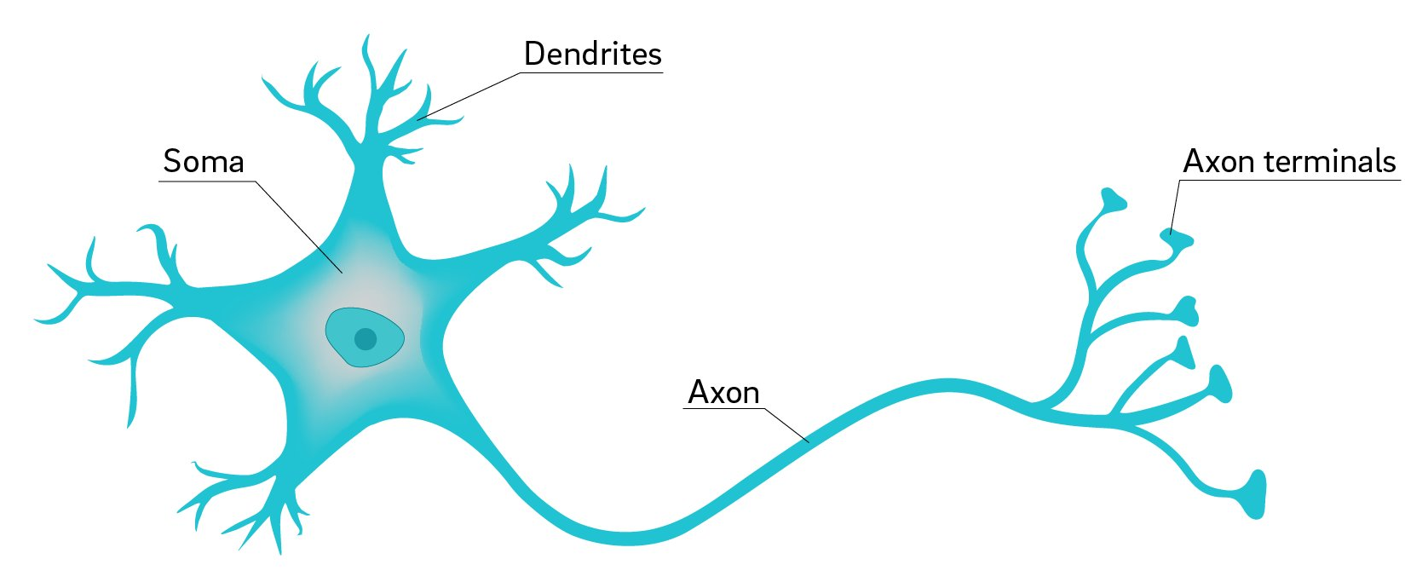
Neuropathic Pain
Pain caused by damage or disease affecting the somatosensory nervous system
Commonly associated with unpleasant sense of touch (dysesthesia) and pain from typically non-painful stimuli (allodynia)
https://3c1703fe8d.site.internapcdn.net/newman/gfx/news/hires/2018/2-whyareneuron.jpg

Slide 3
High-Frequency Stimulation Blocks Action Potential Propagation
Kilohertz high frequency alternating current (KHFAC) stimulation blocks neural signals through persistent depolarization of axons at the electrode-nerve interface (Kilgore et. al 2006)
Intrafascicular electrodes (i.e., Utah Slanted Electrode Arrays) have been used to provide a conduction block selective to nociceptive (pain) fibers (Duncan et. al 2018)
Nociceptive fibers (unmyelinated)
Sensory/motor fibers (myelinated)

Slide 4
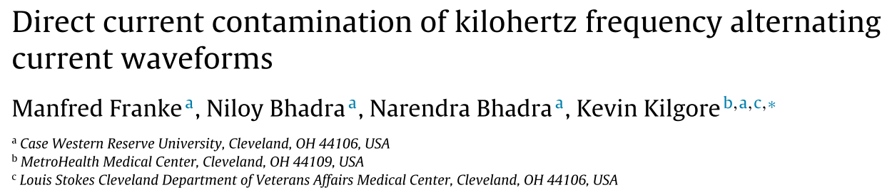
True AC Block?
Is the block due to imperfect waveform generation?
Direct current stimulation known to cause conduction block
What is the physiological mechanism?
“persistent depolarization of axons”? (Kilgore 2006)
What can we learn from a modeling perspective?

Slide 5
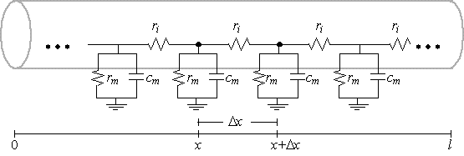
Multi-Compartment HH Model
Length: 1 cm
Diameter range: 0.5 μm – 20 μm
Myelinated/Unmyelinated
100 Compartments

Slide 6
Neuron Model
$$\frac{dV}{dt}=\frac{G_{Na}\left(V_{Na}−V_{IN}\right)+G_{K}\left(V_{K}−V_{IN}\right)\text{ + }G_{L}\left(V_{L}−V_{IN}\right)+\frac{(V_{IN−1}−V_{IN})}{R_{i}}+\frac{(V_{IN+1}−V_{IN})}{R_{i}}}{C_{M}}$$
Notes:
Discuss myelinated vs unmyelinated oK?

Slide 7
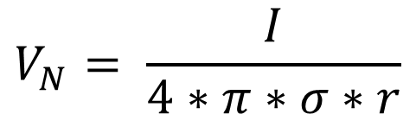
Extracellular Stimulation
Assumptions:
Infinite medium
Homogenous solution
$$V_{N}= \frac{I}{4∗π∗σ∗r}$$

Slide 8
Experimental Design
Extracellularly stimulate (kHz AC and DC) myelinated and unmyelinated neurons of varying sizes to provide conduction block
Start AP at one end of the axon (intracellular)
Try to block at center of axon with different forms of stimulation
Fiber Types
C fibers (0.5-2 um diameter, unmyelinated)
A-delta fibers (1-5 um diameter, myelinated)
A-beta fibers (6-12 um diameter, myelinated)
A-alpha fibers (15-20 um diameter, myelinated)
Stimulation Waveforms
4 kHz AC – constant amplitude
4 kHz AC – ramped
See if we can reduce onset response
DC – Constant amplitude
DC – Ramped

Slide 9
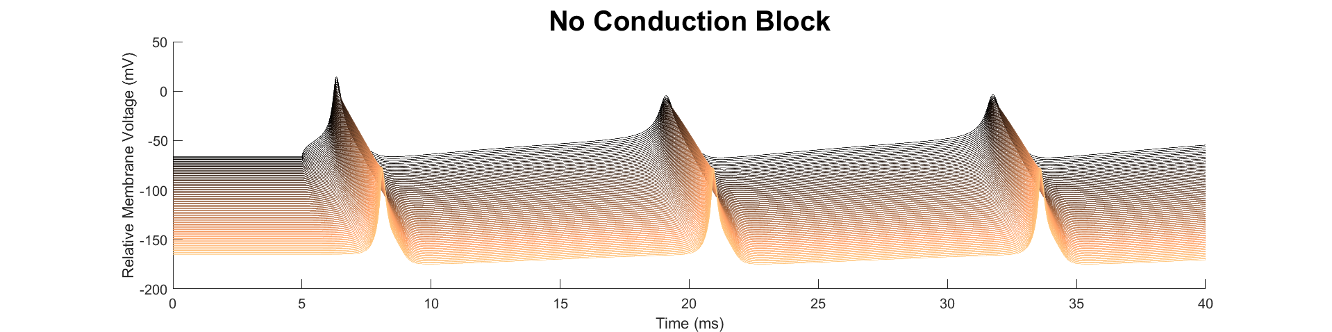
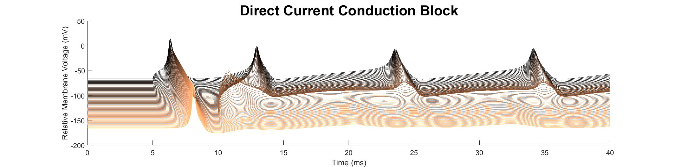
Intracellular Conduction Block
Notes:
Why we started with intracellular

Slide 10
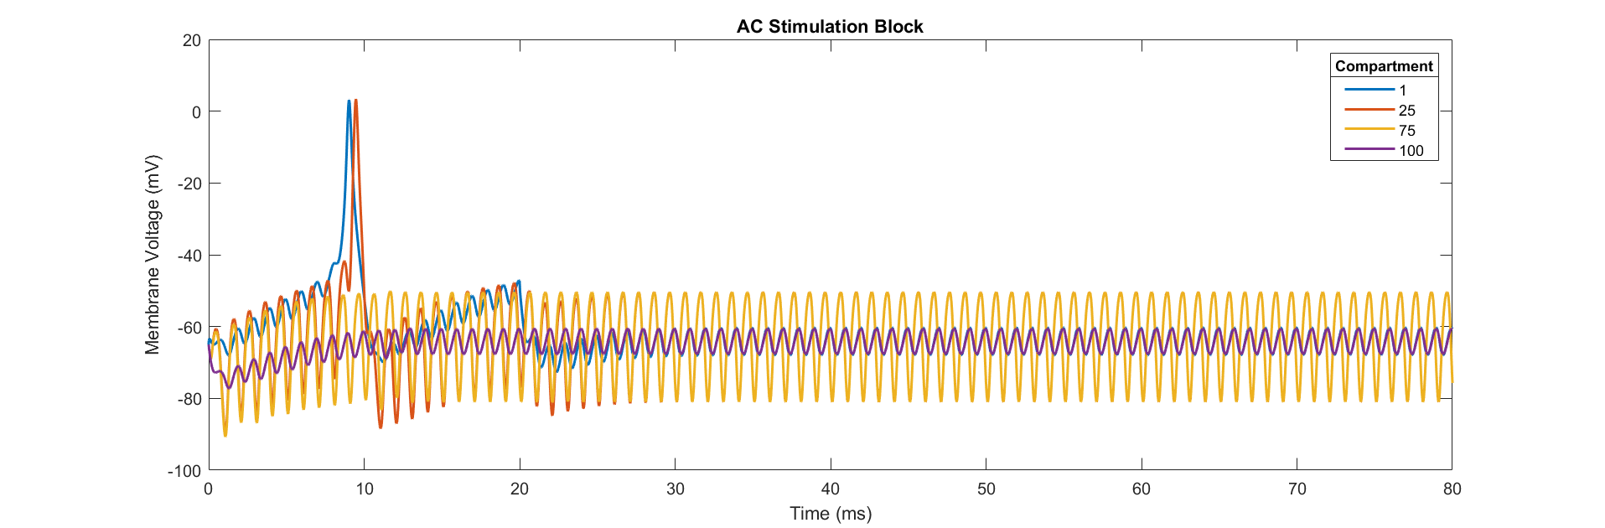
Intracellular Conduction Block

Slide 11
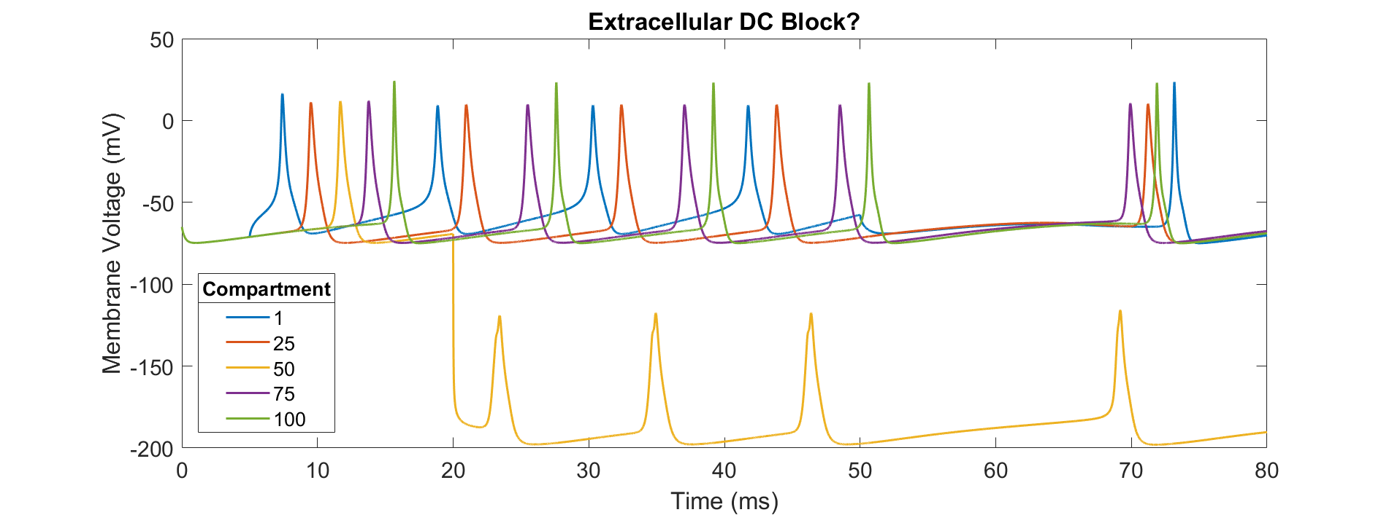
Extracellular Conduction Block
(So Far…)

Slide 12
Conclusions…
Simulated conduction block via intracellular stimulation
Haven’t demonstrated successful conduction block with extracellular DC stimulation
Future work – refine model

Slide 13
Thank you!
Questions?

