Slide 1
Scalability and performance analysis of concurrent data structures.

Slide 2
Queues
Fundamental data structure, used in many programming environments
Applications: Web servers, managing interruptions, communication between processes , pipes, files, cpu scheduling ...
Essential when a First In First Out order needs to be kept.
Usually implemented by a simple linked list

Slide 3
Basic operations
Dequeue
Head
Tail

Slide 4
Basic operations
Dequeue
Tail
Head
Only need to move one pointer

Slide 5
Basic operations
Dequeue
Tail
Head
… then we are free to delete the old node

Slide 6
Basic operations
Enqueue
Head
Tail

Slide 7
Basic operations
Enqueue
Add a new node
Head
Tail

Slide 8
Basic operations
Enqueue
Link it with the last node
Head
Tail

Slide 9
Basic operations
Enqueue
Update Tail
Head
Tail

Slide 10
Concurrent Queues
Sometimes there is need for several threads/processes to use a shared queue
Useful in a scenario where several threads put work items in the queue ,while other worker threads extract them.
An efficient concurrent implementation is needed … but it can be challenging.
Need for:
a) High throughput (operations per second executed )
b) Low latency (the time it takes one thread to perform an operation)

Slide 11
Concurrent Queues
A data structure that inherently does not allow enough concurrency
Operations are serialized on two endpoints
Synchronization is needed to keep it consistent
Thread 1 allocates a new node and reads the Tail
Thread 2 inserts a new node
Thread 1 wakes up inserts the node without being aware of the change
Tail
Head
Head
Tail

Slide 12
Approaches
Locking
Lock – free
Flat combining

Slide 13
1) Global lock
Introduce a simple TTAS lock, protecting the whole data structure
Before performing any operation, take the lock
+ Pros
    Easy to implement
- Cons
    Very bad performance
    Small critical section. Sync cost is dominant
    Over-subscription
    Not robust

Slide 14
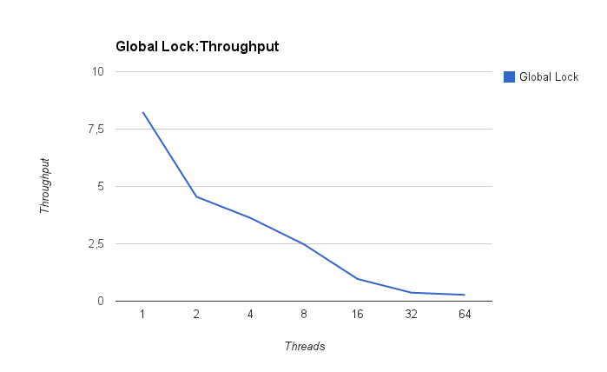
1)Global lock
Reasons for bad scaling
Very small critical section
Cache coherence traffic

Slide 15
Sandman Architecture
L3
L2
L1
0
32
1
33
2
34
3
35
4
36
5
37
6
38
7
39
Numa node
X4 Numa Nodes

Slide 16
Step 1) read shared lock variable
L3
S
S
0
32
1
33
2
34
3
35
4
36
5
37
6
38
7
39
Numa node

Slide 17
Step 1) read shared lock variable
Step2)atomically set lock, invalidating other copies
L3
M
I
0
32
1
33
2
34
3
35
4
36
5
37
6
38
7
39
Numa node

Slide 18
Step 1) read shared lock variable
Step2)atomically set lock, invalidating other copies
Step3)the same with lists's pointers
L3
M
I
I
0
32
1
33
2
34
3
35
4
36
5
37
6
38
7
39
Numa node
Tail

Slide 19
Step 1) read shared lock variable
Step2)atomically set lock, invalidating other copies
Step3)the same with lists's pointers
In the meantime some threads may read the lock
L3
S
I
S
0
32
1
33
2
34
3
35
4
36
5
37
6
38
7
39
Numa node

Slide 20
Step 1) read shared lock variable
Step2)atomically set lock, invalidating other copies
Step3)the same with lists's pointers
In the meantime some threads may read the lock
Step4)unset the lock, invalidating other copies
L3
M
I
I
0
32
1
33
2
34
3
35
4
36
5
37
6
38
7
39
Numa node

Slide 21
If not on the same node, all this traffic goes through Ram and across nodes
miss
L3
M
RAM
0
32
1
33
2
34
3
35
4
36
5
37
6
38
7
39
hit
Numa node
Cache coherence traffic
L3
I
0
32
1
33
2
34
3
35
4
36
5
37
6
38
7
39
Numa node

Slide 22
Critical section is too small compared to the synchronization overhead
Constant reading the lock during spinning creates a lock of traffic
Suggestion: back off
When a thread finds the lock taken, it wont try to check it's state again for a certain period.

Slide 23
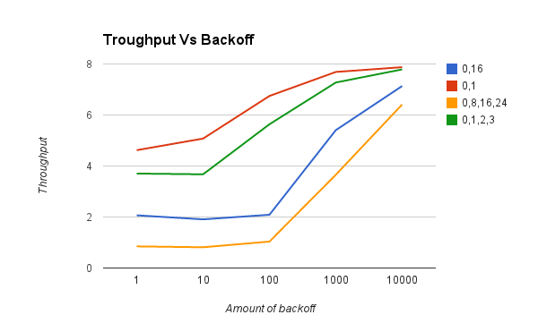
Effect of backoff

Slide 24
Queues seem to benefit from increased backoff
Its possible that the same thread will consecutively take the lock multiple times, improving cache locality.
But... The lock is less fair. Some threads may have their operations stalled, making this approach not fitting for real time applications.

Slide 25
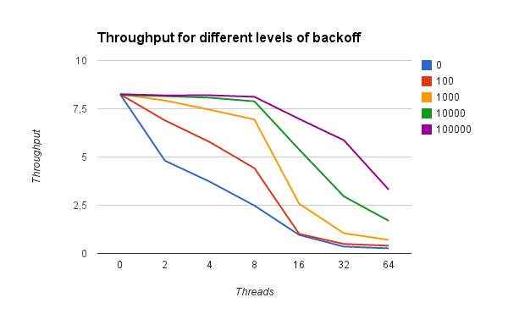
Still need to:
Improve cache footprint
Achieve robustness

Slide 26
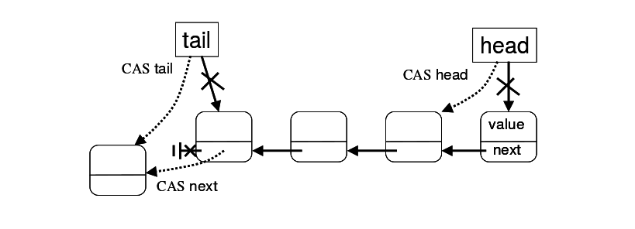
2)Michael Scott Queue
One of the first lock-free approaches on queues
Uses CompareAndSwap to move around pointers instead of local stores
Enqueue normally requires 2 CAS's and dequeue 1 CAS
2
1
1

Slide 27
Now there is no lock so there is one less memory location to modify
Every thread can atomically progress, achieving robustness.

Slide 28
However..
The ABA problem can complicate implementation
“… if a process read a value A in a shared location, computes a new value and then attempts a CAS operation, the CAS may succeed when it should not, if between the read and the CAS, some other procces(es) changed the A to B and then back to A again. “
Common example: Read the Tail pointer and then CAS it, but in the meantime the node pointed to by Tail has been deallocated, and that that address has been given to a newly allocated, completely different node.
Standard solution: Reserve some bit of the pointer to a counter, and update the whole word atomically.
...but programming is more complex + overheads manipulating the bits
counter
pointer
Unsigned long long

Slide 29
… also
CompareAndSwap costs more than a simple store, especially over NUMA.
Failing a CAS means that the operation needs to start over ( re-read Tail, retry the first CAS..)

Slide 30
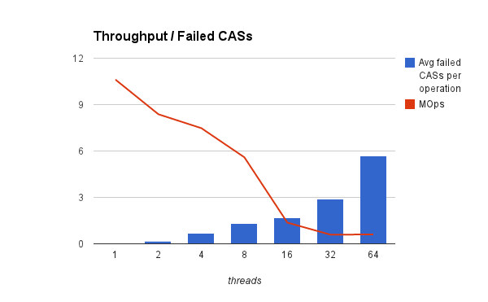

Slide 31
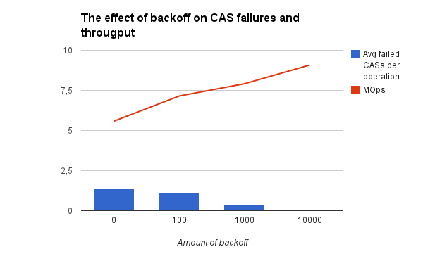
Contention seems to increase cache failures. So we try again to introduce some backoff, just as we did with global locks

Slide 32
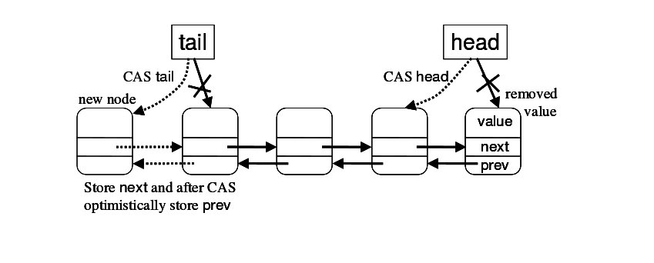
3)Optimistic
Still the Cost is high(especially over NUMA).
Try to reduce it by substituting one of the CASs with a simple local store.
List now becomes doubly linked
Updating tail is done atomically but linking the last node is done locally
Step1:atomically
Step2:locally

Slide 33
normal case ->fast
In the common case, the local store will quickly follow the atomic operation and the queue remains consistent ..
rare case->slow
...but it is possible that another enqueue will succeed between the CAS and the local store. Then we need to traverse the whole list and fix pointers
Optimistic approach = Do the common case fast

Slide 34
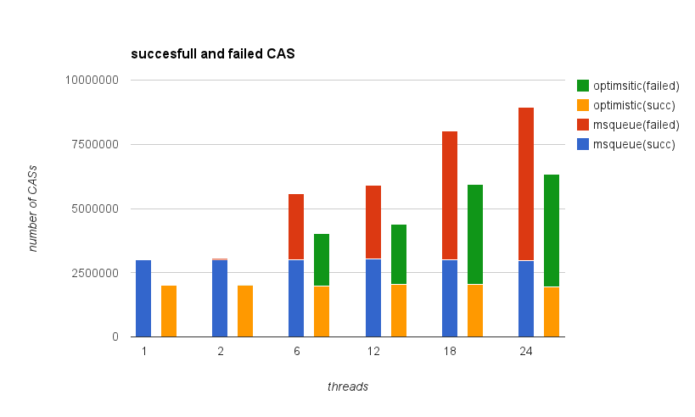

Slide 35
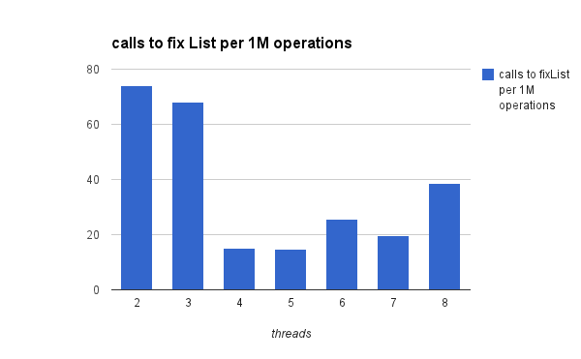
Calls to fixList remains low despite contention

Slide 36
Two problems still remain:
Critical section is too small
Sharing variables between threads kills cache locality
Introducing heavy backoff was a step forward but not fair

Slide 37

4)Flat Combining
A level of abstraction over sequential data structures that provides “parallelization” and synchronization
Step1: Push request in the array of public records
Public records
Data structure
Request parameters

Slide 38
4)Flat Combining
A level of abstraction over sequential data structures that provides “parallelization” and synchronization
Step2: Attempt to acquire the lock( if not taken)
Public records
Data structure
Reuest parameters

Slide 39
4)Flat Combining
A level of abstraction over sequential data structures that provides “parallelization” and synchronization
Step3: If the lock is taken spin on the record
Public records
Data structure
The thread that takes the lock (combiner) traverses through the requests of all threads and applies them on by one.

Slide 40
Benefits
Critical section is bigger. Batches of work
Access in the data structure is done by only one thread . Use of sequential algorithms to perform operations
Instead of applying operations one by one, they can be combined. Example: eliminate push-pop requests for stacks.

Slide 41
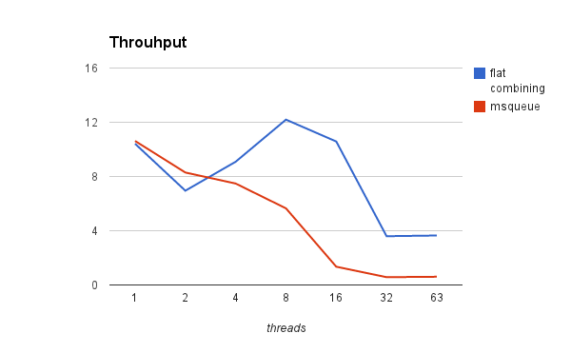
Much better performance inside the node

Slide 42
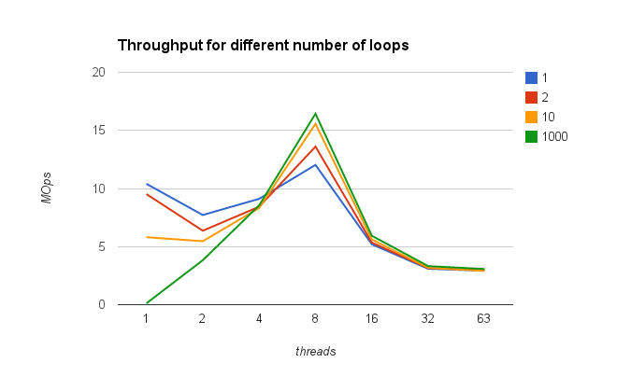
We can keep a combiner looping over the public records more than one time

Slide 43
By extending that idea, we can see that it might be better to have a dedicated combiner, residing in a specific core that will serve all requests. This way references on the lists nodes will always hit

Slide 44
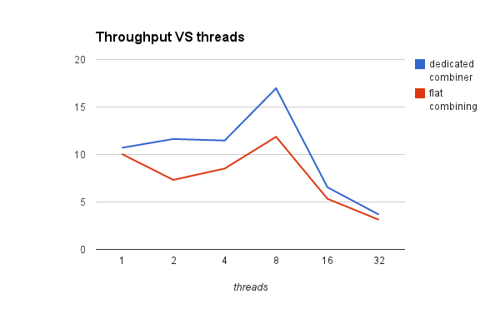

Slide 45
NUMA effect!
Keeping the list in a cache cannot longer give a good speedup. The main overhead is communication over NUMA.

Slide 46
A Hybrid Approach
Perform flat combining on every node
Only the combining threads of each node compete on a simple lock to access the data structure
Flat combining
Flat combining
Numa node
Numa node
Flat combining
Flat combining
Data structure
Numa node
Numa node

Slide 47
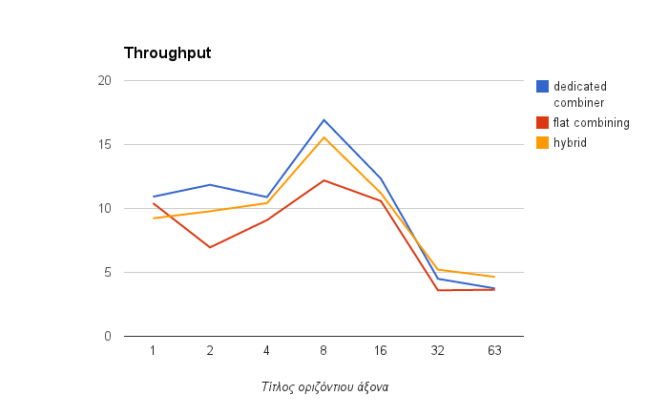
TODO: sygkentrwtiko throughput

Slide 48
