Slide 1
Portable Predictions
Learning Housing Prices Across
Diverse Markets
Mahek Patel
Joe Bryant
Nathan Deering
DATA 780 - FINAL PROJECT
Notes:
6-7 minute Presentation
1-2 minutes of Q/A
2-3 minutes for slide deck
2-3 minutes for live demo of Streamlit application and explantation

Slide 2
PORTABLE PREDICTIONS
Problem & Motivation
DATA 780 - FINAL PROJECT
Why It Matters:
Informs affordability, mortgage risk, investment decisions
Supports planners, lenders, real estate professionals, and policymakers
Key Problems We Aim to Solve:
How to predict housing prices accurately at a granular, local level
Which local/contextual features truly drive housing prices
Why models fail to generalize to new regions
How to make models more transparent and interpretable

Slide 3
PORTABLE PREDICTIONS
Limitations in Current Models
DATA 780 - FINAL PROJECT
What’s Missing from Existing Approaches
Rely on data from a single city or region
Excludes key neighborhood level factors (crime, schools, zoning, etc.)
Are vulnerable to residual bias and low R²
Perform poorly when applied outside of training data areas

Slide 4
PORTABLE PREDICTIONS
Project Goals
DATA 780 - FINAL PROJECT
Boost prediction accuracy
Improve generalizability across regions
Ensure transparency and trustworthiness of homing prices

Slide 5
PORTABLE PREDICTIONS
Our Data & Methods
DATA 780 - FINAL PROJECT
Census ACS PUMS combined with ZIP/PUMA crosswalks for better geographical features
Data is stored in a view sent from a few Python scripts to a PostgreSQL instance deployed on Heroku.
Models: Linear regression, Ridge, Random Forest, XGBoost
Use SHAP to interpret and explain feature influence

Slide 6
PORTABLE PREDICTIONS
Results
DATA 780 - FINAL PROJECT
Ensemble models (Random Forest and XGBoost) outperform linear counterparts (Linear and Ridge)
SHAP Interpretability - Feature Importance
Top Features - Household Income and Income to Value Ratio
Less Impactful Features - Number of Bedrooms and Safety Score

Slide 7
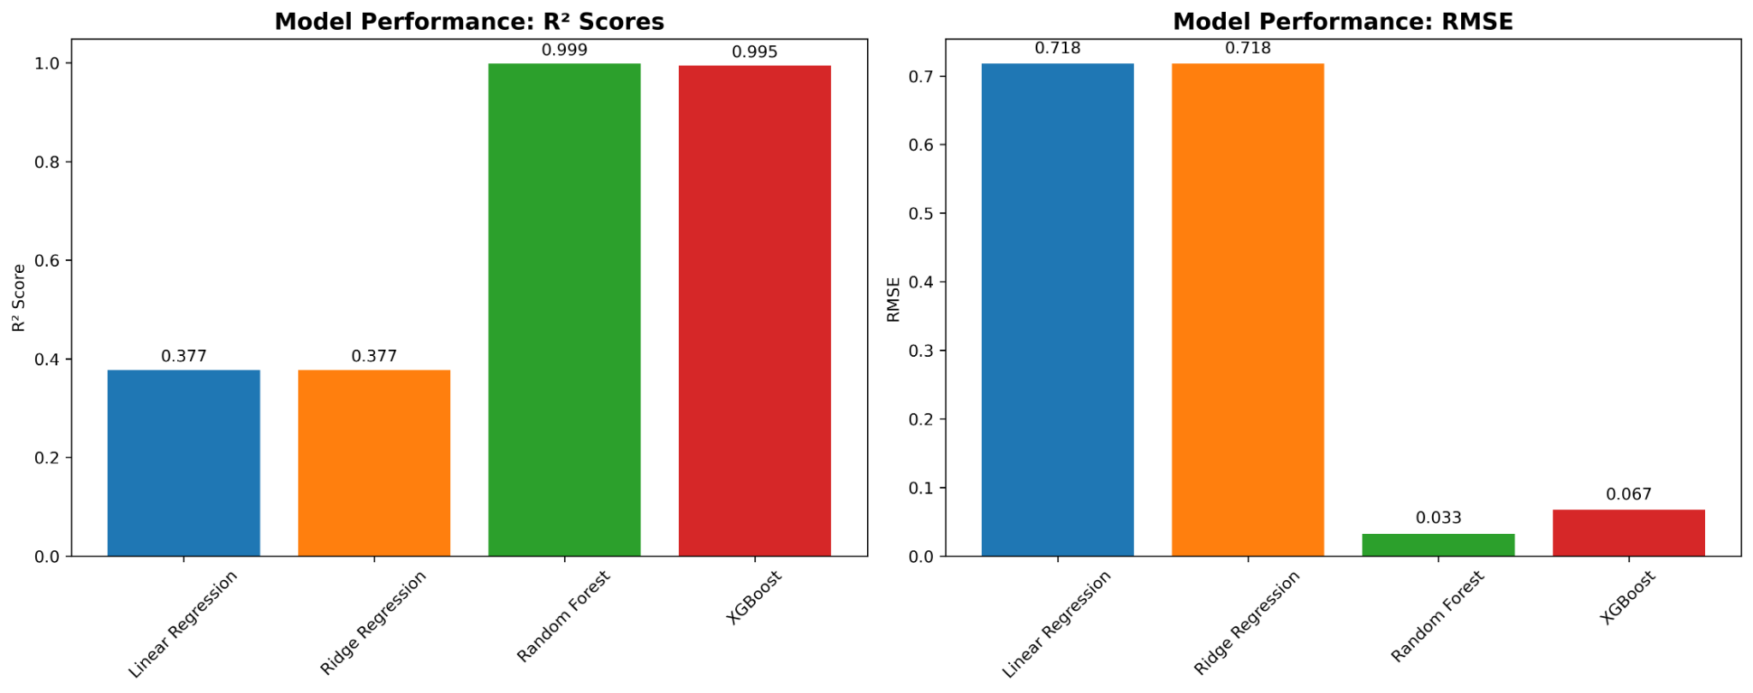
PORTABLE PREDICTIONS
Model Performance
DATA 780 - FINAL PROJECT

Slide 8
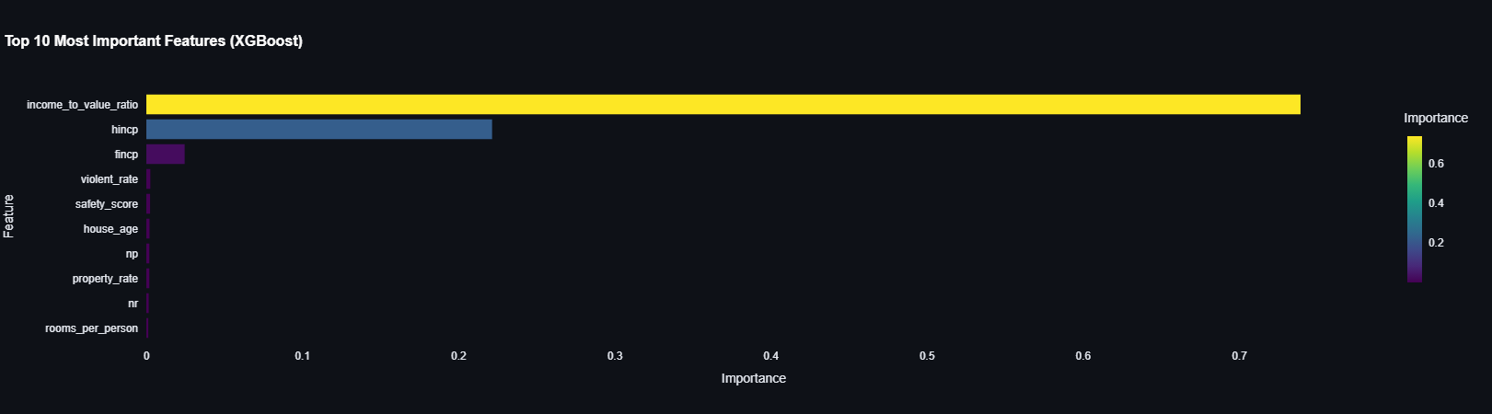
PORTABLE PREDICTIONS
Feature Importance
DATA 780 - FINAL PROJECT

Slide 9
PORTABLE PREDICTIONS
Live Demo
DATA 780 - FINAL PROJECT
Portable Predictions Streamlit Dashboard
https://portablepredictions.streamlit.app/

Slide 10
