Slide 1
Asteroid Adventure
Team 4
Junkai Hu, Meekit Patel, Chris Conover

Slide 2
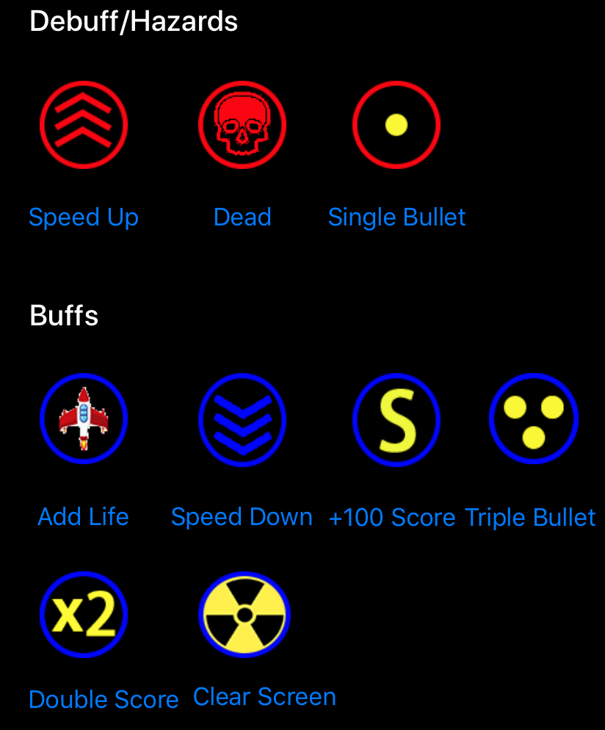
Highlights:
Realtime automatic generated cosmos background
Randomized asteroid (specie, position, angle) and powerups (type, movement direction)
Tilting control of spaceship position
Explosion & sound effects
A lot of powerups with interesting functions and original-designed artworks

Slide 3
How to deal with different kind of interactions
What kind of interactions we want to deal with or not:
✅ bullet and asteroid, asteroid and spaceship, spaceship and powerups
⛔️ asteroids and powerups, bullet and powerups, between asteroids, between powerups
Solution: collisionBitMask & categoryBitMask
if (A.collisionBitMask & B.categoryBitMask != 0 || B.collisionBitMask & A.categoryBitMask != 0 ) {
//perform some interactions
} else {
//No interaction
}
 | collisionBitMask | categoryBitMask
Spaceship | 0000 | 0011
Asteroid | 0010 | 0001
Bullet | 0001 | 0000
Powerup | 0110 | 0000
 | Spaceship | Asteroid | Bullet | Powerup
Spaceship | ⛔️
Asteroid | ✅ | ⛔️
Bullet | ✅ | ✅ | ⛔️
Powerup | ✅ | ⛔️ | ⛔️ | ⛔️

