Slide 1
Recidivism Analysis: Behavioral Thinking Programs, Mental Health, and Reentry Outcomes
Foundations of Data Science Final Project
Mitesh Patel

Slide 2
Introduction – Goal and Importance
Goal: Analyze how cognitive education programs, mental health/substance abuse conditions, and employment exemption status relate to recidivism within 3 years.
Why It's Important:
High recidivism rates challenge successful reentry.
Reducing recidivism helps improve societal safety and reintegration success.
Personal connection: Justice-impacted background (sentence reduced from 180 months to 145 months)
Research Question: How do cognitive education programs, mental health/substance abuse conditions, and employment exemption status affect recidivism within 3 years?

Slide 3
Hypothesis
Null Hypothesis (H₀):
There is no association between the tested factor and recidivism within 3 years. (Receiving cognitive education has no effect on whether someone recidivates.)
Alternative Hypothesis (H₁):
There is an association between the tested factor and recidivism within 3 years. (Receiving cognitive education does affect whether someone recidivates.)

Slide 4
Motivation for This Project
As a justice-impacted individual who served 145 months in federal prison and is currently in a halfway house until February 22, 2027, I have firsthand experience with the challenges of reentry.
I chose this project to explore how reentry programs, especially cognitive education, can help reduce recidivism and create real opportunities for successful reintegration.

Slide 5
Data Source
Source: National Institute of Justice (NIJ) Recidivism Challenge Dataset
Dataset Size:
25,835 individuals released from Georgia state prisons
28 variables (age, gender, education, programs, recidivism, etc.)
Data Link - Public NIJ repository: https://catalog.data.gov/dataset/nijs-recidivism-challenge-test-dataset2

Slide 6
Methodology
Tools: Python (Jupyter Notebook)
Libraries: pandas, seaborn, matplotlib, scipy
Techniques:
Data Cleaning: Lowercase standardization, whitespace removal, boolean replacements, type conversions
Data Transformations: Grouping, cross-tabulation, contingency tables
Statistical Testing: Chi-Square Tests of Independence (p-value comparisons)
Data Visualizations: Stacked bar charts and grouped bar charts

Slide 7
Key Findings
Mental Health/Substance Abuse:
Strongest predictor of recidivism.
Cognitive Education Programs:
Lower recidivism among participants without MH/SA conditions.
Employment Exemption:
Exempt individuals exhibited higher recidivism rates.
Age at Release:
Younger individuals reoffend at higher rates compared to older individuals.

Slide 8
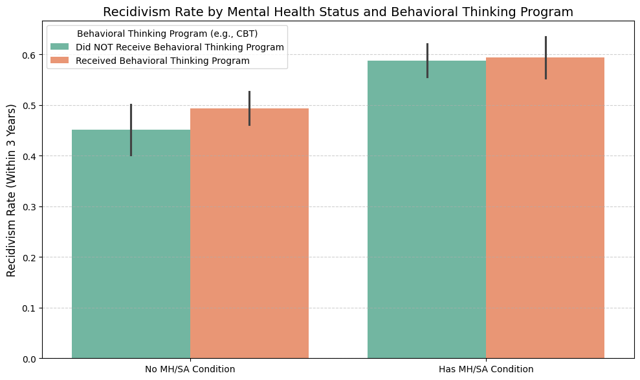
Recidivism by MH/SA & Cognitive Education
Highest recidivism in individuals with MH/SA conditions—even with cognitive education
Suggests that behavioral programs alone may not be sufficient for high-risk groups
Need for integrated mental health and addiction treatment

Slide 9
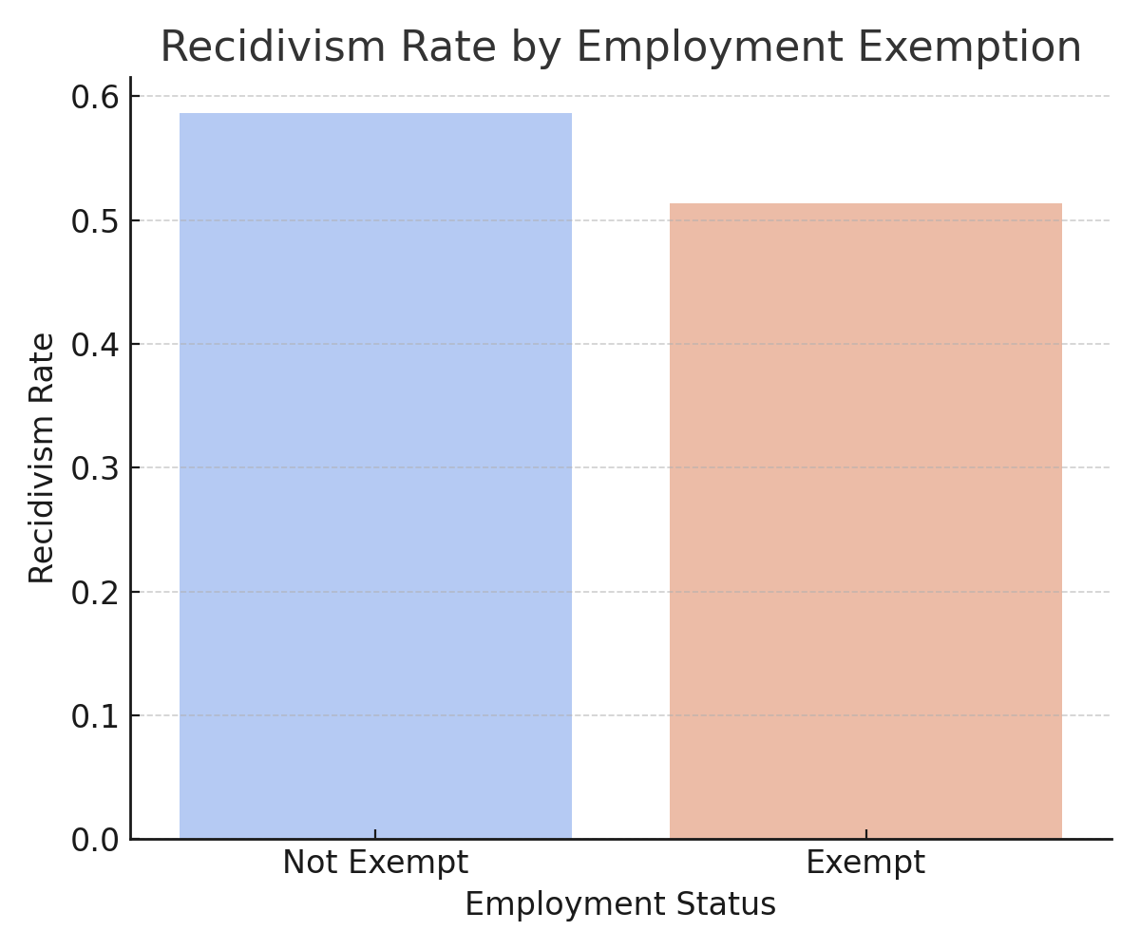
Recidivism by Employment Exemption
Individuals exempt from employment had higher recidivism
Indicates potential vulnerability or lack of reintegration structure
Work placement may contribute to reduced recidivism

Slide 10
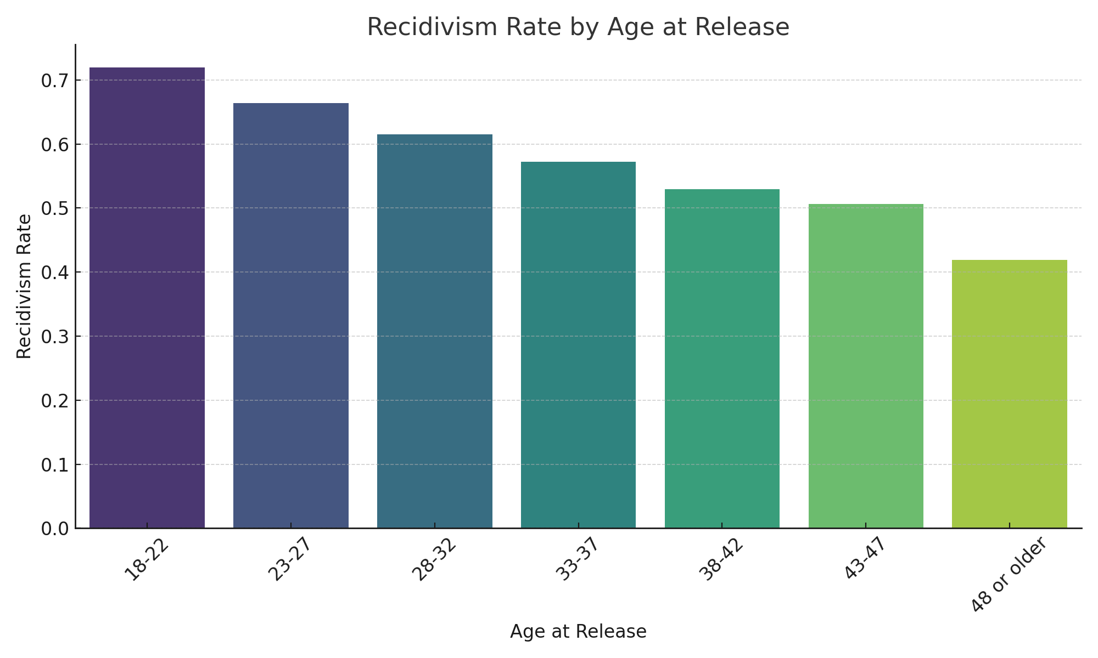
Recidivism by Age at Release
Younger age groups (18–27) showed higher recidivism
May reflect maturity factors and fewer responsibilities
Could inform targeted programming for younger releases

Slide 11
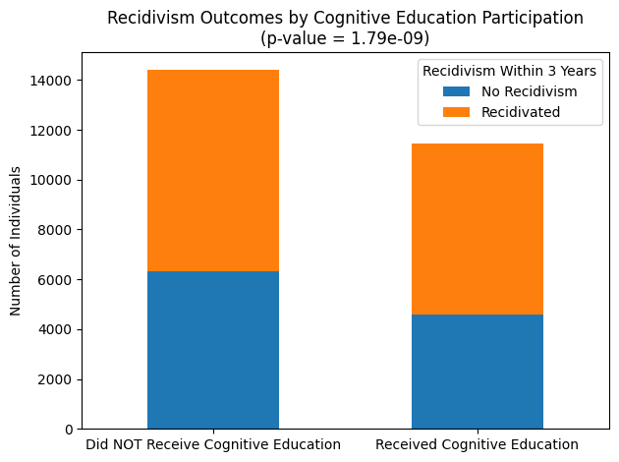
Statistical Summary

Slide 12
Statistical Summary
Chi-Square Test Results:
All p-values were < 0.05, indicating statistically significant relationships.
Significant associations found between:
Mental Health/Substance Abuse conditions and recidivism
Cognitive Education participation and recidivism
Employment Exemption status and recidivism
Inference:
We reject the null hypothesis for all tested variables.

Slide 13
Conclusions
Addressing mental health and substance abuse is critical for reducing recidivism.
Cognitive education programs are helpful but not sufficient alone for high-risk populations.
Structured employment expectations play a key role in successful reentry.

Slide 14
References
National Institute of Justice Recidivism Challenge Dataset
https://data.ojp.usdoj.gov/Courts/NIJ-s-Recidivism-Challenge-Full-Dataset/ynf5-u8nk
Python libraries: pandas, seaborn, matplotlib, scipy
Cognitive Behavioral Therapy info: https://nicic.gov/cognitive-behavioral-interventions

