Slide 1
Lumen Grid
from MATLAB

Slide 2
Transpose
idealised mesh
onto segment

Slide 3
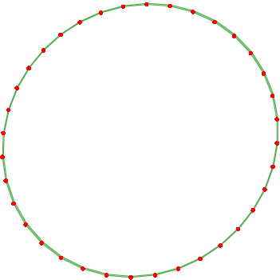
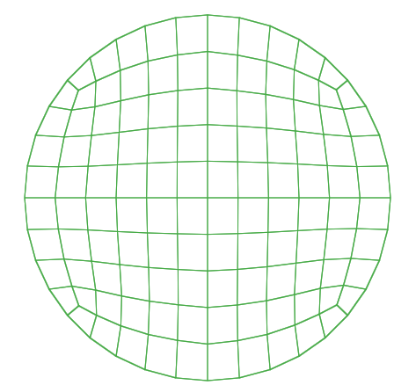
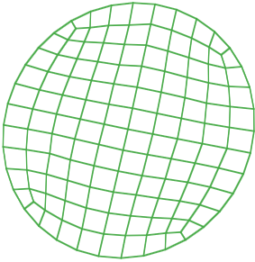
lumen mesh segment
Idealised structured mesh
rotate
transpose

Slide 4
Transpose
1st end layer
and mirror
onto a mid-layer

Slide 5
Transpose
idealised mesh
onto the
two segments

Slide 6
Add elements
to outer
segments

Slide 7
Transpose next
end layer, add
mid-layer &
transpose mesh

Slide 8
Add addition
nodes

Slide 9
Add elements
to remaining
end segments

Slide 10
Add elements
to remaining
end segments

Slide 11
Transpose next
end layer, add
mid-layer &
transpose mesh

Slide 12
Add elements
to end outer
segments
inner to out

Slide 13
Add elements
to end outer
segments
inner to out

Slide 14
Add elements
to end outer
segments
inner to out

Slide 15
Add elements
to remaining
end segments

Slide 16
Add elements
to remaining
end segments

Slide 17
