Slide 1
Lumen Grid
from MATLAB

Slide 2
Transpose
idealised mesh
onto segment

Slide 3
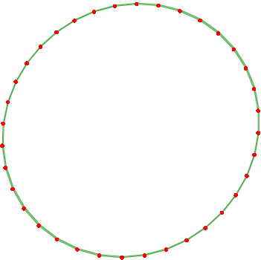
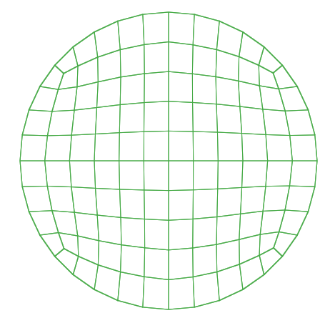
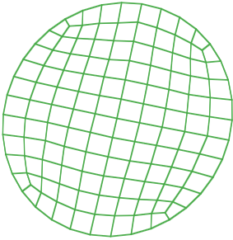
lumen mesh segment
Idealised structured mesh
rotate
transpose

Slide 4
Transpose
1st end layer
and mirror
onto a mid-layer

Slide 5
Transpose
idealised mesh
onto the
two segments

Slide 6
Transpose next
end layer, add
mid-layer &
transpose mesh

Slide 7
Transpose next
end layer, add
mid-layer &
transpose mesh

Slide 8
Continue
transposing
idealised mesh
into constriction

Slide 9
Continue
transposing
idealised mesh
into constriction

Slide 10
Add
elements
to last
end segment

Slide 11
Mirror
next segment
at mid-point

Slide 12
Add elements to
next end segment
& added
mid-segment

Slide 13
Add elements
to remaining
end segments

