Slide 1





HARP: Practically and Effectively Identifying Uncorrectable Errors in Memory Chips That Use On-Die Error-Correcting Codes
Minesh Patel, Geraldo F. Oliveira, Onur Mutlu
Session 6A: Wednesday 20 October, 7:45 PM CEST
Notes:
Hi, I’m Minesh, and today I will introduce HARP.

Slide 2
HARP Summary
Motivation: state-of-the-art memory error mitigations often require the processor to identify which bits are at risk of error (i.e., profiling)
Problem: on-die ECC complicates error profiling by altering how errors appear outside of the memory chip
Goal: understand and address the challenges on-die ECC introduces
Contributions:
​Analytically study on-die ECC’s effects and identify three key challenges
Exponentially increases the number of at-risk bits
Makes individual at-risk bits harder to identify
Interferes with commonly-used memory data patterns
​Hybrid Active-Reactive Profiling (HARP):
Separately identifies (1) raw bit errors and (2) errors introduced by on-die ECC
Effectively reduces profiling with on-die ECC into profiling without on-die ECC
Evaluation: demonstrate that HARP overcomes the three challenges
HARP identifies all errors faster than two baselines, which sometimes fail to achieve full coverage of at-risk bits
Case study showing that HARP identifies all errors faster than the best-performing baseline (e.g., by 3.7x for a raw per-bit error probability of 0.75)
Notes:
[CLICK] Our motivation is that…

Slide 3
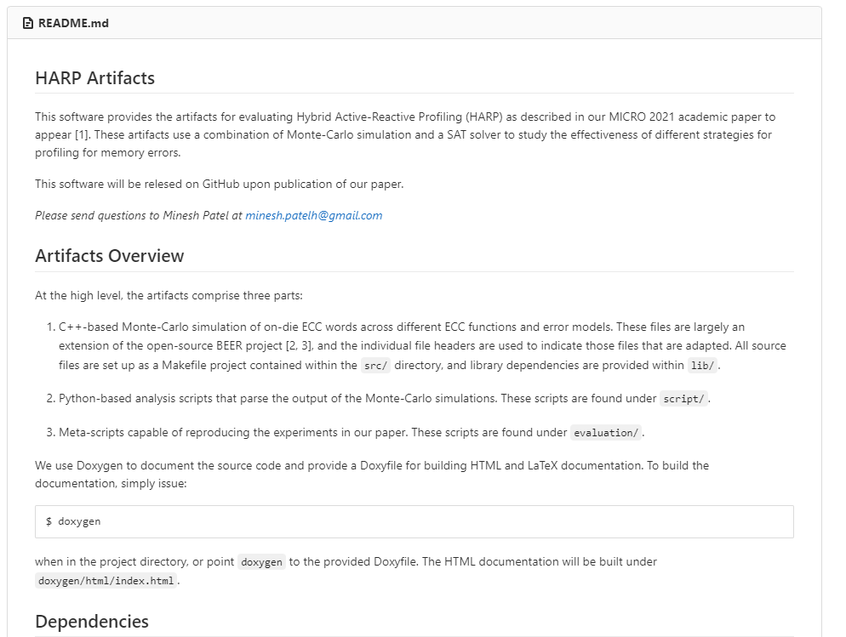
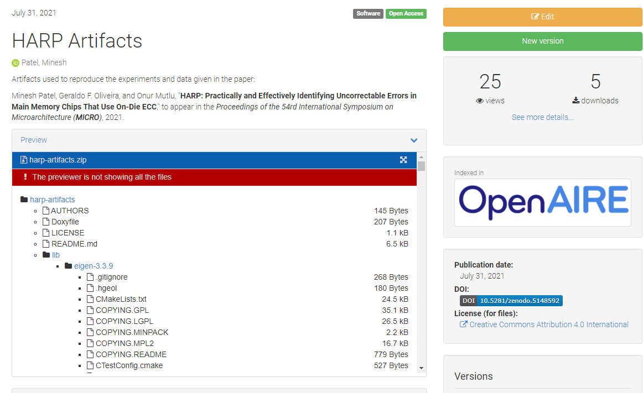
Artifacts are Open-Sourced
https://github.com/CMU-SAFARI/HARP
Notes:
HARP is open-sourced and artifact evaluated.
All necessary source code to reproduce our studies is available on GitHub and Zenodo.

Slide 4
HARP: Practically and Effectively Identifying Uncorrectable Errors in Memory Chips That Use On-Die Error-Correcting Codes
Minesh Patel, Geraldo F. Oliveira, Onur Mutlu
Session 6A: Wednesday 20 October, 7:45 PM CEST
Notes:
We invite everyone to attend our talk in Session 6A on 20th October.

