Slide 1





HARP: Practically and Effectively Identifying Uncorrectable Errors in Memory Chips That Use On-Die Error-Correcting Codes
Minesh Patel, Geraldo F. Oliveira, Onur Mutlu
https://arxiv.org/abs/2109.12697
https://github.com/CMU-SAFARI/HARP
Notes:
Hello everybody, thanks for attending. I’m Minesh, and today I will give a quick recap of our work HARP.

Slide 2
Memory Errors
DRAM
PCM
MRAM
All suffer worsening error rates with
continual technology scaling
Notes:
Let’s start off by talking about memory errors.
[CLICK] There are a broad range of memory technologies that are suitable for main memory
[CLICK] and each of these technologies suffers from various types of errors that worsen with continued memory technology scaling

Slide 3
Memory Repair Mechanisms
Repair mechanisms combat high memory error rates
Identify and repair any bits that are at-risk of error
Memory Controller
Unreliable Memory
Repair Mechanism
Error-Prone
Data Store
write data
write data
To/from CPU
Error Profile
repaired
read data
read data
Must know
which bits to repair
Determined through
“Error Profiling”
Notes:
To manage growing error rates, we consider a state-of-the-art group of solutions known as memory repair mechanisms
[CLICK] These mechanisms address high error rates by identifying and repairing any bits that are at risk of error
[CLICK] Here we have a picture of a system that uses a repair mechanism.
On the right, we have an unreliable memory, and on the left, and a memory controller that contains a repair mechanism.
The repair mechanism itself repairs any bits that are marked as “at risk” within an error profile
[CLICK] When the CPU performs a write operation, the data is written through the repair mechanism.
[CLICK] When the CPU performs a read operation, the data is first repaired before being returned.
[CLICK] However, the repair mechanism can only repair bits that it knows are at-risk of error.
As a consequence, the repair mechanism is dependent on identifying at-risk bits
[CLICK] This process is known as error profiling.

Slide 4
Profiling a Memory Chip
Profiler’s goal: identify all bits that are at risk of error
Profiler cannot see into the memory
Memory Chip
(Without On-Die ECC)
Memory Chip
(With On-Die ECC)
Data Store
Data Store
raw data
On-Die ECC
raw data
post-correction data
Profiler marks the bits
that are observed to fail
Notes:
Let’s take a look at how we profile for memory errors
[CLICK] A profiler’s goal is to identify all bits that are at risk of error.
We have two types of DRAM to consider.
[CLICK] In a memory chip without on-die ECC, the data observed outside of the DRAM chip is the same as the raw data in the data store
[CLICK] For a chip with on-die ECC, post-correction data is observed, which is not necessarily the same as the raw data within the memory chip
[CLICK] In either case, the profiler cannot see directly into the memory
[CLICK] Instead, the profiler simply observes errors at the interface and declares those bits to be at risk of error, regardless of what occurs within the memory itself

Slide 5
Profiling a Memory Chip
Profiler’s goal: identify all bits that are at risk of error
Memory Chip
(Without On-Die ECC)
Memory Chip
(With On-Die ECC)
Data Store
Data Store
raw data
On-Die ECC
raw data
post-correction data
Q: How does on-die ECC
affect error profiling?
Notes:
So the question we ask in this work is “how does on-die ECC affect error profiling?”

Slide 6
Profiling a Memory Chip
Profiler’s goal: identify all bits that are at risk of error
Memory Chip
(Without On-Die ECC)
Memory Chip
(With On-Die ECC)
Goal: understand and address the challenges
that on-die ECC introduces for error profiling
Data Store
Data Store
raw data
On-Die ECC
raw data
post-correction data
Q: How does on-die ECC
affect error profiling?
Notes:
And to answer this question, our goal in this work is to understand and address the challenges that on-die ECC introduces for error profiling.

Slide 7
Challenges Introduced by On-Die ECC
Exponentially increases the at-risk bits
1
A small set of raw bit errors generates a combinatorially larger set of at-risk bits
Harder to identify each at-risk bit
2
At-risk bits are exposed only when specific raw bit error patterns occur
Interferes with data patterns
³
Data patterns must consider combinations of raw bits instead of just individual bits alone
Notes:
To this end, we study how on-die ECC interferes with error profiling and identify three key challenges that on-die ECC introduces
[CLICK] First, on-die ECC exponentially increases the number of at-risk bits the profiler must identify
This is because a small set of raw bit errors can give rise to a combinatorially larger set of at-risk bits
[CLICK] Second, on-die ECC makes each at-risk bit harder to observe
This is because certain at-risk bits can only be exposed by specific raw bit error patterns
[CLICK] Third, on-die ECC interferes with commonly-used memory data patterns
This is because data patterns must now consider multiple bits failing at once

Slide 8
Key Observation: Two Sources of Errors
1
Direct error
Due to errors
in the memory chip
E
-
-
-
ECC Decoder
E
-
E
-
2
Indirect error
Artifact of the
on-die ECC algorithm
Upper-bounded by the ECC algorithm
Notes:
To overcome these challenges, we observe that there are two sources of errors in a memory chip that uses on-die ECC
[CLICK] I will use this simple diagram as a visual aid to illustrate both types of errors.
Here, we show a hypothetical 4-bit error pattern before and after on-die ECC operation.
[CLICK] The first is what we call a “Direct error”, and this occurs due to errors in the memory chip itself
[CLICK] The second is what we call an “Indirect error”, and this occurs due to an artifact of the on-die ECC algorithm
[CLICK] In particular, we observe that the number of indirect errors that occur simultaneously is upper-bounded by the ECC algorithm.
In other words, a single-error correcting code can only cause one indirect error at a time.

Slide 9
Key Observation: Two Sources of Errors
1
Direct error
Due to errors
in the memory chip
Key Idea: decouple profiling
for direct and indirect errors
E
-
-
-
ECC Decoder
E
-
E
-
2
Indirect error
Artifact of the
on-die ECC algorithm
Upper-bounded by the ECC algorithm
Notes:
Based on these observations, our key idea is to decouple the process of identifying direct and indirect errors.

Slide 10
Hybrid Active-Reactive Profiling (HARP)
Active Profiling
1
Quickly identifies direct errors
Memory Controller
Memory Chip
Secondary ECC
Repair Mechanism
Active Profiler
On-Die
ECC
Data
Store
write data
To/from CPU
Error Profile
repaired
read data
on error detected
ECC bypass
Reactive Profiling
2
Safely identifies the indirect errors
Notes:
To this end, we introduce HARP, which implements this key idea to create a two-phase profiling algorithm
[CLICK] First, HARP uses an active profiler within the memory controller along with an on-die ECC bypass path (shown within the memory chip as a dashed orange line) to quickly identify all bits that are at risk of direct errors.
[CLICK] Second, HARP safely identifies all bits at risk of indirect errors using a secondary ECC in the memory controller.
Whenever either the active or reactive profilers identify an at-risk bit, they report it to the repair mechanism for subsequent repair.

Slide 11
Hybrid Active-Reactive Profiling (HARP)
Active Profiling
1
Quickly identifies direct errors
Memory Controller
Memory Chip
HARP reduces the problem of
profiling with on-die ECC
to profiling without on-die ECC
Secondary ECC
Repair Mechanism
Active Profiler
On-Die
ECC
Data
Store
write data
To/from CPU
Error Profile
repaired
read data
on error detected
ECC bypass
Reactive Profiling
2
Safely identifies the indirect errors
Notes:
By separating profiling into two phases, HARP effectively reduces the problem of profiling chips that use on-die ECC to a problem of profiling chips that do not use on-die ECC

Slide 12

Evaluating HARP
We evaluate HARP using Monte-Carlo simulation
Enables accurately measuring coverage (using a SAT solver)
1,036,980 total ECC words
Across 2769 randomly-generated (71, 64) and (136, 128) ECC codes
≈14 CPU-years (20 days on 256 cores) of simulation time
Artifacts are open-sourced
https://github.com/CMU-SAFARI/HARP
Notes:
I will briefly describe our evaluation methodology
[CLICK] We evaluate HARP using Monte-Carlo simulation,
[CLICK] where we can accurately measure error coverage. We do so using a SAT solver.
[CLICK] We simulate over a million total ECC words across many representative on-die ECC codes, amounting to about 14 CPU-years of simulation time
[CLICK] Our artifacts are open-sourced on both Zenodo and GitHub

Slide 13
Evaluation Comparison Points
We evaluate HARP’s error coverage and speed relative to two baseline profiling algorithms:
Naive: round-based profiling that ignores on-die ECC
Each round uses different data patterns (e.g., random data)
Profiler marks observed errors as at-risk bits
BEEP [Patel+,MICRO’20]: knows the exact on-die ECC implementation (i.e., its parity-check matrix)
Same overall round-based strategy as Naive
Data patterns designed using the known parity-check matrix
Notes:
We evaluate HARP
[CLICK] in terms of both coverage and speed relative to two baseline profiling algorithms.
[CLICK] first, naïve, which uses a basic round-based profiling algorithm that ignores on-die ECC
Each round uses a different data pattern, and any observed errors are marked as at risk
[CLICK] second, BEEP, which knows the exact on-die ECC implementation
BEEP uses the same round-based strategy as naive, but designs data patterns using the known parity-check matrix

Slide 14
Evaluation Comparison Points
We evaluate HARP’s error coverage and speed relative to two baseline profiling algorithms:
Naive: round-based profiling that ignores on-die ECC
Each round uses different data patterns (e.g., random data)
Profiler marks observed errors as at-risk bits
BEEP [Patel+,MICRO’20]: knows the exact on-die ECC implementation (i.e., its parity-check matrix)
Same overall round-based strategy as Naive
Data patterns designed using the known parity-check matrix
HARP overcomes
all three profiling challenges
HARP performs 20.6- to 62.1% faster
than the best-performing baseline
Notes:
In our evaluations, we show that HARP overcomes all three profiling challenges and
[CLICK] HARP performs 20-62 percent faster than the best-performing baseline

Slide 15
Case Study: DRAM Data-Retention
We consider a system that uses an ideal repair mechanism to safely reduce the DRAM refresh rate
Memory Controller
DRAM Chip
Secondary ECC
Repair Mechanism
Active Profiler
On-Die ECC
Data Store
To/from CPU
Error Profile
We study how effectively
HARP, Naive, and BEEP
identify errors
Data-retention errors
from reduced refresh rates
Notes:
I will quickly summarize a case study that we perform based on DRAM data-retention errors
[CLICK] We consider a system that uses an ideal repair mechanism that perfectly repairs all at-risk bits to safely reduce the DRAM refresh rate
[CLICK] This diagram illustrates a DRAM chip that uses on-die ECC. We assume that data-retention errors occur within the data store because the system runs at a reduced refresh rate
[CLICK] Within the memory controller, a repair mechanism supported by an active profiler and secondary ECC repairs the data-retention errors
[CLICK] We study how well HARP and the two baseline profilers, Naïve and BEEP identify errors

Slide 16
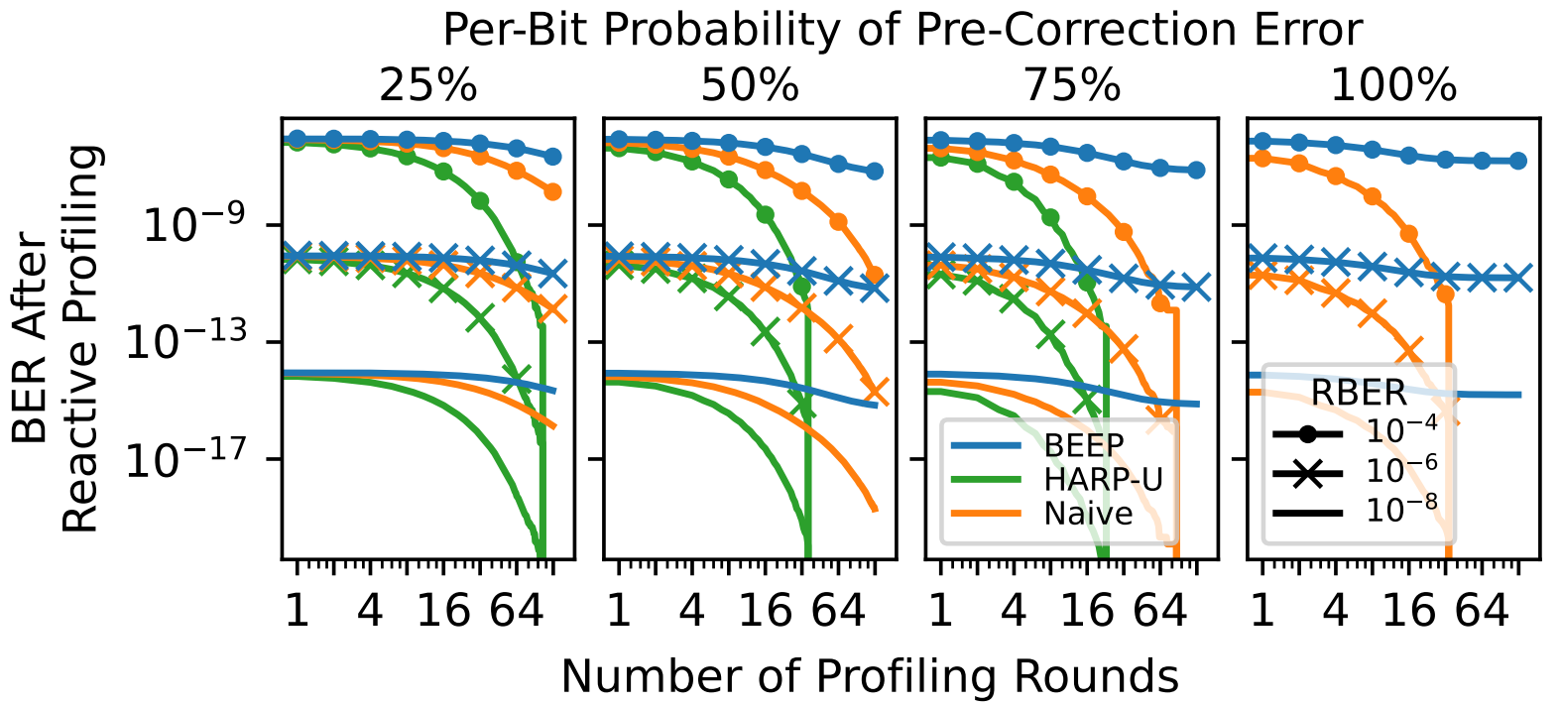
Case Study: DRAM Data-Retention
We measure the end-to-end bit error rate (BER) for each of the profilers
BEEP fails to reach zero BER
HARP always reaches zero BER
Notes:
We study how the end-to-end system bit error rate changes when using different profiling algorithms
[CLICK] Here is the data. The y-axis shows the BER after an X-axis number of profiling rounds.
The different colors represent different profiling algorithms, and the markers represent different raw bit error rates resulting from reducing the DRAM refresh rate by different amounts
[CLICK] We see that HARP always reaches zero BER in all configurations.
[CLICK] In contrast, BEEP fails to reach zero BER in any configuration. This is because, while HARP achieves full coverage of all direct errors, BEEP fails to do so, and Naïve is slow to do so.

Slide 17
Case Study: DRAM Data-Retention
HARP reaches zero BER 3.7x faster
than the best-performing baseline
Notes:
As an example result, we find that HARP reaches zero BER 3.7x faster than Naïve for a per-bit error probability of 0.75

Slide 18
Other Information in the Paper
Detailed analysis of on-die ECC
How on-die ECC introduces statistical dependence between post-correction errors
Differences between direct and indirect errors
Error profiling challenges introduced by on-die ECC
Discussion about HARP’s design decisions
More evaluation results
Coverage of direct and indirect errors
Analysis of profiler bootstrapping
Case study on the end-to-end memory bit error rate (BER)
Detailed artifact description
Notes:
We have many other analyses, discussions, and results in our paper, including:
A detailed analysis of how on-die ECC impacts profiling
More discussion on HARP’s design choices.
More evaluation results
And a detailed description of our open-source artifacts

Slide 19
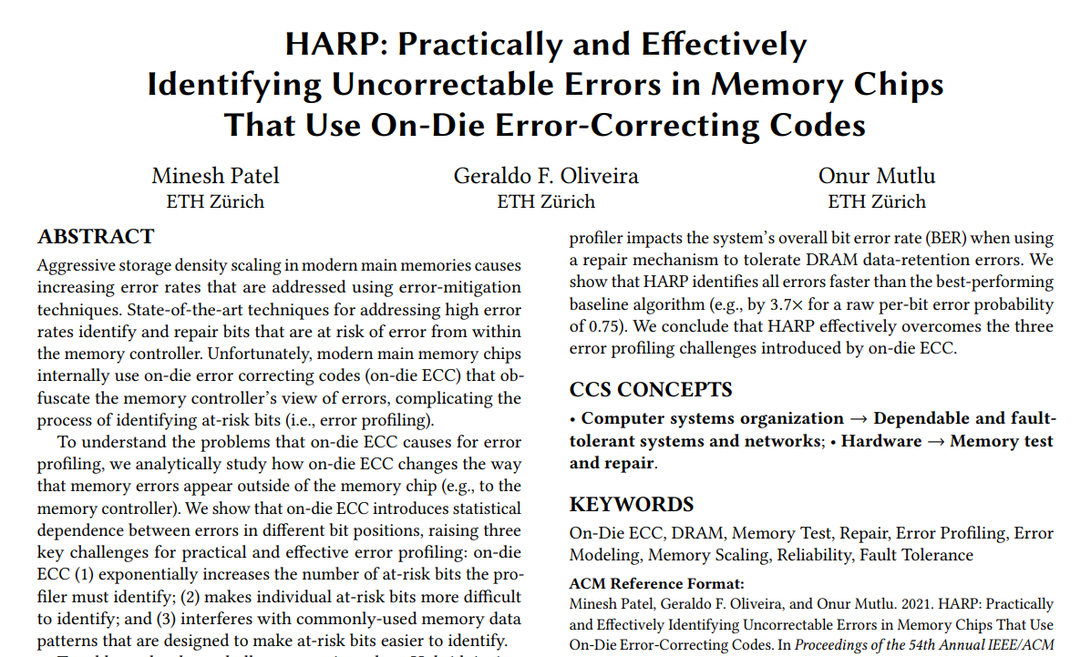
Other Information in the Paper
https://arxiv.org/abs/2109.12697
Notes:
We encourage you to take a look at the paper if you are interested in these details, and [CLICK]

Slide 20
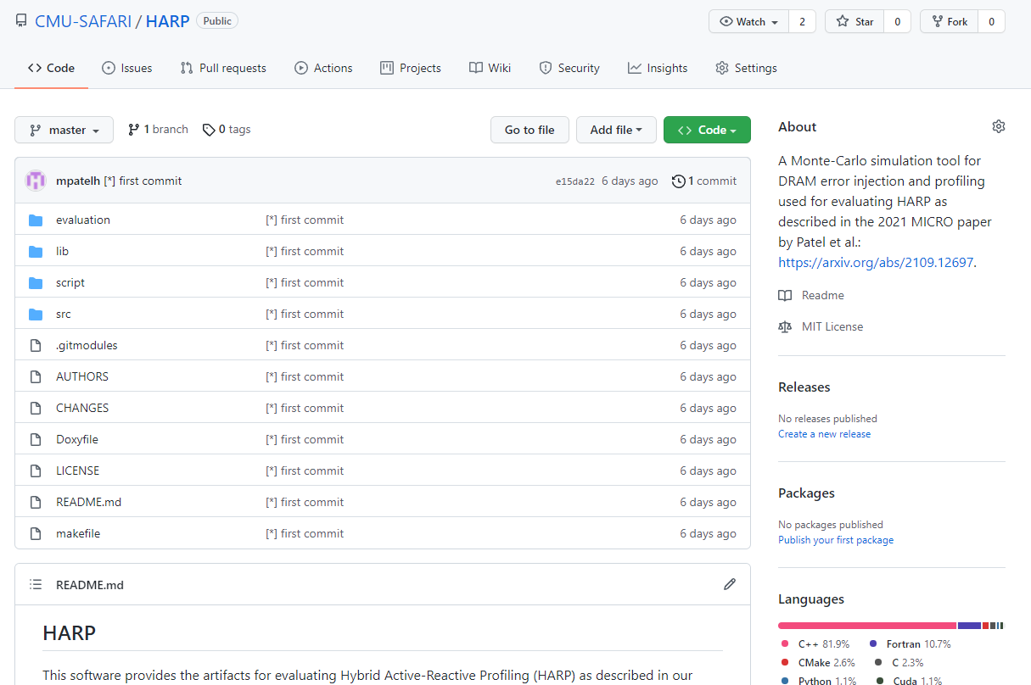
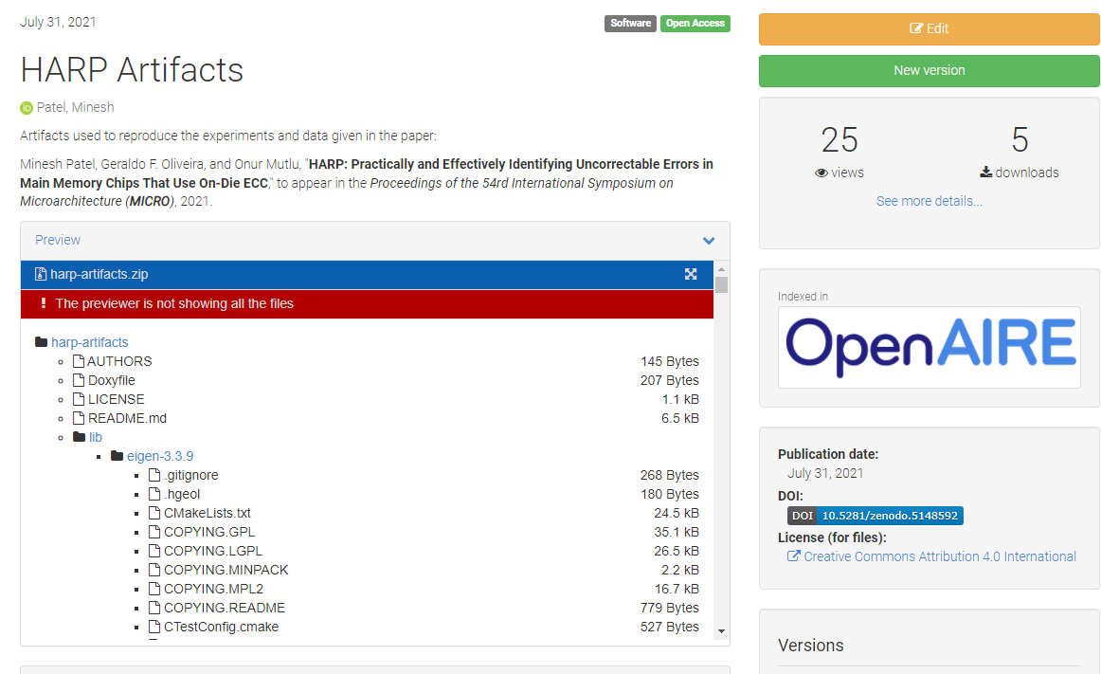
Artifacts are Open-Sourced
https://github.com/CMU-SAFARI/HARP
Notes:
Take a look at our artifacts, which are evaluated and available on both GitHub and Zenodo.

Slide 21
HARP: Practically and Effectively Identifying Uncorrectable Errors in Memory Chips That Use On-Die Error-Correcting Codes
Minesh Patel, Geraldo F. Oliveira, Onur Mutlu
https://arxiv.org/abs/2109.12697
https://github.com/CMU-SAFARI/HARP
Notes:
Thank you for listening, and now I’d like to transition to the Q&A.

