Slide 1






CoNDA: Efficient Cache Coherence Support for Near-Data Accelerators
Amirali Boroumand
Saugata Ghose, Minesh Patel, Hasan Hassan, Brandon Lucia, Rachata Ausavarungnirun, Kevin Hsieh, Nastaran Hajinazar, Krishna Malladi, Hongzhong Zheng, Onur Mutlu

Slide 2

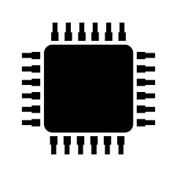

Specialized Accelerators
Specialized accelerators are now everywhere!
ASIC
NDA
GPU
FPGA
ASIC
Recent advancement in 3D-stacked technology enabled Near-Data Accelerators (NDA)
DRAM
CPU
NDA
ASIC
Notes:
Specialized accelerators are now every where, and they are widely used to improve the performance and energy efficiency of computing systems.
At the same time, recent advancement in 3D-stacked technology enabled near data acceleartors. These accelerators can further boost the benefits of specialized accelerator by moving computation close to data and getting rid of data movement.

Slide 3
Coherence For NDAs
Challenge: Coherence between NDAs and CPUs
(1) Large cost of off-chip communication
DRAM
CPU
L2
CPU
L1
CPU
CPU
Compute Unit
(2) NDA applications generate a large amount of off-chip data movement
NDA
ASIC
It is impractical to use traditional coherence protocols
Notes:
However, one of the major system challenges for adopting near data accelartors into computing system is coherence. Maintainig coherence between NDAs and CPUs is very challenging because of two reasons: First, the cost of off-chip communication between NDAs and CPUs is very high. Second, NDA applications typically have poor locality, and generate a large amount of off-chip data movement which leads to a large number of coherence misses. Because of these challenges, it is
Impractical use traditional coherence protocols for coherence, because that leads to a large amount of off-chip coherence messages, which can eliminate a significant portion of NDA benefits

Slide 4
Existing Coherence Mechanisms
We extensively study existing NDA coherence mechanisms and make three key observations:
These mechanisms eliminate a significant portion of NDA’s benefits
1
The majority of off-chip coherence traffic generated by these mechanisms is unnecessary
2
Much of the off-chip traffic can be eliminated if the coherence mechanism has insight into the memory accesses
3
ASIC
Notes:
In this work, We extensively study existing NDA coherence mechanisms and make three key observations:
First, these mechanisms eliminate a significant portion of NDA’s benefits as they generate a large amount of off-chip coherence traffic, Second, … Finally, we find that a significant portion of off-chip traffic can be eliminated if the coherence mechanism has insight into
which memory accesses actually require a coherence operation (what part of the shared data is actually accessed)

Slide 5
An Optimistic Approach
We find that an optimistic approach to coherence can address the challenges related to NDA coherence
1
Gain insights before any coherence checks happen
2
Perform only the necessary coherence requests
We propose CoNDA, a coherence mechanism that lets an NDA optimistically execute an NDA kernel
Optimistic execution enables CoNDA to identify and avoid unnecessary coherence requests
CoNDA comes within 10.4% and 4.4% of performance and energy of an ideal NDA coherence mechanism
ASIC
Notes:
Based on these observations, we find that an optimistic approach to coherence can address the challenges of NDA coherence. We find that an optimistic execution model for NDA enables us to gain insight into the memory accesses before any coherence permissions are
checked, and as a result, enforce coherence with only the necessary data movement/coherence requests.
We propose CoNDA, a new coherence mechanism that optimistically executes code on an NDA to gather information on memory
accesses. Optimistic execution enables CoNDA to identify and avoid performing unnecessary coherence requests
Our evaluation shows that CoNDA consistency retain the benefit of NDA across all of the workloads and …

Slide 6
Outline
Introduction
Background
Motivation
CoNDA
Architecture Support
Evaluation
Conclusion
Notes:
Before we jump into our analysis, lets talk about …

Slide 7

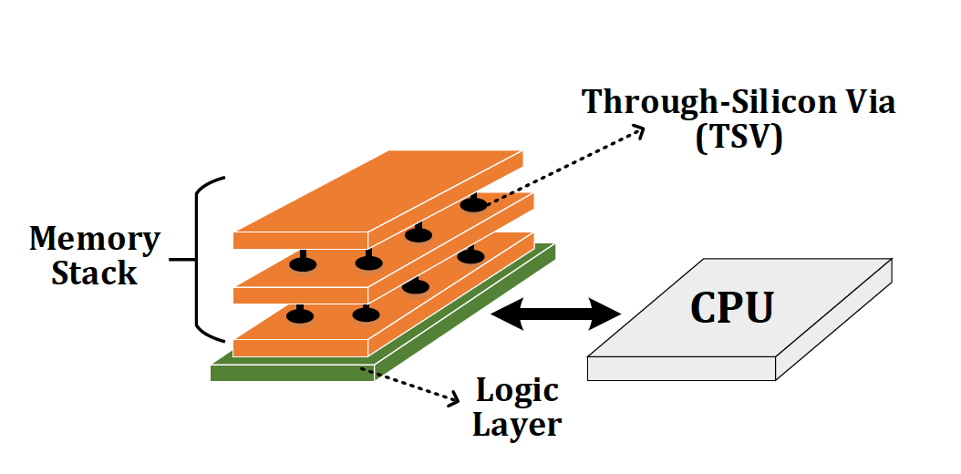
Background
Near-Data Processing (NDP)
A potential solution to reduce data movement
Idea: move computation close to data
Enabled by recent advances in 3D-stacked memory
Reduces data movement
Exploits large in-memory bandwidth
Exploits shorter access latency to memory
Notes:
Before we jump into our analysis, lets talk about …

Slide 8
Outline
Introduction
Background
Motivation
CoNDA
Architecture Support
Evaluation
Conclusion
Notes:
Before we jump into our analysis, lets talk about …

Slide 9
Application Analysis
Notes:
Let me first

Slide 10


Sharing Data between NDAs and CPUs
Hybrid Databases (HTAP)
Graph Processing
We find not all portions of applications benefit from NDA
1
Memory-intensive portions benefit from NDA
2
Compute-intensive or cache friendly portions should remain on the CPU
1st key observation: CPU threads often concurrently access the same region of data that NDA kernels access which leads to significant data sharing
ASIC
Notes:
In this work we extensively analyzed two important class of applications: graph processing framworks and hybrid in memory data bases
We find that not all portions of applications benefit from NDA. While the memory intensive parts can significantly benefit from NDA, compute-intensive parts or those parts that are cache friendly should stay on CPU to maximize performance. We then make a key observation that those portions that run on CPU …
In fact, an application benefit from NDA when the memory intensive parts are offloaded there, those parts that geenrate a lot of data movement and … parts of the application that are compute intensive should …

Slide 11
Shared Data Access Patterns
2nd key observation: CPU threads and NDA kernels typically do not concurrently access the same cache lines
For Connected Components application, only 5.1% of the CPU accesses collide with NDA accesses
CPU threads rarely update the same data that an NDA is actively working on
ASIC
Notes:
To understand data sharing more, we dig deeper and analyze the memory access patterns of the CPU threads and NDA kernels.
We make a second key observation: while CPU threads and NDA kernels share data structures, they often do not concurrently access the same elements
For example, when we analyze one of our graph applications, the Connected Components, we find that only 5.1% of the CPU accesses collide with accesses from the
NDA. In fact, we observe that CPU threads rarely update the same data that an NDA is actively working on

Slide 12
Analysis of NDA Coherence Mechanisms
Notes:
Now I’m gonna tlak about our analysus of existing coherence mechanisms
After we did the application analysis, we start looking at existing coherence mechanism

Slide 13
Analysis of Existing Coherence Mechanism
We analyze three existing coherence mechanisms:
1
Non-cacheable (NC)
Mark the NDA data as non-cacheable
2
Coarse-Grained Coherence (CG)
Get coherence permission for the entire NDA region
3
Fine-Grained Coherence (FG)
Traditional coherence protocols
ASIC
Notes:
One approach to address the coherence problem is to mark the NDA data as non-cacheable. In such a case, we don’t need to worry about coherence as any CPU writes are immediately visible to the NDA.
While this approach works well if there is a limited number of accesses from CPU threads to NDA data, it performs very bad when CPU accesses NDA region frequently. For example, in the hybrid database example, transaction thread operates within the same database with anaylitical threads, and if you mark NDA data as non-cacheable, you end up having a large number of off-chip accesses to DRAM, which eliminate a significant portion of NDA benefit. . It also hurt cpu thread performance, because they no longer can benefit form their large caches
Our analysis shows that Non-cacheable approach fails to …
Conclusion at the end of the slides (either as a banner, or just say it) → while NC works well for
applications where the CPU rarely accesses the NDA data region, it performs poorly for many applications where the CPU accesses
the region often.

Slide 14
Analysis of Existing Coherence Mechanisms
GMEAN
Loses a significant portion of the performance and energy benefits
Increases energy over CPU-only by 64.4% and performs 6.0% worse than CPU-only
Performs 0.4% worse than CPU-only
Poor handling of coherence eliminates much of an NDA’s performance and energy benefits
FG suffers from high amount of unnecessary off-chip coherence traffic
NC suffers from a large number of off-chip accesses from CPU threads
CG unnecessarily flushes a large amount of dirty data
Notes:
So here, on the left, I’m showing you the speedup for different coherence mechanism across a subset of our applications, the average number I’m showing here is across all of our applications. Also I’m showing the result for the ideal-nda which we assume it has zero cost for coherence. And on the right, I’m showing you the average normalized energy across all of the applications
As you can see, all of the coherence mchanisms eliminate a signifcant portion of ..
So now lets take a look at each inidividualy.
In case of non-acheable, we can see that if fails to provide any energy saving and even performs worse than CPU-only baseline. This is because when there is high amount of sharing, it suffers from large number of accesses to DRAM from CPU threads.
For the coarse-grained approach, we find that it eliminate a signifcant portion of energy benefit, and it performs .4% worse than CPU-only. The reason is that, everytime NDA wants to get coherence permission, the cpu has to flush every dirty data in the region back to DRAM, eventhough NDA might not access all of them. And That leads to a large amount of unnecessary coherence traffic. The other problem with CG is that, it uses coarse-grained locks to provide exclusive access to NDA and CPU. Those coarse grained keep CPU and NDA from concurrently executing because when there is high amount of sharing, every time CPU access NDA region, it gets blocked For the FG, even though it performs better than the tow other approaches, it still loses a significant portion of energy and performance benefits. The reason is thatthese application generate a large number of coherence misses, everytime a coherence miss happens, FG genreates an off-chip coherence message. And we already showed that most of them are unnecessary.

Slide 15
Motivation and Goal
Poor handling of coherence eliminates much of an NDA’s benefits
1
1
The majority of off-chip coherence traffic is unnecessary
2
2
Our goal is to design a coherence mechanism that:
3
1
Retains benefits of Ideal NDA
2
Enforces coherence with only the necessary data movement

Slide 16
Outline
Introduction
Background
Motivation
CoNDA
Architecture Support
Evaluation
Conclusion
Notes:
Before we jump into our analysis, lets talk about …

Slide 17
Optimistic NDA Execution
We leverage two key observations:
1
Having insight enables us to eliminate much of unnecessary coherence traffic
2
Low rate of collision for CPU threads and NDA kernels
We propose to use optimistic execution for NDAs
NDA executes the kernel:
1
Assumes it has coherence permission
2
Gains insights into memory accesses
ASIC
When execution is done:
Performs only the necessary coherence requests
Notes:
We levergae to key observations:
lets the NDA optimistically
start execution assuming that it has coherence permissions, without
issuing any coherence messages off-chip.
Majority is unnecessary since they don’t collide in the same cache line
With insight ahead of time, we can eliminate that
Based on our observations from our anaysis, we propose to use optimistic
execution for NDAs. Bascially, we assume that NDA executes in optimistic mode and during that mode
it gains insight into its memory accesses by tracking the
accesses without issuing any coherence requests.
When optimistic
execution is done, the NDA uses the tracking information to perform
necessary coherence requests for only the parts of the shared
data that were actually accessed during execution, which minimizes
coherence-related data movement.
This behavior leads to a very low
re-execution rate of NDA kernels, which is one of our key motivations
behind adopting an optimistic execution model for NDA
coherence

Slide 18
High-Level Overview of Optimistic Execution Model
CPU
NDA
Time
Fits well within the context of NDA coherence:
1
CPU Thread Execution
Allows us to identify the necessary coherence traffic
Starts optimistic execution
2
Most of the time optimistic execution works → low re-execution rate
Concurrent CPU + NDA Execution
Optimistic Execution
No Coherence Request
Coherence Resolution
Commit or Re-execute
Notes:
Here is a high-level overview of our optimistic execution model.
An application is running on the CPU and then it can issue a call to start executing the kernel on an NDA. When the NDA starts executing, the CPU
continue execution in parallel. The NDA executes in optimistic mode, which means that it assumes that it always has coherence permissions on the cache lines that it uses, without checking the CPU coherence directory. This means that there is no off-chip coherence request during execution.
When optimistic execution stops, we use the insight to check if any coherence violation happened and perform the necessary coherence request.
we check if any coherence requests should have been issued to guarantee correctness, using the insight we gathered duriong optimistic mode.
If find out that there is no violation of coherence, the NDA data updates are committed and become visible to the rest of the system. Otherwise, the NDA must resolve any violations by performing only the necessary coherence operations, and re-execute the optimistically-executed code.
Because CPU threads and NDA kernels rarely access the same cache lines during concurrent execution (see Section 3.1), re-execution happens rarely, as we show in Section 7.2, making optimistic execution efficient.

Slide 19
High-Level Overview of CoNDA
We propose CoNDA, a mechanism that uses optimistic NDA execution to avoid unnecessary coherence traffic
CPU
NDA
Time
CPU Thread Execution
Offload NDA kernel
Concurrent CPU + NDA Execution
No Coherence Request
Optimistic Execution
Signature
Signature
Send signatures
Coherence Resolution
Commit or Re-execute
Notes:
So, based on the execution model I just explained, we propose a coherence mechanism, which uses that execution model to avoid unnecessary coherence traffic.
Basically, in Conda, CPU offload the kernel to NDA. NDA starts executing in optimistic mode. During optimistic execution
CoNDA efficiently tracks the addresses of all NDA reads, NDA writes, and CPU write using compressed signatures. When optimistic mode is done, NDA send these signaturs to CPU and CoNDA use these signatures to resolve coherence violations.
If CoNDA detects any coherence violation (1) the NDA invalidates all
Of updates; (2) the CPU resolves the coherence
requests, performing only the necessary coherence operations (including
any cache line updates); and (3) the NDA re-executes the
uncommitted portion of the kernel.
Otherwise, CoNDA performs the necessary coherence operations, clears the uncommitted flag
for all data updates in the NDA L1 cache, and resumes optimistic execution if
the NDA kernel is not finished.

Slide 20
How do we identify coherence violations?
Notes:
So now lets how we actually identify the necessary coherence request during coherence resolution

Slide 21
Necessary Coherence Requests
Coherence requests are only necessary if:
Both NDA and CPU access a cache line
At least one of them updates it
We discuss three possible interleaving of accesses to the same cache line:
1
NDA Read and CPU Write (coherence violation)
2
NDA Write and CPU Read (no violation)
3
NDA Write and CPU Write (no violation)
ASIC
Notes:
A coherecne request is necessary of both NDA and CPU access a cache line and at least one of them, updates it.
A coherence violation happens if we don’t do a necessary coherence request. So to explain coherence violations, here I discuss three ... And show that only one of the interleavings leads to a violation
and requires NDA re-execution to ensure correct execution

Slide 22
Identifying Coherence Violations
CPU
NDA
Time
C1. Wr Z
N1. Rd X
No coherence checks during NDA execution
C2. Rd A
N2. Wr Y
C3. Wr B
N3. Rd Z
1) NDA Read and CPU Write: violation
2) NDA Write and CPU Read : no violation
3) NDA Write and CPU Write: no violation
NDA reads old value of Z
Any Coherence Violation?
Yes. Flush Z to DRAM
Coherence checks happen at the end of NDA kernel
C4. Wr Y
N4. Rd X
C5. Rd Y
N5. Wr Y
N6. Rd Z
“C4” and “C5” are ordered before “N5”
Any Coherence Violation?
No. Commit NDA operations
C6. Wr X
Notes:
Here I’m showing you an example where CPU is executing a bunch of instructions. And we also have NDA kernel that is running concurrently. Here we are considering a case where CPU is updating a cache line and NDA is reading the same cacheline. In this case, CPU updates cache line Z and NDA kernel reads from cacheline z.
Because we don’t do any coherence lookup or update during NDA kernel execution, NDA ends up reading old values of Z from DRAM. That’s a coherence violation, because CPU write has happened before NDA read, and we need to guarantee writes bcome visible right away. and In that case, we need to flush Z to DRAM and re-execute the NDA kernel. So the next time NDA kernel see the updated value. the effective ordering becomes like this.
Now lets consider another case. This time, while NDA is writing to cache line Y, cpu also write and read to same cache line. Neither of these cause coherence violation. The reason is that NDA makes its update visibile to the system at the end of optimistic mode execution. All of the updates are happen at the end of NDA kernel when we ensure there is no coherence violation. As a result, any write and read from CPU during NDA kernel execution, effectively order before the NDA write.
Some one might ask, what if we want this cpu to read the value PIM is updating. In that case, like any normal multi-threaded environemnt, we need to use synchroniztion primitves like semaphore or memory barrier, to make sure CPU read order before PIM write.
So as we said, when we send the signature back, no conflict will be detected, and pim core commit its update. So to summarize, if there is a write from CPU to a cacheline that PIM is reading that is a conflict. If there is a read from CPU to a cacheline PIM is writing to, that read orders before that write, and as a result, it doesn’t create any conflict.
Basically there are three possible conflicts: 1) processor update, pim read, 2) pim update something processor read, and both processor and pim update.

Slide 23
Outline
Introduction
Background
Motivation
CoNDA
Architecture Support
Evaluation
Conclusion
Notes:
Before we jump into our analysis, lets talk about …

Slide 24
CoNDA: Architecture Support
DRAM
CPU
CPU
L1
NDA Core
L1
Shared LLC
NDAReadSet
NDAReadSet
Coherence Resolution
Coherence Resolution
NDAWriteSet
CPUWriteSet
NDAWriteSet
CPUWriteSet
ASIC
Notes:
Here we have the overal architecture of CoNDA. The parts I highlited with blue, are the components we add to baseline architecture to support our mechanism.
I wanna discuss about the hardware support we provide to support optimistic execution , and coherence resolution. Basically I’d like to answer these three questions
When you talk about blue components you added, you can briefly introduce each one

Slide 25
Optimistic Mode Execution
The CPU records all writes to the NDA data region in the CPUWriteSet
CPU
L1
L1
NDA Core
L1
NDA Core
NDAReadSet
Shared LLC
NDAReadSet
NDAWriteSet
Coherence Resolution
NDAWriteSet
CPUWriteSet
CPUWriteSet
Per-word dirty bit mask to mark all uncommitted data updates
ASIC
The NDAReadSet and NDAWriteSet are used to track memory accesses from NDA
Notes:
So we start with Optimistic mode execution. On the left, we have the CPU-side, and on the right, we have the NDAside. As I said before, NDA executes the NDA kernel in optimistic mode assuming it has the required coherence permission. It first makes a checkpoint at starting pc in case a rollback is required later and then start executing the NDA kernel. We add a per-word dirty bit mask to each cache line, to mark all
uncommitted data updates.
The CPUWriteSet records the addresses of all cache lines in the NDA data region that (1) a CPU thread writes to during optimistic execution, or (2) have dirty copies in a CPU cache before an NDA kernel starts.
CoNDA use signatures to track the memory addresses during the optimistic execution to identify necessary coherence requests.
. We use three sets of signatures. A NDAreadsets, which tracks all of the reads by NDA, a NDAwrite set, which records all of the writes by the NDA, and CPUwriteset, which has all of the writes from CPU to NDA data. We also record all dirty cache lines in NDA data region that are still in CPU cache into CPUWriteSet. When NDA kernel execution finished, we use these three to identify necessary coherecne requests

Slide 26
Signatures
Address
h₀
h₁
…
h_{k-1}
CPU
L1
NDA Core
L1
…
0
1
1
0
1
0
1
1
1
0
0
0
NDAReadSet
Shared LLC
NDAReadSet
NDAWriteSet
Coherence Resolution
NDAWriteSet
CPUWriteSet
CPUWriteSet
Bloom filter based signature has two major benefits:
Allows us to easily perform coherence resolution
Allows for a large number of addresses to be stored within a fixed-length register
ASIC
Notes:
To implement compressed signatures, we use fixed-length parallel Bloom filter. The signatures store data by partitioning each signature into multiple fixed-size segments. Each time we want to add an address into the signature, we use a unique hash function that maps the address to a single bit for each segment.
Using parallel Bloom filters we can easily figure out if any coherence violation happened. We can quickly generate the intersection of two signatures by taking the bitwise AND of the two signatures. If we find that any of the M segments in the intersection are empty, no conflicts exist between the two signatures. Otherwise, the intersection contains the hashed values of all ad- dresses that might exist in both signatures (including potential false positives).

Slide 27
Coherence Resolution
CPUWriteSet
NDAReadSet
Conflict
CPU
L1
NDA Core
L1
NDAReadSet
Shared LLC
NDAReadSet
Coherence Resolution
NDAWriteSet
Coherence Resolution
CPUWriteSet
CPUWriteSet
If conflicts happens:
The CPU flushes the dirty cache lines that match addresses in the NDAReadSet
If no conflicts:
Any clean cache lines in the CPU that match an address in the NDAWriteSet are invalidated
NDA invalidates all uncommitted cache lines
ASIC
Signatures are erased and NDA restarts execution
NDA commits data updates
Notes:
Here we explain how we do coherence resolution and identify necessary coherence requests. As I explained before, when optimistic execution is done, both the NDAReadSet and NDAWriteset are sent back to the coherence resolution logic on CPU side. We then compute the intersection of the NDAReadSet and CPUWriteSet to determine if any addresses exist in both signatures.
No conflict: if no match, means that there is no coherence violation. In that case, we invalidate any clean cache line … . NDA also …
Conflict: If there is a match, this means that a coherence violation may have happened. In that case, CoNDA has to perform the necessary coherence and re-execute the NDA kernel. To do so, the CPU flushes any dirty cache lines that match addresses in the NDAReadSet to DRAM

Slide 28
Outline
Introduction
Background
Motivation
CoNDA
Architecture Support
Evaluation
Conclusion
Notes:
Before we jump into our analysis, lets talk about …

Slide 29
Evaluation Methodology
Simulator
Gem5 full system simulator
System Configuration:
CPU
16 cores, 8-wide, 2GHz frequency
L1 I/D cache: 64 kB private, 4-way associative, 64 B block
L2 cache: 2 MB shared, 8-way associative, 64 B blocks
Cache Coherence Protocol: MESI
NDA
16 cores, 1-wide, 2GHz frequency
L1 I/D cache: 64 kB private, 4-way associative, 64 B Block
Cache coherence protocol: MESI
3D-stacked Memory
One 4GB Cube, 16 Vaults per cube

Slide 30
Applications
Ligra
Lightweight multithreaded graph processing
We used three Ligra graph applications
PageRank (PR)
Radii
Connected Components (CC)
Real-world Input graphs:
Enron
arXiV
Gnutella25
Hybrid Database (HTAP)
In-house prototype of an in-memory database
Capable of running both transactional and analytical queries on the same database (HTAP workload)
32K transactions, 128/256 analytical queries
Notes:
We study two classes of applications that are wellsuited for NDA
We evaluate three graph applications from Ligra which is multhreaded graph processing …
We also evaluate an in-house prototype of an in-memory database
(IMDB) that supports HTAP workload

Slide 31
Speedup
66.0%
GMEAN
FG loses a significant portion of Ideal-NDA’s improvement
NDA-only eliminates 82.2% of Ideal-NDA’s improvement
CG and NC eliminate the entire performance benefit of Ideal-NDA execution
CoNDA consistently retains most of Ideal-NDA’s benefits, coming within 10.4% of the Ideal-NDA performance
Notes:
Can be a banner at the end of last slide

Slide 32
Memory System Energy
GMEAN
FG loses a significant portion of benefits because of a large number of off-chip coherence messages
CoNDA significantly reduces energy consumption and comes within 4.4% of Ideal-NDA
Notes:
Can be a banner at the end of last slide

Slide 33
Other Results in the Paper
Results for larger data sets
8.4x over CPU-only
7.7x over NDA-only
38.3% over the best prior coherence mechanism
Sensitivity analysis
Multiple memory stacks
Effect of optimistic execution duration
Effect of signature size
Effect of data sharing characteristics
Hardware overhead analysis
512 B NDA signature, 2 kB CPU signature, 1 bit per page table, 1 bit per TLB entry, 1.6% increase in NDA L1 cache
Notes:
We have more result in the paper. We have result for larger data sets. We also have serveral sensityivty analysis as well as hardware overhead analysis. Please refer to paper for more details.

Slide 34
Outline
Introduction
Background
Motivation
CoNDA
Architecture Support
Evaluation
Conclusion
Notes:
Before we jump into our analysis, lets talk about …

Slide 35
Conclusion
Coherence is a major system challenge for NDA
Efficient handling of coherence is critical to retain NDA benefits
We extensively analyze NDA applications and existing coherence mechanisms. Major Observations:
There is a significant amount of data sharing between CPU threads and NDAs
A majority of off-chip coherence traffic is unnecessary
A significant portion of off-chip traffic can be eliminated if the mechanism has insight into NDA memory accesses
We propose CoNDA, a mechanism that uses optimistic NDA execution to avoid unnecessary coherence traffic
CoNDA comes within 10.4% and 4.4% of performance and energy of an ideal NDA coherence mechanism
Notes:
Before we jump into our analysis, lets talk about …

Slide 36
CoNDA: Efficient Cache Coherence Support for Near-Data Accelerators
Amirali Boroumand
Saugata Ghose, Minesh Patel, Hasan Hassan, Brandon Lucia, Rachata Ausavarungnirun, Kevin Hsieh, Nastaran Hajinazar, Krishna Malladi, Hongzhong Zheng, Onur Mutlu

Slide 37
Backup
Notes:
Now let me give you a little bit background on how prior works deal with the PIM coherence.

Slide 38
Breakdown of Performance Overhead
CoNDA’s execution time consist of three major parts:
(1) NDA kernel execution
(2) Coherence resolution overhead (3.3% of execution time)
(3) Re-execution overhead (8.4% of execution time)
Coherence resolution overhead is low
CPU-threads do not stall during resolution
NDAWriteSet contains only a small number of addresses (6)
Resolution mainly involves sending signatures and checking necessary coherence
Overhead of re-execution is low
The collision rate is low for our applications → 13.4%
Re-execution is significantly faster than original execution
Notes:
We have more result in the paper. We have result for larger data sets. We also have serveral sensityivty analysis as well as hardware overhead analysis. Please refer to paper for more details.

Slide 39






Non-Cacheable (NC) Approach
Mark the NDA data as non-cacheable
Transactions
Analytics
(1) Generates a large number of off-chip accesses
Hybrid Database (HTAP)
(2) Significantly hurts CPU threads performance
Transactions
Analytics
Data Sharing
CPU
NDA
CPU
NC fails to provide any energy saving and perform 6.0% worse than CPU-only
ASIC
Notes:
One approach to address the coherence problem is to mark the NDA data as non-cacheable. In such a case, we don’t need to worry about coherence as any CPU writes are immediately visible to the NDA.
While this approach works well if there is a limited number of accesses from CPU threads to NDA data, it performs very bad when CPU accesses NDA region frequently. For example, in the hybrid database example, transaction thread operates within the same database with anaylitical threads, and if you mark NDA data as non-cacheable, you end up having a large number of off-chip accesses to DRAM, which eliminate a significant portion of NDA benefit. . It also hurt cpu thread performance, because they no longer can benefit form their large caches
Our analysis shows that Non-cacheable approach fails to …
Conclusion at the end of the slides (either as a banner, or just say it) → while NC works well for
applications where the CPU rarely accesses the NDA data region, it performs poorly for many applications where the CPU accesses
the region often.

Slide 40
Coarse-Grained (CG) Coherence
Get coherence permission for the entire NDA region
Unnecessarily flushes a large amount of dirty data, especially in pointer-chasing applications
Flush dirty data
CPU
NDA
CPU
Use coarse-grained locks to provide exclusive access
CPU
NDA
Time
Access to NDA data
Blocks CPU threads when they access NDA data regions
STALL
ASIC
CG fails to provide any performance benefit of NDA and perform 0.4% worse than CPU-only
Notes:
Another potential approach is the CG approach. Instead of getting coherence permission per each cacheline, we can get it for an entire region. The coarse-grained appraoch helps to reduce off-chip coherence traffic. However, the issue with this approach is that, every time an NDA wants to get coherence permissions for the region, the CPU must flush all dirty cache lines in the NDA data region even if the NDA does not access most of the data in the region. And where is high amount of sharing, this results in a significant amount of unnecessary data movement, especially in pointer chasing application thatwe don’t know what part of shared data will be accessed by NDA.
Another issues with CG is that some instances of coarse-grained coherence use coarse-grained locks to provide the CPU or NDA with exclusive access to a coarse- grained
region. And that actually keepCPU and NDA to concurrently access a region of data. Again, this works well when there is limited amount of sharing but when there is a significant amount of sharing, each time cpu wants to access any of cache line in that region, it get blocked, basically it keeps NDA and CPU from concurrently executing.
these works don’t allow concurrent access from CPU to PIM, basically they lock that region while PIM is working. (becuae of that could lead to ping-ponging the coherence permission between cpu and pim if cpu wants to access a cacheline in that region.) because they assume there is zero or limited sharing between CPU and PIM. But we showed that there is actually a significant amount of sharing in many data intensive applications, and as a result each time cpu wants to access any of cache line in that region, it get blocked. And effectively, it doesn’t allow concurrent execution between CPU and PIM, even if they don’t access the same piece of data. This gets even worse considering pointer-intensive data structure that pim lock the entire data structure, like graph. Stalling CPUs and flushing a large number of cache lines makes CG to perform even worse than CPU baseline and eliminate all PIM benefit.
this only works well when there is only limited amount of data sharing between the CPU threads and
the NDA kernel and the application can be well-partitioned between them. When there is a high amount of data sharing and there is no easy way to find what part
of the data will be accessed by the NDA, it generate a large amount of unnecessary data movement.
In fact, every time an NDA wants to get coherence permissions for the region, the CPU must flush all dirty cache lines in the NDA data region even if the NDA does not access most of the data in the region. This results in a significant amount of unnecessary data movement.
Some instances of coarse-grained coherence use coarse-grained locks to provide the CPU or NDA with exclusive access to a coarse- grained
region. Without exclusive access, coherence permission can ping-pong between the CPU and the NDA when they concurrently access the
NDA data region. Coarse-grained locks avoid ping-ponging by having the NDA acquire exclusive access to
a region for the duration of the NDA kernel
Our analysis shows that coarse-grained locks significantly limit performance when there is data sharing between them, as it blocks CPU thread when they want to access NDA data region.
We conclude that while CG works well in some cases, it is not suitable for many important NDA applications

Slide 41
Fine-Grained (FG) Coherence
Using fine-grained coherence has two benefits:
1
Simplifies NDA programming model
2
Allows us to get permissions for only the pieces of data that are actually accessed
(1) Memory-intensive
(2) Poor locality
High amount of off-chip coherence Traffic
CPU
NDA
CPU
FG eliminates 71.8% of the energy benefits of an ideal NDA mechanism
Large amount of these coherence messages are unnecessary
Notes:
The final mechanism we analyzed was FG approach. Using FG has two benefits: First, it simplifies … because using FG the entire system behaves like a multithreaded programs.
(the system behave similar to what we expect from multithreaded programming)
Since NDA kernel has a high number of cache misses, FG generates many off-chip coherence
requests;
Since NDA kernels are memory-intensive and exhibit poor temporal
locality, this fine-grained message exchange generates large
amounts of off-chip data movement. A large amount of those coherence
messages are unnecessary, as our analysis from Section 3.1
shows that the vast majority of NDA accesses do not collide with
CPU writes and, thus, do not need coherence.
Conclusion → while FG acquires permissions for only cache lines that are actually accessed, it still causes a lot of unnecessary
off-chip data movement.

Slide 42
Memory System Energy
NC suffers greatly from the large number of accesses to DRAM
Interconnect and DRAM energy increase by 3.1x and 4.5x
CG and FG loses a significant portion of benefits because of large number of writebacks and off-chip coherence messages
GMEAN
CoNDA significantly reduces energy consumption and comes within 4.4% of Ideal-NDA
Notes:
We model the sum of the energy consumption that takes place within the DRAM, off-chip interconnects, and all caches. We model DRAM energy as the energy consumed per bit, lever- aging estimates from prior work
-The energy consumption of NC suffers greatly from the large number of memory operations that are redirected from the processor caches to DRAM.
-CG has a large number of writebacks, which leads to increased L1 and L2 cache lookups and a large amount of traffic sending dirty data back to DRAM preemptively
-The main energy improvement for LazyPIM over CPU-only comes from a reduction in interconnect and memory utilization, as LazyPIM successfully reduces data movement across the off-chip channel.
, and significantly reduces energy consumption, by an average of 35.5% over FG, 18.0% over CG, 62.2% over NC, and 43.7% over CPU-only.

Slide 43
Speedup
FG loses a significant portion of Ideal-NDA’s improvement
GMEAN
CoNDA consistently retains most of Ideal-NDA’s benefits, coming within 10.4% of the Ideal-NDA performance
NDA-only eliminates 82.2% of Ideal-NDA’s improvement
CG and NC eliminate the entire benefit of Ideal-NDA execution
Notes:
Here we show normalized speedup for different coherence mechanism (fine-grained, coarse-grained, non-cacheable, etc) across all of the workloads. The result is normalized to CPU-only baseline. We also show the performance of an ideal mechanism where there is no performance penalty for coherence. It basically shows if coherence is magically solved and there is no penalty for that, how much upper bound improvement we can get.
Without any coherence overhead, the ideal NDA mechanism significantly outperforms CPU-only across all applications, showing the potential of PIM execution on these workloads. On the other hand, poor handling of coherence by CG and NC leads to drastic performance losses compared to Ideal-PIM. With NC, the processor threads incur a large penalty for going to DRAM frequently to access the PIM data region. CG suffers greatly due to (1) flushing dirty cache lines, and (2) blocking all processor threads that access PIM data during execution. In fact, pro- cessor threads are blocked for up to 73.1% of the total exe- cution time with CG. In fact, on average, they perform worse than CPU-only execution. FG also performs worse than CPU-only. Mostly because many off-chip messages This shows an efficient coherence mechanism is essential for PIM performance.
In contrast, LazyPIM consistently retains most of Ideal-PIM’s benefits for all applications, coming within 11.4% of the Ideal-PIM performance, on average. It also significantly improve performance compare to other approaches.
The reason is that the NDA cannot afford to incorporate
complicated logic and large caches due to power and area
constraints [13, 21, 27], which, for NDA-only, significantly slows
down the parts of the application that are better suited for CPU
execution.

Slide 44
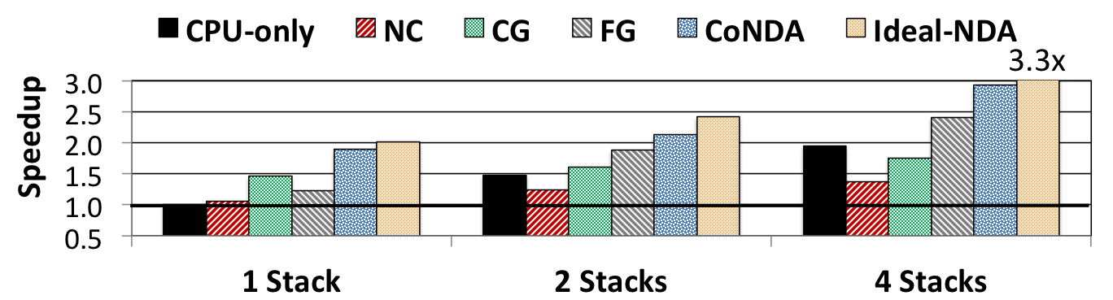
Effect of Multiple Memory Stacks
ASIC
Notes:
Points:
Poor handling of coherence eliminate …
Specifically, CG generates a large number of unnecessary flushes, and it also keeps them from working concurrently
FG generate a large number of unnecessary messages

Slide 45
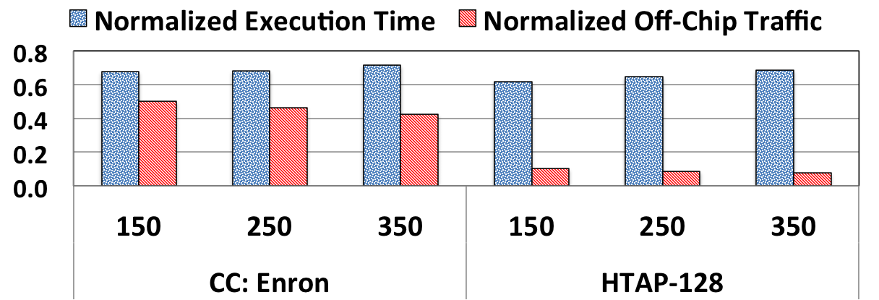
Effect of Optimistic Execution Duration
ASIC
Notes:
Points:
Poor handling of coherence eliminate …
Specifically, CG generates a large number of unnecessary flushes, and it also keeps them from working concurrently
FG generate a large number of unnecessary messages

Slide 46
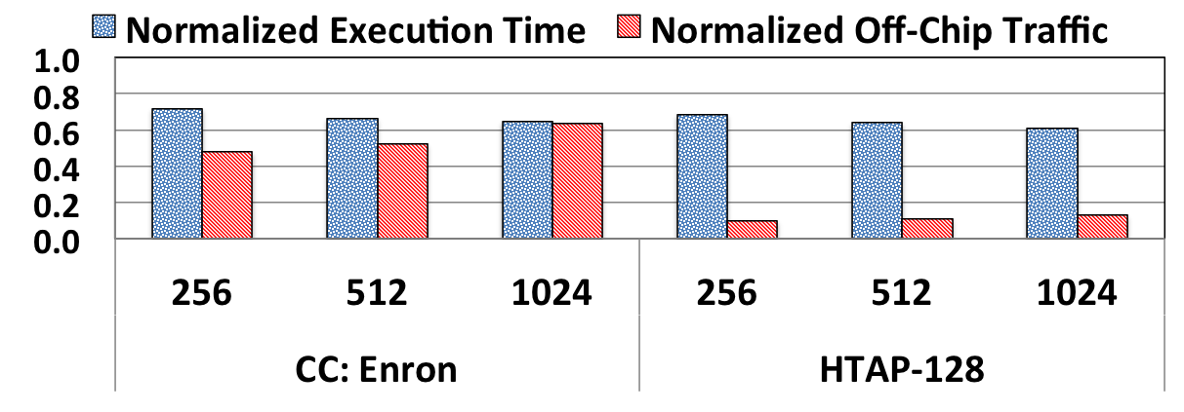
Effect of Signature Size
ASIC
Notes:
Points:
Poor handling of coherence eliminate …
Specifically, CG generates a large number of unnecessary flushes, and it also keeps them from working concurrently
FG generate a large number of unnecessary messages

Slide 47
Identifying Coherence Violations
CPU
NDA
Effective Ordering
Time
C1. Wr Z
C1. Wr Z
N1. Rd X
C2. Rd A
1) NDA Read and CPU Write: violation
2) NDA Write and CPU Read : no violation
3) NDA Write and CPU Write: no violation
C2. Rd A
N2. Wr Y
C3. Wr B
N3. Rd Z
C3. Wr B
Any Coherence Violation?
Yes. Flush Z to DRAM
C4. Wr Y
C4. Wr Y
N4. Rd X
C5. Rd Y
C5. Rd Y
N5. Wr Y
N4. Rd X
N6. Rd Z
N5. Wr Y
Any Coherence Violation?
N6. Rd Z
No. commit NDA operations
C6. Wr X
C6. Wr X
Notes:
Here I’m showing you an example where CPU is executing a bunch of instructions. And we also have NDA kernel that is running concurrently. Here we are considering a case where CPU is updating a cache line and NDA is reading the same cacheline. In this case, CPU updates cache line Z and NDA kernel reads from cacheline z.
Because we don’t do any coherence lookup or update during NDA kernel execution, NDA ends up reading old values of Z from DRAM. That’s a coherence violation, because CPU write has happened before NDA read, and we need to guarantee writes bcome visible right away. and In that case, we need to flush Z to DRAM and re-execute the NDA kernel. So the next time NDA kernel see the updated value. the effective ordering becomes like this.
Now lets consider another case. This time, while NDA is writing to cache line Y, cpu also write and read to same cache line. Neither of these cause coherence violation. The reason is that NDA makes its update visibile to the system at the end of optimistic mode execution. All of the updates are happen at the end of NDA kernel when we ensure there is no coherence violation. As a result, any write and read from CPU during NDA kernel execution, effectively order before the NDA write.
Some one might ask, what if we want this cpu to read the value PIM is updating. In that case, like any normal multi-threaded environemnt, we need to use synchroniztion primitves like semaphore or memory barrier, to make sure CPU read order before PIM write.
So as we said, when we send the signature back, no conflict will be detected, and pim core commit its update. So to summarize, if there is a write from CPU to a cacheline that PIM is reading that is a conflict. If there is a read from CPU to a cacheline PIM is writing to, that read orders before that write, and as a result, it doesn’t create any conflict.
Basically there are three possible conflicts: 1) processor update, pim read, 2) pim update something processor read, and both processor and pim update.

Slide 48
Optimistic NDA Execution
We leverage two key observations
1
Majority of coherence
2
Enforce coherence with only the necessary data movement
We propose to use optimistic execution for NDAs
When executing in optimistic mode:
An NDA gains insight into its memory accesses without issuing any coherence requests
When optimistic mode is done:
ASIC
The NDA uses the tracking information to perform necessary coherence requests
Notes:
We levergae to key observations:
Majority is unnecessary since they don’t collide in the same cache line
With insight ahead of time, we can eliminate that
Based on our observations from our anaysis, we propose to use optimistic
execution for NDAs. Bascially, we assume that NDA executes in optimistic mode and during that mode
it gains insight into its memory accesses by tracking the
accesses without issuing any coherence requests.
When optimistic
execution is done, the NDA uses the tracking information to perform
necessary coherence requests for only the parts of the shared
data that were actually accessed during execution, which minimizes
coherence-related data movement.
This behavior leads to a very low
re-execution rate of NDA kernels, which is one of our key motivations
behind adopting an optimistic execution model for NDA
coherence

Slide 49
Example: Hybrid Database (HTAP)
Transactions
Analytics
Hybrid Database (HTAP)
Transactions
Analytics
Data Sharing
ASIC
CPU
NDA
CPU
Notes:
So now lets look at one of the applications we analyzed as an example.
Our first case study is a hybrid in-memory databases. Today, because we need to perform real-time analytical processing, many industrial and academic databases, combine the transactional and analytical behavior into one single hybrid database, and because of that, you can perform both transactions and analytical queries on the same database (these two used to be separate). When we analyzed this application, we observe that , analytical queries are a good fit for NDA as they generate a large amount of random memory accesses and data movement
In contrast, even though transactional queries access the same data, they perform better if they stay on the CPU, as they have short execution times, are
latency-sensitive, and have cache-friendly access patterns.
And then In such workloads, when we offload analytical threads to NDA, because they are both operating within the same database and share many data structures. data sharing and concurrent accesses from both NDA kernels and CPU threads can not be avoided.

Slide 50
Application Analysis Wrap up
There is a significant amount of data sharing between CPU threads and NDAs
1
CPU threads and NDAs often do not access
the same cache lines concurrently
2
CPU threads rarely update the same data that NDAs are actively working on
3
ASIC
Notes:
To wrap up, here are the key observations from our application analysis. First, we observe that in many important NDA applications, there is a significant amount of sharing ..
Second, we find that while CPU threads and NDA kernels share the same data regions, they typically do not collide concurrently on (i.e., simultaneously access) the same cache line
In fact we observe that CPU thread rarely update ..

Slide 51
Background
Near-Data Processing (NDP)
A potential solution to reduce data movement
Idea: move computation close to data
Enabled by recent advances in 3D-stacked memory
Notes:
Before we jump into our analysis, lets talk about …

Slide 52

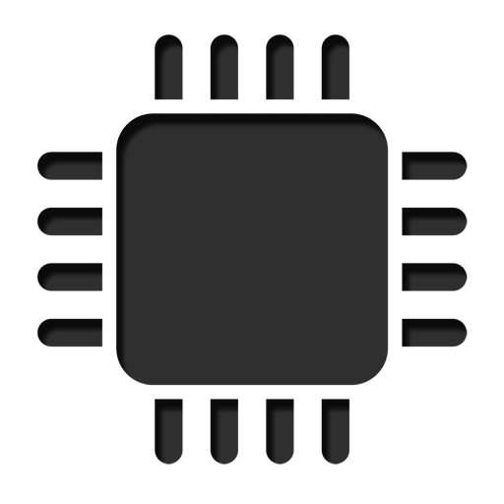
Specialized Accelerators
Specialized accelerators are now everywhere!
Accelerators
ASIC
NDA
GPU
FPGA
ASIC
Near-Data Accelerator
On-chip Accelerators
Off-chip Accelerators
Notes:
Consumer devices like tablets smartphone and wearable are now everywhere and used by billions of people.
One of the major challenge in these devices is battery limitation which makes the energy consumption a critical concern …

Slide 53
Applications
Ligra
Lightweight multithreaded graph processing for shared memory system
We used three Ligra graph applications
PageRank (PR)
Radii
Connected Components (CC)
Input graphs constructed from real-world network datasets:
Enron email communication network (36K nodes, 183K edges)
arXiV General Relativity (5K nodes, 14K edges)
peer-to- peer Gnutella25 (22K nodes, 54K edges).
IMDB
In-house prototype of an in-memory database (IMDB)
Capable of running both transactional queries and analytical queries on the same database tables (HTAP workload)
32K transactions, 128/256 analytical queries
Notes:
We study two classes of applications that are wellsuited for NDA
We evaluate three graph applications from Ligra which is multhreaded graph processing …
We also evaluate an in-house prototype of an in-memory database
(IMDB) that supports HTAP workload

Slide 54
Optimistic NDA Execution
We leverage two key observations:
1
Eliminate much of unnecessary coherence traffic by having insight into memory accesses
2
CPU threads and NDA kernels typically do not concurrently access the same cache lines
We propose to use optimistic execution for NDAs
NDA executes the kernel:
1
Assumes it has coherence permission
2
Gains insights into memory accesses
ASIC
When execution is done:
Performs only the necessary coherence requests
Notes:
We levergae to key observations:
lets the NDA optimistically
start execution assuming that it has coherence permissions, without
issuing any coherence messages off-chip.
Majority is unnecessary since they don’t collide in the same cache line
With insight ahead of time, we can eliminate that
Based on our observations from our anaysis, we propose to use optimistic
execution for NDAs. Bascially, we assume that NDA executes in optimistic mode and during that mode
it gains insight into its memory accesses by tracking the
accesses without issuing any coherence requests.
When optimistic
execution is done, the NDA uses the tracking information to perform
necessary coherence requests for only the parts of the shared
data that were actually accessed during execution, which minimizes
coherence-related data movement.
This behavior leads to a very low
re-execution rate of NDA kernels, which is one of our key motivations
behind adopting an optimistic execution model for NDA
coherence

Slide 55
Analysis of Existing Coherence Mechanisms
GMEAN
Suffers from a large number of off-chip accesses
Unnecessarily flushes a large amount of dirty data
Poor handling of coherence eliminates much of an NDA’s performance and energy benefits
FG suffers from high amount of unnecessary off-chip coherence Traffic
Blocks CPU threads when they access NDA data regions
NC fails to provide any energy saving and perform 6.0% worse than CPU-only
Notes:
Points:
Poor handling of coherence eliminate …
Specifically, CG generates a large number of unnecessary flushes, and it also keeps them from working concurrently
FG generate a large number of unnecessary messages

