Slide 1

CROW A Low-Cost Substrate for Improving DRAM Performance, Energy Efficiency, and Reliability
Hasan Hassan Minesh Patel Jeremie S. Kim A. Giray Yaglikci Nandita Vijaykumar Nika Mansouri Ghiasi Saugata Ghose Onur Mutlu
Notes:
Hi, my name is Hasan.
Today, I will be presenting CROW, which is a substrate that enables mechanisms for improving DRAM performance, energy efficiency, and reliability. This work is done in collaboration with co-authors from ETH Zurich and Carnegie Mellon University.

Slide 2
Summary
Source code available in July:
github.com/CMU-SAFARI/CROW
Challenges of DRAM scaling:
High access latency → bottleneck for improving system performance/energy
Refresh overhead → reduces performance and consume high energy
Exposure to vulnerabilities (e.g., RowHammer)
Copy-Row DRAM (CROW)
Introduces copy rows into a subarray
The benefits of a copy row:
Efficiently duplicating data from regular row to a copy row
Quick access to a duplicated row
Remapping a regular row to a copy row
CROW is a flexible substrate with many use cases:
CROW-cache & CROW-ref
Mitigating RowHammer
We hope CROW enables many other use cases going forward
(20% speedup and consumes 22% less DRAM energy)
Notes:
DRAM offers high memory capacity at low cost.
However, process technology scaling introduces three key challenges to DRAM [CLICK]
First, high DRAM access latency is a bottleneck for improving system performance and energy efficiency. [CLICK]
Second, as the number of cells in a DRAM chip increases, DRAM refresh incurs more performance and energy overheads. [CLICK]
Third, as process technology shrinks, DRAM cells become smaller and get closer to each other. The increasing interference between cells exposes DRAM to vulnerabilities such as RowHammer, which reduce DRAM reliability.
[CLICK] To overcome these scaling challenges of DRAM, we develop a low-cost substrate, which we call Copy-row DRAM or CROW. [CLICK] The key component of the CROW substrate is a copy row, which CROW introduces to a subarray in addition to the conventional regular DRAM rows. [CLICK] a copy row incurs a small area overhead and it has three benefits. First, data can be efficiently duplicated from a regular row into a copy row. Second, [CLICK] data duplicated to regular and copy row can be accessed much faster than only a regular row. Third, [CLICK] a regular row can be remapped to a copy row.
We use CROW to develop mechanisms to address the scaling challenges of DRAM [CLICK]
We develop and evaluate CROW-cache, which enables in-DRAM caching to reduce access latency and CROW-ref, which reduces the performance and energy overhead of DRAM refresh.
According to our evaluation, the two mechanisms together improve system performance by 20% and reduce DRAM energy by 22% on average.
[CLICK] We also propose a third mechanism for mitigating the RowHammer vulnerability. We leave evaluation of this mechanism for future work.
[CLICK] We believe CROW will enable many other use cases going forward.

Slide 3
Outline
1. DRAM Operation Basics
2. The CROW Substrate
CROW-cache: Reducing DRAM Latency
CROW-ref: Reducing DRAM Refresh
Mitigating RowHammer
3. Evaluation
4. Conclusion
Notes:
This is the outline of todays talk. [CLICK]
I will start with describing the basics of DRAM

Slide 4
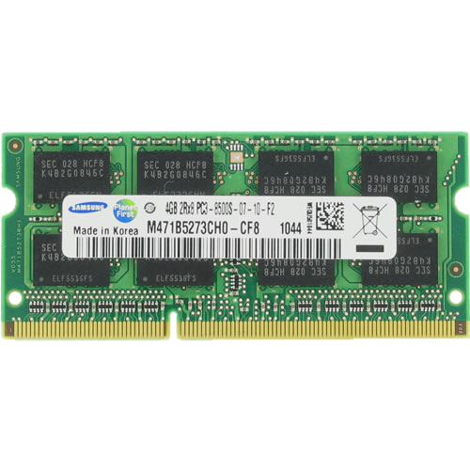
DRAM Organization
DRAM Subarray
DRAM Cell
DRAM Row
Memory
Bus
CPU
Memory Controller
Sense Amplifier
Notes:
Here I show a typical system with a CPU and a DRAM module that has several DRAM chips.
Inside a DRAM chip, [CLICK] there are multiple subarrays, which contain many DRAM cells organized as a two-dimensional array. [CLICK] A DRAM cell stores a single bit of information as electrical charge. In a subarray, [CLICK]
the cells are vertically connected to sense amplifiers, which can read the data from the cells and update it if needed. [CLICK] A row of DRAM cells is called DRAM row.

Slide 5

Accessing DRAM
DRAM Subarray
DRAM Cell
Activate
DRAM Row
Precharge
Read
Sense Amplifier
Notes:
Now, [CLICK] lets look at DRAM commands that the memory controller issues to read data from a particular DRAM cell.
To perform an access, [CLICK] the memory controller first activates (or opens) a row by issuing an activate command. Activate causes [CLICK] the cells of the selected row to share their charge to the sense amplifiers. Based on the charge amount received, the sense amplifiers determine the value that each cell stores and then [CLICK] they restore the charge of the cells back to its initial amount.
After row activation, [CLICK] the memory controller issues a read command to the DRAM. With that command, the data is read from the corresponding sense amplifier, and transferred over the memory bus to the CPU.
Although the memory controller has received the data, it still needs to perform one more operation to prepare the DRAM for a future access to a different row. The memory controller issues [CLICK] a precharge command to close an open row. The precharge operation turns both the row and the sense amplifiers back to their initial states.
This is basically how DRAM is accessed.

Slide 6
Outline
1. DRAM Operation Basics
2. The CROW Substrate
CROW-cache: Reducing DRAM Latency
CROW-ref: Reducing DRAM Refresh
Mitigating RowHammer
3. Evaluation
4. Conclusion
Notes:
Now let me explain you how we slightly modify DRAM to implement the CROW substrate

Slide 7
Challenges of DRAM Scaling
1
access latency
2
refresh overhead
3
exposure to vulnerabilities
Notes:
As I explained at the beginning, DRAM scaling leads to these three key challenges.
[CLICK] access latency
[CLICK] refresh overhead
[CLICK] and exposure to vulnerabilities such as RowHammer, which reduce DRAM reliability.

Slide 8
Our Goal
We want a substrate that enables the duplication and remapping of data within a subarray
Notes:
Our goal in this work is to develop a substrate to overcome the DRAM scaling challenges by duplicating and remapping data within a subarray

Slide 9
The Components of CROW
DRAM Subarray
CROW-table
Memory Controller
Notes:
[CLICK] However, it is not possible to duplicate and remap data in current DRAM. To enable that, the CROW substrate implements two key components.
First, [CLICK] CROW slightly modifies the DRAM subarray by introducing copy rows in addition to the regular rows in conventional DRAM. A copy row is composed of the same DRAM cells a regular row is composed of. Different from the regular rows in the subarray, copy rows have their own address decoder. This enables a copy row to be activated independently from a regular row. This property is useful for enabling two operations that I will explain in the next slides.
Second, [CLICK] CROW implements a small table in the memory controller to store information related to operations performed on copy rows.
Let me show you next what this substrate is useful for.

Slide 10
CROW Operation 1: Row Copy
DRAM Subarray
ACT-c (copy)
Memory Controller
Notes:
The first of the two operations that CROW enables is copying the content of an entire regular row into a copy row.
To initiate the row copy operation, [CLICK] the memory controller issues the new ACT-c command that CROW provides to the DRAM.
[CLICK] This command first activates a regular row. [CLICK] After the data is latched in the sense amplifiers, [CLICK] the command activates a copy row. This results in the sense amplifiers writing the data of the regular row to both of the open rows.
Let me explain how data is copied from one row to another within the DRAM.

Slide 11
Row Copy: Steps
source row:
1
Activation of the source row
2
Charge sharing
destination row:
3
Beginning of restoration
4
Activation of the destination row
Restoration of both rows to source data
5
Sense
Amplifier
Notes:
For simplicity, let’s assume in this slide that DRAM rows have only a single cell.
Here, our goal is to copy data from the source row to the destination row.
There are 5 steps involved. First, [CLICK] the source row is activated.
Following the activation [CLICK], the source row shares its charge with the sense amplifier.
Then, [CLICK] the sense amplifier starts restoration.
At this point, [CLICK] CROW enables the destination row and [CLICK] this results in the sense amplifier restoring both rows to the same value of the source cell.

Slide 12
Row Copy: Steps
source row:
1
Activation of the source row
2
Charge sharing
destination row:
3
Beginning of restoration
Enables quickly copying a regular row into a copy row
4
Activation of the destination row
Restoration of both rows to source data
5
Sense
Amplifier
Notes:
So, CROW enables quickly copying a regular row into a copy row

Slide 13
CROW Operation 2: Two-Row Activation
DRAM Subarray
ACT-t (two row)
Memory Controller
Notes:
The second operation that CROW enables is simultaneously activating a regular row and a copy row.
[CLICK] The memory controller performs multiple row activation by issuing the other new command ACT-t.
When a regular and copy rows are activated together, [CLICK] if the two rows contain the same data, this operation results in low latency activation.
Let me explain why in the next slide.

Slide 14
Two-Row Activation: Steps
both charged or discharged
1
Activation of two rows
fast
2
Charge sharing
3
Restoration
Sense
Amplifier
Notes:
Simultaneous multiple row activation operates similarly to the row copy operation.
The difference is that, [CLICK] two rows containing the same data are activated simultaneously. Doing so, [CLICK] both rows share their charge with the sense amplifier. [CLICK] This accelerates charge sharing as two cells together share more charge with the sense amplifier. As a result, [CLICK] the restoration completes sooner, and read/write operations can be services sooner compared to conventional single row activation.

Slide 15
Two-Row Activation: Steps
both charged or discharged
1
Activation of two rows
fast
2
Charge sharing
Enables fast access to data that is duplicated across a regular row and a copy row
3
Restoration
Sense
Amplifier
Notes:
The CROW substrate enables fast access to data that is duplicated across a regular and a copy row

Slide 16
Outline
1. DRAM Operation Basics
2. The CROW Substrate
CROW-cache: Reducing DRAM Latency
CROW-ref: Reducing DRAM Refresh
Mitigating RowHammer
3. Evaluation
4. Conclusion
Notes:
Now we have the substrate but how can we benefit from it?
The first mechanism we develop is CROW-cache

Slide 17
CROW-cache
Problem: High access latency
Key idea: Use copy rows to enable low-latency access to most-recently-activated regular rows in a subarray
CROW-cache combines:
row copy → copy a newly activated regular row into a copy row
two-row activation → activate the regular row and copy row together on the next access
Reduces activation latency by 38%
Notes:
We use CROW to address the high access latency problem of DRAM by implementing CROW-cache.
[CLICK] The key idea of CROW-cache is to enable low-latency access to the most recently activated regular rows in every subarray.
[CLICK] CROW-cache reduces latency by using both operations that the CROW substrate provides.
First, it uses row copy to copy a newly activated regular row into a copy row.
Second, it uses multiple row activation to activate the regular row and copy row together on the next access
[CLICK] When a recently-activated row is cached in DRAM, CROW-cache activates it with 38% lower latency.
Let me walk you through an example to show how CROW-cache works.

Slide 18

CROW-cache Operation
Request Queue
DRAM Subarray
load row X
[bank conflict]
load row X
1
CROW-table miss
ACT-c
2
Allocate a copy row
ACT-t
3
Issue ACT-c (copy)
CROW-table
Memory Controller
1
CROW-table hit
copy row 0
row X
2
Issue ACT-t (two row)
Notes:
[CLICK] In the middle, you see the CROW subarray and [CLICK] the CROW-table from the previous slide. On the right hand side, [CLICK] we show the queue of requests to be serviced, which is initially empty.
In this example, [CLICK] we first get a load request to address X. Since the CROW-table is initially empty, [CLICK] the request misses in the CROW-table. To enable fast access in the future, [CLICK] CROW-cache allocates a copy row for the regular row that corresponds to address X. [CLICK] Then, the memory controller issues an ACT-c command to perform the row copy operation.
[CLICK] Then, let’s assume DRAM receives requests to other rows causing bank conflict which forces row X to be closed.
In the future, [CLICK] when the request queue receives another request to address X, the memory controller finds that [CLICK] X hits in the CROW-cache, and thus [CLICK] issues ACT-t to perform a low latency access.

Slide 19
CROW-cache Operation
Request Queue
DRAM Subarray
load row X
[bank conflict]
load row X
1
CROW-table miss
2
Allocate a copy row
ACT-t
Issue ACT-c
Second activation of row X is faster
3
CROW-table
Memory Controller
1
CROW-table hit
copy row 0
row X
2
Issue ACT-t
Notes:
This is basically how CROW-cache reduces DRAM latency when accessing a row for the second time.

Slide 20
Outline
1. DRAM Operation Basics
2. The CROW Substrate
CROW-cache: Reducing DRAM Latency
CROW-ref: Reducing DRAM Refresh
Mitigating RowHammer
3. Evaluation
4. Conclusion
Notes:
Now, let me explain how we mitigate Refresh overhead using the CROW substrate

Slide 21
CROW-ref
Problem: Refresh has high overheads. Weak rows lead to high refresh rate
weak row: at least one of the row’s cells cannot retain data correctly when refresh rate is decreased
Key idea: Safely reduce refresh rate by remapping a weak regular row to a strong copy row
CROW-ref uses:
row copy → copy a weak regular row to a strong copy row
CROW-ref eliminates more than half of the refresh requests
Notes:
DRAM refresh operations have high performance and energy overheads and weak rows prevent reducing the refresh rate.
Here, we define a weak row as a row that has at least one cell that cannot retain data correctly when the refresh interval is increased
We use the CROW substrate to implement CROW-ref whose [CLICK] key idea is to reduce refresh rate by remapping a weak regular row to a strong copy row.
[CLICK] CROW-ref uses the row copy operation to remap a weak regular row to a strong copy row.
[CLICK] Doing so, CROW-ref doubles the refresh interval or in other words eliminates half of the refresh requests that the memory controller must issue.
Let me explain how exactly CROW-ref operates

Slide 22

CROW-ref Operation
Perform retention time profiling
1
strong
strong
Remap weak rows to strong copy rows
2
weak
strong
3
On ACT, check the CROW-table
strong
strong
If remapped, activate a copy row
Retention Time Profiler
4
Notes:
The operation of CROW-ref is simple.
[CLICK] CROW-ref uses a DRAM retention time profiling mechanism to discover weak rows and [CLICK] stores the remapping information in the CROW-table. [CLICK] When the memory controller needs to activate a row, it first checks the CROW-table to see whether the row has been remapped. If so, [CLICK] it activates the corresponding copy row instead of the weak regular row.

Slide 23
CROW-ref Operation
Perform retention time profiling
1
strong
strong
Remap weak rows to strong copy rows
2
weak
strong
3
On ACT, check the CROW-table
strong
strong
If remapped, activate a copy row
Retention Time Profiler
4
How many weak rows exist in a DRAM chip?
Notes:
To make this mechanisms work, one question we need to answer is how many weak rows are typically there in a DRAM chip?

Slide 24
Identifying Weak Rows
Weak cells are rare [Liu+, ISCA’13]
weak cell: retention < 256ms
~1000/2³⁸ (32 GiB) failing cells
DRAM Retention Time Profiler
REAPER [Patel+, ISCA’17] PARBOR [Khan+, DSN’16] AVATAR [Qureshi+, DSN’15]
At system boot or during runtime
Notes:
It turns out that the weak rows are actually very rare. [CLICK] Here, we assume a cell to be weak when it cannot retain data for 256 ms. [CLICK] Prior work reports, on DDR3, when the refresh interval is changed from the default 64ms to 256ms, only about 1000 cells in a 32 GiB fail to retain the data correctly.
Based on this information, [CLICK] we calculate the probability of having a subarray with different numbers of weak rows. The figure plots the probability of having a subarray with at least N weak rows. Although the probability of having a subarray with at least one or two weak rows is quite high, [CLICK] the probability rapidly decreases when we consider more weak rows. This motivates that even a small number of copy rows in a subarray are very likely to be sufficient to remap all weak regular rows.
[CLICK] To detect weak rows, there are several prior works that propose DRAM retention time profilers. CROW-ref can adopt any of these profilers. [CLICK] A profiler can either be used at system boot or during runtime as CROW support the CROW-table to be updated at any time.

Slide 25
Identifying Weak Rows
Weak cells are rare [Liu+, ISCA’13]
weak cell: retention < 256ms
~1000/2³⁸ (32 GiB) failing cells
DRAM Retention Time Profiler
REAPER [Patel+, ISCA’17] PARBOR [Khan+, DSN’16] AVATAR [Qureshi+, DSN’15]
At system boot or during runtime
A few copy rows are sufficient to halve the refresh rate
Notes:
Only a few copy rows are sufficient to halve the refresh rate

Slide 26
Outline
1. DRAM Operation Basics
2. The CROW Substrate
CROW-cache: Reducing DRAM Latency
CROW-ref: Reducing DRAM Refresh
Mitigating RowHammer
3. Evaluation
4. Conclusion
Notes:
Let me now tell you about the third mechanism.

Slide 27
Mitigating RowHammer
victim
aggressor
activate
precharge
victim
Key idea: remap victim rows to copy rows
Notes:
In addition to CROW-cache and CROW-ref, in the paper we also briefly discuss a third mechanism that uses CROW to mitigate RowHammer errors.
RowHammer is a vulnerability caused mainly by process technology scaling. [CLICK] As the DRAM cells become smaller and get closer to each other, they become more sensitive to electromagnetic interference. RowHammer errors are basically induced by rapidly [CLICK] activating and precharging a row [CLICK]. This operation disturbs the cell in neighbor rows and has a chance to flip some of the bits stored there.
For mitigating RowHammer errors, [CLICK] our key idea is to use the CROW substrate to remap the victim rows to copy rows. This protects the data in the victim rows as the rows get physically moved away from the aggressor row. Please see our paper for a more detailed description of this mechanism.
We leave the evaluation of this mechanism for future work.

Slide 28
Outline
1. DRAM Operation Basics
2. The CROW Substrate
CROW-cache: Reducing DRAM Latency
CROW-ref: Reducing DRAM Refresh
Mitigating RowHammer
3. Evaluation
4. Conclusion
Notes:
Now, I will move on to the evaluation.

Slide 29
Methodology
Simulator
DRAM Simulator (Ramulator [Kim+, CAL’15])
https://github.com/CMU-SAFARI/ramulator
Workloads
44 single-core workloads
SPEC CPU2006, TPC, STREAM, MediaBench
160 multi-programmed four-core workloads
By randomly choosing from single-core workloads
Execute at least 200 million representative instructions per core
System Parameters
1/4 core system with 8 MiB LLC
LPDDR4 main memory
8 copy rows per 512-row subarray
Source code available in July:
github.com/CMU-SAFARI/CROW
Notes:
To evaluate the CROW mechanisms, we used Ramulator, which is a cycle-accurate DRAM simulation tool. The source code of our simulation infrastructure will be available in July.
[CLICK] We analyze workloads from four benchmark suites, including SPEC CPU 2006.
[CLICK] These are the system parameters and
we implement CROW with 8 copy rows per subarray by default.

Slide 30
CROW-cache Results
7.5%
7.1%
8.2%
6.9%
* with 8 copy rows and a 64Gb DRAM chip (sensitivity in paper)
Notes:
Let me start with showing the performance and energy benefits of CROW-cache.
[CLICK] The figure shows the average speedup that CROW-cache provides for single core and four core workloads. For both, CROW-cache provides 7% speedup, which is very close to an ideal hypothetical mechanisms with CROW-cache that has 100% hit rate.
[CLICK] CROW-cache also saves DRAM energy mainly because of reduction in execution time.

Slide 31
CROW-cache Results
7.5%
7.1%
8.2%
6.9%
CROW-cache improves single-/four-core performance and energy
* with 8 copy rows a 64Gb DRAM chip (sensitivity in paper)
Notes:
So, CROW-cache improves single-core and four core performance and energy

Slide 32
CROW-ref Results
11.9%
7.8%
17.2%
7.1%
* with 8 copy rows and a 64Gb DRAM chip (sensitivity in paper)
Notes:
Let me also quickly show you the performance and energy benefits of CROW-ref.
[CLICK] CROW-ref eliminates many of the DRAM refresh requests, and this leads to 7% speedup for single core workloads and almost 12% speedup for four core workloads.
[CLICK] Eliminating many refreshes also saves significant DRAM energy.

Slide 33
CROW-ref Results
11.9%
7.8%
17.2%
7.1%
CROW-ref significantly reduces the performance and energy overhead of DRAM refresh
* with 8 copy rows a 64Gb DRAM chip (sensitivity in paper)
Notes:
CROW-ref significantly reduces the performance and energy overhead of DRAM refresh

Slide 34
Combining CROW-cache and CROW-ref
17%
20%
23%
22%
Notes:
CROW-cache and CROW-ref are complementary to each other. We combine both mechanisms by keeping 8 copy rows per subarray.
The mechanisms perform well when combined with 8 copy rows per subarray because neither of the mechanisms utilize all of the copy rows in many cases. For example, as I’ve shown previously, it is very unlikely to have too many weak rows in a subarray, so CROW-ref does not make use of majority of the copy rows.
[CLICK] Both mechanisms together provide 17% and 20% speedup for single-core and four-core workloads. And they perform close to an ideal mechanism that has a CROW-cache with 100% hit rate and eliminates all DRAM refresh operations.
[CLICK] CROW-cache and CROW-ref together save significant DRAM energy.

Slide 35
Combining CROW-cache and CROW-ref
17%
20%
23%
22%
CROW-(cache+ref) provides more performance and DRAM energy benefits than each mechanism alone
Notes:
We conclude that, CROW-cache and CROW-ref further improve system performance and DRAM energy when combined.

Slide 36
Hardware Overhead
For 8 copy rows and 16 GiB DRAM:
0.5% DRAM chip area
1.6% DRAM capacity
11.3 KiB memory controller storage
CROW is a low-cost substrate
Notes:
CROW incurs modest overheads in the DRAM and the memory controller when using a configuration with 8 copy rows per subarray,
So, CROW is a low-cost substrate.
Please see the paper for a more detailed hardware overhead evaluation.

Slide 37
Other Results in the Paper
Performance and energy sensitivity to:
Number of copy-rows per subarray
DRAM chip density
Last-level cache capacity
CROW-cache with prefetching
CROW-cache compared to other in-DRAM caching mechanisms:
TL-DRAM [Lee+, HPCA’13]
SALP [Kim+, ISCA’12]
Notes:
Please also see our paper for more detailed evaluation.
[CLICK] There we have sensitivity studies to the number of copy rows per subarray
Chip density, and last-level cache capacity
Also, we evaluate CROW-cache with a stride prefetcher and
we compare CROW-cache to two prior works that also enable in-DRAM caching.

Slide 38
Outline
1. DRAM Operation Basics
2. The CROW Substrate
CROW-cache: Reducing DRAM Latency
CROW-ref: Reducing DRAM Refresh
Mitigating RowHammer
3. Evaluation
4. Conclusion
Notes:
Let me quickly conclude now.

Slide 39
Conclusion
Source code available in July:
github.com/CMU-SAFARI/CROW
Challenges of DRAM scaling:
High access latency → bottleneck for improving system performance/energy
Refresh overhead → reduces performance and consume high energy
Exposure to vulnerabilities (e.g., RowHammer)
Copy-Row DRAM (CROW)
Introduces copy rows into a subarray
The benefits of a copy row:
Efficiently duplicating data from regular row to a copy row
Quick access to a duplicated row
Remapping a regular row to a copy row
CROW is a flexible substrate with many use cases:
CROW-cache & CROW-ref
Mitigating RowHammer
We hope CROW enables many other use cases going forward
(20% speedup and consumes 22% less DRAM energy)
Notes:
[CLICK] We propose CROW, an in-DRAM substrate for addressing the three key challenges of DRAM scaling.
[CLICK] CROW introduces copy rows in addition to regular rows in conventional DRAM.
[CLICK] A copy row provides three key benefits.
[CLICK] Using the CROW substrate, we develop CROW-cache to enable in-DRAM caching, CROW-ref to mitigate DRAM refresh overhead, and a mechanisms for mitigating RowHammer errors.
We believe CROW will enable many other use cases going forward

Slide 40
CROW A Low-Cost Substrate for Improving DRAM Performance, Energy Efficiency, and Reliability
Hasan Hassan Minesh Patel Jeremie S. Kim A. Giray Yaglikci Nandita Vijaykumar Nika Mansouri Ghiasi Saugata Ghose Onur Mutlu
Notes:
Thanks for your patience. I am now happy to answer any question.

Slide 41
Backup Slides

Slide 42
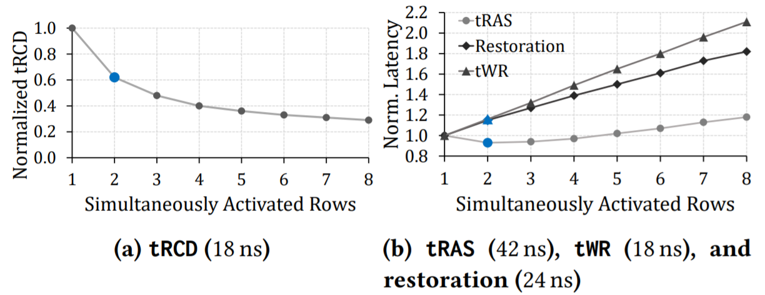
Latency Reduction with MRA

Slide 43
Mitigating RowHammer
victim
aggressor
activate
precharge
victim
Key idea: remap victim rows to copy rows
Notes:
In addition to CROW-cache and CROW-ref, in the paper we also briefly discuss a third mechanism that uses CROW to mitigate RowHammer errors.
RowHammer is a vulnerability caused mainly by process technology scaling. [CLICK] As the DRAM cells become smaller and get closer to each other, they become more sensitive to electromagnetic interference. RowHammer errors are basically induced by rapidly [CLICK] activating and precharging a row [CLICK]. This operation disturbs the cell in neighbor rows and has a chance to flip some of the bits stored there.
For mitigating RowHammer errors, [CLICK] our key idea is to use the CROW substrate to remap the victim rows to copy rows. This protects the data in the victim rows as the rows get physically moved away from the aggressor row. Please see our paper for a more detailed description of this mechanism.
We leave the evaluation of this mechanism for future work.

Slide 44
CROW-cache Performance
6.6%
7.5%
7.1%
0.7%
single-core
four-core
Notes:
Let me start with showing the performance benefits of CROW-cache.
[CLICK] The figure shows the speedup that CROW-cache provides for select single core workloads. It also shows average speedup for all 1-core workloads that we evaluate. On the right-hand side, we show CROW-cache’s performance for four-core workloads with high memory intensity.
[CLICK] CROW-cache with only 1 copy row per subarray provides 6.6% speedup for single-core workloads. But it improves four-core performance by only 1.2%. This is mainly because four-core workloads access the memory more frequently, and a single copy row is insufficient to provide effective in-DRAM caching.
[CLICK] When we increase the number of copy rows to 8, CROW-cache provides 7.1% speedup on average across the four-core workloads. The performance of single-core workloads improve to 7.5% too.
[CLICK] increasing the number of copy rows provides further performance benefits but incurs higher area overhead.
[CLICK] we also provide results for a hypothetical ideal CROW-cache with 100% hit rate. CROW-cache performs close to this ideal mechanism even with a small number of copy rows for many workloads.

Slide 45
CROW-ref Performance
11.9%
7.1%
four-core
single-core
four-core
single-core
Notes:
Let me also quickly show you the performance and energy benefits of CROW-ref.
[CLICK] The figure shows the speedup that CROW-ref provides when the refresh interval is increased from the default 32 ms to 64ms. The figure plots the speedup achieves with DRAM chips that have different densities.
[CLICK] CROW-ref reduces the number of refresh operations that needs to be performed to operate the DRAM correctly. This results in [CLICK] 7.1% average speedup across all workloads for 64Gbit LPDDR4 chip.

Slide 46
CROW-ref Energy Savings
17.2%
7.8%
single-core
four-core
Notes:
With CROW-ref, we see significant reduction in DRAM energy due to performing fewer refresh operations.
[CLICK] On average, CROW-ref reduces DRAM energy by 17.2% for 64 Gbit LPDDR4 DRAM.

Slide 47
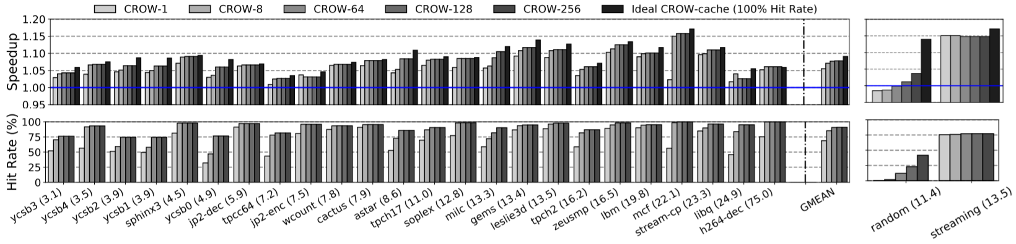
Speedup - CROW-cache
Single-core

Slide 48
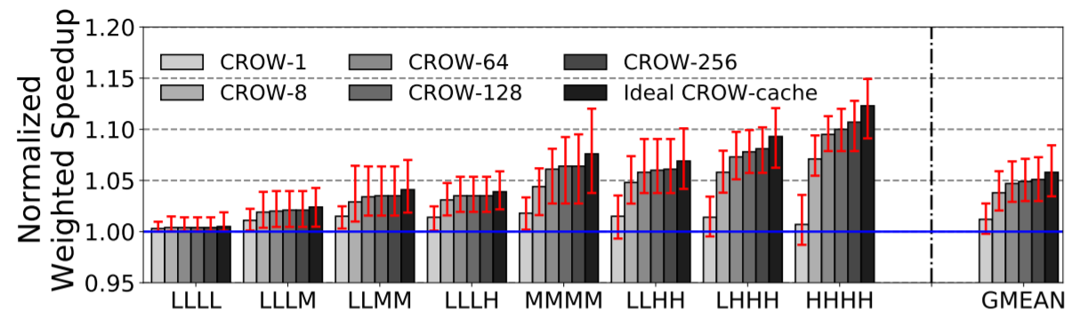
Speedup - CROW-cache
Four-core

Slide 49
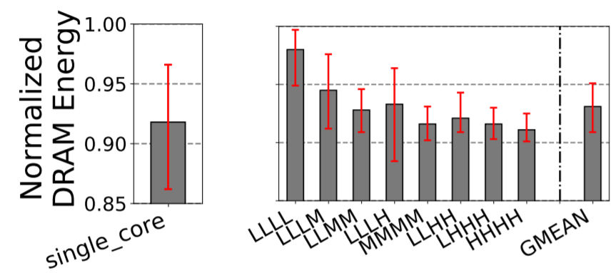
Energy – CROW-cache

Slide 50
Comparison to TL-DRAM and SALP

Slide 51
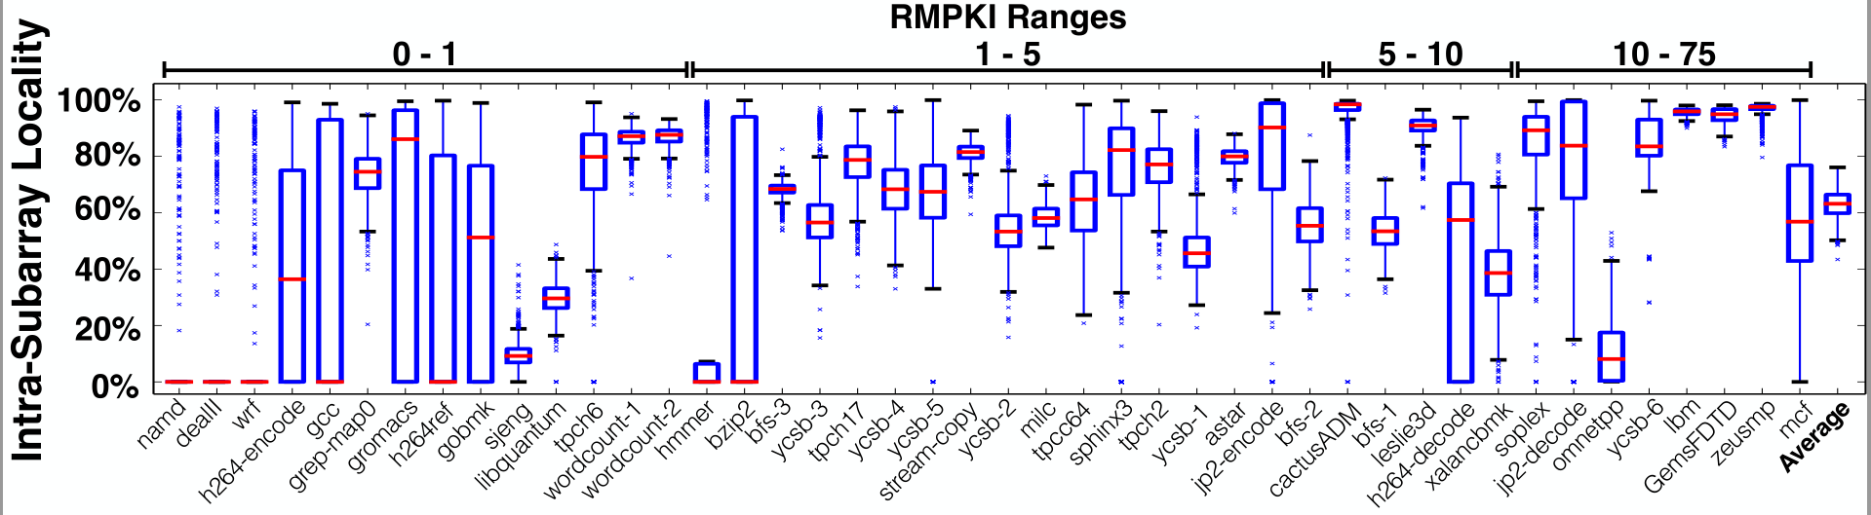
Slide on RLTL

Slide 52
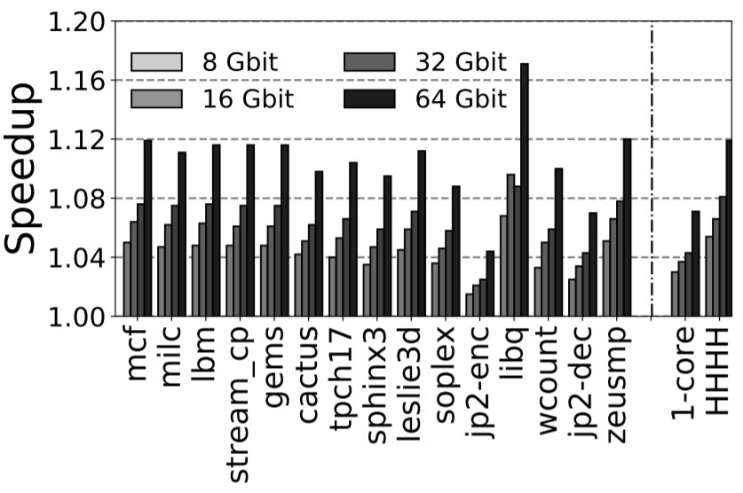
Speedup – CROW-ref

Slide 53
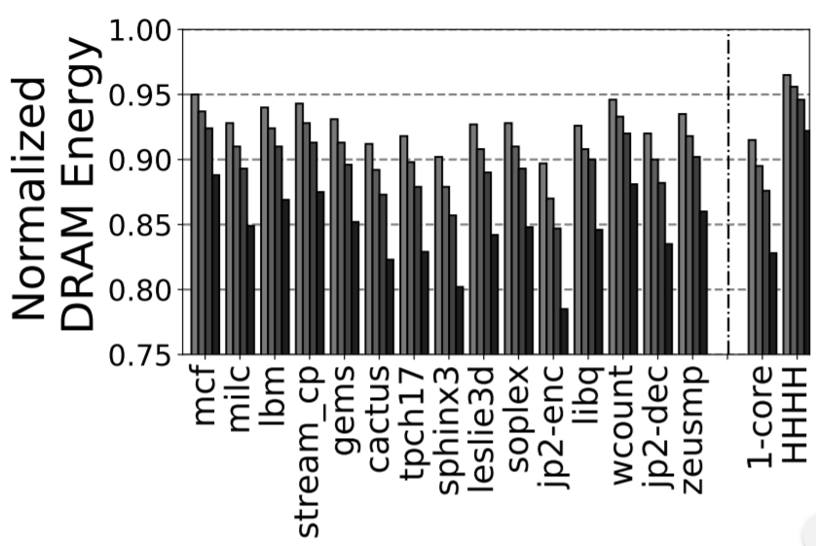
Energy – CROW-ref

Slide 54
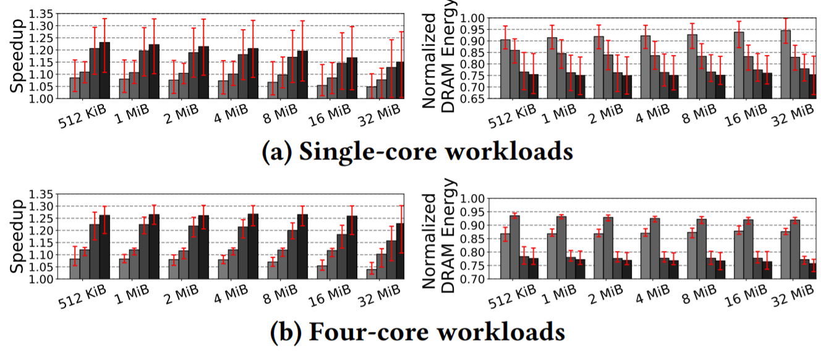
CROW-cache + ref

Slide 55
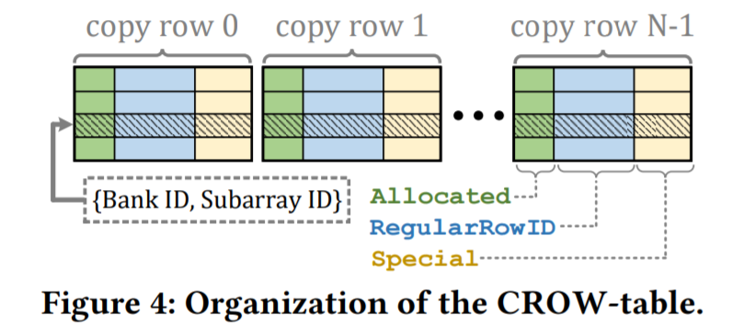
CROW-table Organization

Slide 56
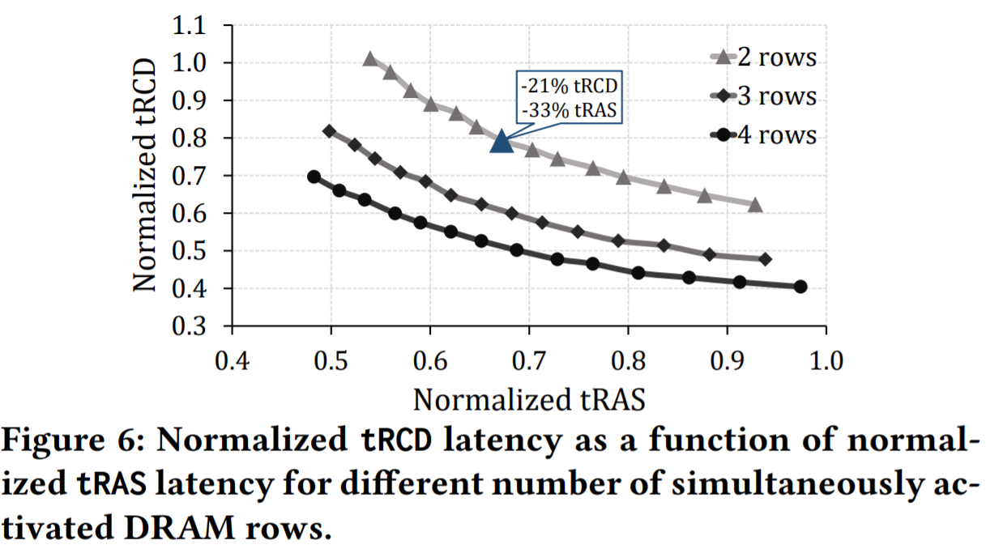
tRCD vs tRAS

Slide 57
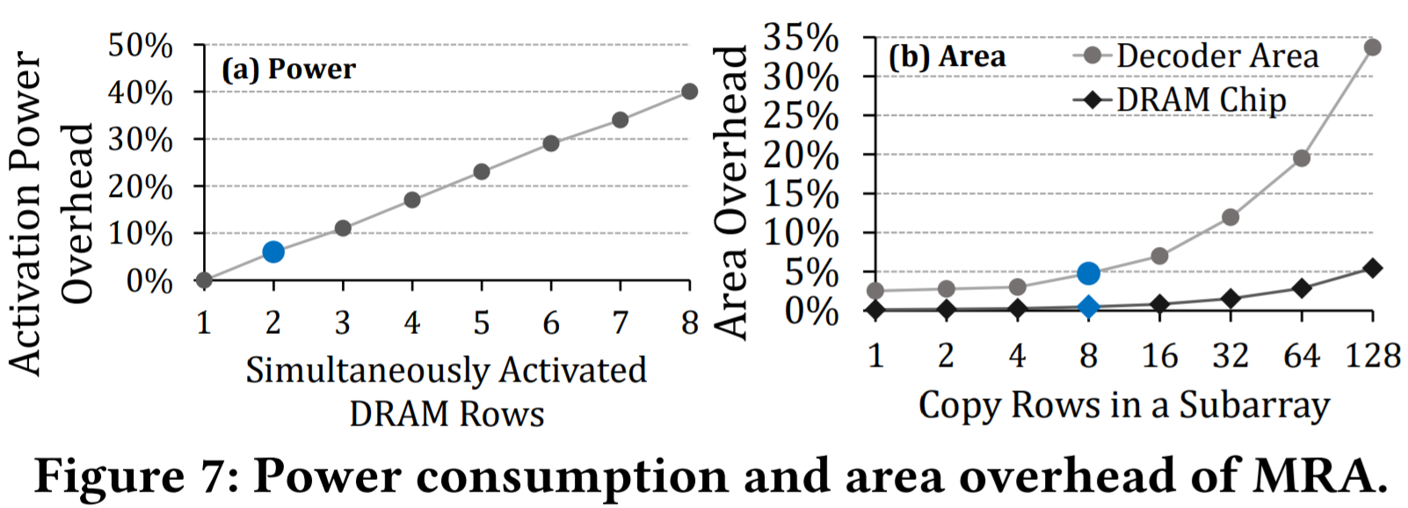
MRA Area Overhead

Slide 58
DRAM Charge over Time
Ready to Access
Ready to
Precharge
Ready to Access
Charge Level
Cell
Cell
Data 1
charge
Sense-Amplifier
Data 0
Sense
Amplifier
Sensing
Restore
Precharge
time
tRCD
ACT
R/W
PRE
tRAS
Notes:
The figure shows how the charge levels of a DRAM Cell and Sense Amplifier change with each DRAM command. The Y-axis shows charge and the X-axis shows the time.
Initially, the cell contains charge that matches the region of Data 1.
[CLICK]
To be able to perform read and write operations, the cell has to be activated and the charge level of the sense amplifier should reach «Read to Access Charge Level».
The memory controller issues an activate command to initiate the Sensing phase.
During sensing, charge flows from the Cell to the Sense-Amplifier.
This results in slight increase in the charge level of the Sense Amplifier. When the Sense Amplifier reaches
the threshold charge to recognize the data, Sensing phase finishes and Restore begins.
[CLICK]
During restore, both the
Sense Amplifier and the DRAM cell are driven back to fully charged state.
At the point where the sense amplifier reaches «ready to access charge level», the
Memory controller is free to issue Read or Write command.
[CLICK]
The latency for issuing a READ or WRITE after an activate is defined as tRCD. [CLICK]
At the end of restore, the memory controller can issue a PRE command to prepare DRAM for a future access to a different row. [CLICK]
That triggers the Precharge phase where the Sense Amplifier charge gets back to its pre-sensing value.
The time from the start of the Sensing upon the completion of Restore is called tRAS. [CLICK]
The main takeaway in this slide is that the memory controller is responsible for issuing DRAM commands and satisfying the timing between the commands to perform an access.

