Slide 1


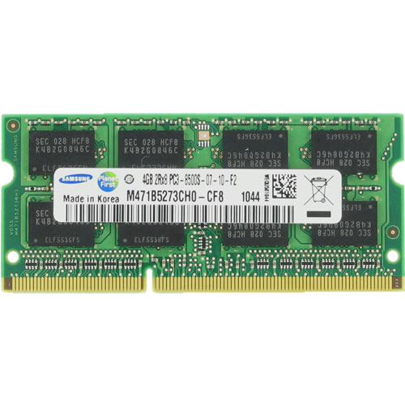

CROW: A Low-Cost Substrate for Improving DRAM Performance, Energy Efficiency, and Reliability
Hasan Hassan Minesh Patel Jeremie S. Kim A. Giray Yaglikci
Nandita Vijaykumar Nika Mansouri Ghiasi Saugata Ghose Onur Mutlu
1: Summary
2: DRAM Operation Basics
Challenges of DRAM scaling:
High access latency → bottleneck for improving system performance/energy
Refresh overhead → reduces performance and consume high energy
Exposure to vulnerabilities (e.g., RowHammer)
Copy-Row DRAM (CROW)
Introduces copy rows into a subarray
The benefits of a copy row:
Efficiently duplicating data from regular row to a copy row
Quick access to a duplicated row
Remapping a regular row to a copy row
Use cases:
CROW-cache & CROW-ref
Mitigating RowHammer
We hope CROW enables many other use cases going forward
DRAM Module
DRAM Cell
DRAM Row
Memory
Bus
CPU
Memory Controller
Sense-Amplifier
A row is opened
The sense amplifiers could be accessed
Many read/write commands can be issued to the open row
Ready to open (activate) a new row
(20% speedup and 22% less DRAM energy)
Each cell stores a single-bit of data
Activate
Read/Write
Precharge
Logic 0
Low Charge
Logic 1
High Charge
3: The Components of CROW
4: CROW Operations
Copy-Row DRAM (CROW): a flexible in-DRAM substrate that can be used in multiple different ways to address the performance, energy efficiency, and reliability challenges of DRAM
Row Copy
Two-Row Activation
DRAM Subarray
1
2
Enables quickly copying a regular row into a copy row
Enables fast access to data that is duplicated across a regular row and a copy row
Memory Controller
CROW-table
DRAM Subarray
DRAM Subarray
ACT-c
ACT-t
Memory Controller
Memory Controller
5: CROW-cache
6: CROW-ref
7: Mitigating RowHammer
Problem: High access latency
Key idea: Use copy rows to enable low-latency access to most-recently-activated regular rows in a subarray
CROW-cache combines:
row copy → copy a newly activated regular row to a copy row
Two-row activation → activate the regular row and copy row together on next access
Reduces activation latency by 38%
Problem: Refresh has high overheads. Weak rows lead to high refresh rate
weak row: at least one of the row’s cells cannot retain data correctly when refresh interval is increased
Key idea: Avoid storing data in a weak regular row by remapping it to a strong copy row
CROW-ref uses:
row copy → copy a weak regular row to a strong copy row
CROW-ref eliminates more than half of the refresh requests
Key idea: remap victim rows to copy rows
victim
aggressor
victim
SA
SA
SA
SA
SA
SA
8: Evaluation
Methodology
CROW-cache Performance
CROW-ref Performance
Simulator
DRAM Simulator (Ramulator [Kim+, CAL’15])
https://github.com/CMU-SAFARI/ramulator
Workloads
44 single-core workloads
SPEC CPU2006, TPC, STREAM, MediaBench
160 multi-programmed four-core workloads
By randomly choosing from single-core workloads
Execute at least 200 million representative instructions per core
System Parameters
1/4 core system with 8 MiB LLC
LPDDR4 main memory
8 copy rows per 512-row subarray
17%
6.6%
7.1%
1.2%
11.9%
3.8%
7.1%
four-core
single-core
four-core
single-core
four-core
single-core
CROW-cache improves single-/four-core system performance
CROW-ref significantly reduces the performance overhead of DRAM refresh
Combining CROW-cache and CROW-ref
Hardware Overhead
Other Results in the Paper
For 8 copy rows:
0.5% DRAM chip area
1.6% DRAM capacity
11.3 KiB memory controller storage
Sensitivity to:
Number of copy-rows per subarray
Chip density
Last-level cache capacity
CROW-cache with prefetching
CROW-cache against other in-DRAM caching mechanisms:
TL-DRAM [Lee+, HPCA’13]
SALP [Kim+, ISCA’12]
17%
20%
23%
22%
CROW-(cache+ref) provides more performance and DRAM energy benefits than each mechanism alone
Available in July:
github.com/CMU-SAFARI/CROW

