Slide 1



CLR-DRAM:
A Low-Cost DRAM Architecture
Enabling Dynamic Capacity-Latency Trade-off
Haocong Luo Taha Shahroodi Hasan Hassan Minesh Patel
A. Giray Yaglıkçı Lois Orosa Jisung Park Onur Mutlu
Notes:
Hello, my name is Haocong. Today, I will be presenting CLR-DRAM, a low cost DRAM architecture that enables a dynamic capacity-latency trade-off.

Slide 2

Executive Summary
Motivation: Workloads and systems have varying memory capacity and latency demands.
Problem: Commodity DRAM makes a static capacity-latency trade-off at design-time.
Existing DRAM cannot adapt to varying capacity and latency demands.
Goal: Design a low-cost DRAM architecture that can be dynamically configured to have high capacity or low latency at a fine granularity (i.e., at the granularity of a row).
CLR-DRAM (Capacity-Latency-Reconfigurable DRAM):
A single DRAM row can dynamically switch between either:
Max-capacity mode with high storage density.
High-performance mode with low access latency and low refresh overhead.
Key Mechanism:
Couple two adjacent cells and sense amplifiers to operate as a high-performance logical cell.
Dynamically turn on or off this coupling at row granularity to switch between two modes.
Results:
Reduces key DRAM timing parameters by 35.2% to 64.2%.
Improves average system performance by 18.6% and saves DRAM energy by 29.7%.
Notes:
[Click] This work is motivated by the fact that workloads and systems have varying memory capacity and latency demands.
[Click] However, commodity DRAM, as the prevalent technology for the main memory, makes a static capacity-latency trade-off at design-time.
[Click] As a result, commodity DRAM could not adapt to changes in the workloads and systems memory capacity and latency demands.
[Click] Our goal is to enable a dynamic capacity-latency trade-off in DRAM at a fine granularity (that is, a single DRAM row) to meet the changing capacity and latency demands of the workloads.
[Click] To this end, we propose CLR-DRAM, which stands for Capacity-Latency-Reconfigurable DRAM.
[Click] CLR-DRAM is capable of dynamically reconfiguring a single DRAM row to operate in either
[Click] a max capacity mode with high storage density or
[Click] a high-performance mode that can operate with low access latency and low DRAM refresh overhead
[Click] The key mechanism of CLR-DRAM consists of two techniques.
[Click ]First, we can couple two adjacent DRAM cells in a row and their two sense amplifiers to operate as a high-performance logical cell.
[Click] Second, we can dynamically turn on or off such coupling to switch between the two modes.
[Click] Our SPICE simulation shows that a high-performance row in CLR-DRAM significantly reduces four major DRAM cell access timing parameters.
[Click] Our system level evaluation shows that mapping pages to high-performance rows in CLR-DRAM improves average performance and saves DRAM energy.
[Click] We hope that future work exploits CLR-DRAM to develop more flexible systems that can adapt to the diverse and dynamically changing DRAM capacity and latency demands of workloads.

Slide 3
Talk Outline
Motivation & Goal
DRAM Background
CLR-DRAM (Capacity-Latency-Reconfigurable DRAM)
High-Performance Mode Benefits
Reducing DRAM Access Latency
Mitigating DRAM Refresh Overhead
Evaluation
SPICE Simulation
System-level Evaluation
Conclusion
Notes:
Here is the outline of this talk. [Click]

Slide 4
Fundamental Capacity-Latency Tradeoff in DRAM
Access Latency
Storage Capacity
DRAM
Notes:
There is a fundamental trade-off between storage capacity and access latency in DRAM. Commodity DRAM overwhelmingly favors storage capacity at the expense of access latency.

Slide 5
Motivation
Motivation: Existing systems miss opportunities to improve performance by adapting to changes in main memory capacity and latency demands.
The memory capacity of a system is usually overprovisioned.
Many workloads underutilize the system’s memory capacity.
e.g., HPC [Panwar+, MICRO’19], Cloud [Chen+, ICPADS’18], and Enterprise [Di+, CLUSTER’12].
Problem: Commodity DRAM makes a static capacity-latency trade-off at design-time.
Existing DRAM cannot adapt to varying capacity and latency demands.
Some state-of-the-art heterogeneous DRAM architectures [Lee+, HPCA’13, Son+, ISCA’13] employ only a fixed-size and small low-latency region.
Does not always provide the best possible operating point within the DRAM capacity-latency trade-off spectrum for all workloads.
Notes:
[Click]
Modern workloads have different main memory capacity and latency demands. Existing systems miss opportunities to improve performance by adapting to changes in main memory capacity and latency demands.
[Click]
The memory capacity of a system is usually overprovisioned
[Click] while many modern workloads tend to underutilize the system’s memory capacity. [Click]
[Click]
However, commodity DRAM, as the prevalent technology for the main memory, makes a static capacity-latency trade-off at design-time.
[Click]
Once manufactured, they are either capacity-optimized at the cost of long latency, or latency-optimized at the cost of small storage capacity.
[Click] Even some state-of-the-art heterogeneous DRAM architectures employ only a fixed-size and small low-latency region, which does not always provide the best possible operating point within the DRAM capacity-latency trade-off spectrum for all workloads.
[Click] As a result, commodity DRAM could not adapt flexibly to the changes in the system’s memory capacity and latency demands.

Slide 6
Goal
Goal: Design a low-cost DRAM architecture that can be dynamically configured to have high capacity or low latency at a fine granularity (i.e., at the granularity of a row).
DRAM Row X
DRAM Row X
Max-capacity mode
High-performance mode
Notes:
[Click] Therefore, our goal is to enable a dynamic DRAM capacity-latency trade-off at a fine granularity (that is, a single DRAM row), as shown pictorially in this figure.

Slide 7
Talk Outline
Motivation & Goal
DRAM Background
CLR-DRAM (Capacity-Latency-Reconfigurable DRAM)
High-Performance Mode Benefits
Reducing DRAM Access Latency
Mitigating DRAM Refresh Overhead
Evaluation
SPICE Simulation
System-level Evaluation
Conclusion
Notes:
Next, I will briefly introducing how DRAM works.

Slide 8
DRAM Background - Array Architecture
SA
SA
SA
bitline
DRAM
Bank
wordline (row)
SA
SA
bitline
Subarray
SA
SA
SA
Open-bitline architecture
Notes:
A DRAM chip contains multiple independent DRAM banks, each consisting of multiple subarrays of DRAM cells. A DRAM cell stores one bit of data using electric charge level.
[Click] A typical density-optimized subarray architecture is shown on the right.
To access data stored in the DRAM cells, the memory controller issues an activate command to activate a row of DRAM cells.
[Click]
The electric charge in the cells are then sensed and read by sense amplifiers
[Click]
placed on both sides of the subarray through bitlines.
This kind of array architecture is called the open-bitline architecture.

Slide 9
DRAM Background - Sense Amplifier
Activated
SA
SA
bitline
DRAM
Bank
SA
SA
SA
bitline
Subarray
SA
SA
Not
Activated
Serves as the reference for the SA
Notes:
[Click] The sense amplifier operates in a differential manner. [Click] It reads data stored in the cell by sensing and amplifying the voltage difference across a pair of bitlines caused by the sharing of charge between a DRAM cell and a bitline when a row is activated.
[Click] During an activation, another bitline in a neighboring subarray is also involved to serve as the reference of the sense amplifier.

Slide 10
DRAM Background - Accessing a Cell
① Charge Sharing
② Charge Restoration
③ Precharge
Voltage
bitline
bitline
cell
①
②
③
VDD
🅐
🅐 ΔV_{th}
VDD/2
🅑
🅑 ΔV_{RCD}
0
tRCD
tRP
tRAS
ACT
RD/WR
PRE
Ready for
Next ACT
Notes:
Here we show the procedure of accessing a fully charged DRAM cell. The x-axis is time and the y-axis is voltage levels in the cell and bitlines. The activate command
[Click] let the DRAM cell share its charge with a bitline,
[Click] creating a voltage difference across the bitline pair. When the difference is large enough,
[Click] the SA start to amplify this difference
[Click] and enters the charge restoration process.
[Click] During charge restoration, when the voltage difference is large enough, we can safely issue a read or write command to the DRAM row. The latency between an activate command and the earliest possible read/write command is called tRCD.
[Click] At the same time, the charge restoration process continue to restore the charge level back to the cell. The latency of fully restoring a DRAM cell is tRAS.
[Click] After tRAS, the row can be safely closed.
[Click] The memory controller issues a precharge command, which takes tRP amount of time to close the row.
Due to charge leakage, DRAM cells have to be periodically refreshed to ensure data integrity.

Slide 11
CLR-DRAM Outline
Motivation & Goal
DRAM Background
CLR-DRAM (Capacity-Latency-Reconfigurable DRAM)
High-Performance Mode Benefits
Reducing DRAM Access Latency
Mitigating DRAM Refresh Overhead
Evaluation
SPICE Simulation
System-level Evaluation
Conclusion
Notes:
Now, I will introduce our new idea, CLR-DRAM, Capacity-Latency-Reconfigurable DRAM

Slide 12
CLR-DRAM (Capacity-Latency-Reconfigurable DRAM)
CLR-DRAM: Enables a single DRAM row to dynamically switch between
max-capacity mode or high-performance mode with low cost.
Key Idea:
Dynamically configure the connections between DRAM cells and sense amplifiers in the density-optimized open-bitline architecture.
SA1
SA1
Type 1
Type 2
Each bitline is
connected to only one SA
bitline mode
select transistors
A
B
A
B
Type 2
Type 1
SA2
SA2
Open-bitline (Baseline)
CLR-DRAM
Notes:
[Click] CLR-DRAM is a low-cost DRAM architecture that enables a single DRAM row to dynamically switch between either max-capacity or high-performance mode.
[Click] The key idea of CLR-DRAM is to enable dynamic configurability of the connections between DRAM cells and sense amplifiers [Click] in the density-optimized open-bitline architecture, which is shown on the left.
[Click]
To do so, CLR-DRAM, which is shown on the right, adds two types of small isolation transistors, called Type 1 and Type 2 bitline mode select transistors to enhance the connectivity between DRAM cells and sense amplifiers.

Slide 13
Max-Capacity Mode
Max-capacity mode mimics the cell-to-SA connections as in the open-bitline architecture.
SA1
Type 1
Type 2
Enable Type 1 transistors
Disable Type 2 transistors
A
A
B
B
Every single cell and its SA operate individually.
Type 2
Type 1
SA2
Max-capacity mode achieves the same storage capacity as the conventional open-bitline architecture
Notes:
For a row to operate in max-capacity mode,
[Click]
CLR-DRAM enables Type 1 and disables Type 2 bitline mode select transistors to mimic exactly the same cell-to-SA connections as in the open-bitline architecture.
[Click]
Doing so enables every single DRAM cell and its sense amplifier in a max-capacity row to operate individually, [Click] and achieving the same storage capacity as a row in the conventional density-optimized open-bitline architecture.

Slide 14
High-Performance Mode
SA1
High-performance mode couples every two adjacent DRAM cells in a row and their SAs.
SA
Type 1
Type 2
Enable Type 1 transistors
logical cell
Connects to both ports
of the same SA
Enable Type 2 transistors
A
A
A
B
Two adjacent DRAM cells in a row coupled as a single logical cell.
Connects to both SAs
Two SAs of the two coupled cells coupled as
a single logical SA.
Type 2
Type 1
SA2
SA
High-performance mode reduces access latency and refresh overhead
via coupled cell/SA operations
Notes:
For a row to operate in high-performance mode,
[Click]
CLR-DRAM enables both types of bitline mode select transistors to enable two kinds of coupled operations simultaneously.
[Click]
First, two adjacent DRAM cells in a row are coupled to operate as a single logical cell because they are connected to both ports of the same sense amplifier.
[Click]
Second, two sense amplifiers, which originally served the two adjacent cells individually, are now coupled to operate as a single logical sense amplifier because the logical cell is connected to both the two sense amplifiers.
[Click]
A high-performance mode row has reduced access latency and refresh overhead via these coupled cell and sense amplifier operations.

Slide 15
CLR-DRAM Outline
Motivation & Goal
DRAM Background
CLR-DRAM (Capacity-Latency-Reconfigurable DRAM)
High-Performance Mode Benefits
Reducing DRAM Access Latency
Mitigating DRAM Refresh Overhead
Evaluation
SPICE Simulation
System-level Evaluation
Conclusion
Notes:
Next, I will explain how could the coupled operations in high-performance rows reduce access latency and refresh overhead. I will start by describing what coupling two cells and two sense amplifiers enables.

Slide 16
High-Performance Mode Benefits: Coupled Cells
bitline
bitline
A logical cell (two coupled cells) always stores opposite charge levels representing the same bit.
SA1
SA
logical cell
A
A
This enables three benefits:
Reducing latency of charge sharing.
Early-termination of charge restoration.
Retaining data for longer time.
A
B
SA2
SA
Notes:
[Click]
A logical cell always stores opposite charge levels in the two coupled cells to represent the same bit of data. This is because the sense amplifier always drives the two bitlines, that each of the coupled cells is connected to, respectively, into complementary voltage levels.
This property of a logical cell enables three benefits [Click] to the operation of a high-performance row in CLR-DRAM. [Click] First, it reduces the latency of charge sharing. Second, it enables the early-termination of charge restoration. Third, it enables retaining data stored in the logical cell for a longer period of time.

Slide 17
High-Performance Mode Benefits: Coupled SAs
A logical SA operates faster by having two SAs driving the same logical cell.
SA1
SA
SA
logical cell
logical SA
A
A
This enables three benefits:
Reducing latency of charge restoration.
Reducing latency of precharge.
Completing refresh in shorter time.
A
B
SA2
SA
SA
Notes:
[Click] A logical sense amplifier operates faster by having two sense amplifiers driving the same logical cell.
[Click ]This also enables three benefits: the reduction in the latency of charge restoration, precharge and refresh.

Slide 18
CLR-DRAM Outline
Motivation & Goal
DRAM Background
CLR-DRAM
High-Performance Mode Benefits
Reducing DRAM Access Latency
Mitigating DRAM Refresh Overhead
Evaluation
SPICE Simulation
System-level Evaluation
Conclusion
Notes:
Now let me explain how operating with a logical cell and a logical sense amplifier reduces DRAM access latency. .

Slide 19
Reducing DRAM Latency: Three Ways
Reducing latency of charge sharing.
Early-termination of charge restoration.
Reducing latency of charge restoration and precharge.
High-performance mode reduces
activation (tRCD), restoration (tRAS) and precharge (tRP) latencies
Notes:
As a recap, the coupled operations of two cells and two sense amplifiers reduces DRAM latency [Click] in three ways. These three ways of latency reduction altogether [Click] reduce the activation, restoration and precharge latencies of a high-performance mode row in CLR-DRAM.

Slide 20
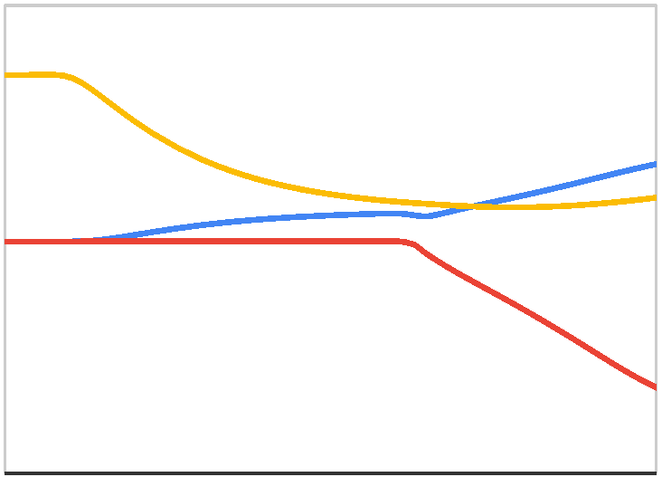
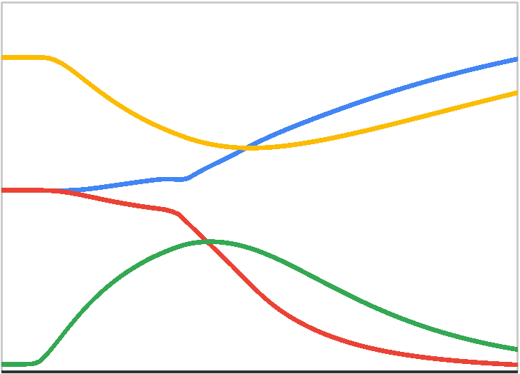
Reducing Charge Sharing Latency
Coupled cells always store opposite charge levels representing the same bit.
Drive both bitlines of a SA into opposite directions during charge sharing.
Charge Sharing
Charge Restoration
Bitline
ΔV_{th}
VDD/2
Bitline
Single
Cell
(Baseline)
Reduction in
charge sharing latency
Cell
Bitline
ΔV_{th}
Bitline
VDD/2
Logical
Cell
Cell
Cell
Charge
Sharing
Charge Restoration
Notes:
[Click] The opposite charge levels stored in the logical cell reduces the charge sharing latency [Click] by driving both bitlines of a sense amplifier into opposite directions during charge sharing.
[Click] It reduces charge sharing latency because the voltage difference across the two bitlines reaches the threshold voltage required by the differential operation of the sense amplifier [Click] earlier than the baseline case where only one DRAM cell is involved during charge sharing.

Slide 21
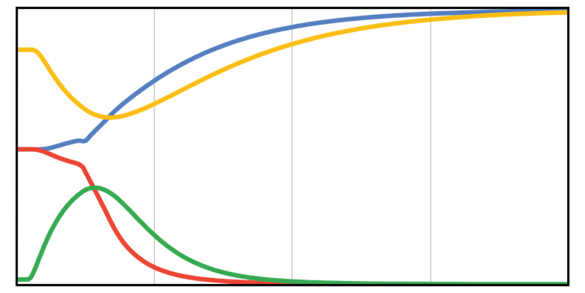
2. Early Termination of Charge Restoration
Observation 1: Charge restoration has a long “tail latency”.
Last 25%
Restored
Charged Cell
~50% Charge Restoration time
Bitline
VDD/2
Bitline
Discharged Cell
Terminating charge restoration early
does not significantly degrade the charge level in the cell
Notes:
The opposite charge levels stored in the logical cell also enables a high-performance mode row in CLR-DRAM to terminate its charge restoration early. We make two observations about charge restoration.
[Click] First, the charge restoration process has a long “tail latency”.
[Click] Our motivational SPICE simulation shows that [Click] it takes about half of the charge restoration time to fully restore the last 25% of charge in a charged cell.
[Click] This means that if we terminate the charge restoration earlier, the charge level restored in the cell does not degrade significantly.

Slide 22
2. Early Termination of Charge Restoration
Observation 2: A discharged cell restores faster than a charged one.
Restored
Charged Cell
Bitline
Restoration latency difference
VDD/2
Bitline
Discharged Cell
Restored
Terminating charge restoration early can still
fully restore the discharged cell.
Notes:
[Click] Second, a discharged cell restores much faster than a charged one. This is because the restoration current of a charging cell is limited more than that of a discharging cell.
[Click] In other words, if we terminate the charge restoration process of a logical cell earlier, we can still have the discharged cell fully restored.
Leveraging these observations, we reduces tRAS by terminating the charge restoration process early. Our SPICE simulation shows that tRAS could be significantly reduced with only a marginal negative impact on tRCD due to the reduced charge level in the cell prior to activation.

Slide 23
3. Reducing Charge Restoration & Precharge Latency
Logical SA contains two physical SAs.
Drive the same logical cell from
both ends of the bitlines.
SA1
SA
Faster
Charge Restoration
Each has a
precharge unit
A
A
A
B
Faster
Precharge
SA2
SA
Notes:
[Click]
The logical sense amplifiers reduces the charge restoration latency simply by having two physical sense amplifiers
[Click][Click]
driving the same logical cell from both ends of the bitlines.
This largely offsets the long latency caused by long bitlines in the density-optimized open-bitline architecture.
[Click]
The precharge latency is also reduced because two precharge units, which are associated with the sense amplifier, are also coupled to precharge the bitlines together.

Slide 24
Reducing DRAM Latency: Three Ways
Reducing latency of charge sharing.
Early-termination of charge restoration.
Reducing latency of charge restoration and precharge.
High-performance mode reduces
activation (tRCD), restoration (tRAS) and precharge (tRP) latencies
Notes:
As a result, by having the coupled operation of two DRAM cells as a single logic cell and two coupled sense amplifiers operating as a single logical sense amplifier, CLR-DRAM reduces the activation, restoration and precharge latencies.

Slide 25
CLR-DRAM Outline
Motivation & Goal
DRAM Background
CLR-DRAM
High-Performance Mode Benefits
Reducing DRAM Access Latency
Mitigating DRAM Refresh Overhead
Evaluation
SPICE Simulation
System-level Evaluation
Conclusion
Notes:
Now let me explain how CLR-DRAM mitigates DRAM refresh overhead in high-performance mode..

Slide 26
Mitigating Refresh Overhead
CLR-DRAM reduces refresh overhead of high-performance rows in two different ways:
Reducing Refresh Latency
Refresh is essentially activation + precharge.
All latency reductions (activation, restoration, precharge) apply to reduce each refresh operation's latency.
Reducing Refresh Rate
A logical cell has larger capacitance.
Tolerates more leakage.
Can be refreshed less frequently.
High-performance mode reduces
refresh latency (tRFC) and refresh rate (increases tREFW)
Notes:
[Click] CLR-DRAM reduces DRAM refresh overhead of high-performance rows in two different ways:
[Click]
First, it reduces the latency of a refresh operation.
[Click] This is because since refresh a row is essentially restoring charge level back to the cells and then perform precharge to close the row, [Click] the activation, restoration and precharge latency reductions also apply to reduce the latency of refreshing a DRAM row.
[Click]
Second, since a logical cell contains two physical DRAM cells, [Click] it has a larger effective capacitance [Click] to tolerate more leakage. [Click] Therefore, less refresh operation is needed for high-performance rows.
We conclude that CLR-DRAM could reduce both the refresh latency and the refresh rate for rows operating in high-performance mode.

Slide 27
CLR-DRAM Outline
Motivation & Goal
DRAM Background
CLR-DRAM
High-Performance Mode Benefits
Reducing DRAM Access Latency
Mitigating DRAM Refresh Overhead
Evaluation
SPICE Simulation
System-level Evaluation
Conclusion
Notes:
Let me move on to the evaluation.

Slide 28
CLR-DRAM Outline
Motivation & Goal
DRAM Background
CLR-DRAM
High-Performance Mode Benefits
Reducing DRAM Access Latency
Mitigating DRAM Refresh Overhead
Evaluation
SPICE Simulation
System-level Evaluation
Conclusion
Notes:
We evaluate the latency impact of CLR-DRAM using SPICE simulation.

Slide 29
SPICE Simulation
Methodology
Model a DRAM subarray based on Rambus DRAM technology parameters [1].
Scaled to 22 nm according to the ITRS roadmap [2].
22nm PTM-HP transistor model [3].
SPICE model will be available in July: github.com/CMU-SAFARI/clrdram
[1] Rambus, “DRAM Power Model (2010),” http://www.rambus.com/energy
[2] ITRS Roadmap, http://www.itrs2.net/itrs-reports.html
[3] http://ptm.asu.edu/
Notes:
[Click]
We model a CLR-DRAM subarray based on previously published technology parameters. We scale the parameters to match with recent technology nodes.
[Click]
We will make our model available freely soon.

Slide 30
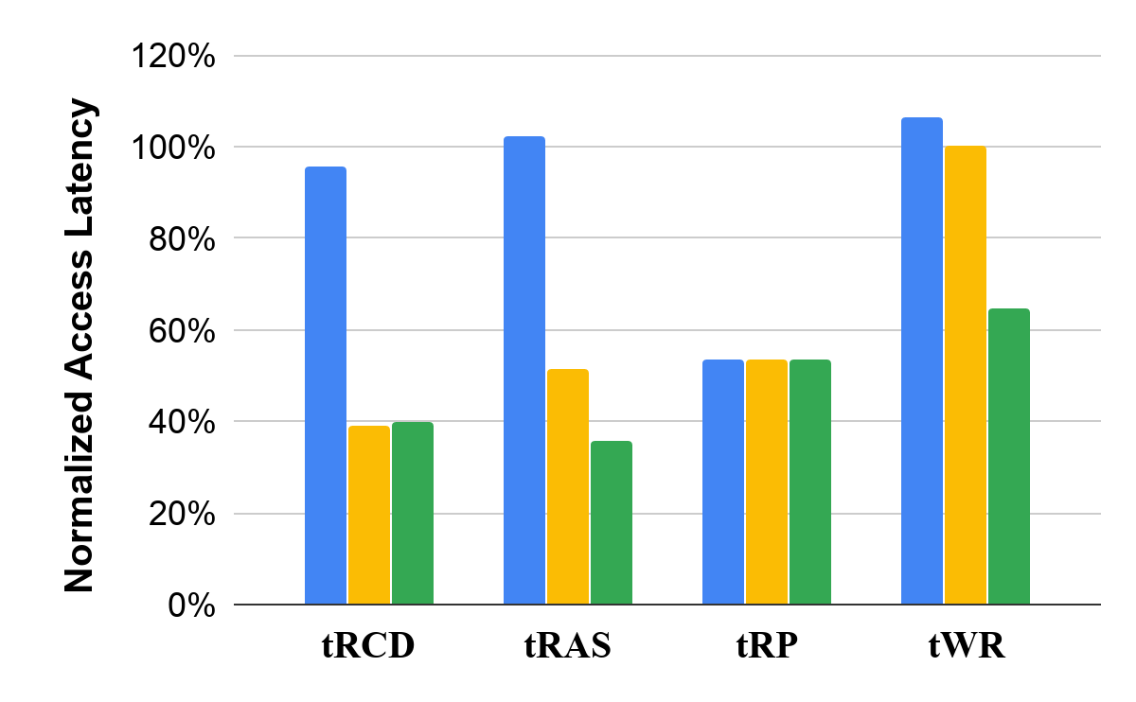
SPICE Simulation: Max-Capacity Mode Latencies
46.4%
Max-capacity
(Activation)
(Restoration)
(Precharge)
(Write)
*The tRP reduction of coupling precharge units also applies to max-capacity mode.
Notes:
[Click] First, we show the four major DRAM access latency of a max-capacity row. We make two observations
[Click] First, the precharge latency is significantly reduced even for a max-capacity row because two precharge units can also be used to precharge the bitlines when closing a max-capacity row.
[Click] Second, the bitline mode select transistors slightly increase the restoration latency and write recovery latency and reduce the activation latency of a max-capacity mode row..

Slide 31
SPICE Simulation: High-Performance Mode Latencies
60.1%
64.2%
46.4%
35.2%
Max-capacity
High-performance
w/o early termination
High-performance
w/ early termination
(Activation)
(Restoration)
(Precharge)
(Write)
*The tRP reduction of coupling precharge units also applies to max-capacity mode.
Notes:
[Click]
For a high-performance mode row, we reduce all the four access latencies of DRAM significantly, ranging from 35.2% to 64.2%.
We make two observations about the early termination of charge restoration.
[Click] First, applying early termination of charge restoration reduces the charge restoration latency even further with [Click] only a marginal increase in activation latency due to the reduced charge level prior to the activation.
[Click] Second, the early termination of charge restoration also enables the reduction of the write recovery latency, which is not reduced without such early termination because only one write driver is involved to write to the two coupled cells.

Slide 32
SPICE Simulation: High-Performance Mode Latencies
60.1%
64.2%
46.4%
35.2%
Max-capacity
High-performance
w/o early termination
High-performance
w/ early termination
CLR-DRAM reduces DRAM latency by 35.2% to 64.2%
in high-performance mode
(Activation)
(Row Close)
(Write)
(Row Open)
(Restoration)
(Row Close)
(Write)
*The tRP reduction of coupling precharge units also applies to max-capacity mode.
Notes:
We conclude that CLR-DRAM significantly reduces DRAM latency.

Slide 33
CLR-DRAM Outline
Motivation & Goal
DRAM Background
CLR-DRAM
High-Performance Mode Benefits
Reducing DRAM Access Latency
Mitigating DRAM Refresh Overhead
Evaluation
SPICE Simulation
System-level Evaluation
Conclusion
Notes:
We evaluate the system-level performance and DRAM energy impact of CLR-DRAM.

Slide 34
System-Level Evaluation - Methodology
Simulator:
Cycle-level DRAM simulator: Ramulator [Kim+, CAL’15]
Workloads:
41 single-core workloads from SPEC CPU2006, TPC, MediaBench
30 in-house synthetic random and stream access workloads
90 multi-programmed four-core workloads
By randomly choosing from our real single-core workloads
System Parameters:
1/4 core system with 8MB LLC
5 configurations: X% of the DRAM rows configured to high-performance mode.
X = 25, 50, 75, 100. Plus a X=0 case where all rows are max-capacity mode.
Map X% of the most accessed pages of workloads to high-performance mode rows.
Notes:
[Click] We use Ramulator, [Click] a cycle-level DRAM simulator to evaluate the system-level performance of CLR-DRAM.
[Click] [Click] We analyze 41 real single-core workloads from benchmark suites,
[Click] 30 synthetic random and stream access workloads and
[Click] [Click] 90 randomly chosen multi-programmed four-core workloads.
[Click] [Click] [Click]
We model 5 configurations of CLR-DRAM, each configures a different portion [Click] of all DRAM rows to high-performance mode.
[Click] For each configuration, [Click] we also map the same portion of the most accessed pages of the workloads to high-performance mode rows.

Slide 35
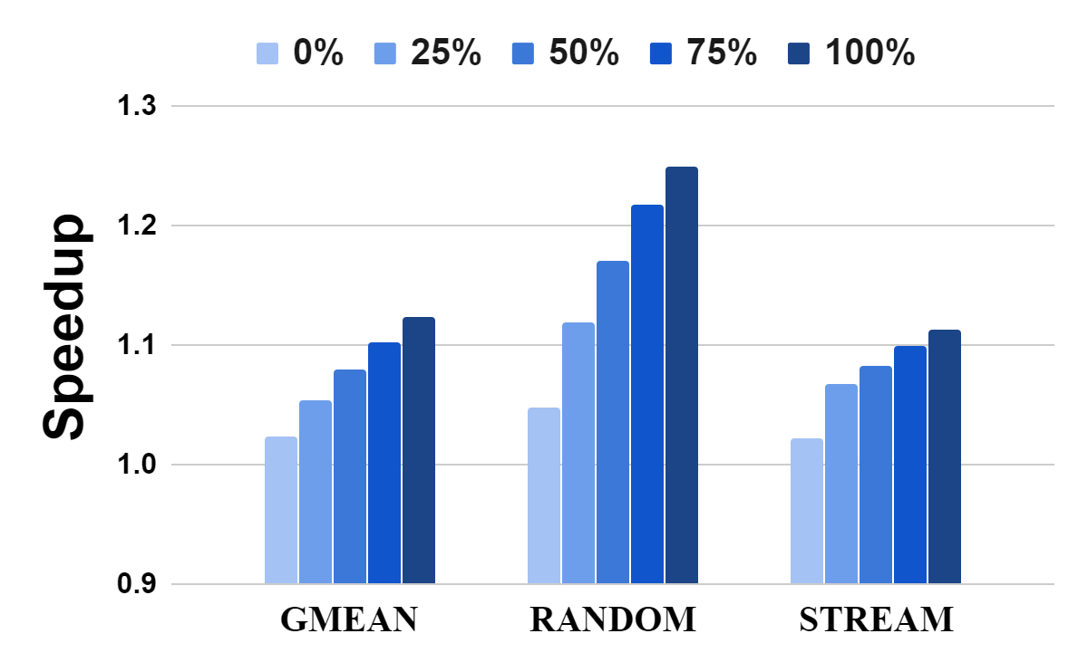
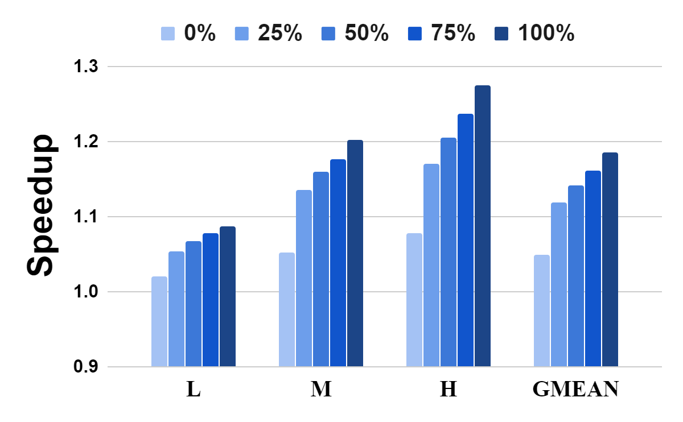
CLR-DRAM Performance
Fraction of High-Performance Rows
Fraction of High-Performance Rows
18.6%
12.4%
*
Single-core
Multi-core
CLR-DRAM improves system performance for
both single-core and multi-core workloads
*GMEAN is the geometric mean of the speed up of the 41 real single-core workloads.
L, M, H stand for different multi-core workload groups with different memory-intensity.
Notes:
I will start with the performance impact of CLR-DRAM.
[Click]
For real single-core workloads, CLR-DRAM row provide an average speedup of 12.4% when all pages are mapped to high-performance mode rows.
[Click]
For the 90 multi-core workloads, mapping all pages to high-performance rows provides an average of 18.6% speedup.
We observe that in all cases the performance improvement increases when we increase the number of pages that are mapped to high-performance mode rows.
For the configuration that all rows are configured to operate in max-capacity mode, CLR-DRAM still achieves a small but positive performance impact [Click], mainly because of the significantly reduced precharge latency of coupling two precharge units.
[Click]
We conclude that CLR-DRAM improves system performance for both single-core and multi-core workloads.

Slide 36
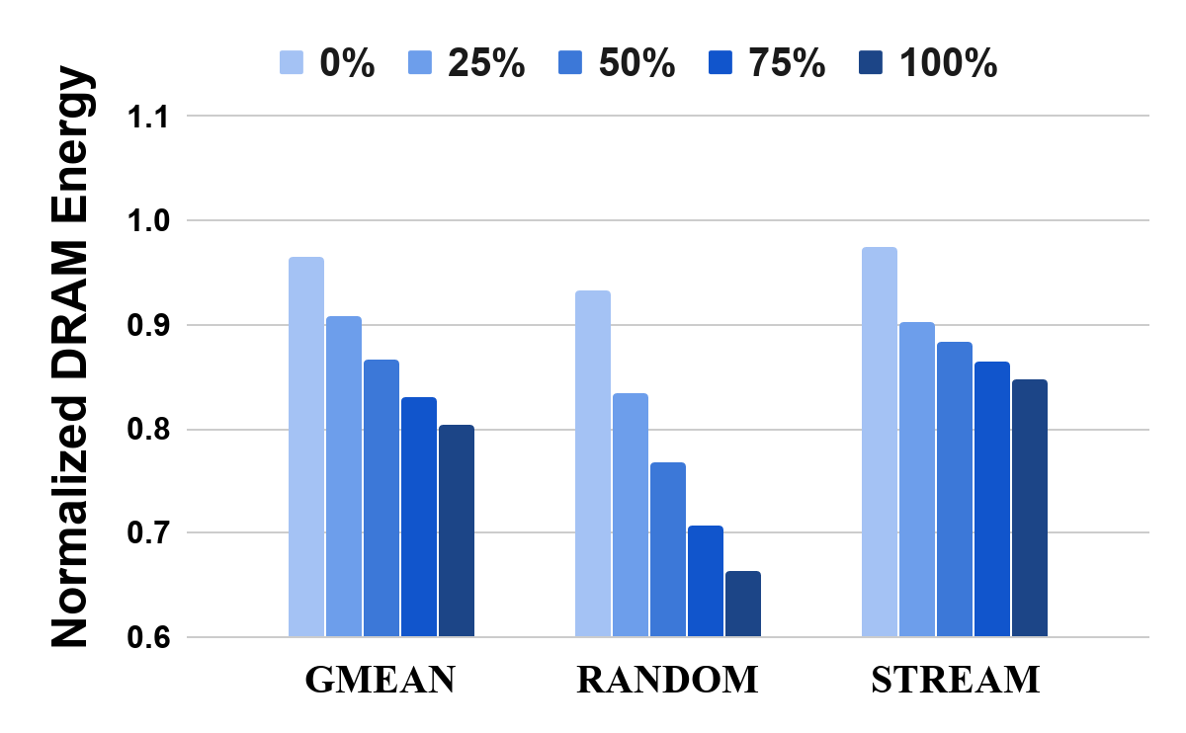
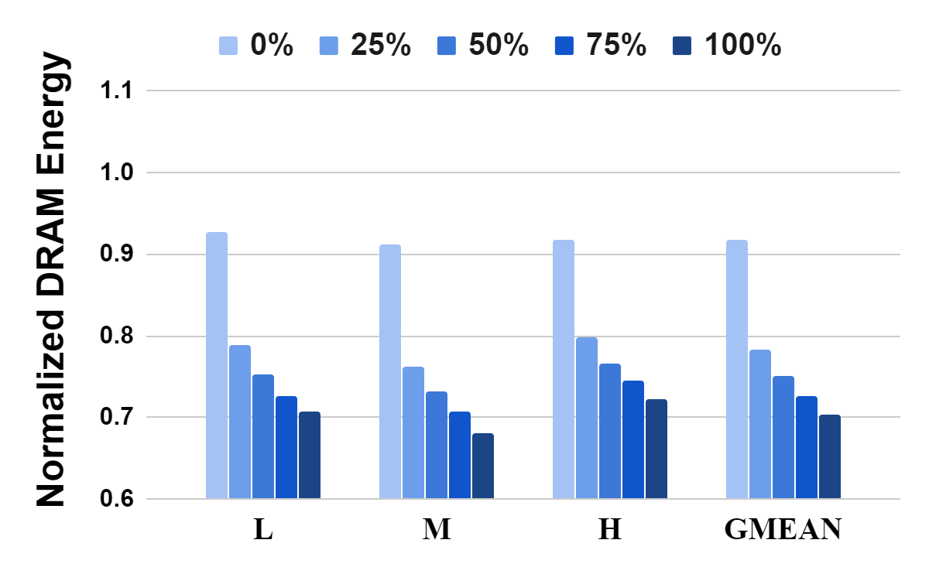
CLR-DRAM Energy Savings
Fraction of High-Performance Rows
Fraction of High-Performance Rows
19.7%
29.7%
*
Single-core
Multi-core
CLR-DRAM saves DRAM energy for
both single-core and multi-core workloads
*GMEAN is the geometric mean of the speed up of the 41 real single-core workloads.
L, M, H stand for different multi-core workload groups with different memory-intensity.
Notes:
Next, we evaluate the DRAM energy consumption of CLR-DRAM.
[Click]
Mapping pages to high-performance mode rows could yield an average of 19.7% DRAM energy savings for single-core workloads
[Click]
and 29.7% for multi-core workloads.
We conclude that CLR-DRAM saves DRAM energy.

Slide 37
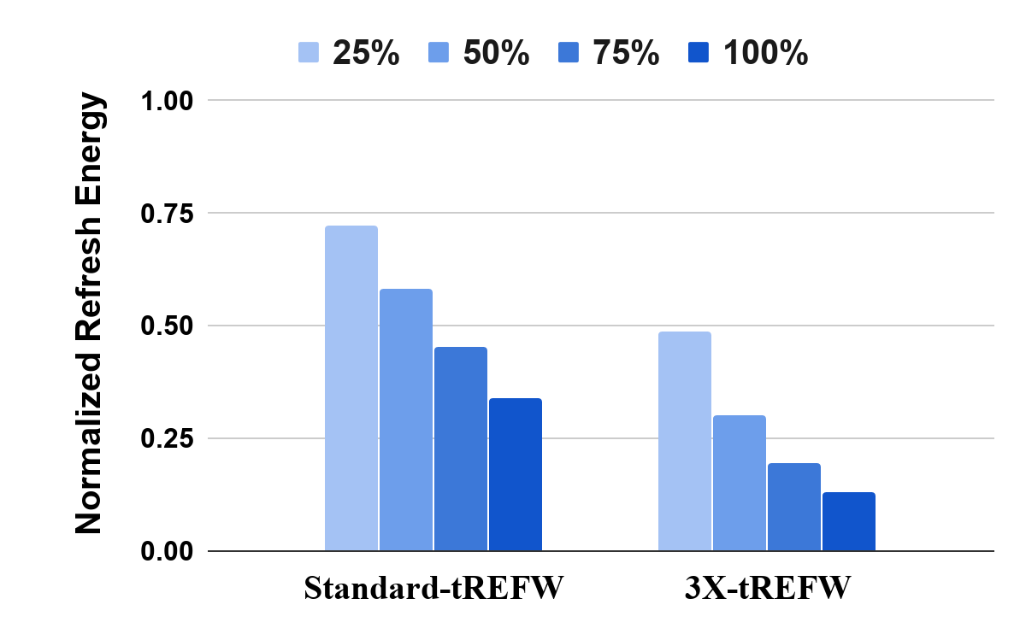
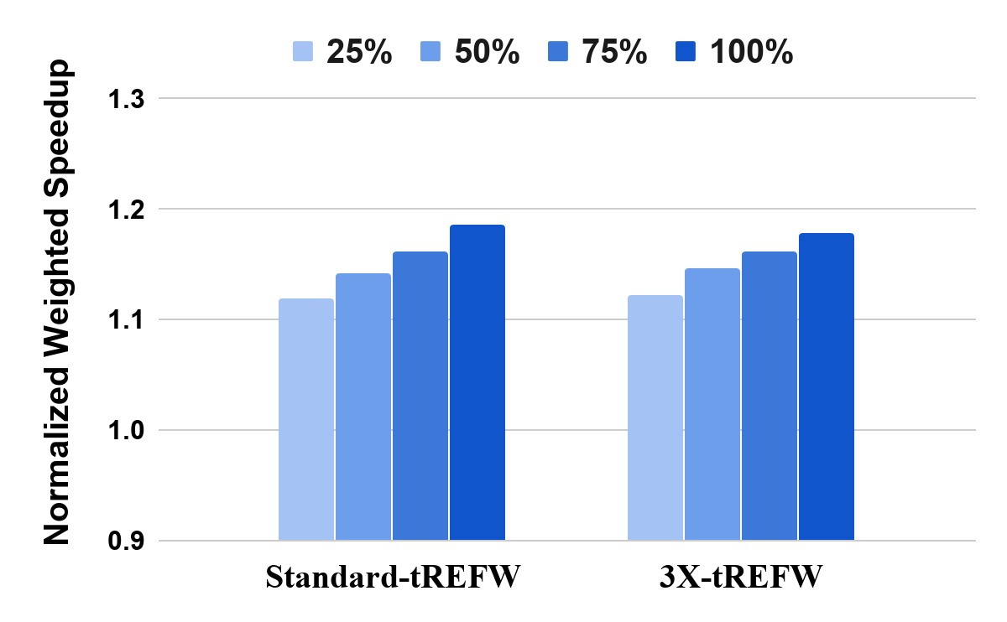
Mitigating Refresh Overhead
Fraction of High-Performance Rows
Fraction of High-Performance Rows
66.1%
87.1%
18.6%
17.8%
CLR-DRAM significantly reduces DRAM refresh energy
Notes:
High-performance mode rows in CLR-DRAM could mitigate the refresh overhead by both reducing the refresh latency (tRFC) and the refresh rate (increase tREFW).
[Click], First we observe that only reducing the refresh latency in CLR-DRAM already saves DRAM refresh energy by 66.1% on average for multicore-workloads. If the refresh rate is reduced by 3X, which our SPICE simulations show is possible, CLR-DRAM could save DRAM refresh energy by 87.1%.
[Click] Doing so still achieves an average speedup of 17.8% for multi-core workloads.

Slide 38
Overhead of CLR-DRAM
DRAM Chip Area Overhead:
3.2% based on our conservative estimates (real overhead is likely lower).
Memory Capacity Overhead:
X% of the rows in high-performance mode incurs X/2% capacity overhead.
[More details in the paper]
CLR-DRAM is a low-cost architecture
Notes:
[Click]
We conservatively estimate CLR-DRAM to have a modest DRAM chip area overhead of 3.2%.
[Click]
Configuring rows to high-performance mode incurs memory capacity overhead. However, due to the flexible reconfigurability of CLR-DRAM, the user is free to find and dynamically determine a favorable operating point in the DRAM capacity-latency trade-off spectrum.
[Click]
We have mode detailed overhead discussions in our paper.
[Click]
We conclude CLR-DRAM is a low-cost DRAM architecture.

Slide 39
Other Results, Analyses and Design Details in the Paper
Sensitivity Study of Reducing Refresh Rate (increasing tREFW)
The trade-off between less refresh operations (increase tREFW) and increased access latency (tRCD and tRAS).
The system-level performance and DRAM refresh energy impact of the trade-off.
Efficient Control of the Bitline Mode Select Transistors
Only two control signals required per-bank for all its subarrays.
Ensures correct SA operation in max-capacity mode.
Maximizing latency-reduction in high-performance mode.
Modifications to Subarray Column Access Circuitry
Column (read/write) access to a high-performance row maintain full bandwidth.
Notes:
[Click]
We also have a more detailed sensitivity analysis on the trade-off between reducing refresh rate and increased activation and restoration latencies and its system-level impact in the paper.
[Click]
Our paper also includes some design details that make CLR-DRAM work efficiently.

Slide 40
CLR-DRAM Outline
Motivation & Goal
DRAM Background
CLR-DRAM
High-Performance Mode Benefits
Reducing DRAM Access Latency
Mitigating DRAM Refresh Overhead
Evaluation
SPICE Simulation
System-level Evaluation
Conclusion
Notes:
Let me conclude my talk.

Slide 41
Conclusion
We introduce CLR-DRAM (Capacity-Latency-Reconfigurable DRAM)
A new DRAM architecture enabling dynamic fine-grained reconfigurability between high-capacity and low-latency operation.
CLR-DRAM can dynamically reconfigure every single DRAM row to operate in either
Max-capacity mode: almost the same storage density as the baseline density-optimized architecture by letting each DRAM cell operate separately.
High-performance mode: low access latency and low refresh overhead by coupling every two adjacent DRAM cells in the row and their sense amplifiers.
Key Results
Reduces four major DRAM timing parameters by 35.2-64.2%.
Improves average system performance by 18.6% and saves DRAM energy by 29.7%.
We hope that CLR-DRAM can be exploited to develop more flexible systems that can adapt to the diverse and changing DRAM capacity and latency demands of workloads.
Notes:
[Click]
We propose CLR-DRAM, Capacity-Latency Reconfigurable DRAM
[Click] a new DRAM architecture that enables dynamic fine-grained reconfigurability between high capacity and low-latency operation.
[Click] CLR-DRAM can dynamically reconfigure every single DRAM row to operate in either
[Click] A max-capacity mode that maintains almost the same storage density as the baseline density-optimized open-bitline architecture by letting each DRAM cell operate separately. OR
[Click] A high-performance mode that provides low access latency and low refresh overhead by coupling every two adjacent DRAM cells in the row and their sense amplifiers.
[Click] Our evaluations show that CLR-DRAM significantly reduces four key DRAM timing parameters, improves system performance and saves DRAM energy.
[Click] We hope that future work exploits CLR-DRAM to develop more flexible systems that can adapt to the diverse and dynamically changing DRAM capacity and latency demands of workloads.

Slide 42
CLR-DRAM:
A Low-Cost DRAM Architecture
Enabling Dynamic Capacity-Latency Trade-off
Haocong Luo Taha Shahroodi Hasan Hassan Minesh Patel
A. Giray Yaglıkçı Lois Orosa Jisung Park Onur Mutlu
Notes:
Thank you for listening to my talk. for many more details, I invite you to read our ISCA 2020 paper.

