Slide 1



CLR-DRAM:
A Low-Cost DRAM Architecture
Enabling Dynamic Capacity-Latency Trade-off
Haocong Luo Taha Shahroodi Hasan Hassan Minesh Patel
A. Giray Yaglıkçı Lois Orosa Jisung Park Onur Mutlu
Notes:
Hello, my name is Haocong. I will be presenting CLR-DRAM, a low cost DRAM architecture that enables a dynamic capacity-latency trade-off.

Slide 2

Motivation & Goal
Workloads and systems have varying main memory capacity and latency demands.
Existing commodity DRAM makes static capacity-latency trade-off at design time.
Systems miss opportunities to improve performance by adapting to changes in main memory capacity and latency demands.
Goal: Design a low-cost DRAM architecture that can be dynamically configured to have high capacity or low latency at a fine granularity (i.e., at the granularity of a row).
DRAM Row X
DRAM Row X
High Storage Capacity
Low Latency
Notes:
[Click] This work is motivated by the fact that workloads and systems have varying main memory capacity and latency demands.
[Click] However, commodity DRAM, as the prevalent technology for the main memory, makes a static capacity-latency trade-off at design-time.
[Click] As a result, existing systems miss opportunities to improve performance by adapting to changes in main memory capacity and latency demands.
[Click] Therefore, our goal is to enable a dynamic DRAM capacity-latency trade-off at a fine granularity (that is, a single DRAM row), as shown pictorially in this figure.

Slide 3
CLR-DRAM (Capacity-Latency-Reconfigurable DRAM)
CLR-DRAM (Capacity-Latency-Reconfigurable DRAM):
A low cost DRAM architecture that enables a single DRAM row to dynamically switch between max-capacity mode or high-performance mode.
Key Idea:
Dynamically configure the connections between DRAM cells and sense amplifiers in the density-optimized open-bitline architecture.
SA1
SA1
Type 1
Type 2
Each bitline is
connected to only one SA
bitline mode
select transistors
A
B
A
B
Type 2
Type 1
SA2
SA2
Open-bitline (Baseline)
CLR-DRAM
Notes:
[Click] To this end, we propose CLR-DRAM, which stands for capacity-latency reconfigurable DRAM.
CLR-DRAM is a low cost DRAM architecture that enables a single DRAM row to dynamically switch between either max-capacity or high-performance mode.
[Click] The key idea of CLR-DRAM is to enable dynamic configurability of the connections between DRAM cells and sense amplifiers in the [Click] density-optimized open-bitline architecture, which is shown on the left.
[Click] To do so, CLR-DRAM, which is shown on the right, adds two types of small isolation transistors, called Type 1 and Type 2 bitline mode select transistors to enhance the connectivity between DRAM cells and sense amplifiers.

Slide 4
CLR-DRAM (Capacity-Latency-Reconfigurable DRAM)
Max-capacity mode
High-performance mode
SA1
SA
SA1
Type 1
Type 2
Type 1
Type 2
mimics the cell-to-SA connections as in the open-bitline architecture
coupled cells
coupled
sense amplifiers
A
B
A
B
A
B
A
A
Type 2
Type 1
Type 2
Type 1
SA2
SA
SA2
The same storage capacity as the conventional open-bitline architecture
Reduced latency and refresh overhead via coupled cell/SA operation
Notes:
[Click] For a row to operate in max-capacity mode, CLR-DRAM enables Type 1 and disables Type 2 bitline mode select transistors to mimic exactly the same cell-to-SA connections as in the open-bitline architecture.
[Click] Doing so enables every single DRAM cell and its sense amplifier in a max-capacity row to operate individually, achieving the same storage capacity as a row in the conventional density-optimized open-bitline architecture.
[Click] For a row to operate in high-performance mode, CLR-DRAM enables both types of bitline mode select transistors to enable two kinds of coupled operations simultaneously.
[Click] First, two adjacent DRAM cells in a row are coupled to operate as a single logical cell because they are connected to both ports of the same sense amplifier.
[Click] Second, two sense amplifiers, which originally served the two adjacent cells individually, are now coupled to operate as a single logical sense amplifier because the logical cell is connected to both the two sense amplifiers.
[Click] A high-performance mode row has reduced access latency and refresh overhead via these coupled cell and sense amplifier operations.

Slide 5
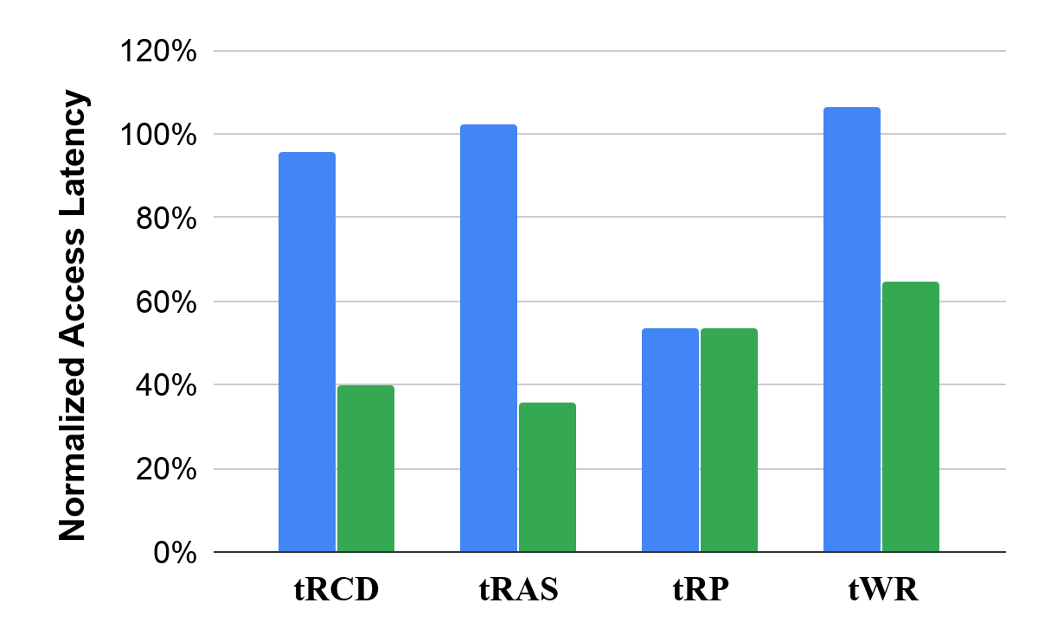
Key Results
DRAM Latency Reduction:
Activation latency (tRCD) by 60.1%
Restoration latency (tRAS) by 64.2%
Precharge latency (tRP) by 46.4%
Write-recovery latency (tWR) by 35.2%
System-level Benefits:
Performance improvement: 18.6%
DRAM energy reduction: 29.7%
DRAM refresh energy reduction: 66.1%
Max-capacity
High-performance
We hope that CLR-DRAM can be exploited to develop more flexible systems that can adapt to the diverse and changing DRAM capacity and latency demands of workloads.
Notes:
[Click] Our SPICE simulations show that CLR-DRAM significantly reduces all four major DRAM access latencies, ranging from 35.2% to 64.2%
[Click] Our system level evaluation shows that CLR-DRAM improves system performance by 18.6%, saves DRAM energy by 29.7% and reduces DRAM refresh energy by 66.1%.
[Click] We hope that CLR-DRAM can be exploited to develop more flexible systems that can adapt to the diverse and changing DRAM capacity and latency demands of workloads.

Slide 6
CLR-DRAM:
A Low-Cost DRAM Architecture
Enabling Dynamic Capacity-Latency Trade-off
Haocong Luo Taha Shahroodi Hasan Hassan Minesh Patel
A. Giray Yaglıkçı Lois Orosa Jisung Park Onur Mutlu
Notes:
Thank you for your attention, and I invite you to watch our full talk and read our paper for more details.

