Slide 1





QUAC-TRNG High-Throughput True Random Number Generation Using Quadruple Row Activation in Real DRAM Chips
Ataberk Olgun
Minesh Patel A. Giray Yağlıkçı Haocong Luo
Jeremie S. Kim F. Nisa Bostancı Nandita Vijaykumar
Oğuz Ergin Onur Mutlu

Slide 2
Executive Summary
Motivation: DRAM-based true random number generators (TRNGs) provide true random numbers at low cost on a wide range of computing systems
Problem: Prior DRAM-based TRNGs are slow:
Based on fundamentally slow processes → high latency
Cannot effectively harness entropy from DRAM rows → low throughput
Goal: Develop a high-throughput and low-latency TRNG that uses commodity DRAM devices
Key Observation: Carefully engineered sequence of DRAM commands can activate four DRAM rows → QUadruple ACtivation (QUAC)
Key Idea: Use QUAC to activate DRAM rows that are initialized with conflicting data (e.g., two ‘1’s and two ‘0’s) to generate random values
QUAC-TRNG: DRAM-based TRNG that generates true random numbers at high-throughput and low-latency by repeatedly performing QUAC operations
Results: We evaluate QUAC-TRNG using 136 real DDR4 chips
5.4 Gb/s maximum (3.4 Gb/s average) TRNG throughput per DRAM channel
Outperforms existing DRAM-based TRNGs by 15.08x (base), and 1.41x (enhanced)
QUAC-TRNG has low TRNG latency: 256-bit RN in 274 ns
QUAC-TRNG passes all 15 NIST randomness tests

Slide 3

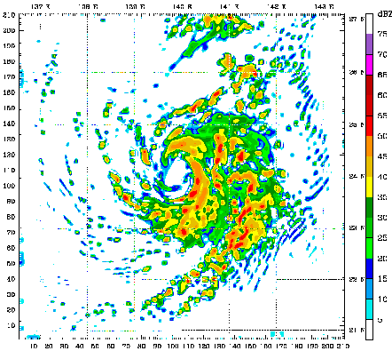
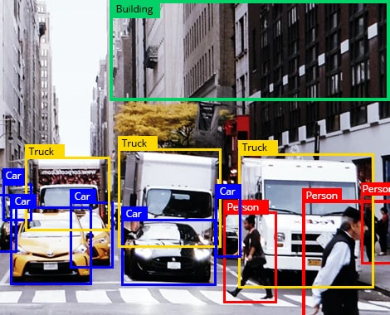
Use Cases of True Random Numbers
High-quality true random numbers are critical to many applications
True random numbers can only be obtained by sampling random physical processes
Not all computing systems are equipped with TRNG hardware (e.g., dedicated circuitry)

Slide 4


DRAM-Based TRNGs
DRAM is ubiquitous in modern computing platforms
DRAM-based TRNGs enable low-cost and high-throughput true random number generation within DRAM
Requires no specialized hardware: Benefits constrained systems
Open application space: Provides high-throughput TRNG
Processing-in-Memory (PIM) systems perform computation directly within memory
Avoid inefficient off-chip data movement
DRAM-based TRNGs
Enable PIM workloads to sample true random numbers directly within the memory chip
Avoid communication to possible off-chip TRNG sources
[Samsung]
[UPMEM]

Slide 5
Motivation and Goal
Prior DRAM-based TRNGs are slow, these TRNGs:
Are based on fundamentally slow physical processes
DRAM retention-based TRNGs
DRAM startup value-based TRNGs
Cannot effectively harness entropy from DRAM rows
DRAM timing failure-based TRNGs
Goal: Develop a high-throughput and low-latency TRNG that can be implemented using commodity DRAM devices
Key Observation
QUadruple ACtivation (QUAC): Carefully-engineered DRAM commands can activate four DRAM rows in real chips

Slide 6
Using QUAC to Generate Random Values
Use QUAC to activate DRAM rows that are initialized with conflicting data (e.g., two ‘1’s and two ‘0’s) to generate random values
Row 3
Row 2
Wordline
Row 1
Bitline
Row 0
Capacitor
Sense Amplifiers
Random Values
ACT
Violate Timing
PRE
Violate Timing
ACT

Slide 7
QUAC-TRNG
Sense Amplifiers
One-time Characterization
Find Shannon Entropy of Each Sense Amplifier
0000000000
1101001001
0 Entropy
1 Entropy
Sum of each bitline’s entropy = 256 bits
Initialize Rows
1
2
Perform QUAC
Memory Controller
SHA-256
3
Read Block
256-bit
True Random Number
Post- process
4

Slide 8
Experimental Methodology
Experimentally study QUAC and QUAC-TRNG using 136 real DDR4 chips
Spatial distribution of entropy
Data pattern dependency of entropy
DDR4 SoftMC → DRAM Testing Infrastructure
[Hassan+ HPCA’17]
https://github.com/CMU-SAFARI/SoftMC

Slide 9
Key Results
5.4 Gb/s TRNG throughput (3.44 Gb/s on average) per channel
Outperform state-of-the-art base by 15.08x and enhanced by 1.41x
Low latency: Generates a 256-bit random number in 274 ns
Passes all 15 standard NIST randomness tests
Negligible area cost: 0.04% of a contemporary CPU
Negligible memory overhead: 0.002% of an 8 GiB DRAM module
Entropy changes with temperature
Entropy remains stable for at least up to a month

Slide 10
QUAC-TRNG High-Throughput True Random Number Generation Using Quadruple Row Activation in Real DRAM Chips
Ataberk Olgun
Minesh Patel A. Giray Yağlıkçı Haocong Luo
Jeremie S. Kim F. Nisa Bostancı Nandita Vijaykumar
Oğuz Ergin Onur Mutlu

