Slide 1
Computer Architecture Lecture 12a: Research Presentation
Prof. Onur Mutlu
ETH Zürich
Fall 2020
30 October 2020

Slide 2


Bit-Exact ECC Recovery (BEER): Determining DRAM On-Die ECC Functions by Exploiting DRAM Data Retention Characteristics
Minesh Patel, Jeremie S. Kim
Taha Shahroodi, Hasan Hassan, Onur Mutlu
MICRO 2020
Extended talk for Computer Architecture HS 2020
Notes:
Hi, I’m Minesh, and today I’m going to talk about our work <TITLE>.
This work was done by researchers in the SAFARI group at ETH Zürich and is presented in the Memory session at MICRO 2020.

Slide 3
Error Correction Codes (ECCs)
Key idea: add metadata that allows the memory controller to reconstruct corrupt data on a bit flip
metadata
(i.e., parity-check bits)
d₀d₁d₂d₃
d₀d₁d₂d₃|p₀p₁p₂
store
ECC Encoder
d₀d₁d₂d₃
d₀d₁d₂d₃|p₀p₁p₂
load
ECC Decoder
CPU Core
DRAM Controller
DRAM
reconstructed using metadata
single-bit error
More metadata allows correcting more errors
Notes:
Let’s first talk about ECC
[CLICK]
The key idea of ECC is to add metadata that allows the memory controller to reconstruct corrupt data on a bitflip
[CLICK]
For example, let’s say we have a system consisting of a CPU core, a DRAM controller and the DRAM itself…

Slide 4
Three Types of DRAM Systems
CPU
DRAM
No-ECC
CPU
XL
DRAM
Rank-level ECC
ECC
On-Die-ECC
CPU
DRAM
ECC
Notes:
There are typically 3 different types of DRAM-based systems

Slide 5
Executive Summary
Problem: DRAM on-die ECC complicates third-party reliability studies
Proprietary design obfuscates raw bit errors in an unpredictable way
Interferes with (1) design, (2) test & validation, and (3) characterization
Goal: understand exactly how on-die ECC obfuscates errors
Contributions:
BEER: new testing methodology that determines a DRAM chip’s unique on-die ECC function (i.e., its parity-check matrix)
Exploits ECC-function-specific uncorrectable error patterns
Requires no hardware support, inside knowledge, or metadata access
BEEP: new error profiling methodology that infers the raw bit error locations of error-prone cells from the observable uncorrectable errors
BEER Evaluations:
Apply BEER to 80 real LPDDR4 chips from 3 major DRAM manufacturers
Show correctness in simulation for 115,300 codes (4-247b ECC words)
We hope BEER and BEEP enable valuable studies in the future
Notes:
First, I'm going to start out with a high level summary of this talk.
PROBLEM
The problem we tackle in this work is that DRAM …
This is because their proprietary designs…
, and this interferes with…
GOAL
To overcome this problem, our goal ….
CONTRIBUTIONS
To achieve this goal, we make 2…
First, …
Second…
EVALUATIONS
We evaluate BEER by experimentally apply it to 80…
To complement our experimental studies, we show BEER’s correctness …
We hope that beer enables many valuable studies going forward

Slide 6
Talk Outline
Challenges Caused by Unknown On-Die ECCs
BEER: Determining the On-Die ECC Function
Evaluating BEER in Experiment and Simulation
BEEP and Other Practical Use Cases for BEER
Notes:
Here’s a high level outline of my talk.
First, I’m going to start out talking about the challenges caused by unknown on-die ECCs.
[CLICK]

Slide 7
Third-Party DRAM Users
System Architects
Design Error Mitigations
Test Engineers
Third-Party Testing
Research Scientists
Error-Characterization
Need to understand
a DRAM chip’s reliability characteristics
Inter-chip variation?
Temperature dependence?
‘Weak’ cell locations?
Statistical error properties?
Aggregate failure rates?
Minimum operating timings?
Notes:
Let’s start out by looking at how third-parties work with commodity DRAM chips
First, system architects who integrate commodity DRAM chips in their system-level designs, for example, system-level error-mitigation mechanisms.
Second, test engineers, who perform extensive third-party testing and validation to ensure that commodity DRAM chips meet design specifications
Finally, research scientists, who conduct experimental error-characterization studies to understand and improve DRAM chips.
[CLICK]
All three groups have one important underlying theme in common.
They all need to understand…
[CLICK]
These characteristics include things like…

Slide 8
Third-Party DRAM Users
But how do we study
DRAM reliability characteristics?
System Architects
Design Error Mitigations
Test Engineers
Third-Party Testing
Research Scientists
Error-Characterization
Need to understand
a DRAM chip’s reliability characteristics
Inter-chip variation?
Temperature dependence?
‘Weak’ cell locations?
Statistical error properties?
Aggregate failure rates?
Minimum operating timings?

Slide 9
Testing and Error Characterization
No-ECC
Rank-level ECC
On-Die-ECC
Tester
DRAM
Tester
XL
DRAM
Tester
DRAM
ECC
ECC
Write
d₀d₁d₂d₃
d₀d₁d₂d₃|p₀p₁p₂
d₀d₁d₂d₃
Encoding
(unknown)
d₀d₁d₂d₃
d₀d₁d₂d₃
d₀d₁d₂d₃|p₀p₁p₂
DRAM
Storage
d₀d₁d₂d₃|p₀p₁p₂
d₀d₁d₂d₃|p₀p₁p₂
d₀d₁d₂d₃|p₀p₁p₂
Decoding
(unknown)
d₀d₁d₂d₃|p₀p₁p₂
d₀d₁d₂d₃|p₀p₁p₂
d₀d₁d₂d₃
d₀d₁d₂d₃
????
Read
d₀d₁d₂d₃
Observed Errors
d₀-d₂-
--d₂-|-p₁-
????
Dependent on errors only
Dependent on both errors and ECC
Notes:
The answer is testing. Testing and error characterization.
Let’s take a look at how this testing works for different types of systems.
[CLICK]
…

Slide 10
A Typical DRAM On-Die ECC Design
128-bit single-error correcting (SEC) Hamming code
DRAM Chip
128
128+8
Chip
I/O
ECC Encoder
Data
Store
External DRAM Bus
128
128+8
ECC Decoder
Invisible outside
the DRAM chip
Fully contained within the chip
Notes:
Here is a typical on-die ECC code used in modern DRAM chips.
This is usually a 128-bit single error correcting Hamming code, and
[CLICK]
here's an illustration of what this code looks like within a DRAM chip.
[CLICK]
We see that the ECC encoder and decoder, which together form the ECC logic, are fully contained with the DRAM chip
[CLICK]
This means that they are completely invisible outside the DRAM chip
[CLICK]

Slide 11
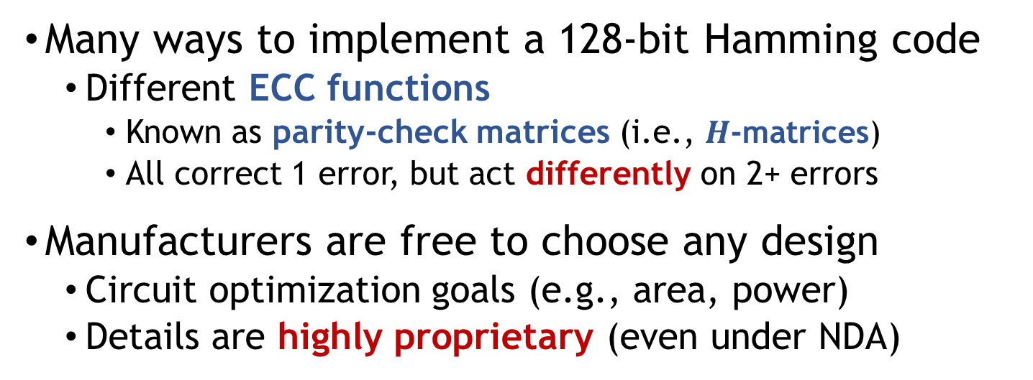
A Typical DRAM On-Die ECC Design
DRAM Chip
128
128+8
Chip
I/O
ECC Encoder
Data
Store
External DRAM Bus
128
128+8
ECC Decoder
Many ways to implement a 128-bit Hamming code
Different ECC functions
Known as parity-check matrices (i.e., $H$-matrices)
All correct 1 error, but act differently on 2+ errors
Manufacturers are free to choose any design
Circuit optimization goals (e.g., area, power)
Details are highly proprietary (even under NDA)
Notes:
There are many ways to implement…

Slide 12
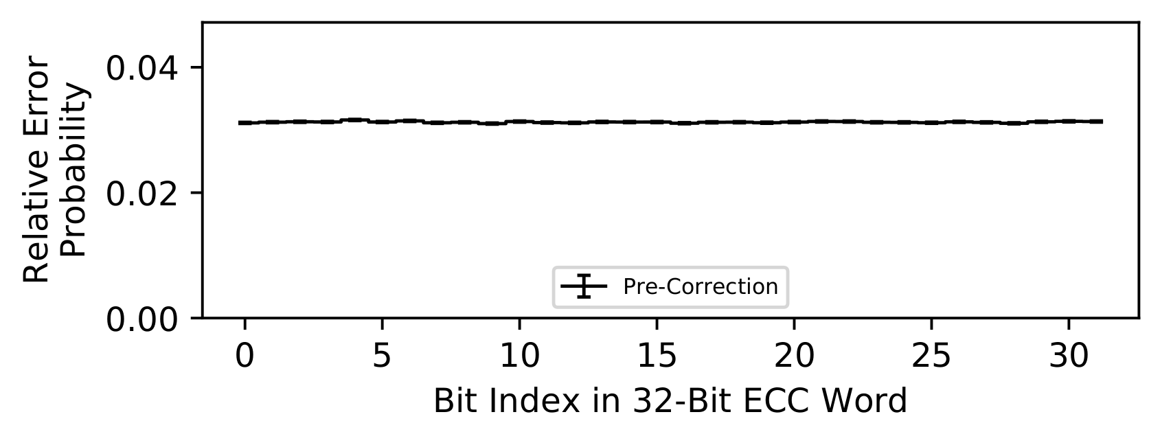
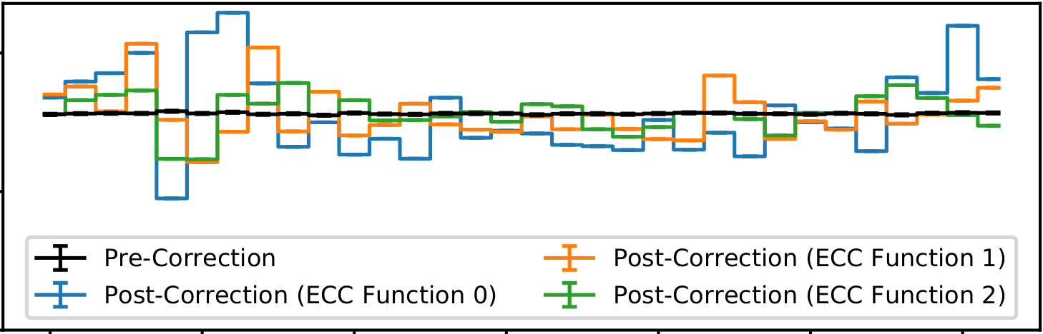
Effect of Different On-Die ECC Designs
Simulating uniform-random errors in a 32b ECC word
0xFF test pattern @ RBER=10⁻⁴
Nonuniform errors
32-bit single-error correction Hamming codes
Three different parity-check matrices
Notes:
Let’s take a look at the effect of using different On-Die ECC designs.
In this experiment, we simulate uniform-random errors within a single 32-bit ECC word.
[CLICK]
Here, the X-axis shows the bit index in the 32-bit ECC word
And the Y-axis shows the relative probability of observing an error in each of the different bit positions
Because we simulate uniform-random errors, the per-bit error probabilities are roughly equal
[CLICK]
However, the post-correction errors look quite different.
Here, we show three different 32-bit Hamming codes
[CLICK]
With three different parity-check matrices.
[CLICK]
We see that the post-correction errors are highly nonuniform and depend on the particular ECC function used.
[CLICK]
Our takeaway from this analysis is that…

Slide 13
Effect of Different On-Die ECC Designs
Simulating uniform-random errors in a 32b ECC word
0xFF test pattern @ RBER=10⁻⁴
Nonuniform errors
The same error characteristics
can appear very different
with different ECC functions
32-bit single-error correction Hamming codes
Three different parity-check matrices
Notes:
Let’s take a look at a concrete example of the effect of using different On-Die ECC implementations.
In this experiment, we simulate uniform-random errors within a single 32-bit ECC word.

Slide 14
Challenges for Third Parties
System Architects: Designing Error Mitigations
On-die ECC forces system architects to support unpredictable, chip-dependent memory reliability characteristics
Test/Validation Engineers: Post-Manufacturing Testing
On-die ECC hides the root-causes of uncorrectable errors and defeats test patterns designed to target physical cells
Research Scientists: Error-Characterization Studies
On-die ECC conflates raw bit errors with ECC artifacts, effectively obfuscating the true physical cell characteristics
Notes:
This causes significant challenges for third parties, who need to understand DRAM reliability characteristics to do their work.
For example, system architects typically design error-mitigation mechanisms to meet system reliability targets.
However, with on-die ECC, they must …
Test and validation engineers typically perform post-manufacturing testing of DRAM chips
Unfortunately
Finally, research scientists typically perform error characterization studies to understand how DRAM chips work.
Unfortunately,

Slide 15
Challenges for Third Parties
System Architects: Designing Error Mitigations
On-die ECC forces system architects to support unpredictable, chip-dependent memory reliability characteristics
These challenges all arise
from the inability to predict
how ECC transforms error patterns
Test/Validation Engineers: Post-Manufacturing Testing
On-die ECC hides the root-causes of uncorrectable errors and defeats test patterns designed to target physical cells
Research Scientists: Error-Characterization Studies
On-die ECC conflates raw bit errors with ECC artifacts, effectively obfuscating the true physical cell characteristics

Slide 16


Overcoming Challenges of On-Die ECC
Our goal: Determine the on-die ECC function without:
(1) hardware support or tools
(2) prior knowledge about on-die ECC
(3) access to ECC metadata (e.g., syndromes)
DRAM
Chip
I/O
$$Fencode$$
Data
Store
$$Fdecode$$
Reveals how on-die ECC scrambles errors (BEER)
Allows inferring raw bit error locations (BEEP)
Notes:
To overcome these challenges, our goal is to…
What this means in the context of the DRAM chip is that we want to know what exactly happens within the encoder and decoder.
This would reveal…

Slide 17
Talk Outline
Challenges Caused by Unknown On-Die ECCs
BEER: Determining the On-Die ECC Function
Evaluating BEER in Experiment and Simulation
BEEP and Other Practical Use Cases for BEER
Notes:
This leads us into our primary contribution, BEER. Let’s take a look at how we determine the on-die ECC function

Slide 18
Typical On-Die ECC Function
128
128+8
DRAM
Chip
I/O
Encoder
Data
Store
128
128+8
Decoder
Encoder and decoder both use linear operations
Encoder
$$d$$
$$G$$
$$dataword$$
$$codeword$$
$$∗$$
. | . | . | . | . | . | .
. | . | . | . | . | . | .
. | . | . | . | . | . | .
. | . | . | . | . | . | .
$$d=$$
$$c=$$
. | . | . | .
. | . | . | .
. | . | . | . | . | . | .
Decoder
Define the ECC function
$$H$$
$$c′$$
$$dataword′$$
$$codeword′$$
$$d′=$$
. | . | . | . | . | . | .
. | . | . | . | . | . | .
. | . | . | . | . | . | .
$$∗$$
$$T$$
$$c′=$$
. | . | . | .
. | . | . | . | . | . | .
. | . | . | . | . | . | .
Notes:
Here we picture a typical 128-bit on-die ECC mechanism.
[CLICK]
It is important to note that both the encoder and decoder use linear operations.
[CLICK]
We can think of the encoder as a black box that accepts a dataword and outputs a codeword.
[CLICK]
Within this black box, the dataword is multiplied by a Generator matrix G to form the codeword
[CLICK]
Similarly, the decoder accepts a codeword_prime, which might contain raw bit errors, and outputs a dataword_prime, which may contain uncorrectable errors
[CLICK]
Within the decoder, the codeword_prime is multiplied by a Parity-Check matrix, H.
[CLICK]
Together, G and H define the ECC function that we want to determine
{CLICK}

Slide 19
Error Correction During Decoding
Two-step decoding algorithm: syndrome decoding
Calculate an error syndrome that points to error(s)
Correct detected errors (if any)
Correctable Errors
Uncorrectable Errors
$$c′$$
$$c′$$
$$H$$
$$s$$
$$H$$
$$s$$
.
.
.
.
.
.
.
.
.
.
.
.
.
.
. | . | . | . | . | . | .
. | . | . | . | . | . | .
. | . | . | . | . | . | .
$$∗$$
$$=$$
.
.
.
. | . | . | . | . | . | .
. | . | . | . | . | . | .
. | . | . | . | . | . | .
$$∗$$
$$=$$
.
.
.
$s$ points to the
error location
(if any)
$s$ points to an arbitrary
$H$-dependent position
Notes:
Now let’s take a closer look at the ECC decoder
[CLICK]
Decoding is typically done using a two-step algorithm known as syndrome decoding
We first calculate an error syndrome that points to the error locations (if any)
Then, we correct any detected errors that were found
[CLICK]
In the case of correctable errors, we compute the error syndrome S by multiplying the parity-check matrix with the codeword_Prime.
And here, we show a single-bit error using a red dot
[CLICK]
After computing the error syndrome, the error syndrome points directly to the single-bit error, which can then be corrected
[CLICK]
However, for uncorrectable errors, the situation is different. Here, we show a mutli-bit uncorrectable error in three different bit positions
[CLICK]
On computing the error syndrome, the error syndrome now points to an arbitrary bit position that depends on the particular H matrix used by the ECC function

Slide 20
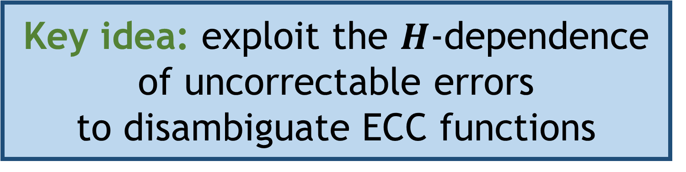
Error Correction During Decoding
Key idea: exploit the $H$-dependence
of uncorrectable errors
to disambiguate ECC functions
Two-step decoding algorithm: syndrome decoding
Calculate an error syndrome that points to error(s)
Correct detected errors (if any)
Correctable Errors
Uncorrectable Errors
$$c′$$
$$c′$$
$$H$$
$$s$$
$$H$$
$$s$$
.
.
.
.
.
.
.
.
.
.
.
.
.
.
. | . | . | . | . | . | .
. | . | . | . | . | . | .
. | . | . | . | . | . | .
$$∗$$
$$=$$
.
.
.
. | . | . | . | . | . | .
. | . | . | . | . | . | .
. | . | . | . | . | . | .
$$∗$$
$$=$$
.
.
.
$s$ points to the
error location
(if any)
$s$ points to an arbitrary
$H$-dependent position
Notes:
And so our key idea for determining the ECC function is to exploit this H-dependence to disambiguate different ECC functions

Slide 21
Determining the On-Die ECC Function
Approach: iteratively isolate linear components of $H$
Demonstrated by [Cojocar+, SP’19] for rank-level ECC
$$c$$
$$c′$$
$$c′$$
$$H$$
$$s$$
0
0
0
0
0
0
0
Inject error
in bit[0]
1
0
0
0
0
0
0
1
0
0
0
0
0
0
. | 0 | 0 | 0 | 0 | 0 | 0
. | 0 | 0 | 0 | 0 | 0 | 0
. | 0 | 0 | 0 | 0 | 0 | 0
$$∗$$
$$=$$
.
.
.
$$s=H col[0]$$
Can systematically extract each column of $H$
Determine entire $H$ by extracting all columns
Notes:
Now, let’s see how we determine the on-die ECC function using uncorrectable errors
[CLICK]
Our approach to determining the on-die ECC function is to iteratively isolate each linear component of the transformation represented by the parity-check matrix H
A similar approach was recently demonstrated by prior work for rank-level ECC
[CLICK]
To achieve this, we start with an error-free codeword c and inject a single error in bit position 0.
[CLICK]
Then, when we compute the error syndrome, the single error isolates the first column of the parity-check matrix.
This means that the generated error syndrome is exactly equal to column[0]
[CLICK]
Through this approach, we can systematically extract each column of the H matrix
And by extracting all of the columns, we can determine the entire H matrix

Slide 22
Determining the On-Die ECC Function
Approach: iteratively isolate linear components of $H$
Demonstrated by [Cojocar+, SP’19] for rank-level ECC
$$c$$
$$c′$$
$$c′$$
On-die ECC causes two challenges:
No way to inject errors in bit[n]
No way to observe error syndromes
$$H$$
$$s$$
0
0
0
0
0
0
0
Inject error
in bit[0]
1
0
0
0
0
0
0
1
0
0
0
0
0
0
. | 0 | 0 | 0 | 0 | 0 | 0
. | 0 | 0 | 0 | 0 | 0 | 0
. | 0 | 0 | 0 | 0 | 0 | 0
$$∗$$
$$=$$
.
.
.
$$s=H col[0]$$
Can systematically extract each column of $H$
Determine entire $H$ by extracting all columns
Notes:
Unfortunately, there are two major challenges in implementing this approach for on-die ECC.
First, we….
Second, we…
Let’s take a look at how we overcome these challenges for DRAM chips with on-die ECC
{CLICK}

Slide 23


Challenge 1: Injecting Errors
Key idea: deliberately induce data-retention errors
Initially CHARGED
REF
REF
Data-Retention
Error
CPU
or
FPGA
Pause
DRAM Refresh
DRAM Cell
Voltage
V_{SAFE}
Initially DISCHARGED
Time
Difference between CHARGED and DISCHARGED cells allows us to restrict errors to specific bit positions
$$\text{Test} \text{Pattern}$$
Encoded Data
1 | 0 | 0 | 0
$$\underset{⇒}{Fencoder}$$
1 | 0 | 0 | 0
? | ? | ?
CHARGED
Assume data is stored unmodified
(systematic encoding)
Possible errors
are limited
to certain bits
Notes:
The first challenge we need to overcome is injecting errors in specific bit positions
[CLICK]
We achieve this by deliberately inducing data retention errors.
[CLICK]
Data-retention errors are relatively easy to induce.
Using a CPU or FPGA, we can simply pause DRAM refresh.
The figure on the right shows how this affects a single DRAM cell.
The X-axis shows time and the Y-axis the cell voltage.
We see that a single cell that starts out in the CHARGED state loses charge over time.
Although periodic refresh operations maintain the CHARGED value,
Once we pause DRAM refresh, the cell voltage drops below the safe voltage value, beyond which we can no longer identify the initial value stored in the cell.
[CLICK]
This results in a data-retention error.
[CLICK]
In contrast, a cell that starts out in the DISCHARGED state remains DISCHARGED for all time.
[CLICK]
This difference between the CHARGED ……..
[CLICK]
For example, let’s consider a test pattern with only one cell CHARGED.
[CLICK]
after ECC encoding, we have only one CHARGED cell, and three unknown parity-check bits.
[CLICK]
Note that we assume the data is stored unmodified, which corresponds to a systematic encoding and is typical of real memory devices.
[CLICK]
In the encoded data, we have effectively restricted possible data-retention errors to specific bits. In this case, the CHARGED bit and any potentially CHARGED parity-check bits
[CLICK]

Slide 24








Challenge 2: Inferring Error Syndromes
$$\text{Test} \text{Pattern}$$
Encoded Data
$$\underset{⇒}{Encode}$$
C | D | D | D
C | D | D | D
D | D | C
Induce data-retention errors
Parity-check bits
Possible Error Patterns
Different $HX$ generate different error syndromes
No error
C | - | - | -
- | - | C
Post-Correction Data
Correctable
D | - | - | -
- | - | C
$$HA$$
C | D | D | D
C | - | - | -
- | - | D
$$HB$$
C | C | D | D
Uncorrectable
$$HC$$
C | D | C | D
D | - | - | -
- | - | D
$$\underset{⇒}{Decode}$$
$$HD$$
C | D | D | C
Notes:
The second challenge we face is inferring error syndromes.
[CLICK]
Let’s suppose that we start with the same test pattern as in the previous slide, but we know that the ECC function sets precisely one parity-check bit to the CHARGED state.
[CLICK]
When we induce errors, there are several different pre-correction error patterns that may occur
…
[CLICK]
Finally, we can have an uncorrectable error pattern where both CHARGED bits fail to the DISCHARGED state.
In this case, depending on the ECC function, the ECC decoder might result in one of 4 possible data patterns.
[CLICK]
This means that different H-matrices cause different uncorrectable error patterns and
[CLICK]

Slide 25

Challenge 2: Inferring Error Syndromes
$$\text{Test} \text{Pattern}$$
Encoded Data
$$\underset{⇒}{Encode}$$
C | D | D | D
C | D | D | D
D | D | C
Induce data-retention errors
We can differentiate error syndromes
from uncorrectable error patterns
Possible Error Patterns
Different $HX$ cause different uncorrectable errors
No error
C | - | - | -
- | - | C
Post-Correction Data
Correctable
D | - | - | -
- | - | C
$$HA$$
C | D | D | D
C | - | - | -
- | - | D
$$HB$$
C | C | D | D
Uncorrectable
$$HC$$
C | D | C | D
D | - | - | -
- | - | D
$$\underset{⇒}{Decode}$$
$$HD$$
C | D | D | C

Slide 26
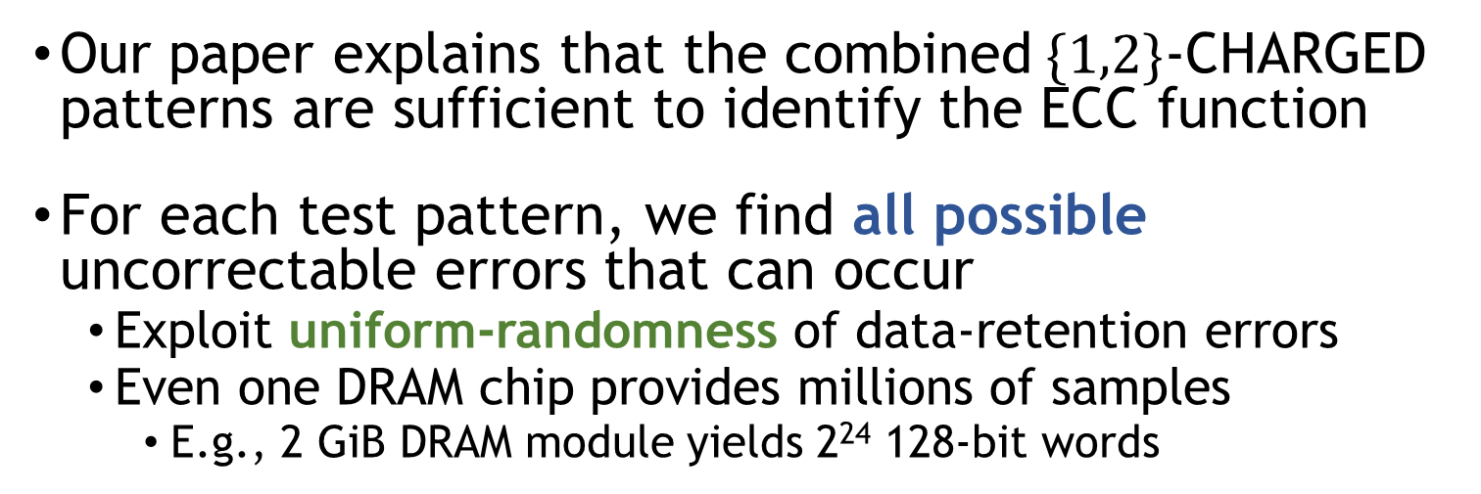
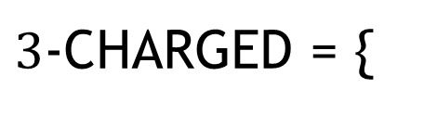
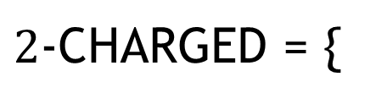
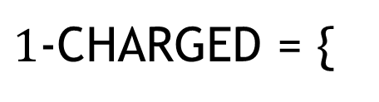
Choosing a Set of Test Patterns
We consider the “$n$-CHARGED” test patterns:
$1$-CHARGED = {
C | D | D | D
,
D | C | D | D
, . . . ,
D | D | D | C
}
$2$-CHARGED = {
C | C | D | D
,
C | D | C | D
, . . . ,
D | D | C | C
}
$3$-CHARGED = {
C | C | C | D
,
C | D | C | C
, . . . ,
D | D | C | C
}
Our paper explains that the combined$\{1,2\}$-CHARGED patterns are sufficient to identify the ECC function
For each test pattern, we find all possible uncorrectable errors that can occur
Exploit uniform-randomness of data-retention errors
Even one DRAM chip provides millions of samples
E.g., 2 GiB DRAM module yields 2²⁴ 128-bit words
Notes:
Now, we simply need to choose a set of test patterns to use.
In our work, we consider the N-charged test patterns
Each of which sets N bits to the CHARGED state.
[CLICK]
Our paper explains that the combined 1 and 2 CHARGED patterns suffice to identify the ECC function
[CLICK]
To test each of the patterns we use, we find all possible uncorrectable errors that can occur.
This is easily done by exploiting the uniform-randomness of data-retention errors
This is because even one DRAM chip…
[CLICK]

Slide 27
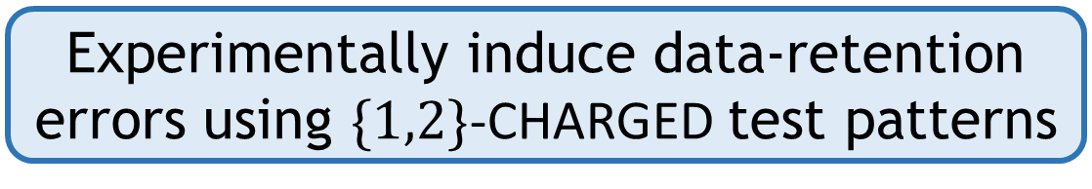
BEER: Bit-Exact ECC Recovery
1
Experimentally induce data-retention
errors using $\{1,2\}$-CHARGED test patterns
2
For each test pattern, identify
all possible uncorrectable errors
3
Solve for the ECC function with the observed behavior using a SAT solver

Slide 28
Talk Outline
Challenges Caused by Unknown On-Die ECCs
BEER: Determining the On-Die ECC Function
Evaluating BEER in Experiment and Simulation
BEEP and Other Practical Use Cases for BEER
Notes:
Now I’ll cover our evaluations of BEER in both experiment and simulation

Slide 29
Experimental Methodology
80 LPDDR4 chips from 3 DRAM manufacturers
Manufacturers anonymized as ‘A’, ‘B’, and ‘C’
Temperature-controlled testing infrastructure
Control over DRAM timings (including refresh)
Refresh windows between 1-30 minutes at 30-80◦C
Leads to bit error rates (BERs) between 10⁻⁷ and 10⁻³
BERs far larger than those of unwanted soft errors

Slide 30
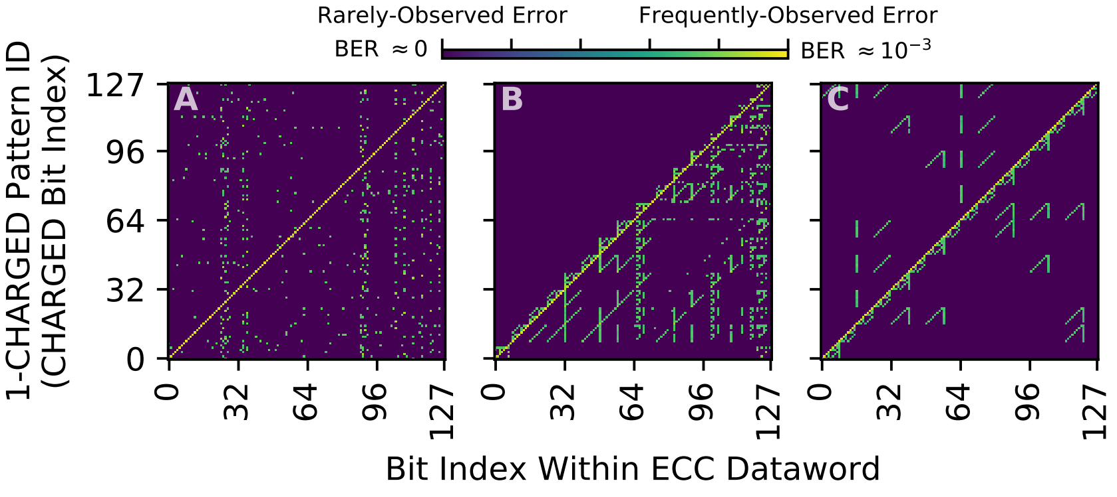
Applying BEER to LPDDR4 Chips
Study the uncorrectable errors in the 1-CHARGED patterns
Variation between manufacturers
indicates different ECC functions
Miscorrections
Data retention errors within CHARGED bits
Repeating patterns indicate structure in the H-matrix
Notes:
Let’s take a look at what happens when we apply BEER to real DRAM chips.
[CLICK]
In this experiment, we study the uncorrectable errors in the 1-CHARGED patterns
[CLICK]
We show the uncorrectable errors for a representative chip of each manufacturer
The X-axis shows the bit index in a 128-bit dataword
The Y-axis shows each of the 128 1-CHARGED test patterns, indexed by the position of the charged bit
[CLICK]
The first thing we see is the data-retention errors within the CHARGED bits along the y=x line.
[CLICK]
Any errors off the y=x line are miscorrections that are purely an artifact of ECC correction since they correspond to discharged data bit positions.
[CLICK]
Comparing the three plots, we see high variation, which indicates that manufacturers use different ECC functions
[CLICK]
Finally, we see repeating patterns within the miscorrections of manufacturers B and C, which indicates underlying structure in their H-matrices
[CLICK]

Slide 31
Applying BEER to LPDDR4 Chips
Study the uncorrectable errors in the 1-CHARGED patterns
Variation between manufacturers
indicates different ECC functions
Miscorrections
Different manufacturers appear to use different on-die ECC functions
Chips of the same model number appear to use identical ECC functions
(shown in our paper)
Data retention errors within CHARGED bits
Repeating patterns indicate structure in the H-matrix

Slide 32
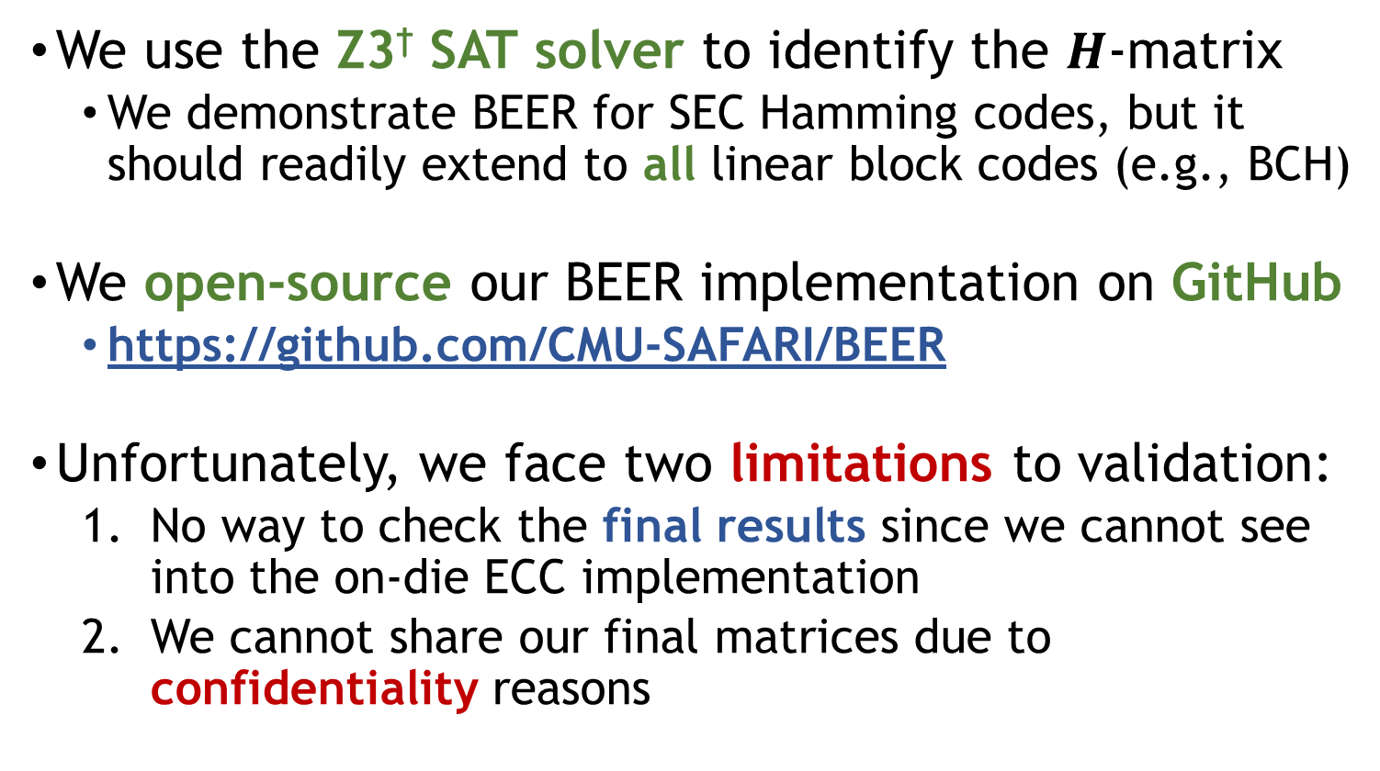
Solving for the ECC Function
We use the Z3† SAT solver to identify the $H$-matrix
We demonstrate BEER for SEC Hamming codes, but it should readily extend to all linear block codes (e.g., BCH)
We open-source our BEER implementation on GitHub
https://github.com/CMU-SAFARI/BEER
Unfortunately, we face two limitations to validation:
No way to check the final results since we cannot see into the on-die ECC implementation
We cannot share our final matrices due to confidentiality reasons
†L. De Moura and N. Bjørner, “Z3: An Effient SMT Solver,” TACAS, 2008.
Notes:
[CLICK]
To identify the specific H-matrix that each chip uses, we use the z3 SAT solver
Although we demonstrate and evaluate BEER for SEC hamming codes, it readily applies to all linear block codes (e.g., BCH)
[CLICK]
We open source our BEER implementation for any END USER to make use of.
[CLICK]
Unfortunately, our experimental studies face two limitations to further validation:
…..

Slide 33

Solving for the ECC Function
We use the Z3† SAT solver to identify the $H$-matrix
We demonstrate BEER for SEC Hamming codes, but it should readily extend to all linear block codes (e.g., BCH)
We open-source our BEER implementation on GitHub
https://github.com/CMU-SAFARI/BEER
Unfortunately, we face two limitations to validation:
No way to check the final results since we cannot see into the on-die ECC implementation
We cannot share our final matrices due to confidentiality reasons
We validate BEER in simulation to:
Evaluate correctness
Overcome confidentiality issues
Test a larger set of ECC codes
†L. De Moura and N. Bjørner, “Z3: An Effient SMT Solver,” TACAS, 2008.

Slide 34
Simulation Methodology
We use the EINSim† DRAM error-correction simulator
We simulate 115,300 different SEC Hamming codes
ECC dataword lengths from 4 to 247 bits
1-, 2-, 3-, and {1,2}-CHARGED test patterns
For each test pattern:
Simulate 10⁹ ECC words (≈14.9 GiB for 128-bit words)
Simulate data-retention errors with BER between 10⁻⁵ and 10⁻²
†Patel et al., “Understanding and Modeling On-Die Error Correction in Modern DRAM:
An Experimental Study Using Real Devices,” DSN, 2019.

Slide 35
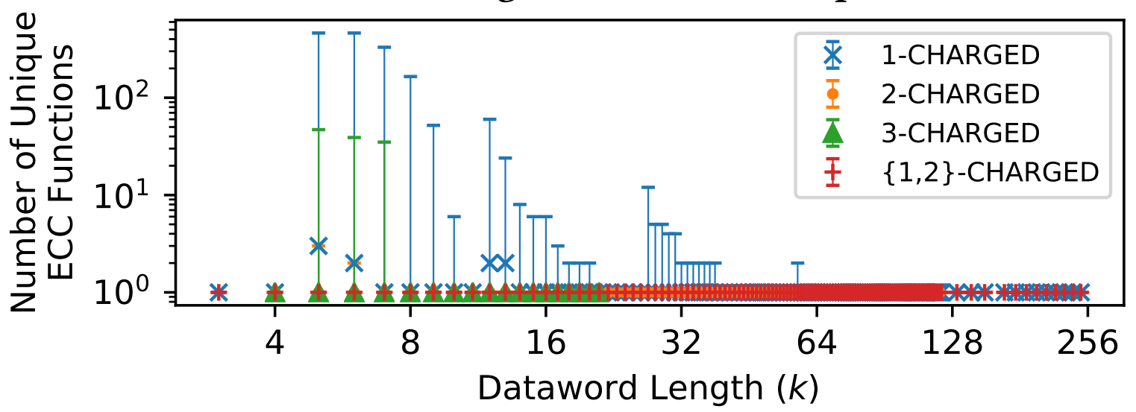
BEER Correctness Evaluation
Evaluate the number of SAT solutions found by BEER
Shows whether the ‘unique’ solution is identified
1-, 2-, 3-CHARGED patterns individually do not always succeed
{1,2} -CHARGED patterns succeed for all test cases
Notes:
Let’s take a look at our correctness evaluation for BEER.
[CLICK]
Here we evaluate the number of unique SAT solution that BEER finds
And this shows whether the ‘unique’ groundtruth solution is identified
[CLICK]
This figure’s X-axis shows the ECC code dataword length
And the Y-axis shows the number of unique ECC functions identified
Each data point shows the minimum/median/maximum values observed across all simulated ECC codes
[CLICK]
The first thing we notice is that the 1 and 2 CHARGED test patterns combined always find a single unique solution for all test cases.
[CLICK]
We also see that the 1-2-and-3-CHARGED patterns individually sometimes find more than one ECC function that can explain the observed uncorrectable errors.
[CLICK]

Slide 36
BEER Correctness Evaluation
Evaluate the number of SAT solutions found by BEER
Shows whether the ‘unique’ solution is identified
BEER successfully identifies
the ECC function using
the {1,2}-CHARGED test patterns
1-, 2-, 3-CHARGED patterns individually do not always succeed
{1,2} -CHARGED patterns succeed for all test cases
Notes:
Our takeaway from this analysis is that BEER…

Slide 37
Two Other Evaluations in the Paper
Practicality of BEER’s SAT problem
Measure SAT problem runtime and memory consumption
Negligible for short codes (i.e., < 1 minute, < 1 MiB RAM)
Realistic for long codes given that BEER is run offline
e.g., 57.1 hours + 6.3 GiB RAM for 128-bit code
Analytical experimental runtime analysis
Majority time is spent waiting for data-retention errors
4.2 hours of testing per chip in our experiments
Notes:
Our paper provides two other evaluations for BEER
[CLICK]
First, we evaluate the practicality of BEER’s SAT problem in terms of runtime and memory consumption.
We find that both are negligible for short codes

Slide 38
Talk Outline
Challenges Caused by Unknown On-Die ECCs
BEER: Determining the On-Die ECC Function
Evaluating BEER in Experiment and Simulation
BEEP and Other Practical Use Cases for BEER
Notes:
Finally, I’d like to talk about BEEP and…

Slide 39
Practical Use Cases for BEER
We provide 5 use cases in our paper to show how knowing the ECC function is useful in practice
Error Profiling
BEEP: identifying raw bit error locations corresponding to observed post-correction errors
System Design
Architecting DRAM controller error mitigations that are informed about on-die ECC
Crafting worst-case test patterns
to enable efficient testing and validation
Testing
Root-cause analysis for uncorrectable errors
Error
Characterization
Studying the statistical properties
of raw bit errors (e.g., spatial distributions)
Notes:
In our paper, we provide 5 use-cases to show how knowing the ECC function is useful in practice
[CLICK]
The first use-case deals with error profiling.
We introduce BEEP, which is a new testing methodology that shows how knowing the ECC function enables identifying…
[CLICK]
The second use-case …

Slide 40
BEEP: Profiling for Raw Bit Errors
Key idea: knowing the ECC function (i.e., via BEER) enables calculating raw bit error positions
Observed Errors
(Uncorrectable)
Raw Error Pattern
ECC Decoder
E | - | - | - | E | E | E
- | E | E | -
Known
Can calculate
(explained in the paper)
BEEP infers which physical cells are susceptible to data-retention errors using only the observed errors

Slide 41
BEEP: High-Level Algorithm
Iteratively test each bit in the ECC word and keep track of the error-prone cells it identifies
For each bit in the ECC word
1
Craft a test pattern
targeting the bit under test
2
Test for data-retention errors
3
Calculate raw bit error locations
corresponding to uncorrectable errors

Slide 42
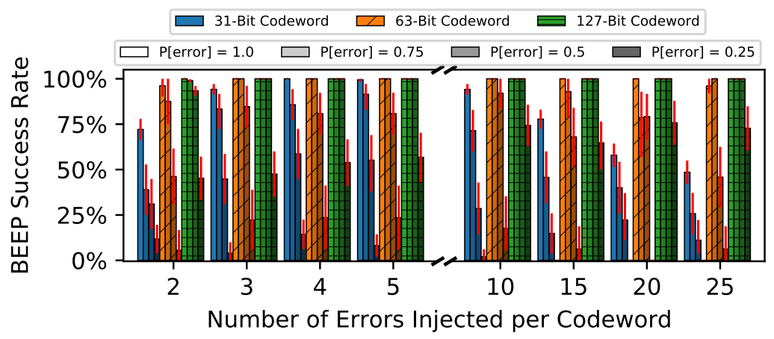
Evaluating BEEP’s Accuracy
We evaluate BEEP’s success rate of identifying raw bit errors in simulation
Varying ECC word lengths and bit error rates
100 ECC words simulated per measurement

Slide 43
Evaluating BEEP’s Accuracy
We evaluate BEEP’s success rate of identifying raw bit errors in simulation
Varying ECC word lengths and bit error rates
100 ECC words simulated per measurement
BEEP is more successful for:
Longer ECC words
Higher-probability errors

Slide 44
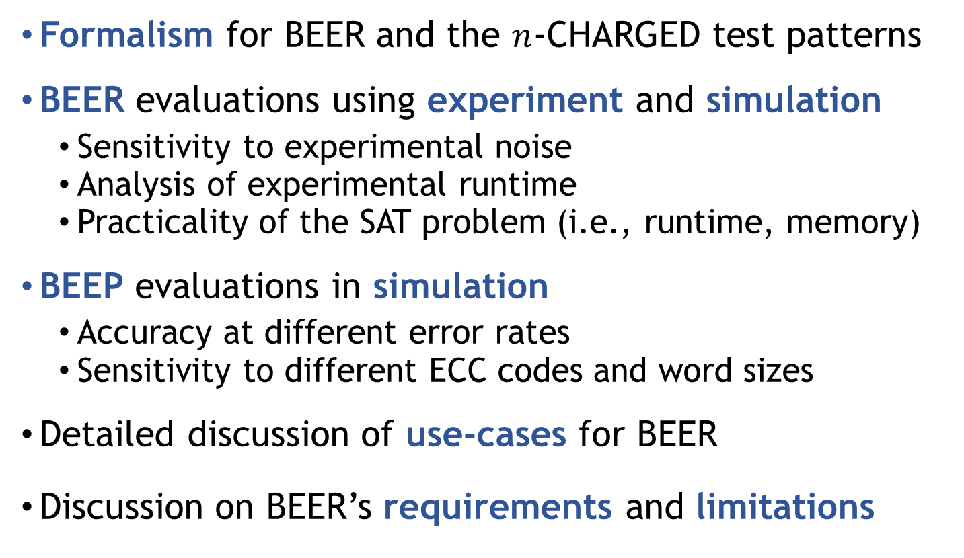
Other Information in the Paper
Formalism for BEER and the $n$-CHARGED test patterns
BEER evaluations using experiment and simulation
Sensitivity to experimental noise
Analysis of experimental runtime
Practicality of the SAT problem (i.e., runtime, memory)
BEEP evaluations in simulation
Accuracy at different error rates
Sensitivity to different ECC codes and word sizes
Detailed discussion of use-cases for BEER
Discussion on BEER’s requirements and limitations
Notes:
Our paper contains a wealth of other information that I did not have time to delve into here today.
[CLICK]
This includes…

Slide 45
Executive Summary
Problem: DRAM on-die ECC complicates third-party reliability studies
Proprietary design obfuscates raw bit errors in an unpredictable way
Interferes with (1) design, (2) test & validation, and (3) characterization
Goal: understand exactly how on-die ECC obfuscates errors
Contributions:
BEER: new testing methodology that determines a DRAM chip’s unique on-die ECC function (i.e., its parity-check matrix)
BEEP: new error profiling methodology that infers the raw bit error locations of error-prone cells from the observable uncorrectable errors
BEER Evaluations:
Apply BEER to 80 real LPDDR4 chips from 3 major DRAM manufacturers
Show correctness in simulation for 115,300 codes (4-247b ECC words)
https://github.com/CMU-SAFARI/BEER
We hope that both BEER and BEEP
enable many valuable studies going forward
Notes:
Finally, I’d like to circle back with a summary of our work.
PROBLEM
The problem we tackle in this work is that DRAM …
GOAL
To overcome this problem, our goal in this work…
CONTRIBUTIONS
To achieve this goal, we make 2 main contributions…
First, …
Second…
EVALUATIONS
We evaluate BEER in both experiment and simulation to show its effectiveness and practicality.
Finally, we open-source our implementation for the community to leverage
And we hope that both BEER and BEEP enables many valuable studies going forward

Slide 46
Bit-Exact ECC Recovery (BEER): Determining DRAM On-Die ECC Functions by Exploiting DRAM Data Retention Characteristics
Minesh Patel, Jeremie S. Kim
Taha Shahroodi, Hasan Hassan, Onur Mutlu
MICRO 2020
Extended talk for Computer Architecture HS 2020
Notes:
Hi, I’m Minesh, and today I’m going to talk about our work <TITLE>.
This work was done by researchers in the SAFARI group at ETH Zürich and is presented in the Memory session at MICRO 2020.

