Slide 1





FIGARO: Improving System Performance via Fine-Grained In-DRAM Data Relocation and Caching
Yaohua Wang¹, Lois Orosa², Xiangjun Peng^{3,1}, Yang Guo¹,
Saugata Ghose^{4,5}, Minesh Patel², Jeremie S. Kim², Juan Gómez Luna², Mohammad Sadrosadati⁶, Nika Mansouri Ghiasi², Onur Mutlu^{2,5}
¹
²
³
⁴
⁵
⁶
MICRO 2020
Notes:
Hello, My name is Lois Orosa, and I will be presenting FIGARO: Improving system performance via Fine-Grained In-DRAM Data Relocation and Caching.

Slide 2
Executive Summary
Problem: DRAM latency is a performance bottleneck for many applications
Goal: Reduce DRAM latency via in-DRAM cache
Existing in-DRAM caches:
Augment DRAM with small-but-fast regions to implement caches
Coarse-grained (i.e., multi-kB) in-DRAM data relocation
Relocation latency increases with physical distance between slow and fast regions
FIGARO Substrate:
Key idea: use the existing shared global row buffer among subarrays within a DRAM bank to provide support for in-DRAM data relocation
Fine-grained (i.e., multi-byte) in-DRAM data relocation and distance-independent relocation latency
Avoids complex modifications to DRAM by using existing structures
FIGCache:
Key idea: cache only small, frequently-accessed portions of different DRAM rows in a designated region of DRAM
Caches only the parts of each row that are expected to be accessed in the near future
Increases row hits by packing more frequently-accessed data into FIGCache
Improves system performance by 16.3% on average
Reduces DRAM energy by 7.8% on average
Conclusion:
FIGARO enables fine-grained data relocation in-DRAM at low cost
FIGCache outperforms state-of-the-art coarse-grained in-DRAM caches
2
Notes:
I will start with the executive summary == click == The problem is that DRAM latency is a performance bottleneck for many applications == click == Our goal in this paper is to reduce DRAM latency via in-DRAM cache == click == Existing in-DRAM caches ==click== try to reduce this latency by augmenting DRAM with small-but-fast regions to implement caches. But they have two main inefficiencies: == click == They use Coarse-grained in-DRAM data relocation == click == And the Relocation latency increases with physical distance between slow and fast regions == click == To overcome these inefficiencies, We propose FIGARO Substrate: == click == The Key idea of FIGARO substrate is to use the existing shared global row buffer among subarrays within a DRAM bank to provide support for in-DRAM data relocation == click == FIGARO uses Fine-grained in-DRAM data relocation and distance-independent relocation latency == click == And it avoids complex modifications to DRAM by using existing structures
== click
Using FIGARo substrate, we design FIGCache
== click
The Key idea of FIGCache is to cache only small, frequently-accessed portions of different DRAM rows in a designated region of DRAM
== click
FIGCache caches only the parts of each row that are expected to be accessed in the near future
== click
FIGCache Increases row hits by packing more frequently-accessed data into FIGCache
== click
Our evaluation shows that FIGCache improves system performance by more than 16% == click == And Reduces DRAM energy by almost 8%
== click
We conclude that == click == FIGARO enables fine-grained data relocation in-DRAM at low cost == click == And that FIGCache outperforms state-of-the-art coarse-grained in-DRAM caches

Slide 3
Outline
Background
Existing In-DRAM Cache Designs
FIGARO Substrate
FIGCache: Fine-Grained In-DRAM Cache
Experimental Methodology
Evaluation
Conclusion
3
Notes:
This is the outline of my talk
== click

Slide 4
Outline
Background
Existing In-DRAM Cache Designs
FIGARO Substrate
FIGCache: Fine-Grained In-DRAM Cache
Experimental Methodology
Evaluation
Conclusion
4
Notes:
First, I will start by introducing some background on DRAM
== click

Slide 5
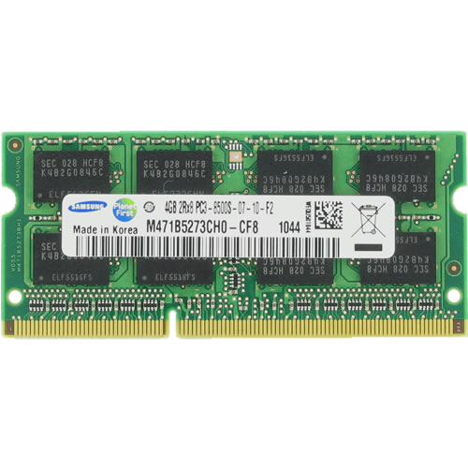
DRAM Organization
Subarray
Bitline
DRAM Cell
Bank
Wordline
Chip I/O
. . .
…
…
…
…
…
…
Global Row Buffer
Local Row Buffer
DRAM Chip
DRAM Bank
DRAM Subarray
5
Notes:
== click
DRAM is organized hierarquically. A rank is composed of multiple DRAM chips that work in lockstep
== click
== click
Each DRAM chip is composed of several banks
== click
each bank is composed of multiple subarrays and a global row buffer,
== click
each subarrays is composed of a two-dimensional array of DRAM cells, organized into rows of cells that are selected using a wordline, and the cells are connected to the local rowbuffer via bitlines
== click

Slide 6
Bank and Subarray Organization
subarray 0
column
DRAM row
. . .
. . .
. . .
column decoder
sense amplifier
local row buffer (LRB)
. . .
global bitline
subarray n-1
. . .
global row buffer (GRB)
to chip I/O logic
Each subarray contains 512– 2048 rows of DRAM cells
DRAM rows are connected to a local row buffer (LRB)
All of the LRBs in a bank are connected to a shared global row buffer (GRB)
The GRB is connected to the LRBs using a set of global bitlines
The GRB has smaller width (e.g., 8B) than the LRBs (e.g., 1kB)
A single column (i.e., a small number of bits) of the LRB is selected using a column decoder to connect to the GRB
6
Notes:
== click
== click
Each subarray in a bank contains more than 500 rows of DRAM cells
== click
the DRAM rows are connected to a local row buffer,
== click.
all the local row buffers in a bank are connected to a shared global row buffer
== click
and the global bitlines connect the local row buffers to the global row buffer.
== click
The global row buffer has smaller width than the local row buffers
== click
A single column of the local row buffer is selected using a column decoder to connect to the global row buffer
== click

Slide 7
DRAM Operation
DRAM controller issues 4 main memory commands
ACTIVATE: activates the DRAM row containing the data
Latches the selected DRAM row into the LRB
PRECHARGE: prepares all bitlines for a subsequent ACTIVATE command to a different row
READ: reads a column of data
One column of the LRB is selected using the column decoder
The GRB then drives the data to the chip I/O logic
WRITE: writes a column of data into DRAM
7
Notes:
== click
DRAM operation is controlled with 4 main memory commands
== click
The activate command activates the DRAM row containing the data, == click == and it latches the selected DRAM row into the local row buffer
== click
The precharge command prepares all bitlines for a subsequent ACTIVATE command to a different row
== click
The read command reads a column of data
== click
by selecting one column of the local row buffer using the column decoder
== click
Then, the global row buffer drives the data to the chip I/O logic
== click
The write command writes a column of data from the I/O into the DRAM
== click

Slide 8
Outline
Background
Existing In-DRAM Cache Designs
FIGARO Substrate
FIGCache: Fine-Grained In-DRAM Cache
Experimental Methodology
Evaluation
Conclusion
8
Notes:
Now I will introduce existing in-DRAM cache designs
== click

Slide 9
In-DRAM Cache Design
Key idea: Introduce heterogeneity in DRAM
Slow subarrays
Same latency and capacity as regular (i.e., slow) DRAM
Fast subarrays (shorter bitlines)
Fast access latency and small capacity
Used as in-DRAM cache for hot data
Many fast subarrays interleaved among slow subarrays
Inclusive cache
Data relocation between normal and fast subarrays
DRAM row granularity (multi-kilobyte)
Relocation latency increases as the physical relocation distance increases
Common in-DRAM cache organization
DRAM Bank
Slow Subarray
Fast Subarray (cache)
Slow Subarray
Fast Subarray (cache)
9
Notes:
== click
The key idea of in-DRAM caches is to introduce heterogeneity in DRAM
== click
Existing in-DRAM cache designs are composed by two types of subarrays
== click
Slow subarrays == click == And fast subarrays
== click
Slow subarrays have the same latency and capacity as regular DRAM
== click
And fast subarrays has fast access latency and small capacity
== click
Fast subarrays are used as in-DRAM cache for hot data
== click
Existing implementations use many fast subarrays interleaved among slow subarrays
== click
And the fast subarrays are inclusive of the slow subarrays
== click
Data relocation between normal and fast subarrays
== click
Is at the granularity of a DRAM row
== click
And the relocation latency increases as the physical relocation distance increases
== click

Slide 10
Inefficiencies of In-DRAM Caches
1) Coarse-grained:
Caching an entire row at a time
hinders the potential of in-DRAM cache
2) Area overhead and complexity:
Many fast subarrays interleaved
among normal subarrays
10
Notes:
We identify two main inefficiencies on existing in-DRAM caches
== click
First, they are coarse grained, which hinders the potential of in-DRAM cache
== click
And Second, they add significant area overhead and complexity, because they require many fast subarrays interleaved among normal subarrays
== click

Slide 11
Outline
Background
Existing In-DRAM Cache Designs
FIGARO Substrate
FIGCache: Fine-Grained In-DRAM Cache
Experimental Methodology
Evaluation
Conclusion
11
Notes:
To solve these inefficiencies, we propose FIGARO substrate,
== click

Slide 12
Observations and Key Idea
Observations:
All local row buffers (LRBs) in a bank are connected to a single shared global row buffer (GRB)
The GRB has smaller width (e.g., 8B) than the LRBs (e.g., 1kB)
Key Idea: use the existing shared GRB among subarrays within a DRAM bank to perform fine-grained in-DRAM data relocation
SRC: Subarray A
A0
A1
A2
A3
A3
A4
A5
A6
A7
Local Row Buffer
(LRB)
1kB
DST: Subarray B
GRB
B0
B1
B2
B3
8B
B4
B5
B6
B7
Local Row Buffer
(LRB)
12
Notes:
== click
Figaro substrate is based on two key observations
== click
First, all local row buffers in a bank are connected to a single shared global row buffer
== click
And second, the global row buffer has smaller width, as small as 8 bytes, than the local row buffers, which are typically 1 kilobyte
== click
The key idea of FIGARO substrate ==click== is to use the existing shared GRB among subarrays within a DRAM bank to perform fine-grained in-DRAM data relocation

Slide 13
FIGARO Overview
FIGARO:
Fine-Grained
In-DRAM Data Relocation Substrate
Relocates data across subarrays within a bank
Column granularity within a chip
Cache-block granularity within a rank
New RELOC command to relocate data between LRBs of different subarrays via the GRB
13
Notes:
== click
FIGARO is a fine-grained in-dram data relocation substrate
== click
That relocates data across subarrays within a bank
== click
It operates at column granularity within a chip,
== click
And with cache-block granularity within a rank
== click
And it uses a new RELOC command to relocate data between the local row buffers of different subarrays via the global row buffer
== click

Slide 14
Transferring Data via FIGARO
1
ACTIVATE subarray A
SRC: Subarray A
Copies data from row to LRB
A0
A1
A2
A3
column decoder
A0
A2
A3
A1
A2
A3
A0
A1
A4
A5
A6
A7
LRB
2
RELOC A col 3 → B col 1
A0
A1
A2
3
A0
A1
A2
A3
Selects Column 3 in Subarray A
Loads A3 into the GRB
Selects Column 1 in Subarray B
DST: Subarray B
A3
GRB
B0
A3
B2
B3
B0
B1
B2
B3
B4
B5
B6
B7
3
ACTIVATE subarray B
A3
B2
B3
B0
A3
1
Overwrites A3 in column 1
14
Notes:
I will show an example of how FIGARO transfers data between subarrays
== click
The figure shows two subarrays, A and B,
== click
we can see that their local row buffers are connected through a global row buffer
== click
To transfer data between these two subarrays,
== click ==
we first issue an activate command that activates the subarray A,
== click
and copies the data from the row to the local row buffer
== click
Second, we issue a RELOC command that == click == Selects column 3 in subarray A == click ==
Loads the content of the column in the global row buffer == click == and selects column 1 in subarray B
== click
Finally, we issue a second activation command that activates the subarray B,
== click
and overwrites the corresponding column with the content of the global row buffer
== click

Slide 15
Key Features of FIGARO
Fine-grained: column/cache-block level data relocation
Distance-independent latency
The relocation latency depends on the length of global bitline
Similar to the latency of read/write commands
Low overhead
Additional column address MUX, row address MUX, and row address latch per subarray
0.3% DRAM chip area overhead
Low latency and low energy consumption
Low latency (63.5ns) to relocate one column
Two ACTIVATEs, one RELOC, and one PRECHARGE commands
Low energy consumption (0.03uJ) to relocate one column
15
Notes:
FIGARO has 4 key features
== click
First, it is fine-grained, as it allows column and cache-block level data relocation
== click
Second, it is distance independent
== click
Because the relocation latency depends on the length of the global bitline,
== click
Which is similar to the latency of read and write commands
== click
Third, FIGARO has low overhead,
== click
It only requires three additional MUXes, and a latch per subarray
== click
That account for only 0.3% DRAM chip area overhead
== click
And Fourth, FIGARO has Low latency
== click
Relocating one column takes only a few nanoseconds, == click == and 4 DRAM commands
== click
And it has low energy consumption
== click

Slide 16
More FIGARO Details in the Paper
Enabling Unaligned Data Relocation
Circuit-level Operation and Timing
SPICE Simulations
Other Use Cases for FIGARO
16
Notes:
We have more details in the paper, such as
== click
How to enable Unaligned Data Relocation
== click
Circuit-level Operation and Timing
== click
SPICE Simulations
== click
And other Use Cases for FIGARO
== click

Slide 17
Outline
Background
Existing In-DRAM Cache Designs
FIGARO Substrate
FIGCache: Fine-Grained In-DRAM Cache
Experimental Methodology
Evaluation
Conclusion
17
Notes:
Using FIGARO substrate, we design FIGCache
== click

Slide 18
FIGCache Overview
Key idea: Cache only small, frequently-accessed portions of different DRAM rows in a designated region of DRAM
FIGCache (Fine-Grained In-DRAM Cache)
Uses FIGARO to relocate data into and out of the cache at the fine granularity of a row segment
Avoids the need for a large number of fast (yet low capacity) subarrays interleaved among slow subarrays
Increases row buffer hit rate
FIGCache Tag Store (FTS)
Stores information about which row segments are currently cached
Placed in the memory controller
FIGCache In-DRAM Cache Designs
Using 1) fast subarrays, 2) slow subarrays, or 3) fast rows in a subarray
18
Notes:
== click
The key idea of FIGCache is to cache only small, frequently-accessed portions of different DRAM rows in a designated region of DRAM
== click
FIGCache
== click
Uses FIGARO to relocate data into and out of the cache at the fine granularity of a row segment
== click
It avoids the need for a large number of fast subarrays interleaved among slow subarrays
== click
And it increases row buffer hit rate
== click
FIGCache uses a tag store == click == for storing information about which row segments are currently cached
== click
And it is Placed in the memory controller
== click
We can design FIGCache
== click
By using fast subarrays, using slow subarrays, or using fast rows in a subarray
== click

Slide 19
Benefits of FIGCache
Fine-grained (cache-block)
caching granularity
Low area overhead
and manufacturing complexity
19
Notes:
FIGCache has two main benefits
== click
First, FIGCache has fine-grained caching granularity
== click
And second, FIGCache has low area overhead and manufacturing complexity
== click

Slide 20
FIGCache Tag Store (FTS)
The memory controller stores information about which row segments are in cache
Fully associative cache
FIGCache Tag Store (FTS)
Benefit: Benefit counter (used for cache replacement)
 | Bank 0
Slot | Tag (Original Address) | V | D | Benefit
0
1
. . . | . . . | . . . | . . . | . . .
511
Bank 1
. . . | . . . | . . . | . . .
Bank n-1
. . . | . . . | . . . | . . .
. . .
20
Notes:
The FIGCache Tag Store
== click
is placed in the memory controller, and it stores information about which row segments are in the cache
== click
The cache is fully associative
== click
And the tag store is very similar to a common tag store
== click
And it includes a benefit counter to implement our replacement policy
== click

Slide 21
Insertion and Replacement
FIGCache insertion policy
Insert-any-miss: every FIGCache miss triggers a row segment relocation into the cache
FIGCache replacement policy
Sum all Benefit values from all segments of the row
The row with least Benefit is selected for eviction
Row granularity replacement
We experimentally find that FIGCache insertion and replacement policies are rather effective
21
Notes:
The insertion policy of FIGCache
== click
is called insert-any-miss:
== click
for every miss in the cache, FIGCache triggers a row segment relocation into the cache
== click
Our replacement policy works as follow:
== click
First, we sum all benefit values from all segments of the row
== click
And second, the row with least Benefit is selected for eviction
== click
The Replacement happen at row granularity
== click
We experimentally find that FIGCache insertion and replacement policies are rather effective

Slide 22
FIGCache Designs
FIGCache using
Fast Subarrays
FIGCache using
Slow Subarrays
(i.e., existing DRAM chips)
DRAM Bank
DRAM Bank
Slow Subarray
Slow Subarray
Slow Subarray
Slow Subarray
Fast Subarray (cache)
Reserved Row (cache)
22
Notes:
I will show a simple example of the operation of two different FIGCache designs
== click
In a FIGCache design that uses fast subarrays
== click
The fast subarray == click == is used as a cache
== click
== click
In a FIGCache design that uses slows subarrays
== click
Reserved rows in slow subarrays ==click== are used as a cache
== click
== click
== click

Slide 23
Outline
Background
Existing In-DRAM Cache Designs
FIGARO Substrate
FIGCache: Fine-Grained In-DRAM Cache
Experimental Methodology
Evaluation
Conclusion
23
Notes:
Next, I will explain the details of our experimental methodology

Slide 24
Experimental Methodology
Simulator
Ramulator open-source DRAM simulator [Kim+, CAL’15] [https://github.com/CMU-SAFARI/ramulator]
Energy model: McPAT, CACTI, Orion 3.0, and DRAMPower
System configuration
8 cores, 3-wide issue, 256-entry instruction window
L1 4-way 64KB, L2 8-way 256KB, L3 LLC 16-way 2MB per core
DRAM DDR4 800MHz bus frequency
FIGCache default parameters
Row segment size: 1/8th of a DRAM row (16 cache blocks)
Fast subarray reduces tRCD by 45.5%, tRP by 38.2%, and tRAS by 62.9%
In-DRAM cache size: 64 rows per bank
Workloads
20 eight-core multiprogrammed workloads from SPEC CPU2006, TPC, BioBench, Memory Scheduling Championship
24
Notes:
We use Ramulator as the DRAM simulator for performance evaluation, and we use several simulators to model the energy consumption of the system.
We configure our system with 8 cores, and with a tipical cache hierarchy with three levels of cache
As default parameters, we use a row segment size of 1/8th of a DRAM row, fast subarrays with reduced tRCD, tRP and tRAS timing parameters, and we use an in-DRAM cache size of 64 rows per bank
We use 20 eight-core multiprogramed workloads from well known benchmark suites

Slide 25
Comparison Points
Baseline: conventional DDR4 DRAM
LISA-VILLA: State-of-the-art in-DRAM Cache
[Chang+, HPCA ’16]
FIGCache-slow: Our in-DRAM cache with cache rows stored in slow subarrays
FIGCache-fast: Our in-DRAM cache with cache rows stored in fast subarrays
FIGCache-ideal: An unrealistic version of FIGCache-Fast where the row segment relocation latency is zero
LL-DRAM: System where all subarrays are fast
25
Notes:
As comparison points, we use
== click
Conventional DDR4 as baseline
== click
LISA-VILLA as state-of-the-art in-DRAM Cache
== click
Our FIGCache with slow
== click
And fast subarrays
== click
an unreaslistic FIGCache with zero relocation latency
== click
And a system where all subarrays are fast
== click

Slide 26
Outline
Background
Existing In-DRAM Cache Designs
FIGARO Substrate
FIGCache: Fine-Grained In-DRAM Cache
Experimental Methodology
Evaluation
Conclusion
26
Notes:
I will move on to our evaluation results
== click

Slide 27
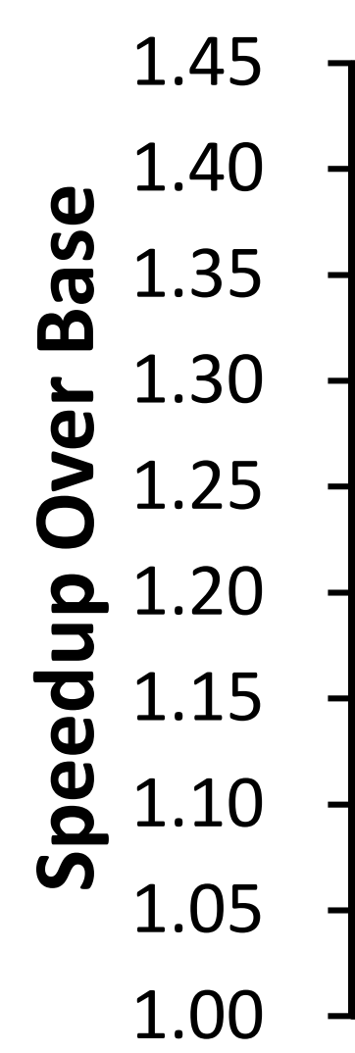
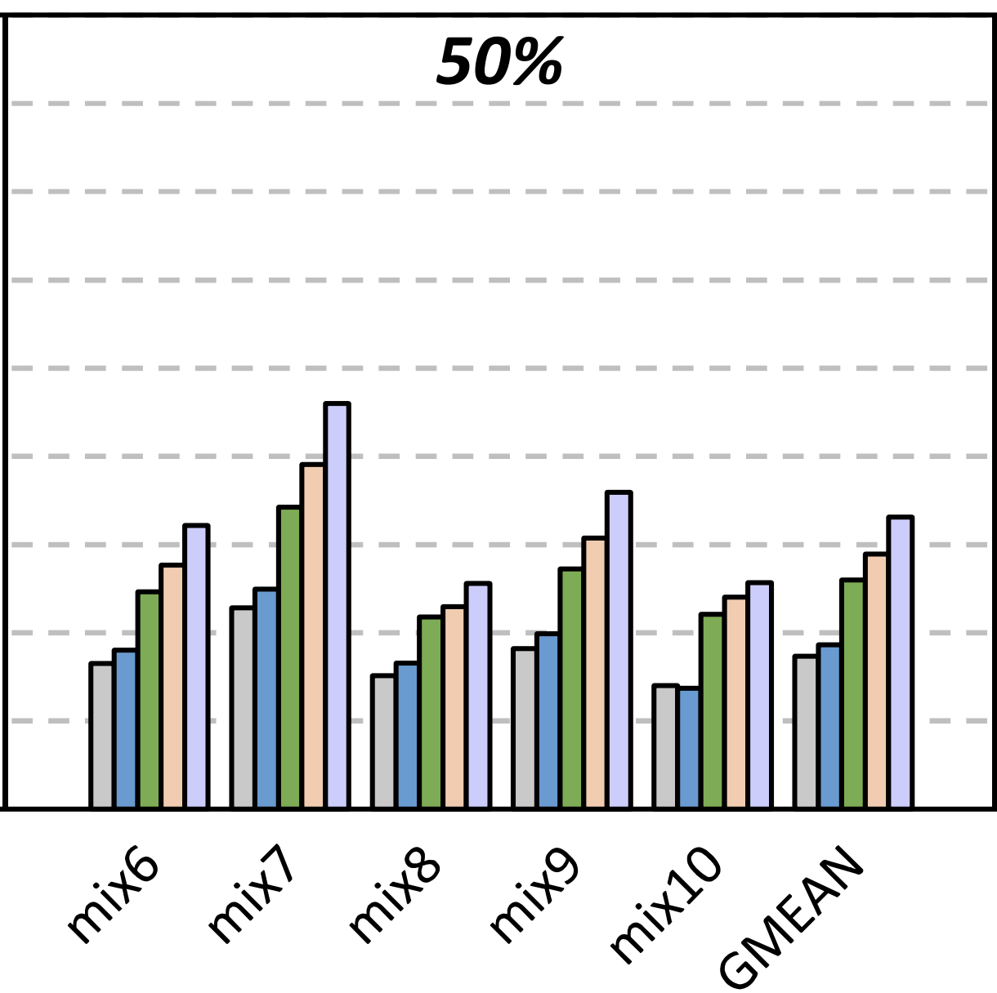
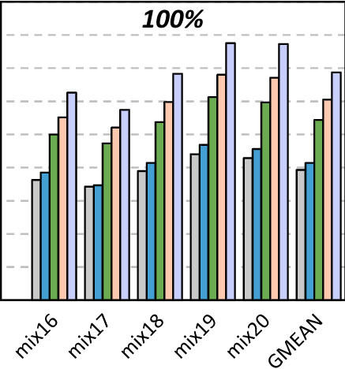


Multicore System Performance
27.1%
Memory intensity
12.9%
Average across all workloads: 16.3%
The benefits of FIGCache-Fast and FIGCache-Slow increase as workload memory intensity increases
Both FIGCache-slow and FIGCache-fast
outperform LISA-VILLA
FIGCache-Fast approaches the ideal performance improvement of both FIGCache-Ideal and LL-DRAM
27
Notes:
== click
This are the performance results for our multicore system configuration
The figure shows the speedup over the baseline on the y-axis, and different mixes of workloads in the x-axis. The different colors of the bars represent different comparison points; the blue bars represent our FIGCAche-slow, and the green bars represent our FIGCache-fast
== click
The figure shows results for mixes of workloads with two different memory intensities
== click
== click
We can see from the figure that FIGCache improves performance by almost 13% for the low intensity memory workloads,
== click
by more than 27% for the high intensity memory workloads
== click
, and by more than 16% across all workloads.
== click
We conclude that the benefits of FIGCache increase as workload memory intensity increases
== click
Both FIGCache-slow and FIGCache-fast outperform LISA-VILLA
== click
And FIGCache-Fast approaches the ideal performance improvement of both FIGCache-Ideal and the system where all subarrays are fast
== click

Slide 28
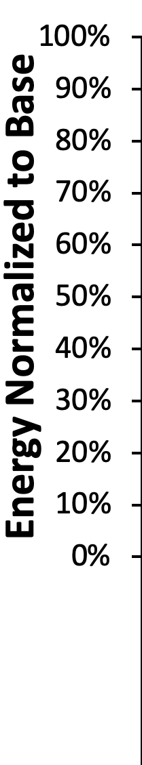
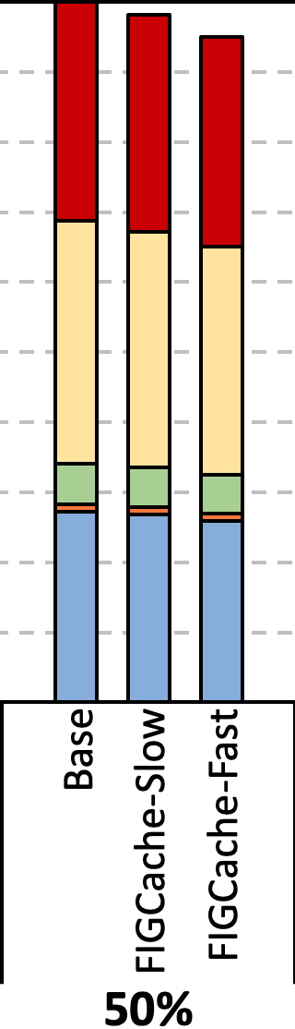
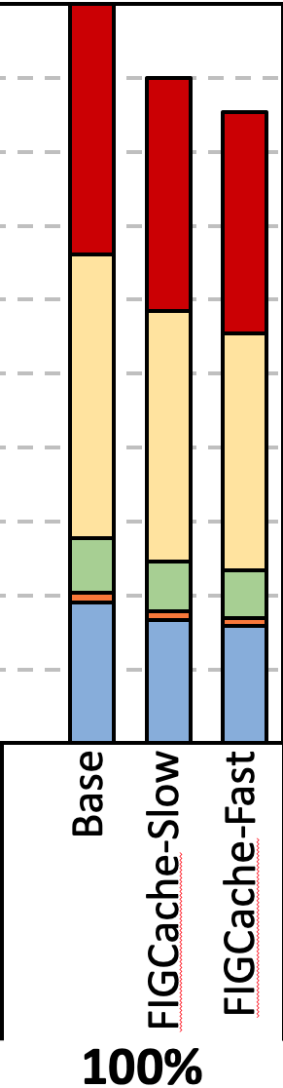



Multicore System Energy Savings
-14%
FIGCache-Slow and FIGCache-Fast consume less energy than Base
Energy reduction comes from:
Improved DRAM row buffer hit rate
Reduced execution time that saves static energy across each component
Memory intensity
FIGCache is effective at
reducing system energy consumption
28
Notes:
== click
These are the energy results for our multicore system configuration
The figure shows the energy normalized to the baseline in the y-axis, and the x-axis represent the baseline and our two configurations, for two memory intensities.
The different colors in the bars corresponds to the energy consumption of each component of the system, such as the caches or DRAM
== click
We observe that FIGCache-Slow and FIG-Cache-fast consume less energy than the baseline
== click
We can see that FIGCache-fast reduces the energy consumption by 14% for the high memory intensive workloads
== click
By analyzing the results, we observe that the energy reductions comes from
== click
The improved DRAM row buffer hit rate
== click
And the reduced execution time that saves static energy across each component
== click
We conclude that FIGCache is effective at reducing system energy consumption
== click

Slide 29


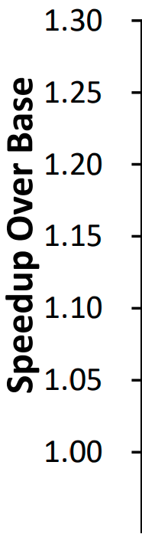
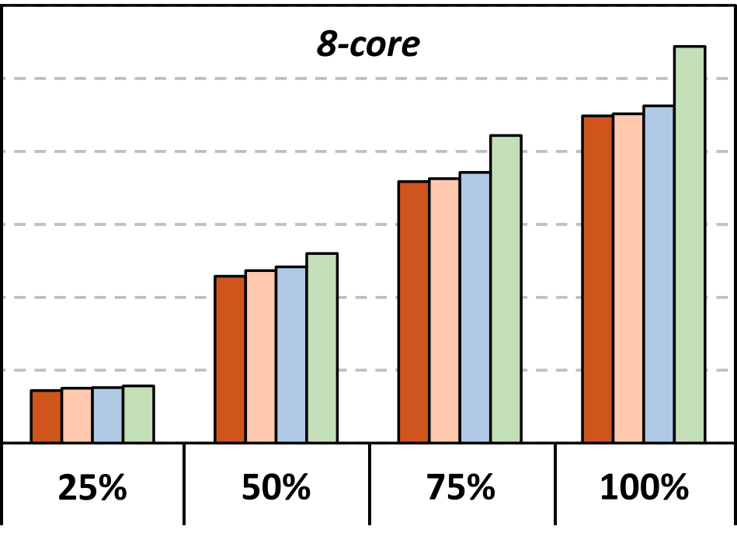
FIGCache Replacement Policies
RowBenefit: FIGCache replacement policy
SegmentBenefit: traditional benefit-based policy [Lee+,HPCA ’13]
Observations:
FIGCache outperforms Base with all replacement policies
RowBenefit outperforms all the other policies
+4.1%
RowBenefit replacement policy
is effective at
capturing temporal locality
29
Notes:
== click
Here I show the effect that different replacement policies have on the overall performance of FIGCache
The figure shows the speedup of FIGCache over baseline on the y-axis, and the x-axis shows workloads with different memory intensities. Different colors on the bars represent different replacement policies,
== click
Being the green bar the RowBenefit policy, which is FIGCache replacement policy
== click
And being the blue bar a traditional benefit-based replacement policy
== click
We make two observations
== click
First, FIGCache outperforms the baseline with all replacement policies
== click
And second, our replacement policy outperforms all the other policies
== click
We can see from the figure that Rowbenefit outperforms the best comparison point by more than 4%, for memory intensive workloads
== click
We conclude that the rowbenefit replacement policy is effective at capturing temporal locality
== click

Slide 30
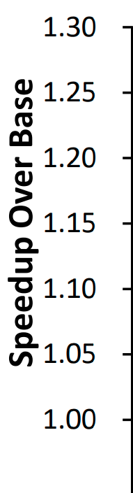

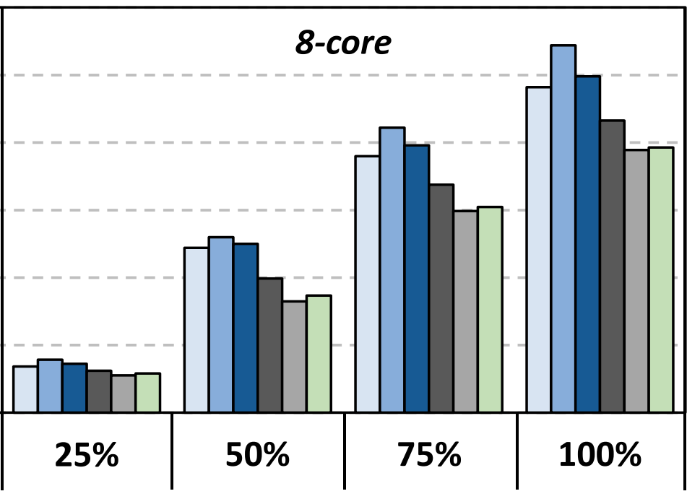
Different Row Segment Sizes
FIGCache 1KB
is the best configuration
Performance highly depends on
the row segment size
30
Notes:
== click
Here I will show the performance impact of different row segment sizes
The figure shows the performance speedup over the baseline in the y-axis, and different memory intensities in the x-axis. Different colors represent different row segment sizes, from 512 bytes to 8 kilobytes
== click
We observe that FIGCache with 1 Kilobyte row segment size is the best configuration in our experiments
== click
From the results in the figure we conclude that the performance highly depends on the row segment size
== click

Slide 31
More Results in the Paper
More Detailed Results
Single-core Workloads
In-DRAM Cache Hit Rate
DRAM Row Buffer Hit Rate
Performance with Different Row Segment Insertion Thresholds
Performance with Different Cache Capacities
31
Notes:
We show more results in the paper, including
== click
More detailed results
== click
Single-core workloads
== click
In-DRAM cache hit rate
== click
DRAm row buffer hit rate
== click
Performance with Different Row Segment Insertion Thresholds
== click
And Performance with Different Cache Capacities
== click

Slide 32
Outline
Background
Existing In-DRAM Cache Designs
FIGARO Substrate
FIGCache: Fine-Grained In-DRAM Cache
Experimental Methodology
Evaluation
Conclusion
32
Notes:
I will conclude my talk …
== click

Slide 33
Executive Summary
Problem: DRAM latency is a performance bottleneck for many applications
Goal: Reduce DRAM latency via in-DRAM cache
Existing in-DRAM caches:
Augment DRAM with small-but-fast regions to implement caches
Coarse-grained (i.e., multi-kB) in-DRAM data relocation
Relocation latency increases with physical distance between slow and fast regions
FIGARO Substrate:
Key idea: use the existing shared global row buffer among subarrays within a DRAM bank to provide support for in-DRAM data relocation
Fine-grained (i.e., multi-byte) in-DRAM data relocation and distance-independent relocation latency
Avoids complex modifications to DRAM by using existing structures
FIGCache:
Key idea: cache only small, frequently-accessed portions of different DRAM rows in a designated region of DRAM
Caches only the parts of each row that are expected to be accessed in the near future
Increases row hits by packing more frequently-accessed data into FIGCache
Improves system performance by 16.3% on average
Reduces DRAM energy by 7.8% on average
Conclusion:
FIGARO enables fine-grained data relocation in-DRAM at low cost
FIGCache outperforms state-of-the-art coarse-grained in-DRAM caches
33
Notes:
by circling back to the executive summary
== click == The problem is that DRAM latency is a performance bottleneck for many applications == click == Our goal is to reduce DRAM latency via in-DRAM cache
== click == Existing in-DRAM caches ==click == try to reduce this latency by augmenting DRAM with small-but-fast regions to implement caches. But they have two main inefficiencies: == click == They use Coarse-grained in-DRAM data relocation == click == And the Relocation latency increases with physical distance between slow and fast regions == click == To overcome these inefficiencies, we propose FIGARO Substrate: == click == The Key idea is to use the existing shared global row buffer among subarrays within a DRAM bank to provide support for in-DRAM data relocation == click == FIGARO uses Fine-grained in-DRAM data relocation and distance-independent relocation latency == click == And it avoids complex modifications to DRAM by using existing structures == click == Using FIGARo substrate, we design FIGCache == click == The Key idea is to cache only small, frequently-accessed portions of different DRAM rows in a designated region of DRAM == click == FIGCache caches only the parts of each row that are expected to be accessed in the near future == click == Which Increases row hits by packing more frequently-accessed data into FIGCache == click ==
Our evaluation shows that FIGCache improves system performance == click == and reduces DRAM energy significantly
== click
We conclude that
== click
FIGARO enables fine-grained data relocation in-DRAM at low cost
== click
And that FIGCache outperforms state-of-the-art coarse-grained in-DRAM caches

Slide 34
FIGARO: Improving System Performance via Fine-Grained In-DRAM Data Relocation and Caching
Yaohua Wang¹, Lois Orosa², Xiangjun Peng^{3,1}, Yang Guo¹,
Saugata Ghose^{4,5}, Minesh Patel², Jeremie S. Kim², Juan Gómez Luna², Mohammad Sadrosadati⁶, Nika Mansouri Ghiasi², Onur Mutlu^{2,5}
¹
²
³
⁴
⁵
⁶
MICRO 2020
Notes:
Thank you, to learn more about FIGARO please read our paper at MICRO 2020

