Slide 1





FIGARO: Improving System Performance via Fine-Grained In-DRAM Data Relocation and Caching
Yaohua Wang¹, Lois Orosa², Xiangjun Peng^{3,1}, Yang Guo¹,
Saugata Ghose^{4,5}, Minesh Patel², Jeremie S. Kim², Juan Gómez Luna², Mohammad Sadrosadati⁶, Nika Mansouri Ghiasi², Onur Mutlu^{2,5}
¹
²
³
⁴
⁵
⁶
MICRO 2020
Notes:
Hello, My name is Yaohua Wang, and I will be presenting FIGARO

Slide 2
Executive Summary
Problem: DRAM latency is a performance bottleneck for many applications
Goal: Reduce DRAM latency via in-DRAM cache
Existing in-DRAM caches:
Augment DRAM with small-but-fast regions to implement caches
Coarse-grained (i.e., multi-kB) in-DRAM data relocation
Relocation latency increases with physical distance between slow and fast regions
FIGARO Substrate:
Key idea: use the existing shared global row buffer among subarrays within a DRAM bank to provide support for in-DRAM data relocation
Fine-grained (i.e., multi-byte) in-DRAM data relocation and distance-independent relocation latency
Avoids complex modifications to DRAM by using (mostly) existing structures
FIGCache:
Key idea: cache only small, frequently-accessed portions of different DRAM rows in a designated region of DRAM
Caches only the parts of each row that are expected to be accessed in the near future
Increases row hits by packing frequently-accessed row segments into FIGCache
Improves system performance by 16.3% on average
Reduces energy consumption by 7.8% on average
Conclusion:
FIGARO enables fine-grained data relocation in-DRAM at low cost
FIGCache outperforms state-of-the-art coarse-grained in-DRAM caches
2
Notes:
DRAM latency has long been a system bottleneck
== click == Our goal is to reduce DRAM latency by in-DRAM cache
== click == Existing in-DRAM caches augment DRAM with small-but-fast regions to serve as caches. But they have two issues:
== click == They use Coarse-grained in-DRAM data relocation, and the corresponding latency increases with physical distance between slow and fast regions
== click == To improve this, we propose FIGARO: The Key idea is to use the existing shared global row buffer for data relocation
== click == This enables Fine-grained in-DRAM data relocation at a distance-independent latency with low overhead.
== click == Based on FIGARO, we design FIGCache, The Key idea is to cache only small, frequently-accessed DRAM row segments in the in-DRAM Cache.
== click == This helps to improve the system performance by more than 16% ,and reduces energy consumption by almost 8%
== click== We conclude that FIGARO enables efficient In-DRAM data relocation, and helps FIGCache to outperform existing in-DRAM cache designs

Slide 3
Outline
Background
Existing In-DRAM Cache Designs
FIGARO Substrate
FIGCache: Fine-Grained In-DRAM Cache
Experimental Methodology
Evaluation
Conclusion
3
Notes:
Here is the outline. First, I will start by introducing some background on DRAM
== click

Slide 4
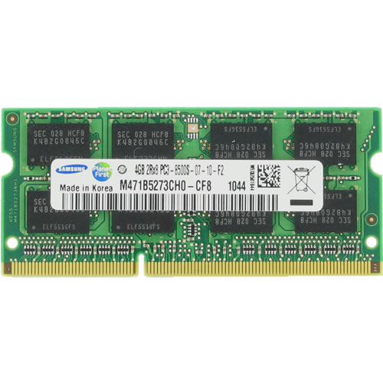
DRAM Organization
Subarray
Bitline
DRAM Cell
Bank
Wordline
Chip I/O
. . .
…
…
…
…
…
…
Global Row Buffer
Local Row Buffer
DRAM Chip
DRAM Bank
DRAM Subarray
4
Notes:
DRAM is organized hierarquically. A rank is composed of multiple DRAM chips
== click
Each DRAM chip has several banks
== click
each bank contains multiple subarrays and a global row buffer,
== click
each subarrays is composed of a two-dimensional array of DRAM cells,
== click

Slide 5
Outline
Background
Existing In-DRAM Cache Designs
FIGARO Substrate
FIGCache: Fine-Grained In-DRAM Cache
Experimental Methodology
Evaluation
Conclusion
5
Notes:
Now I will introduce existing in-DRAM cache designs
== click

Slide 6
Inefficiencies of In-DRAM Caches
1) Coarse-grained:
Caching an entire row at a time
hinders the potential of in-DRAM cache
2) Area overhead and complexity:
Many fast subarrays interleaved
among normal subarrays
6
Notes:
We identify two main inefficiencies on existing in-DRAM caches
== click
First, they are coarse grained, which hinders the potential of in-DRAM cache
== click
And Second, they add significant area overhead and complexity, because they require many fast subarrays interleaved among normal ones
== click
We find that these two inefficiencies are caused by the data relocation substrate employed in the in-DRAM cache.

Slide 7
Outline
Background
Existing In-DRAM Cache Designs
FIGARO Substrate
FIGCache: Fine-Grained In-DRAM Cache
Experimental Methodology
Evaluation
Conclusion
7
Notes:
To solve these inefficiencies, we propose FIGARO,
== click

Slide 8
Observations and Key Idea
Observations:
All local row buffers (LRBs) in a bank are connected to a single shared global row buffer (GRB)
The GRB has smaller width (e.g., 8B) than the LRBs (e.g., 1kB)
Key Idea: use the existing shared GRB among subarrays within a DRAM bank to perform fine-grained in-DRAM data relocation
SRC: Subarray A
A0
A1
A2
A3
A3
A4
A5
A6
A7
Local Row Buffer
(LRB)
1kB
DST: Subarray B
GRB
B0
B1
B2
B3
8B
B4
B5
B6
B7
Local Row Buffer
(LRB)
8
Notes:
There are two key observations
== click
First, all local row buffers in a bank are connected to a single shared global row buffer
== click
And second, the global row buffer is fine-grained compared with the local row buffer
== click
The key idea
==click==
is to use this GRB as a bridge to transport data among subarrays

Slide 9
FIGARO Overview
FIGARO:
Fine-Grained
In-DRAM Data Relocation Substrate
Relocates data across subarrays within a bank
Column granularity within a chip
Cache-block granularity within a rank
9
Notes:
Based on the above observation, we propose FIGARO, a fine-grained in-dram data relocation substrate
== click
That relocates data across subarrays
== click
at column granularity within a chip,
== click
cache-block granularity within a rank

Slide 10
Key Features of FIGARO
Fine-grained: column/cache-block level data relocation
Distance-independent latency
The relocation latency depends on the length of global bitline
Similar to the latency of read/write commands
Low overhead
Additional column address MUX, row address MUX, and row address latch per subarray
0.3% DRAM chip area overhead
Low latency and low energy consumption
Low latency (63.5ns) to relocate one column
Two ACTIVATEs, one RELOC, and one PRECHARGE commands
Low energy consumption (0.03uJ) to relocate one column
10
Notes:
FIGARO has 4 key features
== click
First, it is fine-grained, as it allows cache-block level data relocation
== click
Second, it is distance independent
== click
Third, FIGARO has low overhead,
about 0.3% DRAM chip area overhead
== click
And Fourth, FIGARO has Low latency and energy consumption

Slide 11
Outline
Background
Existing In-DRAM Cache Designs
FIGARO Substrate
FIGCache: Fine-Grained In-DRAM Cache
Experimental Methodology
Evaluation
Conclusion
11
Notes:
Based on FIGARO, we design FIGCache

Slide 12
FIGCache Overview
Key idea: Cache only small, frequently-accessed portions of different DRAM rows in a designated region of DRAM
FIGCache (Fine-Grained In-DRAM Cache)
Uses FIGARO to relocate data into and out of the cache at the fine granularity of a row segment
Avoids the need for a large number of fast (yet low capacity) subarrays interleaved among slow subarrays
Increases row buffer hit rate
FIGCache Tag Store (FTS)
Stores information about which row segments are currently cached
Placed in the memory controller
FIGCache In-DRAM Cache Designs
Using 1) fast subarrays, 2) slow subarrays, or 3) fast rows in a subarray
12
Notes:
The key idea of FIGCache is to cache only small, frequently-accessed portions of different DRAM rows into the in-DRAM cache
== click
FIGCache Uses FIGARO to relocate data into and out of the in-DRAM cache. This overcomes the inefficiencies of existing in-DRAM cache designs.
== click
FIGCache introduces a tag store in the memory controller to store information about which row segments are currently cached
== click
The in-DRAM cache part of FIGCache can be implemented with large flexibility.

Slide 13
Benefits of FIGCache
Fine-grained (cache-block)
caching granularity
Low area overhead
and manufacturing complexity
13
Notes:
FIGCache has two main benefits
== click
First, it has fine-grained caching granularity
== click
And second, it has low area overhead and manufacturing complexity
== click

Slide 14
Outline
Background
Existing In-DRAM Cache Designs
FIGARO Substrate
FIGCache: Fine-Grained In-DRAM Cache
Experimental Methodology
Evaluation
Conclusion
14
Notes:
Next, I will explain our experimental methodology

Slide 15
Experimental Methodology
Simulator
Ramulator open-source DRAM simulator [Kim+, CAL’15] [https://github.com/CMU-SAFARI/ramulator]
8 cores, DRAM DDR4 800MHz bus frequency
Workloads
20 eight-core multiprogrammed workloads from SPEC CPU2006, TPC, BioBench, Memory Scheduling Championship
Comparison points
Baseline: conventional DDR4 DRAM
LISA-VILLA: State-of-the-art in-DRAM Cache
FIGCache-slow: Our in-DRAM cache with cache rows stored in slow subarrays
FIGCache-fast: Our in-DRAM cache with cache rows stored in fast subarrays
FIGCache-ideal: An unrealistic version of FIGCache-Fast where the row segment relocation latency is zero
LL-DRAM: System where all subarrays are fast
15
Notes:
We use Ramulator for performance evaluation
== click
And select 20 8-core workloads.
==click
As comparison points, we use Conventional DDR4 as baseline
== click
LISA-VILLA as state-of-the-art
== click
Our FIGCache with slow and fast subarrays
== click
And two ideal cases of FIGCache

Slide 16
Outline
Background
Existing In-DRAM Cache Designs
FIGARO Substrate
FIGCache: Fine-Grained In-DRAM Cache
Experimental Methodology
Evaluation
Conclusion
16
Notes:
Next is our evaluation results
== click

Slide 17
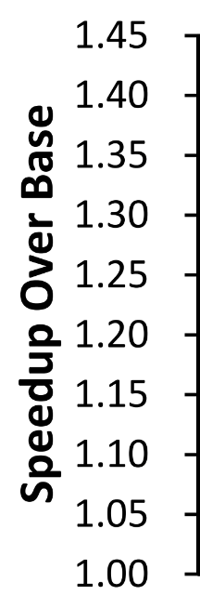
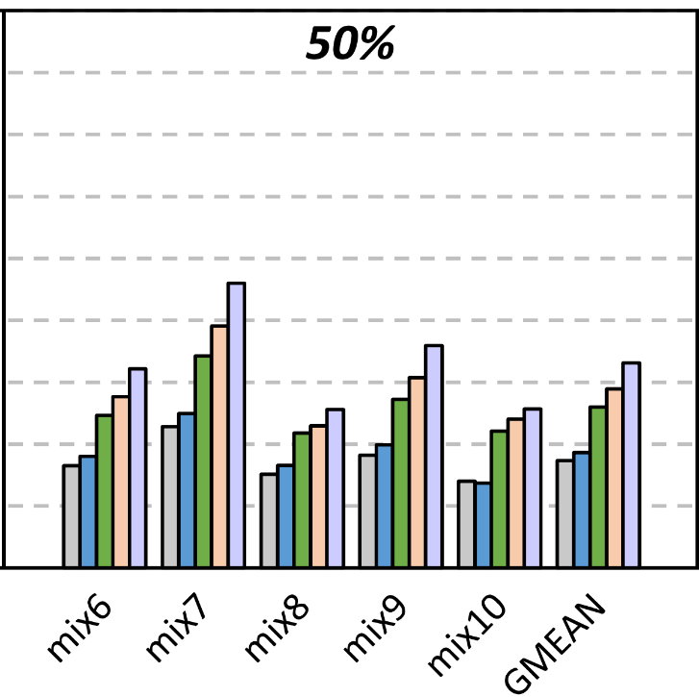
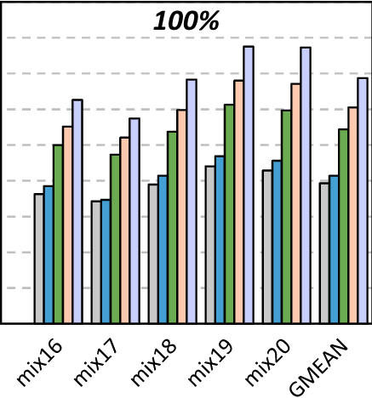


Multicore System Performance
Memory intensity
Average across all workloads: 16.3%
The benefits of FIGCache-Fast and FIGCache-Slow increase as workload memory intensity increases
Both FIGCache-slow and FIGCache-fast
outperform LISA-VILLA
FIGCache-Fast approaches the ideal performance improvement of both FIGCache-Ideal and LL-DRAM
17
Notes:
Here are the performance results for our multicore system configuration
The the y-axis is the speedup, and the x-axis shows the workloads. Different bars represent different comparison points; the blue one is FIGCAche-slow, and the green one is FIGCache-fast
==click
The average performance gain of FIGCache is more than 16% across all workloads.
== click
We conclude that the benefits of FIGCache increase as workload memory intensity increases
== click
Both FIGCache-slow and FIGCache-fast outperform LISA-VILLA
== click
And FIGCache-Fast approaches the idealized versions of in-DRAM cache.
== click

Slide 18
FIGARO: Improving System Performance via Fine-Grained In-DRAM Data Relocation and Caching
Yaohua Wang¹, Lois Orosa², Xiangjun Peng^{3,1}, Yang Guo¹,
Saugata Ghose^{4,5}, Minesh Patel², Jeremie S. Kim², Juan Gómez Luna², Mohammad Sadrosadati⁶, Nika Mansouri Ghiasi², Onur Mutlu^{2,5}
¹
²
³
⁴
⁵
⁶
MICRO 2020
Notes:
Thank you, to learn more about FIGARO please refer to our paper at MICRO 2020

