Slide 1


BlockHammer Preventing RowHammer at Low Cost by Blacklisting Rapidly-Accessed DRAM Rows
Abdullah Giray Yağlıkçı
Minesh Patel Jeremie S. Kim Roknoddin Azizi
Ataberk Olgun Lois Orosa Hasan Hassan Jisung Park
Konstantinos Kanellopoulos Taha Shahroodi
Saugata Ghose* Onur Mutlu
*
Notes:
Hello, my name is Abdullah Giray Yağlıkçı
and I will be presenting our work
BlockHammer: Preventing RowHammer at Low Cost
by Blacklisting Rapidly-Accessed DRAM Rows

Slide 2
Executive Summary
Motivation: RowHammer is a worsening DRAM reliability and security problem
Problem: Mitigation mechanisms have limited support for current/future chips
Scalability with worsening RowHammer vulnerability
Compatibility with commodity DRAM chips
Goal: Efficiently and scalably prevent RowHammer bit-flips without knowledge of or modifications to DRAM internals
Key Idea: Selectively throttle memory accesses that may cause RowHammer bit-flips
Mechanism: BlockHammer
Tracks activation rates of all rows by using area-efficient Bloom filters
Throttles row activations that could cause RowHammer bit flips
Identifies and throttles threads that perform RowHammer attacks
Scalability with Worsening RowHammer Vulnerability:
Competitive with state-of-the-art mechanisms when there is no attack
Superior performance and DRAM energy when a RowHammer attack is present
Compatibility with Commodity DRAM Chips:
No proprietary information of DRAM internals
No modifications to DRAM circuitry
Notes:
I will first begin with an executive summary
[CLICK] RowHammer is a worsening DRAM reliability and security problem.
[CLICK] However, state-of-the-art RowHammer mitigation mechanisms face limitations supporting current and future commodity DRAM chips because of two reasons:
[CLICK] (1) limited scalability with worsening RowHammer vulnerability
[CLICK and (2) limited compatibility with commodity DRAM chips.
[CLICK] The goal of this work is to EFFICIENTLY and SCALABLY prevent RowHammer bit-flips WITHOUT KNOWLEDGE of or MODIFICATIONS to dram internals.
[CLICK] Our key idea to achieve this goal is to SELECTIVELY throttle memory accesses that may cause RowHammer bit flips
[CLICK] Our mechanism BLOCKHAMMER performs three operations
[CLICK] first, it TRACKS activation rates of ALL rows using AREA-EFFICIENT Bloom filters,
[CLICK] second, THROTTLES row activations THAT could lead to RowHammer bit-flips,
[CLICK] and third, IDENTIFIES and THROTTLES the threads that perform RowHammer attacks.
[CLICK] we evaluate BlockHammer’s scalability with worsening RowHammer and demonstrate that
[CLICK] it is competitive with state-of-the-art RowHammer mitigation mechanisms WHEN There is NO ATTACK in the system
[CLICK] and it provides SIGNIFICANTLY HIGHER performance and LOWER dram energy consumption WHEN a RowHammer attack is present.
[CLICK] BlockHammer is compatible with commodity dram chips because
[CLICK] it does NEITHER require proprietary information of dram internals
[CLICK] NOR modifications to dram circuitry.

Slide 3
The RowHammer Phenomenon
DRAM Bank
Row 0
Row 0
Victim Row
Row 1
Row 1
Row 1
Victim Row
Row 2
Row 2
Row 2
Row 2
Row 2
Row 2
open
open
closed
closed
open
Aggressor Row
Row 3
Row 2
Row 3
closed
Row 3
Victim Row
Row 4
Row 4
Victim Row
Repeatedly opening (activating) and closing (precharging)
a DRAM row causes RowHammer bit flips in nearby cells
[Kim+ ISCA’20]
Notes:
Let me briefly explain RowHammer next.
In this figure we see a DRAM array, in which DRAM cells are accessed in a row granularity. To access a DRAM cell, we need to open or activate the row which contains the cell.
[CLICK].
After all requests are serviced from this row, we must close or precharge this row [CLICK] in order to begin accessing data from another row.
Due to an increase in cell-to-cell interference, rapidly activating and precharging
[BACK & FORTH] a DRAM row can result in bit flips in physically adjacent rows [CLICK]
[FORTH & BACK] Continuing to access the same row results in even more failures in nearby rows. This phenomenon is known as RowHammer. [CLICK]
We refer to the rapidly accessed row as an aggressor row and the rows containing bit flips as victim rows.

Slide 4
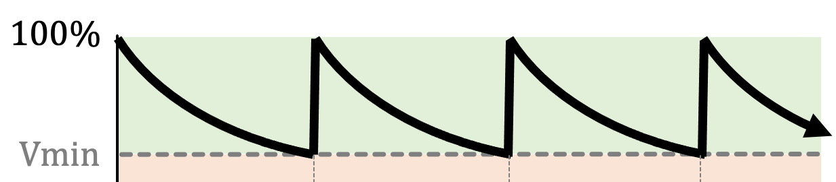
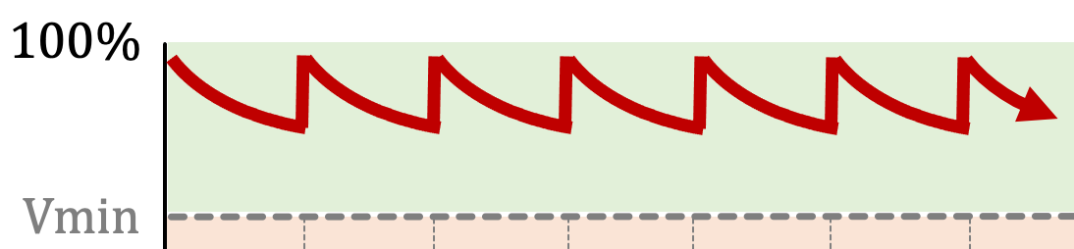

RowHammer Mitigation Approaches
Increased refresh rate
Physical isolation
Reactive refresh
Proactive throttling
REF-to-REF time reduces
Fewer activations can fit
DRAM Bank
Aggressor Row
Isolation Rows
Large-enough distance
Victim Rows
DRAM Bank
Victim Rows
Refresh
Aggressor Row
Rapidly activated (hammered)
Victim rows
Refresh
Fewer activations can be performed
Notes:
There are four high-level RowHammer mitigation approaches.
[CLICK] The first approach is to increase refresh rate
[CLICK] which reduces the refresh window,
[CLICK] and thus the activation count that an attacker can reach in a refresh window.
[CLICK] The second approach is to physically isolate
[CLICK] potential victim rows with sensitive data
[CLICK] from aggressor rows that a potential attacker can hammer
[CLICK] by allocating isolation rows in between.
[CLICK] The third approach is called reactive refresh.
[CLICK] In this approach, when an aggressor row is hammered
[CLICK] potential victim rows are refreshed to avoid bit-flips.
[CLICK] Finally the fourth approach suggests
[CLICK] proactively throttling memory accesses such that no row’s activation rate can reach RowHammer threshold.

Slide 5
Two Key Challenges
Scalability
with worsening RowHammer vulnerability
1
Compatibility
with commodity DRAM chips
Compatibility
with commodity DRAM chips
2
Compatibility
with commodity DRAM chips
2
2
Notes:
Unfortunately, existing mechanisms face two key challenges.
[CLICK] Let's begin with the scalability challenge.

Slide 6
Mitigation Approaches with Worsening RowHammer Vulnerability
Increased refresh rate
Physical isolation
Reactive refresh
Proactive throttling
REF-to-REF time further reduces
Even fewer activations can fit
DRAM Bank
Aggressor Row
Isolation Rows
Isolation Rows
Larger distance
more isolation rows
Victim Rows
DRAM Bank
Refresh more frequently
Refresh more rows
Victim rows
Aggressor row
Victim rows
Refresh more frequently
Refresh more rows
More aggressively throttles row activations
Notes:
As DRAM chips become more vulnerable to RowHammer
[CLICK] Increased refresh rate requires refreshing all rows more frequently and it is not sustainable due to large number of rows that need to be refreshed.
[CLICK] Physical isolation requires allocating more isolation rows
[CLICK] Reactive refresh needs refreshing more potential victim rows more frequently
[CLICK] Proactive throttling slows down the system further more.

Slide 7
Mitigation Approaches with Worsening RowHammer Vulnerability
Increased refresh rate
Physical isolation
Reactive refresh
Proactive throttling
REF-to-REF time further reduces
Even fewer activations can fit
DRAM Bank
Aggressor Row
Mitigation mechanisms face the challenge of scalability with worsening RowHammer
Isolation Rows
Isolation Rows
Larger distance
more isolation rows
Victim Rows
DRAM Bank
Refresh more frequently
Refresh more rows
Victim rows
Aggressor row
Victim rows
Refresh more frequently
Refresh more rows
More aggressively throttles row activations
Notes:
Therefore, scalability with worsening RowHammer vulnerability is an important challenge for all mitigation approaches.

Slide 8
Two Key Challenges
Scalability
with worsening RowHammer vulnerability
Scalability
with worsening RowHammer vulnerability
Scalability
with worsening RowHammer vulnerability
1
1
1
Compatibility
with commodity DRAM chips
2
Compatibility
with commodity DRAM chips
2
Notes:
[CLICK] The second challenge is compatibility with commodity DRAM chips.

Slide 9
Compatibility with Commodity DRAM Chips
Application
Level
Virtual Memory Address
Visible within
the Processor
System
Level
Physical Memory Address
Memory
Controller
DRAM Bus Addresses
(Channel, Rank, Bank Group, Bank, Row, Col)
DRAM
Chip
In-DRAM
Mapping
Physical Rows and Columns
Notes:
In a typical system, a virtual memory address is translated to DRAM bus addresses such as row and column addresses within the processor.
[CLICK] These addresses go through an additional mapping within the DRAM chip that we call in-DRAM mapping, which is NOT visible to the rest of the system.

Slide 10
Compatibility with Commodity DRAM Chips
Vendors apply in-DRAM mapping for two reasons:
Design Optimizations: By simplifying DRAM circuitry to provide better density, performance, and power
Yield Improvement: By mapping faulty rows and columns to redundant ones
In-DRAM mapping scheme includes insights into chip design and manufacturing quality
In-DRAM mapping is proprietary information
Notes:
This in-DRAM mapping is important because [CLICK] it enables
circuit design optimizations to meet density, performance, and power constraints
[CLICK] and improves yield by mapping faulty rows and columns to redundant ones
[CLICK] Therefore, in-DRAM mapping includes insights into CHIP DESIGN and MANUFACTURING QUALITY.
[CLICK] and that is why, it is PROPRIETARY information.

Slide 11
RowHammer Mitigation Approaches
Increased refresh rate
Physical isolation
Reactive refresh
Proactive throttling
REF-to-REF time reduces
Fewer activations can fit
DRAM Bank
Aggressor Row
Isolation Rows
Victim Rows
DRAM Bank
Victim Rows
Aggressor Row
Victim rows
Identifying victim and isolation rows requires
proprietary knowledge of in-DRAM mapping
Fewer activations can be performed
Notes:
Unfortunately,
[CLICK] physical isolation and reactive refresh need this proprietary information to identify which rows to isolate or refresh.

Slide 12
Our Goal
To prevent RowHammer efficiently and scalably
without knowledge of or modifications to DRAM internals
Notes:
To address scalability and compatibility challenges,
OUR GOAL in this paper is to prevent RowHammer efficiently and scalably without knowledge of or modification to DRAM internals.

Slide 13
BlockHammer Key Idea
Selectively throttle memory accesses
that may cause RowHammer bit-flips
Notes:
BlockHammer's key idea is to selectively throttle memory accesses
that may cause RowHammer bit-flips.

Slide 14
BlockHammer Overview of Approach
RowBlocker
Tracks row activation rates using area-efficient Bloom filters
Blacklists rows that are activated at a high rate
Throttles activations targeting a blacklisted row
AttackThrottler
Identifies threads that perform a RowHammer attack
Reduces memory bandwidth usage of identified threads
No row can be activated at a high enough rate to induce bit-flips
Greatly reduces the performance degradation
and energy wastage a RowHammer attack inflicts on a system
Notes:
BlockHammer consists of two mechanisms [CLICK] RowBlocker [CLICK] and AttackThrottler.
RowBlocker [CLICK] tracks ROW ACTIVATION RATES using area-efficient Bloom filters
[CLICK] BLACKLISTS rows that are activated at a high rate
[CLICK] THROTTLES activations targeting a blacklisted row.
[CLICK] By doing so, RowBlocker ensures that NO ROW can be activated at a high enough rate to induce RowHammer bit-flips.
[CLICK] AttackThrottler IDENTIFIES threads that try activating blacklisted rows.
[CLICK] and reduces their memory bandwidth consumption by throttling their memory requests.
[CLICK] By doing so, AttackThrottler greatly reduces the performance degradation and energy wastage a RowHammer attack inflicts on a system.

Slide 15
Evaluation Performance and DRAM Energy
Cycle-level simulations using Ramulator and DRAMPower
System Configuration:
Single-Core Benign Workloads:
22 SPEC CPU 2006
4 YCSB Disk I/O
2 Network Accelerator Traces
2 Bulk Data Copy with Non-Temporal Hint (movnti)
Randomly Chosen Multiprogrammed Workloads:
125 workloads containing 8 benign applications
125 workloads containing 7 benign applications and 1 RowHammer attack thread
Processor | 3.2 GHz, {1,8} core, 4-wide issue, 128-entry instr. window
LLC | 64-byte cacheline, 8-way set-associative, {2,16} MB
Memory scheduler | FR-FCFS
Address mapping | Minimalistic Open Pages
DRAM | DDR4 1 channel, 1 rank, 4 bank group, 4 banks per bank group
RowHammer Threshold | 32K
Notes:
Let me quickly go over the keyevaluation results next.
to evaluate the performance and DRAM energy consumption,
we conduct cycle-level simulations using RAMULATOR and DRAMPOWER for two types of eight-core multiprogrammed workloads:
workloads that contain eight benign applications
and workloads that contain seven benign applications along with one thread performing RowHammer attack.

Slide 16
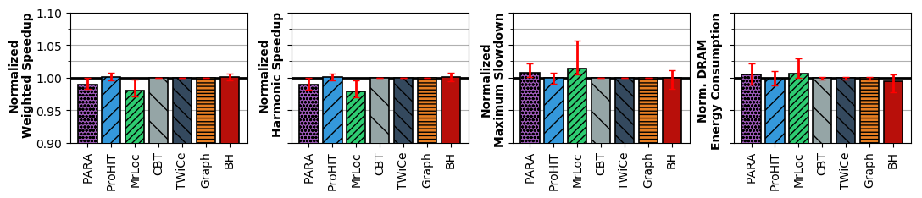
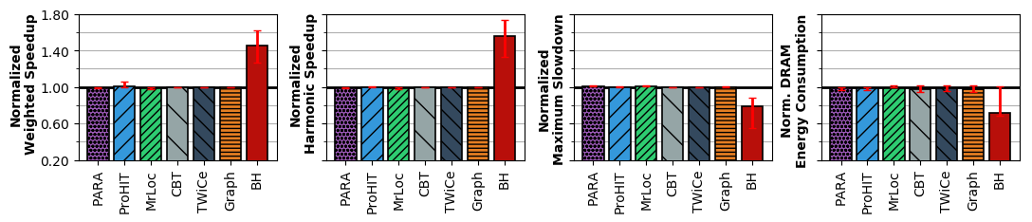
Evaluation Performance and DRAM Energy
System throughput (weighted speedup)
Job turnaround time (harmonic speedup)
Unfairness (maximum slowdown)
DRAM energy consumption
No
RowHammer
Attack
BlockHammer introduces very low performance (<0.5%) and DRAM energy (<0.4%) overheads
RowHammer
Attack
Present
BlockHammer significantly increases benign application performance (by 45% on average)
and reduces DRAM energy consumption (by 29% on average)
Notes:
We evaluate BlockHammer and compare it with six state-of-the-art mitigation mechanisms
for multiprogrammed workloads
[CLICK] when there is no RowHammer attack.
[CLICK] and when there is a RowHammer attack present.
[CLICK] We use four metrics in this evaluation to demonstrate
the system throughput,
job turnaround time,
unfairness,
and DRAM energy consumption.
[CLICK] When there is no attack in the system, BlockHammer introduces very low performance and DRAM energy overheads.
[CLICK] When there is an attack present in the system,
BlockHammer significantly increases benign application performance
and reduces DRAM energy consumption.

Slide 17
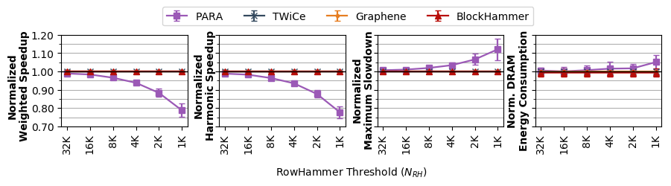
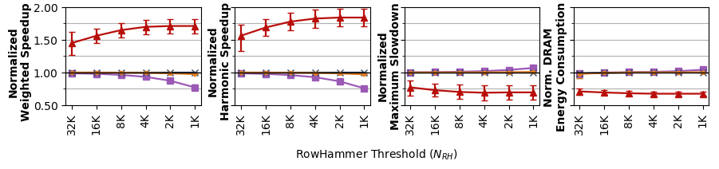
Evaluation Scaling with RowHammer Vulnerability
System throughput (weighted speedup)
Job turnaround time (harmonic speedup)
Unfairness (maximum slowdown)
DRAM energy consumption
No RowHammer
Attack
BlockHammer’s performance and energy overheads remain negligible (<0.6%)
RowHammer
Attack Present
BlockHammer scalably provides much higher performance (71% on average)
and lower energy consumption (32% on average) than state-of-the-art mechanisms
Notes:
We conduct a scalability study with worsening RowHammer vulnerability.
[CLICK] again for the cases where there is no RowHammer attack
[CLICK] and when there is a RowHammer attack present.
We scale the RowHammer threshold from 32K down to 1K.
[CLICK] We observe that BlockHammer's performance and energy overheads remain negligible even when RowHammer threshold is scaled downto 1K
[CLICK] and BlockHammer scalably provides much higher performance and lower energy consumption than state-of-the-art mechanisms when there is a RowHammer attack present.

Slide 18
Evaluation BlockHammer’s Hardware Complexity
Mitigation |  | SRAM | CAM | Area |  | Access Energy | Static Power
Mechanism |  | KB | KB | mm² | %CPU | pJ | mW
BlockHammer |  | 51.48 | 1.73 | 0.14 | 0.06 | 20.30 | 22.27
PARA [73] |  | - | - | <0.01 | - | - | -
ProHIT [137] |  | - | 0.22 | <0.01 | <0.01 | 3.67 | 0.14
MRLoc [161] |  | - | 0.47 | <0.01 | <0.01 | 4.44 | 0.21
CBT [132] |  | 16.00 | 8.50 | 0.20 | 0.08 | 9.13 | 35.55
TWiCe [84] |  | 23.10 | 14.02 | 0.15 | 0.06 | 7.99 | 21.28
Graphene [113] |  | - | 5.22 | 0.04 | 0.02 | 40.67 | 3.11
BlockHammer |  | 441.33 | 55.58 | 1.57 | 0.64 | 99.64 | 220.99
PARA [73] |  | - | - | <0.01 | - | - | -
ProHIT [137] |  | x | x | x | x | x | x
MRLoc [161] |  | x | x | x | x | x | x
CBT [132] |  | 512.00 | 272.00 | 3.95 | 1.60 | 127.93 | 535.50
TWiCe [84] |  | 738.32 | 448.27 | 5.17 | 2.10 | 124.79 | 631.98
Graphene [113] |  | - | 166.03 | 1.14 | 0.46 | 917.55 | 93.96
Mitigation |  | SRAM | CAM | Area |  | Access Energy | Static Power
Mechanism |  | KB | KB | mm² | %CPU | pJ | mW
BlockHammer |  | 51.48 | 1.73 | 0.14 | 0.06 | 20.30 | 22.27
PARA [73] |  | - | - | <0.01 | - | - | -
ProHIT [137] |  | - | 0.22 | <0.01 | <0.01 | 3.67 | 0.14
MRLoc [161] |  | - | 0.47 | <0.01 | <0.01 | 4.44 | 0.21
CBT [132] |  | 16.00 | 8.50 | 0.20 | 0.08 | 9.13 | 35.55
TWiCe [84] |  | 23.10 | 14.02 | 0.15 | 0.06 | 7.99 | 21.28
Graphene [113] |  | - | 5.22 | 0.04 | 0.02 | 40.67 | 3.11
Mitigation |  | SRAM | CAM | Area |  | Access Energy | Static Power
Mechanism |  | KB | KB | mm² | %CPU | pJ | mW
BlockHammer |  |  |  |  | 0.06 | 20.30 | 22.27
PARA [73]
ProHIT [137]
MRLoc [161]
CBT [132] |  |  |  |  | 0.08 |  | 35.55
TWiCe [84] |  |  |  |  | 0.06 |  | 21.28
Graphene [113] |  |  |  |  | 0.02 | 40.67 | 3.11
BlockHammer |  |  |  |  | 0.64 | 99.64 | 220.99
PARA [73]
ProHIT [137]
MRLoc [161]
CBT [132] |  |  |  |  | 1.60 |  | 535.50
TWiCe [84] |  |  |  |  | 2.10 |  | 631.98
Graphene [113] |  |  |  |  | 0.46 | 917.55 | 93.96
N_{RH}=32K
10x
5x
10x
N_{RH}=1K
23x
20x
35x
23x
15x
30x
30x
BlockHammer’s hardware complexity scales more efficiently than state-of-the-art mechanisms
Notes:
Next, we analyze the scalability with worsening RowHammer vulnerability from the hardware complexity aspect in terms of
[CLICK] chip area,
[CLICK] access energy,
[CLICK] and static power consumption.
[CLICK] We observe that BlockHammer’s hardware complexity scales more efficiently than state-of-the-art RowHammer mitigaiton mechanisms.

Slide 19
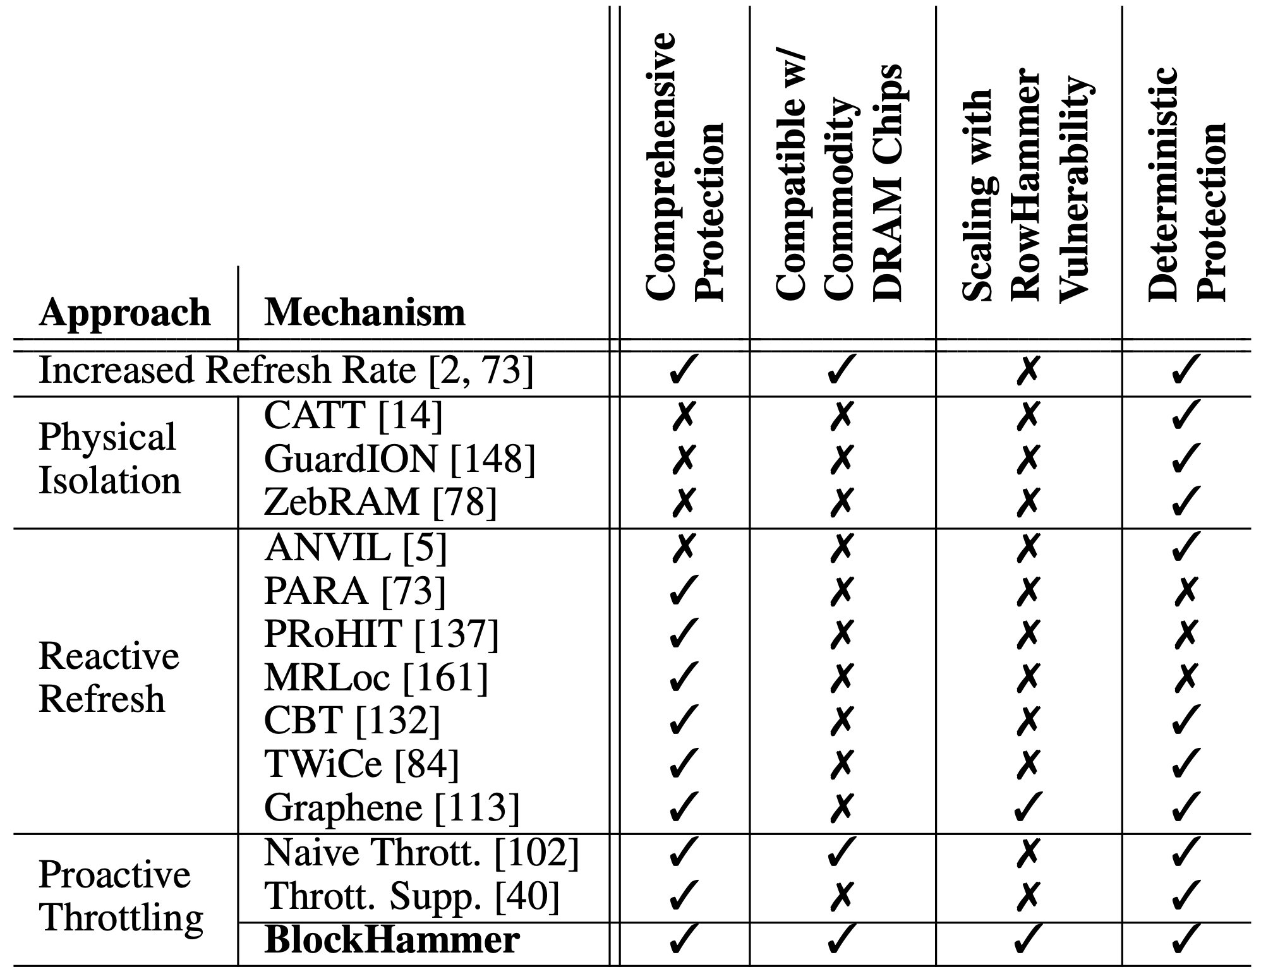
More in the Paper
Security Proof
Mathematically represent all possible access patterns
We show that no row can be activated high-enough times to induce bit-flips when BlockHammer is configured correctly
Addressing Many-Sided Attacks
Evaluation of 14 mechanisms representing four mitigation approaches
Comprehensive Protection
Compatibility with Commodity DRAM Chips
Scalability with RowHammer Vulnerability
Deterministic Protection
Notes:
We provide more analyses and implementation details available in the full paper.
[CLICK] First, the paper shares a security proof where we mathematically represent ALL POSSIBLE access patterns and show that NO ROW can be activated at a high-enough rate to induce bit-flips when BlockHammer is configured correctly.
[CLICK] Second, the paper explains how BlockHammer addresses many-sided attacks by tuning its thresholds.
[CLICK] Third, we evaluate all four high-level RowHammer mitigation approaches through analyzing 14 mechanisms from four aspects
[CLICK] comprehensive protection
[CLICK] compatibiltiy with commodity DRAM chips
[CLICK] scalability with worsening RowHammer vulnerability
[CLICK] and deterministic protection.
[CLICK] We show that BlockHammer is the only mechanism that satisfies all of them.
[END]

Slide 20
BlockHammer Preventing RowHammer at Low Cost by Blacklisting Rapidly-Accessed DRAM Rows
Abdullah Giray Yağlıkçı
Minesh Patel Jeremie S. Kim Roknoddin Azizi
Ataberk Olgun Lois Orosa Hasan Hassan Jisung Park
Konstantinos Kanellopoulos Taha Shahroodi
Saugata Ghose* Onur Mutlu
*
Notes:
This concludes my talk. Thank you for your time and attention. I will be happy to answer your questions.

Slide 21
BlockHammer Preventing RowHammer at Low Cost by Blacklisting Rapidly-Accessed DRAM Rows
Backup Slides
Notes:
This concludes my talk . Thank you for your time and attention. For many more details, I invite you to read our HPCA 2021 paper.

Slide 22
Evaluation Performance and DRAM Energy
Cycle-level simulations using Ramulator and DRAMPower
System Configuration:
Single-Core Benign Workloads:
22 SPEC CPU 2006
4 YCSB Disk I/O
2 Network Accelerator Traces
2 Bulk Data Copy with Non-Temporal Hint (movnti)
Randomly Chosen Multiprogrammed Workloads:
125 workloads containing 8 benign applications
125 workloads containing 7 benign applications and 1 RowHammer attack thread
Processor | 3.2 GHz, {1,8} core, 4-wide issue, 128-entry instr. window
LLC | 64-byte cacheline, 8-way set-associative, {2,16} MB
Memory scheduler | FR-FCFS
Address mapping | Minimalistic Open Pages
DRAM | DDR4 1 channel, 1 rank, 4 bank group, 4 banks per bank group
RowHammer Threshold | 32K
Notes:
We conduct cycle-level simulations using RAMULATOR and DRAMPOWER to evaluate the performance and DRAM energy consumption.
[CLICK] We simulate a realistic system with a DDR4 DRAM module.
[CLICK] We use single-core workloads from four benchmarks in our simulations.
22 SPEC benchmarks, 4 disk I/O memory access traces from YCSB benchmark suite, 2 memory access traces collected from a network accelerator chip, and 2 synthetic traces that mimic bulk data copy with non-temporal hint.
[CLICK] We randomly combine these workloads to create two types of eight-core multiprogrammed workloads:
[CLICK] workloads that contain eight benign applications
[CLICK] and workloads that contain seven benign applications along with one thread performing RowHammer attack.

Slide 23
Timing Constraints for DRAM Row Activations
Timing row activations is critical to meet reliability and power constraints.
Two timing constraints limit row activation rates.
time
Bank A
ACT
Row X
ACT
Row Y
Time difference > t_{RC} (~45-50ns)
Bank B
ACT
Row Z
Bank C
ACT
Row T
Bank D
ACT
Row U
Bank E
ACT
Row V
Time difference > t_{FAW} (~30-35ns)
Bank F
ACT
Row W
Time difference > t_{FAW} (~30-35ns)
1
2
3
4
5
6
7
t_{RC.} : Minimum delay between two consecutive activations in a bank.
t_{FAW}: Rolling time window in which at most four rows can be activated in a rank.
Notes:
The memory controller obeys a set of timing constraints while performing row activations.
[CLICK] This is important to meet reliability and power constraints.
[CLICK] Two parameters limit row activation rates that I will explain on a timeline.
[CLICK] A minimum time delay called TRC should be satisfied between two consecutive activations in a bank.
[CLICK] During this time delay, rows in other banks can be activated, allowing bank level parallelism.
[CLICK] After activating four rows in a rank, [CLICK] the fifth activation should be delayed until a minimum time delay is satisfied between the

Slide 24
Scalability with Worsening RowHammer Vulnerability
DRAM chips are more vulnerable to RowHammer today
RowHammer bit-flips occur at much lower activation counts (more than an order of magnitude decrease):
139.2K [Y. Kim+, ISCA 2014]
9.6K [J. S. Kim+, ISCA 2020]
RowHammer blast radius has increased by 33%:
9 rows [Y. Kim+, ISCA 2014]
12 rows [J. S. Kim+, ISCA 2020]
In-DRAM mitigation mechanisms are ineffective [Frigo+, S&P 2020]
RowHammer is a more serious problem than ever
Notes:
Recent works show that DRAM chips became more vulnerable to RowHammer in the last decade.
[CLICK] RowHammer bit-flips can occur in much lower activation counts
[CLICK] and hammering a row can disturb more rows than before.
[CLICK] And furthermore, in-DRAM mitigation mechanisms are shown to be ineffective.
[CLICK] Therefore, RowHammer is a more serious problem than ever today.

Slide 25
RowBlocker
Modifies the memory request scheduler to throttle row activations
Blacklists rows with a high activation rate and delays subsequent activations targeting blacklisted rows
Notes:
RowBlocker modifies the memory request scheduler TO THROTTLE row activations that could lead to bit-flips.
[CLICK] to do so, it [CLICK] BLACKLISTS rows with high activation rates and [CLICK] DELAYS subsequent activations targeting them.
[END]

Slide 26
RowBlocker
Blocks a row activation if the row is both blacklisted and recently activated
Notes:
In a nutshell,
[CLICK] Before activating a row Memory request scheduler pings RowBlocker with a "is the row activation RowHammer-safe" query.
[CLICK] if a row is blacklisted [CLICK] and recently activated,
activating the row can be unsafe.
Therefore, the row activation is blocked.
Meanwhile, other requests in the request queue can be serviced.
[END]

Slide 27
RowBlocker-BL Blacklisting Logic
Blacklists a row when the row’s activation count in a time window exceeds a threshold
Employs two counting Bloom filters for area-efficient activation rate tracking
Notes:
The blacklisting logic tracks row activation rates
and Blacklists a row when its activation count in a time window exceeds a threshold.
[CLICK] To do this in an area-efficient way, it employs two counting Bloom filters and uses them in a time-interleaved manner
I will not get into the details about this time interleaving scheme now.
But, you can find how it works in the full talk and the paper.

Slide 28
RowBlocker-HB Delaying Row Activations
RowBlocker-HB ensures no subsequent blacklisted row activation is performed sooner than t_{Delay}
RowBlocker-HB implements a history buffer for row activations that can fit in a t_{Delay} time window
A blacklisted row activation is blocked as long as a valid activation record of the row exists in the history buffer
No row can be activated at a high enough rate to induce bit-flips
Notes:
Delaying logic enforces a certain time delay called tDelay between subsequent activations targeting a blacklisted row
[CLICK] To do so, it implements a history buffer that contains the information of all row activations that can fit in a tDelay time window.
[CLICK] A blacklisted row activation is blocked as long as a valid activation record of the row exists in the history buffer.
[CLICK] this way, no row can be activated at a high enough rate to induce bit-flips.

Slide 29
BlockHammer Overview of Approach
RowBlocker
Tracks row activation rates using area-efficient Bloom filters
Blacklists rows that are activated at a high rate
Throttles activations targeting a blacklisted row
AttackThrottler
Identifies threads that perform a RowHammer attack
Reduces memory bandwidth usage of identified threads
No row can be activated at a high enough rate to induce bit-flips
Greatly reduces the performance degradation
and energy wastage a RowHammer attack inflicts on a system
Notes:
This was RowBlocker
[CLICK] let’s move to AttackThrottler

Slide 30
AttackThrottler
Tackles a RowHammer attack’s performance degradation and energy wastage on a system
A RowHammer attack intrinsically keeps activating blacklisted rows
RowHammer Likelihood Index (RHLI): Number of activations that target blacklisted rows (normalized to maximum possible activation count)
RHLI
0.0
1.0
Benign application
No blacklisted row activations
RowHammer attack Blacklisted row activation count approaches RowHammer threshold
RHLI is larger when the thread’s access pattern
is more similar to a RowHammer attack
Notes:
AttackThorttler tackles the performance degradation and energy wastage that a RowHammer attack causes.
AttackThrottler identifies a RowHammer attack by using the observation that
[CLICK] A RowHammer attack intrinsically keeps activating blacklisted rows.
[CLICK] Now, AttackThrottler introduces a new metric called RowHammer Likelihood Index (RHLI), which is a normalized measure of blacklisted row activation count.
[CLICK] RHLI of a thread increases when the thread behaves more similar to a RowHammer attack.

Slide 31
AttackThrottler
Applies a smaller quota to a thread’s in-flight request count as RHLI increases
Reduces a RowHammer attack’s memory bandwidth consumption, enabling a larger memory bandwidth for concurrent benign applications
RHLI can also be used as a RowHammer attack indicator by the system software
RHLI
0.0
1.0
Benign application
No blacklisted row activations
No quota applied
RowHammer attack Blacklisted row activation count approaches RowHammer threshold
No request is allowed
Greatly reduces the perfomance degradation and energy wastage
a RowHammer attack inflicts on a system
Notes:
AttackThrottler applies a smaller quota to a thread’s in-flight request count as RHLI increases.
[CLICK] By doing so, AttackThrottler reduces a thread’s memory bandwidth consumption proportional to its similarity to a RowHammer attack, and frees up memory bandwidth for concurrent benign applications.
[CLICK] This way, AttackThrottler greatly reduces the perfomance degradation and energy wastage a RowHammer attack inflicts on the system.
[CLICK] Alternatively, RHLI can also be used as a RowHammer attack indicator
by the system software for software-level countermeasures.

Slide 32
BlockHammer Hardware Complexity
RowBlocker
RowBlocker-BL: Implemented per-bank
1K counters in a CBF
4 H3 hash functions
RowBlocker-HB: Implemented per-rank
887 entries
AttackThrottler
Two counters per <Bank, Thread> pair.

Slide 33
RowHammer Characteristics
RowHammer Threshold (N_{RH}): The minimum row activation count in a refresh window to induce a RowHammer bit-flip.
Blast Radius (r_{Blast}): The maximum physical distance from the aggressor row at which RowHammer bit-flips can be observed.
Blast Impact Factor (c_{i}): Set of coefficients that scale a RowHammer attacks impact on victim rows based on their physical distance to the aggressor row.
Notes:
Two properties indicate how vulnerable a DRAM chip is to RowHammer.
[CLICK] RowHammer threshold is the minimum number of row activations in a refresh window to induce a RowHammer bit-flip.
[CLICK] Blast radius is the maximum physical distance from the aggressor row at which RowHammer bit-flips can be observed.

Slide 34
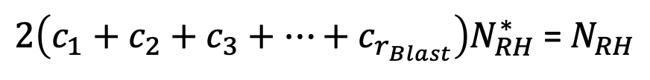
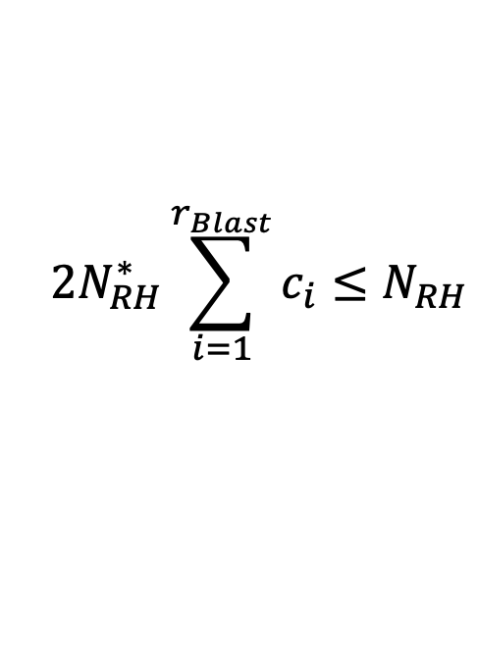
Many-Sided Attacks
N_{RH} : RowHammer threshold for single-sided attack.
N_{RH}* : Maximum activation count that BlockHammer allows in a refresh window.
r_{Blast} : Blast radius
c_{i} : Blast impact factor
We configure N_{RH}* such that hammering all rows N_{RH}* times does not cause bit-flips.
$2\left(c_{1}+c_{2}+c_{3}+…+c_{r_{Blast}}\right)N_{RH}^{∗}$ = $N_{RH}$
$$2N_{RH}^{∗}\sum_{i=1}^{r_{Blast}}{c_{i}}≤N_{RH}$$

Slide 35
Counting Bloom Filters
Blacklisting logic counts activations using counting Bloom filters
A row’s activation count
can be observed more than it is (false positive)
cannot be observed less than it is (no false negative)
To avoid saturating counters, we adopt a time-interleaving approach.
ACT Row A
Test Row A
ACT Row B
ACT Row A
Hash functions
1
1
1
1
0
2
1
1
1
1
1
0
0
0
0
1
0
0
0
0
0
2
1
2
3
2
2
2
3
2
3
1
1
2
1
Minimum
2
Notes:
[CLICK] A counting Bloom filter is essentially an array of counters
[CLICK] addressed by hashed identifiers
[CLICK] When a row A is activated,
its row id is provided to a set of hash functions
that evaluate a set of indices to the counter array
[CLICK] each of which is incremented.
[CLICK] activating another row,
say row B,
increments another subset of counters.
[CLICK] Therefore, a counter can be used for more than one row ids
therefore, a row's activation count can be observed
more than its actual value leading false positives.
[CLICK] Counter values grow
as [CLICK] row activations take place.
[CLICK] A row's activation count is
[CLICK] the minimum value across its corresponding counters.
[CLICK] this way, a row’s activation count cannot be observed less than its actual value, hence no false negatives.
[CLICK] The counters can saturate as they never decremented. To avoid this, we periodically reset them without losing data by adopting a time-interleaving approach.

Slide 36
RowBlocker-BL Blacklisting Logic
Blacklisting logic employs two counting Bloom filters.
A new row activation is inserted in both filters.
Only one filter (active filter) responds to test queries.
The active filter changes at every epoch.
Assume that the row is
activated at a high rate
Assume that the row is
not activated at a high rate
Notes:
I will explain this time interleaving in several epochs.
[CLICK] Blacklisting logic employs TWO counting bloom filters
[CLICK] A new row activation is inserted in BOTH filters at ALL times.
[CLICK] Only one filter responds to test queries at a given time that we call ACTIVE FILTER.
[CLICK] The active filter alternates at every epoch between two filters.
[CLICK] Let's look at the operation of two filters CBFA and CBFB across the timeline shown here.
[CLICK] A green bar indicates that the filter is active at a given time. For example, at timestamp 1, CBFA is active.
[CLICK] We call the other filter PASSIVE and indicate its state with a gray bar.
[CLICK] Assume that a row is activated at a high rate
in epochs one and two
[CLICK] and at a low rate later on.
[CLICK] A blue bar shows that the row's activation count is below the blacklisting threshold.
[CLICK] at timestamp 2, the row's activation count reaches blacklisting threshold (NBL)
and the row is blacklisted as indicated by the red bar.
[CLICK] at timestamp 3, the active filter (CBFA) is cleared
and CBFB becomes the active filter for epoch 2.
since CBFB knows the high activation rate during epoch 1, it keeps the row blacklisted until the end of epoch 2.
[CLICK] meanwhile, at timestamp 4, row's activation counters in CBFA exceeds blacklisting threshold again
[CLICK] causing CBFA to blacklist the row when it becomes active at timestamp 5.
[CLICK] Assuming that the row is no longer rapidly activated during epoch 3, its counters in CBFB remain below the blacklisting threshold
[CLICK] and it is no longer blacklisted starting from timestamp 6.
[END]

Slide 37
Evaluation BlockHammer’s Hardware Complexity
When configured for a RowHammer threshold of 32K:
0.06% chip area overhead¹
20pJ access energy and 22mW static power consumption
For a RowHammer threshold of 1K: BlockHammer’s area, access energy, static power are 1.25X – 2.5X smaller than two major prior mechanisms.
BlockHammer is low cost and competitive with state-of-the-art mechanisms
BlockHammer’s hardware complexity scales more efficiently than state-of-the-art mechanisms
¹Assuming a high-end 28-core Intel Xeon processor system with 4-channel single-rank DDR4 DIMMs
** TWiCe [Lee+, ISCA’19] and CBT [Seyedzadeh+ ISCA’18]. The paper has a comprehensive comparison with other mechanisms.
Area | Access Energy | Static Power
< 40% | < 80% | < 42%
Notes:
We evaluate BlockHammer’s hardware complexity based on a realistic implementation
for a high-end 28-core Intel Xeon processor system with four memory channel DDR4 DRAM modules.
When configured for a RowHammer threshold of 32K, which is a realistic assumption for current DRAM chips,
BlockHammer is LOW COST and competitive with state-of-the-art RowHammer mitigation mechanisms
[CLICK] When configured for a RowHammer threshold of 1K, which is projected for future DRAM chips,
BlockHammer’s hardware complexity scales more efficiently than state-of-the-art mechanisms.
[END]

Slide 38
More in the Paper
Evaluation of 14 Mechanisms representing Four Mitigation Approaches
Comprehensive Protection
Compatibility with Commodity DRAM Chips
Scalability with RowHammer Vulnerability
Deterministic Protection
Notes:
Fourth, we evaluate all four high-level RowHammer mitigation approaches through analyzing 14 mechanisms from four aspects
[CLICK] comprehensive protection
[CLICK] compatibiltiy with commodity DRAM chips
[CLICK] scalability with worsening RowHammer vulnerability
[CLICK] and deterministic protection.
[CLICK] We show that BlockHammer is the only mechanism that satisfies all of them.

Slide 39
DRAM Organization
A DRAM bank is hierarchically organized into subarrays
local
bitline
DRAM cell
wordline
DRAM Bank
DRAM row
Columns of cells in subarrays share a local bitline
Rows of cells in a subarray share a wordline
Notes:
[CLICK] Each DRAM bank is hierarchically organized into subarrays. [CLICK] Each circle in the cartoon represents a single DRAM cell. [CLICK] columns of DRAM cells in a subarray are connected with a wire referred to as a local bitline. [CLICK] and rows of DRAM cells are connected with a wire referred to as a wordline, and [CLICK] a row of DRAM cells is called a DRAM row. [CLICK] at the peripherals of the core cell arrays are a local row decoder, which selects the row to read and write to, and a local row-buffer which amplifies the data that is stored in the cell to an I/O readable value. [CLICK] DRAM is comprised of many subarrays which are often composed of 512 to 1024 rows. [CLICK] Further peripherals exist containing groups of subarrays called [CLICK] a bank. The global row decoder selects the local row decoder that will drive the wordline, and global row buffer aids in the transfer of data to and from the CPU. A DRAM device is comprised of several banks, and each bank can be accessed independently [CLICK]

Slide 40
DRAM Operation
Cache line
…
Row Decoder
…
…
…
…
…
Local Row Buffer
Local Row Buffer
Local Row Buffer
READ
READ
READ
READ
READ
READ
DRAM Command Sequence
ACT R0
RD
RD
RD
PRE R0
ACT R1
RD
RD
RD
time
Notes:
Let’s take a look at how DRAM operates in the scope of a single subarray. [CLICK] Because memory controllers typically access DRAM at the granularity of a cache line, we combine consecutive, aligned DRAM cells as cache lines in our diagram. [CLICK] First, we activate the first row, which [CLICK] copies the entire rows' data into the row buffer. At this point, we can [CLICK] read our data at the granularity [CLICK] of cache lines within the [CLICK] activated or opened row. When we want to access data on another row, we must precharge [CLICK] the currently opened row, which prepares the row buffer for copying data from another row. We can now [CLICK] activate the second row, before reading data from it [CLICK][CLICK][CLICK]

Slide 41
DRAM Cell
Each cell encodes information in leaky capacitors
wordline
access
transistor
charge
leakage
paths
capacitor
bitline
Stored data is corrupted if too much charge leaks (i.e., the capacitor voltage degrades too much)
[Patel+ ISCA’17, Kim+ ISCA’20]
Notes:
Each cell encodes data in fundamentally leaky cells [CLICK] Here is a simplified diagram of a DRAM cell, where the data is stored as capacitor voltage and the accessed through the access
[CLICK]
There are a number of leakage paths by which charge can enter or exit the capacitor.
[CLICK]
The stored data can be corrupted if too much charge leaks
[END]

Slide 42
Organizing and Accessing DRAM Cells
A DRAM cell consists of a capacitor and an access transistor
A row needs to be activated to access its content
Notes:
A processor’s memory controller
[CLICK] communicates with a set of DRAM chips, called a DRAM Rank through a memory channel.
[CLICK] Each DRAM chip contains multiple banks.
[CLICK] DRAM cells are organized as
an array of DRAM rows within each bank.
[CLICK] Here is a simplified diagram of a DRAM cell, where the data is stored as capacitor voltage and accessed through the access transistor
[CLICK] To access a DRAM cell, its row is activated
by fetching the data stored in the cell capacitor into the row buffer.

Slide 43
DRAM Refresh
Refresh Operations
Refresh Window t_{REFW}
100%
Vmin
Capacitor voltage (Vdd)
0%
REF
REF
REF
time
Periodic refresh operations preserve stored data
[Patel+ ISCA’17, Kim+ ISCA’20]
Notes:
Here, we have a simplified diagram of the capacitor voltage over time
We see that the voltage decreases over time in an exponential decay.
There’s a threshold voltage Vmin
[CLICK]
above which the stored data can be read successfully.
[CLICK]
However, as soon as the voltage drops below Vmin, a bit-flip can occur.
In order to prevent failures from charge leakage,
[CLICK] periodic refresh operations are issued to restore the capacitor voltage.
[CLICK] The interval between refresh commands are referred to as the refresh window.
[END]

Slide 44
RowBlocker
When a row activation is performed, both RowBlocker-BL and RowBlocker-HB are updated with the row activation information
Notes:
When the memory request scheduler issues a row activation,
BOTH components are updated with the row activation information.

Slide 45
Counting Bloom Filters
Blacklisting logic counts activations using counting Bloom filters
A row’s activation count
can be observed more than it is (false positive)
cannot be observed less than it is (no false negative)
To avoid saturating counters, we use a time-interleaving approach
ACT Row A
Test Row A
ACT Row B
Hash functions
1
1
1
1
0
2
1
1
1
1
1
0
0
0
0
1
0
0
0
0
0
1
1
1
2
1
1
1
2
1
Minimum
1
Notes:
A counting Bloom filter is essentially an array of counters
[CLICK] addressed by hashed identifiers
[CLICK] When a row A is activated,
its row id is provided to a set of hash functions
that evaluate a set of indices to the counter array
each of which is incremented.
[CLICK] Activating another row,
[CLICK] say row B,
increments another subset of counters.
[CLICK] As shown here, counter can be used for more than one row ids.
[CLICK] Therefore, a row's activation count can be observed
more than its actual value leading false positives.
[CLICK] We estimate a row's activation count as
[CLICK] the minimum value across its corresponding counters.
[CLICK] These counters are never decremented. Therefore, a row’s activation count cannot be observed less than its actual value, hence no false negatives.
[CLICK] The counters can saturate though as they are never decremented. To avoid this, we periodically reset them without losing data by adopting a time-interleaving approach.

Slide 46
RowBlocker-BL Blacklisting Logic
Blacklisting logic employs two counting Bloom filters
A new row activation is inserted in both filters
Only one filter (active filter) responds to test queries
The active filter changes at every epoch
CBF_{A} is active
CBF_{A} is passive
CBF_{B} is passive
CBF_{B} is active
Notes:
I will explain this time interleaving next
[CLICK] Blacklisting logic employs TWO counting bloom filters
[CLICK] A new row activation is inserted in BOTH filters at ALL times.
[CLICK] Only one filter responds to test queries at a given time that we call the ACTIVE FILTER.
[CLICK] The active filter alternates at every epoch between two filters.
[CLICK] Let's look at the operation of two filters CBFA and CBFB across the timeline shown here.
[CLICK] A green bar indicates that the filter is active at a given time.
[CLICK] We call the other filter PASSIVE and indicate its state with a gray bar.
[END]

Slide 47
RowBlocker-BL Blacklisting Logic
Blacklisting logic employs two counting Bloom filters
A new row activation is inserted in both filters
Only one filter (active filter) responds to test queries
The active filter changes at every epoch
Blacklists a row if its activation count reaches the blacklisting threshold (N_{BL})
Assume that the row is
activated at a high rate
Assume that the row is
not activated at a high rate
Notes:
At timestamp 1, CBFA is active.
[CLICK] Assume that a row is activated at a high rate
in epochs one and two
[CLICK] and at a low rate later on.
[CLICK] RowBlocker blacklists a row if the row's activation count reaches the blacklisting threshold called NBL
A blue bar shows that the row's activation count is below the blacklisting threshold.
[CLICK] at timestamp 2, the row's activation count reaches blacklisting threshold (NBL)
and the row is blacklisted
[CLICK] as indicated by the red bar.
[CLICK] at timestamp 3, the active filter (CBFA) is cleared
[CLICK] and CBFB becomes the active filter for epoch 2.
[CLICK] since CBFB knows the high activation rate during epoch 1, it keeps the row blacklisted until the end of epoch 2.
[CLICK] meanwhile, at timestamp 4, row's activation counters in CBFA exceeds blacklisting threshold again
[CLICK] At the end of epoch 2 (at timestamp 5), CBFB is cleared
[CLICK] and CBFA becomes the active filter again.
CBFA immediately blacklists the row because its counters reached NBL at timestamp 4.
[CLICK] Assuming that the row is no longer rapidly activated during epoch 3, its counters in CBFB remain below the blacklisting threshold
[CLICK] and it is no longer blacklisted starting from timestamp 6.
[END]

Slide 48
Limiting the Row Activation Rate
The activation rate is RowHammer-safe if it is smaller than or equal to RowHammer threshold (N_{RH}) activations in a refresh window (t_{REFW})
RowBlocker limits the activation count (N_{CBF}) in a CBF’s lifetime (t_{CBF})
$$Activation Rate in a t_{CBF}≤ N_{RH} activations in a refresh window (t_{REFW})$$
Clear CBF_{A}
Clear CBF_{A}
t_{CBF}
t_{CBF}
Clear CBF_{B}
Clear CBF_{B}
Notes:
To ensure RowHammer-safe operation, RowBlocker limits the activation rate of blacklisted rows at a RowHammer-safe level.
[CLICK] An activation rate is RowHammer-safe if it is smaller than the ratio of RowHammer threshold (NRH) to the refresh window tREFW.
[CLICK] RowBlocker ensures this activation rate within the lifetime of each counting Bloom filter (tCBF) which is bounded by CLEAR operations.
[CLICK] Therefore, we write the RowHammer-safe condition as activation rate in a tCBF to be smaller than or equal to NRH row activations per tREFW refresh window.
[END]

Slide 49

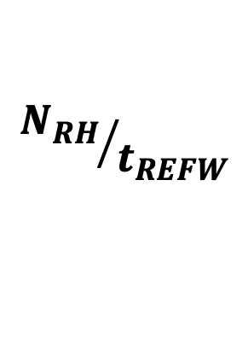
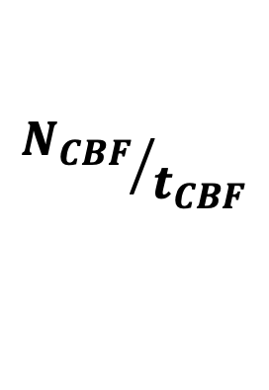
Limiting the Row Activation Rate
The activation rate is RowHammer-safe if it is smaller than or equal to RowHammer threshold (N_{RH}) activations in a refresh window (t_{REFW})
RowBlocker limits the activation count (N_{CBF}) in a CBF’s lifetime (t_{CBF})
$$Activation Rate in a t_{CBF}≤ N_{RH} activations in a refresh window (t_{REFW})$$
RowHammer Safety Constraint
$${N_{CBF}}/{t_{CBF}}$$
$$≤$$
$${N_{RH}}/{t_{REFW}}$$
Clear CBF_{A}
Clear CBF_{A}
t_{CBF}
t_{CBF}
Clear CBF_{B}
Clear CBF_{B}
Notes:
Denoting the number of activations in a tCBF as nCBF, we derive the shown constraint.

Slide 50
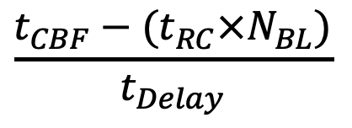
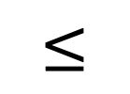
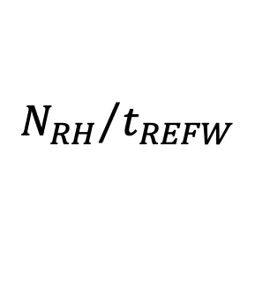
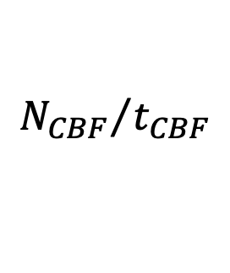

RowBlocker-HB Limiting the Row Activation Rate
Ensures that all rows experience a RowHammer-safe activation rate
We limit N_{CBF} by configuring t_{Delay} :
$${N_{CBF}}/{t_{CBF}}$$
$$≤$$
$${N_{RH}}/{t_{REFW}}$$
N_{CBF} row activations
N_{BL} row activations
Blacklisted row activation
Row
activation
t_{RC}
t_{Delay}
t_{Delay}
t_{Delay}
t_{Delay}
time
t_{RC} x N_{BL}
t_{CBF} – (t_{RC} ✖️N_{BL})
t_{CBF}
$$\frac{t_{CBF}−(t_{RC}×N_{BL})}{t_{Delay}}$$
$$N_{CBF}≤N_{BL}+$$
Notes:
RowBlocker-HB is the component which ensures that all rows experience a RowHammer-safe activation rate.
[CLICK] I will explain how this mechanism works on a timeline.
[CLICK] Within a tCBF time window,
[CLICK] RowBlocker limits a row’s activation count to NCBF.
[CLICK] Now assume that an attacker tries hammering a row as rapidly as possible.
Each spike in this illustration represents a row activation.
Due to the DDR specs, there has to be a minimum time window between subsequent activations called tRC.
[CLICK] Therefore, A row’s activation count can reach the blacklisting threshold (NBL) at a minimum time window of tRC times NBL.
[CLICK] At this point the row is blacklisted and subsequent activations targeting the row are throttled until the end of tCBF time window.
[CLICK] A red spike represents an activation targeting the row when the row is blacklisted.
[CLICK] To throttle subsequent row activations, RowBlocker ensures a time delay (tDelay) between them.
Therefore, a row can be activated at most this [CLICK] many times when it is blacklisted.
[CLICK] and by configuring tDelay, RowBlocker limits NCBF.
Please refer to the full paper for more details about this calculation.
[END]

Slide 51
Evaluation BlockHammer’s Hardware Complexity
We analyze six state-of-the-art mechanisms and BlockHammer
We calculate area, access energy, and static power consumption*
Mitigation |  | SRAM | CAM | Area |  | Access Energy | Static Power
Mechanism |  | KB | KB | mm² | %CPU | pJ | mW
BlockHammer
PARA [73]
ProHIT [137]
MRLoc [161]
CBT [132]
TWiCe [84]
Graphene [113]
Mitigation |  | SRAM | CAM | Area |  | Access Energy | Static Power
Mechanism |  | KB | KB | mm² | %CPU | pJ | mW
BlockHammer |  | 51.48 | 1.73 | 0.14 | 0.06 | 20.30 | 22.27
PARA [73] |  | - | - | <0.01 | - | - | -
ProHIT [137] |  | - | 0.22 | <0.01 | <0.01 | 3.67 | 0.14
MRLoc [161] |  | - | 0.47 | <0.01 | <0.01 | 4.44 | 0.21
CBT [132] |  | 16.00 | 8.50 | 0.20 | 0.08 | 9.13 | 35.55
TWiCe [84] |  | 23.10 | 14.02 | 0.15 | 0.06 | 7.99 | 21.28
Graphene [113] |  | - | 5.22 | 0.04 | 0.02 | 40.67 | 3.11
N_{RH}=32K
BlockHammer is low cost and competitive
with state-of-the-art mechanisms
*Assuming a high-end 28-core Intel Xeon processor system with 4-channel single-rank DDR4 DIMMs with a RowHammer threshold (NRH) of 32K
Notes:
We analyze and compare BlockHammer's hardware complexity
with six state-of-the-art RowHammer mitigation mechanisms, namely
PARA, ProHIT, MRLoc, CBT, TWiCe, and Graphene.
[CLICK] we calculate hardware complexity in terms of AREA, ACCESS ENERGY, and STATIC POWER consumption for a RowHammer threshold of 32K,
which is a realistic assumption for current DRAM chips
[CLICK] We observe that BlockHammer is LOW COST and competitive with state-of-the-art RowHammer mitigation mechanisms

Slide 52
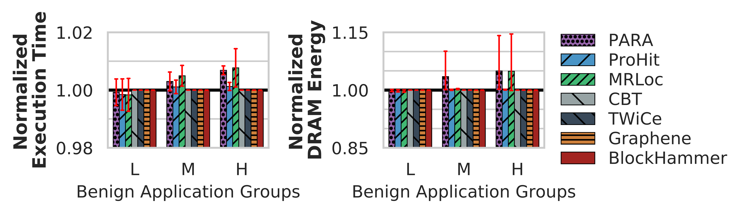
Evaluation Performance and DRAM Energy
We classify single-core workloads into three categories based on row buffer conflicts per thousand instructions
No application’s row activation count exceeds BlockHammer’s blacklisting threshold (N_{BL})
0.0
1.0
5.0
RBCPKI
Low (L)
Medium (M)
High (H)
BlockHammer does not incur performance or DRAM energy overheads for single-core benign applications
Notes:
We start with evaluating for single-core benign workloads.
[CLICK] We classify single-core workloads into three categories based on their Row Buffer Conflicts per Kilo Instruction
[CLICK] We evaluate the performance and DRAM energy consumption for BlockHammer and six state-of-the-art RowHammer mitigation mechanisms.
[CLICK] We observe that no application’s row activation count exceeds BlockHammer’s blacklisting threshold.
[CLICK] Therefore, BlockHammer does not change the performance or DRAM energy consumption for single-core benign applications.

Slide 53
Conclusion
Motivation: RowHammer is a worsening DRAM reliability and security problem
Problem: Mitigation mechanisms have limited support for current/future chips
Scalability with worsening RowHammer vulnerability
Compatibility with commodity DRAM chips
Goal: Efficiently and scalably prevent RowHammer bit-flips without knowledge of or modifications to DRAM internals
Key Idea: Selectively throttle memory accesses that may cause RowHammer bit-flips
Mechanism: BlockHammer
Tracks activation rates of all rows by using area-efficient Bloom filters
Throttles row activations that could cause RowHammer bit flips
Identifies and throttles threads that perform RowHammer attacks
Scalability with Worsening RowHammer Vulnerability:
Competitive with state-of-the-art mechanisms when there is no attack
Superior performance and DRAM energy when a RowHammer attack is present
Compatibility with Commodity DRAM Chips:
No proprietary information of DRAM internals
No modifications to DRAM circuitry
Notes:
This paper tackles
[CLICK] RowHammer as a worsening DRAM reliability and security problem,
[CLICK] while state-of-the-art RowHammer mitigation mechanisms face limitations supporting current and future commodity DRAM chips due to:
[CLICK] limited scalability with worsening RowHammer vulnerability
[CLICK and limited compatibility with commodity DRAM chips.
[CLICK] The goal of this work is to EFFICIENTLY and SCALABLY prevent RowHammer bit-flips WITHOUT KNOWLEDGE of or MODIFICATIONS to dram internals.
[CLICK] Our key idea to achieve this goal is to SELECTIVELY throttle memory accesses that may cause RowHammer bit flips
[CLICK] Our mechanism BLOCKHAMMER performs three operations
[CLICK] first, it TRACKS activation rates of ALL rows using AREA-EFFICIENT Bloom filters,
[CLICK] second, THROTTLES row activations THAT could lead to RowHammer bit-flips,
[CLICK] and third, IDENTIFIES and THROTTLES the threads that perform RowHammer attack.
[CLICK] we evaluate BlockHammer’s scalability with worsening RowHammer and demonstrate that
[CLICK] BlockHammer is competitive with state-of-the-art RowHammer mitigation mechanisms WHEN There is NO ATTACK in the system
[CLICK] and BlockHammer provides SIGNIFICANTLY HIGHER performance and LOWER dram energy consumption WHEN a RowHammer attack is present.
[CLICK] BlockHammer is compatible with current and future commodity dram chips because
[CLICK] BlockHammer does NEITHER require proprietary information of dram internals
[CLICK] NOR modifications to dram circuitry.

Slide 54
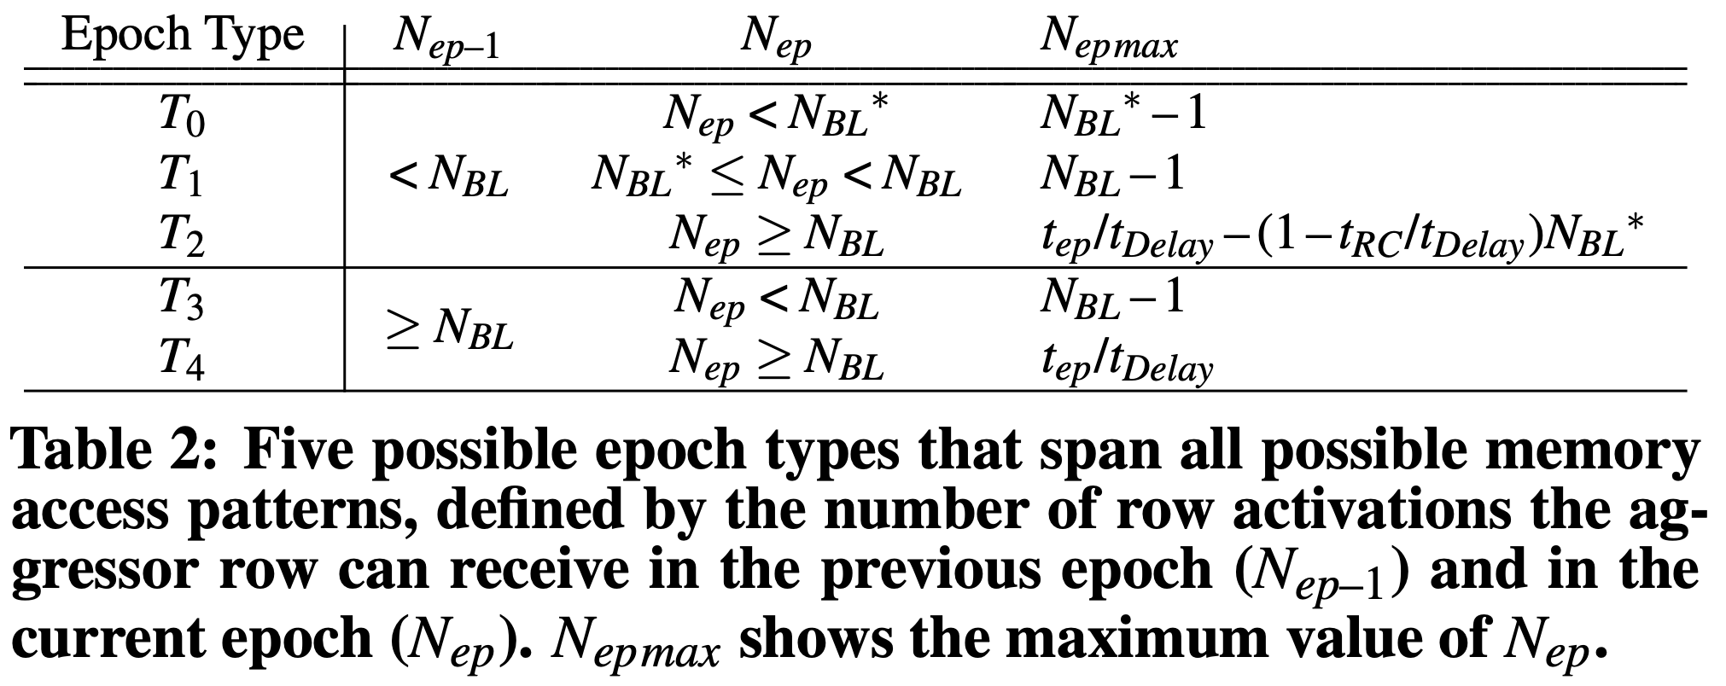
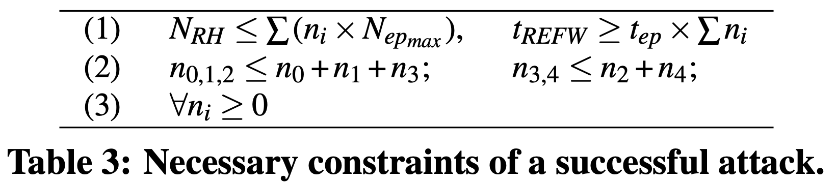
Security Analysis
No permutation of epochs can satisfy the necessary constraints of a successful attack

