Slide 1
CLI tools in Python + interesting/useful packages
Martin Pavlásek
DevConf, 2016-02-05
~ Workshop ~

Slide 2

Real life 😕

Slide 3
Real life 😕
{"gifts":{"socks":{"S": 2, "M": 5, "L": 1}, "toys": ["Yellow duck", "Wooden bricks"]},"TODO":["bake Vanocka","pack gifts","tidy own desk"]}

Slide 4
Better life 😊
$ pytube \
'https://www.youtube.com/watch?v=jrmZIgVoQw4'

Slide 5
Better life 😊
$ python -m json.tool ugly.json
{
"TODO": [
"bake Vanocka",
"pack gifts",
"tidy own desk"
],
"gifts": {
"socks": {
"L": 1,
"M": 2,
"S": 5
},
"toys": [
"Yellow duck",
"Wooden bricks"
]
}
}

Slide 6
Preparation ...

Slide 7
What can you expect?
demo of some existings handy (often CLI) tools
as-short-as-necessary introduction to pip, PyPI and virtualenv
it's not necessary know the language
What do not expect:
course like "Programming in Python"

Slide 8
Try it on your own!
Everything for this workshop is available in:
http://github.com/mpavlase/python-talk
Prepare workplace:
cd python-talk
./prepare-env.sh

Slide 9
PyPI/pip
PyPI = Python Package Index repository of software
for Python
$ sudo pip install odpdown
target: /usr/lib/python2.7/site-packages
... or
$ pip install --user odpdown
target: ~/lib/python2.7/site-packages
... or

Slide 10
virtualenv
$ sudo dnf install python-virtualenv
$ mkdir -p ~/sandbox
$ cd ~/sandbox
$ virtualenv venv
$ source venv/bin/activate
$ pip install odpdown
target:
~/sandbox/venv/usr/lib/python2.7/site-packages

Slide 11
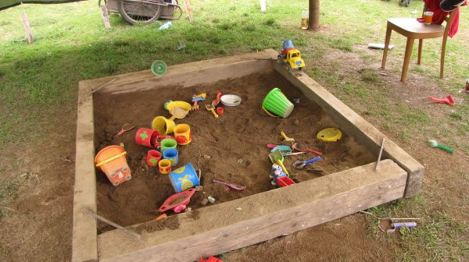
Demo time!

Slide 12
Overview
File manipulation
Text/image transformation
Python
Data generators
Presentation
System utilities
Internet / multimedia
Terminal

Slide 13
File manipulation

Slide 14
zipfile
Basic operations with ZIP archives. [builtin]
$ python -m zipfile -c my.zip file [...]
$ python -m zipfile -e my.zip dest-folder
$ python -m zipfile -l my.zip
$ python -m zipfile -t my.zip
in Python:
from zipfile import ZipFile
with ZipFile('my.zip', 'w') as myzip:
myzip.write('content.txt')

Slide 15
filecmp
Compare two directories. [builtin]
python -m filecmp dir1 dir2
in Python:
from filecmp import dircmp
diff = dircmp('a', 'b')
diff.report()

Slide 16
Text/image transformation

Slide 17
json.tool
Reformat JSON (and validate as well). [builtin]
$ python -m json.tool < ugly.json
$ python -m json.tool ugly nice
in Python:
import json
j = {'1': 25, 'key': ['arr']}
print json.dumps(j, indent=4)

Slide 18
encodings.rot_13
En/decoding stream oneliner. [builtin]
$ echo "abcd" | python -m encodings.rot_13
$ echo "nopq" | python -m encodings.rot_13
in Python:
from encodings import rot_13
rot_13.rot13(open('file.in'), open('file.out', 'w'))

Slide 19
markdown
Convert Markdown into HTML. [pypi]
$ python -m markdown example.md
in Python:
from markdown import markdown
print markdown("# I'm a H1!")

Slide 20
markdownify
Convert HTML into Markdown. [pypi]
in Python:
from markdownify import markdownify
print markdownify('Be <b>bold</b>')

Slide 21
oneliner
similar to nl, but much more versatile. (pypi)
$ python -m oneliner -ne \
'"(%s): %s" % (NR, _.upper())' \
example.py

Slide 22
pygments
Make your code colorful! [pypi]
$ pygmentize < example.sh
$ pygmentize -O full,style=monokai -o demo.html example.py

Slide 23
imgdiff
Display visual difference of two pictures. [pypi]
$ imgdiff -H --opacity 30 \
-o diff.png a.png b.png

Slide 24
Python

Slide 25
pudb
Interactive text-based debugger. [pypi]
in Python:
import pudb; pudb.set_trace()

Slide 26
notebook
Web-based interactive env.(IDE) and more. [pypi]
$ python -m notebook

Slide 27
Data generators

Slide 28
randomdata.datagen
Generates CSV according to spec file. [pypi]
$ echo spec.conf < \
"id, IntID
age, Int, {'maximum': 100}"
$ python -m randomdata.datagen \
-l 10

Slide 29
fake-factory
Generates fake userdata (name, email, ...) [pypi]
$ faker -r 5 name
in Python:
from faker import Faker
fake = Faker()
for _ in range(5):
print fake.name()

Slide 30
Presentation

Slide 31
python-pydown
Make HTML presentation from Markdown. [pypi]
$ cat > slides.md <<EOF
!SLIDE
# pydown
!SLIDE
## heading text
EOF
$ pydown slides.md html
# entry point: html/index.html

Slide 32
odpdown
Create presentation from Markdown. [pypi]
$ odpdown --content-master content\
--break-master chapter \
input.md template.odp output.odp

Slide 33
playitagainsam
Record and replay terminal session. [pypi]
$ pias record session.pias
$ pias play --auto-type 50 \
--auto-waypoint 500 session.pias
Note: there exists HTML/js player as well.

Slide 34
System utilities

Slide 35
copypaste
Platform independent copy + paste. [pypi]
$ date | copy
$ paste

Slide 36
pyinotify
Linux filesystem events monitoring. [pypi]
$ pyinotify -v .

Slide 37
Internet / multimedia

Slide 38
SimpleHTTPServer
Share current folder as HTTP page. [builtin]
$ python -m SimpleHTTPServer

Slide 39
telnetlib
Telnet client. [builtin]
$ python -m telnetlib url port

Slide 40
pytube
Download videos from YouTube. [pypi]
$ pytube \
--extension mp4 \
--resolution 720p \
'https://www.youtube.com/watch?v=jrmZIgVoQw4'

Slide 41
status_server
HTTP status code on demand. [pypi]
$ status_server
$ curl -i http://localhost:8888/404/200

Slide 42
sigal
Simple image gallery generator. [pypi]
$ sigal init
# will process ./pictures folder
$ sigal build
Run webserver with the gallery:
$ sigal serve

Slide 43
Terminal

Slide 44
pychalk
Print color text into terminal. [pypi]
in Python:
import chalk
chalk.green("Hello world!")

Slide 45
rad
Console highlighter. [pypi]
$ rad -n # new rule
$ cat some.log | rad log

Slide 46
ConwayCPU
Game of Life (cellular automata), changes according of CPU usage. [pypi]
$ ConwayCPU.py

Slide 47
Disclamer
"During work on this topic wasn't hurt even killed any zoologist or snake."

Slide 48
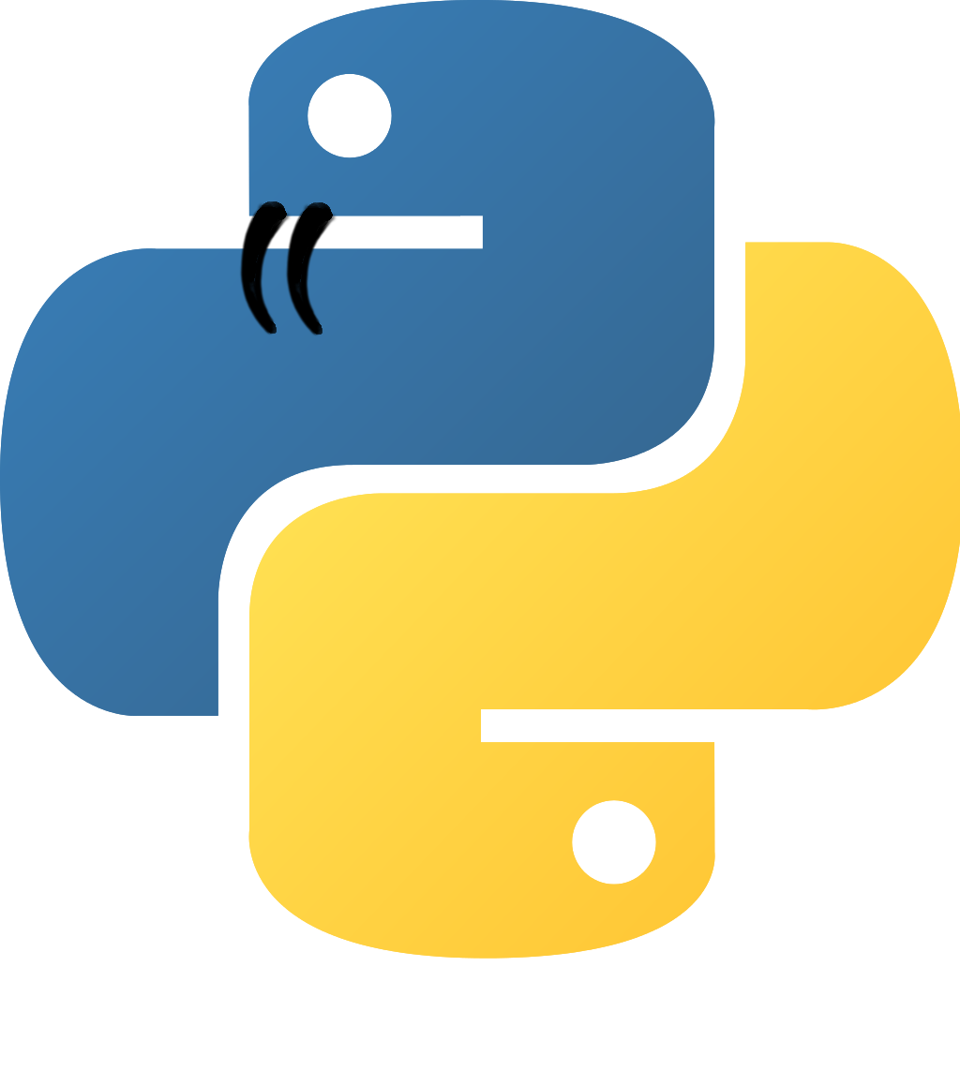
Python ...

Slide 49
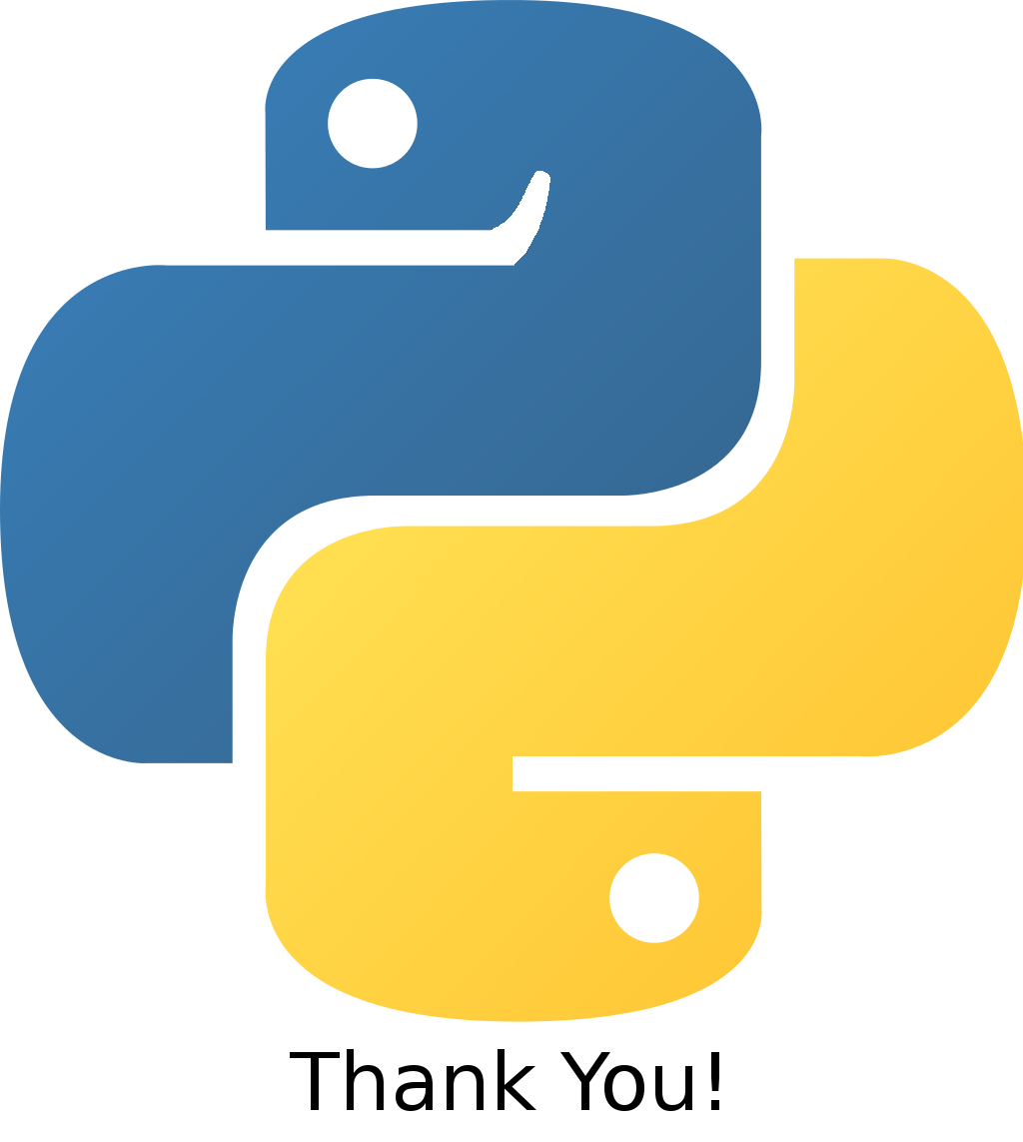
Python ...

Slide 50
Resources
https://twitter.com/pypi
https://pymotw.com/2/
https://groups.google.com/d/topic/comp.lang.python/_QLuMFfSLKk/discussion
http://pythonwise.blogspot.cz/2015/01/python-m.html
... and pypi pages to each showed package

