Slide 1

Lung X-Ray Data Augmentation using Generative Adversarial Networks

Slide 2

Team members and Responsibilities
Abhiram Varma Gadhiraju (36893508): EDA, Data cleaning and preparation.
Meghanath Payasam (37720961): Model building and customized training
Bhuvana Chandra Jammu (40033893): Building visualization & evaluating the model

Slide 3

Introduction
According to World Health Organization, annual death rate due to pneumonia infection is 30% in USA with highest rate of 64% in individuals over age of 80. Automating the diagnosis can be a huge improvement in treatment process. However, collecting large samples of medical files for working on advancements specially in case of AI based Neural Nets is a challenge. Here, GANs can be helpful through their synthetic data generation applications for Data augmentations.

Slide 4
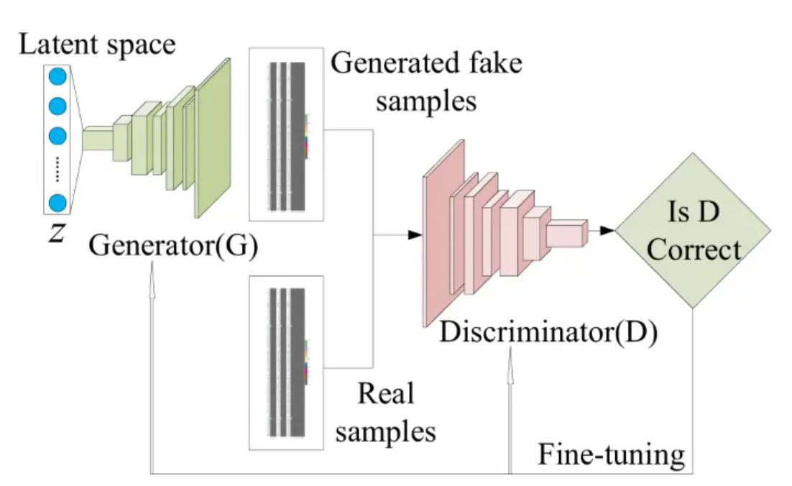
Technologies we used
GANs:
GANs are Neural Nets which works on principle of CNNs. GANs can synthesis images, text and audio data accurately. GANs perform unsupervised learning where both generator and discriminator will be self-correcting the losses through the optimizers. Generator takes an input of random noise and generates a synthetic sample whereas discriminator take the generated synthetic image and real image to classify real or fake. The model will get good performance when generator gets succeeded in fooling discriminator.

Slide 5
Background review
Classic data augmentation techniques performed in earlier models used to be less accurate and more redundant in comparison with real images. These techniques involve color space manipulation, geospatial manipulation of the data. This causes the Neural Nets to underperform due to the poor quality of the data. This drawback can be overcome by Neural Nets based on architecture of GANs.
In general, GANs are designed to synthesis artificial data from the original samples. This creates a change to replace traditional data augmentation techniques with GAN base synthetic data augmentations.

Slide 6
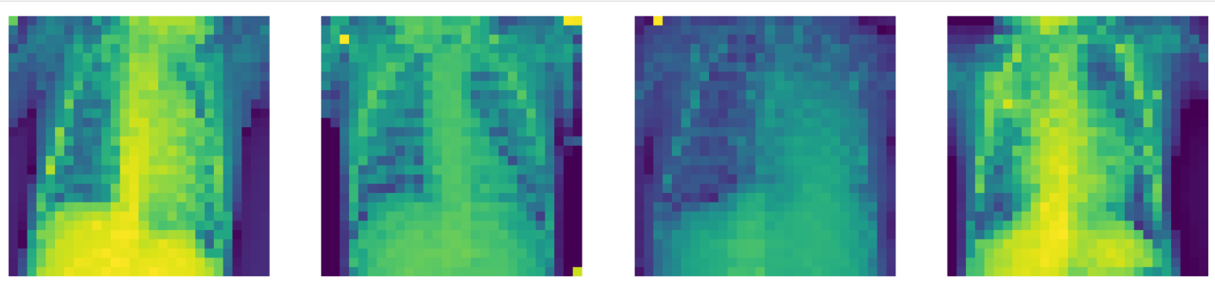
Dataset
The dataset comprises of 3883 JPEG Lung X ray images of pneumonia patients. The dimensions are resized/reshaped to 28x28x1 for modeling. As it is unsupervised model, all 3883 images are used for training.
Dataset source: Kaggle - https://www.kaggle.com/datasets/tolgadincer/labeled-chest-xray-images

Slide 7
Technologies used in our project
GAN (generator) : The generator works as Transposed CNN. It starts with a dense layer of 7x7x256 dimensions and followed by 3 transposed convolution layers. The input random noise is transformed into image of 28x28x1. Activation function used is LeakyReLU. Generator uses Binary cross entropy as loss function and Adam/RMSprop as optimizers.
GAN (discriminator): The discriminator work as CNN classification model. It takes an input of dimensions 28x28x1 and transforms it into a single valued out through 2 convolutional layers. It has a dense layer at the end which takes the flattened values from convolution layers. Activation function used is LeakyReLU. Discriminator uses Binary cross entropy as loss function and Adam/RMSprop as optimizers.
Inception Model (V3): We used InceptionV3 model for calculating Inception score. The Inception Score uses the pre trained InceptionV3 model, a convolutional neural network that is primarily used for tasks related to image classification. With more training on a large dataset InceptionV3 can identify a wide range of objects and patterns in photos.

Slide 8
Design parameters
Generator:
The Generator is designed to process images using 3 transposed convolution Nets which are of 128, 64, 1 filtered respectively and a dense layer at input stage
Input : Random noise if shape [None,1], Output : Image of shape 28x28x1
Activation function : LeakyReLU
Optimizer : Adam & RMSprop
Loss function : Binary cross entropy
Learning rate : 0.001
Discriminator:
The Discriminator is designed to process image in 2 convolutional layers with a dense layer at the end. The filters used in convolution layers are 64, 128 respectively.
Input : Image of shape 28x28x1, Output : Binary classification output of 1 or 0
Activation function : LeakyReLU
Optimizer : Adam & RMSprop
Loss function : Binary cross entropy
Learning rate : 0.001

Slide 9
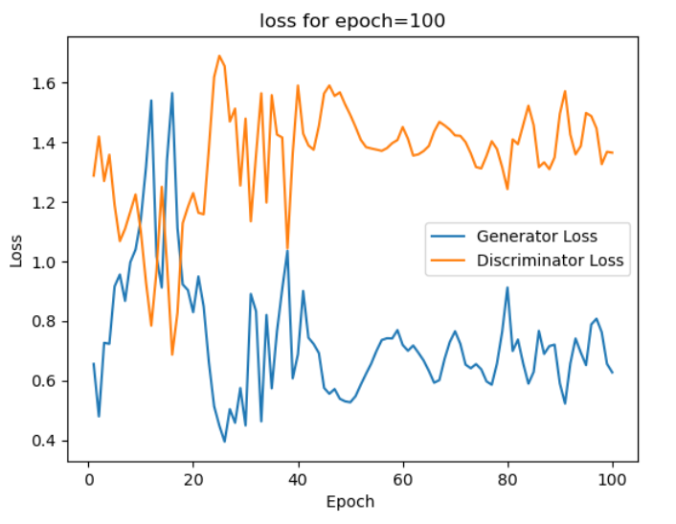
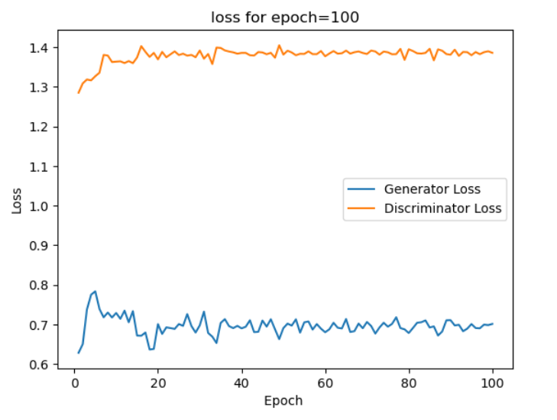
Experiments
We experimented with the GAN model by changing the epochs and changing the optimizer to examine the performance of the model
Learning rate=0.001
Optimizer=Adam
Loss= Binary_crossentropy
Epochs = 100
Learning rate=0.001
Optimizer= RMSprop
Loss = Binaryl_crossentropy
Epochs = 100
Drop out = 30%

Slide 10
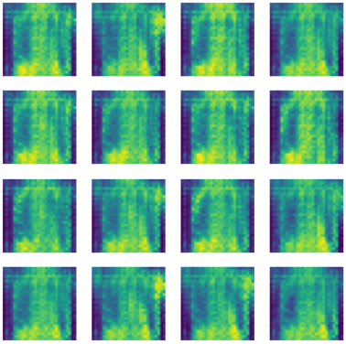
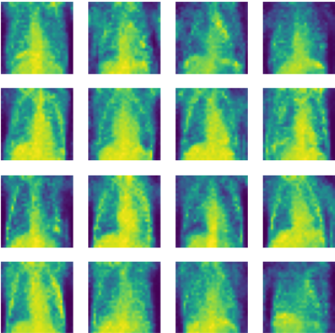
Results
Results shows that with increase in epoch to 100 and changing optimizers impacted the quality of generators drastically.
Generator with Adam optimizer has less Inception score with 1.0008662 and less resolution on the image. Generator with RMSprop has better Inception score with better resolution on the image.
Generator with Adam optimizer
Generator with RMSprop optimizer

Slide 11
Contribution to the project
Designed the modeling components namely Generator, discriminator and Customized training loop for the GAN.
Experimented with multiple convolutional layers to achieve the best fit to the model by tunning the parameters like filters, strides, kernels, dropout and learning rate.
Build a customized training loop required for the parallel training of the generator and discriminator
Performed extensive literature survey and contributed to reporting the project documentation.

Slide 12
Conclusion & Future scope
We got to understand the impact of epochs and optimizers on a GAN by experimenting through this project. It is evident that design architecture of the convolution layers and type of dataset are greatly influenced by key factor like Optimizer and loss functions. GANs are said to have better performance when they are trained at very higher epochs I.e. (10,000 – 20,000).
Furthermore, Data augmentation can be even extended to better level by implementing even advanced GANs like conditional GANs and pix2pix GANS.

Slide 13
References
[1]: Fabio Henrique Kiyoiti dos Santos Tanaka and Claus Aranha. Data Augmentation Using GANs. In Proceedings of Machine Learning Research, 2019.
[2]: Fadaee, Marzieh, Bisazza, Arianna, Monz, Christof. Data augmentation for lowresource neural machine translation. arXiv:1705.00440, 2017.
[3]: L. Engstrom, D. Tsipras, L. Schmidt and A. Madry, A Rotation and a Translation Suffice: Fooling CNNs with Simple Transformations, 2017.
[4]: J. Jin, A. Dundar and E. Culurciello, Robust convolutional neural networks under adversarial noise, 201

