Slide 1
Chapter 3: Processes

Slide 2
Chapter 3: Processes
Process Concept
Process Scheduling
Operations on Processes
Interprocess Communication
Examples of IPC Systems
Communication in Client-Server Systems

Slide 3
Objectives
To introduce the notion of a process -- a program in execution, which forms the basis of all computation
To describe the various features of processes, including scheduling, creation and termination, and communication
To describe communication in client-server systems

Slide 4
Process Concept
An operating system executes a variety of programs:
  Batch system – jobs
  Time-shared systems – user programs or tasks
Textbook uses the terms job and process almost interchangeably
Process – a program in execution; process execution must progress in sequential fashion
A process includes:
  program counter
  stack
  data section

Slide 5

Process in Memory

Slide 6
Process State
As a process executes, it changes state
  new: The process is being created
  running: Instructions are being executed
  waiting: The process is waiting for some event to occur
  ready: The process is waiting to be assigned to a processor
  terminated: The process has finished execution

Slide 7

Diagram of Process State

Slide 8
Process Control Block (PCB)
Information associated with each process
Process state
Program counter
CPU registers
CPU scheduling information
Memory-management information
Accounting information
I/O status information

Slide 9

Process Control Block (PCB)

Slide 10

CPU Switch From Process to Process

Slide 11
Process Scheduling Queues
Job queue – set of all processes in the system
Ready queue – set of all processes residing in main memory, ready and waiting to execute
Device queues – set of processes waiting for an I/O device
Processes migrate among the various queues

Slide 12

Ready Queue And Various I/O Device Queues

Slide 13
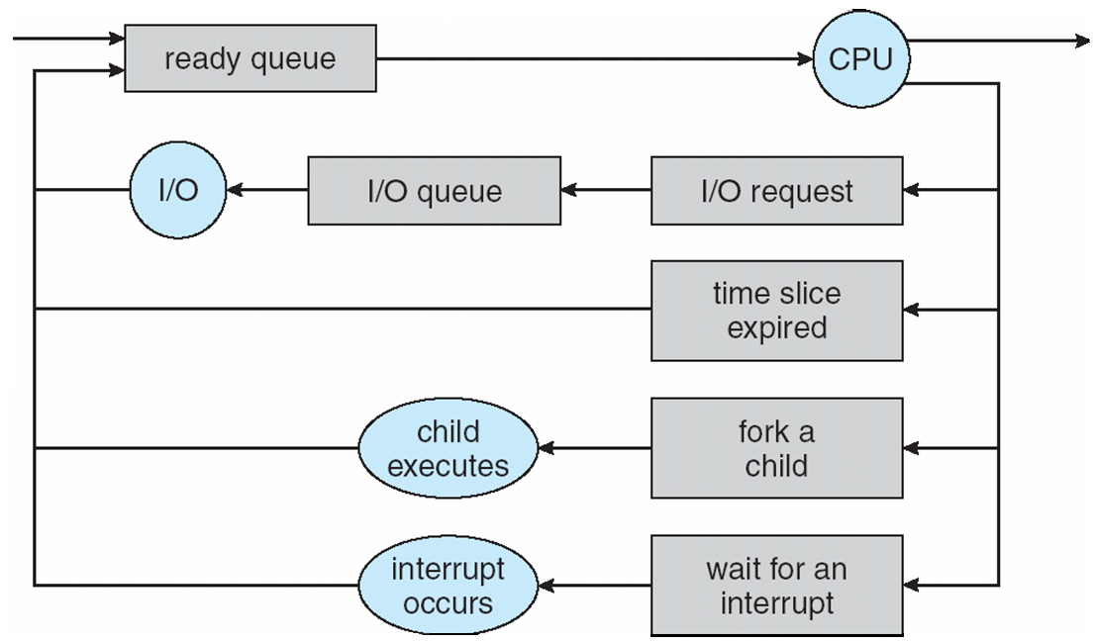
Representation of Process Scheduling

Slide 14
Schedulers
Long-term scheduler (or job scheduler) – selects which processes should be brought into the ready queue
Short-term scheduler (or CPU scheduler) – selects which process should be executed next and allocates CPU

Slide 15

Addition of Medium Term Scheduling

Slide 16
Schedulers (Cont)
Short-term scheduler is invoked very frequently (milliseconds) ⇒ (must be fast)
Long-term scheduler is invoked very infrequently (seconds, minutes) ⇒ (may be slow)
The long-term scheduler controls the degree of multiprogramming
Processes can be described as either:
  I/O-bound process – spends more time doing I/O than computations, many short CPU bursts
  CPU-bound process – spends more time doing computations; few very long CPU bursts

Slide 17
Context Switch
When CPU switches to another process, the system must save the state of the old process and load the saved state for the new process via a context switch
Context of a process represented in the PCB
Context-switch time is overhead; the system does no useful work while switching
Time dependent on hardware support

Slide 18
Process Creation
Parent process create children processes, which, in turn create other processes, forming a tree of processes
Generally, process identified and managed via a process identifier (pid)
Resource sharing
  Parent and children share all resources
  Children share subset of parent’s resources
  Parent and child share no resources
Execution
  Parent and children execute concurrently
  Parent waits until children terminate

Slide 19
Process Creation (Cont)
Address space
  Child duplicate of parent
  Child has a program loaded into it
UNIX examples
  fork system call creates new process
  exec system call used after a fork to replace the process’ memory space with a new program

Slide 20
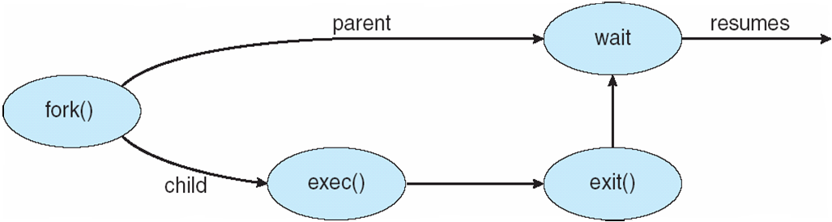
Process Creation

Slide 21
C Program Forking Separate Process
int main()
{
pid_t pid;
/* fork another process */
pid = fork();
if (pid < 0) { /* error occurred */
fprintf(stderr, "Fork Failed");
exit(-1);
}
else if (pid == 0) { /* child process */
execlp("/bin/ls", "ls", NULL);
}
else { /* parent process */
/* parent will wait for the child to complete */
wait (NULL);
printf ("Child Complete");
exit(0);
}
}

Slide 22
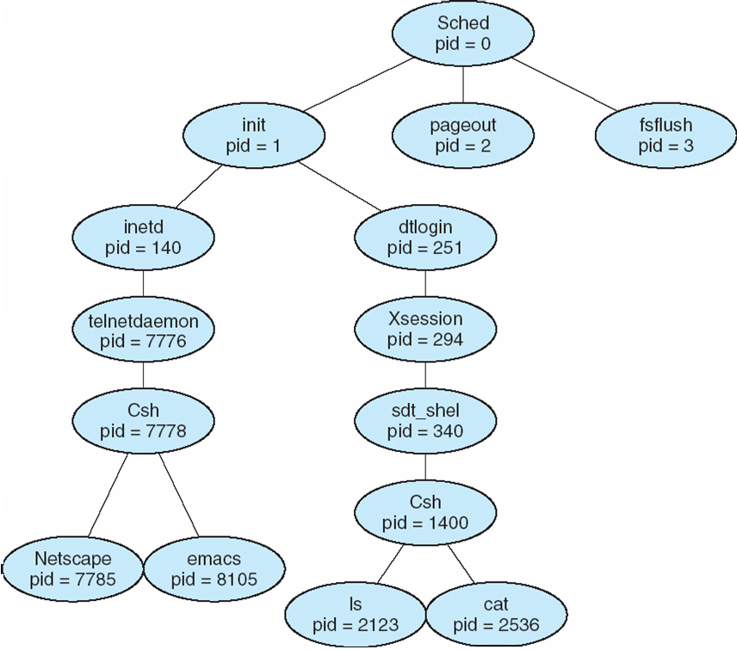
A tree of processes on a typical Solaris

Slide 23
Process Termination
Process executes last statement and asks the operating system to delete it (exit)
  Output data from child to parent (via wait)
  Process’ resources are deallocated by operating system
Parent may terminate execution of children processes (abort)
  Child has exceeded allocated resources
  Task assigned to child is no longer required
  If parent is exiting
    Some operating system do not allow child to continue if its parent terminates
      All children terminated - cascading termination

